Slide 1
Ethereal/WireShark Tutorial
Yen-Cheng Chen
IM, NCNU
April, 2006

Slide 2
Introduction
Ethereal is a network packet analyzer.
A network packet analyzer will try to capture network packets and tries to display that packet data as detailed as possible.
Download Ethereal:
  http://www.ethereal.com/download.html
What will be captured
  All packets that an interface can ”hear”
  At your PC connected to a switch
    Unicast (to and from the interface only)
    Multicast, RIP, IGMP,…
    Broadcast, e,g ARP,

Slide 3

WireShark
The Ethereal network protocol analyzer has changed its name to Wireshark.
  http://www.wireshark.org/
Download:
  http://prdownloads.sourceforge.net/wireshark/wireshark-setup-0.99.5.exe
Wireshark User's Guide
  http://www.wireshark.org/docs/wsug_html/

Slide 4
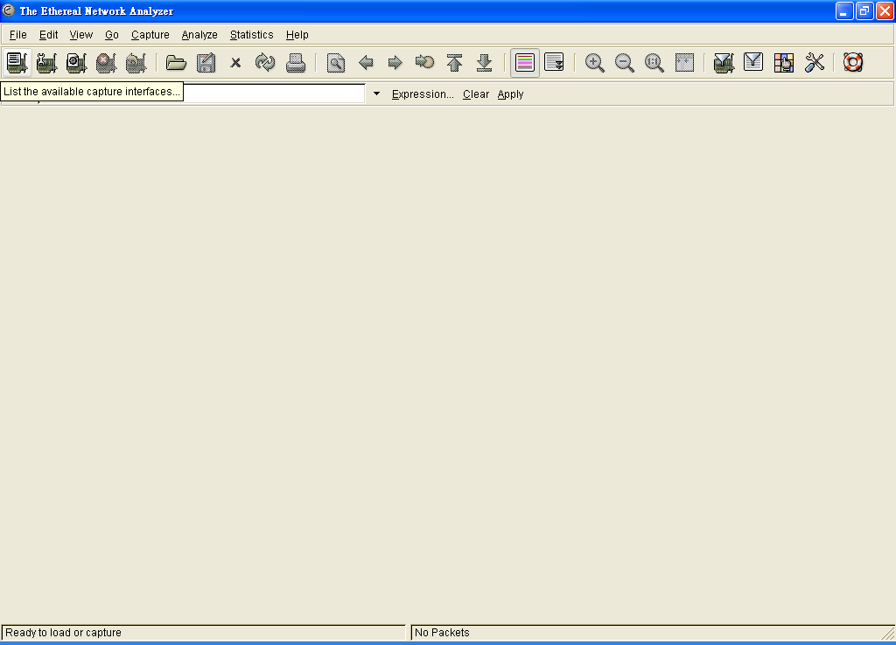
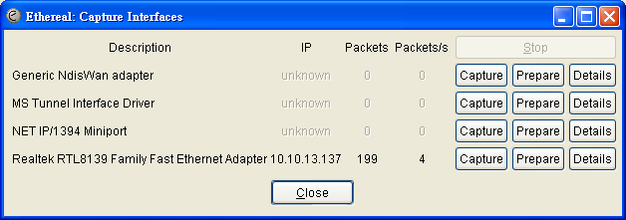
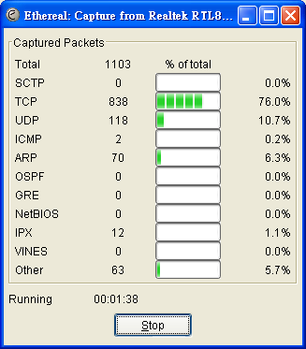
1
List available capture
interfaces
2
Start a capture
3
Stop the capture

Slide 5
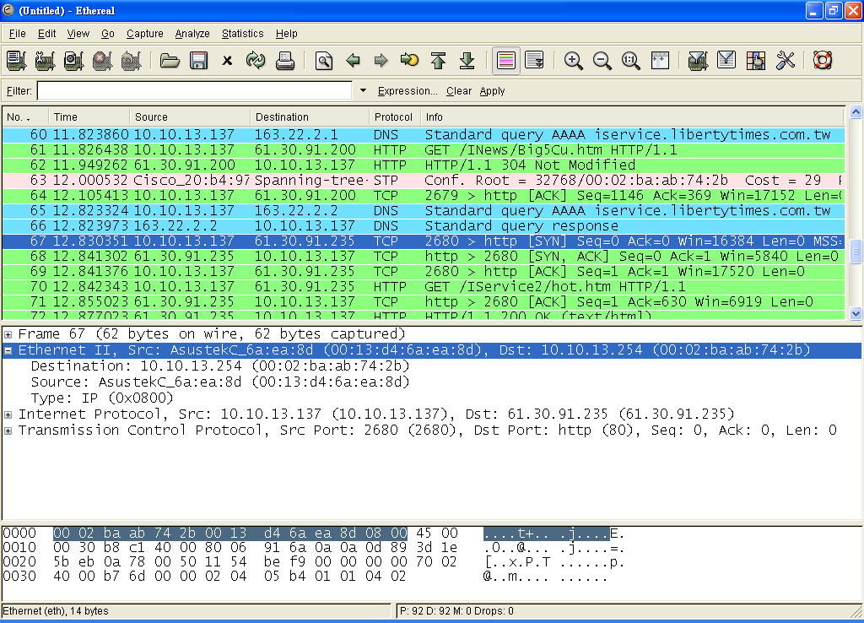
⬅ menu
⬅ main toolbar
⬅ filter toolbar
⬅ packet list pane
⬅ packet details pane
ipconfig /renew
⬅ packet bytes pane
⬅ status bar

Slide 6
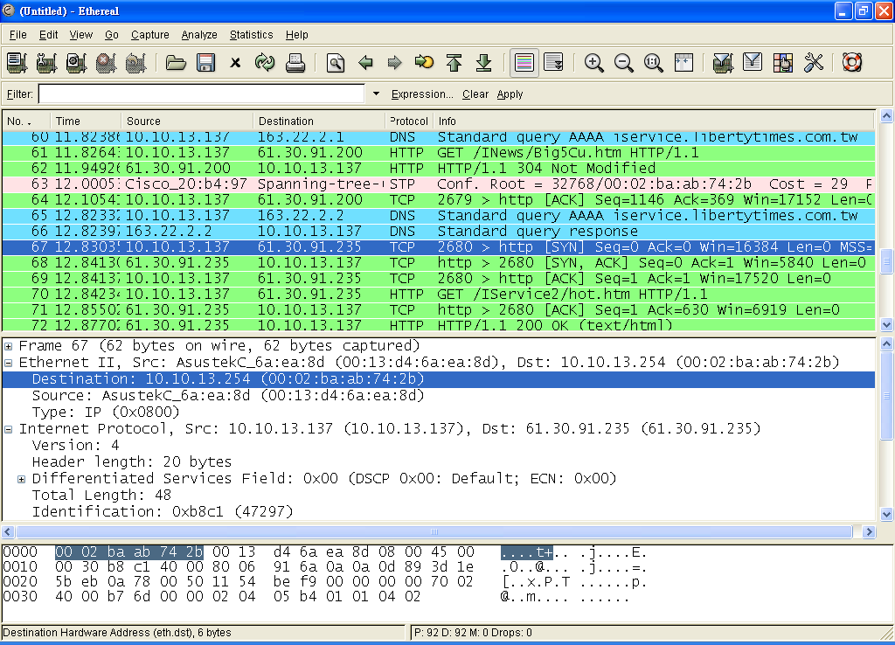
packet list pane

Slide 7
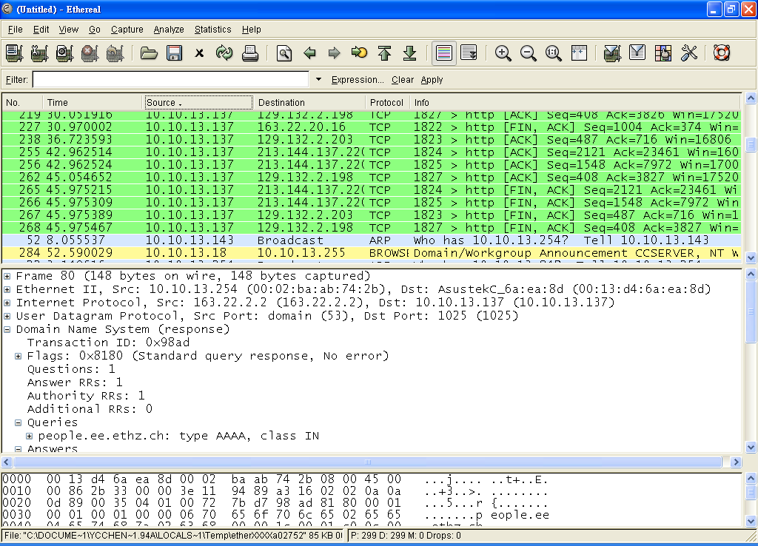
Sort by source

Slide 8
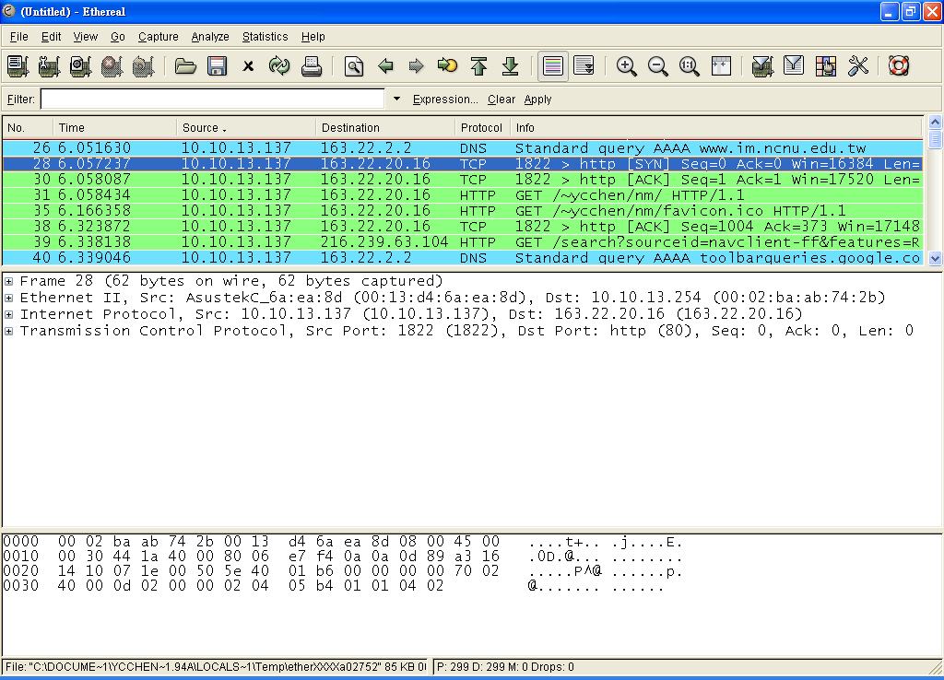
packet details pane

Slide 9
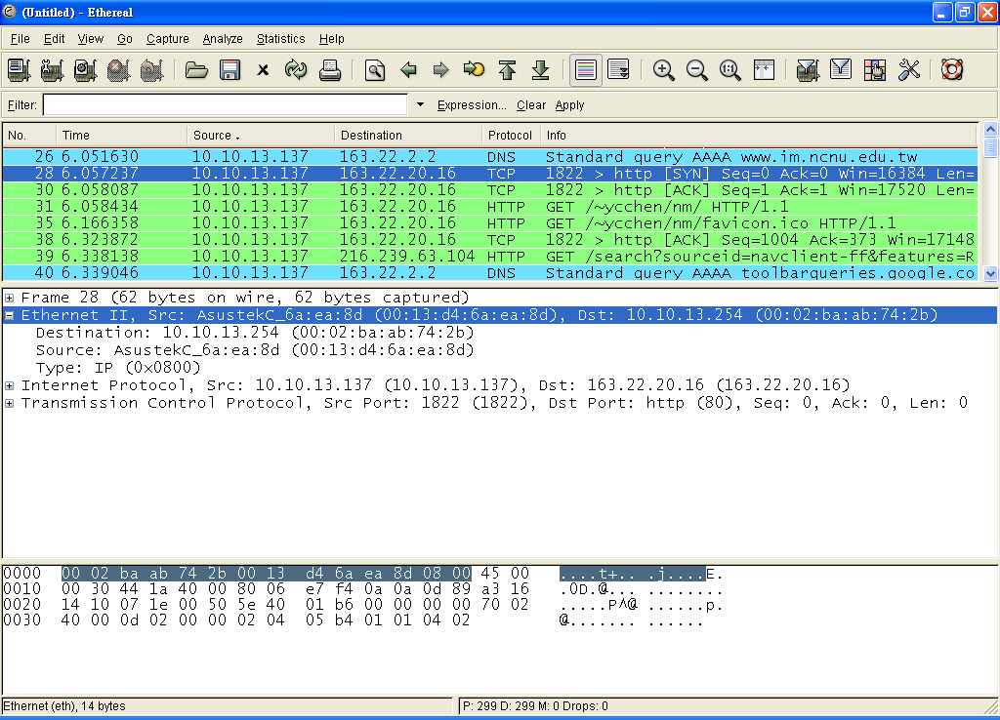
packet bytes pane

Slide 10
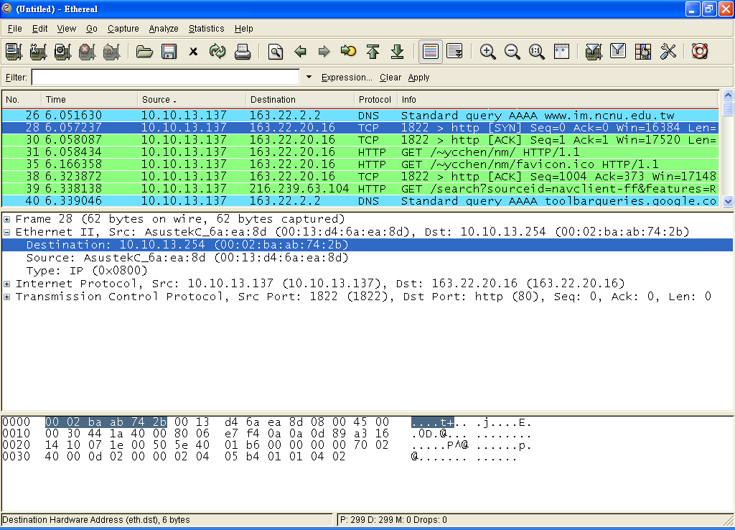

Slide 11
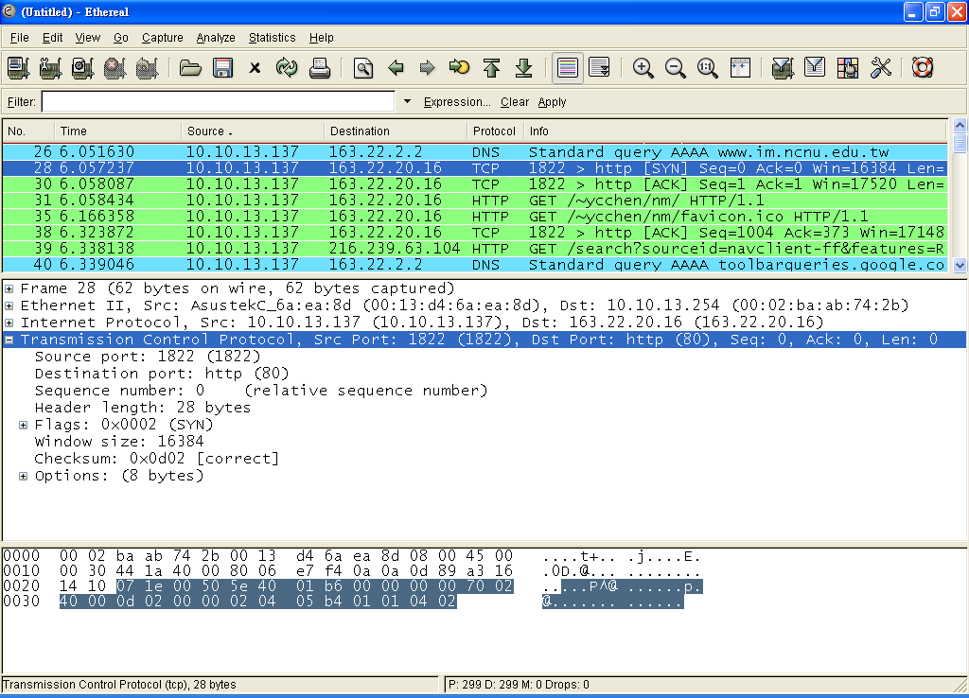

Slide 12
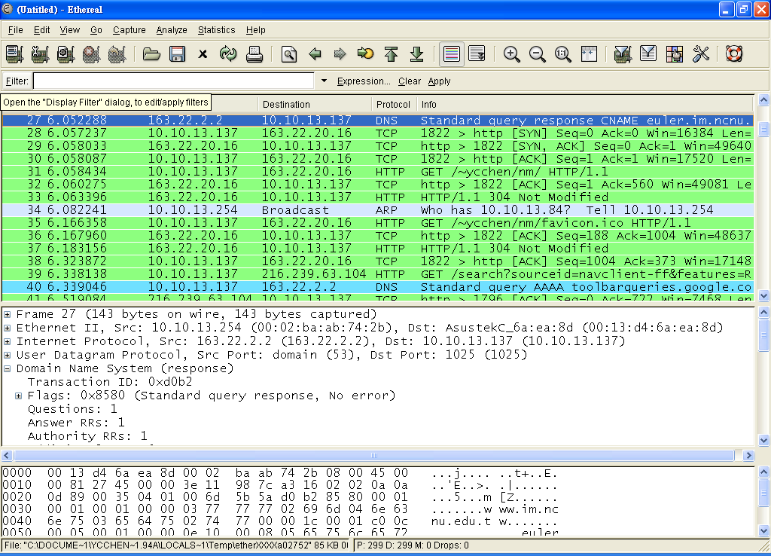
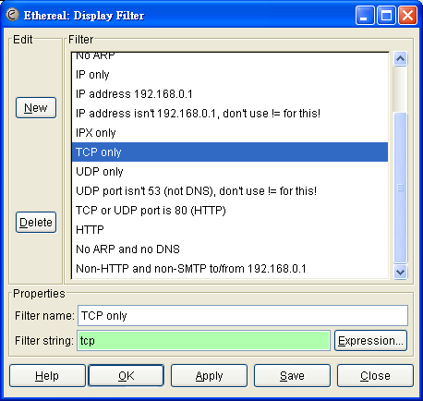
Filter

Slide 13
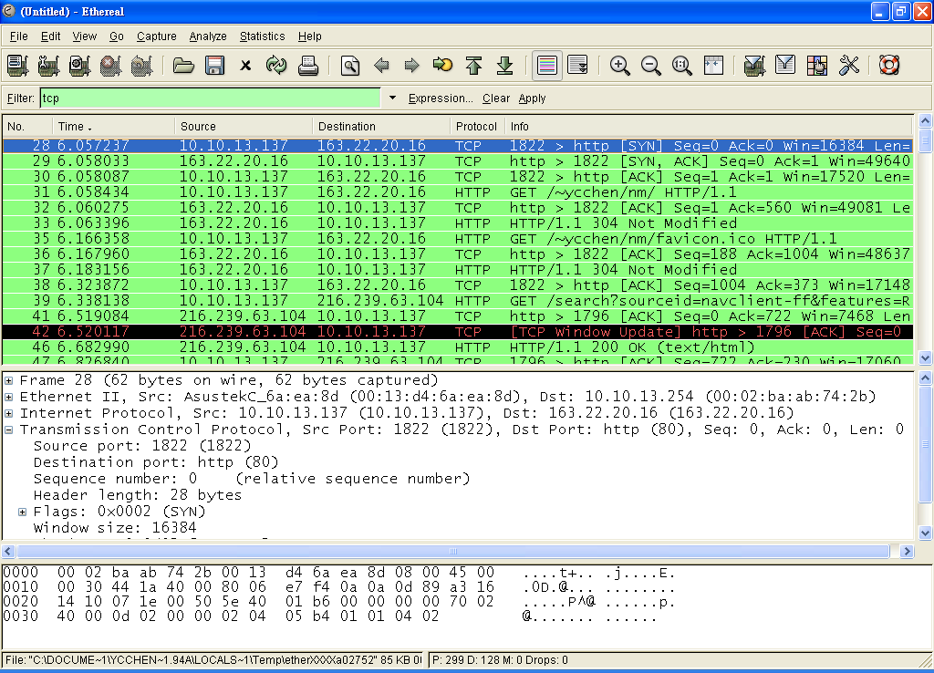

Slide 14


Slide 15
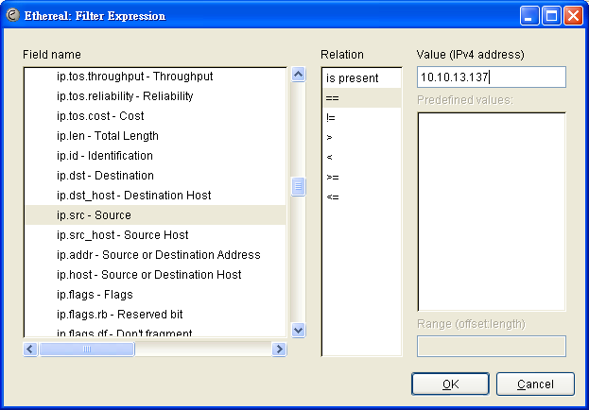
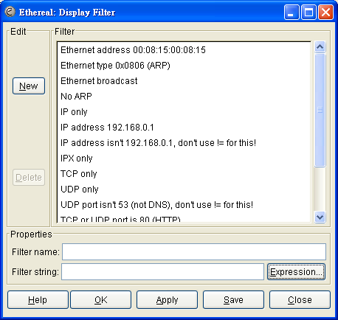
3
1
2
4

Slide 16
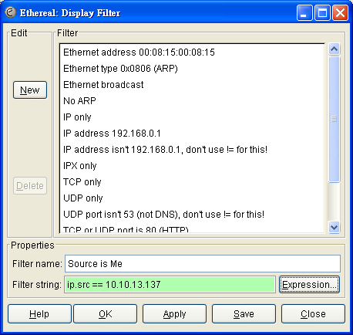
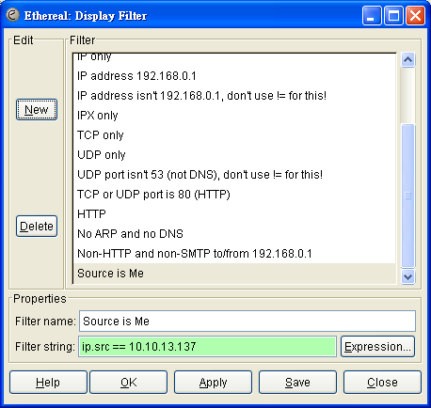
2
1

Slide 17
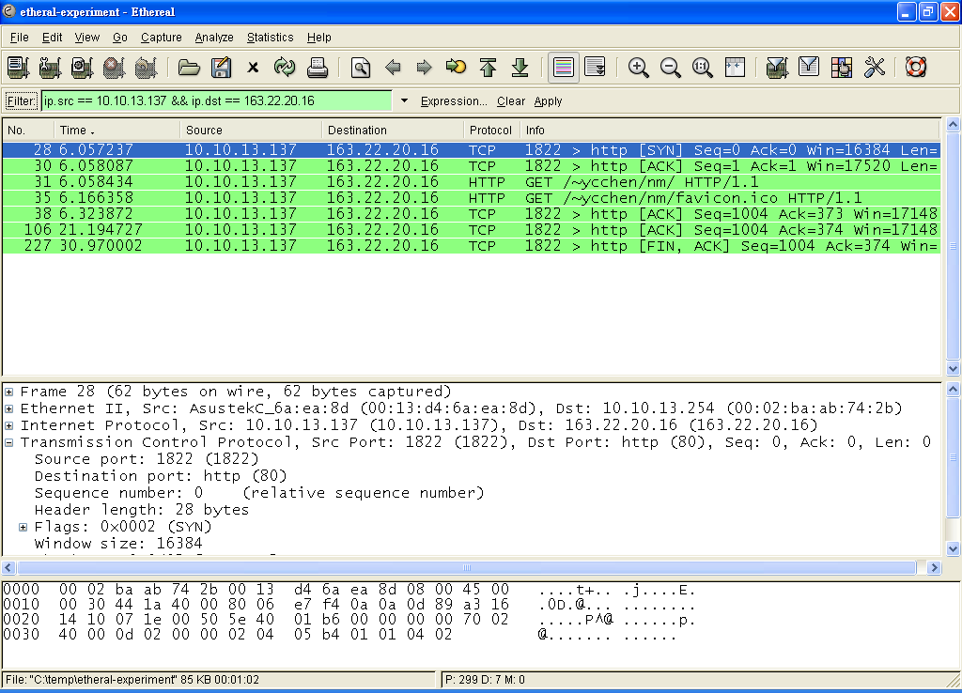
Filter Expression
ip.src == 10.10.13.137 && ip.dst == 163.22.20.16
ip.src eq 10.10.13.137 and ip.dst eq 163.22.20.16
ip.src == 10.10.13.137 || ip.src == 163.22.20.16
http && ( ip.src == 10.10.13.137 || ip.src == 163.22.20.16)
!(ip.dst == 10.10.13.137)

Slide 18
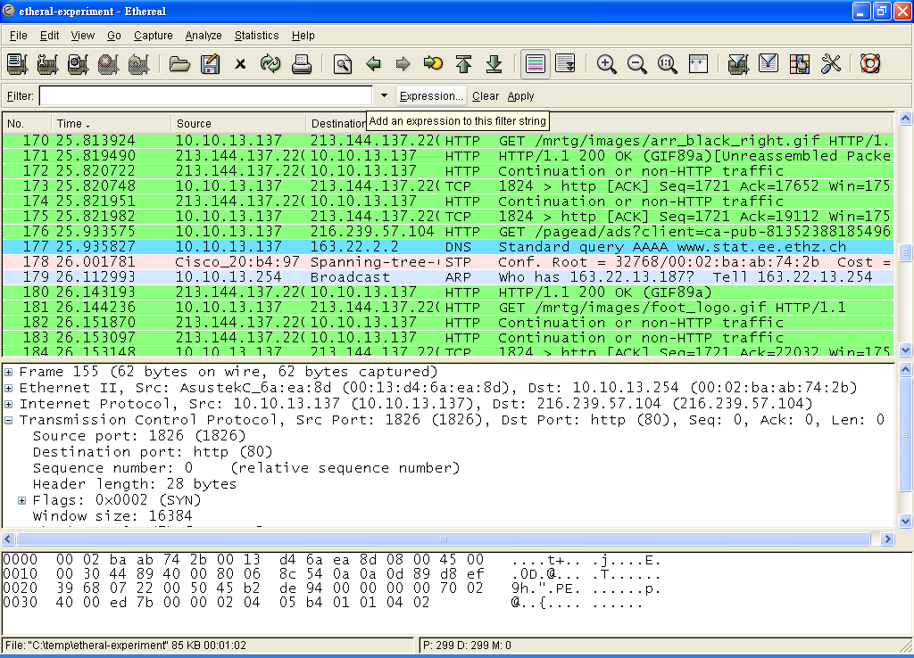
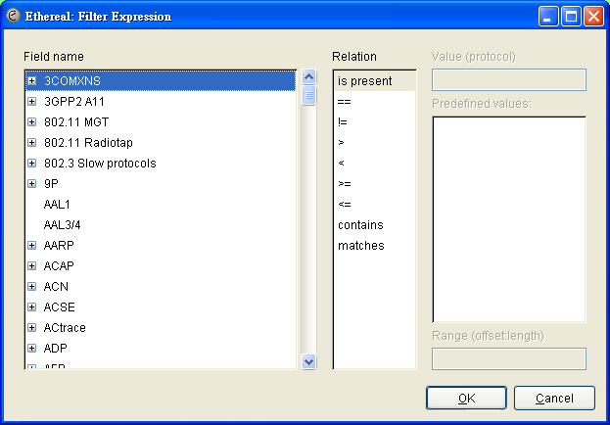

Slide 19
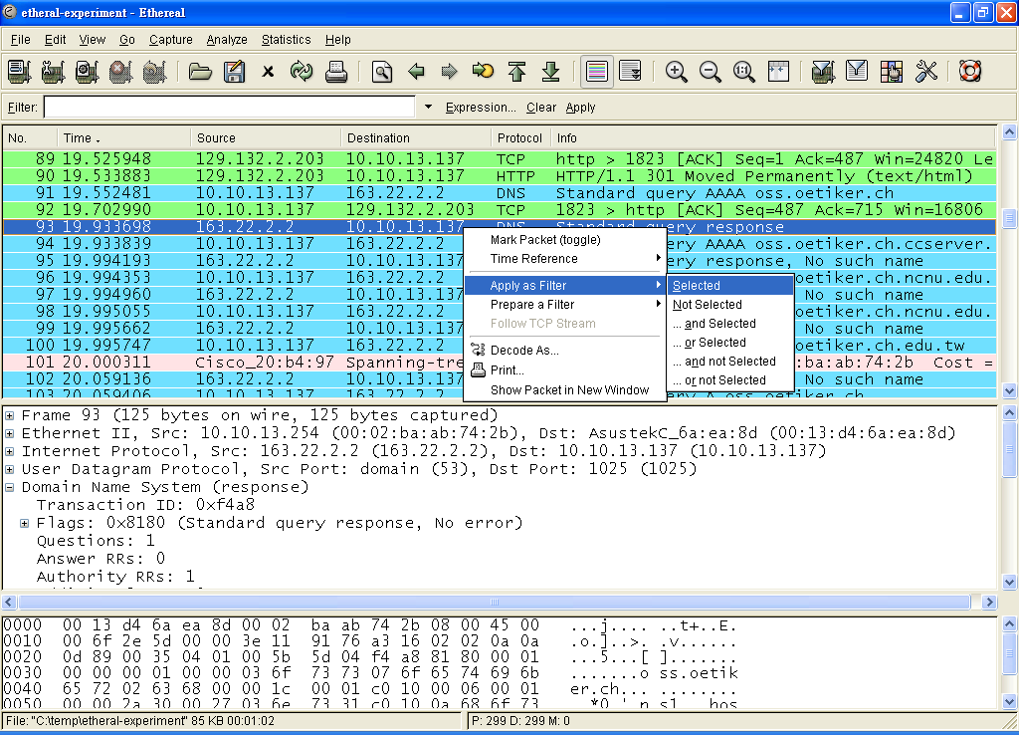

Slide 20
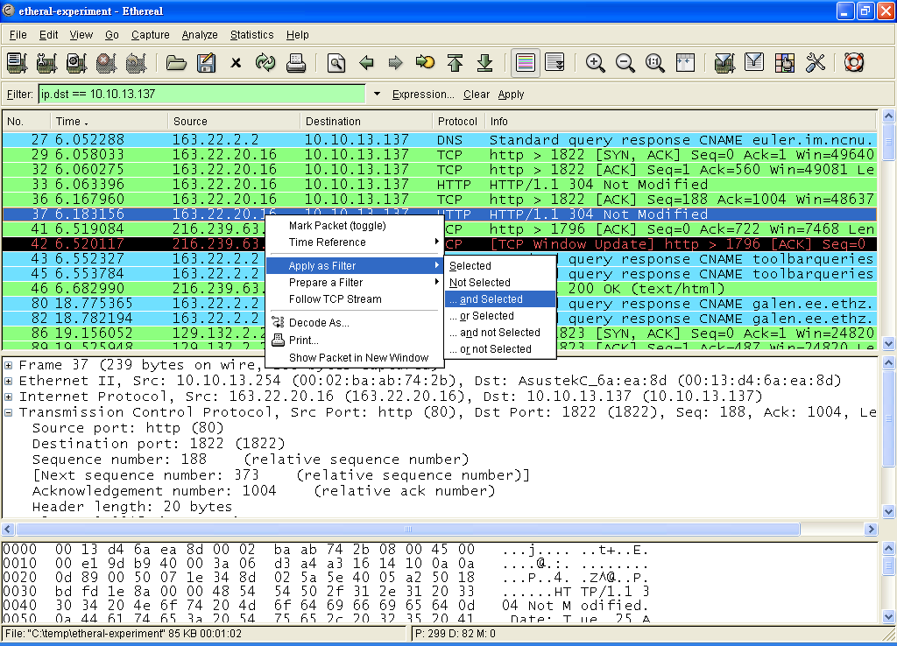

Slide 21
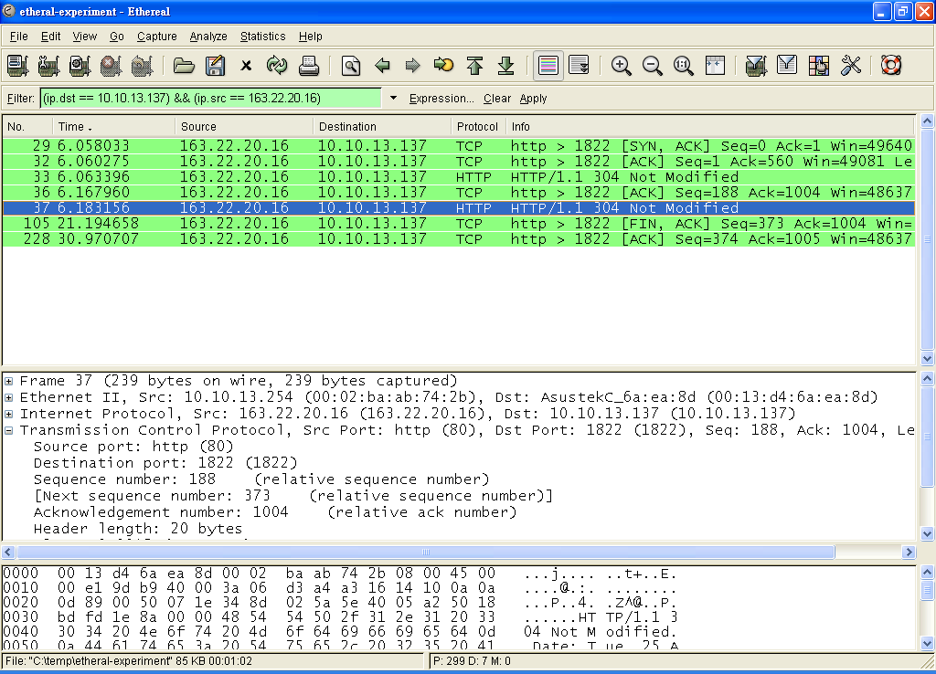
(ip.dst == 10.10.13.137) && (ip.src == 163.22.20.16)

Slide 22
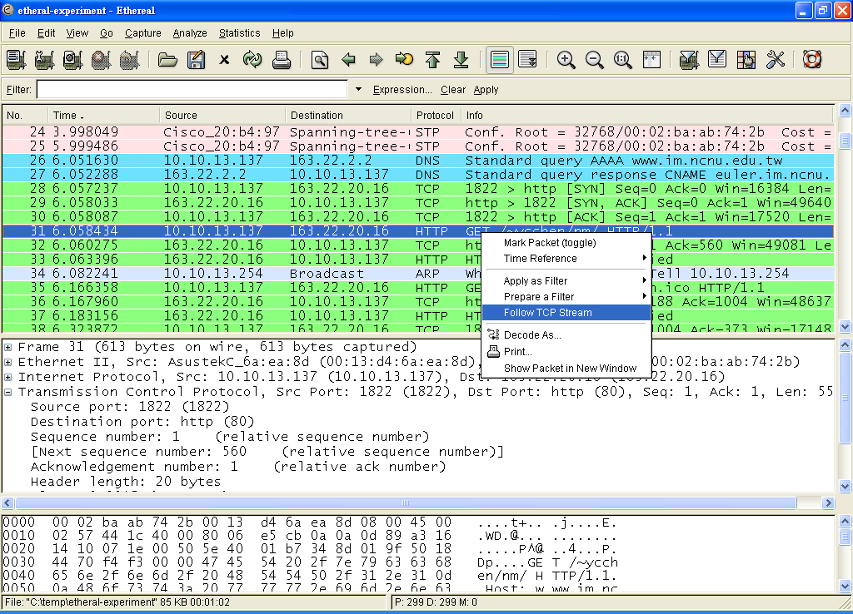
Follow TCP Stream

Slide 23
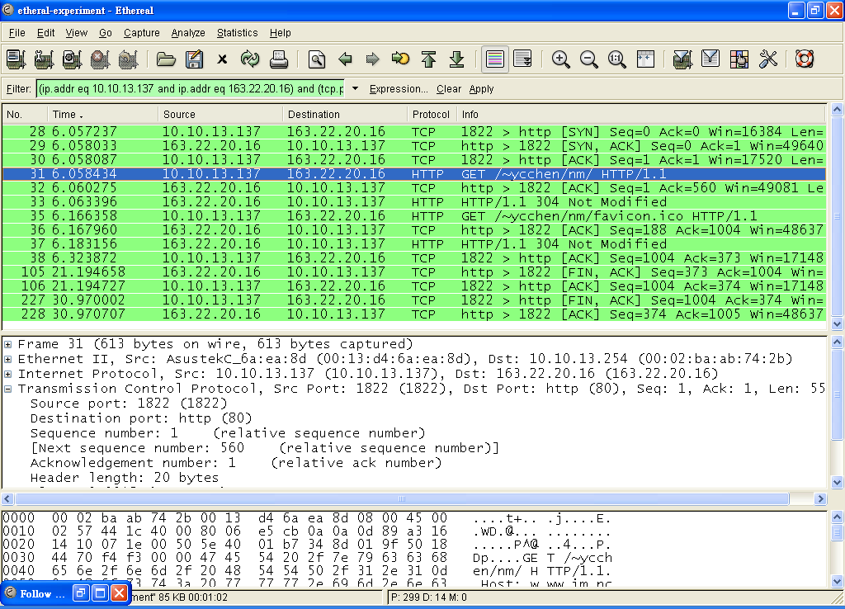

Slide 24
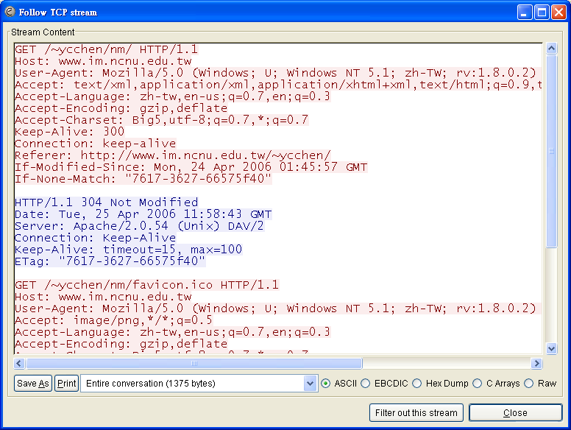

Slide 25
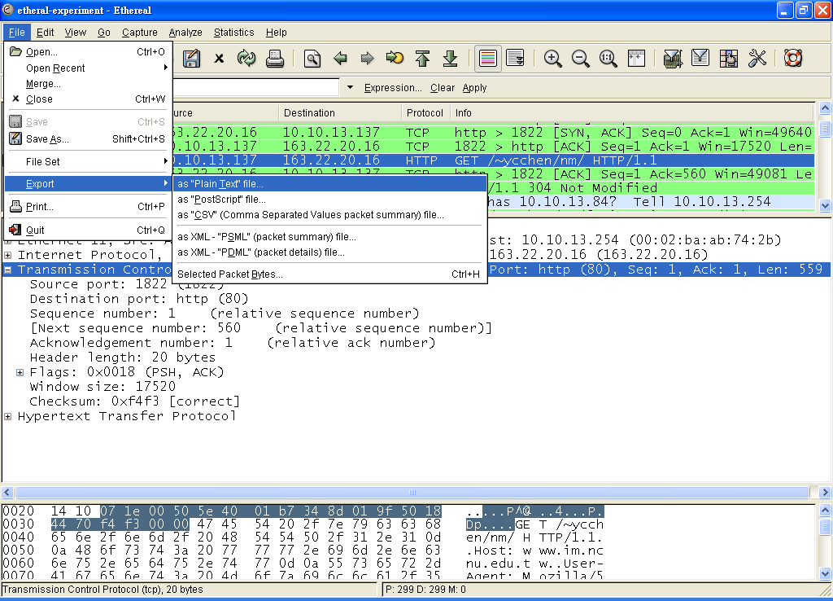
Export

Slide 26
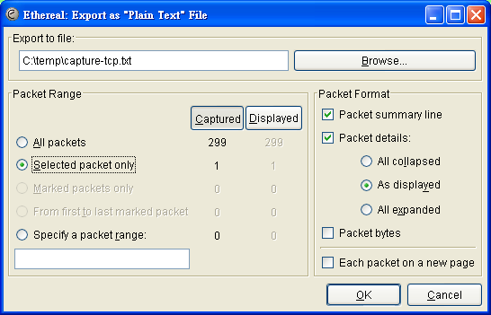
No. Time Source Destination Protocol Info
31 6.058434 10.10.13.137 163.22.20.16 HTTP GET /~ycchen/nm/ HTTP/1.1
Frame 31 (613 bytes on wire, 613 bytes captured)
Ethernet II, Src: AsustekC_6a:ea:8d (00:13:d4:6a:ea:8d), Dst: 10.10.13.254 (00:02:ba:ab:74:2b)
Internet Protocol, Src: 10.10.13.137 (10.10.13.137), Dst: 163.22.20.16 (163.22.20.16)
Transmission Control Protocol, Src Port: 1822 (1822), Dst Port: http (80), Seq: 1, Ack: 1, Len: 559
Source port: 1822 (1822)
Destination port: http (80)
Sequence number: 1 (relative sequence number)
Next sequence number: 560 (relative sequence number)
Acknowledgement number: 1 (relative ack number)
Header length: 20 bytes
Flags: 0x0018 (PSH, ACK)
Window size: 17520
Checksum: 0xf4f3 [correct]
Hypertext Transfer Protocol

Slide 27
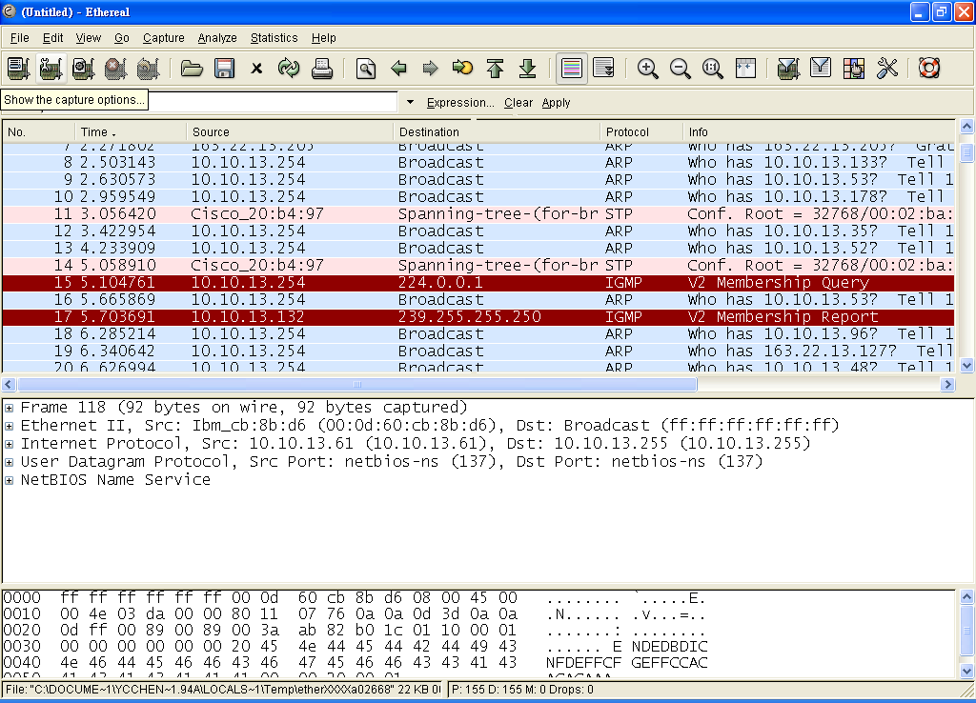
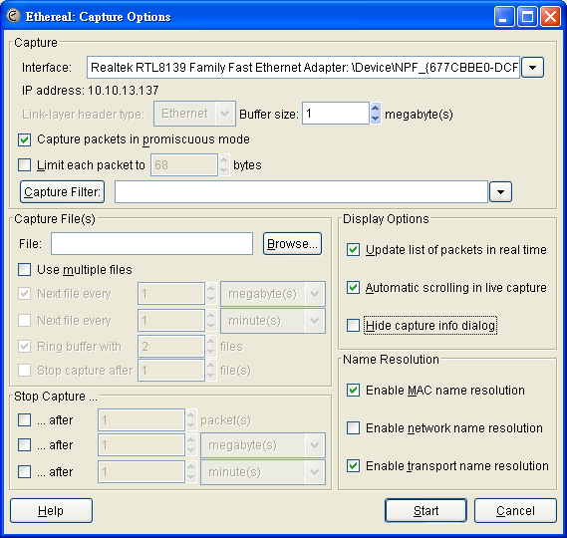
Capture Options

Slide 28
Assignments
# A1 (Deadline: 5/4)
  Layered Structure
  Ethernet frames
  Destination Address = FF FF FF FF FF FF
  Source Address == Your IP address
#A2
  IP Packet Header
  TCP Segment Header
  A TCP Connection stream
#A3
  HTTP Messages
#Bonus
  SMTP, POP3
  SSL
  …

