Slide 1
Feed-Forward Neural Networks
Hankui Zhuo
May 15, 2019
http://xplan-lab.org

Slide 2
Content
Single-Layer Perceptron Networks
Learning Rules for Single-Layer Perceptron Networks
  Perceptron Learning Rule
  Adaline Leaning Rule
  δ-Leaning Rule
Multilayer Perceptron
Back Propagation Learning algorithm

Slide 3
The Single-Layered Perceptron
y₁
y₂
. . .
y_{n}
. . .
w_{1m}
w_{2m}
w_{n1}
w₁₂
w₂₂
w_{n2}
w₁₁
w₂₁
w_{nm}
. . .
x₁
x₂
x_{m-1}
x_{m}= −1

Slide 4
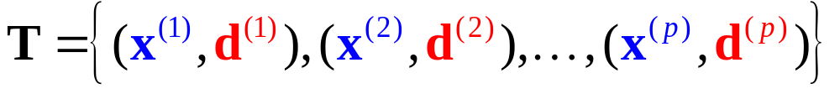


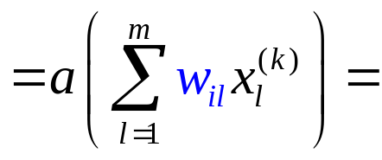

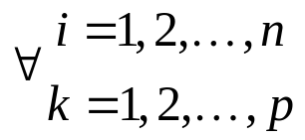
Training a Single-Layered Perceptron
Training Set
y₁
y₂
. . .
y_{n}
Goal:
d₁
d₂
d_{n}
. . .
w_{1m}
w_{2m}
w_{n1}
w₁₂
w₂₂
w_{n2}
w₁₁
w₂₁
w_{nm}
. . .
x₁
x₂
x_{m-1}
x_{m}= −1

Slide 5
Learning Rules
Training Set
Linear Threshold Units (LTUs) : Perceptron Learning Rule
Linearly Graded Units (LGUs) : Widrow-Hoff learning Rule
y₁
y₂
. . .
y_{n}
Goal:
d₁
d₂
d_{n}
. . .
w_{1m}
w_{2m}
w_{n1}
w₁₂
w₂₂
w_{n2}
w₁₁
w₂₁
w_{nm}
. . .
x₁
x₂
x_{m-1}
x_{m}= −1

Slide 6
Feed-Forward Neural Networks
Learning Rules for
Single-Layered Perceptron Networks
Perceptron Learning Rule
Adline Leaning Rule
δ-Learning Rule

Slide 7
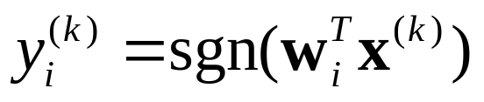
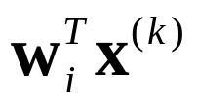
Perceptron
Linear Threshold Unit
x₁
w_{i1}
x₂
sgn
w_{i2}
∑
.
.
.
+1
−1
w_{im} =θ_{i}
x_{m}= −1

Slide 8
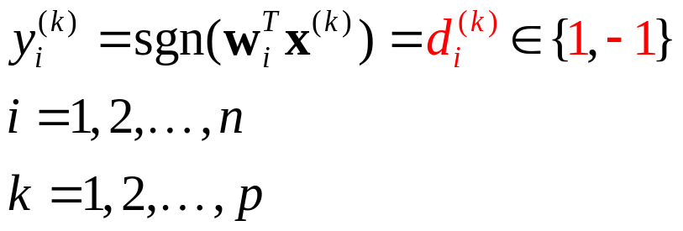
Perceptron
Goal:
Linear Threshold Unit
x₁
w_{i1}
x₂
sgn
w_{i2}
∑
.
.
.
+1
−1
w_{im} =θ_{i}
x_{m}= −1

Slide 9


Example
Goal:
Class 1 (+1)
Class 2 (−1)
x₂
y
Class 1
g(x) = −2x₁ +x₂+2=0
x₁
−2
1
−2
Class 2
x₁
x₂
x₃= −1

Slide 10
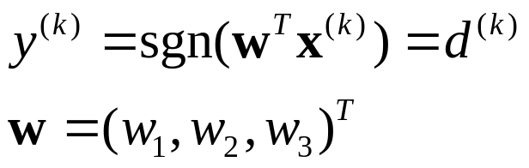
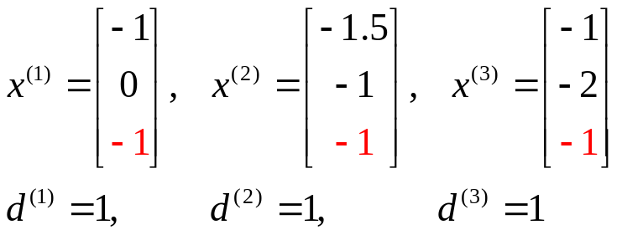
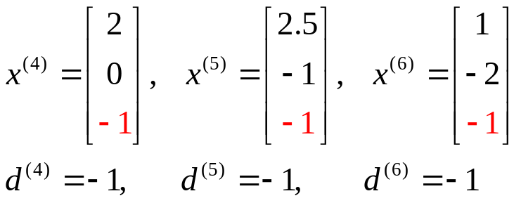
Augmented input vector
增强输入向量
Goal:
Class 1 (+1)
Class 2 (−1)
y
Class 1 (+1)
−2
1
−2
Class 2 (−1)
x₁
x₂
x₃= −1

Slide 11


Augmented input vector
Goal:
x₃
x₂
x₁
(0,0,0)
Class 1
(−1,0, −1)
y
(−1.5, −1, −1)
(2,0, −1)
(2.5, −1, −1)
(−1, −2, −1)
(1, −2, −1)
−2
1
−2
Class 2
x₁
x₂
x₃= −1

Slide 12
Augmented input vector
Goal:
A plane passes through the origin in the augmented input space.
x₃
x₂
x₁
(0,0,0)
Class 1
(−1,0, −1)
y
(−1.5, −1, −1)
(2,0, −1)
(2.5, −1, −1)
(−1, −2, −1)
(1, −2, −1)
−2
1
−2
Class 2
x₁
x₂
x₃= −1

Slide 13
Linearly Separable vs.
Linearly Non-Separable
线性可分 线性不可分
AND
OR
XOR
1
1
1
0
0
0
1
1
1
Linearly Separable
Linearly Separable
Linearly Non-Separable

Slide 14
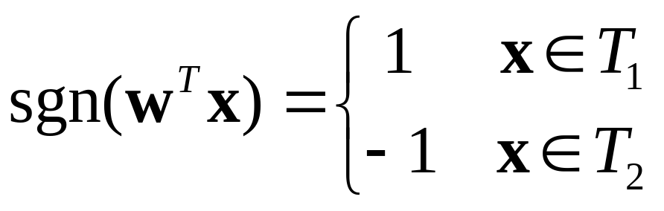
Goal
Given training sets T₁∈C₁ and T₂ ∈ C₂ with elements in form of x=(x₁, x₂ , ... , x_{m-1} , x_{m}) ^{T} , where x₁, x₂ , ... , x_{m-1} ∈R and x_{m}= −1.
Assume T₁ and T₂ are linearly separable.
Find w=(w₁, w₂ , ... , w_{m}) ^{T} such that

Slide 15
Goal
w^{T}x = 0 is a hyperplain passes through the origin of augmented input space.
Given training sets T₁∈C₁ and T₂ ∈ C₂ with elements in form of x=(x₁, x₂ , ... , x_{m-1} , x_{m}) ^{T} , where x₁, x₂ , ... , x_{m-1} ∈R and x_{m}= −1.
Assume T₁ and T₂ are linearly separable.
Find w=(w₁, w₂ , ... , w_{m}) ^{T} such that

Slide 16
Observation
d = +1
+
d = −1
−
x₂
Which w’s correctly classify x?
+
w₁
x
w₂
w₆
x₁
w₅
w₃
What trick can be used?
w₄

Slide 17
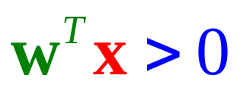
Observation
d = +1
+
d = −1
−
x₂
Is this w ok?
+
w
x
w₁x₁ +w₂x₂ = 0
x₁

Slide 18

Observation
d = +1
+
d = −1
−
x₂
w₁x₁ +w₂x₂ = 0
Is this w ok?
+
x
x₁
w

Slide 19
Observation
d = +1
+
d = −1
−
x₂
w₁x₁ +w₂x₂ = 0
Is this w ok?
+
x
How to adjust w?
?
x₁
w
?
Δw = ?

Slide 20
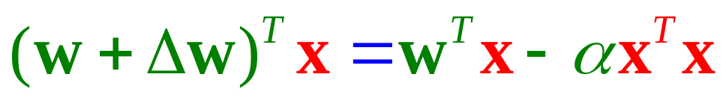
Observation
d = +1
+
d = −1
−
x₂
Is this w ok?
+
x
How to adjust w?
x₁
w
Δw = −αx
reasonable?
<0
>0

Slide 21
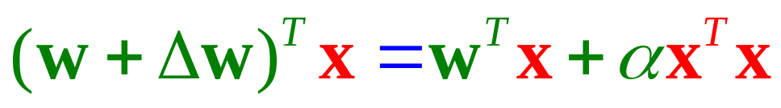
Observation
d = +1
+
d = −1
−
x₂
Is this w ok?
+
x
reasonable?
How to adjust w?
Δw = αx
x₁
w
<0
>0

Slide 22
Observation
d = +1
+
d = −1
−
x₂
Is this w ok?
−
w
x
Δw = ?
x₁
+αx
−αx
or

Slide 23
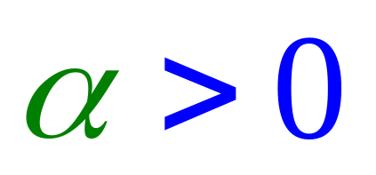


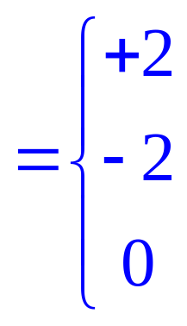
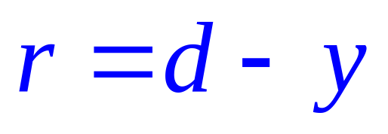
Perceptron Learning Rule
Upon misclassification on
d = +1
+
d = −1
−
Define error
+
−
−
+
No error

Slide 24

Perceptron Learning Rule
Define error
+
−
−
+
No error

Slide 25
Perceptron Learning Rule
Learning Rate
Error (d − y)
Input

Slide 26
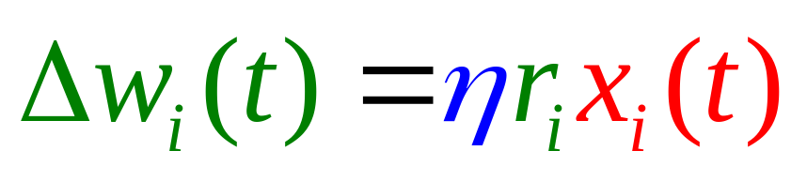
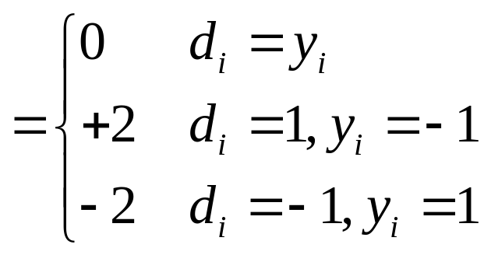
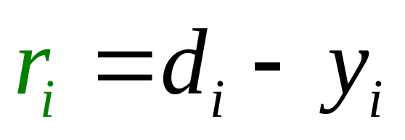
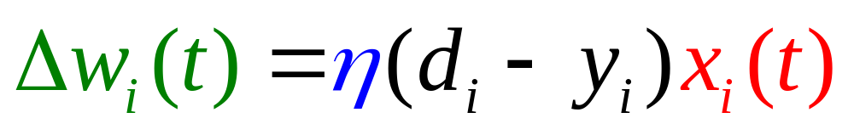
Summary −
Perceptron Learning Rule
Based on the general weight learning rule.
correct
incorrect

Slide 27


Summary −
Perceptron Learning Rule
Converge?
x
y
.
.
.
.
.
.
−
d
+
η

Slide 28
Perceptron Convergence Theorem
If the given training set is linearly separable, the learning process will converge in a finite number of steps.
x
y
.
.
.
.
.
.
−
d
+
η

Slide 29
The Learning Scenario
Linearly Separable.
x₂
x⁽¹⁾
+
x⁽²⁾
+
x₁
x⁽³⁾
−
x⁽⁴⁾
−

Slide 30
The Learning Scenario
x₂
x⁽¹⁾
+
x⁽²⁾
+
x₁
x⁽³⁾
−
x⁽⁴⁾
w₀
−

Slide 31
The Learning Scenario
x₂
x⁽¹⁾
+
x⁽²⁾
w₁
+
x₁
Δw₀
x⁽³⁾
−
x⁽⁴⁾
w₀
−

Slide 32
The Learning Scenario
x₂
x⁽¹⁾
w₂
+
Δw₁
x⁽²⁾
w₁
+
x₁
Δw₀
x⁽³⁾
−
x⁽⁴⁾
w₀
−

Slide 33
The Learning Scenario
x₂
Δw₂
x⁽¹⁾
w₃
w₂
+
Δw₁
x⁽²⁾
w₁
+
x₁
Δw₀
x⁽³⁾
−
x⁽⁴⁾
w₀
−

Slide 34
The Learning Scenario
w₄ = w₃
x₂
Δw₂
x⁽¹⁾
w₃
w₂
+
Δw₁
x⁽²⁾
w₁
+
x₁
Δw₀
x⁽³⁾
−
x⁽⁴⁾
w₀
−

Slide 35

The Learning Scenario
x₂
x⁽¹⁾
w
+
x⁽²⁾
+
x₁
x⁽³⁾
−
x⁽⁴⁾
−

Slide 36
The Learning Scenario
The demonstration is in augmented space.
x₂
x⁽¹⁾
w
+
x⁽²⁾
+
x₁
x⁽³⁾
−
x⁽⁴⁾
−
Conceptually, in augmented space, we adjust the weight vector to fit the data.

Slide 37
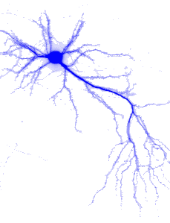
Feed-Forward Neural Networks
Learning Rules for
Single-Layered Perceptron Networks
Perceptron Learning Rule
Adaline Leaning Rule
δ-Learning Rule

Slide 38
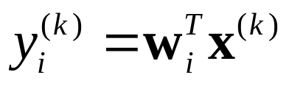
Adaline (Adaptive Linear Element)
Widrow [1962]
x₁
w_{i1}
x₂
w_{i2}
∑
.
.
.
w_{im}
x_{m}

Slide 39
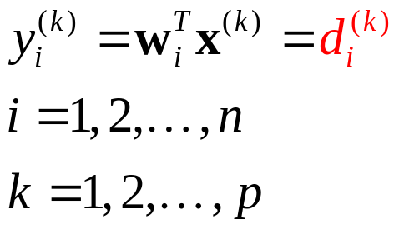
Adaline (Adaptive Linear Element)
In what condition, the goal is reachable?
Widrow [1962]
Goal:
x₁
w_{i1}
x₂
w_{i2}
∑
.
.
.
w_{im}
x_{m}

Slide 40
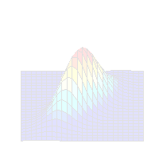
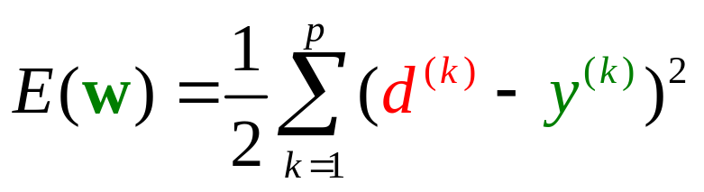
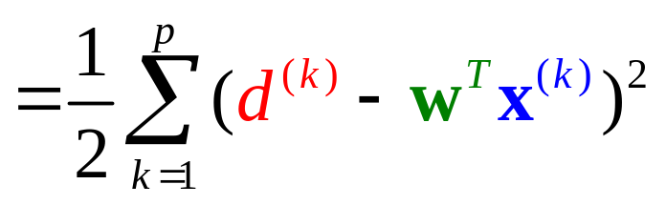
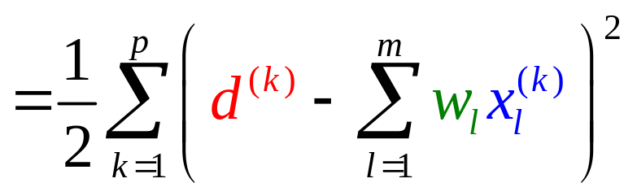
LMS (Least Mean Square)
Minimize the cost function (error function):

Slide 41
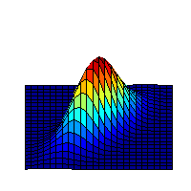
Gradient Decent Algorithm
Our goal is to go downhill.
E(w)
w₂
Contour Map
Δw
Δw₂
(w₁, w₂)
w₁
Δw₁

Slide 42
Gradient Decent Algorithm
Our goal is to go downhill.
How to find the steepest decent direction?
E(w)
w₂
Contour Map
Δw
Δw₂
(w₁, w₂)
w₁
Δw₁

Slide 43
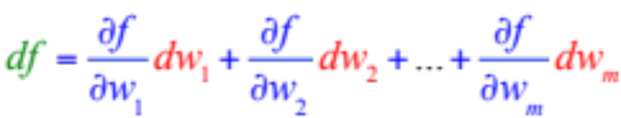
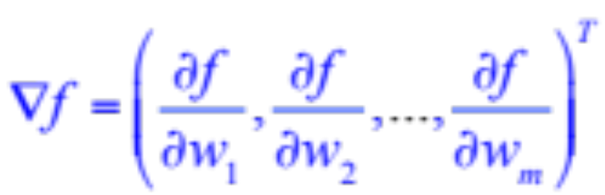
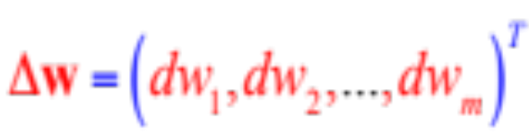
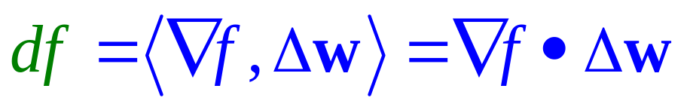
Gradient Operator
Let f(w) = f (w₁, w₂,…, w_{m}) be a function over R^{m}.
Define

Slide 44
Gradient Operator
Δw
∇f
Δw
∇f
∇f
Δw
df : positive
df : zero
df : negative
Go uphill
Plain
Go downhill

Slide 45
The Steepest Decent Direction
To minimize f , we choose
Δw = −η ∇ f
Δw
∇f
Δw
∇f
∇f
Δw
df : positive
df : zero
df : negative
Go uphill
Plain
Go downhill

Slide 46
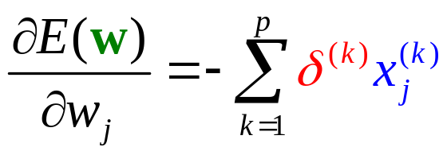

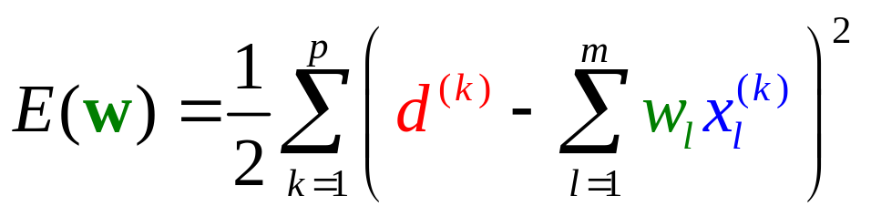
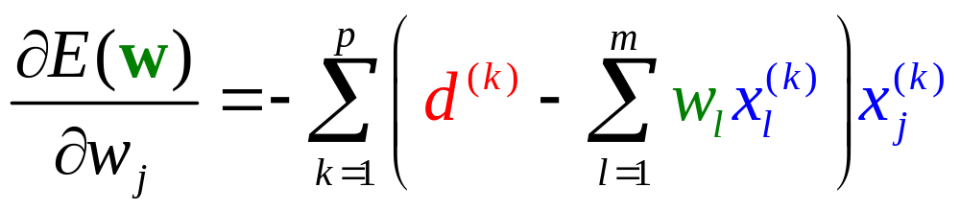
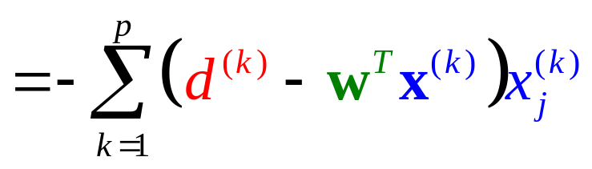
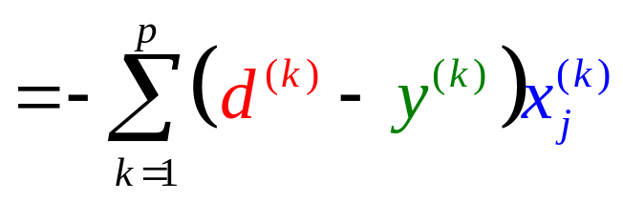
LMS (Least Mean Square)
Minimize the cost function (error function):
δ ^{(k)}

Slide 47
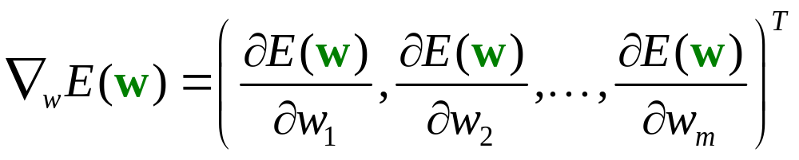

Adaline Learning Rule
Minimize the cost function (error function):
Weight Modification Rule

Slide 48
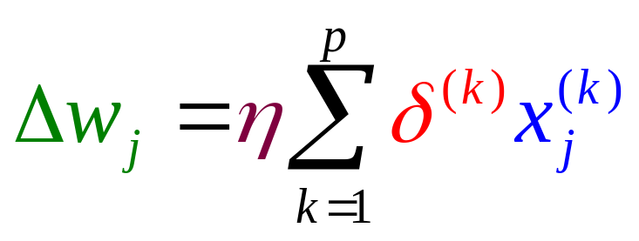
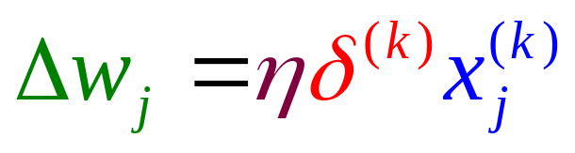
Learning Modes
Batch Learning Mode:
Incremental Learning Mode:

Slide 49
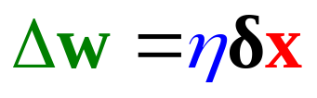
Summary −
Adaline Learning Rule
δ-Learning Rule
LMS Algorithm
Widrow-Hoff Learning Rule
Converge?
x
y
.
.
.
.
.
.
−
δ
d
+
η

Slide 50
Feed-Forward Neural Networks
Learning Rules for
Single-Layered Perceptron Networks
Perceptron Learning Rule
Adaline Leaning Rule
δ-Learning Rule

Slide 51
Adaline
x₁
w_{i1}
x₂
w_{i2}
∑
.
.
.
w_{im}
x_{m}

Slide 52
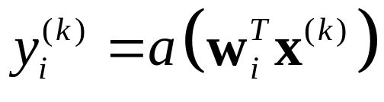
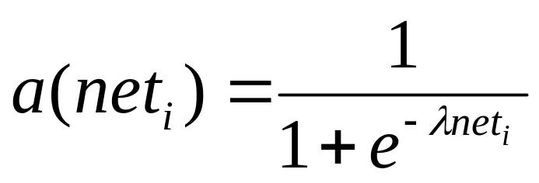
Unipolar Sigmoid
x₁
w_{i1}
x₂
w_{i2}
∑
.
.
.
w_{im}
x_{m}

Slide 53
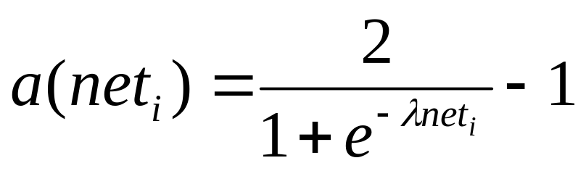
Bipolar Sigmoid
x₁
w_{i1}
x₂
w_{i2}
∑
.
.
.
w_{im}
x_{m}

Slide 54
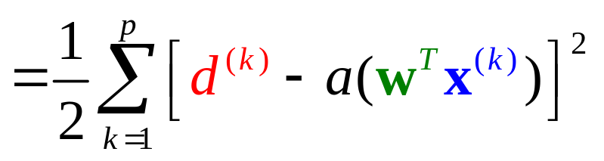
Goal
Minimize

Slide 55
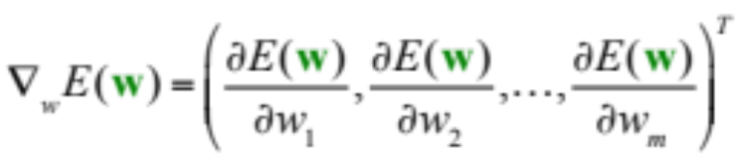

Gradient Decent Algorithm
Minimize

Slide 56
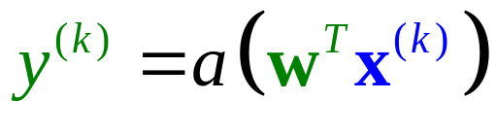
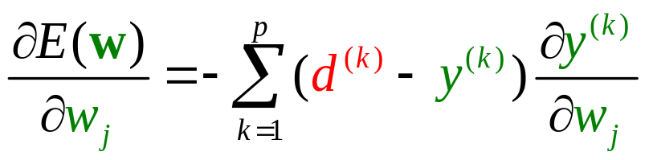
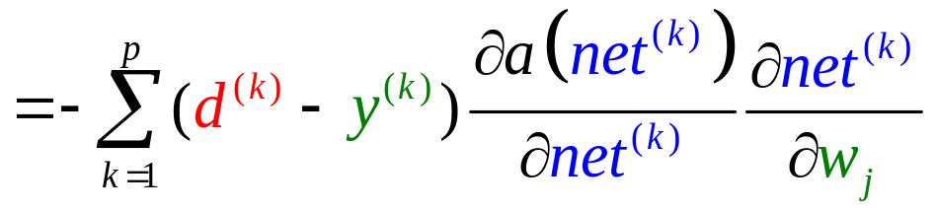
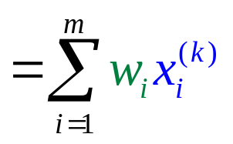


The Gradient
Minimize
Depends on the activation function used.
?
?

Slide 57





Weight Modification Rule
Minimize
Batch
Learning Rule
Incremental

Slide 58





The Learning Efficacy
Minimize
Sigmoid
Adaline
Unipolar
Bipolar
Exercise

Slide 59



Learning Rule − Unipolar Sigmoid
Minimize
Weight Modification Rule

Slide 60





Comparisons
Batch
Adaline
Incremental
Batch
Sigmoid
Incremental

Slide 61

The Learning Efficacy
Adaline
Sigmoid
y=a(net) = net
y=a(net)
net
net
constant
depends on output

Slide 62
The Learning Efficacy
Adaline
Sigmoid
The learning efficacy of Adaline is constant meaning that the Adline will never get saturated.
y=a(net) = net
y=a(net)
a’(net)
net
1
net
y=net
constant
depends on output

Slide 63

The Learning Efficacy
The sigmoid will get saturated if its output value nears the two extremes.
Sigmoid
Adaline
y=a(net) = net
y=a(net)
a’(net)
net
net
0
1
y
depends on output
constant

Slide 64
Initialization for Sigmoid Neurons
Before training, its weight must be sufficiently small.
x₁
w_{i1}
x₂
w_{i2}
∑
.
.
.
w_{im}
x_{m}

Slide 65
Feed-Forward Neural Networks
Back Propagation Learning algorithm

Slide 66




Activation Function — Sigmoid
1
0.5
net
0
Remember this

Slide 67

Supervised Learning
Training Set
o₁
o₂
o_{n}
d₁
d₂
d_{n}
Output Layer
. . .
Hidden Layer
. . .
. . .
Input Layer
. . .
x₁
x₂
x_{m}

Slide 68


Supervised Learning
Training Set
Sum of Squared Errors
o₁
o₂
o_{n}
d₁
d₂
d_{n}
. . .
. . .
Goal:
. . .
Minimize
. . .
x₁
x₂
x_{m}

Slide 69
Back Propagation Learning Algorithm
o₁
o₂
o_{n}
d₁
d₂
d_{n}
Learning on Output Neurons
Learning on Hidden Neurons
. . .
. . .
. . .
. . .
x₁
x₂
x_{m}

Slide 70




Learning on Output Neurons
o₁
o_{j}
o_{n}
d₁
d_{j}
d_{n}
. . .
j
. . .
w_{ji}
. . .
i
. . .
. . .
. . .
?
?
. . .
. . .

Slide 71


Learning on Output Neurons
o₁
o_{j}
o_{n}
d₁
d_{j}
d_{n}
. . .
j
. . .
w_{ji}
. . .
i
. . .
. . .
. . .
. . .
. . .
depends on the activation function

Slide 72


Learning on Output Neurons
o₁
o_{j}
o_{n}
d₁
d_{j}
d_{n}
. . .
j
. . .
w_{ji}
. . .
i
. . .
. . .
. . .
. . .
. . .
Using sigmoid,

Slide 73


Learning on Output Neurons
o₁
o_{j}
o_{n}
d₁
d_{j}
d_{n}
. . .
j
. . .
w_{ji}
. . .
i
. . .
. . .
. . .
. . .
. . .
Using sigmoid,

Slide 74



Learning on Output Neurons
o₁
o_{j}
o_{n}
d₁
d_{j}
d_{n}
. . .
j
. . .
w_{ji}
. . .
i
. . .
. . .
. . .
. . .
. . .

Slide 75


Learning on Output Neurons
o₁
o_{j}
o_{n}
d₁
d_{j}
d_{n}
. . .
j
. . .
How to train the weights connecting to output neurons?
w_{ji}
. . .
i
. . .
. . .
. . .
. . .
. . .

Slide 76


Learning on Hidden Neurons
. . .
j
. . .
w_{ji}
. . .
i
. . .
?
?
w_{ik}
. . .
k
. . .
. . .
. . .

Slide 77


Learning on Hidden Neurons
. . .
j
. . .
w_{ji}
. . .
i
. . .
w_{ik}
. . .
k
. . .
. . .
. . .

Slide 78


Learning on Hidden Neurons
. . .
j
. . .
w_{ji}
. . .
i
. . .
w_{ik}
. . .
k
. . .
?
. . .
. . .

Slide 79




Learning on Hidden Neurons
. . .
j
. . .
w_{ji}
. . .
i
. . .
w_{ik}
. . .
k
. . .
. . .
. . .

Slide 80


Learning on Hidden Neurons
. . .
j
. . .
w_{ji}
. . .
i
. . .
w_{ik}
. . .
k
. . .
. . .
. . .

Slide 81
Back Propagation
o₁
o_{j}
o_{n}
d₁
d_{j}
d_{n}
. . .
j
. . .
. . .
i
. . .
. . .
k
. . .
. . .
. . .
x₁
. . .
x_{m}

Slide 82

Back Propagation
o₁
o_{j}
o_{n}
d₁
d_{j}
d_{n}
. . .
j
. . .
. . .
i
. . .
. . .
k
. . .
. . .
. . .
x₁
. . .
x_{m}

Slide 83

Back Propagation
o₁
o_{j}
o_{n}
d₁
d_{j}
d_{n}
. . .
j
. . .
. . .
i
. . .
. . .
k
. . .
. . .
. . .
x₁
. . .
x_{m}

Slide 84
Backpropagation Training Algorithm
Create the K-layer network with H hidden units. Set weights to small random real values.
Until all training examples produce correct value (within ε), or mean squared error ceases to decrease, or other termination criteria:
Begin epoch
For each training example, d, do:
Calculate network output for d ’s input values
Compute error between output and label for d
Update weights using learning rule
End epoch

Slide 85
Reading
Shi Zhong and Vladimir Cherkassky, “Factors Controlling Generalization Ability of MLP Networks.” In Proc. IEEE Int. Joint Conf. on Neural Networks, vol. 1, pp. 625-630, Washington DC. July 1999. (http://www.cse.fau.edu/~zhong/pubs.htm)
Rumelhart, D. E., Hinton, G. E., and Williams, R. J. (1986b). "Learning Internal Representations by Error Propagation," in Parallel Distributed Processing: Explorations in the Microstructure of Cognition, vol. I, D. E. Rumelhart, J. L. McClelland, and the PDP Research Group. MIT Press, Cambridge (1986).
(http://www.cnbc.cmu.edu/~plaut/85-419/papers/RumelhartETAL86.backprop.pdf).

