Slide 1
Chapter 5: Markov Decision Processes
Hankui Zhuo
March 22, 2019

Slide 2
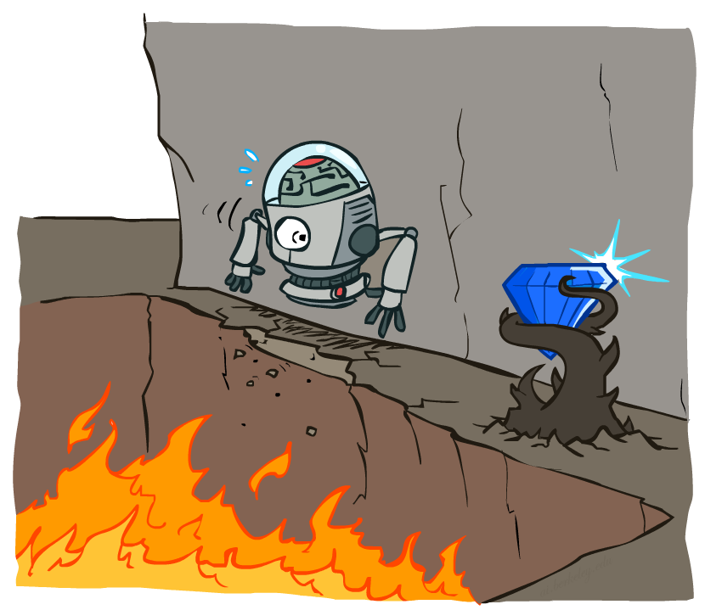
Non-Deterministic Search

Slide 3
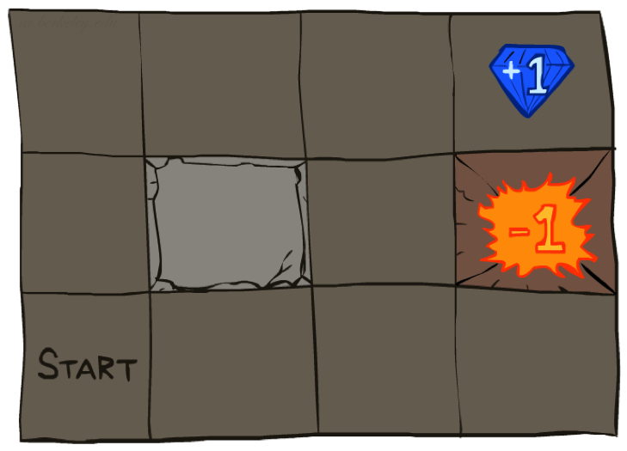




Example: Grid World
A maze-like problem
The agent lives in a grid
Walls block the agent’s path
Noisy movement: actions do not always go as planned
80% of the time, the action North takes the agent North (if there is no wall there)
10% of the time, North takes the agent West; 10% East
If there is a wall in the direction the agent would have been taken, the agent stays put
The agent receives rewards each time step
Small “living” reward each step (can be negative)
Big rewards come at the end (good or bad)
Goal: maximize sum of rewards

Slide 4
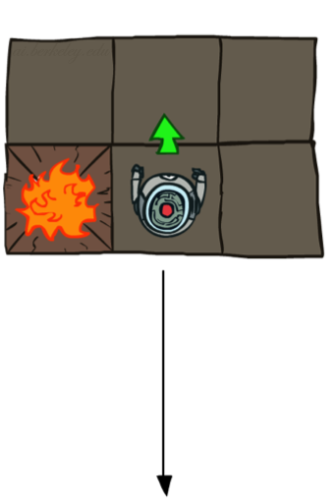
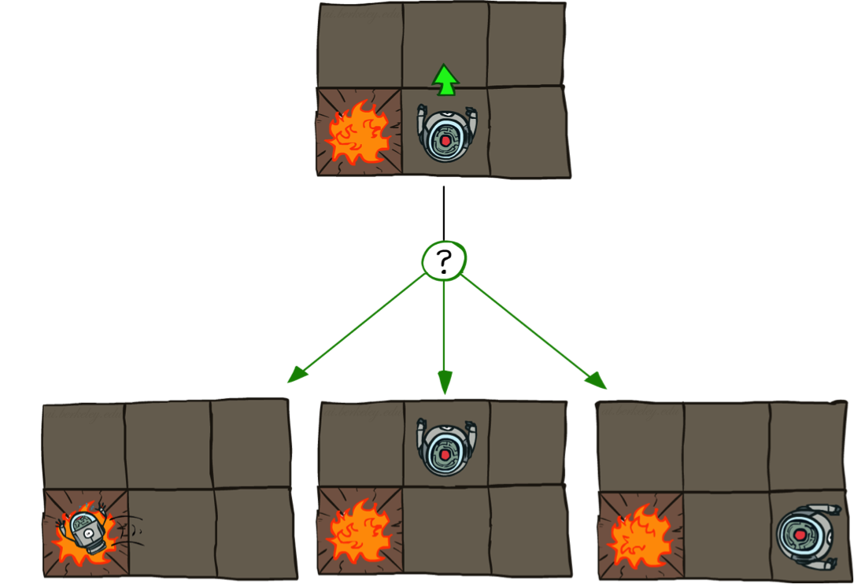
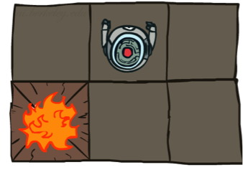
Grid World Actions
Deterministic Grid World
Stochastic Grid World

Slide 5
Markov Decision Processes
An MDP is defined by:
A set of states s ∈ S
A set of actions a ∈ A
A transition function T(s, a, s’)
Probability that a from s leads to s’, i.e., P(s’| s, a)
Also called the model or the dynamics
A reward function R(s, a, s’)
A start state
A terminal state

Slide 6
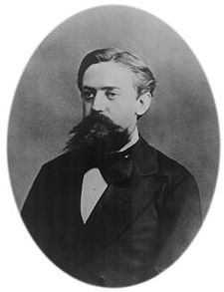

What is Markov about MDPs?
“Markov” generally means that given the present state, the future and the past are independent
For Markov decision processes, “Markov” means action outcomes depend only on the current state
Andrey Markov (1856-1922)
a₀
a₁
a₂
a_{t}
s₀
s₁
s₂
…
s_{t}
s_{t+1}

Slide 7
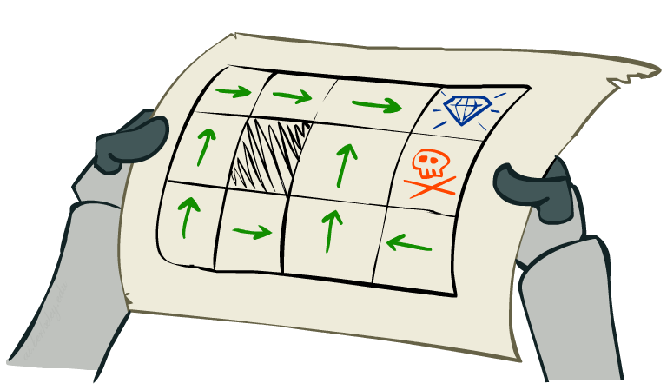
Policies
In deterministic single-agent search problems, we wanted an optimal plan, or sequence of actions, from start to a goal
For MDPs, we want an optimal policy π*: S → A
A policy π gives an action for each state
An optimal policy is one that maximizes expected utility
s₀
a₁ a₂ …… a_{n}
g
Optimal policy when R(s, a, s’) = -0.03 for all non-terminals s

Slide 8
Optimal Policies
R(s) = -0.01
R(s) = -0.03
R(s) = -0.4
R(s) = -2.0

Slide 9
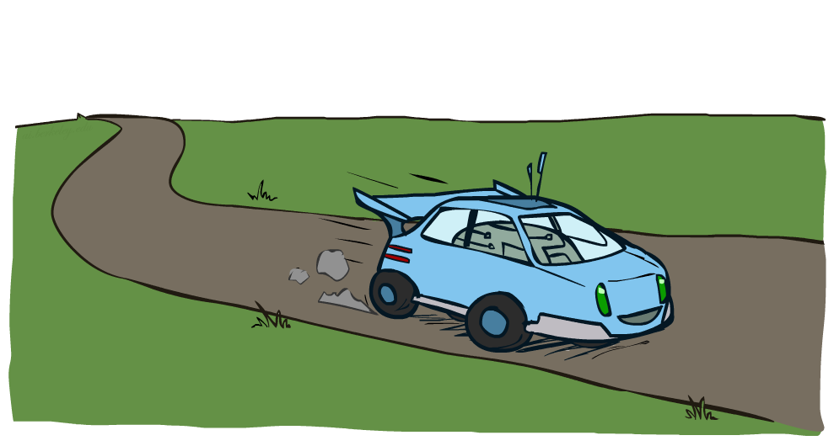
Example: Racing

Slide 10
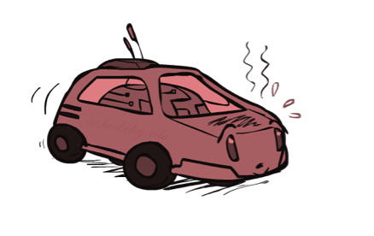
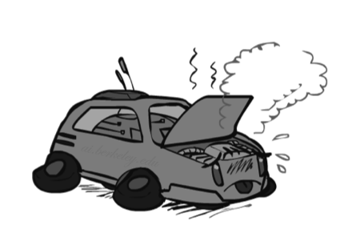
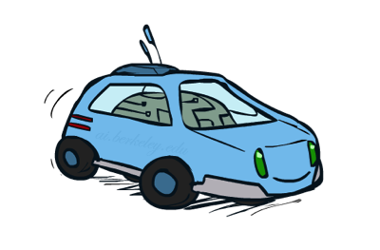
Example: Racing
A robot car wants to travel far, quickly
Three states: Cool, Warm, Overheated
Two actions: Slow, Fast
Going faster gets double reward
0.5
+1
1.0
Fast
Slow
-10
+1
0.5
Warm
Slow
Fast
0.5
+2
Cool
0.5
Overheated
+1
1.0
+2

Slide 11


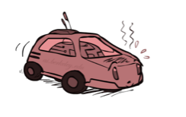

Racing Search Tree

Slide 12
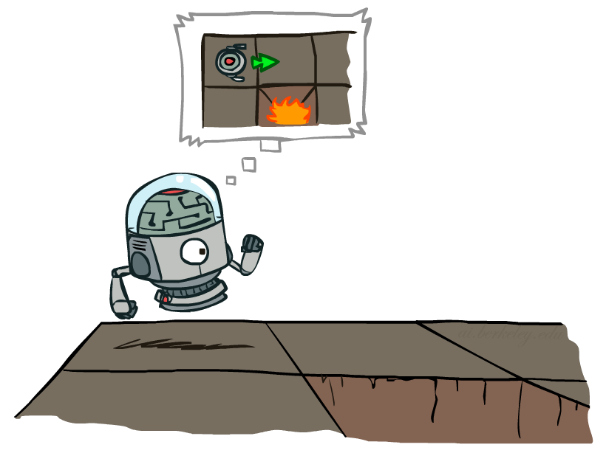

MDP Search Trees
Each MDP state projects an expectimax-like search tree
s
s is a state
a
(s, a) is a q-state
s, a
(s,a,s’) called a transition
T(s,a,s’) = P(s’|s,a)
R(s,a,s’)
s,a,s’
s’

Slide 13
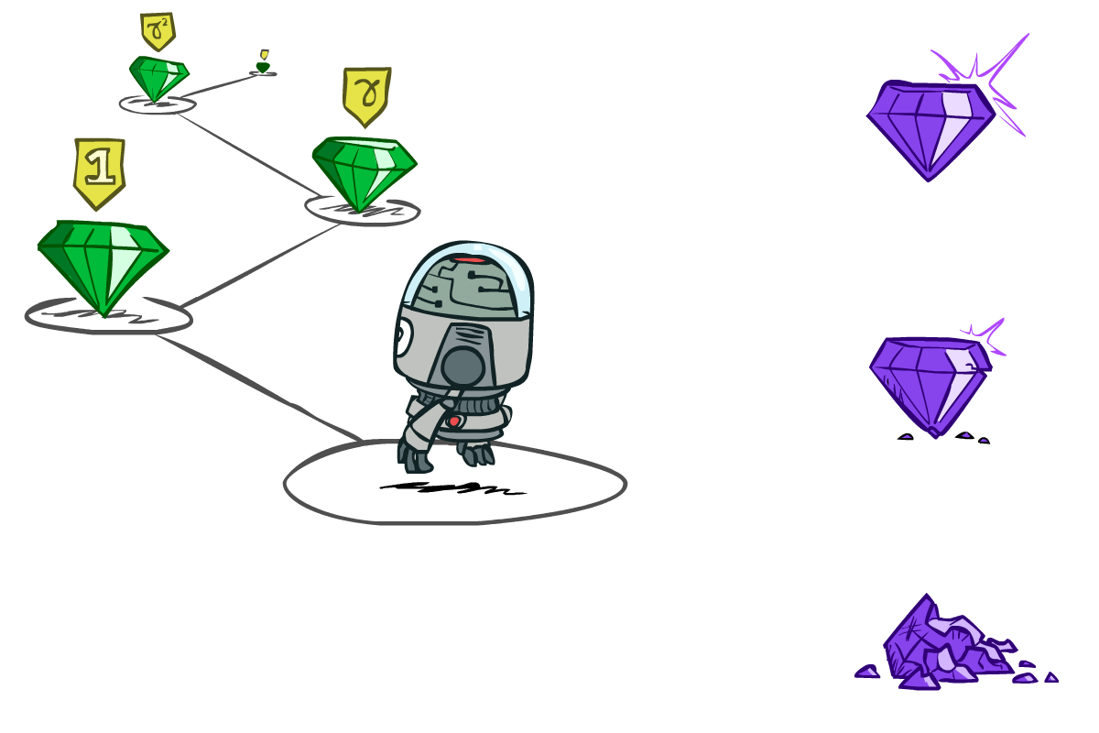

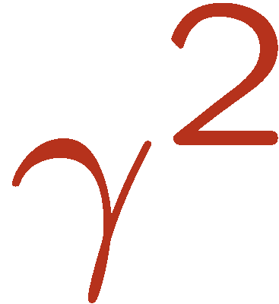
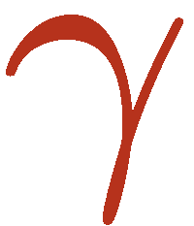
Discounting
It’s reasonable to maximize the sum of rewards
It’s also reasonable to prefer rewards now to rewards later
One solution: values of rewards decay exponentially
Worth Now
Worth Next Step
Worth In Two Steps

Slide 14

Discounting
How to discount?
Each time we descend a level, we multiply in the discount once
Why discount?
Sooner rewards probably do have higher utility than later rewards
Example: discount of 0.5
U([1,2,3]) = 1*1 + 0.5*2 + 0.25*3
U([1,2,3]) < U([3,2,1])

Slide 15
Optimal Quantities
The value (utility) of a state s:
V*(s) = expected utility starting in s and acting optimally
The value (utility) of a q-state (s,a):
Q*(s,a) = expected utility starting out having taken action a from state s and (thereafter) acting optimally
The optimal policy:
π*(s) = optimal action from state s
s
s is a state
a
(s, a) is a q-state
s, a
s,a,s’
(s,a,s’) is a transition
s’
[Demo – gridworld values (L8D4)]
Notes:
[Note: this demo doesn’t show anything in action, just pops up V and Q values.]

Slide 16

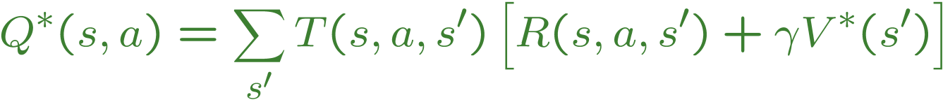
Values of States
Fundamental operation: compute the (expectimax) value of a state
Expected utility under optimal actions
Average sum of (discounted) rewards
Recursive definition of value:
s
a
s, a
s,a,s’
s’
These are the Bellman equations, and they characterize optimal values in a way we’ll use over and over

Slide 17
Value Iteration
Bellman equations characterize the optimal values:
Value iteration computes them:值迭代
Value iteration is just a fixed point solution method
V(s)
a
s, a
s,a,s’
V(s’)

Slide 18
Value Iteration
Start with V₀(s) = 0:
no time steps left means an expected reward sum of zero
Given vector of V_{k}(s) values, do one ply of expectimax from each state:
Repeat until convergence
Complexity of each iteration: O(S²A)
Theorem: will converge to unique optimal values收敛 （Homework： Proof）
Basic idea: approximations get refined towards optimal values
V_{k+1}(s)
a
s, a
s,a,s’
V_{k}(s’)

Slide 19


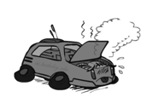
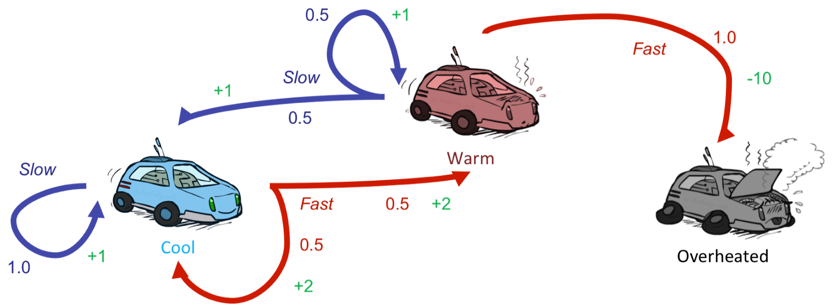
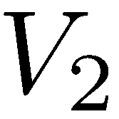
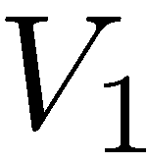
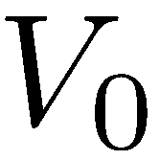
Example: Value Iteration
3.5 2.5 0
2 1 0
Assume no discount!
0 0 0

Slide 20
Fixed Policies固定的策略
Do the optimal action
Do what π says to do
s
s
a
π(s)
s, a
s, π(s)
s,a,s’
s, π(s),s’
s’
s’
Expectimax trees max over all actions to compute the optimal values
If we fixed some policy π(s), then the tree would be simpler – only one action per state每个状态只有一个后续动作
… though the tree’s value would depend on which policy we fixed

Slide 21
Utilities for a Fixed Policy固定策略的值
Another basic operation:
compute the utility of a state s under a fixed (generally non-optimal) policy
Define the utility of a state s, under a fixed policy π:
V^{π}(s) = expected total discounted rewards starting in s and following π
Recursive relation (one-step look-ahead / Bellman equation):
s
π(s)
s, π(s)
s, π(s),s’
s’

Slide 22

Policy Evaluation策略评估
s
How do we calculate the value V for a fixed policy π?
Idea 1: Turn recursive Bellman equations into updates
(like value iteration)
Efficiency: O(S²) per iteration
Idea 2: Without the maxes, the Bellman equations are just a linear system 没有最大化计算，仅为线性系统
π(s)
s, π(s)
s, π(s),s’
s’

Slide 23
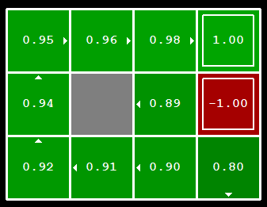

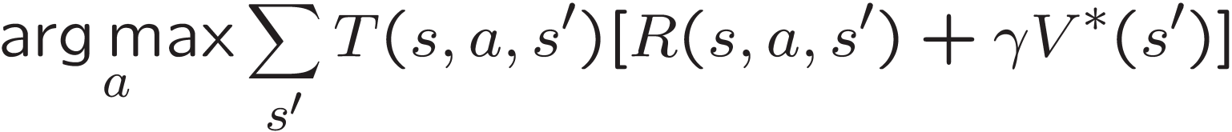
Computing Actions from Values
Let’s imagine we have the optimal values V*(s)
How should we act?
It’s not obvious!
We need to do a mini-expectimax (one step)
This is called policy extraction策略提取, since it gets the policy implied by the values 已知最优值，计算得最优动作，作为策略

Slide 24
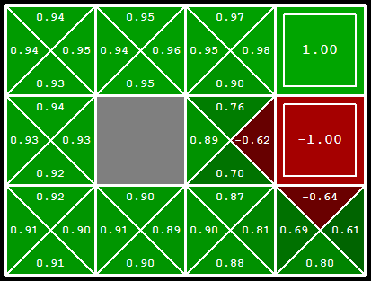
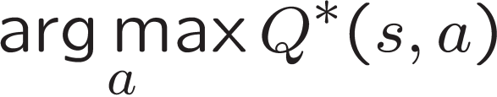
Computing Actions from Q-Values
Let’s imagine we have the optimal q-values:
How should we act?
Completely trivial to decide!
Important lesson: actions are easier to select from q-values than values!
已知q值，选择最大的q值，相应的动作为策略

Slide 25
Policy Iteration策略迭代
Alternative approach for optimal values:
Step 1: Policy evaluation: calculate utilities for some fixed policy (not optimal utilities!) until convergence 对一些固定策略进行评估
Step 2: Policy improvement: update policy using one-step look-ahead with resulting converged (but not optimal!) utilities as future values 策略提升，根据第一步产生的value、qvalue选择动作，更新策略
Repeat steps until policy converges 直到策略收敛
This is policy iteration
It’s still optimal!
Can converge (much) faster under some conditions

Slide 26
Policy Iteration
Evaluation: For fixed current policy π, find values with policy evaluation:
Iterate until values converge:
Improvement: For fixed values, get a better policy using policy extraction
One-step look-ahead:

Slide 27
Comparison
Both value iteration and policy iteration compute the same thing (all optimal values)
In value iteration:
Every iteration updates both the values and (implicitly) the policy
We don’t track the policy, but taking the max over actions implicitly recomputes it
In policy iteration:
We do several passes that update utilities with fixed policy (each pass is fast because we consider only one action, not all of them)
After the policy is evaluated, a new policy is chosen (slow like a value iteration pass)
The new policy will be better (or we’re done)
Both are dynamic programs for solving MDPs

Slide 28
Summary: MDP Algorithms
So you want to….
Compute optimal values: use value iteration or policy iteration
Compute values for a particular policy: use policy evaluation
Turn your values into a policy: use policy extraction (one-step lookahead)
These all look the same!
They basically are – they are all variations of Bellman updates
They all use one-step lookahead expectimax fragments
They differ only in whether we plug in a fixed policy or max over actions

Slide 29
Homework
1. Thinking: Please prove the convergence property of the value iteration algorithm! -- March 29, 2019
2. Coding: Please implement the value iteration and policy iteration algorithms to compute the optimal policy! – April 12, 2019
80% of the time, the action North takes the agent North (if there is no wall there)
10% of the time, North takes the agent West; 10% East
If there is a wall in the direction the agent would have been taken, the agent stays put
R(s, a, s’) = -0.03 for all non-terminals s

Slide 30
The End！

