Slide 1
Chapter 7: Reinforcement Learning
Hankui Zhuo
March 29, 2019

Slide 2
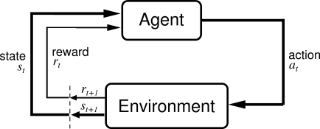
Reinforcement Learning强化学习
Basic idea:
Receive feedback in the form of rewards
Agent’s utility is defined by the reward function
Must (learn to) act so as to maximize expected rewards

Slide 3
Reinforcement Learning
Reinforcement learning:
Still assume an MDP:
A set of states s ∈ S
A set of actions (per state) A
A model T(s,a,s’)
A reward function R(s,a,s’)
A discount factor γ (could be 1)
Still looking for a policy π(s)
New twist: don’t know T or R
i.e. don’t know which states are good or what the actions do
Must actually try actions and states out to learn
无法事先知道奖赏，也无法知道动作的结果

Slide 4
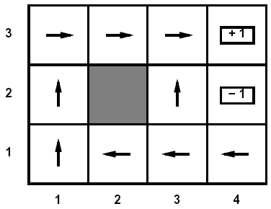
Passive Learning
Simplified task
You don’t know the transitions T(s,a,s’)
You don’t know the rewards R(s,a,s’)
You are given a policy π(s)
Goal: learn the state values
In this case:
No choice about what actions to take
Just execute the policy and learn from experience 执行策略，从经验中学习
This is NOT offline planning! You actually take actions in the world and see what happens…

Slide 5
Model-Based Learning基于模型的学习
Idea:
Learn the model empirically through experience
Solve for values as if the learned model were correct
Simple empirical model learning
从经验中估计T，发现R
Count outcomes for each s,a
Normalize to give estimate of T(s,a,s’)
Discover R(s,a,s’) when we experience (s,a,s’)
Solving the MDP with the learned model
再使用学习到的模型计算
Iterative policy evaluation, for example
s
π(s)
s, π(s)
s, π(s),s’
s’

Slide 6
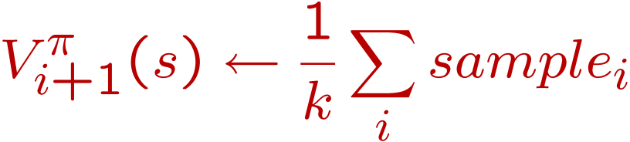
Sample-Based Policy Evaluation?基于样本的策略评估
s
Approximate the expectation with samples 计算期望(drawn from T!)
π(s)
s, π(s)
s, π(s),s’
s₂’
s₁’
s₃’
s’

Slide 7
Temporal-Difference Learning时序差分学习
Big idea: learn from every experience!
Update V(s) each time we experience (s,a,s’,r)
Likely s’ will contribute updates more often
Temporal difference learning
Policy still fixed!
Move values toward value of whatever successor occurs: running average!
s
π(s)
s, π(s)
s’
Sample of V(s):
Update to V(s):

Slide 8

Exponential Moving Average
Exponential moving average
Makes recent samples more important
Forgets about the past (distant past values were wrong anyway)
Easy to compute from the running average
Decreasing learning rate can give converging averages

Slide 9
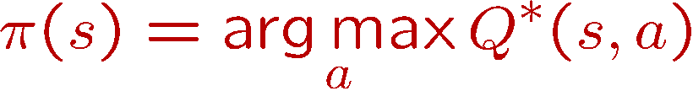
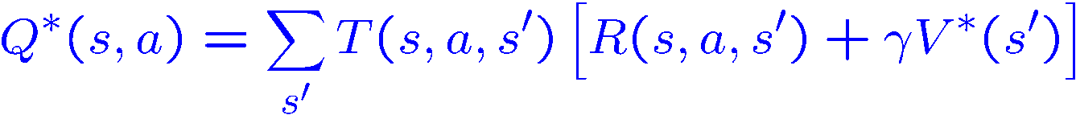
Problems with TD Value Learning
TD value leaning is a model-free way to do policy evaluation
However, if we want to turn values into a (new) policy, we’re sunk:
Idea: learn Q-values directly
Makes action selection model-free too!
s
a
s, a
s,a,s’
s’

Slide 10
Active Learning主动学习
Full reinforcement learning
You don’t know the transitions T(s,a,s’)
You don’t know the rewards R(s,a,s’)
You can choose any actions you like 可选择动作
Goal: learn the optimal policy
In this case:
Learner makes choices!
Fundamental tradeoff: exploration vs. exploitation
This is NOT offline planning! You actually take actions in the world and find out what happens…

Slide 11

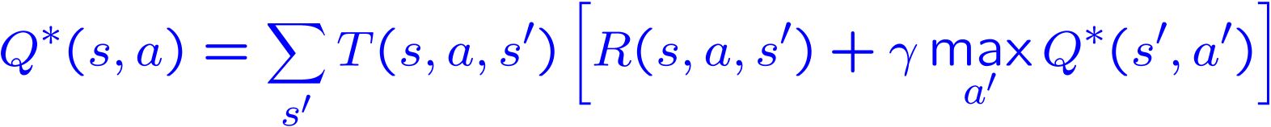
Q-Learning
Learn Q*(s,a) values
Receive a sample (s,a,s’,r)
Consider your old estimate:
Consider your new sample estimate:
Incorporate the new estimate into a running average:

Slide 12
Q-Learning Properties
Amazing result: Q-learning converges to optimal policy
If you explore enough
If you make the learning rate small enough
… but not decrease it too quickly!
Basically doesn’t matter how you select actions (!)

Slide 13
Exploration探索 / Exploitation开发
Several schemes for forcing exploration
Simplest: random actions (ε greedy)
Every time step, flip a coin
With probability ε, act randomly
With probability 1-ε, act according to current policy
Problems with random actions?
You do explore the space, but keep thrashing around once learning is done
One solution: lower ε over time 随时间推移，探索几率降低

Slide 14
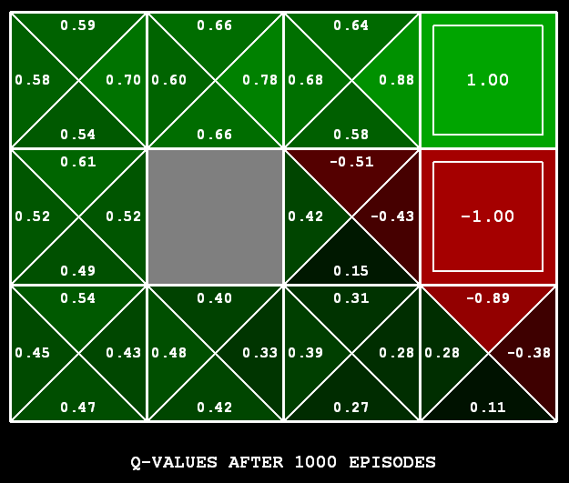
Q-Learning
Q-learning produces tables of q-values:

Slide 15
The Story So Far: MDPs and RL
Things we know how to do:
Techniques:
If we know the MDP
Compute V*, Q*, π* exactly
Evaluate a fixed policy π
If we don’t know the MDP
We can estimate the MDP then solve（基于模型）
We can estimate V for a fixed policy π
We can estimate Q*(s,a) for the optimal policy while executing an exploration policy
Model-based DPs
Value and policy Iteration
Policy evaluation
Model-based RL
Model-free RL:
Value learning
Q-learning

Slide 16
Q-Learning
In realistic situations, we cannot possibly learn about every single state! 现实中无法学习到所有状态
Too many states to visit them all in training
Too many states to hold the q-tables in memory
Instead, we want to generalize:
Learn about some small number of training states from experience 从少数经验中学习
Generalize that experience to new, similar states 生成新的经验
This is a fundamental idea in machine learning

Slide 17
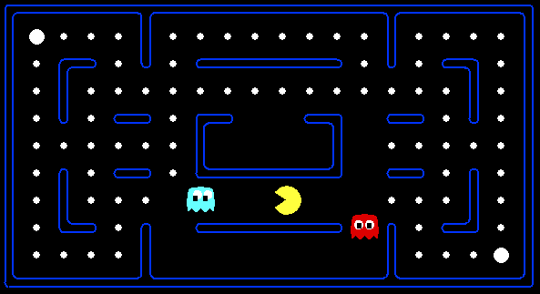



Feature-Based Representations
Solution: describe a state using a vector of features
Features are functions from states to real numbers (often 0/1) that capture important properties of the state
Example features:
Distance to closest ghost
Distance to closest dot
Number of ghosts
1 / (dist to dot)²
Is Pacman in a tunnel? (0/1)
…… etc.
Can also describe a q-state (s, a) with features (e.g. action moves closer to food)

Slide 18
Linear Feature Functions 线性特征函数
Using a feature representation, we can write a q function (or value function) for any state using a few weights:
Advantage: our experience is summed up in a few powerful numbers 用数字总结经验
Disadvantage: states may share features but be very different in value! 有共同特点的状态值可能差异很大

Slide 19
Function Approximation
Q-learning with linear q-functions:
作业
Intuitive interpretation:
Adjust weights of active features
E.g. if something unexpectedly bad happens, disprefer all states with that state’s features

Slide 20
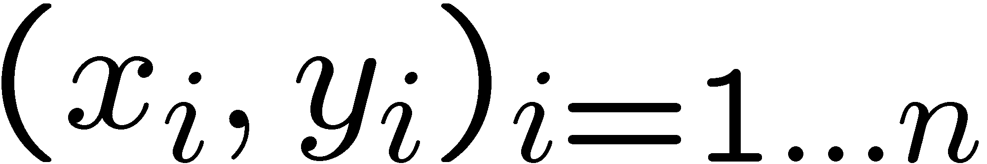
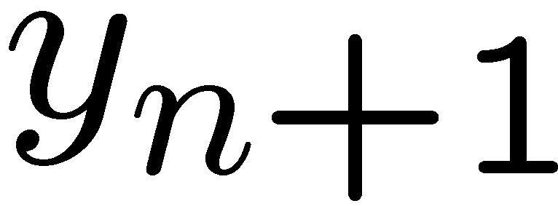
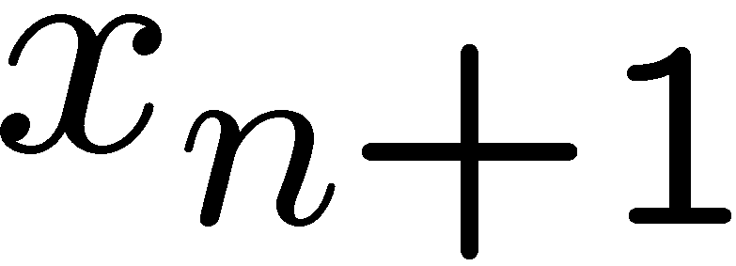
Linear regression
40
26
24
20
22
20
30
20
40
30
0
10
20
0
10
20
0
10
0
Given examples
Predict
given a new point
Notes:
Figure 1: scatter(1:20,10+(1:20)+2*randn(1,20),'k','filled'); a=axis; a(3)=0; axis(a);

Slide 21
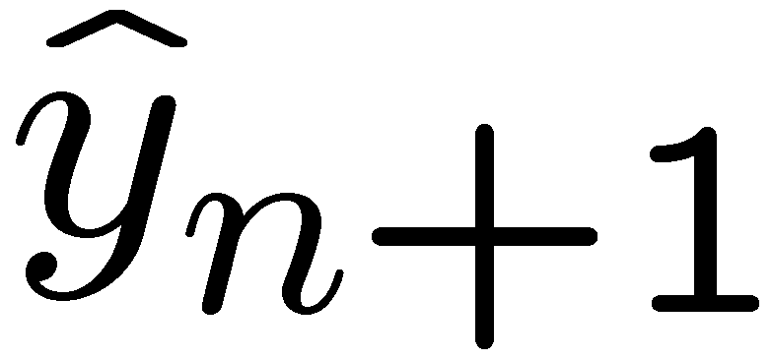
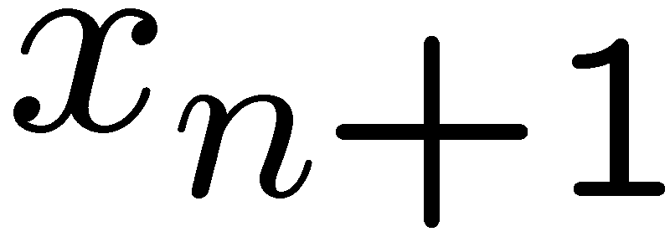
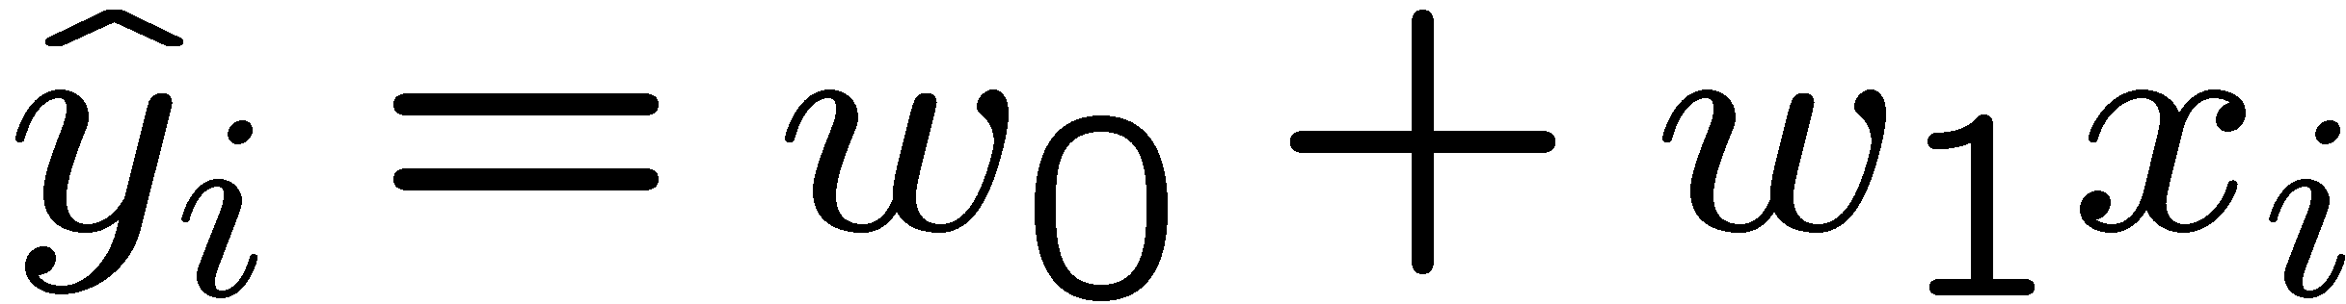
Linear regression线性回归
40
26
24
20
22
20
30
20
40
30
0
10
20
0
20
0
10
0
Prediction
Prediction
Notes:
Figure 1: scatter(1:20,10+(1:20)+2*randn(1,20),'k','filled'); a=axis; a(3)=0; axis(a);

Slide 22
The End!

