Slide 1
Chapter 8: Planning Representation And Algorithms
Hankui Zhuo
April 12, 2019

Slide 2
Quick Review of Classical Planning
s₁
s₀
Classical planning
requires all eight of the
restrictive assumptions:
  A0: Finite
  A1: Fully observable
  A2: Deterministic
  A3: Static
  A4: Attainment goals
  A5: Sequential plans
  A6: Implicit time
  A7: Offline planning
put
take
location 1
location 2
location 1
location 2
move2
move1
move2
move1
s₃
s₂
put
take
location 1
location 2
location 1
location 2
unload
load
s₄
s₅
move2
move1
location 1
location 2
location 1
location 2

Slide 3
Representations: Motivation
In most problems, far too many states to try to represent all of them explicitly as s₀, s₁, s₂, …
Represent each state as a set of features
  e.g.,
    a vector of values for a set of variables
    a set of ground atoms in some first-order language L
Define a set of operators that can be used to compute state-transitions
Don’t give all of the states explicitly
  Just give the initial state
  Use the operators to generate the other states as needed

Slide 4
Outline
Representation schemes
  Classical representation
  Set-theoretic representation
  State-variable representation
  Examples: DWR and the Blocks World
  Comparisons

Slide 5
Classical Representation
Start with a function-free first-order language
  Finitely many predicate symbols and constant symbols,
  but no function symbols
Example: the DWR domain
  Locations: l1, l2, …
  Containers: c1, c2, …
  Piles: p1, p2, …
  Robot carts: r1, r2, …
  Cranes: k1, k2, …

Slide 6
Classical Representation
Atom: predicate symbol and args
  Use these to represent both fixed and dynamic relations
    adjacent(l,l’) attached(p,l) belong(k,l)
    occupied(l) at(r,l)
    loaded(r,c) unloaded(r)
    holding(k,c) empty(k)
    in(c,p) on(c,c’)
    top(c,p) top(pallet,p)
Ground expression: contains no variable symbols - e.g., in(c1,p3)
Unground expression: at least one variable symbol - e.g., in(c1,x)
Substitution: θ = {x₁ ← v₁, x₂ ← v₂, …, x_{n} ← v_{n}}
  Each x_{i} is a variable symbol; each v_{i} is a term
Instance of e: result of applying a substitution θ to e
  Replace variables of e simultaneously, not sequentially

Slide 7
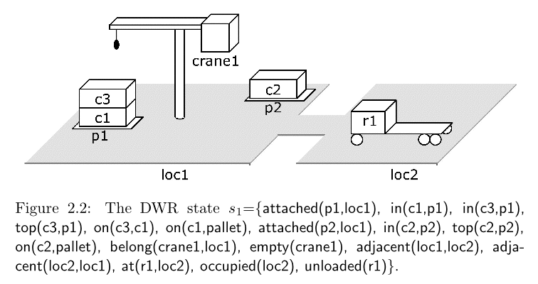
States
State: a set s of ground atoms 状态：原子的集合
  The atoms represent the things that are true in one of Σ’s states
  Only finitely many ground atoms, so only finitely many possible states

Slide 8
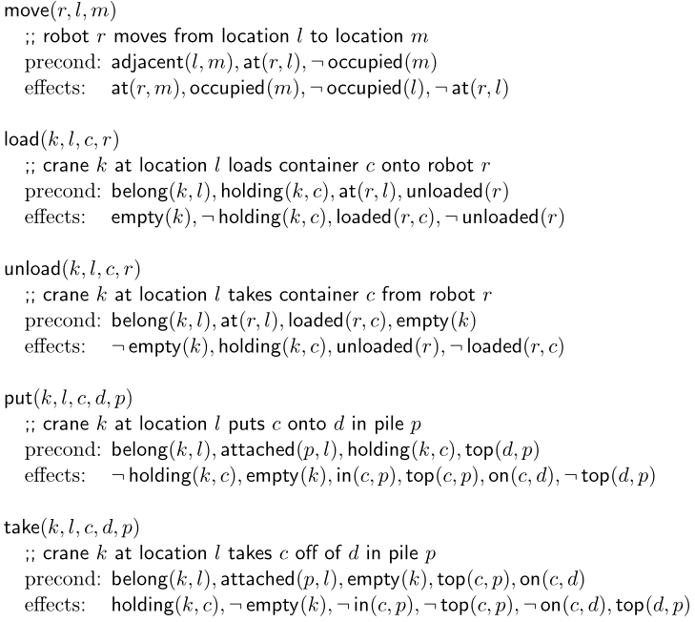
Operators操作
Operator: a triple o=(name(o), precond(o), effects(o))
  name(o) is a syntactic expression of the form n(x₁,…,x_{k})名字 参数
    n: operator symbol - must be unique for each operator
    x₁,…,x_{k}: variable symbols (parameters)
      must include every variable symbol in o
  precond(o): preconditions前提
    literals that must be true in order to use the operator
  effects(o): effects后果
    literals the operator will make true

Slide 9
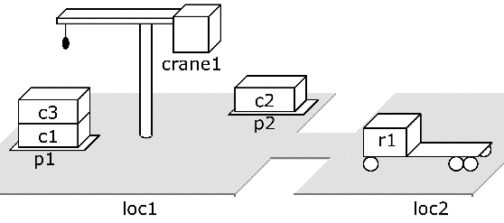
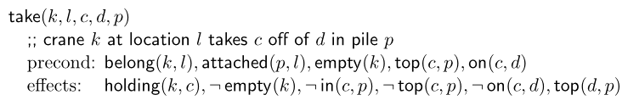
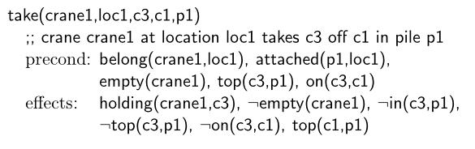
Actions
Action: ground instance (via substitution) of an operator

Slide 10
Notation
Let S be a set of literals. Then
  S⁺ = {atoms that appear positively in S}
  S– = {atoms that appear negatively in S}
More specifically, let a be an operator or action. Then
  precond⁺(a) = {atoms that appear positively in a’s preconditions}
  precond–(a) = {atoms that appear negatively in a’s preconditions}
  effects⁺(a) = {atoms that appear positively in a’s effects}
  effects–(a) = {atoms that appear negatively in a’s effects}
  effects⁺(take(k,l,c,d,p) = {holding(k,c), top(d,p)}
  effects–(take(k,l,c,d,p) = {empty(k), in(c,p), top(c,p), on(c,d)}

Slide 11
Applicability
An action a is applicable to a state s if s satisfies precond(a),
  i.e., if precond⁺(a) ⊆ s and precond–(a) ∩ s = ∅
Here are an action and a state that it’s applicable to:

Slide 12
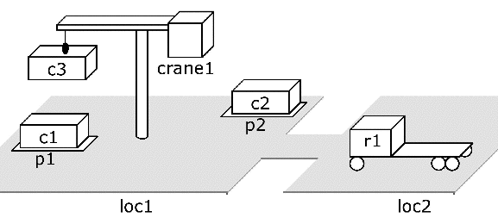
Result of Performing an Action
If a is applicable to s, the result of performing it is
  γ(s,a) = (s – effects–(a)) ∪ effects⁺(a)
  Delete the negative effects, and add the positive ones

Slide 13
Planning domain: language plus operators
  Corresponds to a
  set of state-transition systems
  Example:
  operators for the DWR domain

Slide 14
Planning Problems
Given a planning domain (language L, operators O)
  Statement of a planning problem: a triple P=(O,s₀,g)两者等价，规划问题
    O is the collection of operators
    s₀ is a state (the initial state)
    g is a set of literals (the goal formula)
  The actual planning problem: P = (Σ,s₀,S_{g})
    s₀ and S_{g} are as above
    Σ = (S,A,γ) is a state-transition system
    S = {all sets of ground atoms in L}
    A = {all ground instances of operators in O}
    γ = the state-transition function determined by the operators
I’ll often say “planning problem” when I mean the statement of the problem

Slide 15
Plans and Solutions
Plan: any sequence of actions σ = ⟨a₁, a₂, …, a_{n}⟩ such that
each a_{i} is a ground instance of an operator in O
The plan is a solution for P=(O,s₀,g) if it is executable and achieves g
  i.e., if there are states s₀, s₁, …, s_{n} such that
    γ (s₀,a₁) = s₁
    γ (s₁,a₂) = s₂
    …
    γ (s_{n–1},a_{n}) = s_{n}
    s_{n} satisfies g

Slide 16
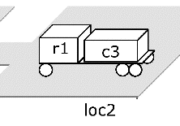
Example
g₁={loaded(r1,c3),
at(r1,loc2)}
Let P₁ = (O, s₁, g₁), where
  O is the set of operators given earlier

Slide 17
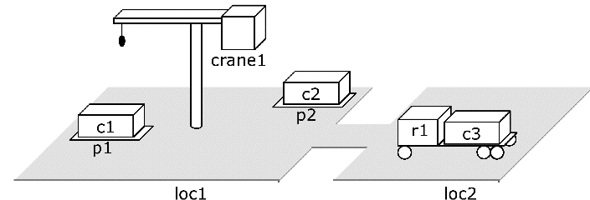
Example (continued)
Here are three solutions for P₁:
  ⟨take(crane1,loc1,c3,c1,p1), move(r1,loc2,loc1), move(r1,loc1,loc2),
  move(r1,loc2,loc1), load(crane1,loc1,c3,r1), move(r1,loc1,loc2)⟩
  ⟨take(crane1,loc1,c3,c1,p1), move(r1,loc2,loc1),
  load(crane1,loc1,c3,r1), move(r1,loc1,loc2)⟩
  ⟨move(r1,loc2,loc1), take(crane1,loc1,c3,c1,p1),
  load(crane1,loc1,c3,r1), move(r1,loc1,loc2)⟩
Each of them produces
the state shown here:

Slide 18
Example (continued)
The first is redundant: can remove actions and still have a solution
  ⟨take(crane1,loc1,c3,c1,p1), move(r1,loc2,loc1), move(r1,loc1,loc2),
  move(r1,loc2,loc1), load(crane1,loc1,c3,r1), move(r1,loc1,loc2)⟩
  ⟨take(crane1,loc1,c3,c1,p1), move(r1,loc2,loc1),
  load(crane1,loc1,c3,r1), move(r1,loc1,loc2)⟩
  ⟨move(r1,loc2,loc1), take(crane1,loc1,c3,c1,p1),
  load(crane1,loc1,c3,r1), move(r1,loc1,loc2)⟩
The 2nd and 3rd
are irredundant
and shortest

Slide 19
Set-Theoretic Representation 集合论表示
Like classical representation, but restricted to propositional logic
States:
  Instead of a collection of ground atoms …
  {on(c1,pallet), on(c1,r1), on(c1,c2), …, at(r1,l1), at(r1,l2), …}
  … use a collection of propositions (boolean variables):
  {on-c1-pallet, on-c1-r1, on-c1-c2, …, at-r1-l1, at-r1-l2, …}

Slide 20
Instead of operators like this one, 将操作全部实例化
take all of
the operator
instances,
e.g., this one,
and rewrite
ground atoms
as propositions
take-crane1-loc1-c3-c1-p1
precond: belong-crane1-loc1, attached-p1-loc1,
empty-crane1, top-c3-p1, on-c3-c1
delete: empty-crane1, in-c3-p1, top-c3-p1, on-c3-p1
add: holding-crane1-c3, top-c1-p1

Slide 21
Comparison
A set-theoretic representation is equivalent to a classical representation in which all of the atoms are ground
Exponential blowup 集合论的表示，不含变量，枚举全部状态
  If a classical operator contains n atoms
  and each atom has arity k,
  then it corresponds to c^{nk} actions where c = |{constant symbols}|

Slide 22
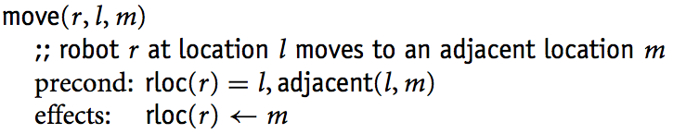
State-Variable Representation
Use ground atoms for properties that do not change, e.g., adjacent(loc1,loc2)
For properties that can change, assign values to state variables
  Like fields in a record structure
Classical and state-variable representations take similar amounts of space
  Each can be translated into the other in low-order polynomial time
{top(p1)=c3,
cpos(c3)=c1,
cpos(c1)=pallet,
holding(crane1)=nil,
rloc(r1)=loc2,
loaded(r1)=nil, …}

Slide 23
Example: The Blocks World
Infinitely wide table, finite number of blocks
Ignore where a block is located on the table
A block can sit on the table or on another block
Want to move blocks from one configuration to another
  e.g.,
  initial state goal
Can be expressed as a special case of DWR
  But the usual formulation is simpler
I’ll give classical, set-theoretic, and state-variable formulations 3种表示方式
  For the case where there are five blocks
a
d
c
b
a
b
e
c

Slide 24
Classical Representation: Symbols
Constant symbols:
  The blocks: a, b, c, d, e
Predicates:
  ontable(x) - block x is on the table
  on(x,y) - block x is on block y
  clear(x) - block x has nothing on it
  holding(x) - the robot hand is holding block x
  handempty - the robot hand isn’t holding anything
d
c
a
b
e

Slide 25
Classical Operators
c
unstack(x,y)
Precond: on(x,y), clear(x), handempty
Effects: ~on(x,y), ~clear(x), ~handempty,
holding(x), clear(y)
a
b
c
stack(x,y)
Precond: holding(x), clear(y)
Effects: ~holding(x), ~clear(y),
on(x,y), clear(x), handempty
a
b
c
pickup(x)
Precond: ontable(x), clear(x), handempty
Effects: ~ontable(x), ~clear(x),
~handempty, holding(x)
a
b
c
b
putdown(x)
Precond: holding(x)
Effects: ~holding(x), ontable(x),
clear(x), handempty
a
c
a
b

Slide 26
Set-Theoretic Representation: Symbols
For five blocks, there are 36 propositions
Here are 5 of them:
  ontable-a - block a is on the table
  on-c-a - block c is on block a
  clear-c - block c has nothing on it
  holding-d - the robot hand is holding block d
  handempty - the robot hand isn’t holding anything
d
c
a
b
e

Slide 27
Set-Theoretic Actions
c
unstack-c-a
Pre: on-c,a, clear-c, handempty
Del: on-c,a, clear-c, handempty
Add: holding-c, clear-a
a
b
Fifty different
actions
Here are four of them:
c
stack-c-a
Pre: holding-c, clear-a
Del: holding-c, clear-a
Add: on-c-a, clear-c, handempty
a
b
c
pickup-c
Pre: ontable-c, clear-c, handempty
Del: ontable-c, clear-c, handempty
Add: holding-c
a
b
c
b
putdown-c
Pre: holding-c
Del: holding-c
Add: ontable-c, clear-c, handempty
a
c
a
b

Slide 28
State-Variable Representation: Symbols
Constant symbols:
  a, b, c, d, e of type block
  0, 1, table, nil of type other
State variables:
  pos(x) = y if block x is on block y
  pos(x) = table if block x is on the table
  pos(x) = nil if block x is being held
  clear(x) = 1 if block x has nothing on it
  clear(x) = 0 if block x is being held or has another block on it
  holding = x if the robot hand is holding block x
  holding = nil if the robot hand is holding nothing
d
c
a
b
e

Slide 29
State-Variable Operators
c
a
b
unstack(x : block, y : block)
Precond: pos(x)=y, clear(y)=0, clear(x)=1, holding=nil
Effects: pos(x)=nil, clear(x)=0, holding=x, clear(y)=1
c
a
b
stack(x : block, y : block)
Precond: holding=x, clear(x)=0, clear(y)=1
Effects: holding=nil, clear(y)=0, pos(x)=y, clear(x)=1
c
a
b
pickup(x : block)
Precond: pos(x)=table, clear(x)=1, holding=nil
Effects: pos(x)=nil, clear(x)=0, holding=x
c
b
a
putdown(x : block)
Precond: holding=x
Effects: holding=nil, pos(x)=table, clear(x)=1
c
a
b

Slide 30
Expressive Power
Any problem that can be represented in one representation can also be represented in the other two
Can convert in linear time and space, except when converting to set-theoretic (where we get an exponential blowup)
P(x₁,…,x_{n})
becomes
f_{P}(x₁,…,x_{n})=1
trivial
Set-theoretic
representation
Classical
representation
State-variable
representation
write all of
the ground
instances
f(x₁,…,x_{n})=y
becomes
P_{f}(x₁,…,x_{n},y)

Slide 31
Comparison
Classical representation
  The most popular for classical planning, partly for historical reasons
Set-theoretic representation
  Can take much more space than classical representation
  Useful in algorithms that manipulate ground atoms directly
    e.g., planning graphs (Chapter 6), satisfiability (Chapters 7)
  Useful for certain kinds of theoretical studies
State-variable representation
  Equivalent to classical representation in expressive power
  Less natural for logicians, more natural for engineers
  Useful in non-classical planning problems as a way to handle numbers, functions, time

Slide 32
Planning Algorithms

Slide 33
Motivation
Nearly all planning procedures are search procedures 规划过程约等于搜索过程
Different planning procedures have different search spaces
State-space planning 状态空间规划
  Each node represents a state of the world
    A plan is a path through the space
Plan-space planning 计划空间规划
  Each node is a set of partially-instantiated operators, plus some constraints
    Impose more and more constraints, until we get a plan

Slide 34
Outline
State-space planning
  Forward search
  Backward search
  Lifting
  STRIPS
  Block-stacking

Slide 35
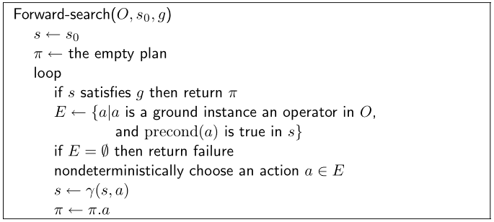
Forward Search
take c3
take c2
…
move r1
…

Slide 36
Deterministic Implementations
Some deterministic implementations
of forward search:
  breadth-first search
  depth-first search
  best-first search (e.g., A*)
  greedy search
Breadth-first and best-first search are sound and complete
  But they usually aren’t practical because they require too much memory
  Memory requirement is exponential in the length of the solution
In practice, more likely to use depth-first search or greedy search
  In general, sound but not complete
    But classical planning has only finitely many states 状态有限，故深度优先可以是完备的
    Thus, can make depth-first search complete by doing loop-checking 深度优先，带环检测
a₁
s₁
a₄
s₄
s₀
s₂
s_{g}
a₂
s₅
a₅
…
a₃
s₃

Slide 37
Branching Factor of Forward Search
a₁
a₂
a₁
a₂
a₃
…
a₅₀
a₃
initial state
goal
Forward search can have a very large branching factor
  E.g., many applicable actions that don’t progress toward goal
Why this is bad:
  Deterministic implementations can waste time trying lots of irrelevant actions
Need a good heuristic function and/or pruning procedure
避免执行过多无用动作

Slide 38
Backward Search
For forward search, we started at the initial state and computed state transitions
  new state = γ(s,a)
For backward search, we start at the goal and compute inverse state transitions
  new set of subgoals = γ^{–1}(g,a)
To define γ⁻¹(g,a), must first define relevance:
  An action a is relevant for a goal g if 动作与目标相关的条件
    a makes at least one of g’s literals true 动作后果使部分目标成立
      g ∩ effects(a) ≠ ∅
    a does not make any of g’s literals false 动作不使目标矛盾
      g⁺ ∩ effects–(a) = ∅ and g– ∩ effects⁺(a) = ∅

Slide 39
Inverse State Transitions
If a is relevant for g, then
  γ^{–1}(g,a) = (g – effects(a)) ∪ precond(a)
Otherwise γ^{–1}(g,a) is undefined
Example: suppose that
  g = {on(b1,b2), on(b2,b3)}
  a = stack(b1,b2)
What is γ^{–1}(g,a)?

Slide 40
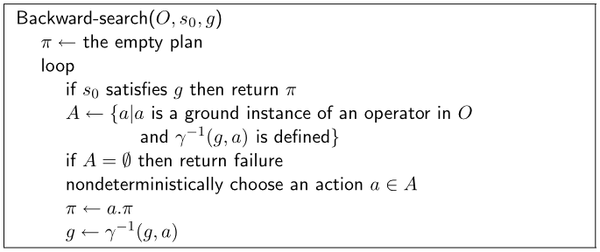
g₁
a₁
g₄
a₄
g₂
g₀
a₂
s₀
a₅
g₅
a₃
g₃

Slide 41
Efficiency of Backward Search
b₁
b₁
b₂
b₃
…
b₅₀
initial state
goal
Backward search can also have a very large branching factor
  E.g., an operator o that is relevant for g may have many ground instances a₁, a₂, …, a_{n} such that each a_{i}’s input state might be unreachable from the initial state
As before, deterministic implementations can waste lots of time trying all of them

Slide 42
Lifting
p(a₁,a₁)
p(a₁,a₂)
foo(a₁,a₁)
foo(x,y)
precond: p(x,y)
effects: q(x)
foo(a₁,a₂)
p(a₁,a₃)
foo(a₁,a₃)
q(a₁)
. . .
p(a1,a₅₀)
foo(a₁,a₅₀)
Can reduce the branching factor of backward search if we partially instantiate the operators 将操作部分实例化
  this is called lifting
foo(a₁,y)
q(a₁)
p(a₁,y)

Slide 43
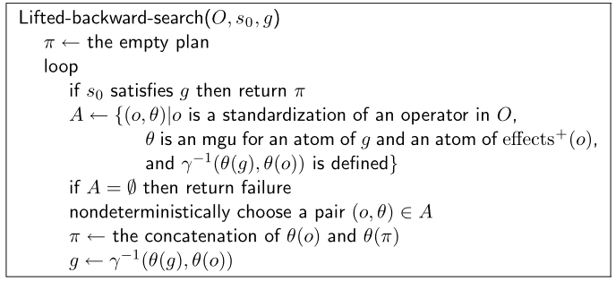
Lifted Backward Search ？
More complicated than Backward-search
  Have to keep track of what substitutions were performed
But it has a much smaller branching factor

Slide 44
The Search Space is Still Too Large
Lifted-backward-search generates a smaller search space than Backward-search, but it still can be quite large
  Suppose actions a, b, and c are independent, action d must precede all of them, and there’s no path from s₀ to d’s input state
  We’ll try all possible orderings of a, b, and c before realizing there is no solution
d
a
b
c
d
b
a
s₀
d
b
a
goal
b
d
a
c
d
b
c
a
d
c
b

Slide 45
Plan-space planning

Slide 46
Motivation
State-Space Planning
Problem with state-space search
  In some cases we may try many different orderings of the same actions before realizing there is no solution
Least-commitment strategy: don’t commit to orderings, instantiations, etc., until necessary
g₁
a₁
g₄
a₄
g₂
g₀
a₂
s₀
a₅
g₅
a₃
g₃
dead end
…
a
b
c
dead end
…
b
a
dead end
…
b
a
b
goal
dead end
…
a
c
dead end
…
b
c
a
dead end
…
c
b

Slide 47
Outline
Basic idea
Open goals
Threats
The PSP algorithm
Long example
Comments

Slide 48
Plan-Space Planning - Basic Idea
Backward search from the goal
Each node of the search space is a partial plan
    A set of partially-instantiated actions
    A set of constraints
Types of constraints:
  precedence constraint:
  a must precede b
  binding constraints:
    inequality constraints, e.g., v₁ ≠ v₂ or v ≠ c
    equality constraints (e.g., v₁ = v₂ or v = c) and/or substitutions
  causal link:
    use action a to establish the precondition p needed by action b
bar(y)
  Precond: ¬p(y)
  Effects: …
x ≠ y
foo(x)
  Precond: …
  Effects: p(x)
p(z)
baz(z)
  Precond: p(z)
  Effects: …
x = z

Slide 49
Plan-Space Search
Initial plan
Start with an initial plan (will explain this later)
Make more and more refinements to the plan, until a solution is found
If there are no refinements to a plan during search, then backtrack
Questions:
  How to tell we have a solution?
    No more flaws in the plan
  How to refine a plan?
    Resolve the existing flaws
d
c
b
d
b
c
b
d
b
c
a
a
Solution!
b
d
a
e
Fail!

Slide 50
Flaws: 1. Open Goals
Open goal:
  An action a has a precondition p that we haven’t
  decided how to establish
Resolving the flaw:
  Find an action b
      (either already in the plan, or insert it)
  that can be used to establish p
      can precede a and produce p
  Instantiate variables and/or
  constrain variable bindings
  Create a causal link 因果连接
p(z)
foo(x)
  Precond: …
  Effects: p(x)
baz(z)
  Precond: p(z)
  Effects: …
p(x)
foo(x)
  Precond: …
  Effects: p(x)
baz(x)
  Precond: p(x)
  Effects: …

Slide 51
Flaws: 2. Threats
Threat: a deleted-condition interaction
  Action a establishes a precondition (e.g., pq(x)) of action b
  Another action c is capable of deleting pq
Resolving the flaw:
  impose a constraint to
  prevent c from deleting pq
Three possibilities:
  Make b precede优先于 c
  Make c precede a
  Constrain variable(s)
  to prevent c from
  deleting pq
clobber(y)
  Precond: …
  Effects: ¬pq(y)
pq(x)
foo(x)
  Precond: …
  Effects: pq(x)
baz(x)
  Precond: pq(x)
  Effects: …

Slide 52
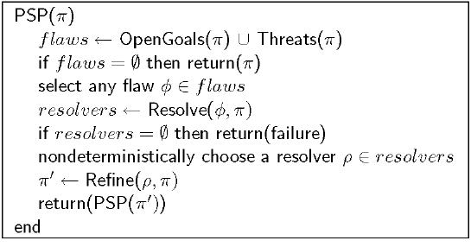
The PSP Procedure
Initial plan
d
c
b
d
b
c
a
b
d
a
b
c
Solution!
a
b
d
e
Fail!
PSP is both sound and complete
It returns a partially ordered solution plan
  Any total ordering of this plan will achieve the goals
  Or could execute actions in parallel if the environment permits it

Slide 53
Example
Similar (but not identical) to an example in Russell and Norvig’s Artificial Intelligence: A Modern Approach (1st edition)
Operators:
  Start
    Precond: none
    Effects: At(Home), sells(HWS,Drill), Sells(SM,Milk), Sells(SM,Banana)
  Finish
    Precond: Have(Drill), Have(Milk), Have(Banana), At(Home)
    Effects: none
  Go(l,m)
    Precond: At(l)
    Effects: At(m), ¬At(l)
  Buy(p,s)
    Precond: At(s), Sells(s,p)
    Effects: Have(p)
Start and Finish are dummy actions that we’ll use instead of the initial state and goal

Slide 54
Example (continued)
Need to give PSP a plan π as its argument
  Initial plan: Start, Finish, and
  an ordering constraint
Start
Effects:
At(Home), Sells(HWS,Drill),
Sells(SM,Milk), Sells(SM,Bananas)
Precond:
Have(Drill)
Have(Milk)
Have(Bananas)
At(Home)
Finish

Slide 55
Example (continued)
The first three refinement steps
  These are the only possible ways to establish the Have preconditions
Start
At(s₁)
Sells(s₁, Drill)
At(s₂)
Sells(s₂,Milk)
At(s₃)
Sells(s₃,Bananas)
Buy(Drill, s₁)
Buy(Milk, s₂)
Buy(Bananas, s₂)
Buy(Drill, s₁)
Have(Drill)
Have(Milk)
Have(Bananas)
At(Home)
Finish

Slide 56
Example (continued)
Three more refinement steps
  The only possible ways to establish the Sells preconditions
Start
At(HWS)
Sells(HWS,Drill)
At(SM)
Sells(SM,Milk)
At(SM)
Sells(SM,Bananas)
Buy(Drill, HWS)
Buy(Milk, SM)
Buy(Bananas, SM)
Buy(Drill, s₁)
Have(Drill)
Have(Milk)
Have(Bananas)
At(Home)
Finish

Slide 57
Example (continued)
Two more refinements: the only ways to establish At(HWS) and At(SM)
  This time, several threats occur
Start
At(l₂)
At(l₁)
Go(l₂, SM)
Go(l₁,HWS)
At(HWS)
Sells(HWS,Drill)
At(SM)
Sells(SM,Milk)
At(SM)
Sells(SM,Bananas)
Buy(Drill, HWS)
Buy(Milk, SM)
Buy(Bananas, SM)
Buy(Drill, s₁)
Have(Drill)
Have(Milk)
Have(Bananas)
At(Home)
Finish

Slide 58
Example (continued)
Finally, a nondeterministic choice: how to resolve the threat to At(s₁)?
  Our choice: make Buy(Drill) precede Go(SM)
  This also resolves the other two threats
Start
At(l₂)
At(l₁)
Go(l₂, SM)
Go(l₁,HWS)
At(HWS)
Sells(HWS,Drill)
At(SM)
Sells(SM,Milk)
At(SM)
Sells(SM,Bananas)
Buy(Drill, HWS)
Buy(Milk, SM)
Buy(Bananas, SM)
Buy(Drill, s₁)
Have(Drill)
Have(Milk)
Have(Bananas)
At(Home)
Finish

Slide 59
Example (continued)
Nondeterministic choice: how to establish At(l₁)?
  We’ll do it from Start, with l₁=Home
Start
At(l₂)
At(Home)
Go(l₂, SM)
Go(Home,HWS)
At(HWS)
Sells(HWS,Drill)
At(SM)
Sells(SM,Milk)
At(SM)
Sells(SM,Bananas)
Buy(Drill, HWS)
Buy(Milk, SM)
Buy(Bananas, SM)
Buy(Drill, s₁)
Have(Drill)
Have(Milk)
Have(Bananas)
At(Home)
Finish

Slide 60
Example (continued)
Nondeterministic choice: how to establish At(l₂)?
  We’ll do it from Go(Home,HWS), with l₂= HWS
Start
At(HWS)
At(Home)
Go(HWS, SM)
Go(Home,HWS)
At(HWS)
Sells(HWS,Drill)
At(SM)
Sells(SM,Milk)
At(SM)
Sells(SM,Bananas)
Buy(Drill, HWS)
Buy(Milk, SM)
Buy(Bananas, SM)
Buy(Drill, s₁)
Have(Drill)
Have(Milk)
Have(Bananas)
At(Home)
Finish

Slide 61
Example (continued)
The only possible way to establish At(Home) for Finish
  This creates a bunch of threats
Start
At(HWS)
At(Home)
Go(HWS, SM)
Go(Home,HWS)
At(HWS)
Sells(HWS,Drill)
At(SM)
Sells(SM,Milk)
At(SM)
Sells(SM,Bananas)
Buy(Drill, HWS)
Buy(Milk, SM)
Buy(Bananas, SM)
Buy(Drill, s₁)
Go(l₃, Home)
Have(Drill)
Have(Milk)
Have(Bananas)
At(Home)
Finish

Slide 62
Example (continued)
To remove the threats to At(SM) and At(HWS), make them precede Go(l₃,Home)
  This also removes the other threats
Start
At(HWS)
At(Home)
Go(HWS, SM)
Go(Home,HWS)
At(HWS)
Sells(HWS,Drill)
At(SM)
Sells(SM,Milk)
At(SM)
Sells(SM,Bananas)
Buy(Drill, HWS)
Buy(Milk, SM)
Buy(Bananas, SM)
Buy(Drill, s₁)
Go(l₃, Home)
Have(Drill)
Have(Milk)
Have(Bananas)
At(Home)
Finish

Slide 63
Final Plan
Establish At(l₃) with l₃=SM
Start
At(HWS)
At(Home)
Go(HWS, SM)
Go(Home,HWS)
At(HWS)
Sells(HWS,Drill)
At(SM)
Sells(SM,Milk)
At(SM)
Sells(SM,Bananas)
Buy(Drill, HWS)
Buy(Milk, SM)
Buy(Bananas, SM)
Buy(Drill, s₁)
Go(SM, Home)
Have(Drill)
Have(Milk)
Have(Bananas)
At(Home)
Finish

Slide 64
Discussion
a
b
How to choose which flaw to resolve first
and how to resolve it?
  There are lots of things!!!
PSP doesn’t commit to orderings and
instantiations until necessary
  Avoids generating search trees like this one:
Problem: how to prune infinitely long paths?
  In state-space planning, loop detection is based on recognizing states
  we’ve seen before
  In a partially ordered plan, we don’t know the states
Can we prune if we see the same action more than once?
  No. Sometimes we might need the same action several times in different states of the world (see next slide)
c
b
a
b
a
goal
b
a
c
b
c
a
c
b
• • •
go(b,a)
go(a,b)
go(b,a)
at(a)

Slide 65
Example
3-digit binary counter starts at 000, want to get to 110
      s₀ = {d3=0, d2=0, d1=0}
      g = {d3=1, d2=1, d1=0}
Operators to increment the counter by 1:
      incr0
      Precond: d₁=0
      Effects: d₁=1
      incr01
      Precond: d₂=0, d₁=1
      Effects: d₂=1, d₁=0
      incr011
      Precond: d₃=0, d₂=1, d₁=1
      Effects: d₃=1, d₂=0, d₁=0

Slide 66
A Weak Pruning Technique
Can prune all partial plans of n or more actions, where n = |{all possible states}|
  This doesn’t help very much
There’s no good pruning technique for plan-space planning
  Russell and Norvig’s Artificial Intelligence: A Modern Approach describes a preliminary approach
  In early 90’s, researchers have looked at learning pruning rules during PSP planning

Slide 67
Thanks and Questions!

