Slide 1
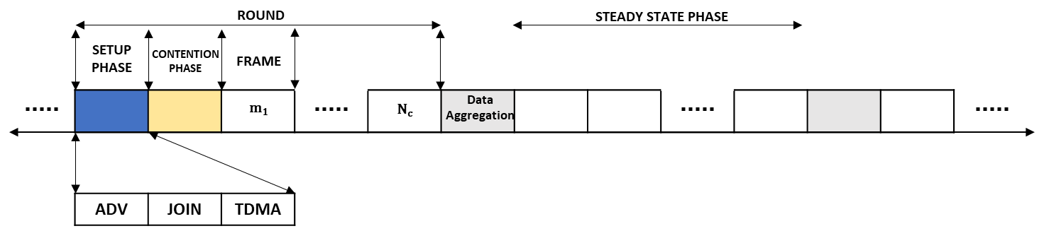
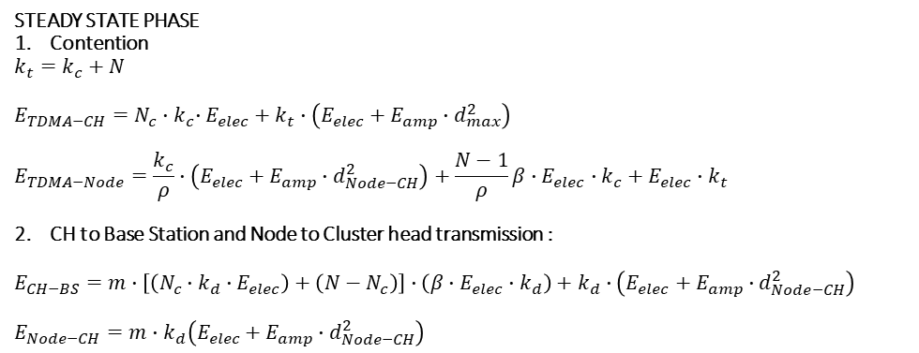
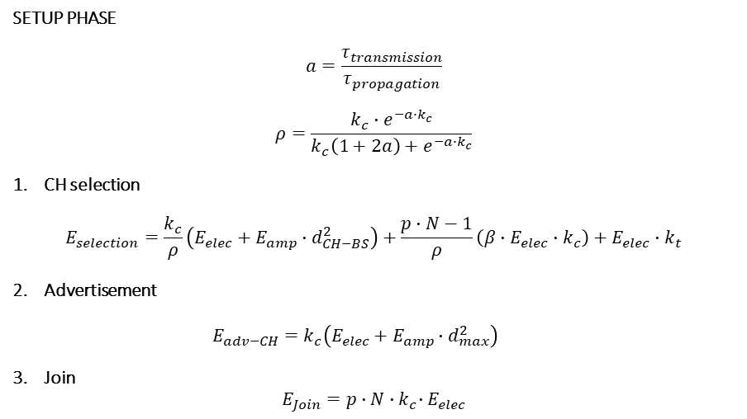
ENERGY MODEL
SETUP PHASE
$$a=\frac{τ_{transmission}}{τ_{propagation}}$$
$$ρ=\frac{k_{c}∙e^{−a∙k_{c}}}{k_{c}\left(1+2a\right)+e^{−a∙k_{c}}}$$
CH selection
$$E_{selection}=\frac{k_{c}}{ρ}\left(E_{elec}+E_{amp}∙d_{CH−BS}^{2}\right)+\frac{p∙N−1}{ρ}\left(β∙E_{elec}∙k_{c}\right)+E_{elec}∙k_{t}$$
Advertisement
$$E_{adv−CH}=k_{c}\left(E_{elec}+E_{amp}∙d_{max}^{2}\right)$$
Join
$$E_{Join}=p∙N{∙k}_{c}∙E_{elec}$$
STEADY STATE PHASE
Contention
$$k_{t}=k_{c}+N$$
$$E_{TDMA−CH}=N_{c}{∙k}_{c}∙E_{elec}+k_{t}∙\left(E_{elec}+E_{amp}∙d_{max}^{2}\right)$$
$$E_{TDMA−Node}=\frac{k_{c}}{ρ}∙\left(E_{elec}+E_{amp}∙d_{Node−CH}^{2}\right)+\frac{N−1}{ρ}β∙E_{elec}∙k_{c}+E_{elec}∙k_{t}$$
CH to Base Station and Node to Cluster head transmission :
$$E_{CH−BS}=m∙\left[\left(N_{c}∙k_{d}∙E_{elec}\right)+\left(N−N_{c}\right)\right]∙\left(β∙E_{elec}∙k_{d}\right)+k_{d}∙\left(E_{elec}+E_{amp}∙d_{Node−CH}^{2}\right)$$
$$E_{Node−CH}=m∙k_{d}\left(E_{elec}+E_{amp}∙d_{Node−CH}^{2}\right)$$
*Referensi [4][12-14]]
[

Slide 2
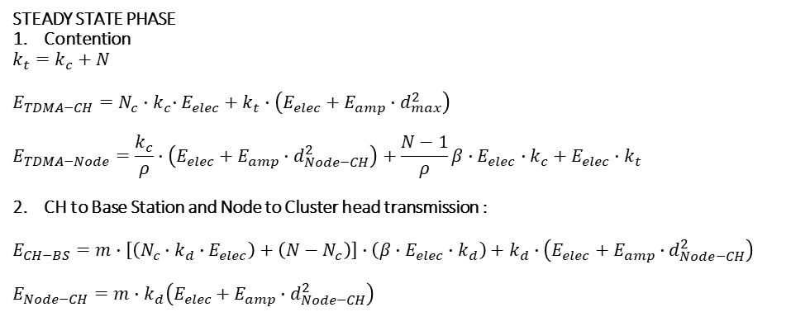



ENERGY MODEL 2
$$k_{opt}=\frac{\sqrt{N}}{\sqrt{2π}}\frac{\sqrt{ε_{fs}}}{\sqrt{ε_{mp}}}\frac{M}{d_{CH−BS}^{2}}$$
$$P_{r}=P_{t}G_{t}G_{r}{\left(\frac{λ}{4πd}\right)}^{2}e^{−2αd}$$
SETUP PHASE
$$a=\frac{τ_{transmission}}{τ_{propagation}}$$
$$ρ=\frac{k_{c}∙e^{−a∙k_{c}}}{k_{c}\left(1+2a\right)+e^{−a∙k_{c}}}$$
CH selection
$$E_{selection}=P_{t}T_{c}+\left(N−1\right)P_{i}T_{c}+P_{r}T_{CH}+P_{t}T_{d}$$
Advertisement
$$E_{adv−CH}=k_{c}\left(E_{elec}+E_{amp}∙d_{max}^{2}\right)$$
Join
$$E_{Join}=p∙N{∙k}_{c}∙E_{elec}$$
STEADY STATE PHASE
Contention
$$k_{t}=k_{c}+N$$
$$E_{TDMA−CH}=N_{c}{∙k}_{c}∙E_{elec}+k_{t}∙\left(E_{elec}+E_{amp}∙d_{max}^{2}\right)$$
$$E_{TDMA−Node}=\frac{k_{c}}{ρ}∙\left(E_{elec}+E_{amp}∙d_{Node−CH}^{2}\right)+\frac{N−1}{ρ}β∙E_{elec}∙k_{c}+E_{elec}∙k_{t}$$
CH to Base Station and Node to Cluster head transmission :
$$E_{CH−BS}=m∙\left[\left(N_{c}∙k_{d}∙E_{elec}\right)+\left(N−N_{c}\right)\right]∙\left(β∙E_{elec}∙k_{d}\right)+k_{d}∙\left(E_{elec}+E_{amp}∙d_{Node−CH}^{2}\right)$$
$$E_{Node−CH}=m∙k_{d}\left(E_{elec}+E_{amp}∙d_{Node−CH}^{2}\right)$$
[

Slide 3
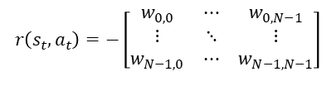

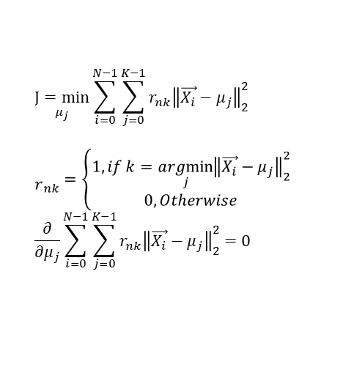
ENERGY MODEL
$$K−Mean based Cluster Head Selection$$
$$\underset{μ_{j}}{J=min}{\sum_{i=0}^{N−1}{\sum_{j=0}^{K−1}{r_{nk}{\left\|\vec{X_{i}}−μ_{j}\right\|}_{2}^{2} }}}$$
$${\begin{aligned} \\ r\end{aligned}}_{nk}=\left\{\begin{aligned}1, if k=\underset{j}{argmin}{{\left\|\vec{X_{i}}−μ_{j}\right\|}_{2}^{2}} \\ 0, Otherwise\end{aligned}\right.$$
$$\frac{∂}{∂μ_{j}}\sum_{i=0}^{N−1}{\sum_{j=0}^{K−1}{r_{nk}{\left\|\vec{X_{i}}−μ_{j}\right\|}_{2}^{2}}=0}$$
$$μ_{j}=\frac{\sum_{i=0}^{N−1}{r_{nk}\vec{X_{i}}}}{\sum_{i=0}^{N−1}{r_{nk}}}$$
$$Multi Hop based sequential multi agent Q Learning transmission$$
$$Q_{t+1}^{i}\left(s_{t},a_{t}\right)=Q_{t}^{i}\left(s_{t},a_{t}\right)+η\left[r\left(s_{t},a_{t}\right)+γ\max_{a_{t}}{Q_{t}^{i}\left(s_{t+1},a\right)−Q_{t}^{i}\left(s_{t},a_{t}\right)}\right]$$
$$r\left(s_{t},a_{t}\right)=−\left[\begin{matrix}w_{0,0} & ⋯ & w_{0,N−1} \\ ⋮ & ⋱ & ⋮ \\ w_{N−1,0} & ⋯ & w_{N−1,N−1}\end{matrix}\right]$$
[

