Slide 1
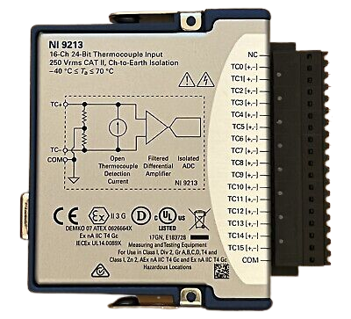
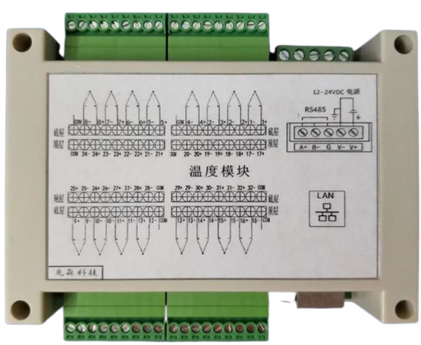
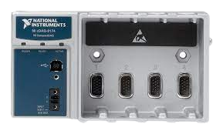
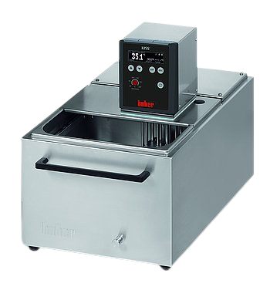

NI-9213
low cost thermocouples DAQ
NI-cDAQ 9174
cooling thermostatic bath
thermocouples
thermocouples
communication data RS-485
laptop
communication data
USB RS232

