Slide 1

GROUP 1 · XML/XSD MODELLING · XPATH / XQUERY
A Unified XML Schema for Interoperable
Medicinal Plant Databases
Integrating 3,999 plant-phytochemical records across Dr. Duke's, IMPPAT and NMPP-DB into one queryable, schema-validated resource.
Bashiru · Adediran · Adejumo · Ademulure · Adeniyi · Adeosun
Federal University of Technology, Akure · July 2026

Slide 2


01 · THE PROBLEM
Medicinal plant knowledge is scattered
across incompatible databases
Three major resources describe the same underlying concepts — plant identity, phytochemicals, biological activity — with different column names, vocabularies and formats, and no shared identifier scheme.
Kew MPNS
NMPP-DB
IMPPAT
Nomenclatural name-resolution service; no bulk species list — an access barrier this study surfaced first-hand.
500+ Nigerian medicinal plants and 2,000+ phytochemicals compiled from peer-reviewed literature.
1,742 Indian medicinal plants, 9,596 phytochemicals, curated for therapeutic research.
Research question: How can a unified XML schema improve interoperability between global medicinal plant databases — and what does building one reveal about the real obstacles?
02

Slide 3




02 · METHODS
Four sources, one harmonised pipeline
Raw files were standardised onto 17 controlled fields, concatenated, then deduplicated by source-priority order to keep the richest record for every plant–part–compound triple.
→
→
→
4 Source Files
Standardise
Dedupe
Master Dataset
Dr. Duke's · IMPPAT · NMPP-DB · Combined
17 controlled fields
Priority-ordered by richness
3,999 clean records
Honest deviation: The brief called for a Kew MPNS + NMPP-DB pairing, but MPNS is a name-validation service, not a bulk-downloadable list. Dr. Duke's and IMPPAT were substituted so a genuinely integrated multi-source dataset could still be produced — reported transparently, not hidden.
03

Slide 4
03 · XSD DESIGN
A referentially-enforced XML schema
MedicinalPlants (root)
Validation, run for real
Plant [id, name, family, origin]
plant.xml validates cleanly against plant.xsd — the conceptual model is internally consistent.
Every Plant @ref resolves to a real PhytochemicalLibrary @id — integrity genuinely enforced, not just declared.
The flat 3,999-record export uses a second vocabulary that does not yet validate against plant.xsd — flagged as follow-up work, not hidden.
Phytochemicals/Phytochemical @ref →
⇅
xs:key / xs:keyref
referential integrity
PhytochemicalLibrary
Phytochemical [id, name, CAS, Activity]
Reference [DOI, year]
04

Slide 5
04 · THE INTEGRATED DATASET
What the harmonised pipeline produced
3,999
33
2,194
22
Harmonised
records
Plant
species
Unique
phytochemicals
Botanical
families
Field completeness is uneven — and that's a real finding
Species, family, part and phytochemical fields: ~100% complete Biological activity of plant extract: 94.8% missing | Dosage: 78.5% missing | Phytochemical class: 78.0% missing
05

Slide 6
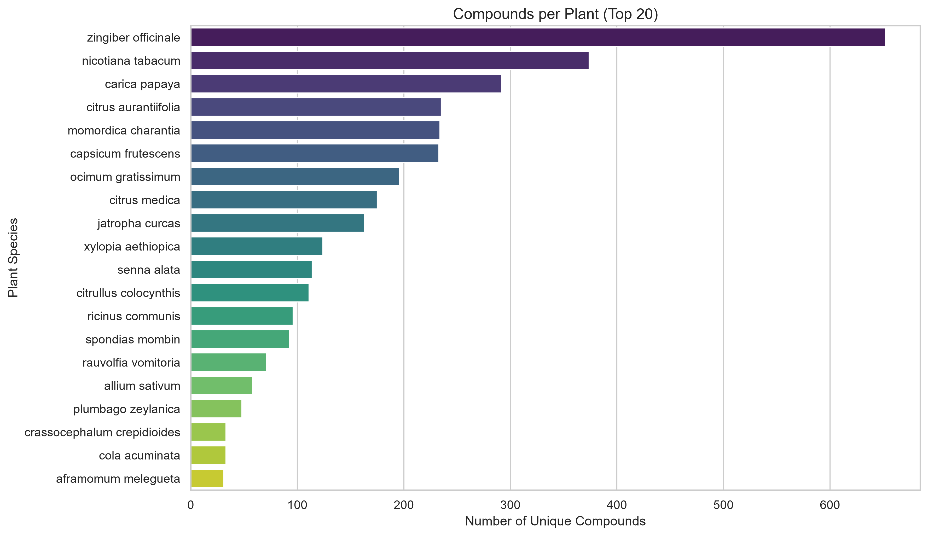
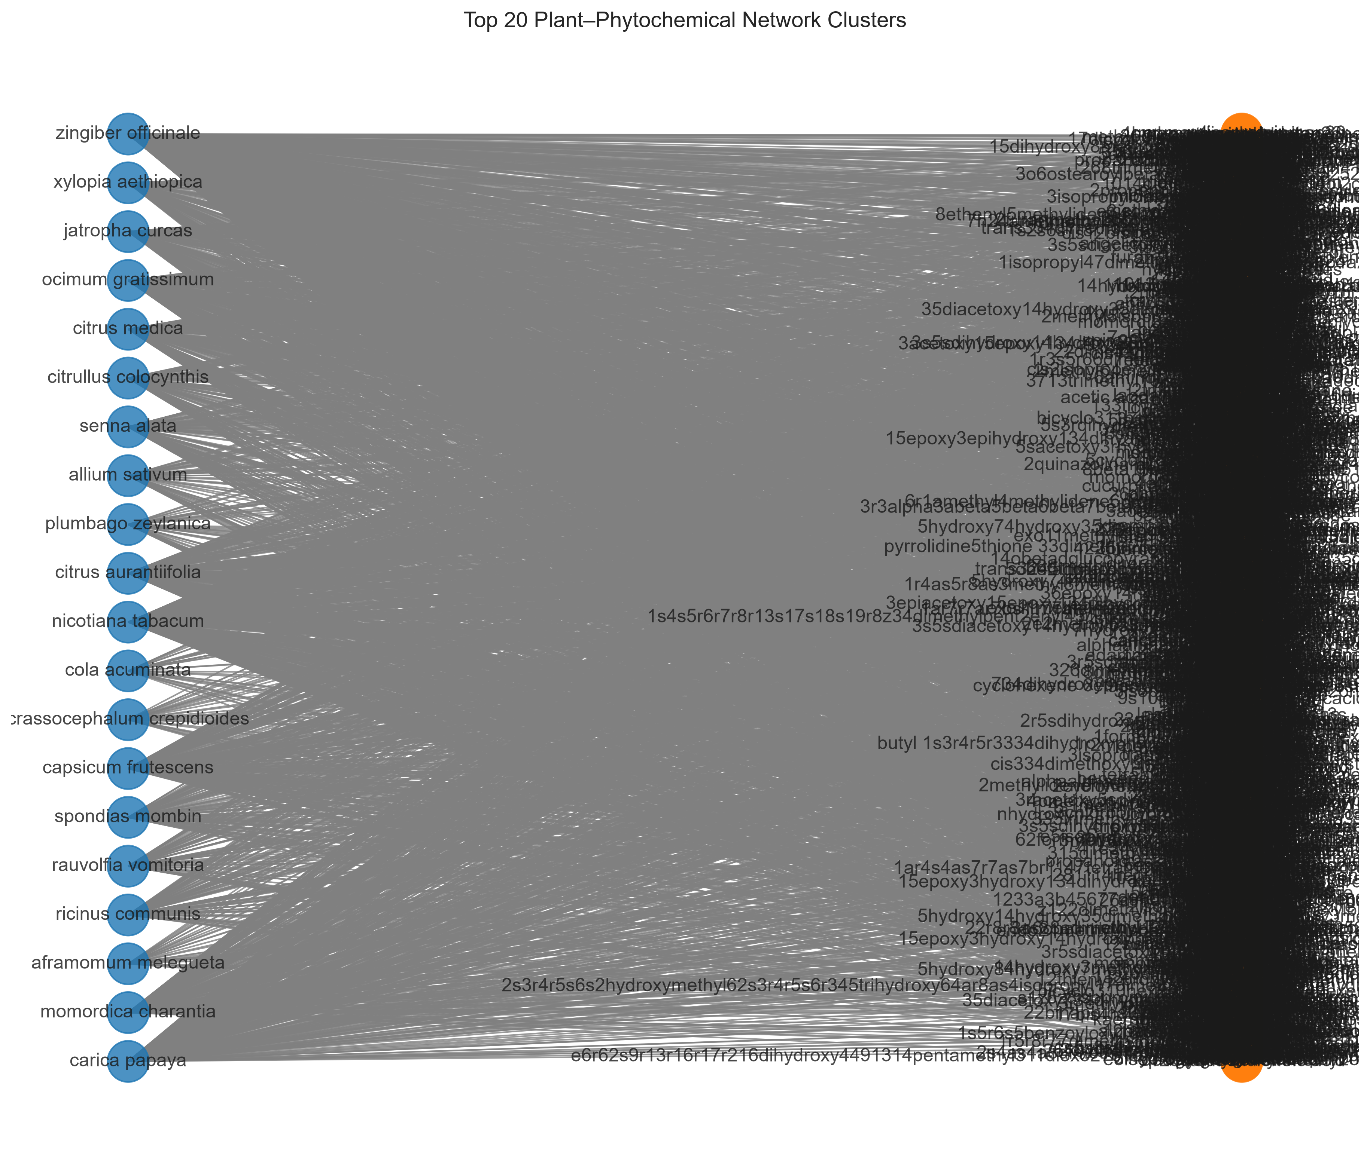
05 · FINDINGS
Ginger dominates; a few hub species
and hub compounds drive the network
Zingiber officinale (ginger) leads with 652 unique compounds, followed by Nicotiana tabacum (374) and Carica papaya (292).
Bipartite plant–compound network, top 20 species: star-like structure around a few chemically prolific hub species.
06

Slide 7

06 · STATISTICAL TESTS & LIMITS
Significant, but small — and one
analysis couldn't be completed as specified
Chi-square: family × anti-inflammatory tag
Jaccard overlap: not computable as specified
χ²(7, N=3,376) = 17.82, p = .013
Cramér's V = 0.073 → statistically significant, but a small effect
Zingiberaceae (7.3%) and Solanaceae (8.5%) show the highest tagged rates; Fabaceae the lowest (1.5%). With 70.5% of activity fields missing, this reflects reporting patterns as much as biology.
No bulk, machine-readable Kew MPNS species list was obtainable — MPNS validates names, it doesn't publish a downloadable master list.
Reported as a documented access-layer limitation, not smoothed over or faked with a placeholder result.
07

Slide 8
07 · CONCLUSION
A schema is necessary, but not
sufficient, for interoperability
A working, validated XSD harmonised 3,999 real records into one queryable resource and supported analyses the four original spreadsheets could not — while surfacing three concrete, reproducible barriers: internal schema drift, free-text vocabulary inconsistency, and a data-access barrier at Kew MPNS.
Reproducible
1
Publish bulk, versioned, machine-readable exports alongside interactive validation services.
Full code, data and schema version-controlled on GitHub
2
Adopt shared controlled vocabularies for activity and therapeutic-class annotation.
3
Treat XML Schema as an enforced contract in the data pipeline — not just documentation.
github.com/Bigjayd/
Medical-Plant-Database
Group 1 · FUTA · IFS/CSC Group Assessment
08

