Slide 1
Sales Data
Offline Sales Channel

Slide 2
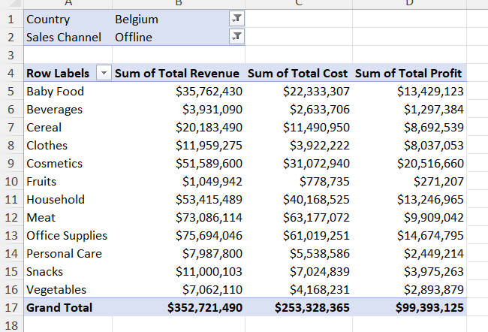
Belgium

Slide 3
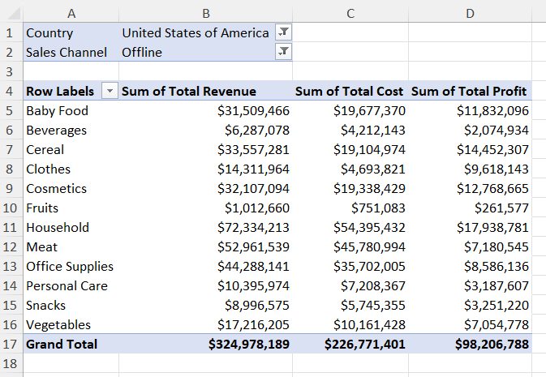
United States

Slide 4
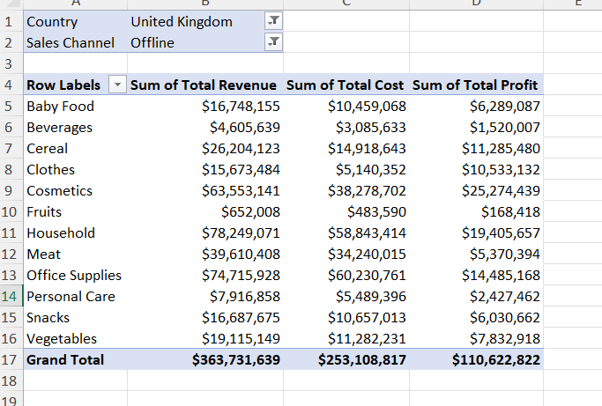
United Kingdom

