Slide 1
Introduction to Web Development
Coding Blocks – Arnav Gupta

Slide 2
The Internet
Some facts and history

Slide 3
Internet by the Numbers
4.5 billion users
>50% of all world population has access
1.5 billion websites
10x increase from 1999 to 2013

Slide 4
Internet History
1958 – Bell Labs – Modem
1961 – MIT – Packet Switching
1968 – ARPANET
1972 – University Internet Nodes, UCLA Chat
1974 – Vint Cerf – TCP

Slide 5
How the Web works
Servers
Clients
ISPs
DNS
Datacenters

Slide 6
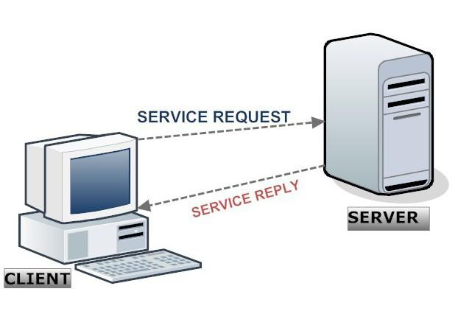
Client Server Model

Slide 7
Domain Name Server
Phone book of the Internet
Maps domains (www.google.com, www.yahoo.com ) to IP addresses (112.123.21.22, 8.8.22.56)
Humans remember domains
Computers work with IP

Slide 8
Internet Service Provider
Company that provides access to user
Internet can be over DSL, Phone Line, Cable, Fibre, Wireless and other medium

Slide 9
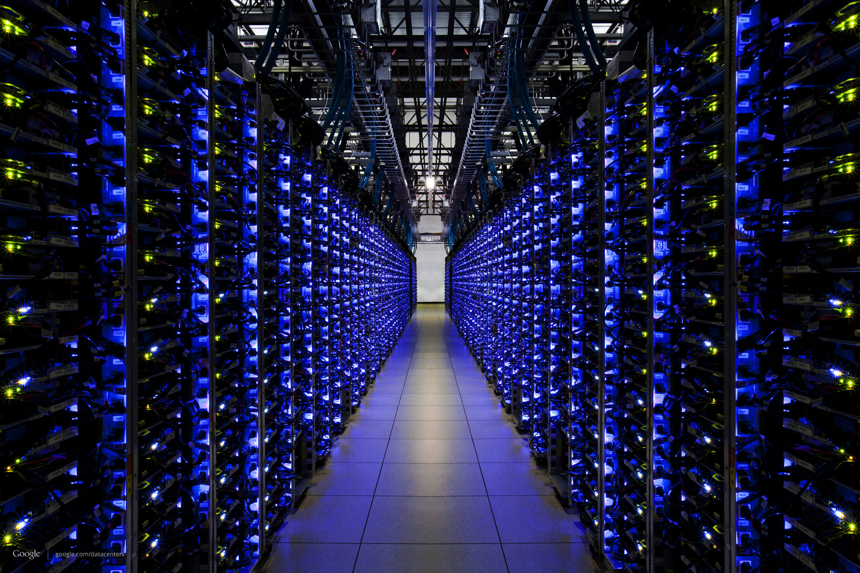
Datacenters

Slide 10

Datacenters

Slide 11
Web terminologies
Protocols
Addresses
Packets

Slide 12
Web Protocols
TCP/IP
HTTP
DHCP
FTP
SMTP
SSH
Telnet

Slide 13
Web Addresses
Domain Names
IP Address
MAC Address

Slide 14
Domain Names
Human-readable web address
<subdomain>.<domain>.<TLD>
TLD – Top level domain
.org
.com
.net
Country based - .uk, .in,
Purpose based - .edu, .aero, .info

Slide 15
IP Addresses
32-bit, 4-word address (IPv4)
Uniquely defines a server, a client, a node, or a router.
IPv6 Address – Default in future - 128-bit (16 octet)
IP allows –
Subnets
Gateways
Private Ips

Slide 16
MAC Address
Media Access Control
An ID unique to a hardware Network Interface
Is not dynamic like IP. Is fixed for a hardware device.
Used by all IEEE 802 Network Technologies

Slide 17
Components of the Web
Web Pages
Web Sites
Web Servers
Search Engines

Slide 18
Web Page
A document that can be viewed over web
Transported over Internet
Viewed on a browser
Uses markup (HTML) and styling. Can contain scripts

Slide 19
Web Site
Collection of webpages
Also can include other media (audio, images, video)

Slide 20
Web Servers
A hardware (or software) that hosts the website.
One website can be spread over multiple servers
One server can host multiple websites

Slide 21
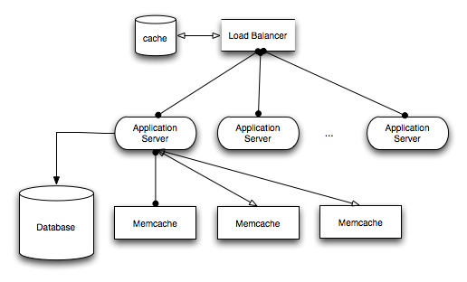
Web Server Architecture

Slide 22
Search Engines
A website that indexes other websites/webpages
Helps you find websites
Uses techniques like ‘crawling’ to cache content for searching
Google.com, Bing.com, Yahoo.com

Slide 23
How web technologies work

Slide 24
Server
Hardware
OS
Server Framework
Containers/Servlets
Server Applications

Slide 25
Server Side Frameworks
Java
Spring
Play
Jboss
Python
Flask
Django
Bottle

Slide 26
Server Side Frameworks
Ruby
Rails
PHP
Codeigniter
Laravel
Node.js
Express
Hapi.js

Slide 27
Client Side Techologies
HTML (Markup)
CSS (Styling)
SASS
LESS
Javascript (Scripting/Events)
jQuery
Angular
React
Backbone
Knockout

Slide 28
Server-side Databases
RDBMS
MySQL
Postgres
Oracle
MS Database
NoSQL
MongoDB
CouchDB
Memcache
Redis

Slide 29
Client-side Storage
localStorage
sessionStorage
Cookies
indexedDB
cache

Slide 30
Types of websites
Static Websites
All HTML content is created and saved on server
Dynamic Website
Content is generated on demand for each user
Responsive
Reacts to user, and his screen size

Slide 31
RESTful APIs
A contract between servers and clients
GET
POST
PUT
DELETE
PATCH

Slide 32
Data exchange formats
JSON
XML

Slide 33
Website design principles
Reactive websites
Single-Page Applications
MVC, MVP, MVVM and MV* architectures
Web Application Frameworks

Slide 34
Latest developments
VirtualDOM, ShadowDOM
Sockets
Pub/Sub, Push Notifications
Browser Native APIs (Locations, User data)

