Slide 1
TECHNICAL ASSIGNMENT — SOFTWARE ENGINEERING INTERNSHIP
Weekly Report Generator
& Team Dashboard
A full-stack app where team members submit structured weekly reports and managers analyze them in one dashboard.
React · Node.js / Express · PostgreSQL
Presented by Bihindu Wijesooriya
Notes:
Introduce yourself. One-line pitch: team members write one fixed-structure report per week; managers get a consolidated dashboard with filters, submission tracking, charts, and an AI assistant.

Slide 2
SOLUTION OVERVIEW
What the system does
Team members
1
Write one weekly report in a fixed, identical structure: tasks completed, tasks planned, blockers, hours, notes — tagged to a project.
Managers
2
See every report for any week, filter by member / project / date range, and track submitted, pending, and late status per person.
Insights
3
Summary metrics and charts: compliance rate, open blockers, task trends, workload by project — plus an AI assistant for questions.
Notes:
Frame the two roles first — everything in the design flows from the member/manager split.

Slide 3
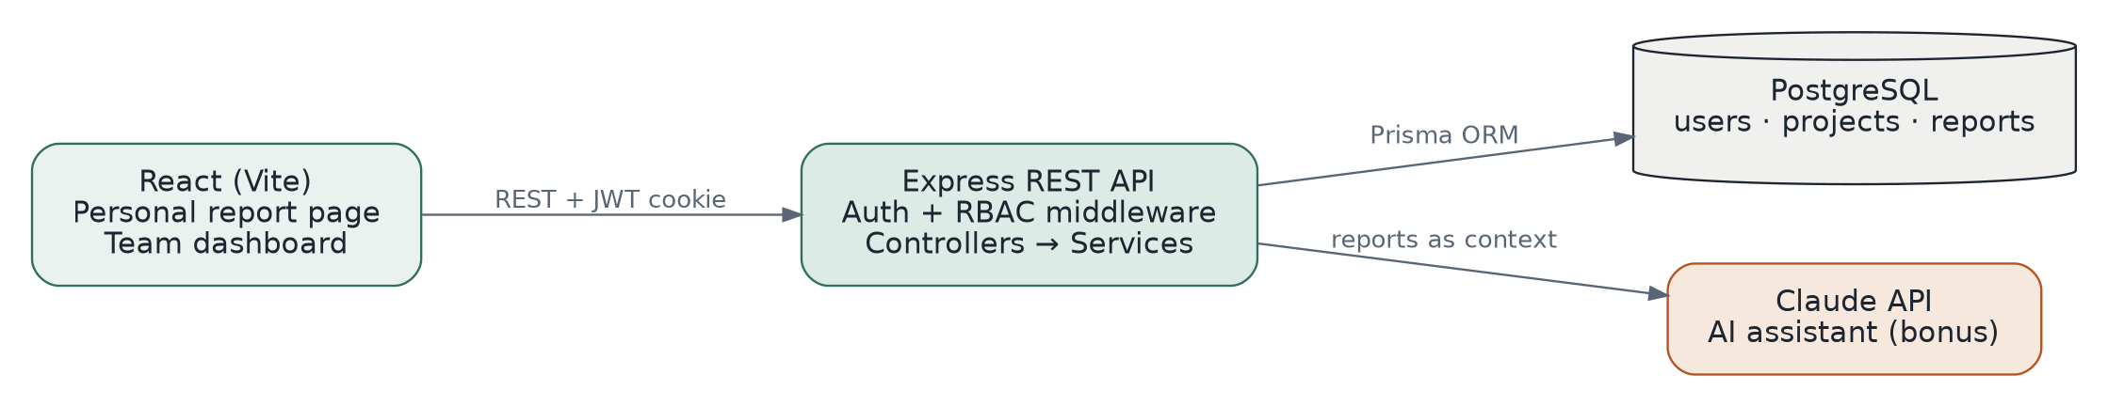
ARCHITECTURE
System architecture
Single REST boundary
RBAC at the middleware layer
Clean layering
The browser only ever talks to the Express API; the database and AI provider stay server-side.
requireAuth verifies the JWT cookie; requireRole('MANAGER') gates team-wide endpoints.
Routes validate input, services hold logic, Prisma handles data access — easy to test and extend.
Notes:
Walk left to right: React app → REST calls with the JWT cookie → Express (auth middleware, then controllers/services) → Prisma → Postgres. The AI branch reuses the same data layer.

Slide 4
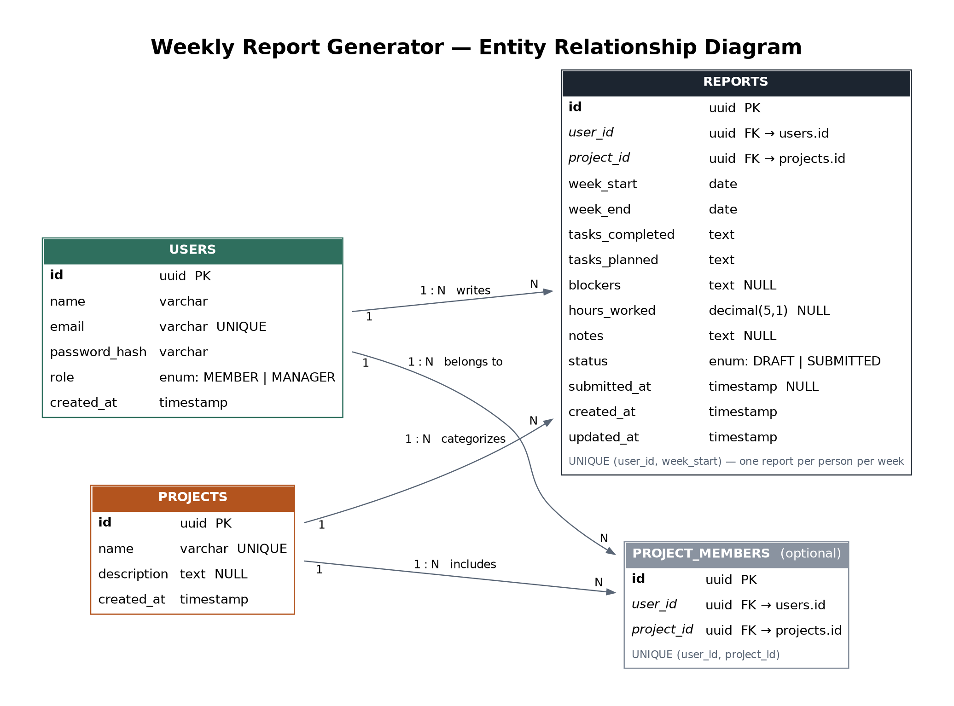
DATA MODEL
Database design
Fixed structure = real columns
Report fields are schema columns, not JSON — the database itself enforces identical reports for everyone.
One report / person / week
UNIQUE (user_id, week_start) pushes the rule into the database, not app code.
Derived status
submitted / pending / late computed from status + submitted_at vs the week deadline — nothing to keep in sync.
Role as an enum
Two static roles don't justify a roles table; extension path is clear if that changes.
Notes:
Point at the reports table: the fixed field list from the assignment maps 1:1 to columns. Mention the unique index and derived status — these usually get follow-up questions.

Slide 5
FRONTEND
Two separate experiences, one app
Personal report page
Team dashboard
/my-reports · every user
/dashboard · managers only (route-guarded)
Fixed-order form — no custom fields anywhere
Create draft → edit → submit workflow
History organized by week with status badges
Week picker snaps any date to its Monday
Summary metrics + 3 Recharts visualizations
Filters: week, member, project, date range
Submitted / pending / late per team member
Recent activity feed + AI chat widget
Notes:
The assignment explicitly asks for clear separation between these two pages — they are separate routes, separate components, and the dashboard route is guarded by role both in the router and again on the API.

Slide 6
FRONTEND
Component structure & organization
Reusable by design
src/
StatusBadge renders submitted/pending/late/draft consistently on both pages; Layout carries nav + role display everywhere.
api/ fetch client (one wrapper)
context/ AuthContext — session state
components/ Layout, StatusBadge,
AssistantWidget
pages/ Login, Register, MyReports,
TeamDashboard, Projects
State where it belongs
Auth lives in one context; pages own their data fetching; no global store needed at this scale.
Responsive layout
CSS grid metrics and chart cards collapse to a single column under 860px.
Notes:
Component reusability is an explicit evaluation criterion — call out StatusBadge as the concrete example used on both the member page and the dashboard.

Slide 7
BACKEND
REST API with role-based access
Endpoint | Access | Purpose
POST /api/auth/register · login · logout | Public | Sessions via JWT in an httpOnly cookie
GET/POST/PATCH /api/reports… | Owner | Own reports only — ownership checked per request
GET /api/reports/team, /team/status | Manager | Team-wide reports, filters, submission status
POST/PATCH/DELETE /api/projects… | Manager | Manage projects (reads open to all users)
GET /api/dashboard/summary, /trends | Manager | Metrics + pre-aggregated chart series
POST /api/assistant/chat | Manager | AI Q&A grounded in stored reports
Two middleware do all the gating: requireAuth verifies the token → requireRole('MANAGER') returns 403 for members.
Notes:
Emphasize: RBAC is enforced on the server, per endpoint — hiding buttons in the UI is not security. Frontend route guards are UX; the API check is the real control.

Slide 8
BACKEND
Request validation & session security
Zod schemas on every write
Passwords never stored
Types, required fields, ranges (hours 0–168), and enum values validated before any handler logic; failures return structured 400s.
bcrypt hashes with salt; login compares hashes; responses never include the hash field.
JWT in an httpOnly cookie
Integrity in the database
Token is invisible to JavaScript (blocks XSS token theft); SameSite=Lax; CORS locked to the frontend origin with credentials.
Unique constraints (email, user+week), FK cascades, and delete protection for projects that still have reports.
Notes:
If asked why cookies over localStorage: httpOnly cookies can't be read by injected scripts, which removes the most common token-theft vector in SPAs.

Slide 9
REFLECTION
Challenges & how they were solved
Defining a 'week' consistently
Problem Users could pick any date; comparisons need one canonical key. Solution Every date normalizes to its Monday (UTC) on the server; weekStart becomes the unique, filterable week key.
Late vs pending vs submitted
Problem Three states, but only one status column felt right. Solution Store only DRAFT/SUBMITTED + submitted_at; derive 'late' against the week's deadline at query time — no sync bugs.
Chart data shape
Problem Recharts needs aggregated series, not raw rows. Solution A dedicated /dashboard/trends endpoint aggregates server-side, keeping the frontend simple and the payload small.
Notes:
Pick the challenge you personally found hardest and expand on it verbally — evaluators want to hear genuine problem-solving, not a rehearsed list.

Slide 10
ROADMAP
Future improvements
Admin role management
Notifications
Report exports
Move MANAGER assignment out of signup into an admin flow with invitations.
Email or Slack reminders before the weekly deadline; nudges for pending reports.
CSV / PDF export of any filtered dashboard view for stakeholders.
Deeper AI features
Testing & CI
Deployment
Auto-generated weekly team summary; blocker clustering across weeks; tool-use for live queries.
API integration tests (Supertest) and component tests wired into GitHub Actions.
Dockerize the API + frontend and deploy with a managed Postgres instance.
Notes:
Frame these as deliberate scope decisions, not omissions: 'I prioritized the core requirements and a working bonus feature over breadth.'

Slide 11
Thank you
Live demo & questions
GitHub repository <link>
Demo video <link>
ER diagram <link>
Notes:
Replace the three <link> placeholders with your real GitHub, Google Drive video, and dbdiagram.io links before presenting.

