Slide 1
PC1 Software Defect Classification & Prediction
By Paritosh Shirodkar &
Kevin Rodrigues

Slide 2
The Dataset
One of the NASA Metrics Data Program defect data sets.
Data from flight software for earth orbiting satellite.
Data comes from McCabe and Halstead features extractors of source code.
These features were defined in an attempt to objectively characterize code features that are associated with software quality.
Source: www.openml.org

Slide 3
Halstead’s Metrics
Halstead’s metrics depends upon the actual implementation of the program and its measures, which are computed directly from the operators and operands from source code, in a static manner.
It allows evaluating testing time, vocabulary, size, difficulty, errors, and efforts for source code.

Slide 4
The Attributes
1. loc: numeric % McCabe's line count of code
2. v(g): numeric % McCabe "cyclomatic complexity"
3. ev(g): numeric % McCabe "essential complexity"
4. iv(g): numeric % McCabe "design complexity"
5. n: numeric % Halstead total operators + operands
6. v: numeric % Halstead "volume"
7. l: numeric % Halstead "program length"
8. d: numeric % Halstead "difficulty"
9. i: numeric % Halstead "intelligence"
10. e: numeric % Halstead "effort"
11. b: numeric % Halstead
12. t: numeric % Halstead's time estimator

Slide 5
The Attributes
13. lOCode: numeric % Halstead's line count
14. lOComment: numeric % Halstead's count of lines of comments
15. lOBlank: numeric % Halstead's count of blank lines
16. lOCodeAndComment: numeric
17. uniq_Op: numeric % unique operators
18. uniq_Opnd: numeric % unique operands
19. total_Op: numeric % total operators
20. total_Opnd: numeric % total operands
21. branchCount: numeric % of the flow graph
22. branchCount: numeric % of the flow graph
23. defects : {false,true} % module has/has not one or more reported defects

Slide 6
Data Mining Goal
To classify whether the module has one or more defect or not i.e true or false

Slide 7
Data-Preprocessing
Binning the dataset
Splitting the dataset into
training set (66.67%) and test set (33.33%)

Slide 8
Attribute Selection Algorithms
Gain Ratio
WrapperSubsetEval
SymmetricalUncertAttributeEval
CfsSubsetEval
By Intuition

Slide 9
Gain Ratio
Wrapper Subset Eval
To reduce a bias towards multi-valued attributes, we use gain ratio. In this technique, we take into consideration the number and size of branches whenever choosing an attribute.
In the wrapper approach to feature subset selection, a search for an optimal set of features is made using the induction algorithm as a black box. The estimated future performance of the algorithm is the heuristic guiding the search. Statistical methods for feature subset selection including forward selection, backward elimination, and their stepwise variants can be viewed as simple hill-climbing techniques in the space of feature subsets.

Slide 10
SymmetricalUncertAttributeEval
CfsSubsetEval
Evaluates the worth of an attribute by measuring the symmetrical uncertainty with respect to the class.
Evaluates the worth of a subset of attributes by considering the individual predictive ability of each feature along with the degree of redundancy between them. Subsets of features that are highly correlated with the class while having low intercorrelation are preferred.

Slide 11
Classification Algorithms
Multilayer Perceptron
J48
IBK
Random Forest
Naive Bayes

Slide 12
Multilayer Perceptron
A multilayer perceptron (MLP) is a deep, artificial neural network. It is composed of more than one perceptron. They are composed of an input layer to receive the signal, an output layer that makes a decision or prediction about the input, and in between those two, an arbitrary number of hidden layers that are the true computational engine of the MLP. MLPs with one hidden layer is capable of approximating any continuous function. Multilayer perceptrons are often applied to supervised learning problems. They train on a set of input-output pairs and learn to model the correlation (or dependencies) between those inputs and outputs. Training involves adjusting the parameters, or the weights and biases, of the model in order to minimize error. Backpropagation is used to make those weights and bias adjustments relative to the error, and the error itself can be measured in a variety of ways, including by root mean squared error (RMSE).

Slide 13
J48
The C4.5 algorithm for building decision trees is implemented in WEKA as a classifier called J48. First, C4.5 uses information gain when generating the decision tree. Second, although other systems also incorporate pruning, C4.5 uses a single-pass pruning process to mitigate over-fitting. Pruning results in many improvements. Third, C4.5 can work with both continuous and discrete data. Our understanding is it does this by specifying ranges or thresholds for continuous data thus turning continuous data into discrete data.
Instance Based KNN (IBK)
The k-nearest neighbors algorithm (KNN) is a non-parametric method used for classification and regression. In both cases, the input consists of the k closest training examples in the feature space. In KNN classification, the output is a class membership. An object is classified by a majority vote of its neighbors, with the object being assigned to the class most common among its k nearest neighbors (k is a positive integer, typically small). If k = 1, then the object is simply assigned to the class of that single nearest neighbor. In KNN regression, the output is the property value for the object. This value is the average of the values of its k nearest neighbors. KNN is a type of instance-based learning, or lazy learning, where the function is only approximated locally and all computation is deferred until classification.

Slide 14
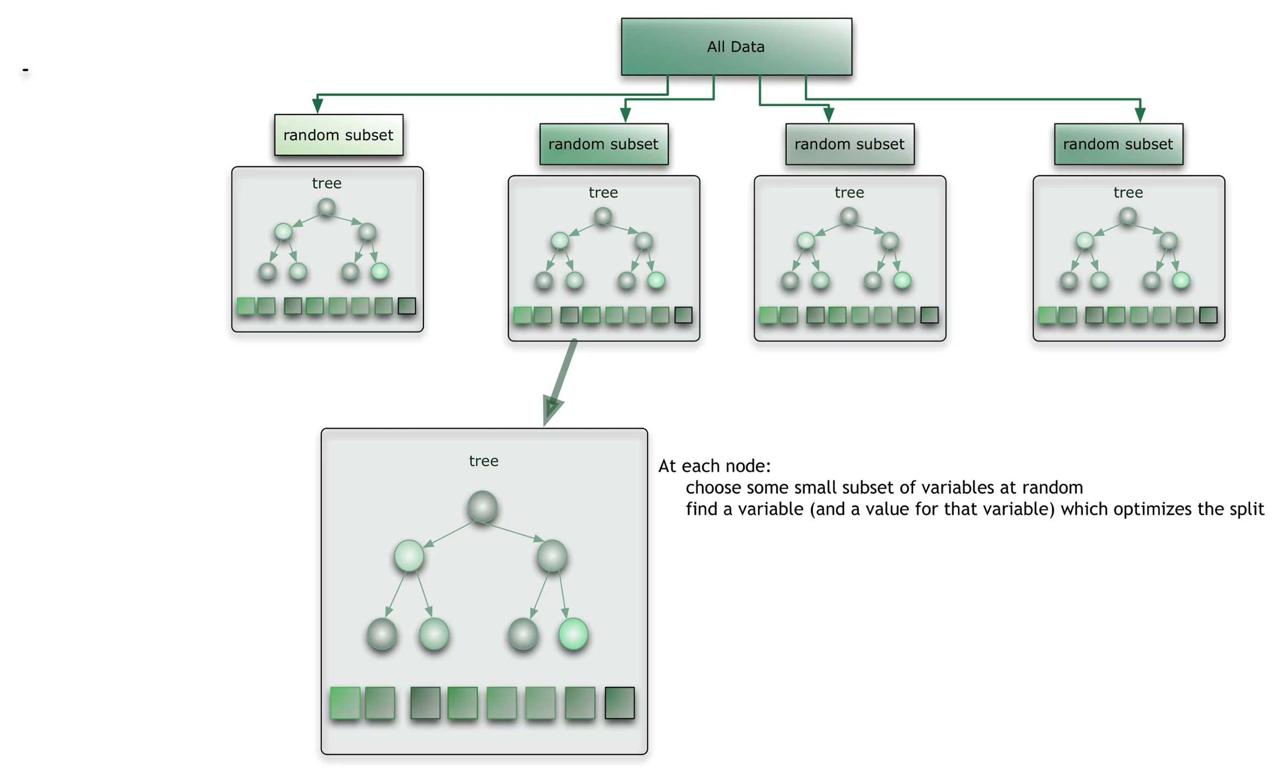
Random Forest
The random forest starts with a standard machine learning technique called a “decision tree” which, in ensemble terms, corresponds to our weak learner. In a decision tree, an input is entered at the top and as it traverses down the tree the data gets bucketed into smaller and smaller sets. Thus, in ensemble terms, the trees are weak learners and the random forest is a strong learner.

Slide 15

Naive Bayes
Naive Bayesian classifier assumes that the effect of an attribute value on a given class is independent of the values of the other attributes. This assumption is called class conditional independence. It is made to simplify the computations involved in this algorithm.
Bayesian Theorem: • The purpose of the Bayesian theorem is to predict the class label for a given tuple. • Let X be a data tuple. • In Bayesian terms, X is considered “evidence.” • It is described by measurements made on a set of n attributes. • Let H be some hypothesis, such as that the data tuple X belongs to a specified class C. • For classification problems, we are looking for the probability that tuple X belongs to class C, given that we know the attribute description of X.

Slide 16
Classifier Models

Slide 17
Attributes selected by respective algorithms
Gain Ratio: T, E, lOComment, lOCodeAndComment and lOCode
WrapperSubsetEval: v.g., ev.g., iv.G., N, V, D, I, lOComent, locCodeAndComment, unique_Op and total_Opnd.
SymmetricalUncertAttributeEval: loComment, locCodeandComment, I, loBlank, Uniq_opnd

Slide 18
Attributes selected by respective algorithms
CfsSubsetEval: lOComment, locCodeandComment, I
By Intuition: I, lOComment, locCodeandComent, Unique_Op, Total_Op

Slide 19
Gain Ratio
Classification Model | TP Rate | FP Rate | Precision | Recall | F-Measure | ROC Area | Accuracy
Multilayer Perceptron | 0.937 | 0.820 | 0.926 | 0.937 | 0.915 | 0.652 | 93.69
Naive Bayes | 0.937 | 0.783 | 0.923 | 0.937 | 0.919 | 0.648 | 93.69
J48 | 0.942 | 0.708 | 0.933 | 0.942 | 0.928 | 0.662 | 94.25
Random Forest | 0.942 | 0.671 | 0.932 | 0.942 | 0.931 | 0.666 | 94.25
IBK (K=10) | 0.937 | 0.820 | 0.926 | 0.937 | 0.915 | 0.658 | 93.69

Slide 20
WrapperSubsetEval
Classification Model | TP Rate | FP Rate | Precision | Recall | F-Measure | ROC Area | Accuracy
Multilayer Perceptron | 0.942 | 0.745 | 0.937 | 0.942 | 0.926 | 0.654 | 94.25
Naive Bayes | 0.94 | 0.783 | 0.932 | 0.94 | 0.92 | 0.651 | 93.97
J48 | 0.94 | 0.746 | 0.928 | 0.94 | 0.924 | 0.652 | 93.97
Random Forest | 0.94 | 0.746 | 0.928 | 0.94 | 0924 | 0.634 | 93.97
IBK (K=10) | 0.932 | 0.932 | ud | 0.932 | ud | 0.651 | 93.15
Note: The value of Precision and F-Measure is undefined (ud) since the value of TP and FP for IBK classifier is 0.

Slide 21
SymmetricalUncertAttributeEval
Classification Model | TP Rate | FP Rate | Precision | Recall | F-Measure | ROC Area | Accuracy
Multilayer Perceptron | 0.934 | 0.820 | 0.916 | 0.934 | 0.913 | 0.676 | 93.43
Naive Bayes | 0.929 | 0.635 | 0.918 | 0.929 | 0.922 | 0.694 | 92.87
J48 | 0.932 | 0.820 | 0.909 | 0.932 | 0.911 | 0.600 | 93.15
Random Forest | 0.934 | 0.820 | 0.916 | 0.934 | 0.913 | 0.562 | 93.42
IBK (K=10) | 0.942 | 0.782 | 0.946 | 0.942 | 0.922 | 0.662 | 94.25

Slide 22
CfsSubsetEval
Classification Model | TP Rate | FP Rate | Precision | Recall | F-Measure | ROC Area | Accuracy
Multilayer Perceptron | 0.937 | 0.783 | 0.923 | 0.937 | 0.919 | 0.671 | 93.69
Naive Bayes | 0.934 | 0.783 | 0.916 | 0.934 | 0.917 | 0.664 | 93.43
J48 | 0.932 | 0.932 | ud | 0.932 | ud | 0.500 | 93.15
Random Forest | 0.934 | 0.783 | 0.916 | 0.934 | 0.917 | 0.659 | 93.43
IBK (K=10) | 0.934 | 0.783 | 0.916 | 0.934 | 0.917 | 0.659 | 93.43
Note: The value of Precision and F-Measure is undefined (ud) since the value of TP and FP for J48 classifier is 0.

Slide 23
By Intuition
Classification Model | TP Rate | FP Rate | Precision | Recall | F-Measure | ROC Area | Accuracy
Multilayer Perceptron | 0.937 | 0.82 | 0.926 | 0.937 | 0.915 | 0.736 | 93.69
Naive Bayes | 0.918 | 0.636 | 0.912 | 0.918 | 0.914 | 0.724 | 91.79
J48 | 0.932 | 0.820 | 0.909 | 0.932 | 0.911 | 0.559 | 93.15
Random Forest | 0.934 | 0.783 | 0.916 | 0.934 | 0.917 | 0.645 | 93.43
IBK (K=10) | 0.940 | 0.783 | 0.932 | 0.940 | 0.920 | 0.560 | 93.97

Slide 24
The Winner
Attribute Selection Algorithm | Classifier Algorithm | TP | FP | Precision | Recall | F | ROC Area | Accuracy
Gain Ratio | Random Forest | 0.942 | 0.671 | 0.932 | 0.942 | 0.931 | 0.666 | 94.25
SymetricalUncertSubsetAttributeEval | IBK (K=10) | 0.942 | 0.782 | 0.946 | 0.942 | 0.922 | 0.662 | 94.25
CfsSubsetEval | Multilayer Perceptron | 0.937 | 0.783 | 0.923 | 0.937 | 0.919 | 0.671 | 93.69
WrapperSubsetEval | Multilayer Perceptron | 0.942 | 0.745 | 0.937 | 0.942 | 0.926 | 0.654 | 94.25
By Intuition | Random Forest | 0.934 | 0.783 | 0.916 | 0.934 | 0.917 | 0.645 | 93.43

Slide 25
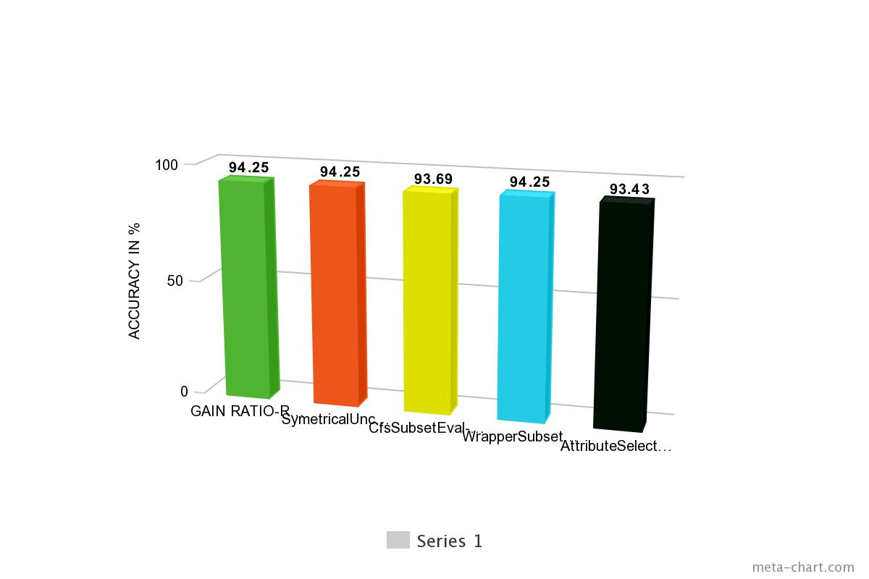

Slide 26
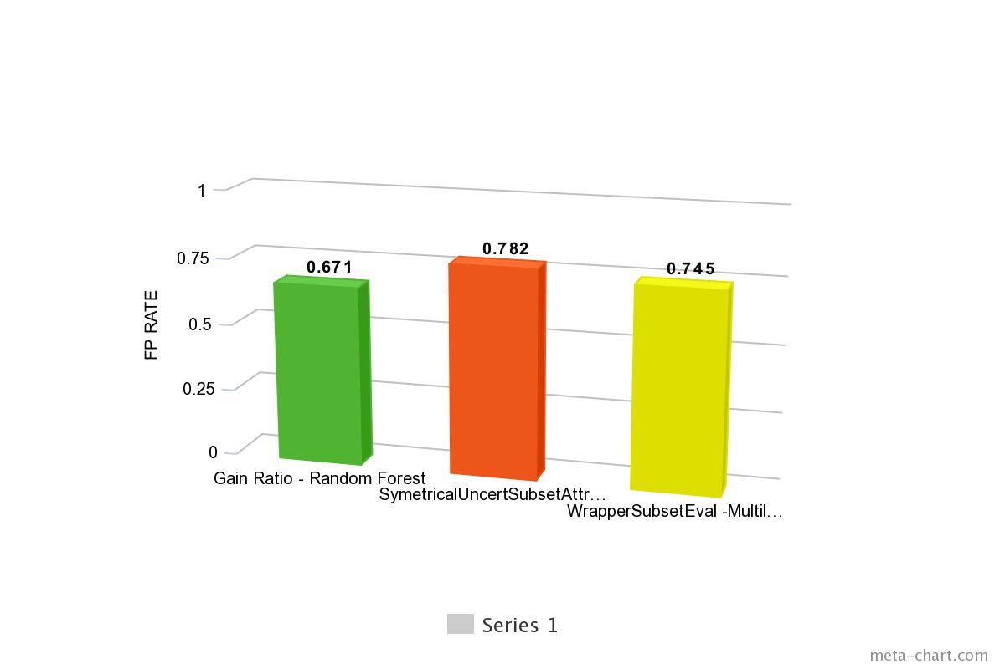

Slide 27
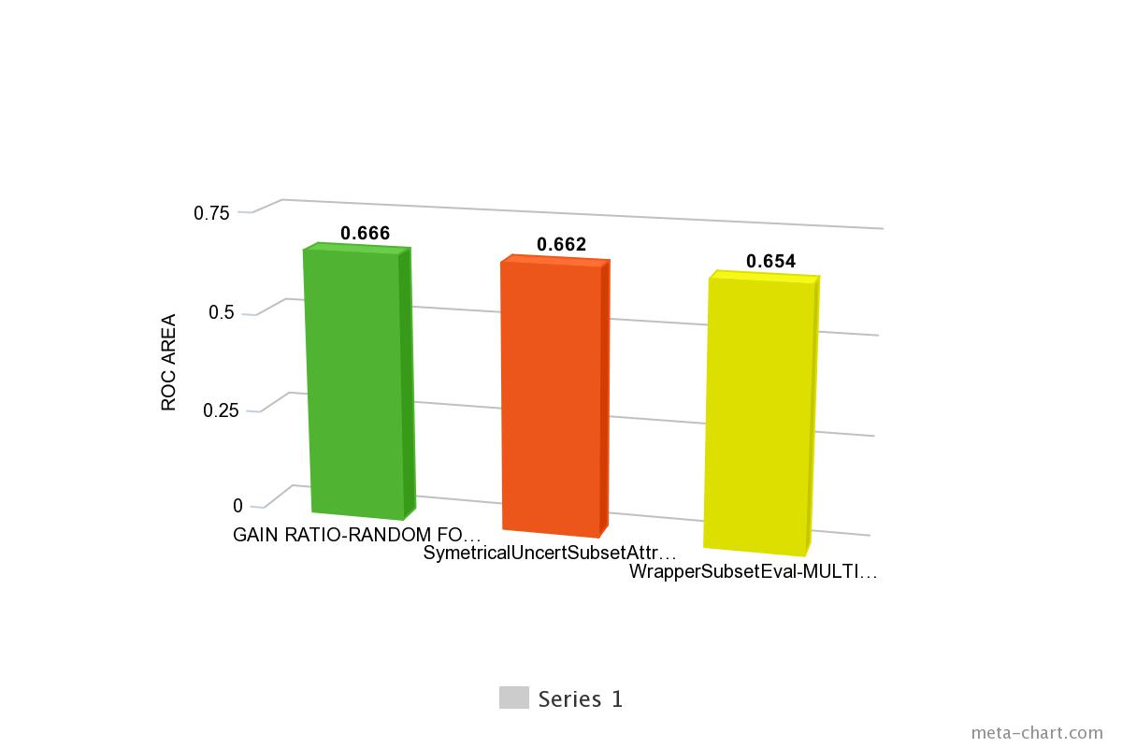

Slide 28
Justification
As seen in the previous table 3 models have the same accuracy of 94.25%.
IBK(k=10) using SymetricalUncertAttributeEval as attribute selection algorithm.
Multilayer Perceptron using WrapperSubsetEval as attribute selection algorithm.
Random Forest using Gain Ratio as attribute selection algorithm.
Of all the 5 models we can consider Random Forest using Gain Ratio to be the best model since it has the least FP rate and the highest ROC area.

Slide 29
Practical Application

Slide 30
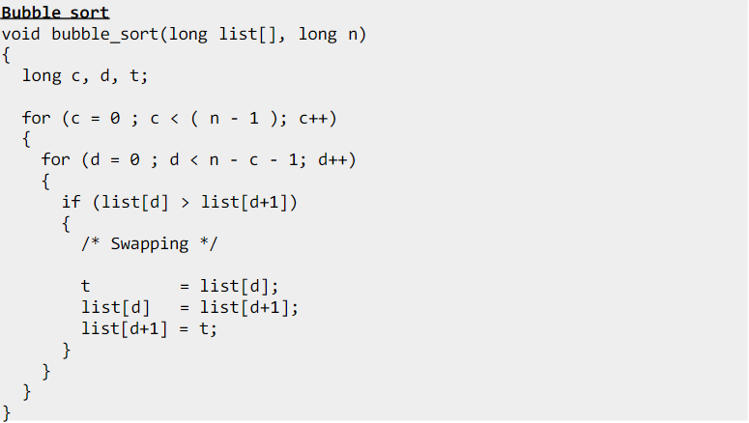
Sample Code

Slide 31
Halstead Metrics
n1 = Number of distinct operators.
n2 = Number of distinct operands.
N1 = Total number of occurrences of operators.
N2 = Total number of occurrences of operands.
n = n1 + n2
N = N1 + N2
V = Size * (log₂ vocabulary) = N * log₂(n)
D = (n1 * N2) / (n2 * 2)
E = Difficulty * Volume = D * V
T = E / (18)

Slide 32
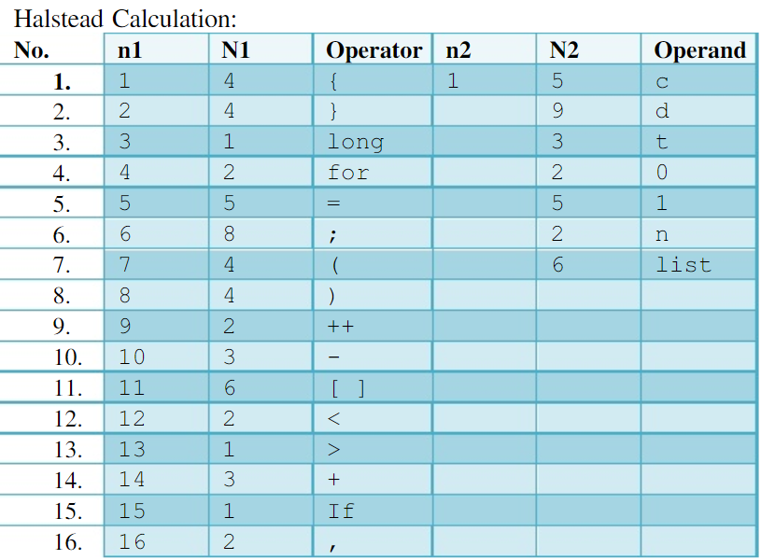
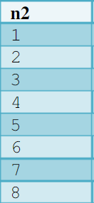
Halstead Calculation

Slide 33

Generating attributes

Slide 34
Predicting class attribute
The Multiple Logistic Regression model is used to make this prediction.
Predictions are made based only on the basis of the attributes selected by the Gain Ratio Algorithm.

Slide 35
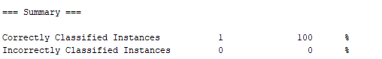
Testing

Slide 36
References
Han, J., Kamber, M., Pei, J., “Data mining: concepts and techniques,” 3rd Ed., Morgan Kaufmann, 2012
http://www.aaai.org/Papers/KDD/1995/KDD95-049.pdf
http://weka.sourceforge.net/doc.dev/weka/attributeSelection/SymmetricalUncertAttributeEval.html
http://weka.sourceforge.net/doc.dev/weka/attributeSelection/CfsSubsetEval.html
https://www.youtube.com/user/WekaMOOC
https://skymind.ai/wiki/multilayer-perceptron
https://hackerbits.com/data/c4-5-data-mining-algorithm/
http://blog.citizennet.com/blog/2012/11/10/random-forests-ensembles-and-performance-metrics
http://sciencewise.info/resource/Ibk_algorithm/Ibk_algorithm_by_Wikipedia
http://www.academia.edu/23024048/Applying_Halstead_Metrics_in_Your_Programs
http://www.ques10.com/p/166/write-short-note-on-bayesian-classification/

Slide 37
Q & A

