Slide 1
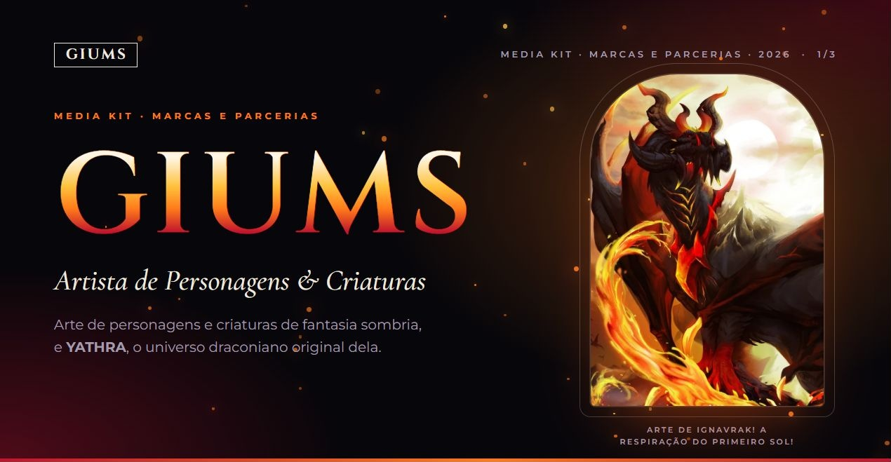
Notes:
Cover. Source: https://github.com/Biieru/GIUMS.Mediakit (index.html, css/style.css, js/brand.js, assets). Visual reproduced from the website at its original proportions. Audience figures as supplied: October 2026.

Slide 2
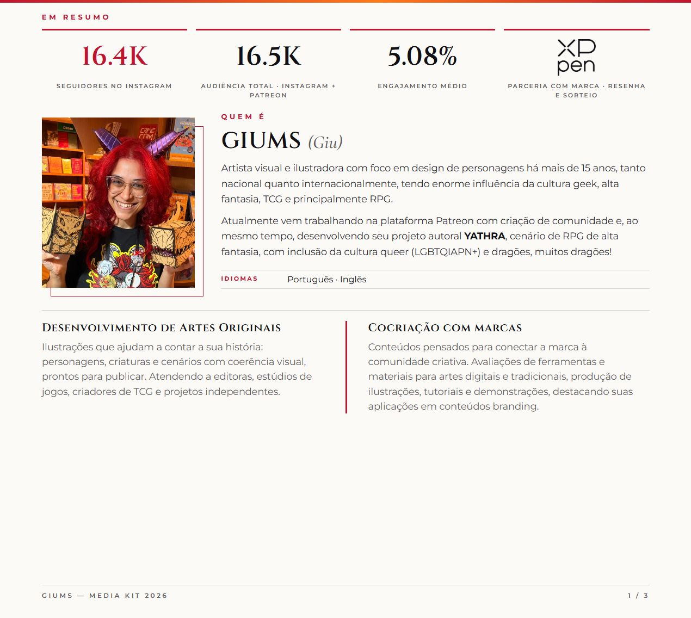
Notes:
Artist and original art. Source: https://github.com/Biieru/GIUMS.Mediakit (index.html, css/style.css, js/brand.js, assets). Visual reproduced from the website at its original proportions. Audience figures as supplied: October 2026.

Slide 3
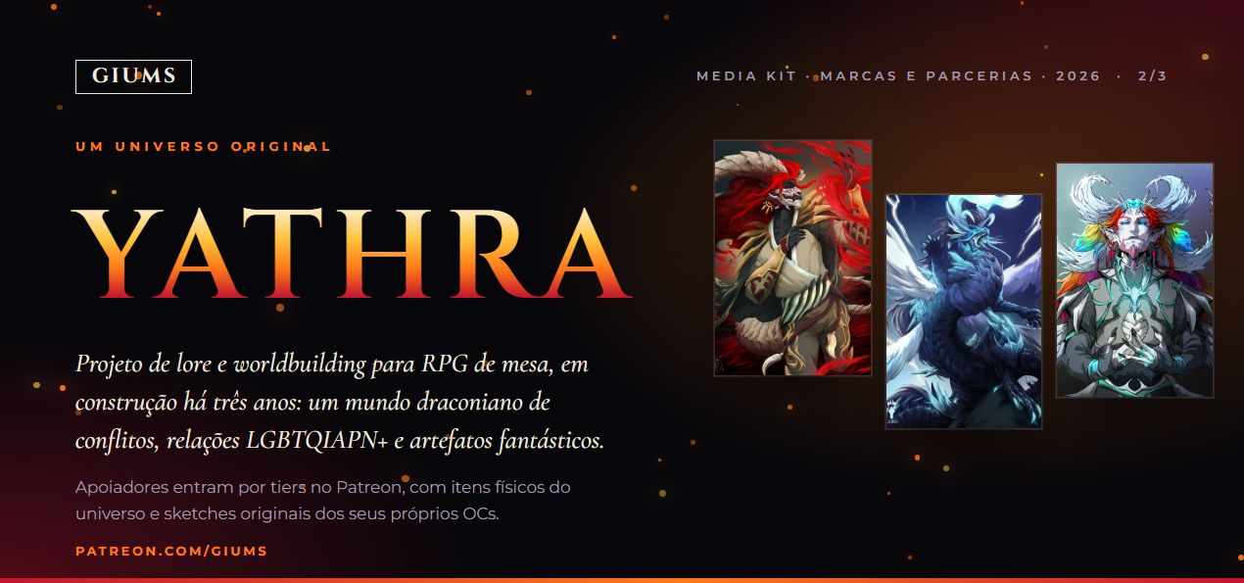
Notes:
YATHRA. Source: https://github.com/Biieru/GIUMS.Mediakit (index.html, css/style.css, js/brand.js, assets). Visual reproduced from the website at its original proportions. Audience figures as supplied: October 2026.

Slide 4
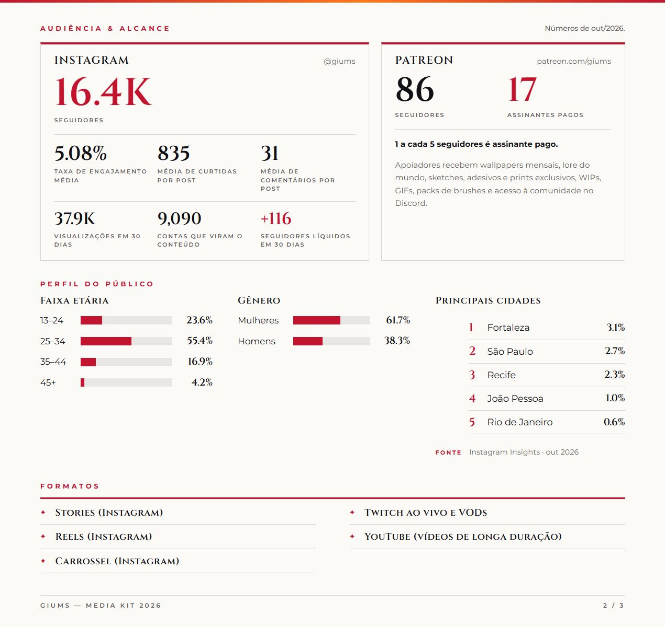
Notes:
Audience and reach. Source: https://github.com/Biieru/GIUMS.Mediakit (index.html, css/style.css, js/brand.js, assets). Visual reproduced from the website at its original proportions. Audience figures as supplied: October 2026.

Slide 5
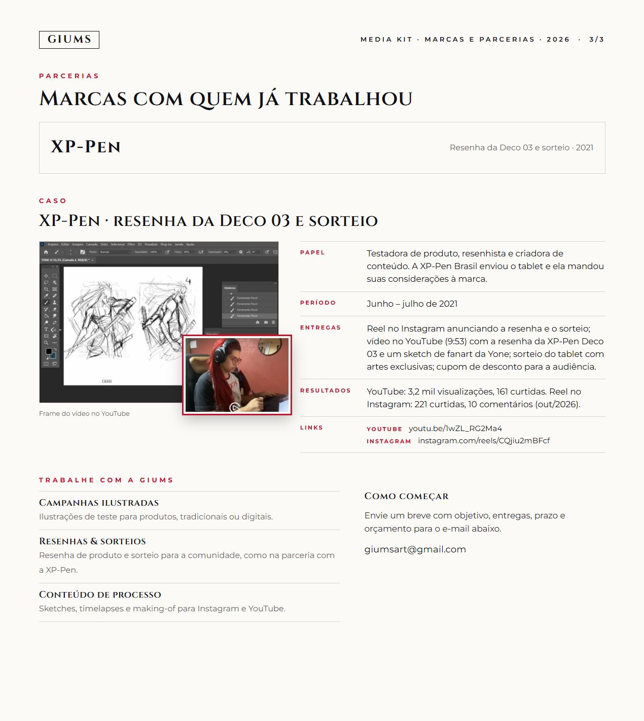
Notes:
Brand partnerships. Source: https://github.com/Biieru/GIUMS.Mediakit (index.html, css/style.css, js/brand.js, assets). Visual reproduced from the website at its original proportions. Audience figures as supplied: October 2026.

Slide 6
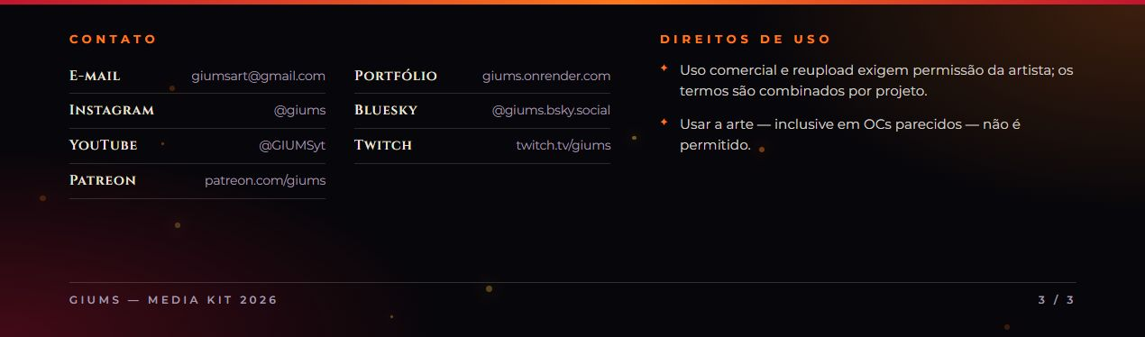
Notes:
Contact and usage rights. Source: https://github.com/Biieru/GIUMS.Mediakit (index.html, css/style.css, js/brand.js, assets). Visual reproduced from the website at its original proportions. Audience figures as supplied: October 2026.

