Slide 1
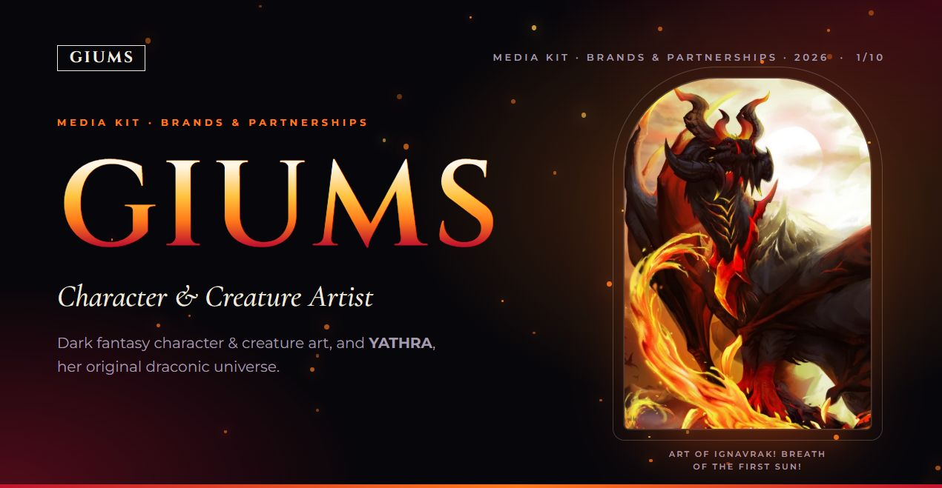
Notes:
Cover reproduced from the original website composition. Source: https://github.com/Biieru/GIUMS.Mediakit (index.html, css/style.css, js/brand.js, assets).

Slide 2
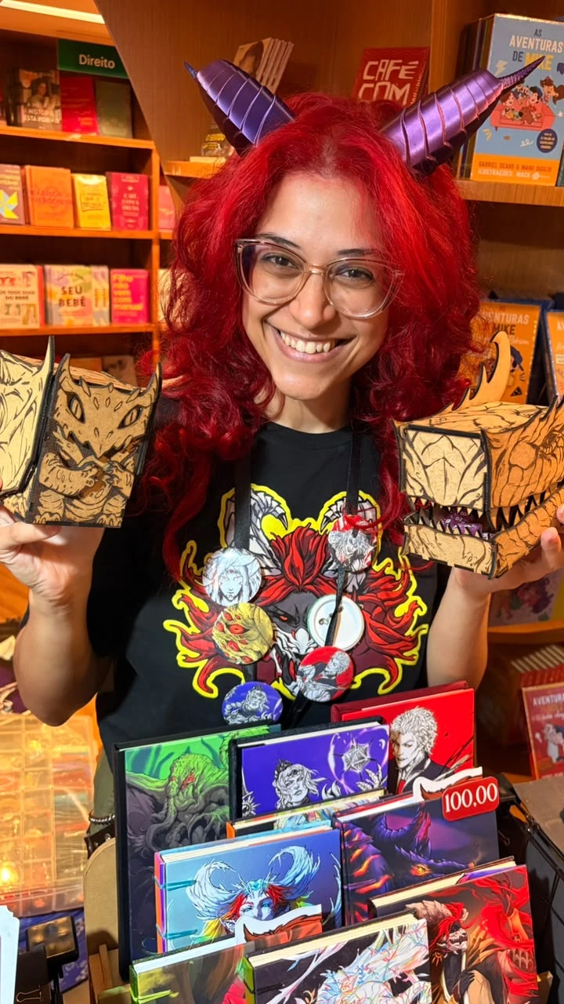
GIUMS
MEDIA KIT · BRANDS & PARTNERSHIPS · 2026
Who she is
GIUMS (Giu)
Visual artist and illustrator focused on character design for over 15 years, working both in Brazil and internationally, with a strong influence from geek culture, high fantasy, TCG and, above all, RPG.
She is currently building a community on Patreon while developing her original project YATHRA: a concept art book and high fantasy swashbuckling RPG setting book, embracing queer culture (LGBTQIAPN+) and dragons. Lots of dragons!
Languages: Portuguese · English
2 / 10
Notes:
Source: https://github.com/Biieru/GIUMS.Mediakit (index.html, js/brand.js, assets). Audience figures: October 2026, as supplied in the media kit.

Slide 3
GIUMS
MEDIA KIT · BRANDS & PARTNERSHIPS · 2026
Co-creations
Original Artwork Development
Co-creation with brands
Illustrations that help tell your story: characters, creatures and settings with visual consistency, ready to publish. Serving publishers, game studios, TCG creators and independent projects.
Content designed to connect brands with the creative community. Reviews of tools and materials for digital and traditional art, alongside illustrations, tutorials and demonstrations highlighting their applications in branding content.
3 / 10
Notes:
Source: https://github.com/Biieru/GIUMS.Mediakit (index.html, js/brand.js, assets). Audience figures: October 2026, as supplied in the media kit.

Slide 4
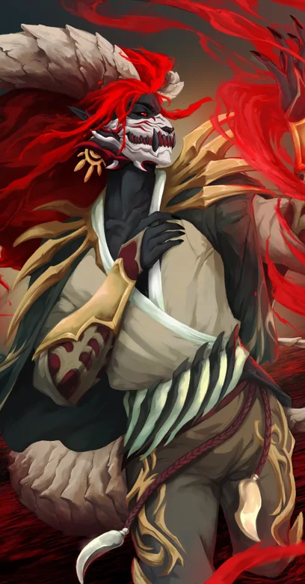
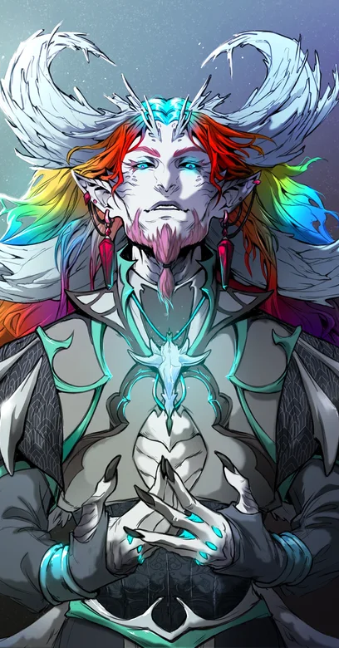
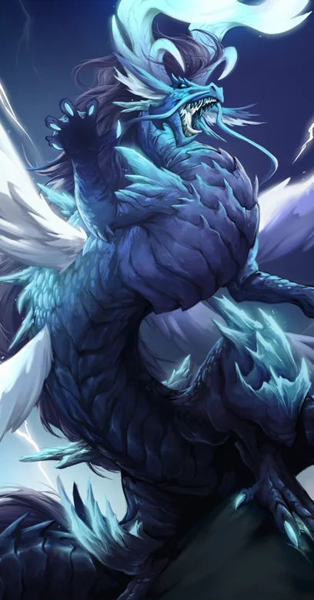
GIUMS
MEDIA KIT · BRANDS & PARTNERSHIPS · 2026
YATHRA
An original universe
A lore & tabletop RPG worldbuilding project, three years in the making: a draconic world of conflict, LGBTQIAPN+ relationships and fantastic artifacts.
Supporters join through Patreon tiers, with physical items from the universe and original sketches of their own OCs.
patreon.com/giums
4 / 10
Notes:
Source: https://github.com/Biieru/GIUMS.Mediakit (index.html, js/brand.js, assets). Audience figures: October 2026, as supplied in the media kit.

Slide 5
GIUMS
MEDIA KIT · BRANDS & PARTNERSHIPS · 2026
Audience & reach
Figures as of Oct 2026.
Instagram
Patreon
16.4K
86 / 17
followers
followers / paid subscribers
5.08%
835
31
1 in 5 followers is a paid subscriber.
average engagement rate
average likes per post
average comments per post
total audience · Instagram + Patreon: 16.5K
5 / 10
Notes:
Source: https://github.com/Biieru/GIUMS.Mediakit (index.html, js/brand.js, assets). Audience figures: October 2026, as supplied in the media kit.

Slide 6
GIUMS
MEDIA KIT · BRANDS & PARTNERSHIPS · 2026
Reach and community
37.9K
9,090
+116
views in the last 30 days
accounts that viewed the content
net followers in 30 days
Patreon
Supporters get monthly wallpapers, world lore, sketches, exclusive stickers & prints, WIPs, GIFs, brush packs and access to the Discord community.
Figures as of Oct 2026.
6 / 10
Notes:
Source: https://github.com/Biieru/GIUMS.Mediakit (index.html, js/brand.js, assets). Audience figures: October 2026, as supplied in the media kit.

Slide 7
GIUMS
MEDIA KIT · BRANDS & PARTNERSHIPS · 2026
Audience profile
Age
Gender
Top countries
13–24
23.6%
Women
61.7%
United States
28.7%
25–34
55.4%
Men
38.3%
Brazil
23.9%
35–44
16.9%
Italy
3.6%
Germany
3.4%
45+
4.2%
France
3.2%
Source: Instagram Insights · Oct 2026
7 / 10
Notes:
Source: https://github.com/Biieru/GIUMS.Mediakit (index.html, js/brand.js, assets). Audience figures: October 2026, as supplied in the media kit.

Slide 8
GIUMS
MEDIA KIT · BRANDS & PARTNERSHIPS · 2026
Work with Giums
Formats
Illustrated campaigns
Test illustrations for products, traditional or digital.
Stories (Instagram)
Reels (Instagram)
Reviews & giveaways
Carousel (Instagram)
Product reviews and giveaways for her community, as in the XP-Pen partnership.
Live on Twitch and VODs
Process content
YouTube (long-form videos)
Sketches, timelapses and making-of for Instagram and YouTube.
8 / 10
Notes:
Source: https://github.com/Biieru/GIUMS.Mediakit (index.html, js/brand.js, assets). Audience figures: October 2026, as supplied in the media kit.

Slide 9
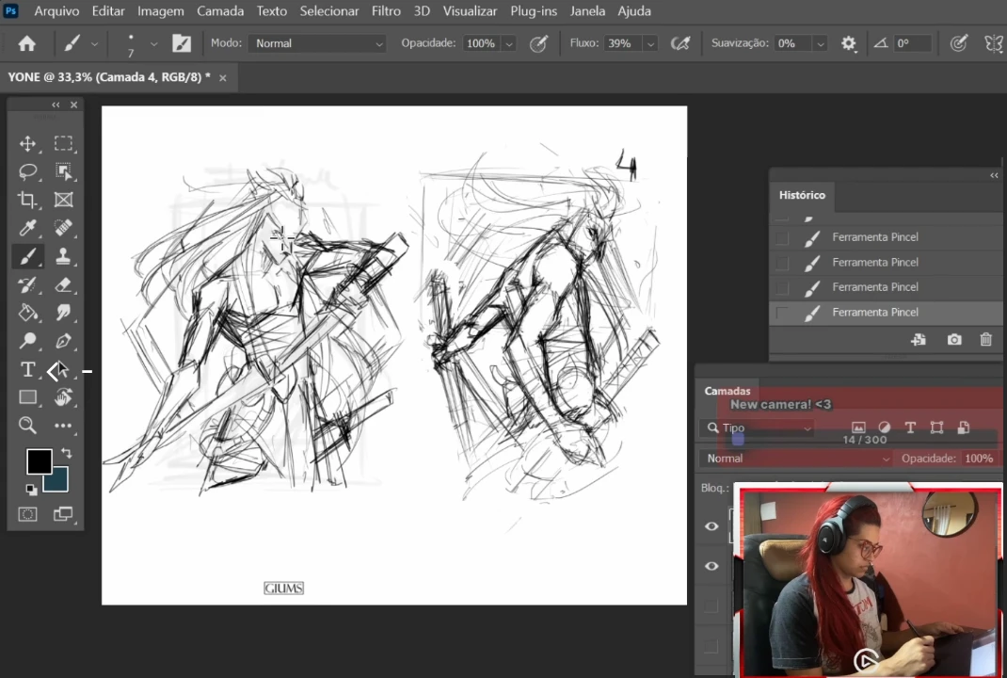
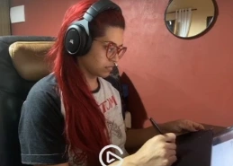
GIUMS
MEDIA KIT · BRANDS & PARTNERSHIPS · 2026
XP-Pen · Deco 03 review & giveaway
June – July 2021
Product tester, reviewer and content creator. XP-Pen Brasil sent the tablet and she sent them her feedback.
Deliverables
Instagram reel announcing the review and giveaway; YouTube video (9:53) with the XP-Pen Deco 03 review and a Yone fan art sketch; tablet giveaway with exclusive art; discount code for her audience.
Results
YouTube: 3.2K views, 161 likes. Instagram reel: 221 likes, 10 comments (Oct 2026).
Frame from the YouTube video
YouTube
Instagram
9 / 10
Notes:
Source: https://github.com/Biieru/GIUMS.Mediakit (index.html, js/brand.js, assets). Audience figures: October 2026, as supplied in the media kit.

Slide 10
GIUMS
MEDIA KIT · BRANDS & PARTNERSHIPS · 2026
Contact
How to start
Usage rights
Send a short brief with goals, deliverables, timeline and budget to the e-mail below.
Commercial use and reuploads require the artist's permission; terms are agreed per project.
giumsart@gmail.com
giums.onrender.com
@giums
Using the artwork — including for similar-looking OCs — is not allowed.
@giums.bsky.social
@GIUMSyt
twitch.tv/giums
patreon.com/giums
10 / 10
Notes:
Source: https://github.com/Biieru/GIUMS.Mediakit (index.html, js/brand.js, assets). Audience figures: October 2026, as supplied in the media kit.

