Slide 1
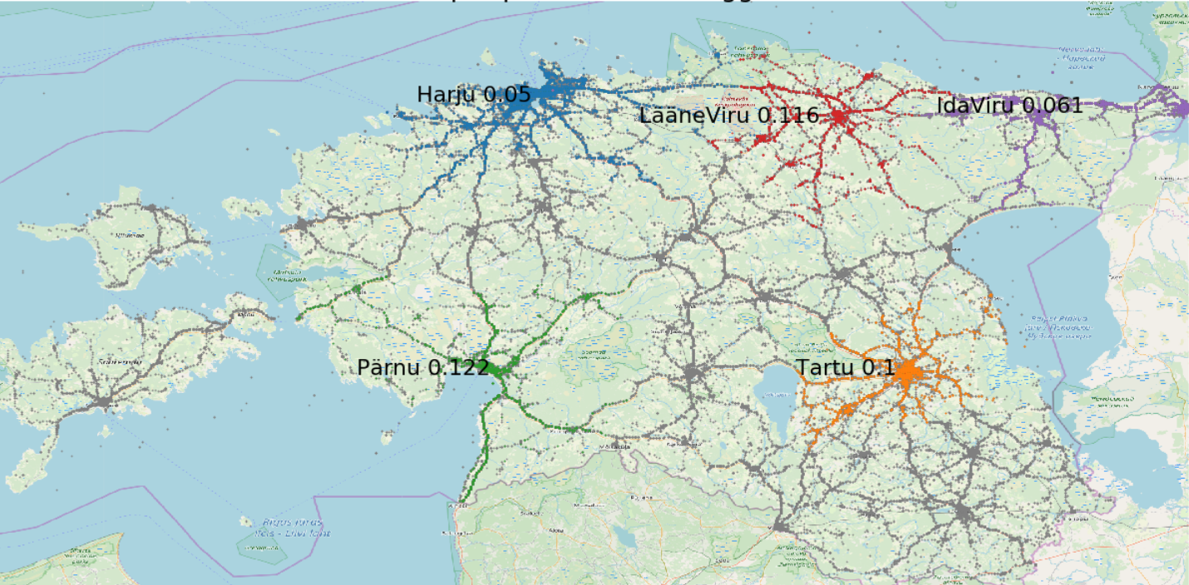
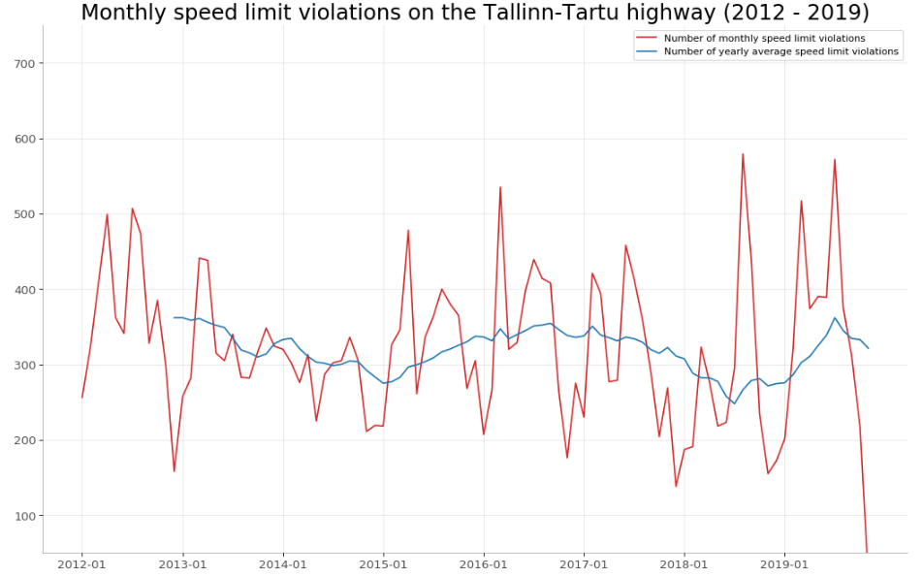
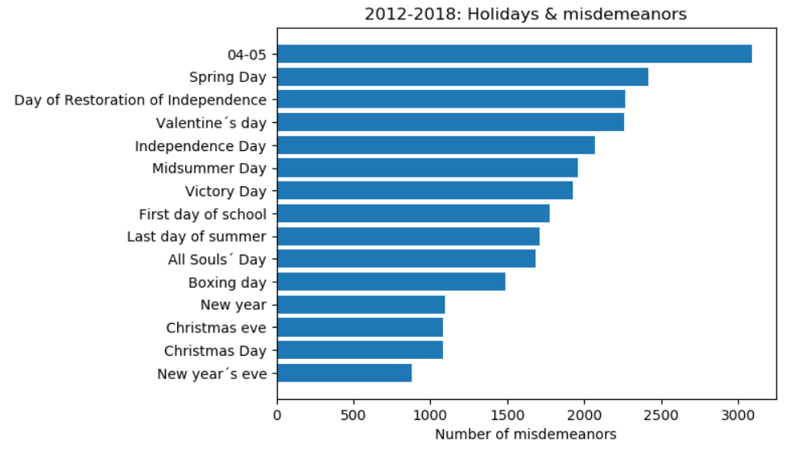


Misdemeanors detected in the course of traffic control in Estonia during 2012-2018
About
Over the years the number of accidents in traffic has risen. Only this year over 51 people have died and 1562 have injured due to an accident.
The government has changed the speed limit on many roads but still there are a lot of misdemeanors- speeding, driving while drunk, driving without a driving license etc.
There are different awareness campaigns to draw attention to these problems, but people still decide to break the law and put in danger themselves and others.
Methods and materials
We used 3 diferent datasets provided by the Estonian Government as our main source of information. A big part of the Project was merging these datasets together and cleaning data.
We used Python as the main language for data processing. Data analysis involved plotting data to the Estonian map, building graphs for visualisation and using other Pandas methods.
Dependencies between weather and misdemeanors coud not be found due to not enough information. Estonian Statistical Office provided a database with only monthly observations till year 2014.
Misdemeanors in 2018
The infographic map shows us the number of misdemeanours per person from 5 biggest counties in Estonia in the last year.
As we can see the least amount of misdemeanours happen in Harju county and the most happen in Pärnu county. Our hypothesis was that Tallinn and Tartu have the most misdemeanours per person in 2018 but it is not correct as we can see. Other counties are represented by gray scatter dots.
Speed cameras
From the graph above, we can see that overall the number of speeding misdemeanors in Estonia is decreasing. However, on the Tallinn-Tartu highway it’s the opposite.
Although, the number of speeding misdemeanors decreased in the years 2012-2015, after the speed cameras were installed, overall the number has stayed the same.
Conclusion
Overall, what took the most time was gathering and cleaning the data so it would suit our researching goals. E.g converting coordinates and cleaning the dataset.
It was interesting to find and convert LEST coordinates to latitude and longitude coordinates and plot them on a map according to the ratio and measurements of a Estonian map.
Some hypothesis turned out to be wrong and it was interesting to see the real results that were sometimes quite surprising. For example the holidays & misdemeanors top 5.
It was a fun experience!
Did you know …
that the highest number of misdemeanors (2012-2018) happened on the 5 th of April?
that the top 3 holidays with the highest number of misdemeanors are Spring Day (1st of May), Day of Restoration of Independence (20th of August) and Valentine’s day (14th of February)?
that the overall number of misdemeanors has decreased?
that the biggest misdemeanor is speeding?
that most of the misdemeanors happen in March?
that You can get more fun facts and try it yourself?
Marten Tamm Cristian Noop Maria Pibilota Murumaa

