Slide 1
Activity recognition with healthy older people using a batteryless wearable sensor Data Set

Slide 2
Instroduction
Human Activity monitoring has become a vital area of research in the health care domain. The rise in popularity of smart wearable devices like smart watches, with embedded sensors, has facilitated the process of collecting high quality data both easily and effectively. This area of research is highly intriguing as it finds applications across a wide range of domains. Some of the interesting application include, monitoring the physical activity and health condition of geriatric population, predicting the motion of a robot using sensors, and to develop systems that help the elderly people walk etc. The primary objective of this project is to come up with an innovative and robust system to monitor the human activity and to classify the positioning of a user into one of the 4 classes, Sitting on bed, Sitting on chair, Lying on bed, Ambulating, where ambulating includes standing, walking around the room., using a battryless wearable sensor. The idea is to model this as a learning problem given the quality data of human activity belonging to the four classes mentioned above. The data has been collected for training the models and to build inference systems for predicting unobserved data sets. The experiments are based on the battery less wearable sensor data collected by four different users. The battery less wearable users contributed a couple of hours of data for each activity. The battery less wearable is embedded with highly precise sensors like Accelerometer, Gyroscope, sensors for measuring the orientation, recording gravity, step count, rotation motion etc. The signals captured by these sensors are well indicative of the hand motion and enables us to predict the activity of the user. The experiments were conducted on several machine learning models like K-means clustering and random forest. We have found some interesting observations such as, increasing number of sensors for tracking the activity and considering larger time windows improve the accuracy of the model.

Slide 3
Problem Statement
Human activity recognition is the problem of human body gestures or motion via sensors and determine human activity or action. This project uses different machine learning models to discover multiple human activity patterns and specifically detecting which activity a person is doing, through signals received by sensors, by analysing the patterns in the results through a predictive model, and design and generate individualized output result to further predict the accuracy of the results.

Slide 4
Data discription
Data collection:
Download dataset from:https://archive.ics.uci.edu/ml/datasets/Activity+recognition+with+healthy+older+people+using+a+batteryless+wearable+sensor
Dataset description
The data is Activity recognition with healthy older people, they are using a battery-less wearable sensor which gives 75128 observation. There are nine features,
1: Time in seconds
2: Acceleration reading in G for frontal axis
3: Acceleration reading in G for vertical axis
4: Acceleration reading in G for lateral axis
5: Id of Sensor reading sensor
6: Received signal strength indicator (RSSI)
7: Phase
8: Frequency The class variable is,
9: Activity, 1: sit on bed, 2: sit on the chair, 3: lying, 4: ambulating .

Slide 5
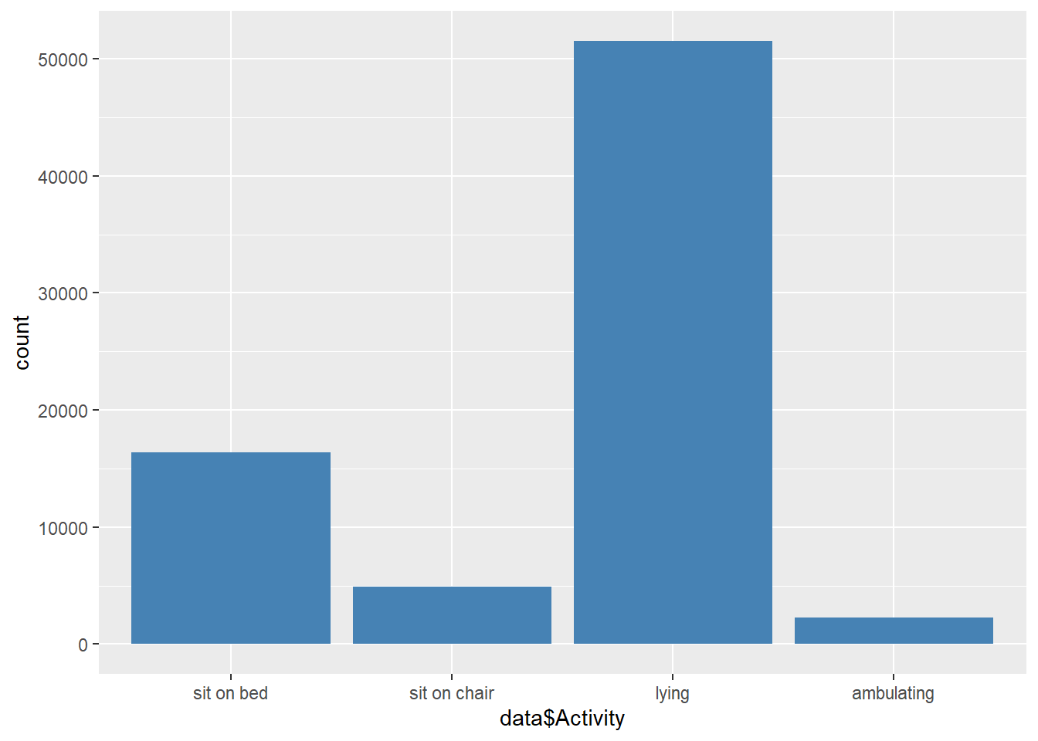
Activity distribution in Dataset
Notes:
In this plot, we can see most of healthy older people doing lying activities.

Slide 6
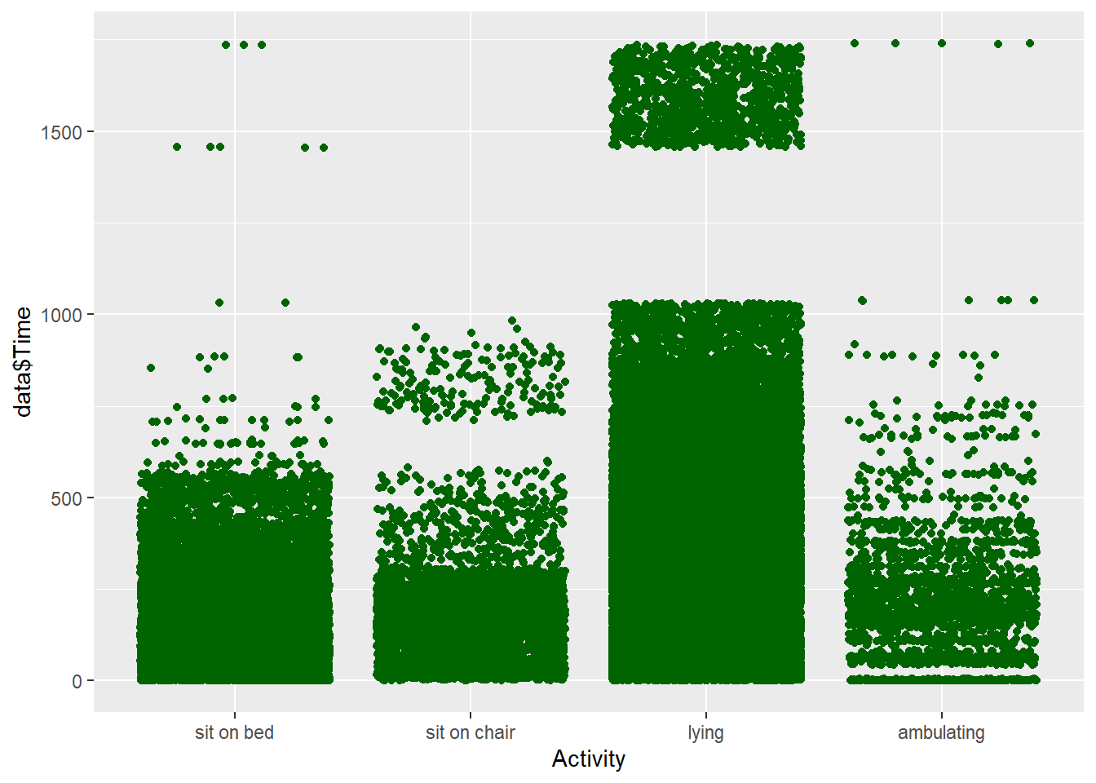
Activity distribution by Time
Notes:
In this scatter plot, we can see the Activity distribution by Time. Most of older people spend Time on lying activity.

Slide 7
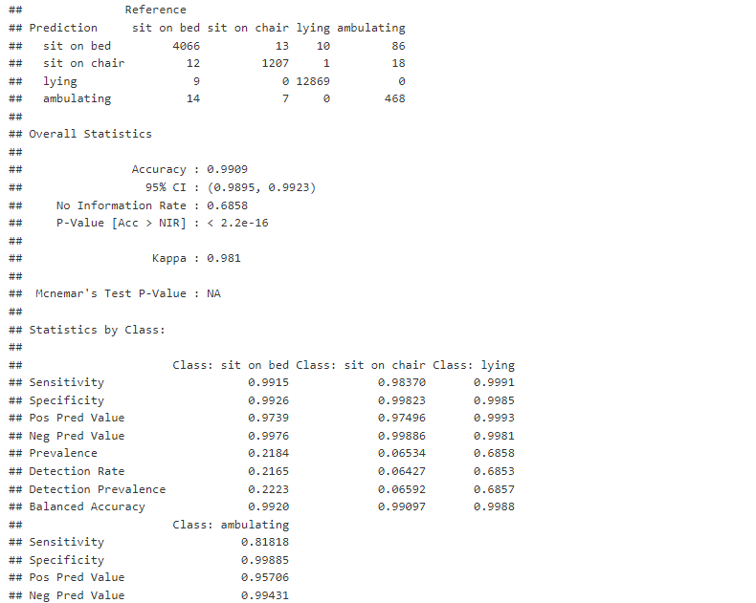
Classification model: Random Forest model
Notes:
We use accuracy to quantify the performance of our models after considering the following reasons: as per the problem statement, we are only interested in predicting each class equally and accurately without preferring one above the others, hence discrediting the purpose of recall and precision metrics. This problem is a multiclass classification, where accuracy is more commonly used and more interpretable than ROC-AUC metrics.

Slide 8
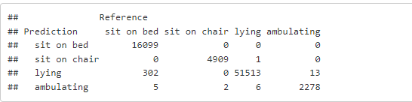
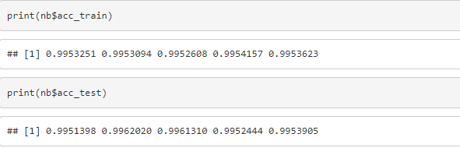
Classification model: Naïve bayes model
Lastly, as can be seen below, based on the accuracy resulted from predicting train and test dataset, we could see that the model is already decent, not underfit or overfit to train dataset except for the fourth fold. Hence, we couldn’t rely much on trading off bias and variance to improve the model performance.
Notes:
Naive Bayes model gives best result with 99.5% accuracy.

Slide 9
Conclusion:
The human activity recognition database is built by healthy older people using a battery less wearable the activities of daily living. The values are captured by a waist-mounted using a battery less wearable with embedded inertial sensors. These results not only allow these models to be efficient but in future they will give enhanced results in terms on Human Activity recognition, Human Computer interaction and other platforms where Machine learning is necessary. However, there is always room for improvement and we believe our best result can be made more better as we progress in technology and data. We believe that adding more features like time when the activity performed, we can draw more valuable insights in addition to predicting the activities. Random Forest & Naive bayes are clearly wins as the best model. Random Forest is able to recognize human activities based on their behavior with an outstanding 99% accuracy.

