Slide 1
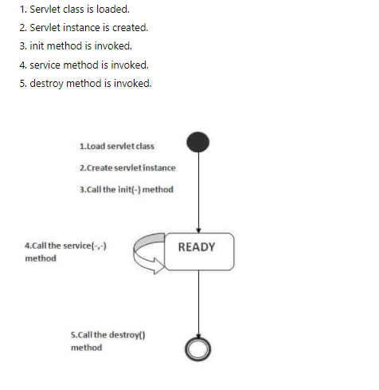
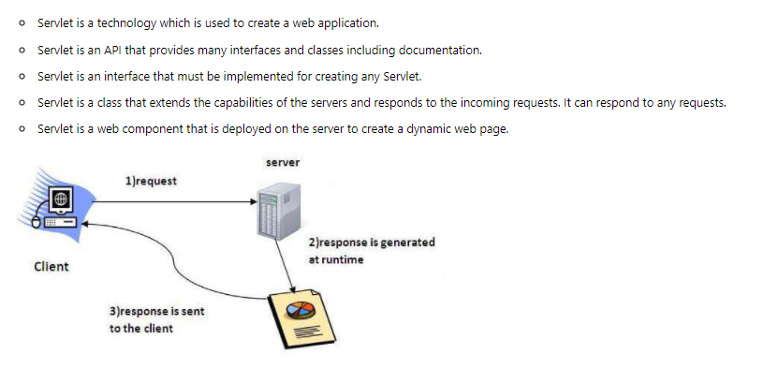
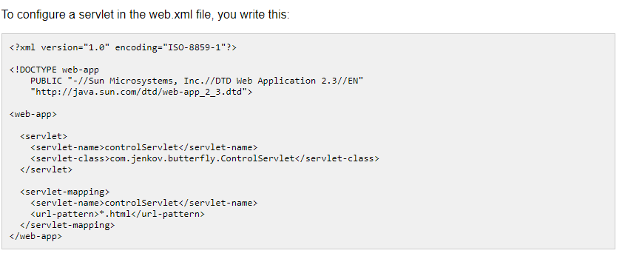
Java Servlet

Slide 2
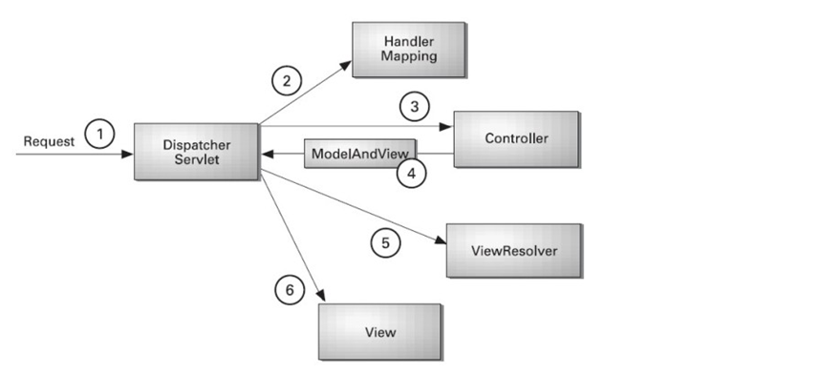

Slide 3
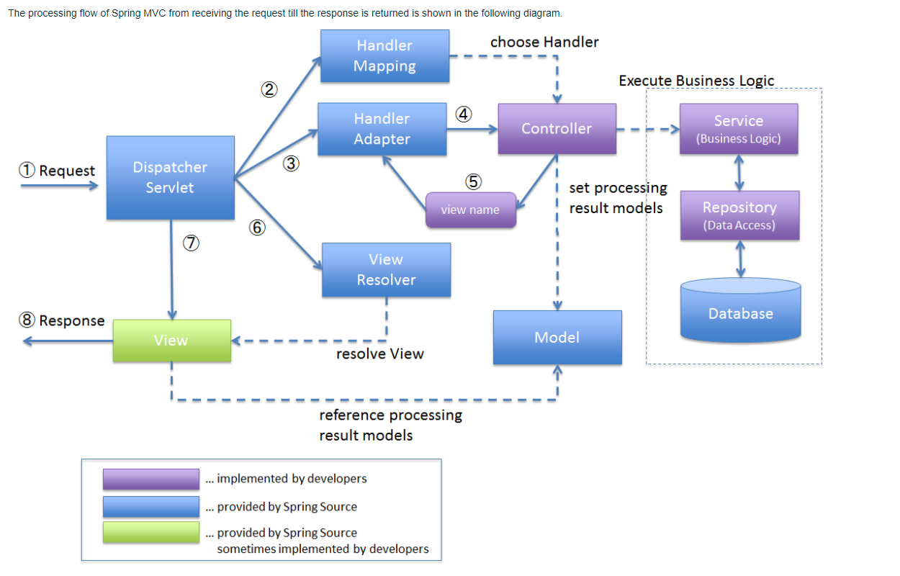
https://terasolunaorg.github.io/guideline/1.0.x/en/Overview/SpringMVCOverview.html

Slide 4
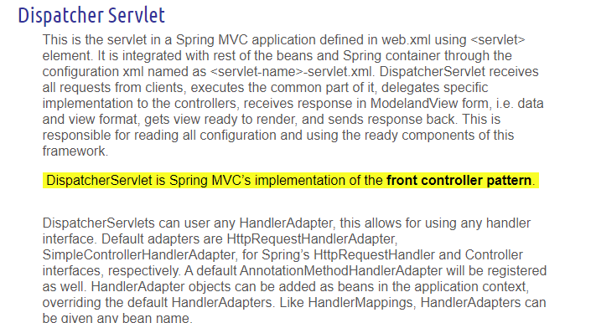
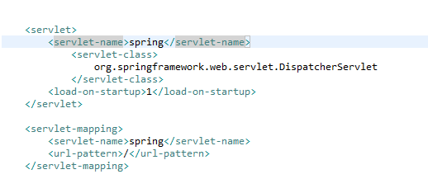
Web.xml

Slide 5
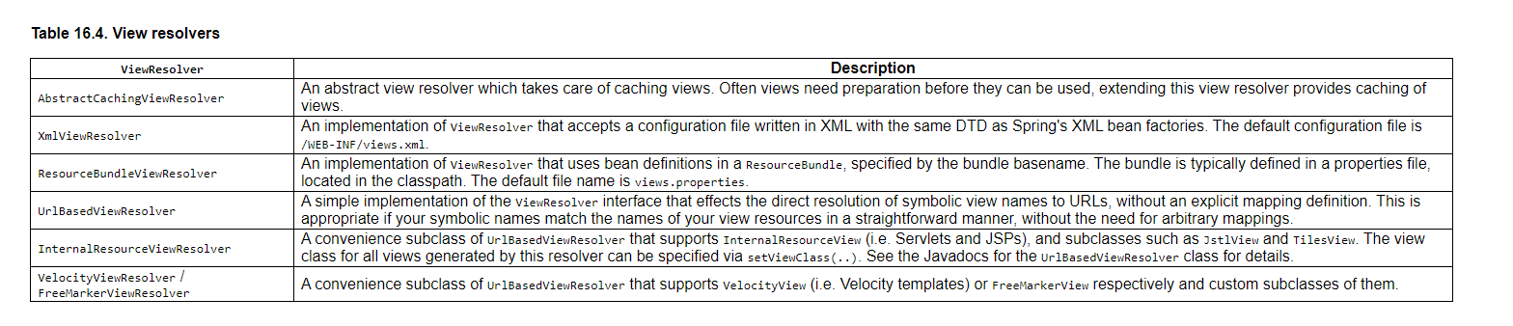
All MVC frameworks for web applications provide a way to address views. Spring provides view resolvers, which enable you to render models in a
browser without tying you to a specific view technology. Out of the box, Spring enables you to use JSPs, Velocity templates and XSLT views, for example.
The section entitled Chapter 17, View technologies has details of how to integrate and use a number of disparate view technologies.
The two interfaces which are important to the way Spring handles views are ViewResolver and View. The ViewResolver
provides a mapping between view names and actual views. The View interface addresses the preparation of the request and hands the request over to one of the view technologies.

Slide 6
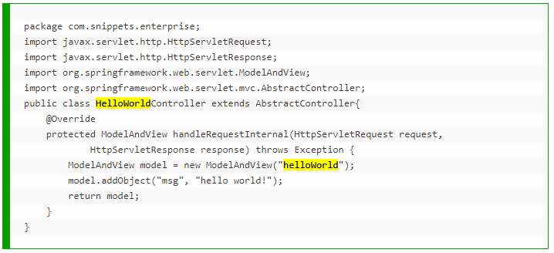
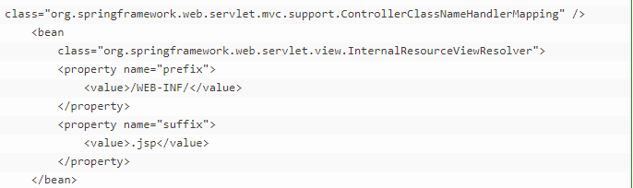
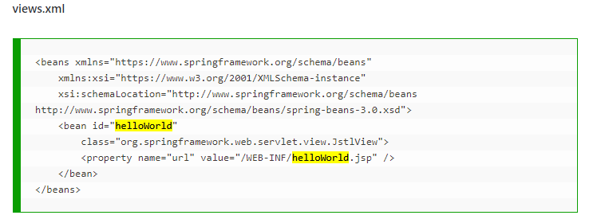
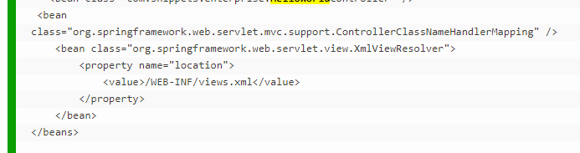

Slide 7



Slide 8
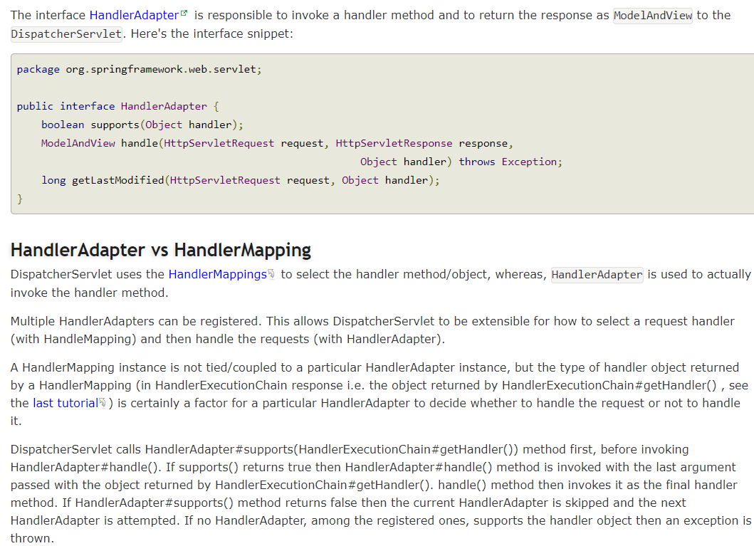
http://localhost:8080/springmvc/students/getAllStudents

Slide 9
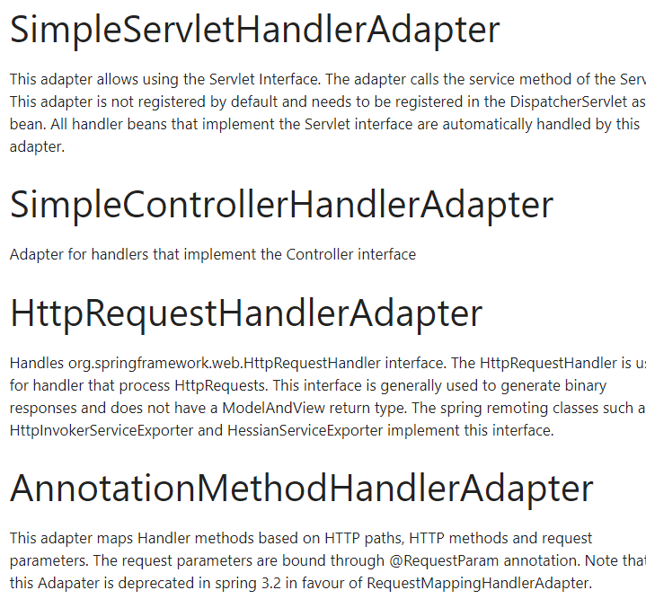
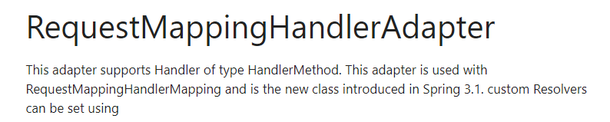
https://www.studytrails.com/2016/09/15/spring-mvc-handler-adapter/

Slide 10
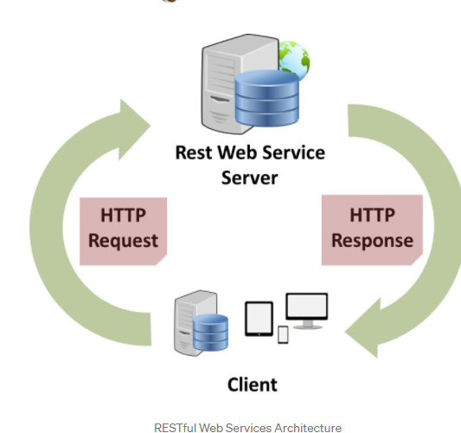
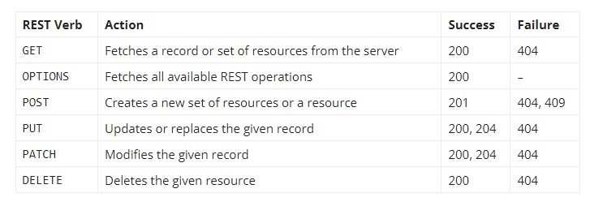
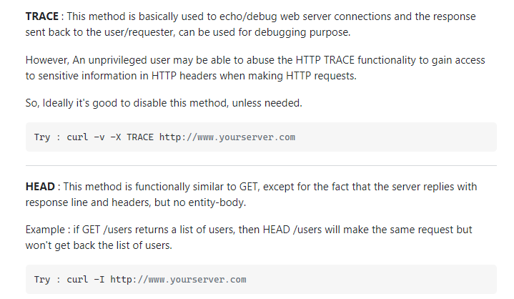
https://medium.com/@sagar.mane006/understanding-rest-representational-state-transfer-85256b9424aa
https://hub.packtpub.com/what-are-rest-verbs-and-status-codes-tutorial/

Slide 11
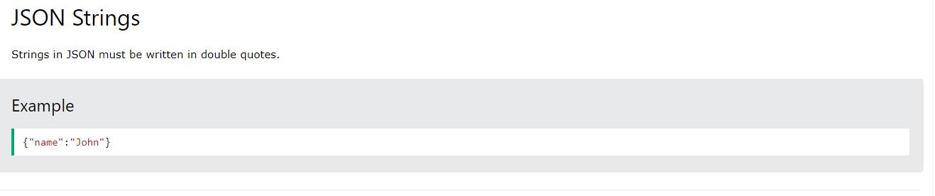
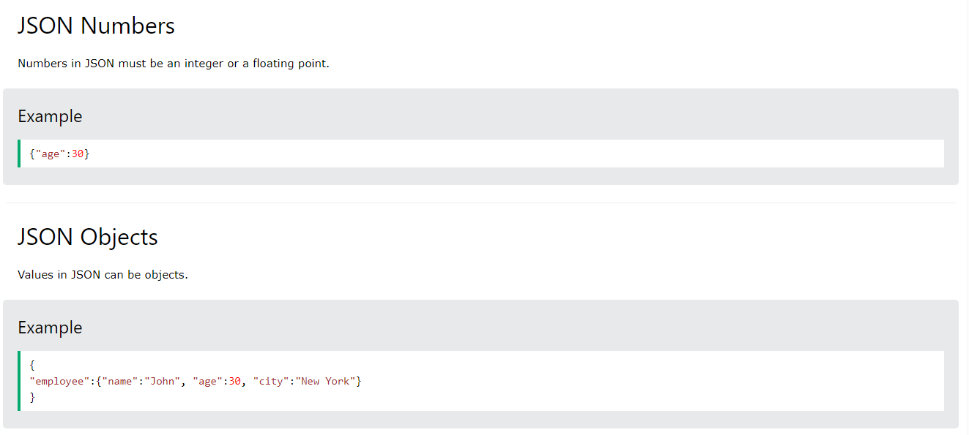
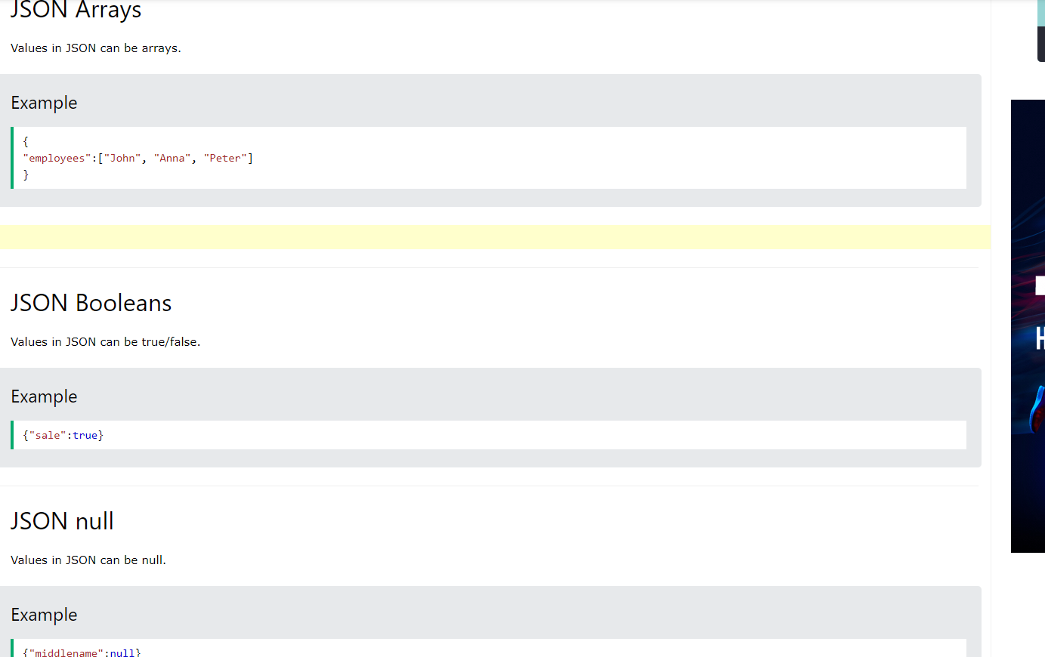

Slide 12
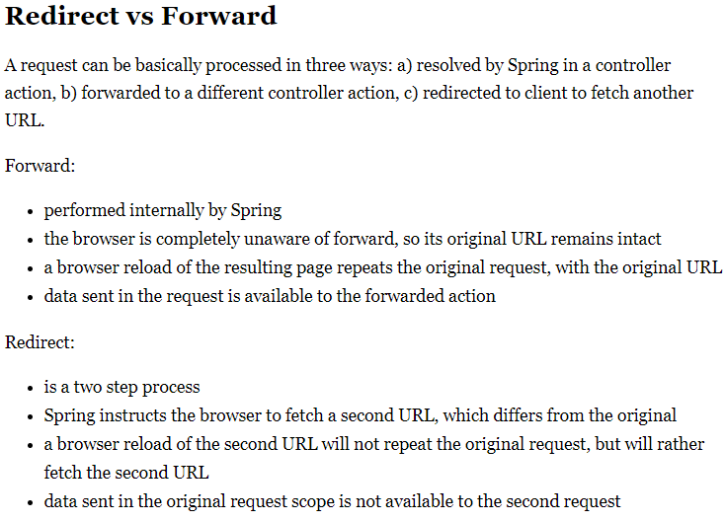
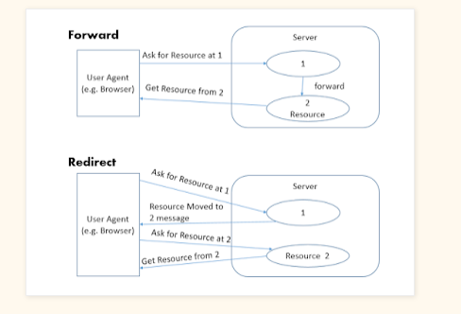
return "redirect:finalPage";
return "forward:/newpage";

Slide 14
CheckLogin()
Service method call check login returns either true /false
//Return “somepage”
If(true)
forward:”showdashboard”
Else
forward: “showerror”
Controller function Showdashboard() -> dashboard
showerror()-> error
3. Create two jsp files
dashboard.jsp
error.jsp

Slide 15
SPA->Single page application
react + spring = SPA
Facebook feed
POSTS
Advertisement
Friend Suggestion
Group Suggestion

Slide 16
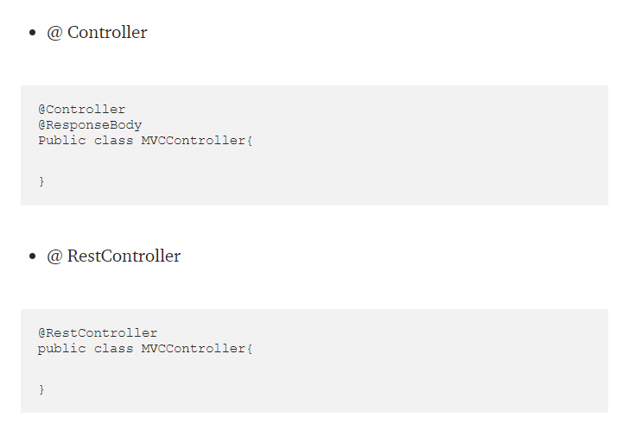

Slide 17
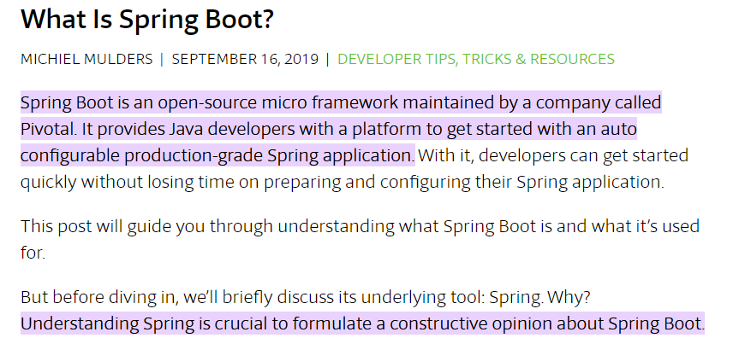

Slide 18
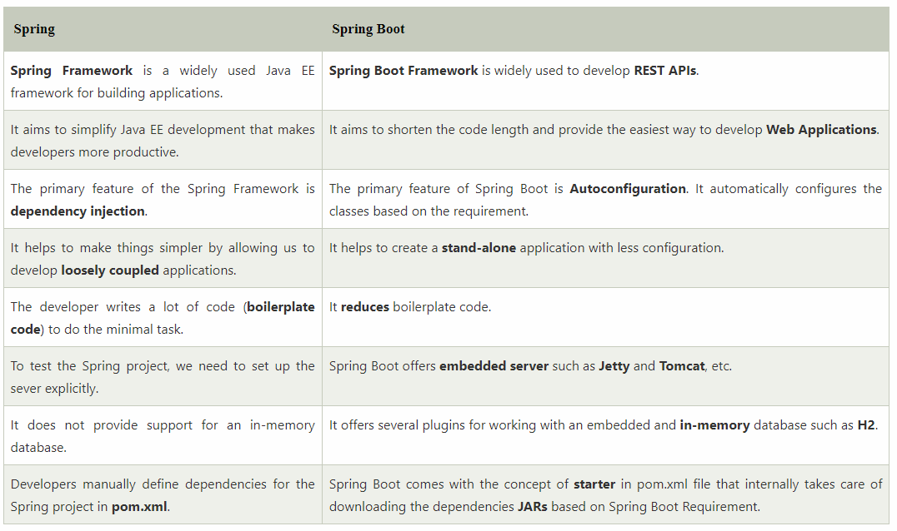

Slide 19
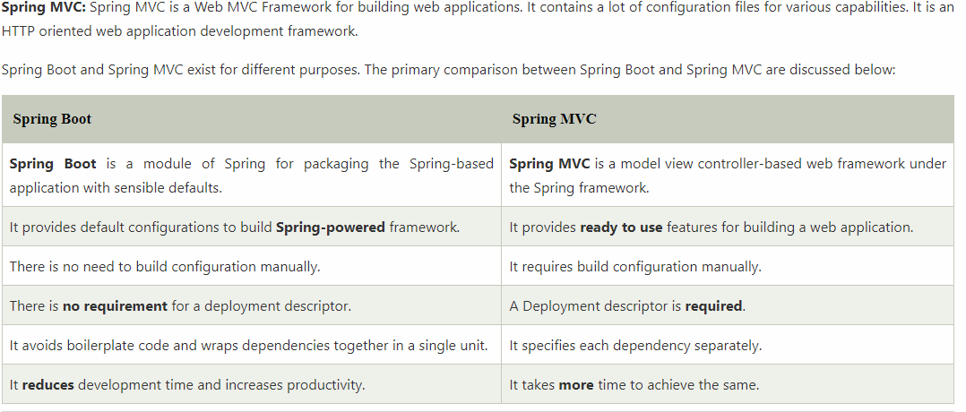

Slide 20
user
Load Balancer
U3
U2
getUserName (U1)
U1
session
session
session
S1
S2
S3
Sticky session

Slide 21
user
Load Balancer
getUserName
U3
U1
getUserDetail (U1)
S1
S2
S3

Slide 22
www.amazon.in
Approach-1
Central part
Home – spring MVC
getAllProductData
{
1. calls service to get model
2. Model and View will be returned
}
Part -1 -Laptop
Part -1 -Mobile
Load the skeleton page
Approach-2
Home – spring MVC
getLandingPage
{
call service
Get homepage image
Model and View
}
getLaptopData
getMobileData

Slide 23
1. MVC internal architecture – Dispatcher servlet ->Handler Mapping, Handler Adapter, View Resolver.
2. SPA
3. Forward and Redirect
4. Session ,Sticky session, Load balancer
5. REST API + verbs (GET,PUT,POST,DELETE,OPTION,HEAD,PATCH)
6. JSON
7. POSTMAN
8. Jackson databinder -> converts json string to java classes

