Slide 1
Data Science Project Cycle
Bijay Adhikari

Slide 2
Business Understanding & Problem Definition:
Uncertain weather disturbs people monotonous life but mostly damage the agricultural goods and products.
Having better weather prediction system would have foretell and save from damaging the products
Project Aim: To build a weather prediction system based on provided data

Slide 3
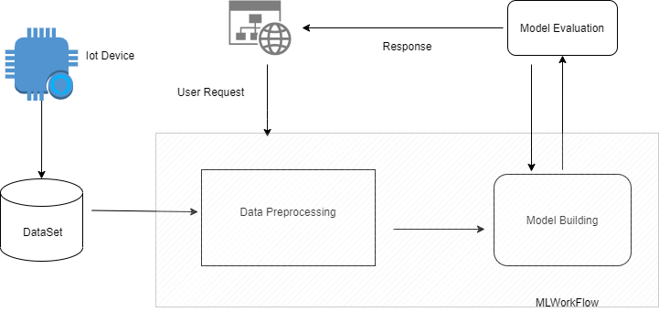
Project WorKFlow

Slide 4
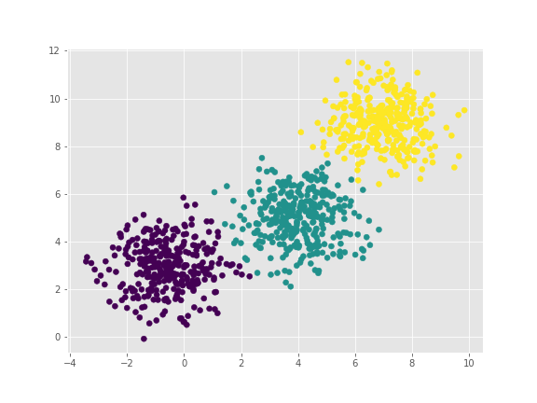
Data Acquisition
The Data is collected from IOT Sensors
installed at 3 major cities .
The collected data has temperature and humidity
information
Data exploration and data cleaning to extract
meaningful insights from the data.
Fig: Different color for different cities

Slide 5

Model Building
Building of model
Model Evaluation
Model Tuning

Slide 6
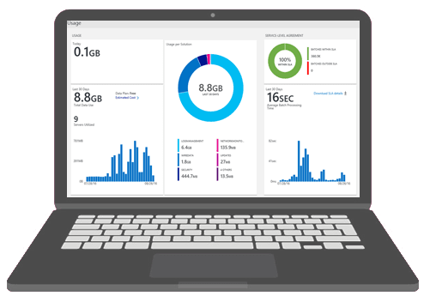
Deployment and Evaluation
Understanding the model behaviour in real scenario
Scalable and Flexibility
Customer Acceptance

Slide 7
Project Scope
1 week
1 month
2 weeks
1 weeks
Business Understanding
Data Acquisition and understanding
Model Building
Deployment and Evaluation
Project Problem Description
Usefulness in current scenario
Data Cleaning, EDA, feature engineering
Best fitter optimized model
Model Evaluation
Model Tuning
Deployment
Margin of customer acceptance
Scalable and flexibility

Slide 8
Thank You !!!

