Slide 1
FRAS
attendance by recognition
FACE RECOGNITION ATTENDANCE SYSTEM
01
ENROL A FACE
A Java-based attendance management platform with face recognition, user management, academic setup and reporting.
02
OPEN A SESSION
03
TAKE THE REGISTER
Project Presentation
Bijay Ayer · Sandeep Tamang · Gaurav · Pratik
2026

Slide 2
01 · CONTEXT
02
Why FRAS?
The system addresses the practical problems of manual attendance.
Manual effort
Human error
Weak traceability
PROBLEM 01
PROBLEM 02
PROBLEM 03
Taking attendance name-by-name consumes class time and creates repetitive administrative work.
Paper or manually entered records can contain omissions, duplicates and incorrect entries.
Scattered records make attendance history, reporting and later verification harder.
FRAS · Face Recognition Attendance System

Slide 3
02 · GOAL
03
Project objectives
What the project is designed to achieve.
01
Automate attendance
02
Recognize students
03
Manage records
Reduce repetitive manual attendance work.
Identify registered students through the camera.
Keep students, teachers and academic data organized.
04
Secure access
05
Generate reports
06
Improve usability
Use accounts, roles and authenticated requests.
Export attendance information for later use.
Provide one desktop interface for the workflow.
FRAS · Face Recognition Attendance System

Slide 4
03 · SOLUTION
04
Proposed system
A single workflow from enrollment to attendance and reporting.
01
02
03
04
05
06
Enroll
Open session
Recognize
Record
Review
Export
Register student + face template
Start the classroom camera
Detect and match registered faces
Create the attendance entry
Read register and history
Generate PDF / Excel output
Camera → Face Recognition → Student → Attendance → Database → Reports
FRAS · Face Recognition Attendance System

Slide 5
04 · STACK
05
Technology stack
Technologies visible in the project structure and documented implementation.
Java
JavaFX
Spring Boot
OpenCV
Core application language
Desktop user interface
REST backend / application services
Camera + face processing
Hibernate / JPA
Maven
JWT
H2 / SQL database
Persistence / ORM
Build and dependency management
Authentication and authorization
Application data persistence
FRAS · Face Recognition Attendance System

Slide 6
05 · ARCHITECTURE
06
System architecture
The desktop client communicates with a secured backend and persistent data layer.
JAVA FX CLIENT
SPRING BOOT API
DATA LAYER
• Login & roles
HTTP / REST
• JWT security
JPA / SQL
• Students / teachers
• Student / teacher UI
• REST controllers
• Academic entities
• Live camera session
• Business services
• Attendance records
• Attendance & reports
• Access policies
• Face enrollment data
FRAS · Face Recognition Attendance System

Slide 7
06 · ROLES
07
Who uses the system?
Access is organized around the responsibilities of each user.
ADMIN
TEACHER
STUDENT
System management
Classroom workflow
Personal attendance
• Manage accounts
• Open attendance sessions
• Access permitted student data
• Manage students / teachers
• Use live recognition
• View own attendance
• Configure academic structure
• Review attendance
• No administrative controls
• Administrative controls
• Export reports
FRAS · Face Recognition Attendance System

Slide 8
07 · FACE PIPELINE
08
Face enrollment & recognition
The recognition workflow is separate from the attendance record itself.
Camera frame
Face detection
Face crop
Face representation
Similarity check
Student ID
CAPTURE
LOCATE
PREPARE
ENCODE
MATCH
IDENTIFY
Recognition result
Known face → identify student → attendance can be recorded
Unknown face → no student match → do not attribute attendance
FRAS · Face Recognition Attendance System

Slide 9
08 · ATTENDANCE
09
Attendance workflow
A clear separation between recognition and recording keeps the process auditable.
1
Teacher signs in
2
Select / open session
3
Camera scans classroom
4
Recognize registered face
5
Record attendance
6
Review register
FRAS · Face Recognition Attendance System

Slide 10
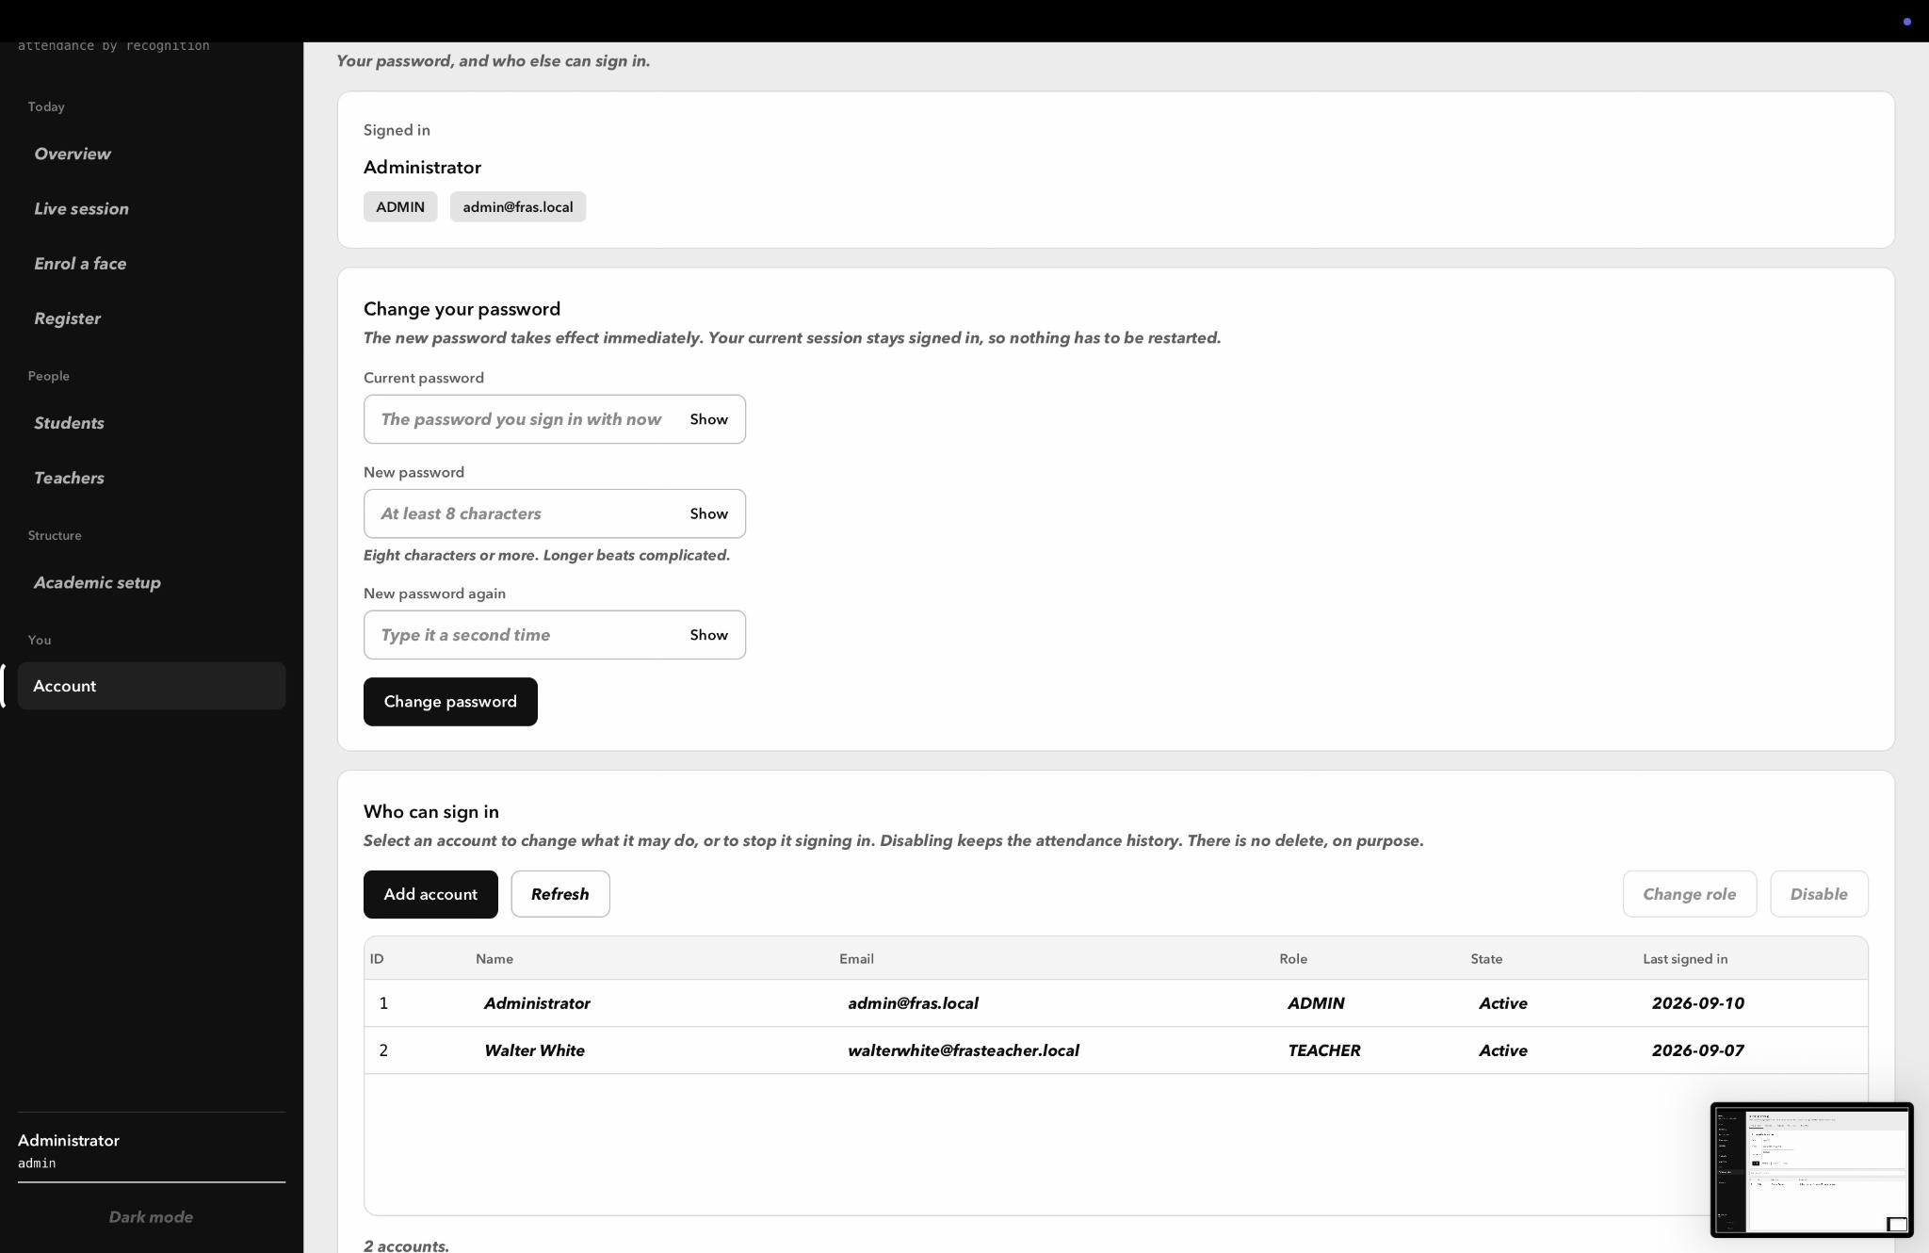
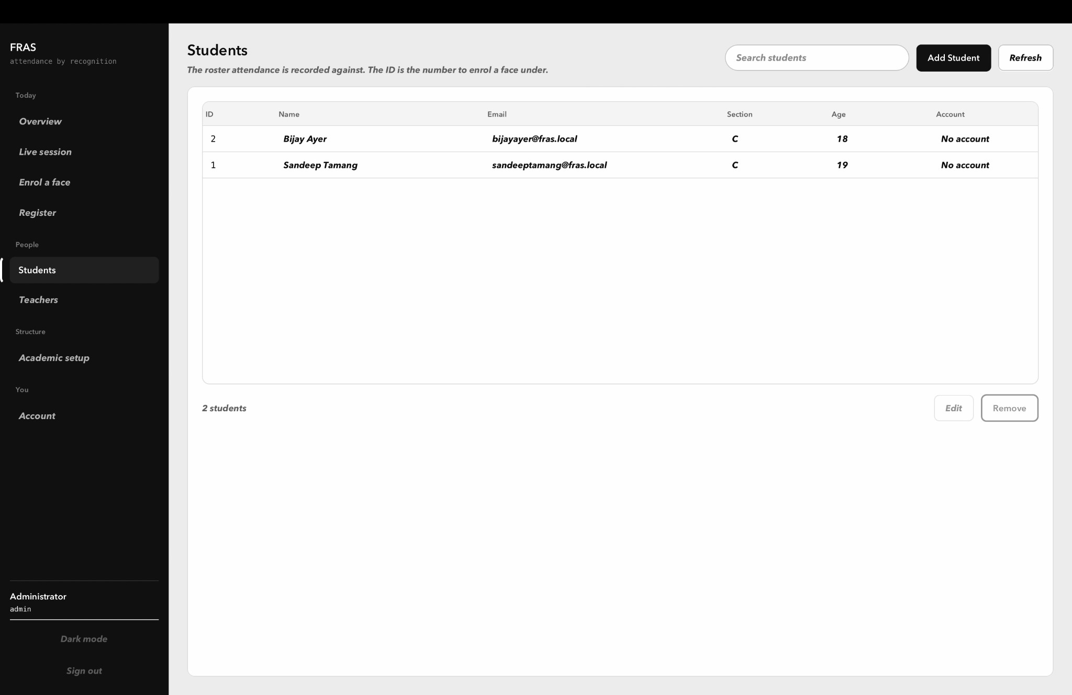
09 · UI
10
Application interface
The UI follows a restrained monochrome design so hierarchy comes from spacing, weight and structure.
LOGIN
STUDENT ROSTER
FRAS · Face Recognition Attendance System

Slide 11
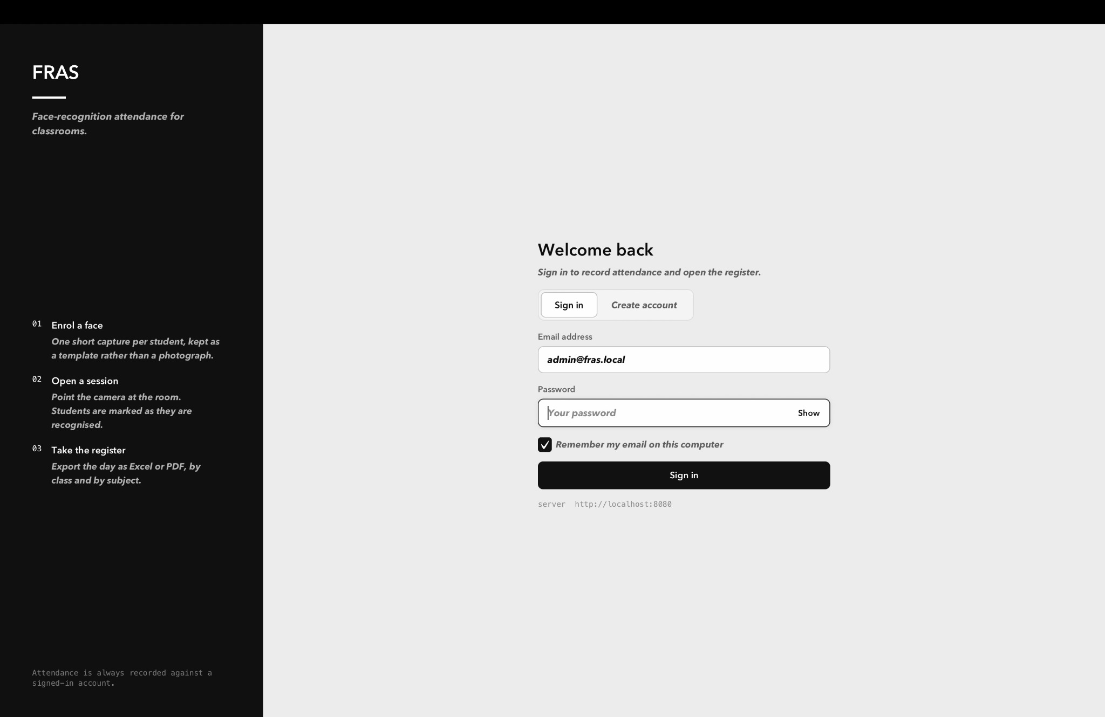
10 · MANAGEMENT
11
Student, teacher & account management
Administrative screens support the roster and account lifecycle around attendance.
Students
Roster fields include ID, name, email, section, age and account state.
Accounts
Role-aware account controls and password management.
FRAS · Face Recognition Attendance System

Slide 12
11 · DATA
12
Database & domain structure
The system connects people, academic structure and attendance records.
Department
Student
Semester
Attendance
Timetable
Subject
Teacher
Classroom
Conceptual view — exact relationships are implemented through the project's entity/repository layer.
FRAS · Face Recognition Attendance System

Slide 13
12 · SECURITY
13
Authentication & access control
Security is part of the application boundary, not only a UI feature.
Authentication
JWT-based sign-in keeps protected API requests tied to an authenticated account.
Authorization
Role and ownership checks control which records an account can access.
Registration
Privileged roles require server-side approval through a registration code.
Data protection
Attendance access is checked against the requested student rather than trusting the URL alone.
FRAS · Face Recognition Attendance System

Slide 14
13 · REPORTING
14
Attendance register & exports
The register is designed to be readable by people, not just by the database.
Readable register
Complete session output
Portable records
REGISTER
PDF / EXCEL
OUTPUT
Student, subject and classroom are resolved into meaningful names rather than raw database IDs.
Exports represent students in the roster, including students who were not marked present.
PDF and Excel outputs make attendance easier to share, print and archive.
FRAS · Face Recognition Attendance System

Slide 15
14 · VERIFICATION
15
Testing & quality checks
The repository documents integration tests and structural checks around critical behavior.
52
146
5
37
integration tests
Java sources
FXML files
stylesheet values
Across six test suites
Structural checks applied
Parsing + controller binding checked
Confirmed as grayscale
Important limitation: source-level / structural verification is not the same as a successful build or real-world accuracy benchmark.
FRAS · Face Recognition Attendance System

Slide 16
15 · ENGINEERING
16
Key problems solved
The project evolved through debugging beyond the basic feature implementation.
Security boundary
Restricted attendance access to the correct student/account.
Role escalation
Stopped public registration from creating privileged accounts.
Data integrity
Added protections around deletes and stale database constraints.
Concurrency
Moved timetable overlap enforcement to the backend.
Camera stability
Prevented native camera lifetime races that could crash the JVM.
Resource use
Reduced face-pipeline/native-resource leaks and repeated model loading.
FRAS · Face Recognition Attendance System

Slide 17
16 · REALITY CHECK
17
Limitations & future enhancements
A good project presentation should clearly distinguish current capability from future scope.
CURRENT LIMITATIONS
FUTURE ENHANCEMENTS
• Recognition can be affected by lighting and camera quality.
• Face angle and registration quality can affect matching.
• Desktop deployment requires the backend and JavaFX client workflow.
• No claim of 100% recognition accuracy without a controlled benchmark.
• Liveness / anti-spoofing support.
• Better performance under difficult lighting and angles.
• Multi-camera and multi-classroom deployment.
• Web/mobile administration and centralized deployment.
• Attendance analytics and notifications.
FRAS · Face Recognition Attendance System

Slide 18
FRAS
From manual attendance to recognition-assisted records.
LIVE SESSION
Camera
Face detected
A Java-based system combining face recognition, classroom management, authentication, attendance tracking and reporting.
Student matched
Attendance recorded
THANK YOU
Questions & Live Demonstration

