Slide 1

EpiDeep: Exploiting Embeddings for Epidemic Forecasting
Bijaya Adhikari, Xinfeng Xu,
Naren Ramakrishnan, B. Aditya Prakash
Department of Computer Science
Virginia Tech
SIGKDD. Anchorage, Alaska August 6th, 2019

Slide 2
Outline
Motivation
Problem Statements
Our Approach
Experiments
Conclusion

Slide 3


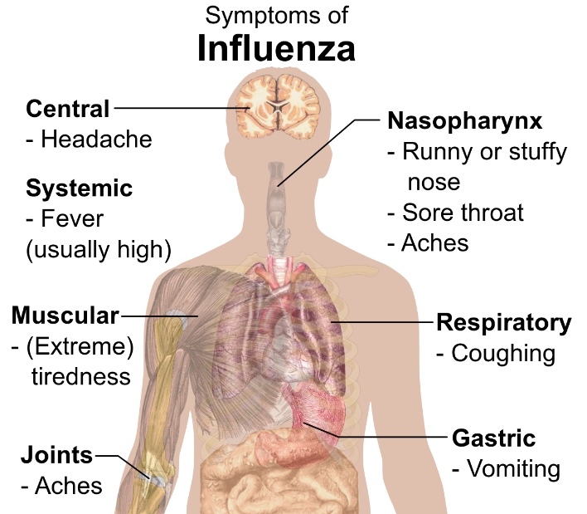
Influenza
Influenza (aka flu) is a contagious respiratory illness
Centers for Disease Control and Prevention (CDC) lists influenza symptoms as:
  Fever* or feeling feverish/chills
  Cough
  Sore throat
  Runny or stuffy nose
  Muscle or body aches
  Headaches
  …

Slide 4

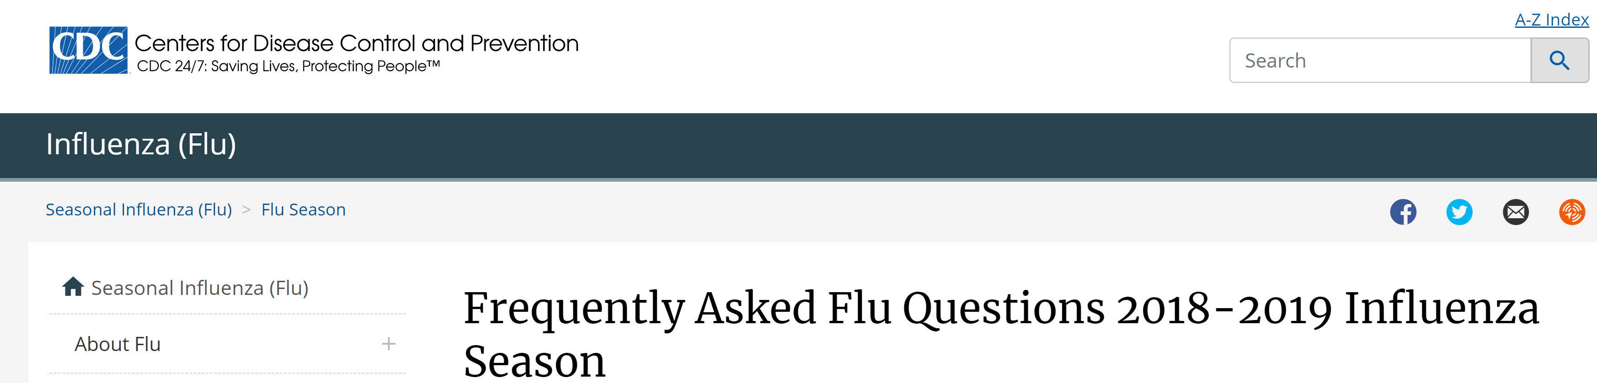
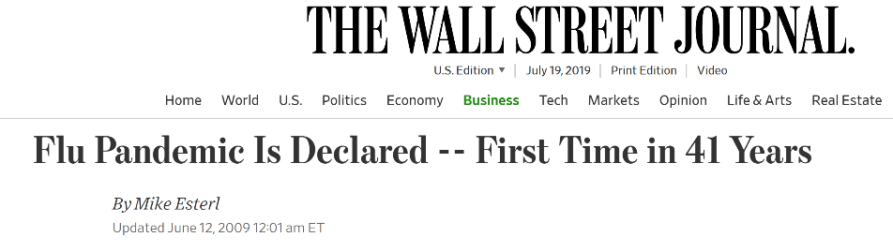
Influenza is a burden
In 2018/19 only in USA
  Deaths: 18k to 31k
  Hospitalizations: 289k to 347k
  Confirmed cases: 22.8m to 26.3 million
  Annual economic impact: $26.8 ~ $87.1 billion dollars
2009-10 H1N1 influenza pandemic (globally)
  Deaths: 151,700 to 575,400
  80% of victims were younger than 65 years of age
https://www.cdc.gov/flu/season/flu-season-2018-2019.htm

Slide 5
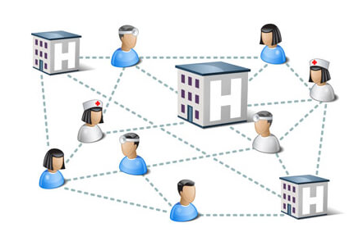
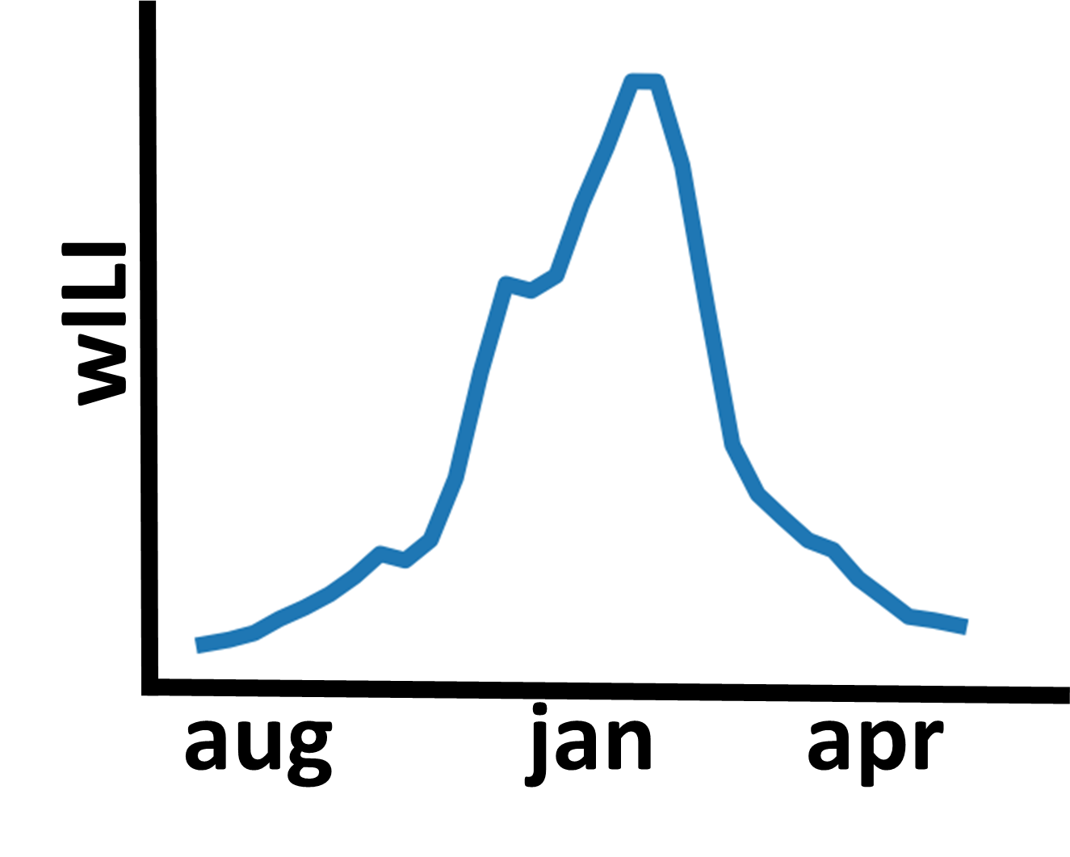
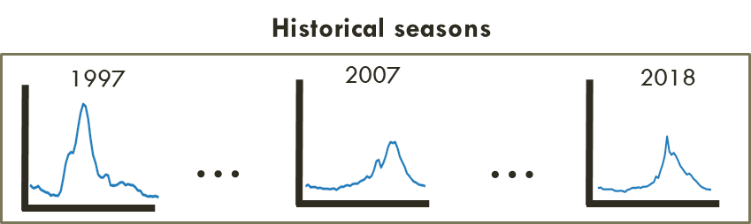
Influenza Surveillance DATA
CDC collects influenza surveillance data
Network of healthcare providers report % of visitors related to Influenza-Like Illness (ILI)
CDC releases the processed weighted Influenza-Like Illness (wILI) counts every week
Historical wILI data publicly available at:
  https://gis.cdc.gov/grasp/fluview/fluportaldashboard.html
ILINet surveillance network
wILI time-series

Slide 6

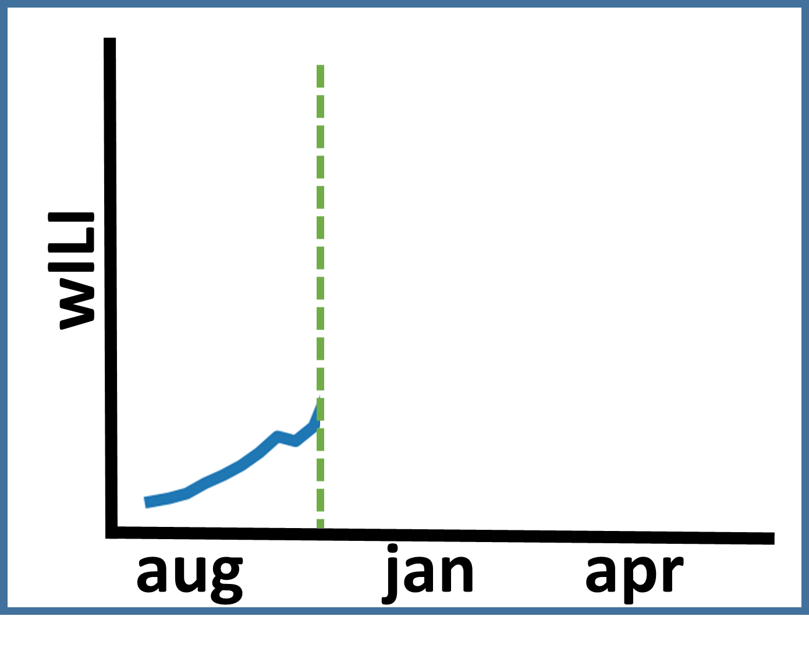
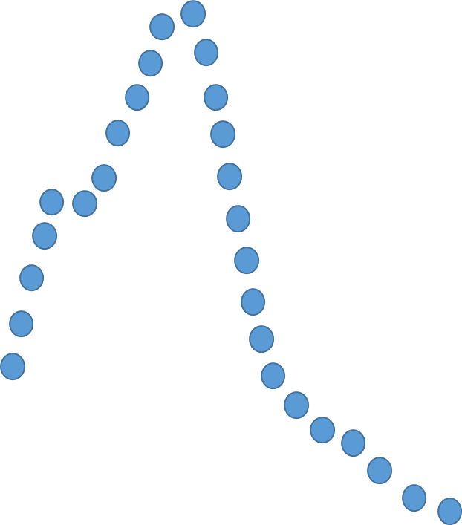
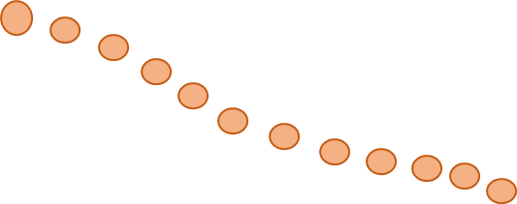

Influenza forecasting
CDC tries to predict various aspects of wILI curve
  How the curve will look like in future?
  When it will peak?
  What is the wILI value at the peak?
Helps policy makers, general public, healthcare providers …
  Decide on allocating vaccines and distribution strategy
  Decide on intervention like school closure, public events cancellations and so on
  Communication
dec 5
?

Slide 7
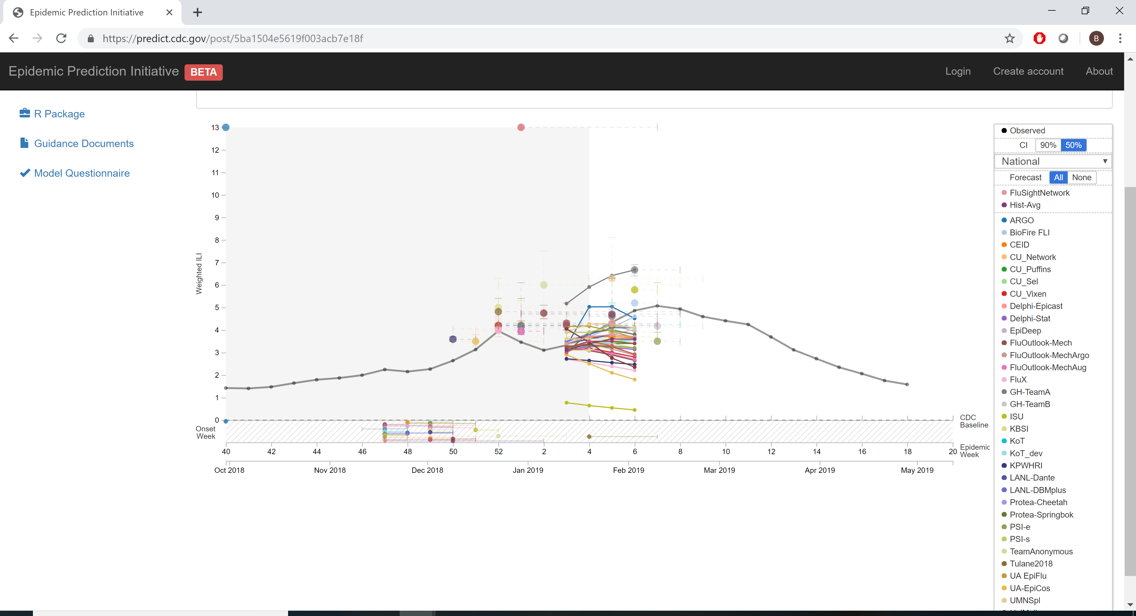
CDC FluSight Challenge
Annual influenza forecasting challenge hosted by CDC
  Encourages research in flu forecasting
  Participated by researchers around the world
CDC Flusight challenge website

Slide 8
Outline
Motivation
Problem Statements
Our Approach
Experiments
Conclusion

Slide 9
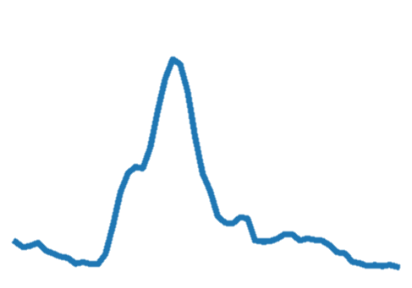
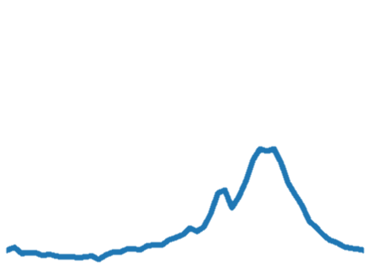
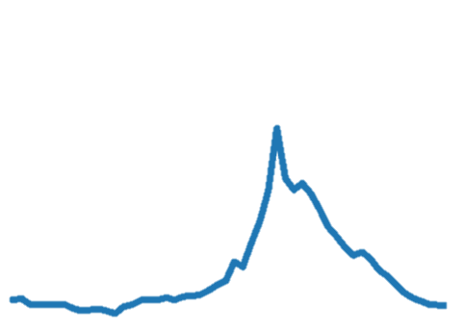
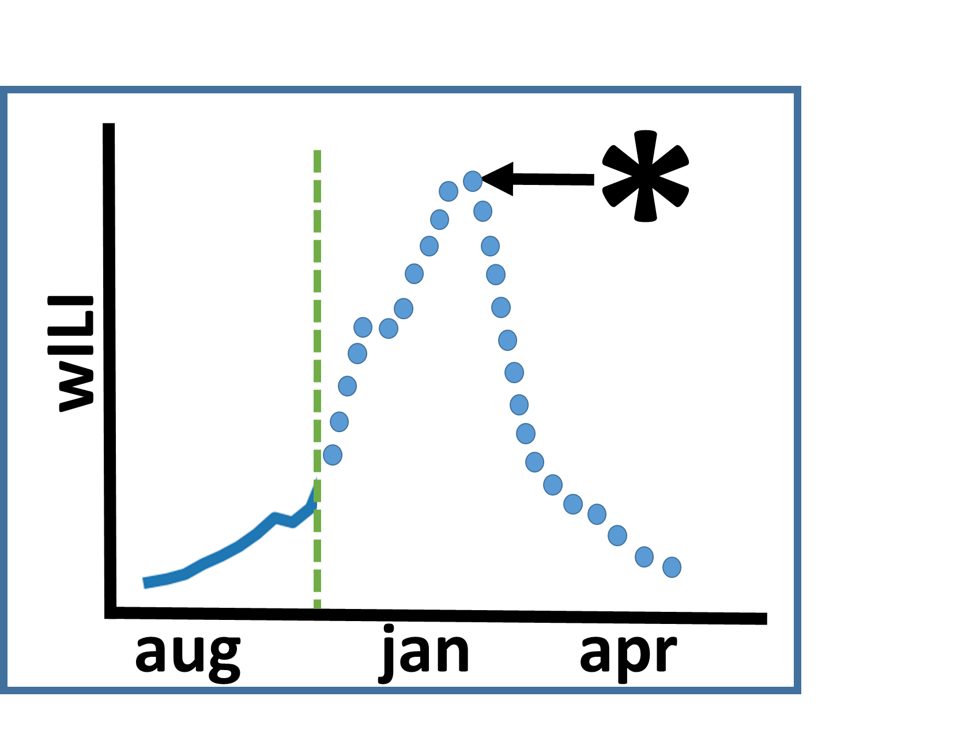
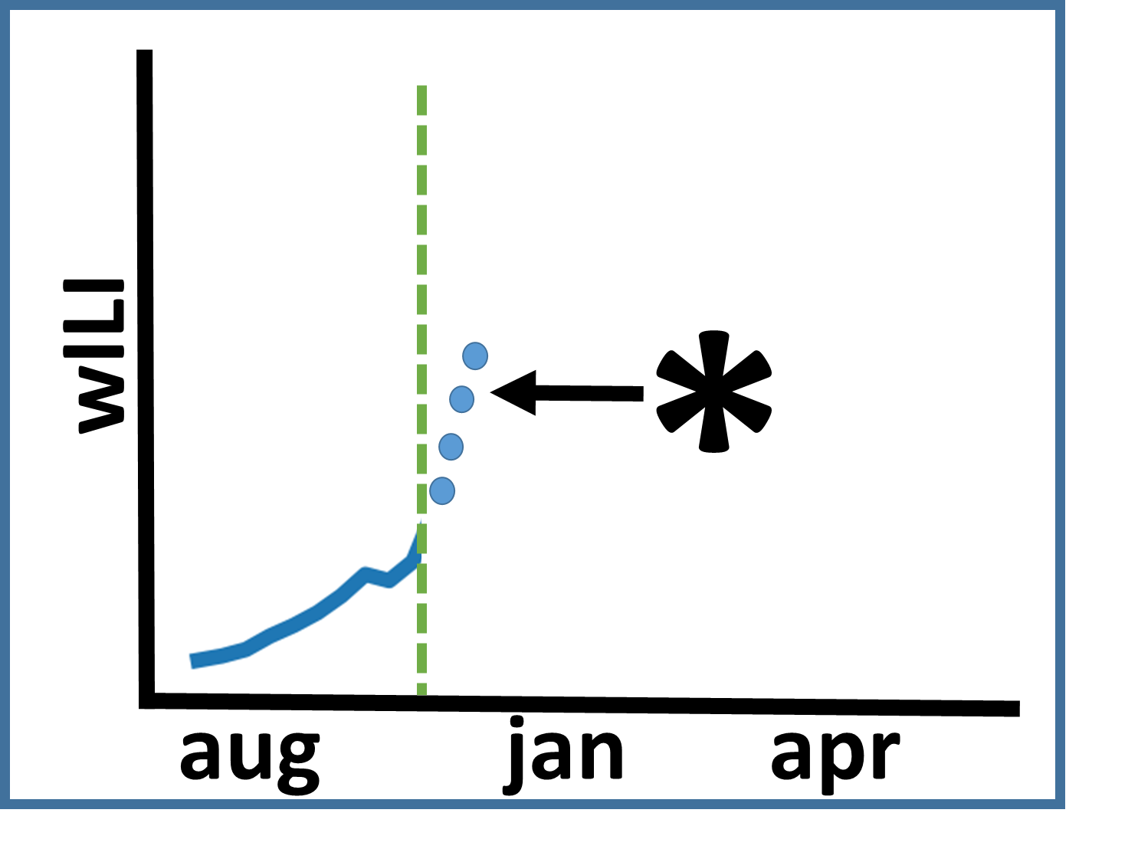
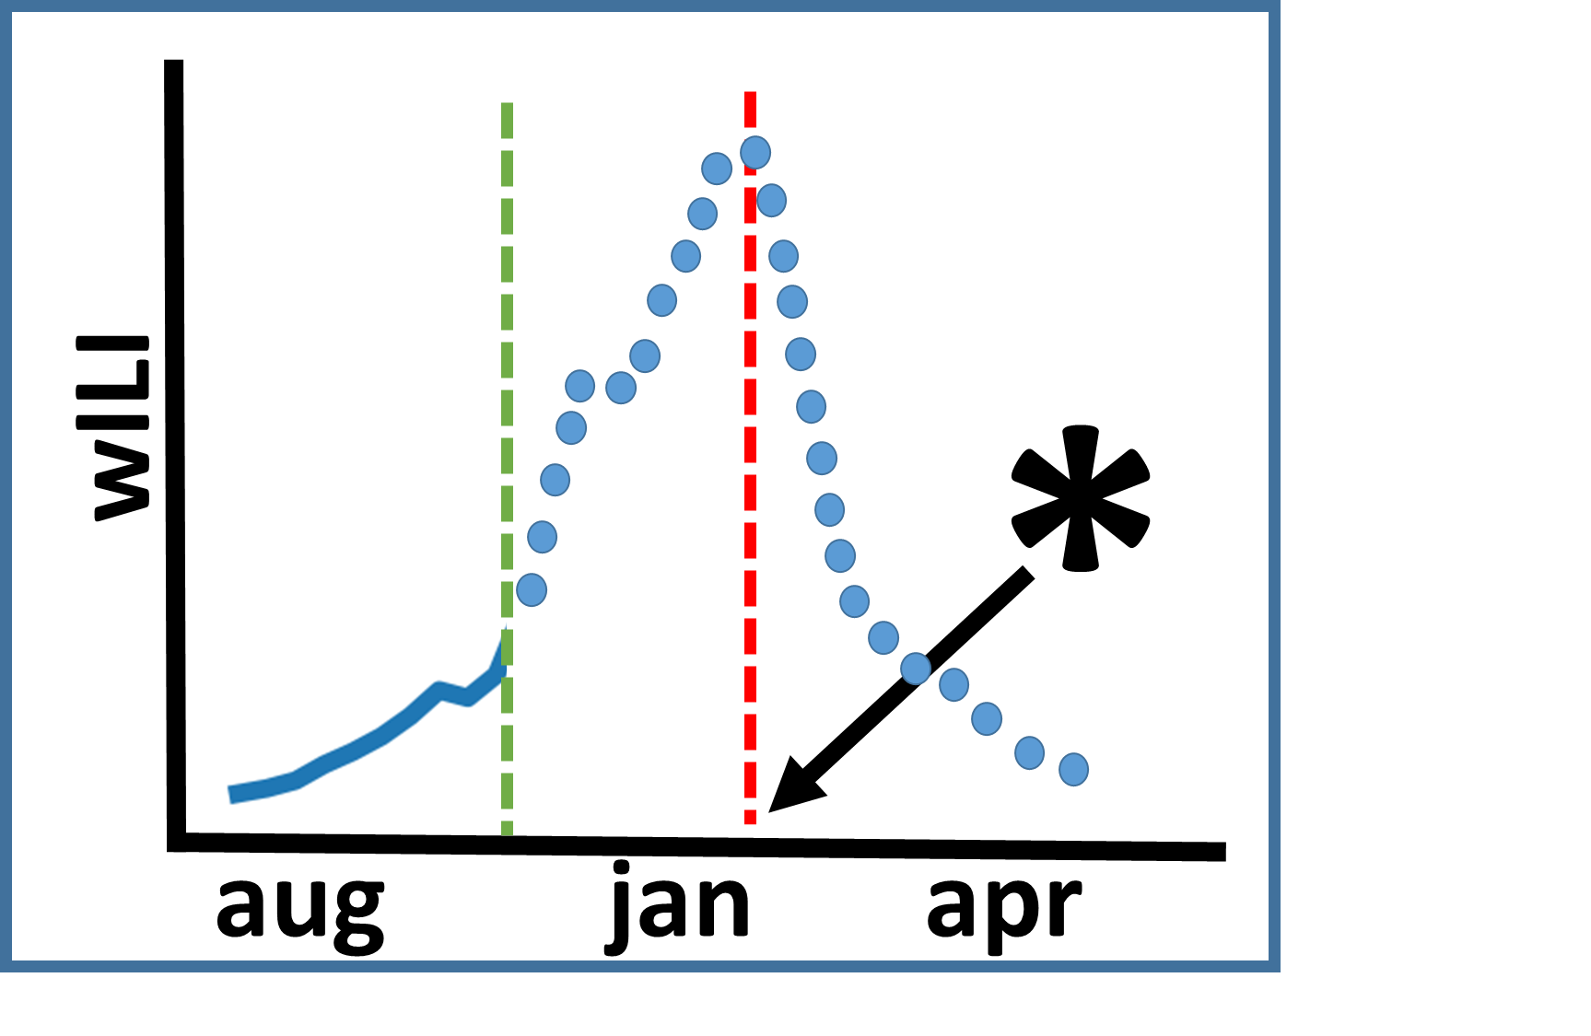
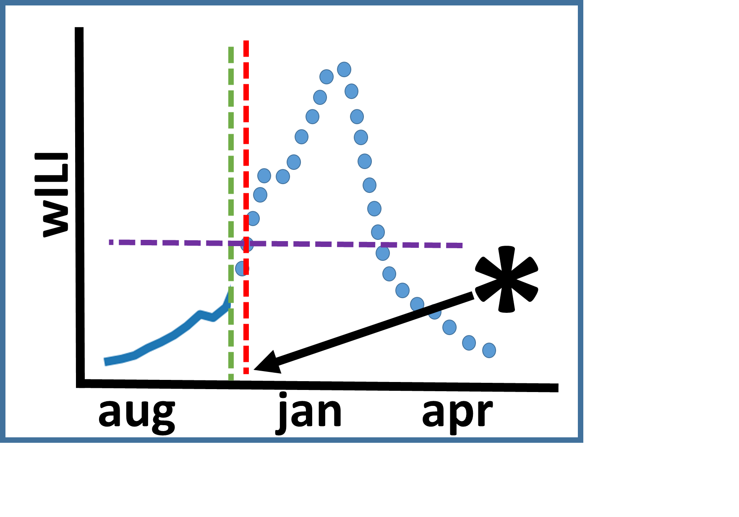
Problem STATEMENTS
Historical seasons
…
…
Given
  Historical seasons
  Partially observed influenza incidence curve till week t.
Predict
  Future incidence for next four observations
  The peak intensity
  The peak time
  The onset
Partially observed season
t
Future incidence
Peak
t
t
Peak time
Onset
Time-series forecasting problem
t
t

Slide 10
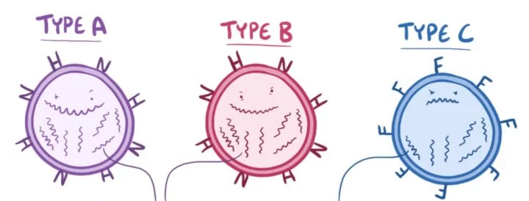
challenges
C1: Influenza seasons tend to vary a lot
  Different virus types
  Human mobility
  Weather
  …
C2: Data sparsity
  wILI curves are available only from 1997
How to overcome these challenges?

Slide 11
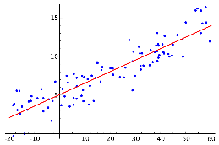
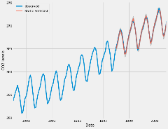
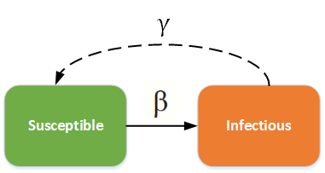
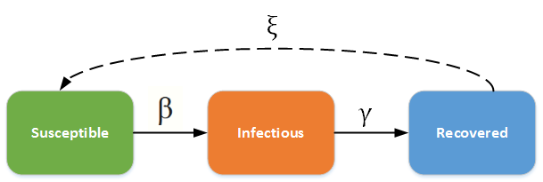
existing Approaches
Background
[Brooks+, PLoS ComBIO 2015, Venna+, IEEE Access 2017]
Statistical methods
  Fit a pre-defined statistical model on historical data
  Drawbacks
      Typically too simple
      Fail to include domain knowledge
      Lack interpretability
Mechanistic methods
  Motivated by domain knowledge and biology of disease model
  Simulation includes various factors like mobility, weather
  Drawbacks
      Require lot of calibration
      Too rigid to generalize well
Regression
ARIMA
[Nsoesie+, Stats. Com in Infectious Diseases 2011;
Zhang+, WWW 2017]
Susceptible-Infected
Susceptible-Infected-Recovered

Slide 12
Outline
Motivation
Problem Statements
Our Approach
Experiments
Conclusion

Slide 13
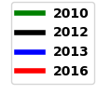
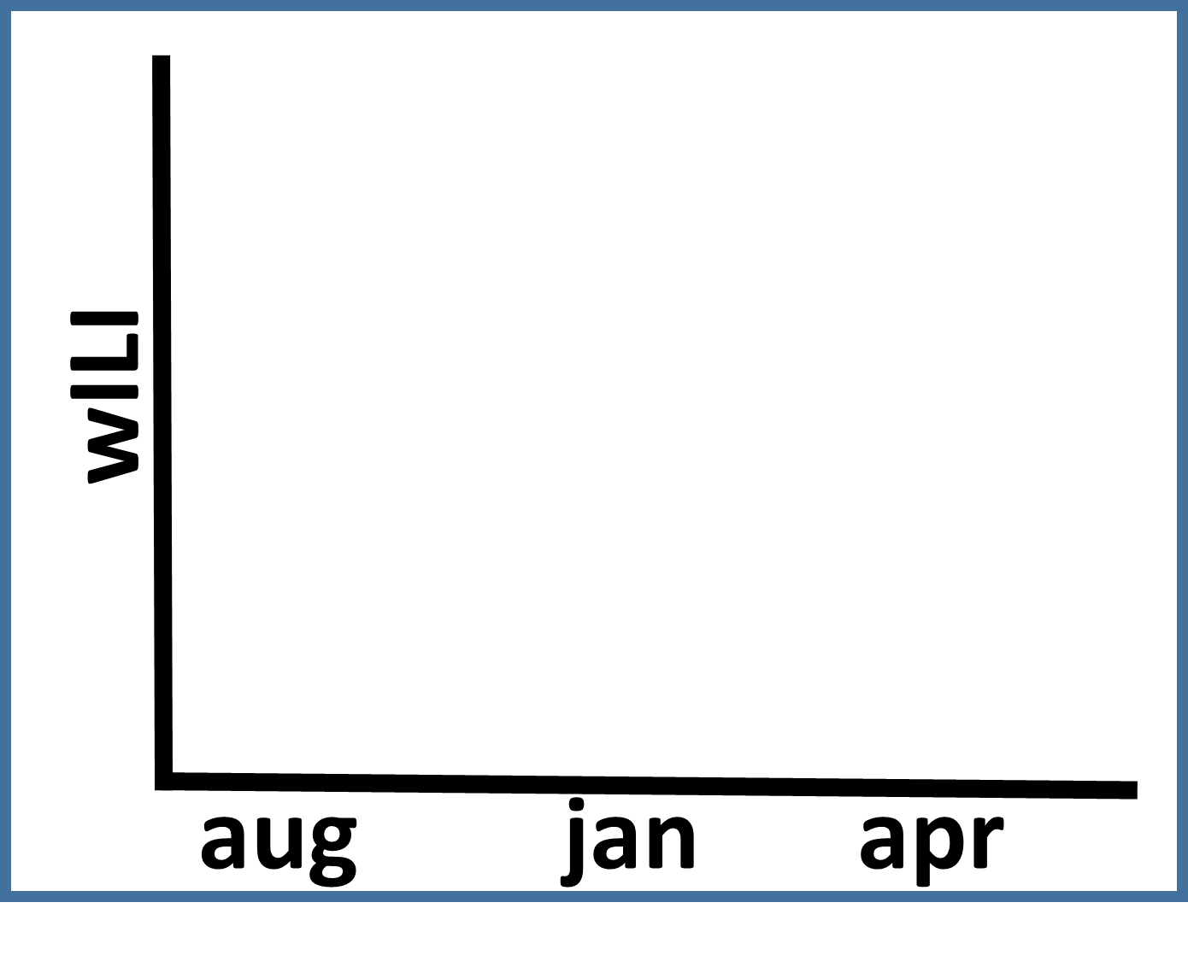
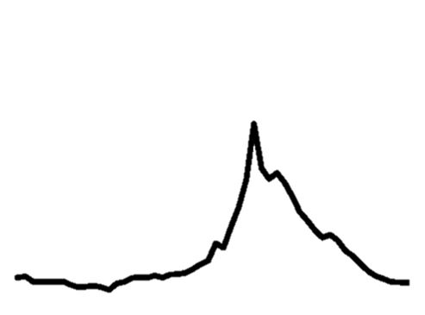
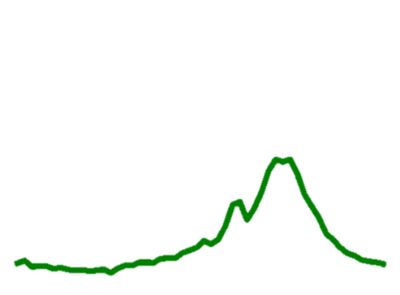
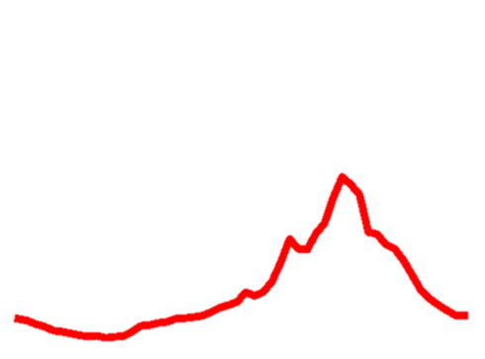
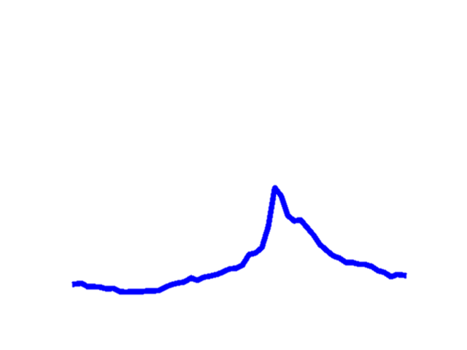
Our Approach: Overview
Our Idea: Dynamic deep clustering for prediction with limited data

Slide 14
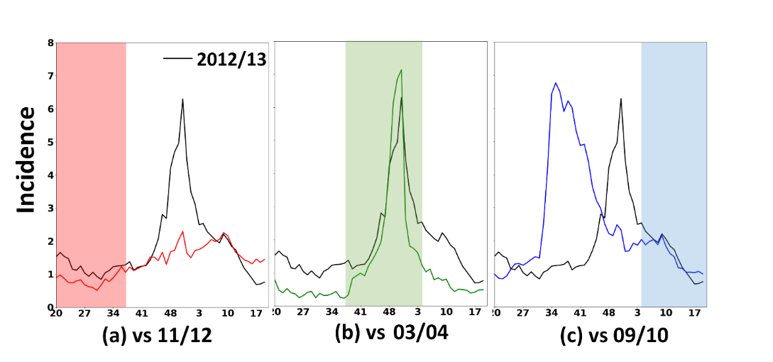
Our Approach: Overview CONTD.
Our Idea: Dynamic deep clustering for prediction with limited data

Slide 15
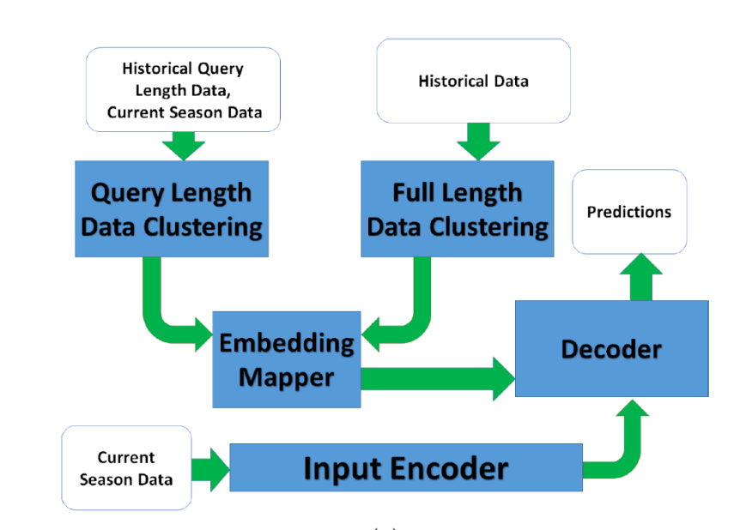
Our Approach: Overview CONTD.
Our Idea: Dynamic deep clustering for prediction with limited data

Slide 16
Our Approach: Overview CONTD.
Our Idea: Dynamic deep clustering for prediction with limited data

Slide 17
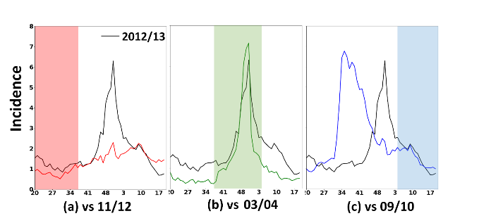
Our Approach: EpiDeep
An end-to-end architecture
Automatically learns meaningful representations of historical incidence curves at the time-of-prediction
Predicts various metrics of interest for partially observed current influenza season
First deep learning approach for influenza forecasting ensuring interpretability as well as accuracy
t
Partially observed
incidence curve

Slide 18

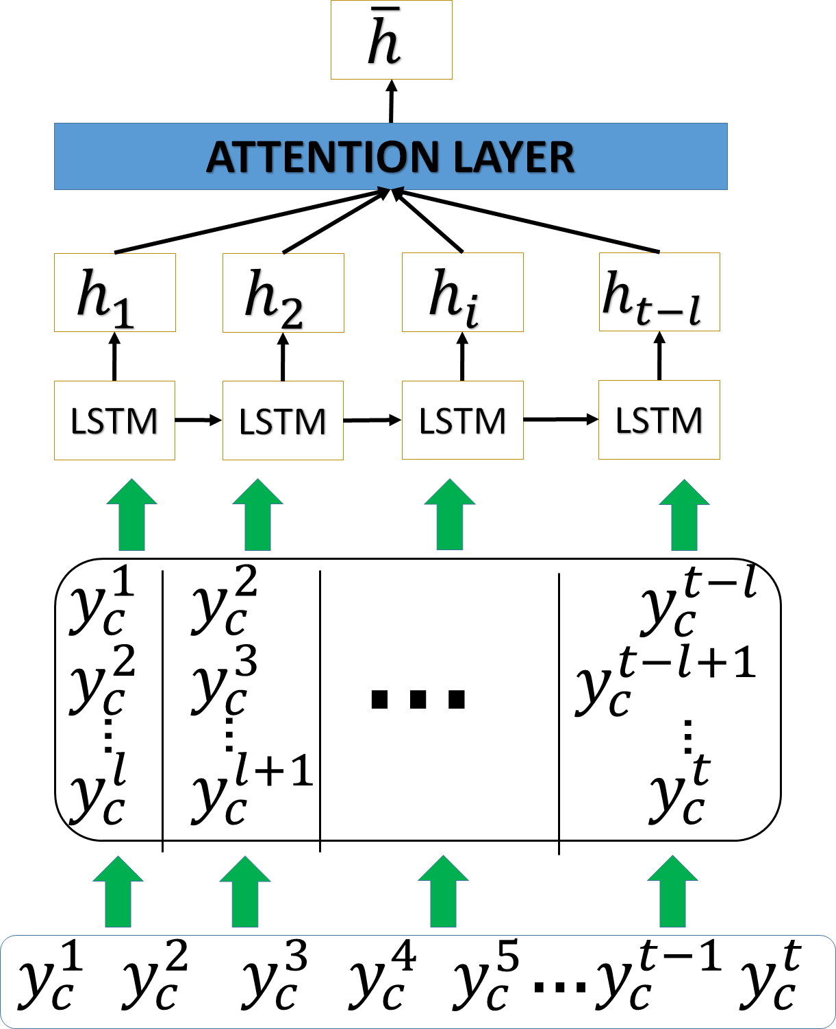
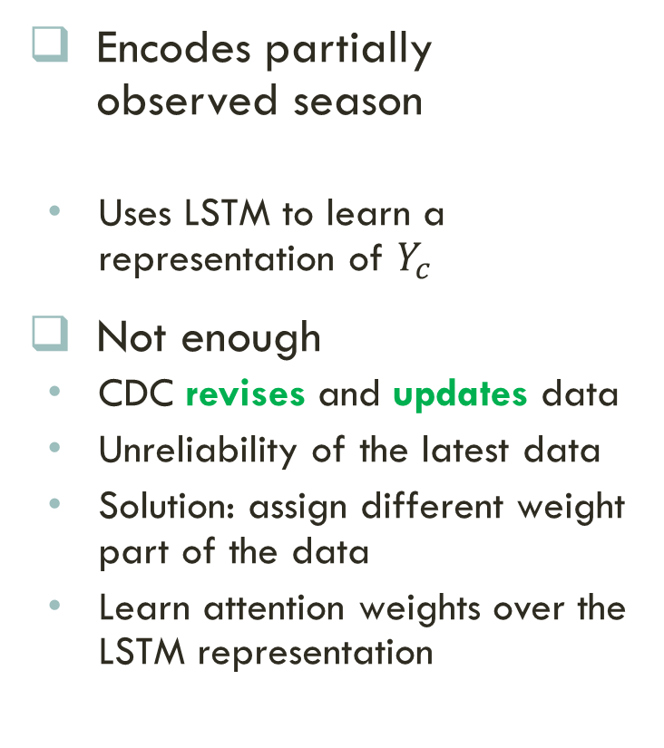
Component 1: The Input EncodeR
Encodes partially observed season
  Uses LSTM to learn a representation of $Y_{c}$
Not enough
  CDC revises and updates data
  Unreliability of the latest data
  Solution: assign different weight part of the data
  Learn attention weights over the LSTM representation

Slide 19
Is It Enough?
Just using LSTM to encode the data is not enough
  Sparse data
  Model easily overfits
  Does not generalize
Training
Testing
Need more information from the data

Slide 20
Our Idea: Embed the historical Seasons
Embed the historical seasons to capture the similarity with the current season
Current season is observed only till week t
Use snippets of historical seasons till week t to learn embedding
Current season
Historical seasons
t
t
t
t

Slide 21
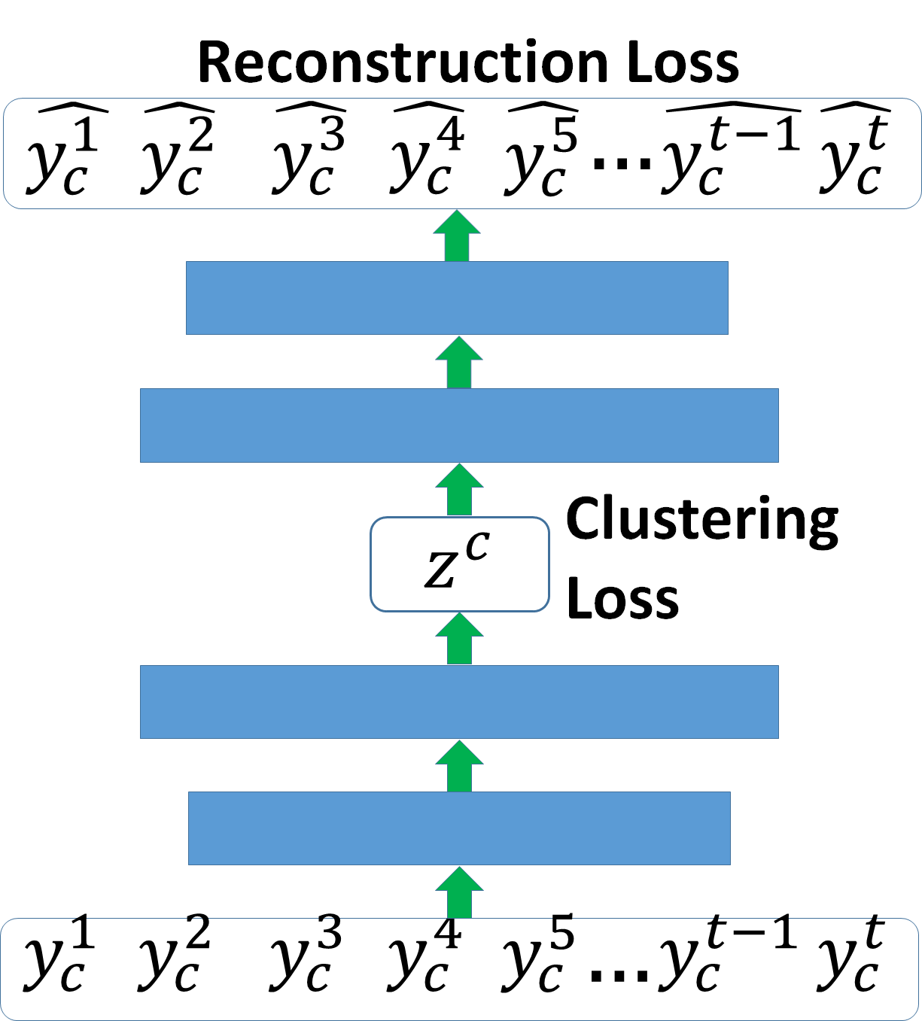
Component 2: Clustering Query Length Data
Learn meaningful embeddings of the historical data till week t
Improved Deep Embedded Clustering [Guo+,2017]
  Auto-encoder with clustering loss
  Minimizes
  where

Slide 22
The embedding Component
Not all data is utilized to learn the embeddings
Want to utilize the entire data
Our Idea
  Embed the full length historical seasons separately
  Learn a mapper between two embedding space
Current seasons
Historical seasons

Slide 23
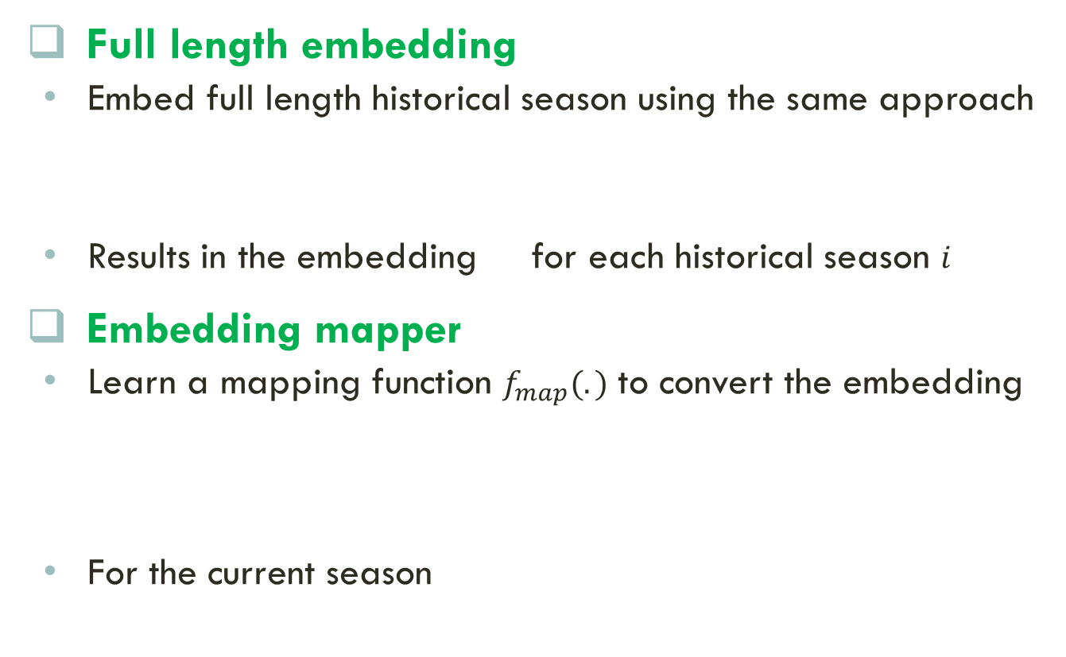
The embedding Component CONTD.
Full length embedding
  Embed full length historical season using the same approach
  Results in the embedding for each historical season $i$
Embedding mapper
  Learn a mapping function $f_{map}(.)$ to convert the embedding
  For the current season
Full length embedding
Feed-forward embedding
Query length embedding

Slide 24

The Decoder
Different architectures for different tasks
Task 1
  Future incidence for next four observations
Task 2
  The peak intensity
Task 3
  The peak time
Task 4
  The onset
Architecture
Loss function
L2
Feed-forward
Similar to above
Cross-Entropy
softmax
Similar to above

Slide 25
Training
The overall objective is
Learning procedure
  Pre-train the clustering components and the embedding mapper
  Jointly train the entire model
We used Adaptive Moment Estimation Optimization (ADAM) algorithm for optimization

Slide 26
Outline
Motivation
Problem Statements
Our Approach
Experiments
Conclusion

Slide 27
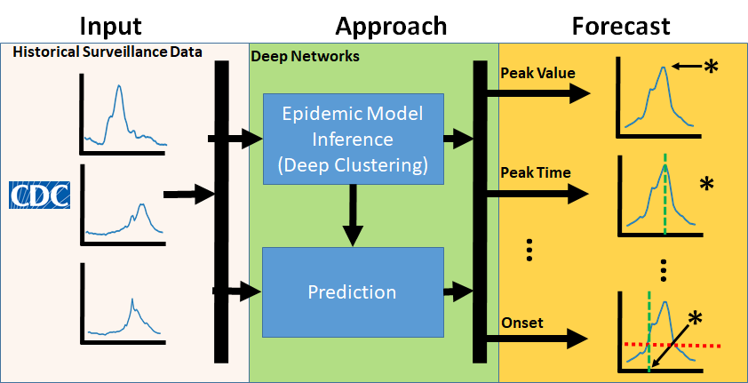
Experiments: Dataset
We use only the publicly available wILI surveillance data released by the CDC
Available for the years 1997-2019
Data available at: https://gis.cdc.gov/grasp/fluview/fluportaldashboard.html

Slide 28
Experiments: Baselines
EB: an empirical bayesian approach. [Brooks+, PLOS ComBio 2015 ]
  published and publicly available version
ARIMA: an auto-regressive method for making predictions on time-series data.
HIST: historical average of all previous seasons.
KNN: selects the top k closest historical seasons to the current season, and make predictions on their average. [Nsoesie+, Stats Com in Infectious Dieases 2011]
LSTM: a version of [Venna+, IEEE Access 2017] without climate and geographical data.

Slide 29
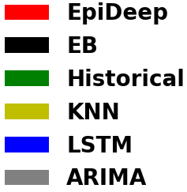
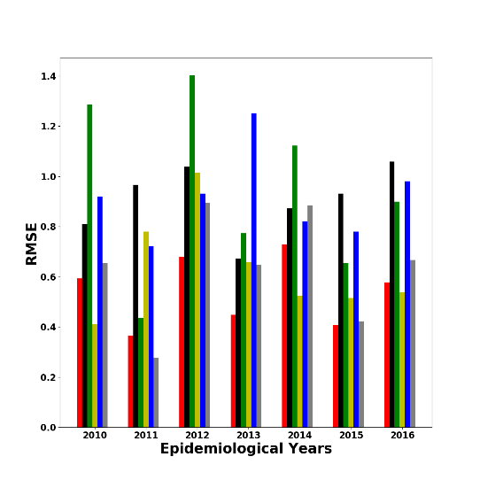
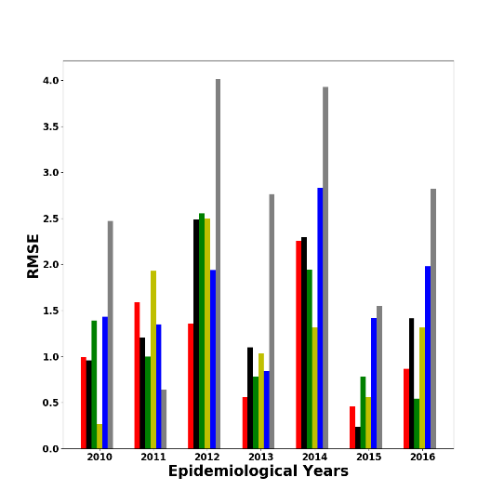
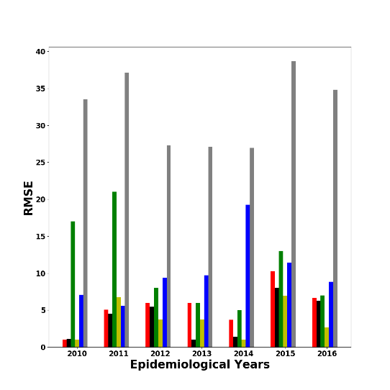
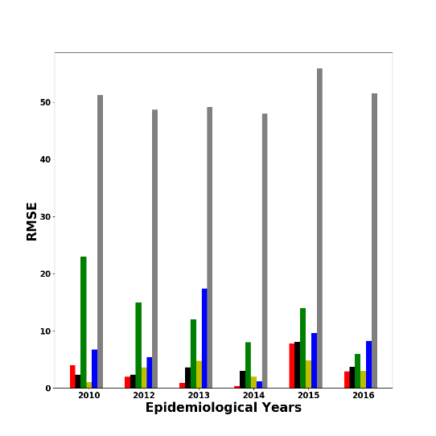
Performance : National Region
More results in the paper
How well does EPIDEEP perform in different tasks for the national region?
Future Incidence
Peak Intensity
Peak Week
Onset
Lower is better
EPIDEEP outperforms baselines in most settings.

Slide 30
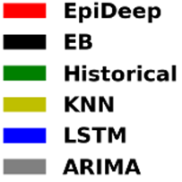
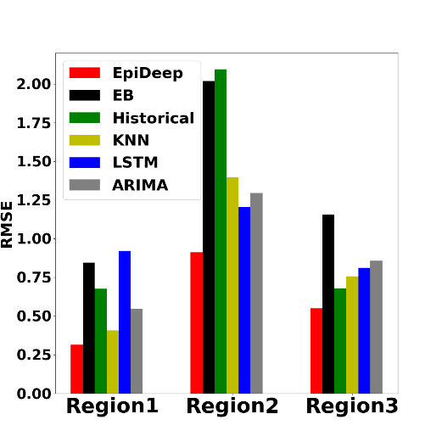
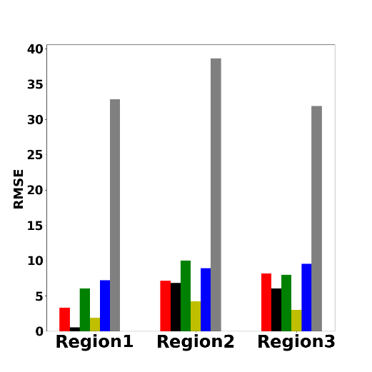
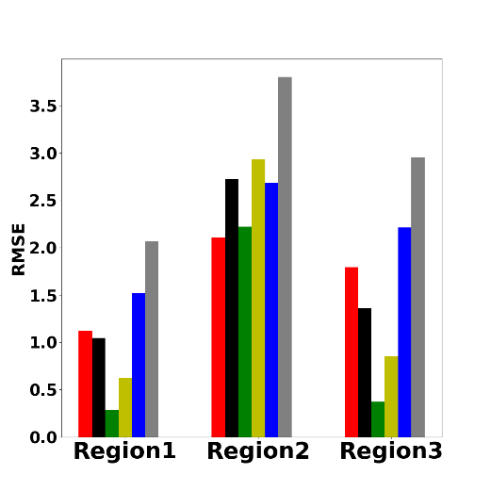
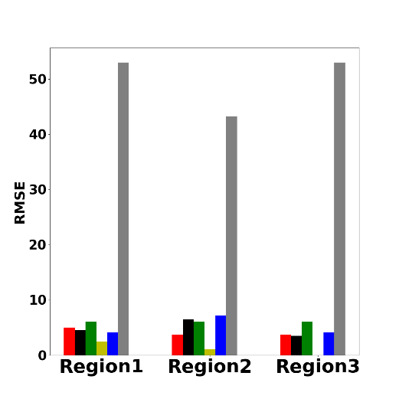
Performance : HHS Regions
More results in the paper
How well does EPIDEEP perform in different tasks for the HHS regions?
Future Incidence
Peak Intensity
Peak Week
Onset
Lower is better
EPIDEEP outperforms baselines in most settings.

Slide 31
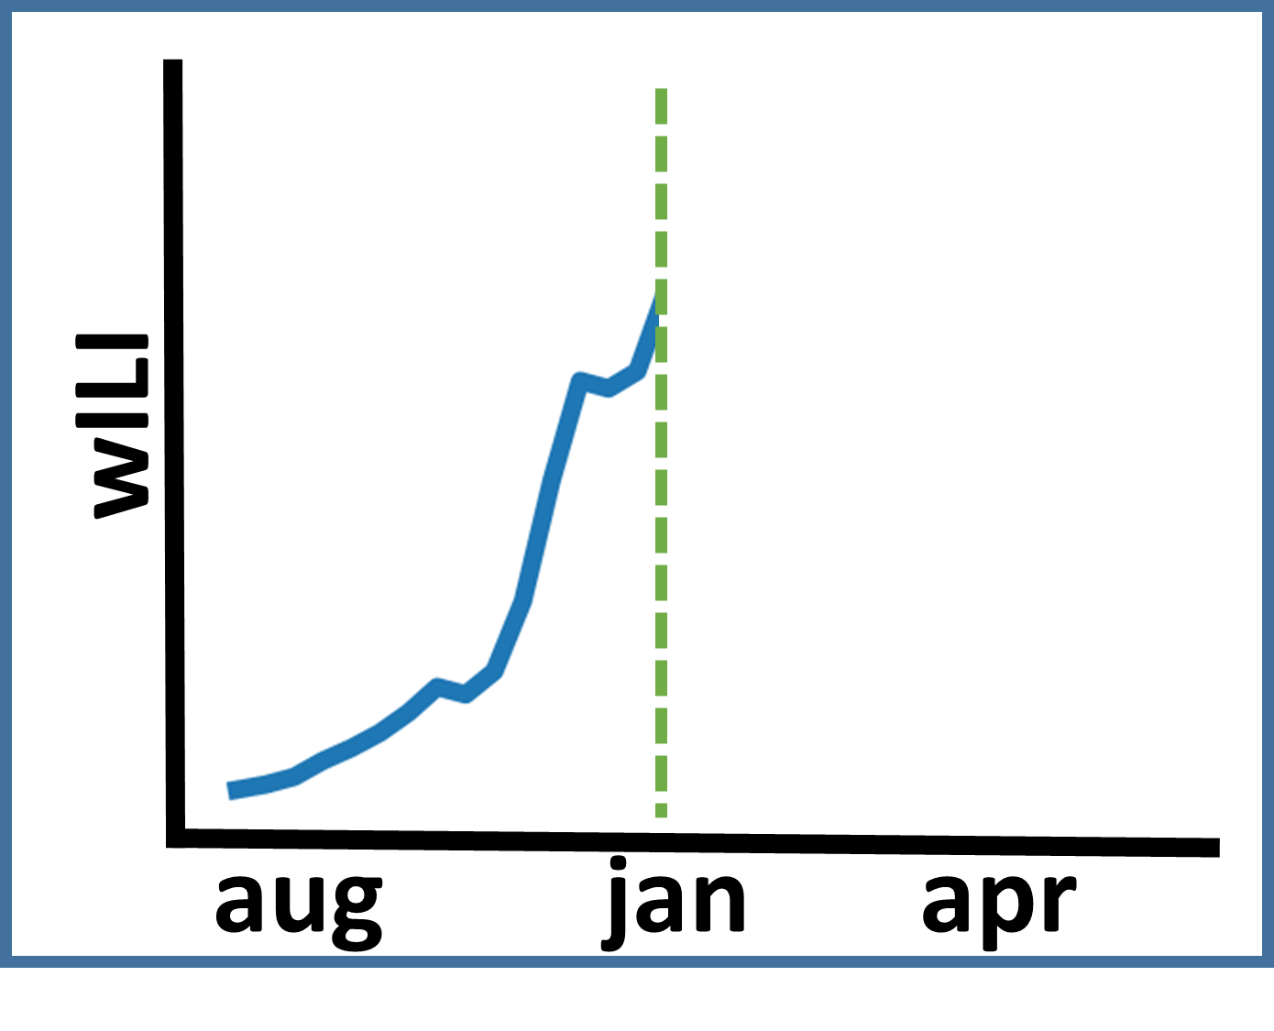
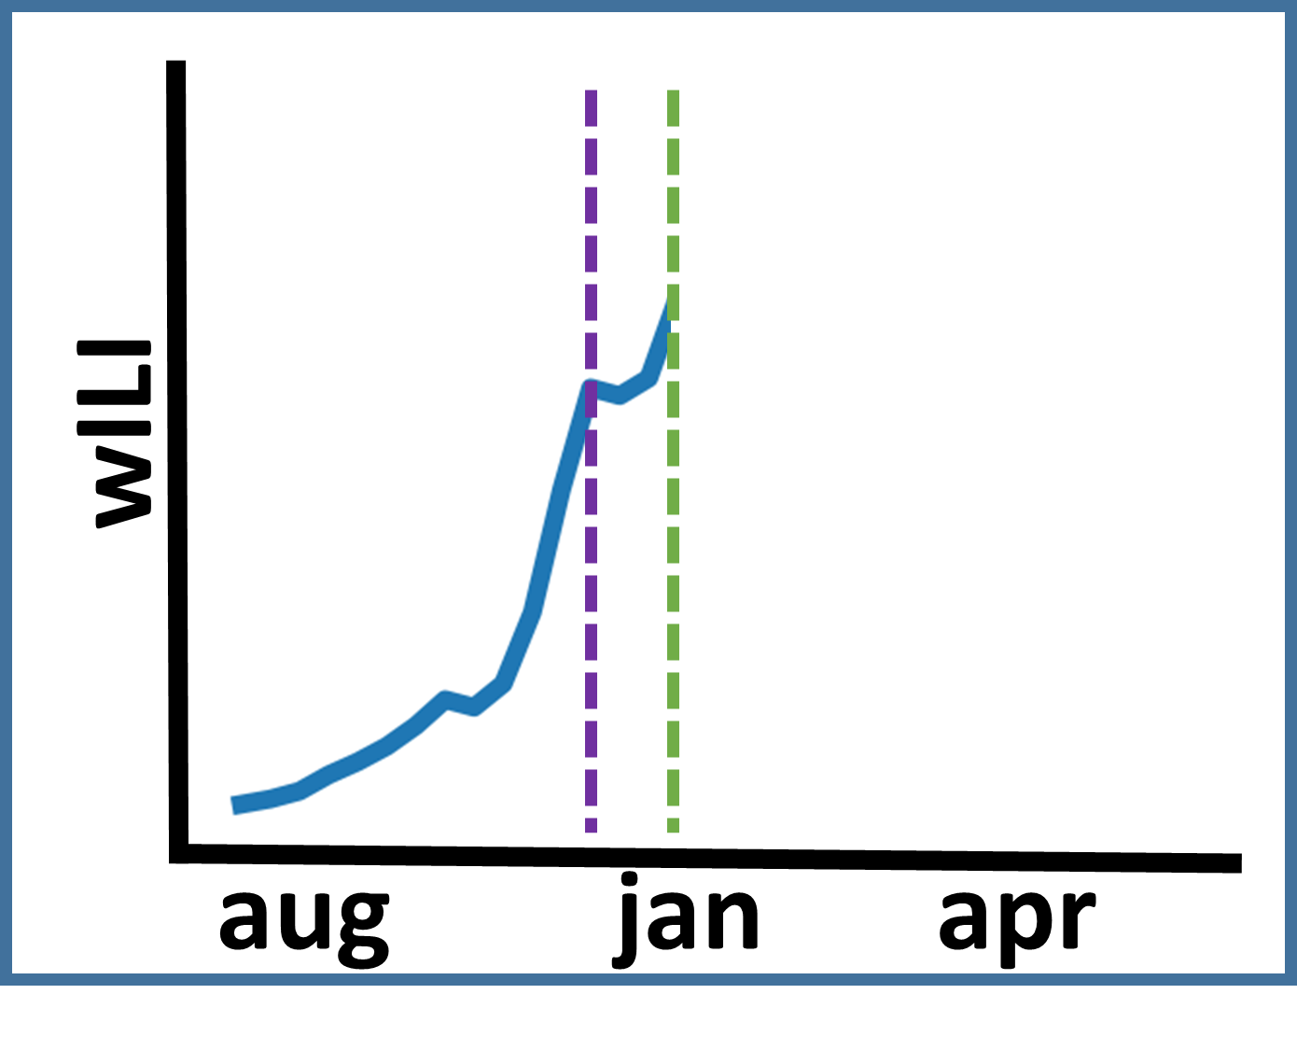
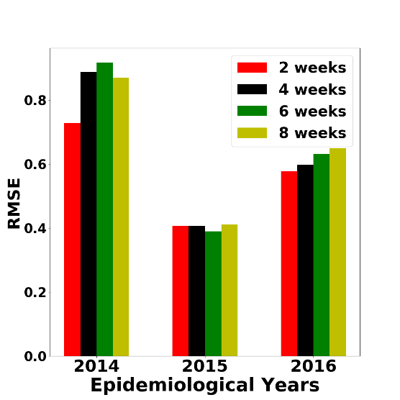
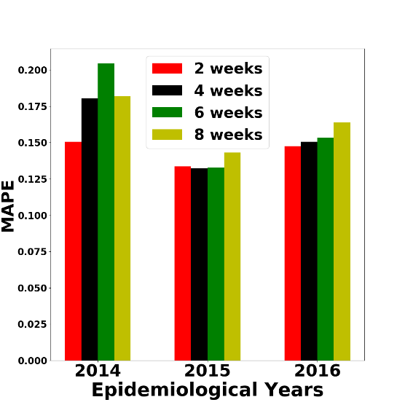
Performance : Delayed Data Arrival
jan 1
jan 15
How well does EPIDEEP perform if the delay in data is larger?
RMSE
MAPE
Lower is better
EPIDEEP’s performance is consistent even when data arrives late.

Slide 32








Interpretability of the embeddings
More results in the paper
Here we show incidence curves and 2-d projection of learnt embeddings.
20 weeks data
32 weeks data
40 weeks data
Whole Season
EPIDEEP learns interpretable embeddings.

Slide 33
Outline
Motivation
Problem Statements
Our Approach
Experiments
Conclusion

Slide 34

Conclusion
Problem
  Tackled four problems based on CDC FluSight challenge
Approach
  Proposed first end-to-end deep learning method EpiDeep for influenza forecasting
  Provides accurate forecasts
  Learns interpretable embeddings
Experiments
  Competitive results against baselines
  Our interpretable embedding helps in understanding evolving seasonal differences

Slide 35








THANK YOU
The code and paper available at: http://people.cs.vt.edu/~bijaya/

Slide 36
Problem Setup
We are given a set of historical wILI curves
And a partially observed wILI curve from the current season
Historical seasons
1997
2007
2018
…
…
Current season
t

Slide 37

Problem
How to accurately forecast influenza?
Partially observed season
Aspects of entire season
Time-series forecasting problem

