Slide 1

Near optimal mapping of network states using probes
Bijaya Adhikari*, Pavan Rangudu^{+*},
B. Aditya Prakash*, and Anil Vullikanti^{+*}
*Department of Computer Science
⁺NDSSL, Biocomplexity Institute
Virginia Tech
SDM, San Diego, May 3rd, 2018

Slide 2
Outline
Motivation
Problem Formulation
Methods
Experiments
Conclusion

Slide 3
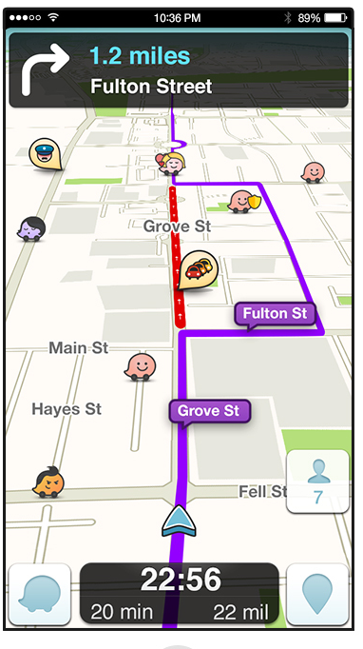

Crowd sourced Traffic analysis
Example: Waze
  Navigation
  Reporting incidents on road
Users report incidents like
  Accidents
  Traffic Jam
  Stranded Vehicles
  …

Slide 4

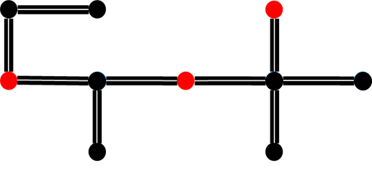
Example: Data from waze
Multiple users report multiple incidents
  With some probability
  Not all incidents reported
Each report is an incident at a particular location
  Reports == probes
probes

Slide 5
Data is incomplete
Complete information on all affected locations are not known
Important to know all the affected locations (locations with incidents)
  Routing
  Emergency response
  …
probes
???
General Problem: How to infer all the affected locations given some partial probes?

Slide 6
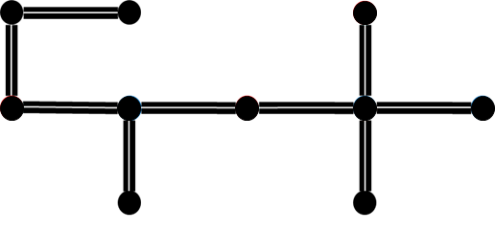
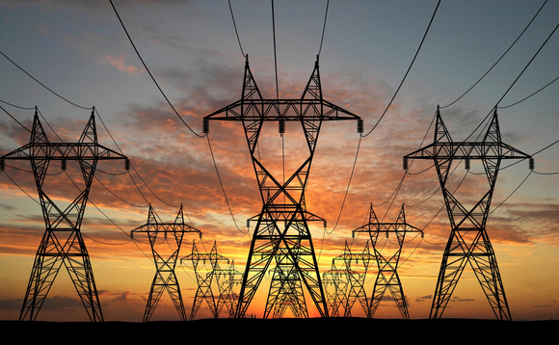
Generality of the problem
Similar problems are observed in many infrastructure networks
  Transportation Networks
  Power grids
  Communication Channels
  …
Road Network
Power Grids
Tutorial on Mining Critical Infrastructure Networks
Slides at http://people.cs.vt.edu/~badityap/TALKS/18-sdm-tutorial/

Slide 7
Outline
Motivation
Problem Formulation
Methods
Experiments
Conclusion

Slide 8
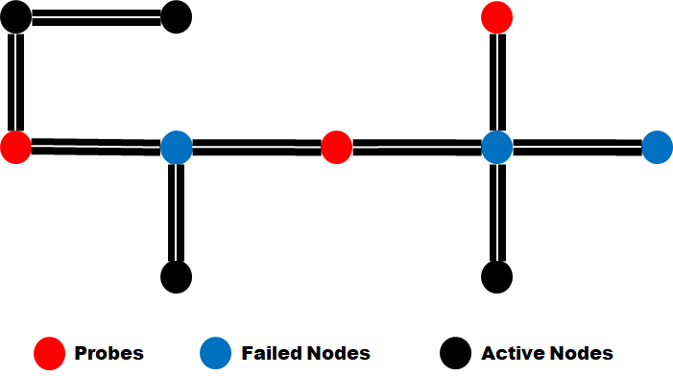
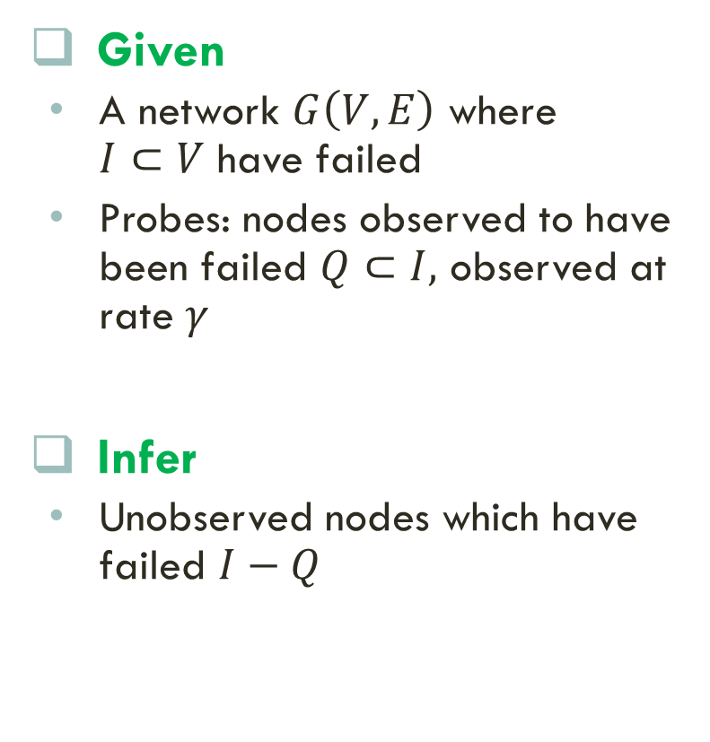


Problem Formulation: Setting
Given
  A network $G\left(V,E\right)$ where $I⊂V$ have failed
  Probes: nodes observed to have been failed $Q⊂I,$ observed at rate $γ$
Infer
  Unobserved nodes which have failed $I−Q$
Road Network Failure
Observed failures $Q$
Inferred failures $I −Q$

Slide 9
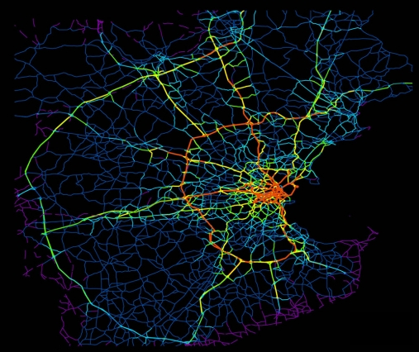
Failures Are Geographically Correlated
A geographically correlated process [Agarwal et al., IEEE/ACM ToN 2013]
Process:
  Starts with localized failure
  Causes other nodes to fail
  Probability decays with distance from the source
Used to capture failures in events like natural disaster
source
Failed Nodes
Identifying source of traffic
MIT NEWS, Dec 2012

Slide 10
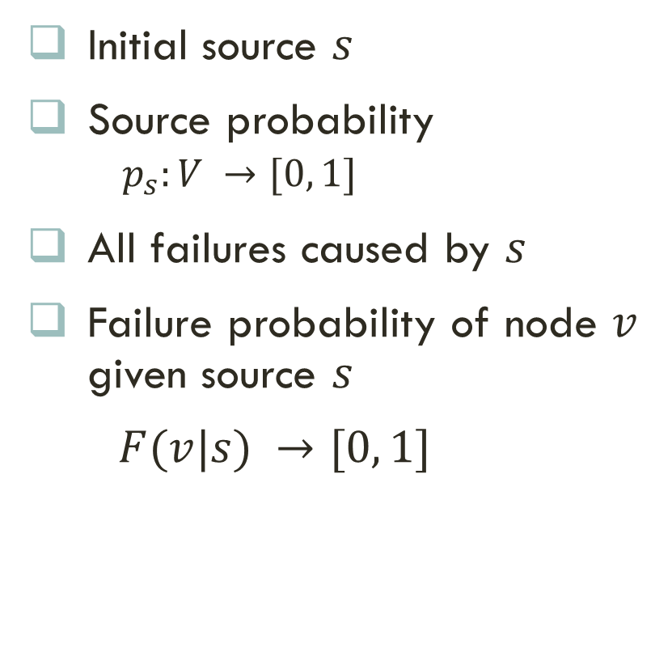


Our Failure Process
Initial source $s$
Source probability
  $p_{s}:V →[0, 1]$
All failures caused by $s$
Failure probability of node $v$ given source $s$
$F(v|s) →[0, 1]$
$v$
Source $s$
Failed Nodes

Slide 11
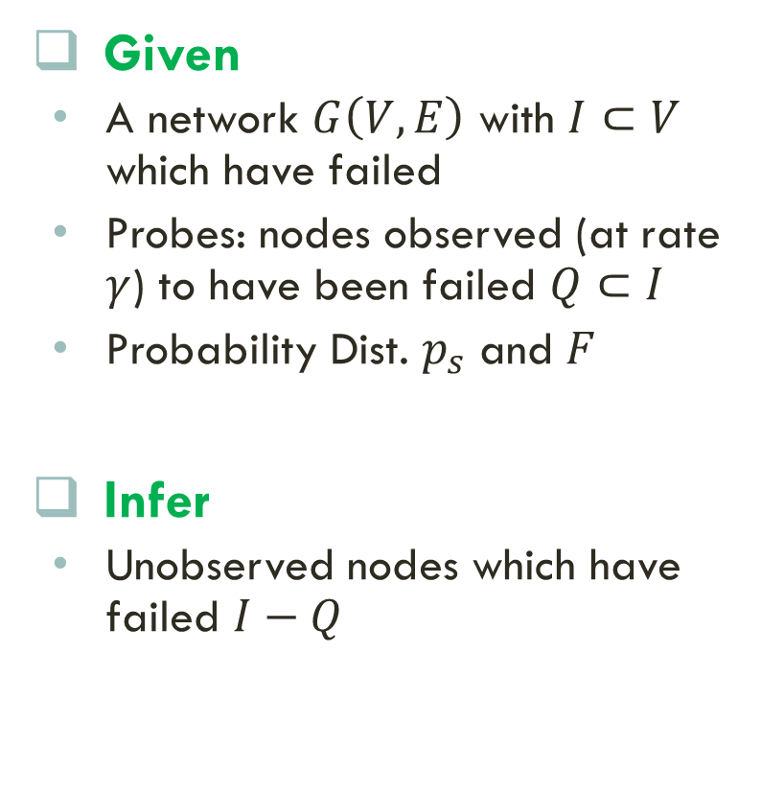
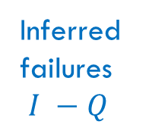
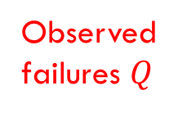
Informal problem statement
Given
  A network $G\left(V,E\right)$ with $I⊂V$ which have failed
  Probes: nodes observed (at rate $γ$) to have been failed $Q⊂I$
  Probability Dist. $p_{s}$ and $F$
Infer
  Unobserved nodes which have failed $I−Q$
Road Network Failure
Inferred
failures
$I −Q$
Observed
failures $Q$

Slide 12
Formulation Challenge
Maximize likelihood?
  Not known how many nodes have failed
  Source is unknown
How to formulate?
source
Failed Nodes
Identifying source of traffic
MIT NEWS
12

Slide 13

Our formulation: MDL
Minimum Description Length principle
Simplest solution is the best

Slide 14


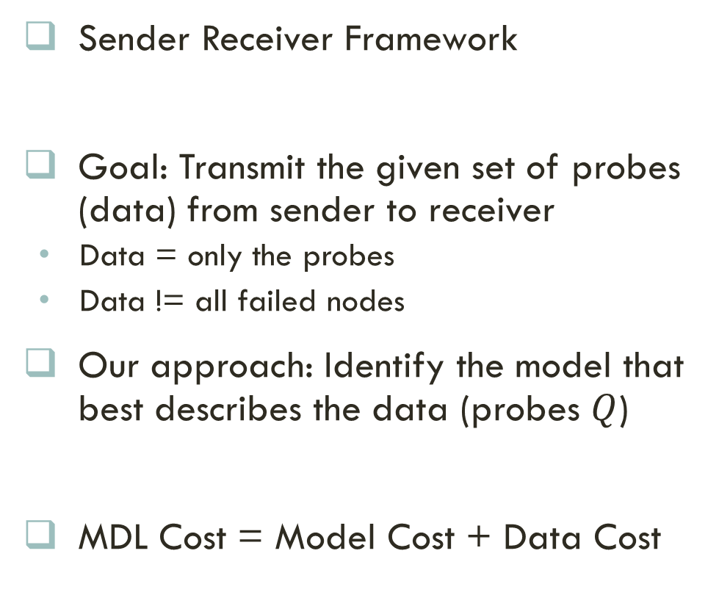
MDL Cost
These nodes have failed
Sender Receiver Framework
Goal: Transmit the given set of probes (data) from sender to receiver
  Data = only the probes
  Data != all failed nodes
Our approach: Identify the model that best describes the data (probes $Q$)
MDL Cost = Model Cost + Data Cost
How to define the MDL model space?

Slide 15
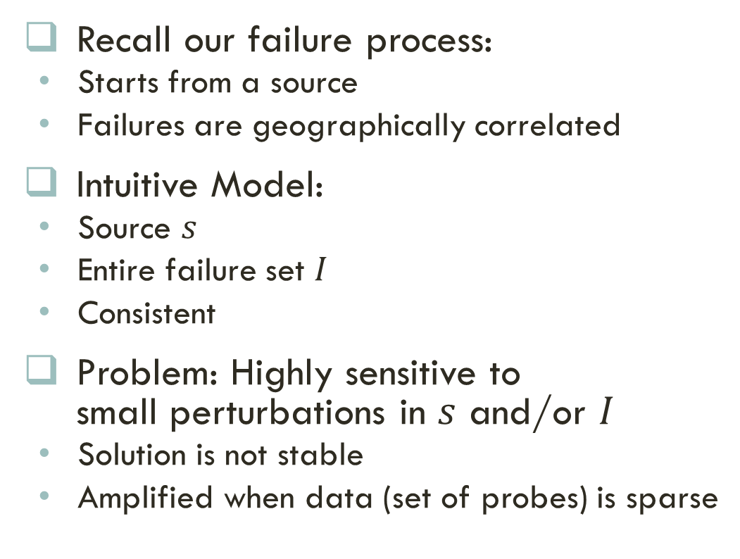
MDL Model Space
Recall our failure process:
  Starts from a source
  Failures are geographically correlated
Intuitive Model:
  Source $s$
  Entire failure set $I$
  Consistent
Problem: Highly sensitive to small perturbations in $s$ and/or $I$
  Solution is not stable
  Amplified when data (set of probes) is sparse
s2
s1
How to define a robust MDL model space?

Slide 16
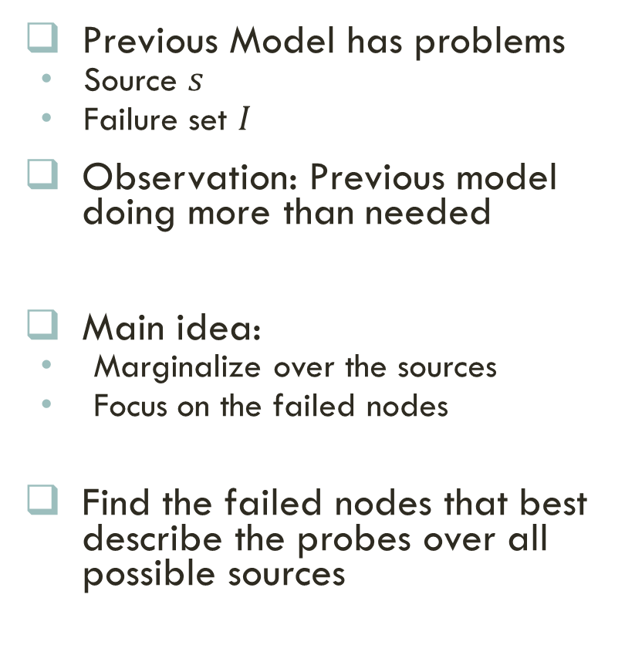
Our MDL Model Space
Previous Model has problems
  Source $s$
  Failure set $I$
Observation: Previous model doing more than needed
Main idea:
  Marginalize over the sources
  Focus on the failed nodes
Find the failed nodes that best describe the probes over all possible sources
source
Marginalize over all
possible sources

Slide 17

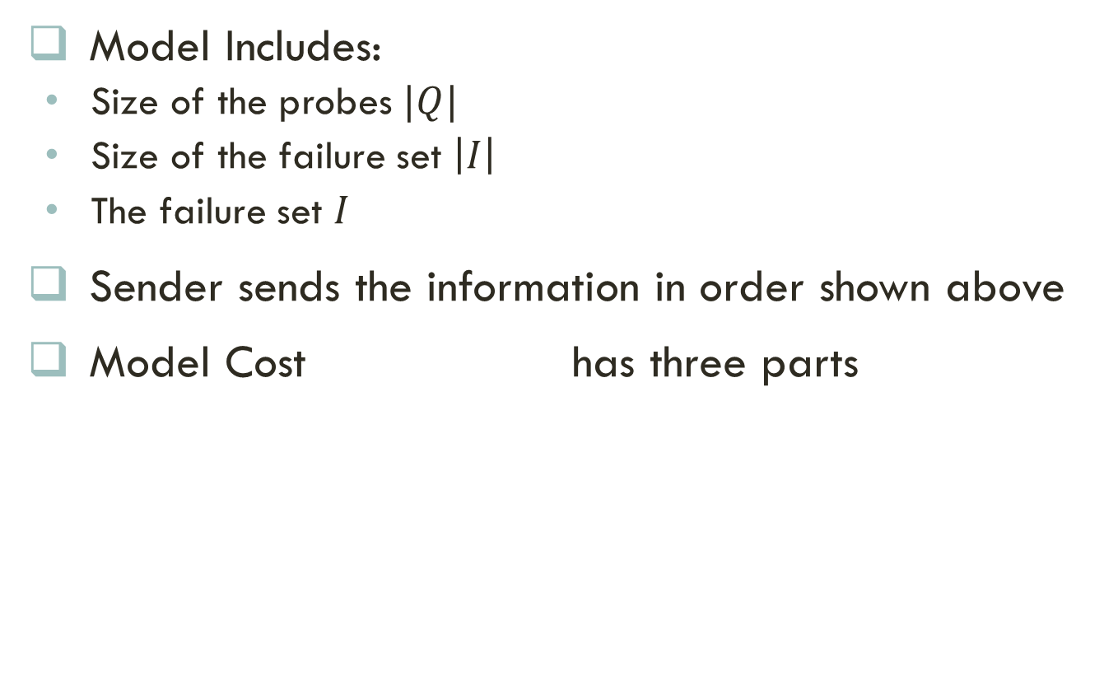
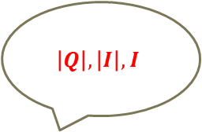
MDL Model Cost
$$\left|Q\right|, \left|I\right|, I$$
Model Includes:
  Size of the probes $|Q|$
  Size of the failure set $\left|I\right|$
  The failure set $I$
Sender sends the information in order shown above
Model Cost has three parts
Cost of size of probes
Cost of the failure set given the rest
Cost of size of failure set given the size of probes

Slide 18
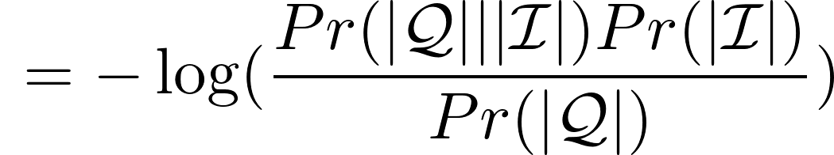


MDL Model Cost Continued
Details in the paper
Part 1: by Shannon-Fano code
Part 2:
  Use sampling assumption to compute
Part 3:
  Use failure process to get
Bayes
Theorem

Slide 19
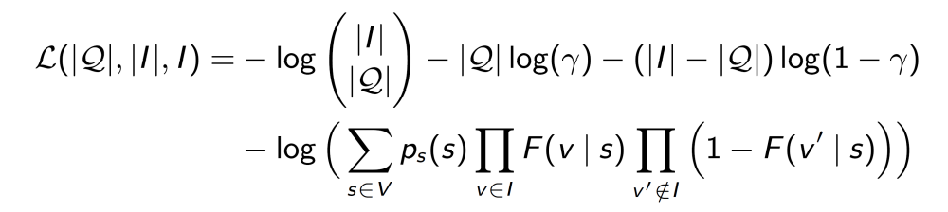
Final MDL ModeL COst
Putting all together
After algebra:
Sampling Process
Failure Process

Slide 20
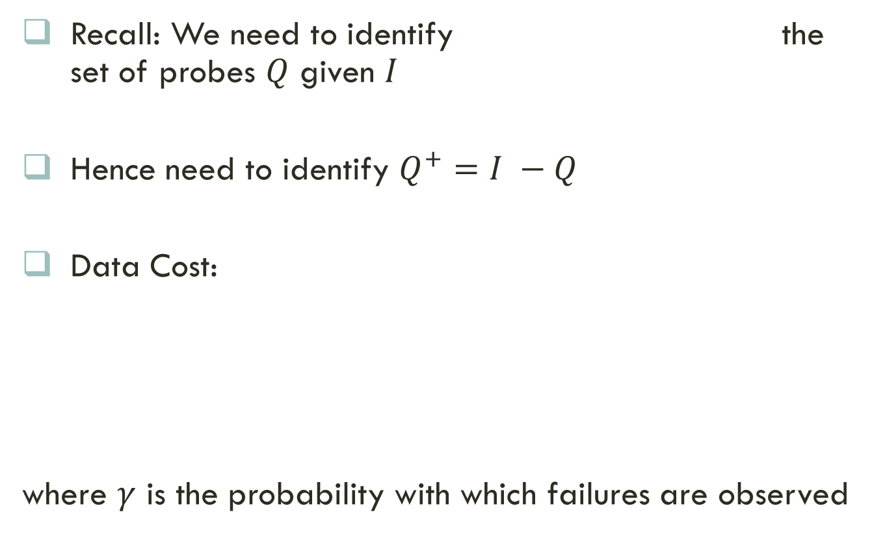
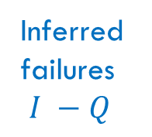
MDL Data Cost
Recall: We need to identify the set of probes $Q$ given $I$
Hence need to identify $Q^{+}=I −Q$
Data Cost:
where $γ$ is the probability with which failures are observed
Inferred
failures
$I −Q$

Slide 21
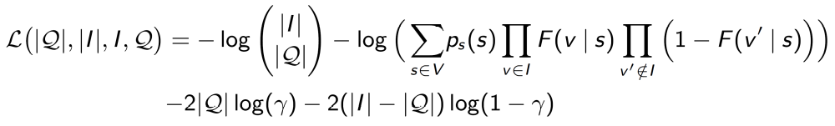
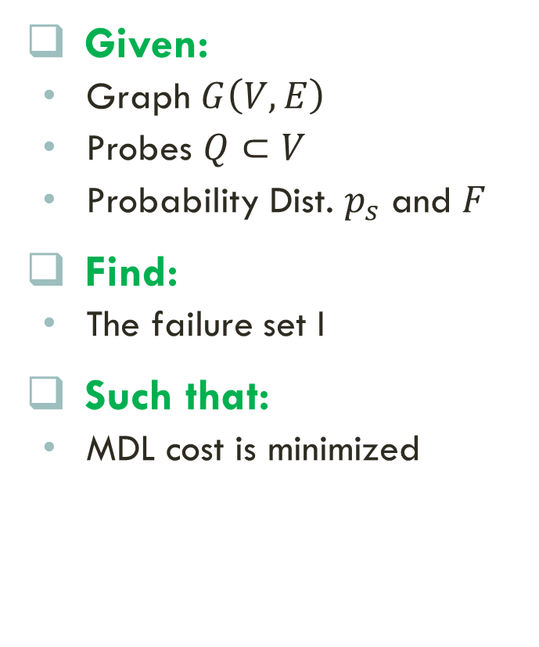
GRAPHSTATEINF Problem Statement
Given:
  Graph $G\left(V,E\right)$
  Probes $Q⊂V$
  Probability Dist. $p_{s}$ and $F$
Find:
  The failure set I
Such that:
  MDL cost is minimized

Slide 22
Outline
Motivation
Problem Formulation
Methods
Experiments
Conclusion

Slide 23


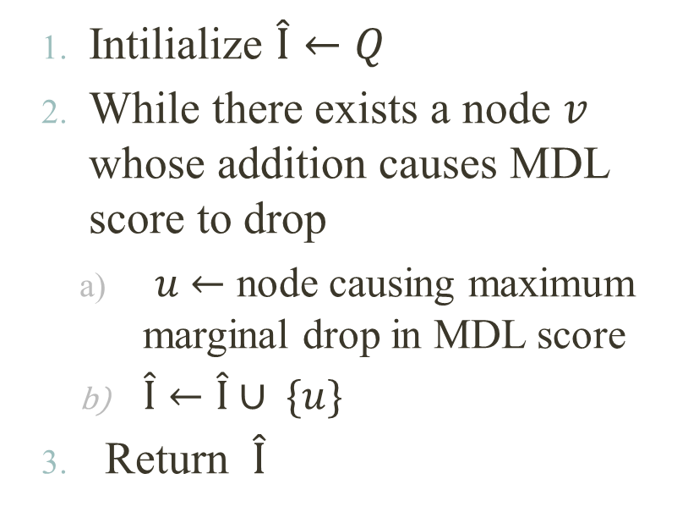

Greedy Heuristic
Toy Example
LOCALSEARCH
1
0
7
  Intilialize $\hat{I}←Q$
  While there exists a node $v$ whose addition causes MDL score to drop
    $u$ $←$ node causing maximum marginal drop in MDL score
    $\hat{I}←\hat{I}∪ \{u\}$
  Return $\hat{I}$
2
3
5
6
8
4
9
$$Q$$
2
5
7
$\hat{I}$
2
5
7
3
6
  No guarantee on quality of $\hat{I}$

Slide 24
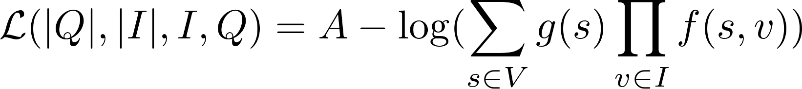
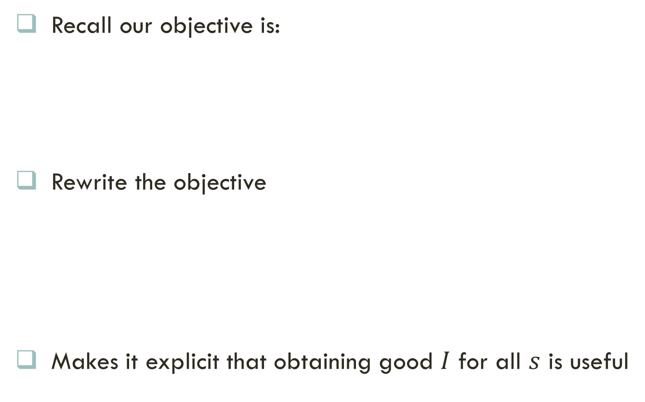

Our IDEA: GraphMAP
Recall our objective is:
Rewrite the objective
Makes it explicit that obtaining good $I$ for all $s$ is useful
Constant
Cost of the source
Cost of the set $I$

Slide 25



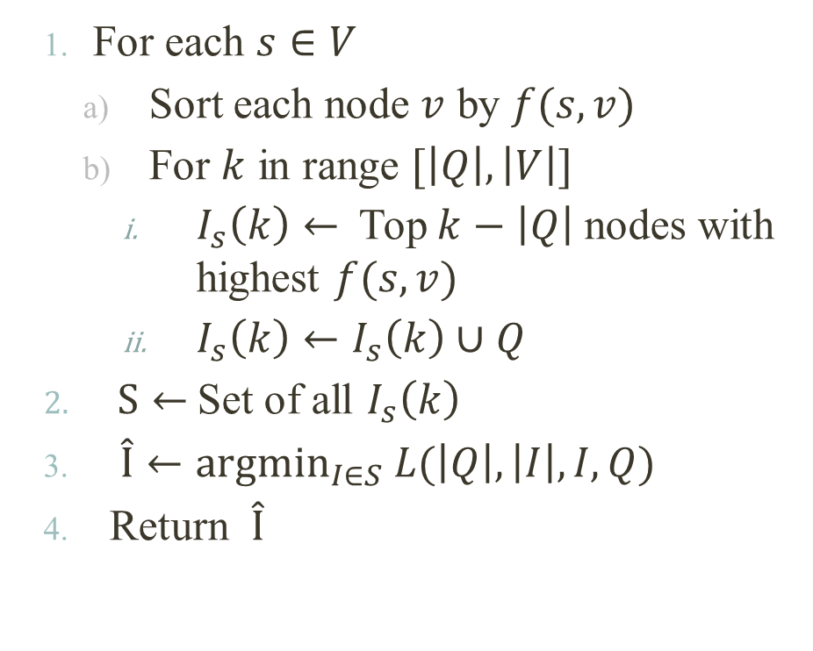






Our Method
Details in the paper
Toy Example
1
0
7
GRAPHMAP
2
3
5
6
8
  For each $s∈V$
    Sort each node $v$ by $f(s,v)$
    For $k$ in range $[\left|Q\right|, \left|V\right|]$
      $I_{s}\left(k\right)←$Top $k−$ $\left|Q\right|$nodes with highest $f(s,v)$
      $I_{s}\left(k\right)←I_{s}\left(k\right)∪Q$
  $S←$Set of all $I_{s}\left(k\right)$
  $\hat{I}←argmin_{I∈S} L(\left|Q\right|,\left|I\right|,I,Q)$
  Return $\hat{I}$
4
9
$$Q$$
2
5
7
${\hat{I}}_{1}\left(4\right)$
$$s=1, k=4$$
2
5
7
1
${\hat{I}}_{1}\left(5\right)$
$$s=1, k=5$$
2
5
7
1
0
${\hat{I}}_{2}\left(5\right)$
$$s=2, k=5$$
2
5
7
1
3
…
$$s=5, k=6$$
${\hat{I}}_{5}\left(6\right)$
2
5
7
3
6
8

Slide 26
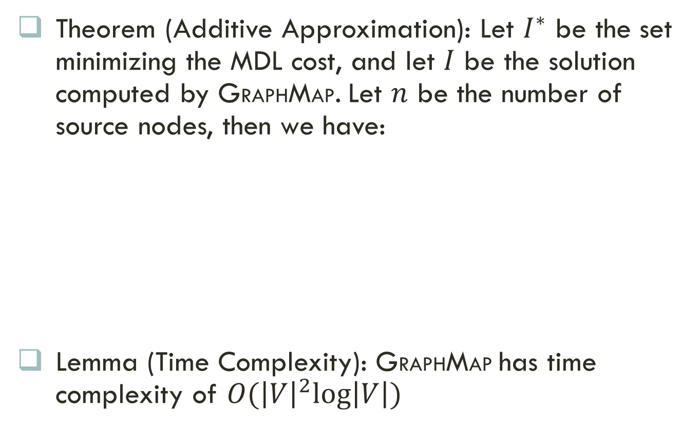
Analysis of GraphMap
Proofs in the paper
Theorem (Additive Approximation): Let $I^{∗}$ be the set minimizing the MDL cost, and let $I$ be the solution computed by GRAPHMAP. Let $n$ be the number of source nodes, then we have:
Lemma (Time Complexity): GRAPHMAP has time complexity of $O({\left|V\right|}^{2}log⁡\left|V\right|)$
Our MDL Cost
Optimal MDL Cost
GRAPHMAP is near optimal

Slide 27
Outline
Motivation
Problem Formulation
Methods
Experiments
Conclusion

Slide 28
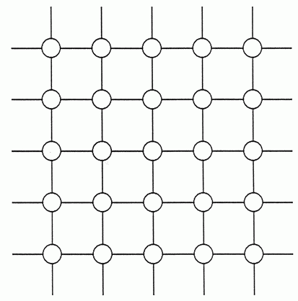
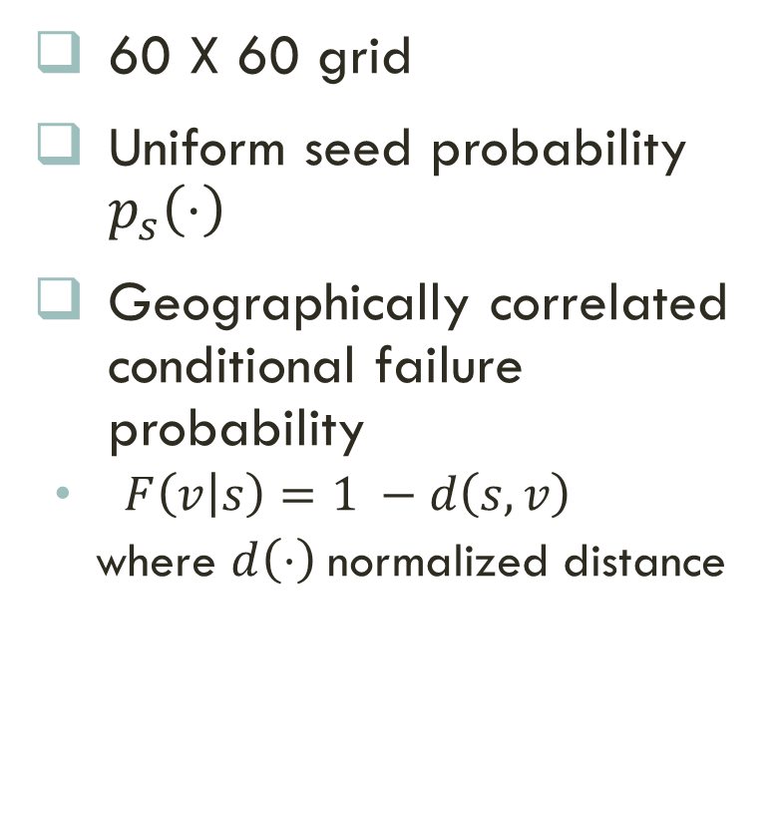

Synthetic data
60 X 60 grid
Uniform seed probability $p_{s}\left(⋅\right)$
Geographically correlated conditional failure probability
  $F\left(v | s\right)=1 −d\left(s,v\right)$
  where $d\left(⋅\right)$normalized distance
v
$$d(s,v)$$
s

Slide 29
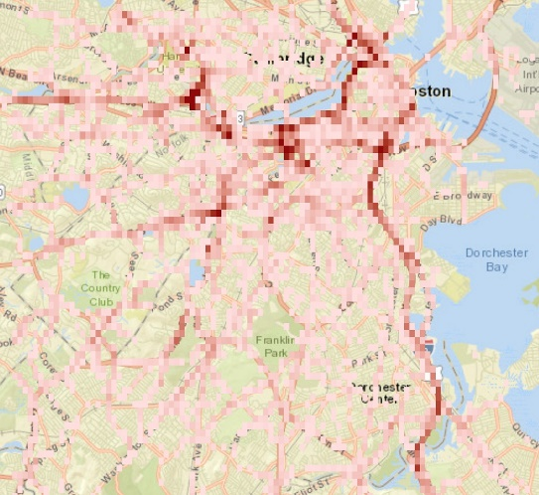
Real Data
Waze
  Consists of logs of road incidents in Boston
  Includes
    Type of incidents (like jam, accident, closure due to bad weather and so on)
    Geo-location
    Start and end time of incidents
    Get two datasets (Jam and Weather)
Power-grid
  Consists of logs of electrical disturbances
  Includes
    Location of disturbance
    Start and end time of the disturbance
Source/Failure probabilities: uniform, gaussian and empirical
Boston Road Network
Higher probability in the city
Seed Distribution

Slide 30
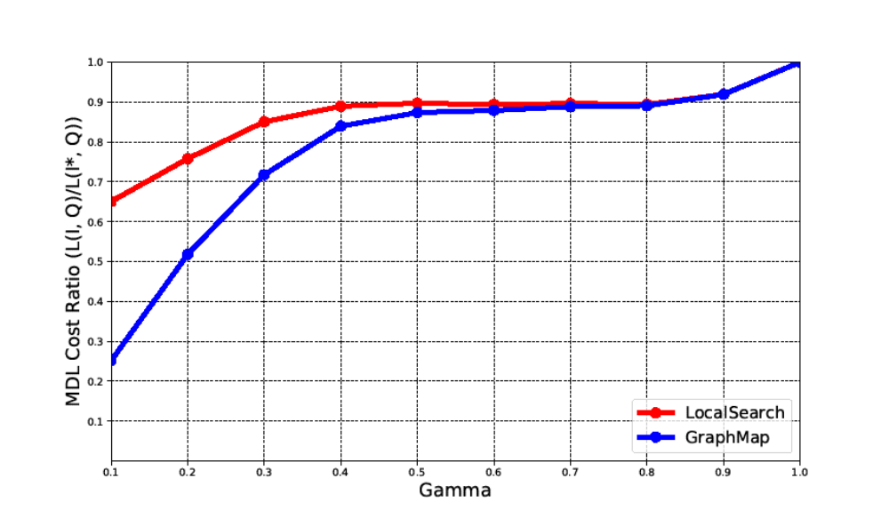
Performance: MDL
Jam dataset with empirical conditional failure
Task is harder
Nomralized MDL Score
Lower
is better
Observation rate
GRAPHMAP outperforms LOCALSEARCH

Slide 31
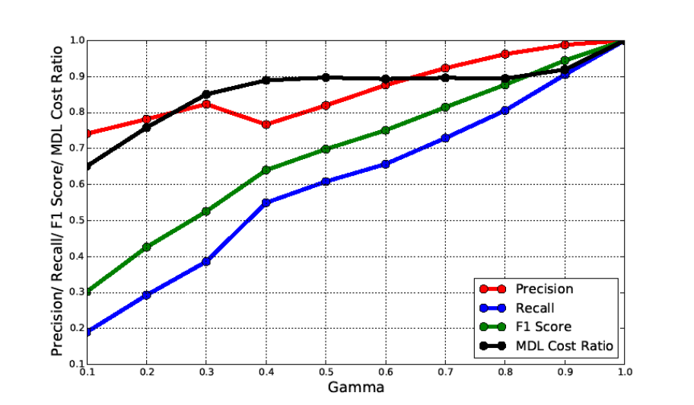
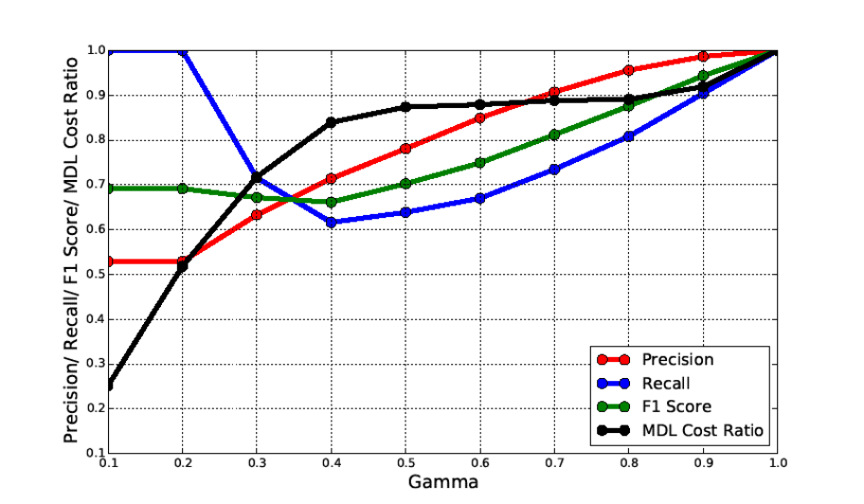
PerformancE: Precision, Recall and F1
More results in the paper
Performance
Performance
Higher
is better
Observation rate
Observation rate
LOCALSEARCH
GRAPHMAP
GRAPHMAP results in higher F1 Score

Slide 32
Outline
Motivation
Problem Formulation
Methods
Experiments
Conclusion

Slide 33
Conclusion
Problem
  Formulated novel GRAPHSTATEINF problem using MDL
Near Optimal Algorithm
  Proposed LOCALSEARCH and GRAPHMAP algorithms
  GRAPHMAP gives log(n) additive approximation
Experiments
  Conducted extensive experiments on real and synthetic data
Future Works
  Include other failure models
  Include other probes (path queries)
  …

Slide 34








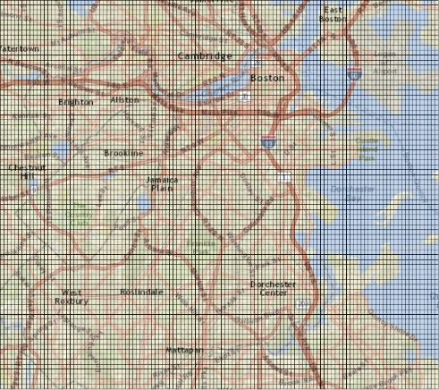

Any Questions?
Funding:
Code and Data at:
http://people.cs.vt.edu/~bijaya
Bijaya
Pavan
Aditya
Anil

Slide 35
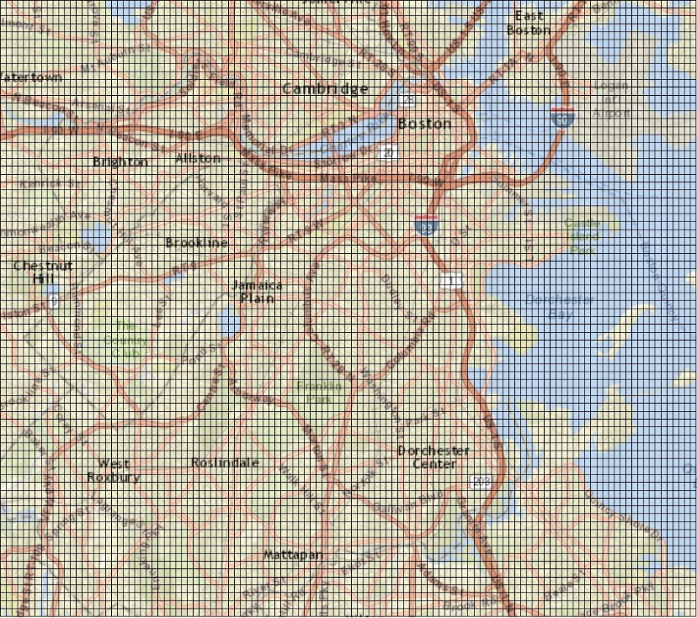
Real Dataset Summary
JAM
  Partition Boston region into 119 X 78 grid
  Each cell is a node
  Prune nodes with zero failures
  Grid with 2650 nodes
WEATHER
  Grid with 1520 nodes
POWER-GRID
  Power transmission network with 24 nodes
Overlaying a grid over Boston

Slide 36
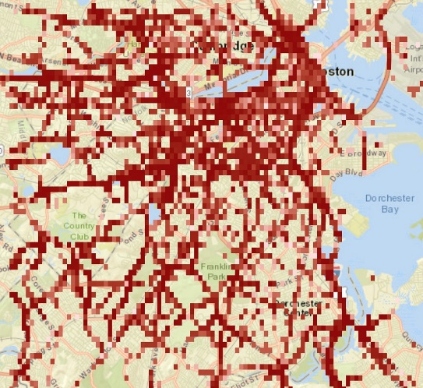
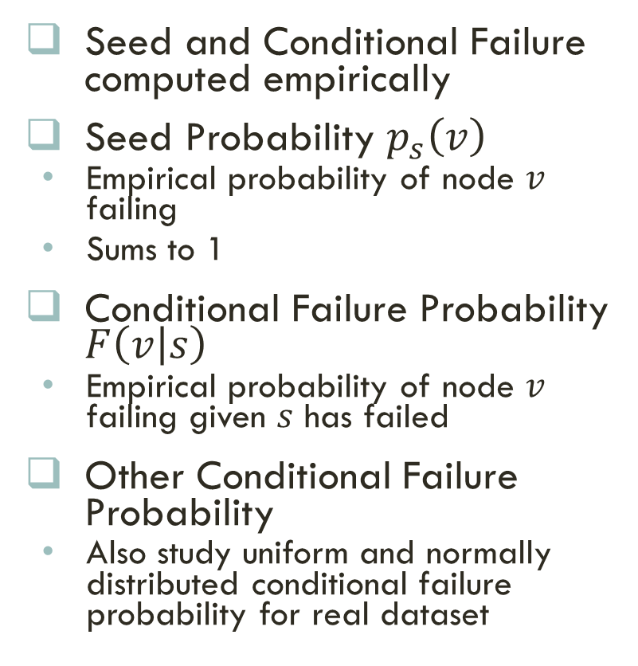
Real DaTa: Failure probability
Seed and Conditional Failure computed empirically
Seed Probability $p_{s}\left(v\right)$
  Empirical probability of node $v$ failing
  Sums to 1
Conditional Failure Probability $F\left(v | s\right)$
  Empirical probability of node $v$ failing given $s$ has failed
Other Conditional Failure Probability
  Also study uniform and normally distributed conditional failure probability for real dataset
Higher probability in the city
Seed Distribution
Conditional Failure Distribution

