Slide 1

Mining E-Commerce Query Relations using Customer Interaction Networks
Bijaya Adhikari*, Parikshit Sondhi⁺, Wenke Zhang⁺,
Mohit Sharma⁺ and B. Aditya Prakash*
*Department of Computer Science, Virginia Tech
⁺Walmart Labs
WWW, Lyon, April 26th, 2018

Slide 2
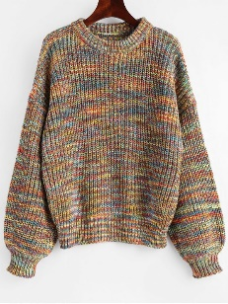
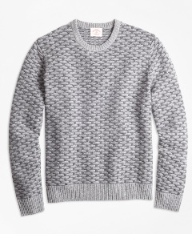
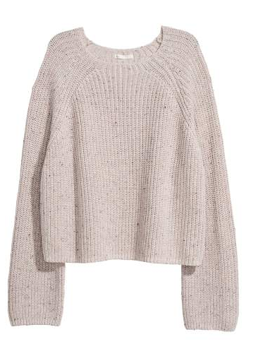


User Engagement
“sweater”
Begins with query submission
List of results are produced
Based on the result
  Click
  Purchase
  Reformulate the query
    Specialization
    Generalization
“red sweater”

Slide 3
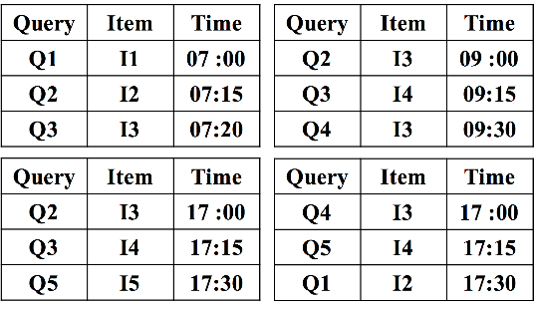
Engagement data
Log of Engagement
  Organized by `sessions’
Consists of
  Queries and engagement
  Sorted by time
Engagement data captures
  User intent
  Measure of satisfaction
  Evolution of intent
Engagement log
Many possible applications

Slide 4

Application 1: Intent Based Query Clustering
Important to group queries with similar intents
  Improve search results
A natural question
  How to group queries with the same intents?
“Phone” “Mobile” “TV” “Television”
“TV” “Television”
“Phone” “Mobile”

Slide 5
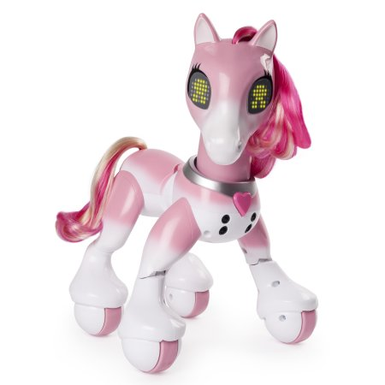
Application 2: item recommendation
Many queries have little/no engagement data
  ``rare’’ queries
Problem
  How to recommend items for such queries?
“unicorn”

Slide 6


6
Application 3: critical queries
Queries impact each other
  Engagement data from one can be used for another
A natural question
  Which queries have the highest cumulative impact on others?
Critical Queries
  Meaningful representatives
  Improve other queries
  Measure state of the search system
‘‘iPhone’’
‘‘Phone’’
Adhikari, Sondhi, Zhang, Sharma, Prakash

Slide 7
Challenges
A1: Intent based Query Clustering
  Naïve methods like string matching don’t work well
  Meta data like query category not available
A2: Item recommendation
  No engagement data
A3: Mining critical queries
  Characterizing impact and importance
Engagement log

Slide 8
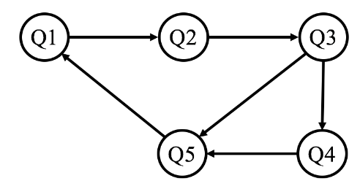
Main Idea
All problems rely on query/item relations
Our Idea:
  Build graphs
  Capture relations
  Leverage graphs to solve
Engagement log

Slide 9
Goal of our work
Engagement log
Generate
  Generate meaningful Customer Interaction Networks from engagement data
Understand
  Develop insights of the nature of the generated networks
Exploit
  Leverage new insights for Query Mining tasks
CIN
Query Mining Tasks
Intent based Query Clustering
Item Recommendation
Mining Critical Queries
…

Slide 10
Outline
Motivation
Customer Interaction Networks
Application 1: Intent Based Query Clustering
Application 2: Item Recommendation
Application 3: Critical Queries
Conclusion

Slide 11
Networks
We generate following networks:
  Query Reformulation Network (QRN)
  Item Click Network (ICN)
  Composite Click Network (CCN)
  Cover Network (CN)
Engagement log
CIN

Slide 12
QRN: Query Reformulation Network
Engagement log
Query-to-Query relations
Nodes: Queries
Edges: Reformulation
Construction
  Consecutive queries in a session
  Having minimum
    Appearance threshold
    Reformulation threshold
Query Reformulation
Network

Slide 13
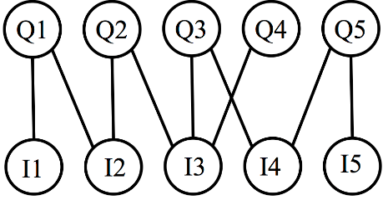
ICN: Item Click Network
Engagement log
Query-to-Item relations
Nodes: Queries/Items
Edges: Click
Construction
  Clicks observed in the log
  Having minimum
    Appearance threshold
    Click threshold
Item Click
Network

Slide 14
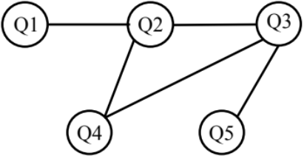
Other CINs
CN: Cover Network
CCN: Composite Click Network
Item Click Network
Cover Network
Item Click + Query Reformulation = Composite Click Network
Not considering other networks which use content

Slide 15
Empirical properties and implications
Network | # Nodes | # Edges | Degree Dist. | Assortativity | Diameter | Average CC | GCC
QRN | 2.11 M | 2.14 M | PL/LN | None | 94 | 0.05 | No
ICN | 5.4 M | 18.4 M | LN | None | 37 | 0.12 | No
CCN | 6.3 M | 20.5 M | PL | None | 36 | 0.17 | No
CN | 785 K | 71 M | LN | Positive | 13 | 0.76 | Yes
Observations
Implications
Low Density
Heavy Tailed Distributions
Positive Assortativity
Long Diameter
Low Clustering
No GCC
Sparse
Skewed
Clustering of Popular queries
Separation of queries with different intents

Slide 16
Empirical properties and implications
Network | # Nodes | # Edges | Degree Dist. | Assortativity | Diameter | Average CC | GCC
QRN | 2.11 M | 2.14 M | PL/LN | None | 94 | 0.05 | No
ICN | 5.4 M | 18.4 M | LN | None | 37 | 0.12 | No
CCN | 6.3 M | 20.5 M | PL | None | 36 | 0.17 | No
CN | 785 K | 71 M | LN | Positive | 13 | 0.76 | Yes
QRN: Sparse, star-like, low clustering, long diameter
ICN : Sparse, low-clustering, long diameter
CCN: Sparse, low clustering, long diameter
Cover: Denser, high clustering, shorter diameter
More
useful

Slide 17
Outline
Motivation
Customer Interaction Networks
Application 1: Intent Based Query Clustering
Application 2: Item Recommendation
Application 3: Critical Queries
Conclusion

Slide 18
Reminder: Intent Based Query Clustering
Important to group queries with similar intents
  Improve search results
Query categories are not available for all queries
A natural question
  How to group queries with the same intents?
“Phone” “Mobile” “TV” “Television”
“TV” “Television”
“Phone” “Mobile”

Slide 19

Informal problem On QRN
Given
  A Query Reformulation network
  An Integer k
Find
  A k-partition of the network
Such that
  Each partition contains queries with the same intent
Why use QRN?
  Network Nature: Similar queries have edge
  Sparsity: Queries are well separated

Slide 20
Problem formulation
Want to find partitions:
  Homogenous
  Each having different Intents
Homogeneity: Shortest Paths
  Each Edge: significant reformulation
  Short distance: Closer relationship
  Good candidate for intent similarity
Different intents: High in-degree nodes
  Tend to be general queries
  In edges are generalizations
  Good candidates to represent intent of broad region

Slide 21
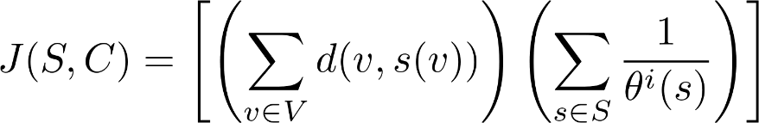
Putting it together
Want to find communities:
  Homogenous
  Each have different Intents
Quality of a partition
Short Distance to center
High in-degree center

Slide 22
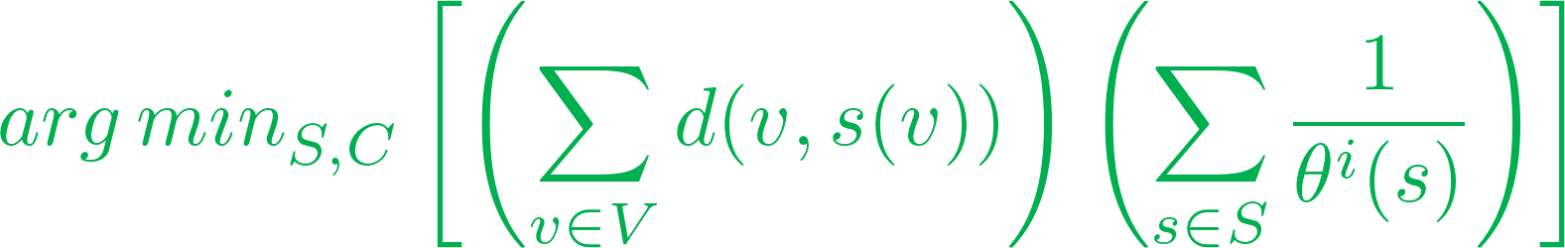
Problem Statement
Given
  A Query Reformulation Network G(V, E)
  An Integer k
Find
  A set S of k general query nodes
  A set C of k partitions of G
Such that
  Each Partition contains one element of S
  Minimizes the objective

Slide 23

Our Method: Hub-Query-Expansion
Our main Idea: Leverage newly discovered properties of QRN
Our Method:
Detect Communities in each component
Assign ‘hubs’ to each Community
Use BFS to expand communities
(No GCC)
(Skewed Degree)
(Sparsity)
Bottomline
Linear Time and Space Complexity
Well suited for large networks

Slide 24
Baseline Methods
Some of the methods we considered are:
BigClam[Yang+, 2013]: Leverage latent relevance to find overlapping clusters
Louvian[Blondel+, 2008]: Modularity based community detection method
LouvSmall: Modify Louvian to generate smaller communities
Star: Generate Star Shaped Communities

Slide 25
Category Based Evaluation
Challenge: How to evaluate with partial ground truth (categories)?
AIH: Average Intent Homogeneity
  Intuitively measures category based precision
AIS: Average Inverse Spread
  Intuitively measures category based recall
F1: Harmonic mean of AIH and AIS

Slide 26
Performance
More results
in the paper
HubQExpansion outperforms the baselines

Slide 27
Qualitative results
Some example query clusters
zebra animal
zebra stuffed animal
plush zebra stuffed animal
stuffed animals zebra
zebra stuffed toy
stuffed zebras
zebra stuff animal
stuffed zebra
zebra plush
10 key for laptop
10 key
10key
10 key calculator with paper
10 key calculator with tape
10 key calculator
10 key printing calculator
10 key pad
10-key
10 key keypad
10 key usb keypad

Slide 28
Outline
Motivation
Customer Interaction Networks
Application 1: Intent Based Query Clustering
Application 2: Item Recommendation
Application 3: Critical Queries
Conclusion

Slide 29
Reminder: item recommendation
Many queries have little/no engagement data
  ``rare’’ queries
Problem
  How to recommend items for such queries?
“unicorn”

Slide 30
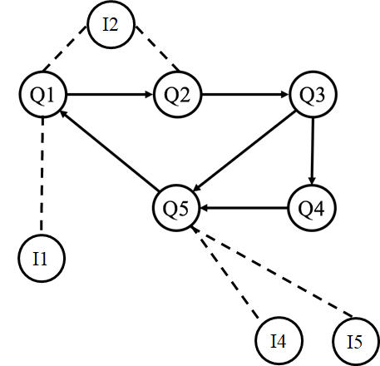
Item Recommendation: Problem
Problem
  For queries with no/little engagement data
  How to recommend items?
Composite Click
Network
How to recommend items for query 4?

Slide 31
Our Main Idea
Details in the paper
Composite Click Network
Leverage Random Walk [Craswell+, 2007]
  Treat a query (eg Q4) as a source node
  Items as sink nodes
  Start multiple random walks from Q4
  Recommend the products where most of the random walks end

Slide 32
Experiments and Results
Experiment
  Implemented and deployed
  A/B test
Result
  34% improvement in NDGC over current Walmart.com search engine!

Slide 33
Outline
Motivation
Customer Interaction Networks
Application 1: Intent Based Query Clustering
Application 2: Item Recommendation
Application 3: Critical Queries
Conclusion

Slide 34
34
Reminder: critical queries
Queries impact each other
  Engagement data from one can be used for another
A natural question
  Which queries have the highest cumulative impact on others?
Critical Queries
  Meaningful representatives
  Improve other queries
  Measure state of the search system
‘‘iPhone’’
‘‘Phone’’
Adhikari, Sondhi, Zhang, Sharma, Prakash

Slide 35

Informal Problem
Given
  A Query Reformulation Network G(V, E)
  An Integer k
Find
  A set T of k nodes
Such that
  The nodes in T have the highest cumulative impact on other queries
Query Reformulation
Network
How to model the impact of queries?

Slide 36

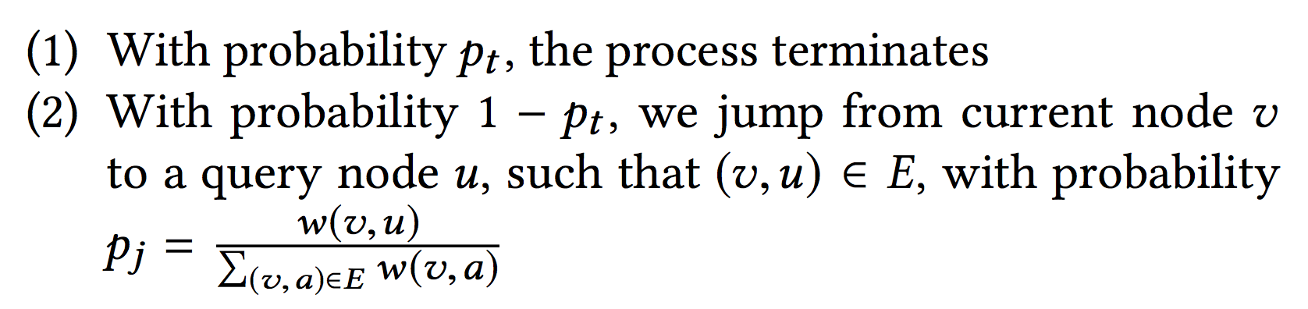
Our Idea: model user interaction
RUN (randomized user navigation) model
Starts from arbitrary Node
Reformulation Log:
Q1, Q2, Q3, Q5

Slide 37
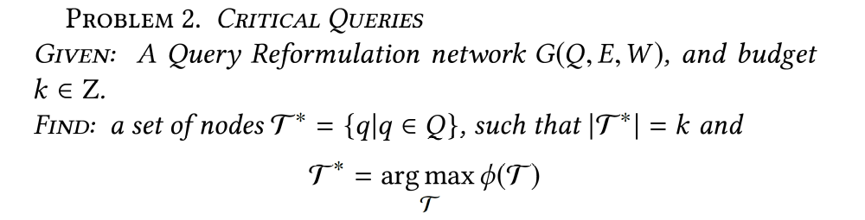
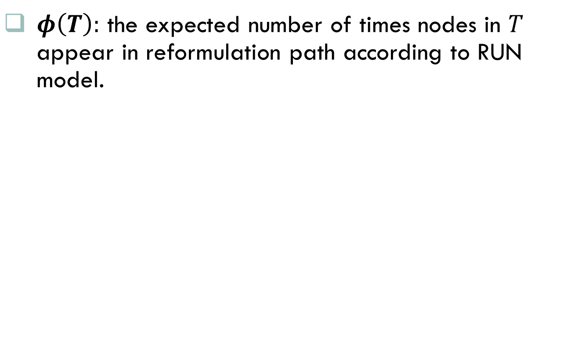
Formal Problem
$φ\left(T\right):$ the expected number of times nodes in $T$ appear in reformulation path according to RUN model.
NP-Hard

Slide 38
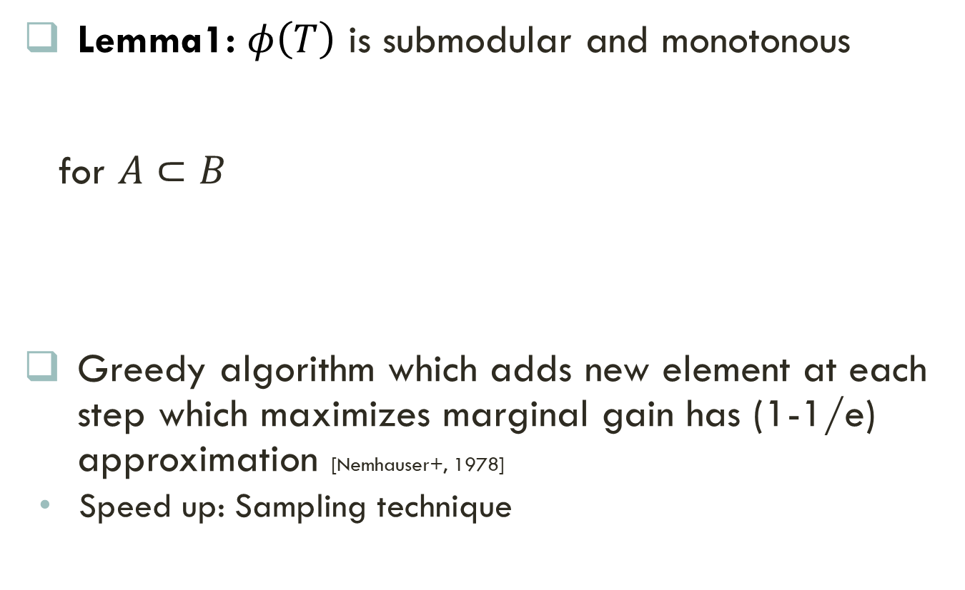
Our Method: CriticalQueries
Lemma1: $φ\left(T\right)$ is submodular and monotonous
for $A⊂B$
Greedy algorithm which adds new element at each step which maximizes marginal gain has (1-1/e) approximation [Nemhauser+, 1978]
  Speed up: Sampling technique

Slide 39
Baseline Methods
One can leverage many methods/definitions
Most Frequent Queries
Queries Appearing in Most Sessions
Queries with highest PageRank
Queries with highest Eigenvector Centrality

Slide 40



Usability Evaluation Metric
INFluenced Queries (InfQ):
  Number of related queries within some radius
Sum of related Items (SumI)
  Number of related items shared with other queries within some radius
$$InfQ=2$$
3
2
$$SumI=5$$

Slide 41
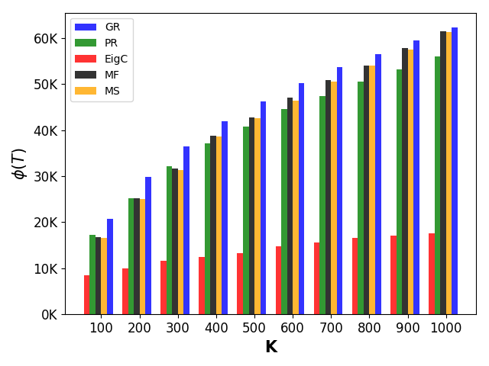
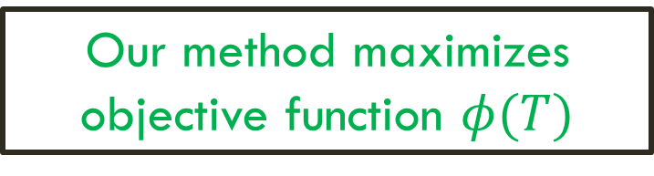
Results: Objective
Higher is better
Our method maximizes objective function $φ(T)$

Slide 42
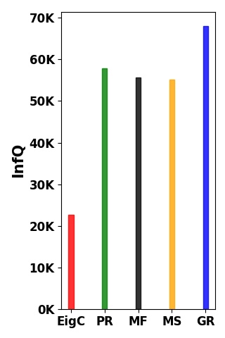
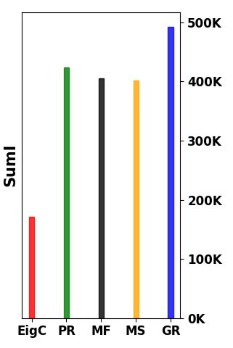

Results: Usability
Higher is better
Our method has the best usability

Slide 43
Outline
Motivation
Customer Interaction Networks
Application 1: Intent Based Query Clustering
Application 2: Item Recommendation
Application 3: Critical Queries
Conclusion

Slide 44
Take-Aways
Query Reformulation
Network
CINs are useful
  They have useful properties
  A1: Intent Based Query Clustering
  A2: Item Recommendation
  A3: Critical Queries
Formulation and Methods
  exploit CINs properties
  scalable
Future Work
  Add content
  Add query attributes
  Other applications like type-ahead, query curation, and so on
Item Click Network
Cover Network

Slide 45

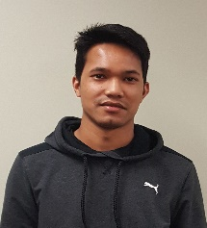


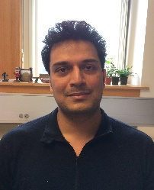




Any questions?
Additional
Funding:
Slides: http://people.cs.vt.edu/~bijaya/
Bijaya
Parikshit
Wenke
Mohit
Aditya
Query
Clustering
Engagement log
CINs
Critical
Queries
…
Walmart Labs is hiring @ job fair!

