Slide 1
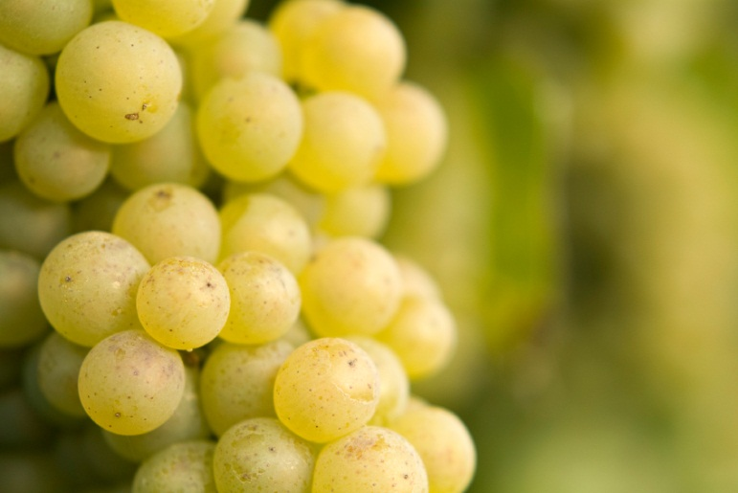
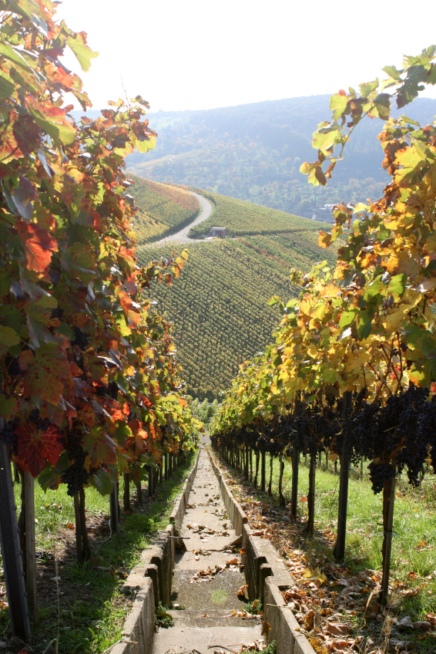
Wine Quality Prediction
Prepared for Unicorn Winery
By Bijaya Krishna Das
[13-04-2018]

Slide 2
Introduction
Market Opportunity
Unicorn Challenges
Analytic Objectives
In 2014, $180 billion USD spent on wine (27 billion liters) worldwide
Steady growth predicted from 2015 to 2020
Understand wine production and marketing options for increasing consumer appeal and sales of our wines
Identify relationships between physiochemical properties of wine and perceptions of quality
Identify additional analyses to provide insights for wine production and marketing decisions

Slide 3
Analytic Approach
Dataset
Method(s)
6,497 samples of red and white Vinho Verde
Features include 1 sensory-based measure of quality and 11 physiochemical properties
Fixed acidity, volatile acidity, citric acid, pH, alcohol, residual sugar, chlorides, density, sulphates, free sulfur dioxide and total sulfur dioxide
No missing values
Based on our data provided and problem statement.
Our Target Variable is to predict wine quality on a scale of 1-10 based on other given parameters.
This is a popular classification problem.
We can solve this by using several classification algorithms available to us.

Slide 4
Algorithms
LogisticRegression()
LinearDiscriminantAnalysis()
KNeighborsClassifier()
DecisionTreeClassifier()))
GaussianNB()
SVM
MLP Classifier
Etc…

Slide 5
My Approach
I have taken the data.
The I pre-processed the data.
Then Trained the models.
Then Predicted the score.
More will follow in iPython Coding exercise.

