Slide 1


SMART INDIA HACKATHON 2025
Ayura : Ayurvedic Diet Plan Manager
Problem Statement ID – SIH25024
Problem Statement Title- Comprehensive Cloud-Based Practice Management & Nutrient Analysis Software for Ayurvedic Dietitians, Tailored for Ayurveda-Focused Diet Plans
Theme- HealthTech
PS Category- Software/Hardware- Software
Team ID-
Team Name (Registered on portal)- Digital Dynamo

Slide 2
IDEA TITLE
Digital
Dynamo
Proposed Solution: Ayurvedic Diet Management Software
Detailed Explanation
  Development of an Ayurvedic Diet Management Software for hospitals and practitioners.
  Provides automated, customized diet charts for patients with easy-to-use interface.
  Supports large food database covering Indian and global cuisines.
How it Addresses the Problem
  Eliminates manual handwritten charts, saving doctors’ time.
  Bridges the gap between Ayurveda and modern nutrition tracking.
  Enhances patient experience with clear, easy-to-follow diet plans.
  Provides scalable, digital, and paperless solution for hospitals.
Innovation & Uniqueness
  Integrates scientific nutrient analysis + Ayurvedic food properties in one tool.
  Ensures data privacy & compliance with health regulations.

Slide 3
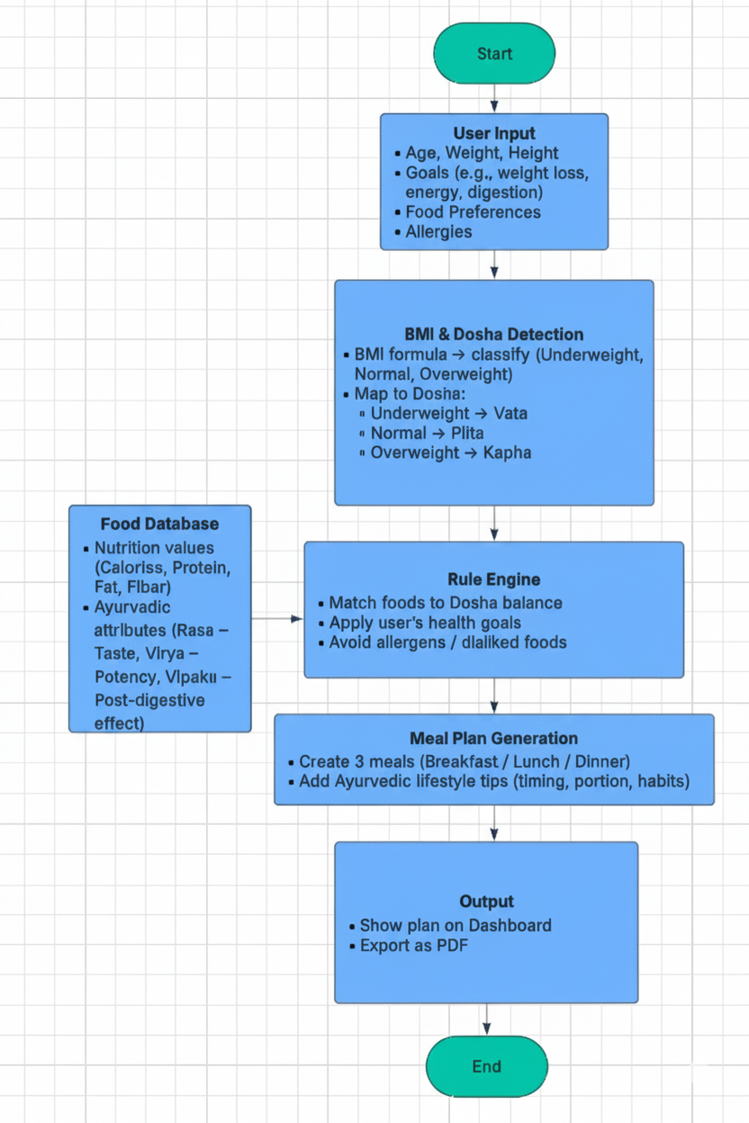
TECHNICAL APPROACH
Digital
Dynamo
Technologies to be used
Programming Language :- Java
Framework :- Spring Boot
Build Tool :- Maven
Database :- MySQL
Frontend :-
  React
  JavaScript
  CSS
  HTML
Deployment :-
  AWS for scalable hosting
  Docker for containerization
  GitHub for version control
  GitLab for CI/CD

Slide 4
FEASIBILITY AND VIABILITY
Digital
Dynamo
Feasibility
This means: Is it possible to make this software with the available tools, time, and skills?
  Technically Possible: Yes! Tools like React , java and databases like MySQL can easily handle diet charts, patient data, and Ayurvedic food properties.
  Team Skills: A small team with developers, designers, and one Ayurvedic expert can build a basic working prototype in a few weeks.
Viability
This means: people use it? Can it grow into a successful product?
  Useful for Hospitals: Ayurvedic hospitals and clinics need digital tools to replace handwritten diet charts.
  Easy to grow : Can be expanded to support multiple languages, regions, and even modern hospitals.
  Market Demand: Ayurveda is growing in India and abroad. Doctors and patients want personalized care.
  Revenue Potential: Clinics can subscribe to the software, or hospitals can integrate it into their systems.

Slide 5
IMPACT AND BENEFITS
Digital
Dynamo
IMPACT AND BENEFITS
Digitizes Ayurvedic diet planning fast and accurate—no more manual charts.
Saves doctors’ time by automating diet chart creation , so doctors can focus more on patients.
Combines Ayurvedic wisdom with modern nutrition science for better results.
Gives clear food guidance, which helps improve recovery and overall wellness.
Enhances data privacy with secure patient records.
Benefits of the solution
  Social Benefits
    Helps people get personalized, healthy diets based on Ayurveda.
    Makes healthcare more accessible, even in rural areas.
  Economic Benefits
    Saves time and money for doctors and hospitals.
    Creates new jobs in tech, wellness, and Ayurvedic services.
  Environmental Benefits
    Promotes seasonal and local food choices, reducing food transport.
    Reduces paper use by switching to digital diet charts.

Slide 6
RESEARCH AND REFERENCES
Digital
Dynamo
Ayurvedic References
Ministry of AYUSH Guidelines on Ayurvedic diet practices
🔗 https://www.ayush.gov.in
Nutrition & Health References
World Health Organization (WHO) – Reports on global nutrition & health management
🔗 https://www.who.int/health-topics/nutrition
Springer Research – AI-based personalized nutrition systems and healthcare applications
🔗 https://link.springer.com
Conclusion
“In conclusion, our Ayurvedic Diet Management Software is not just a tool—it’s a bridge between ancient wisdom and modern technology. It saves time, improves patient care, supports doctors, and contributes to a healthier, more sustainable future. Thank you. “

