Slide 1
Big Data Analytics Project Predictive Regression Model using PySpark
Group Name: - DEVDYNAMOS
Team Members :-
Subrat Malik Shyam Sundar Bala Amlan Jyoti Parida Basak Pramanik Swagnik Shit Swattik Shit Bijaya Kumar Rout Chandan Goria Sai Sankar Sethi Brajendra Prasad Samal Rakesh Samal Alok Kumar Bisoi
Problem Statement:
Explore Ethereum price fluctuations, clean and validate the dataset, apply regression models to forecast price trends, and report findings with plots and insights.

Slide 2

Objective
This project aims to develop a comprehensive pipeline for Ethereum price forecasting using scalable Big Data technologies and machine learning models.
Specific Objectives
Perform data exploration and descriptive analysis using PySpark and Pandas
Apply data cleaning, preprocessing, feature engineering, and validation steps
Construct and train regression models using Spark MLlib
Assess model accuracy through RMSE, MAE, and R² metrics
Visualize predictions and insights using Matplotlib, Seaborn, and Plotly
Generate a reliable forecasting workflow suitable for large-scale datasets

Slide 3
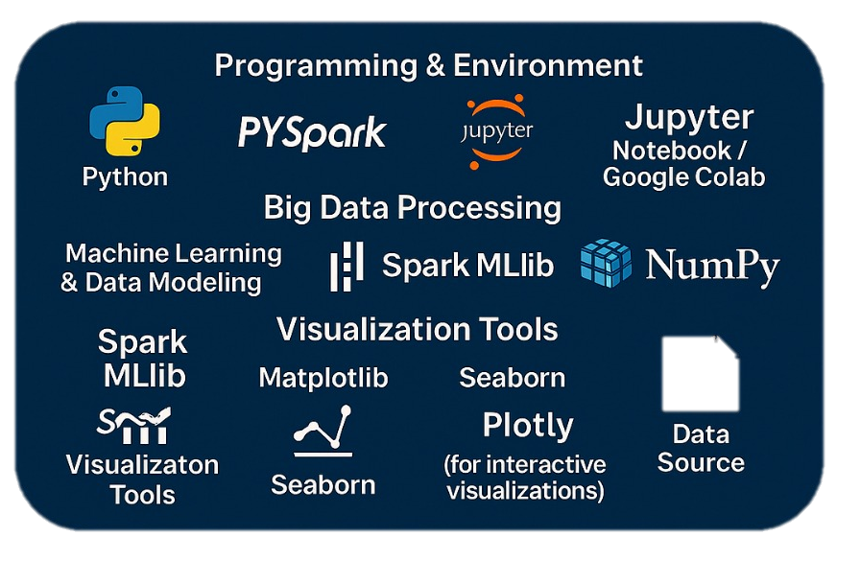
Technology Stack Overview
Programming & Environment
Python
Jupyter Notebook / Google Colab
Big Data Processing
PySpark
Spark SQL
Machine Learning & Data Modelling
Spark MLlib
Vector Assembler, Regression Models, Cross Validator
Data Analysis & Numerical Computing
Pandas
NumPy
Visualization Tools
Matplotlib
Seaborn
Plotly (for interactive visualizations)
Data Source
CSV dataset file

Slide 4
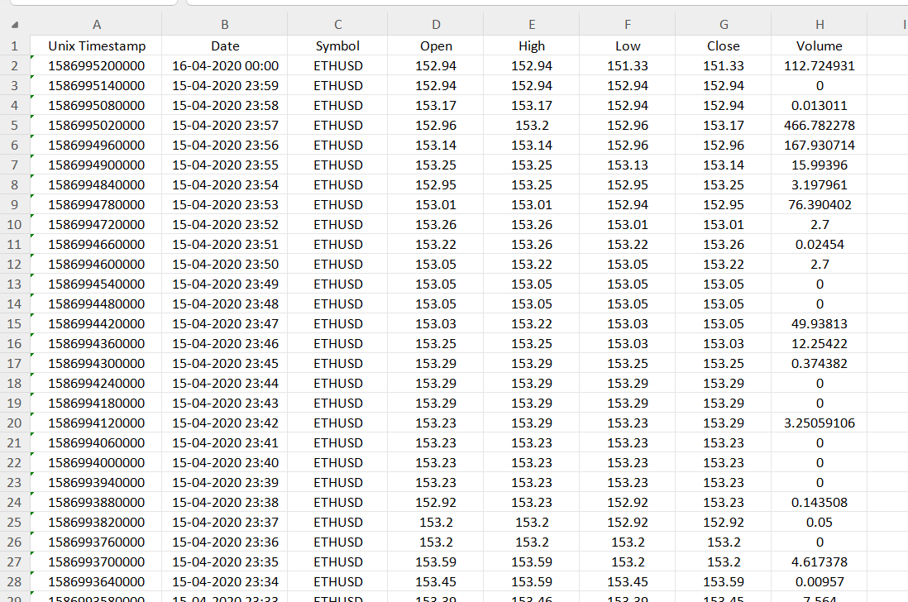
Data Collection & Dataset Description
Dataset collected from Kaggle
Dataset Columns:Unix Timestamp (record time), Date (readable timestamp), Symbol (ETHUSD), Open (opening price), High (highest price), Low (lowest price), Close (closing price), Volume (trading volume).
The data is ideal for time-series analysis, regression modeling, and price prediction tasks using PySpark.

Slide 5
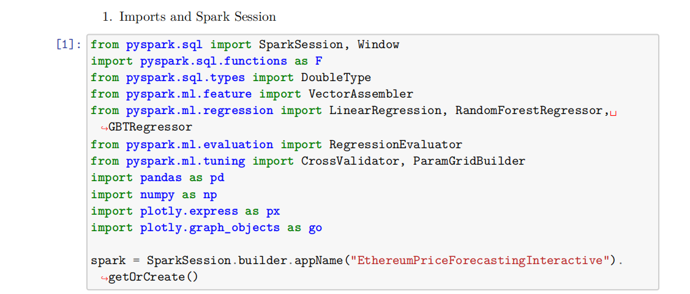
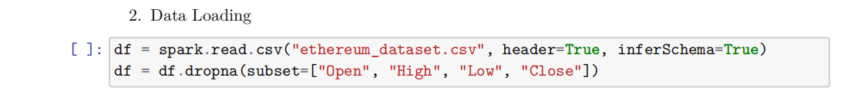
Dataset Loading
Steps performed:
Imported necessary PySpark libraries
Created Spark Session
Loaded the dataset into a Spark Data Frame

Slide 6
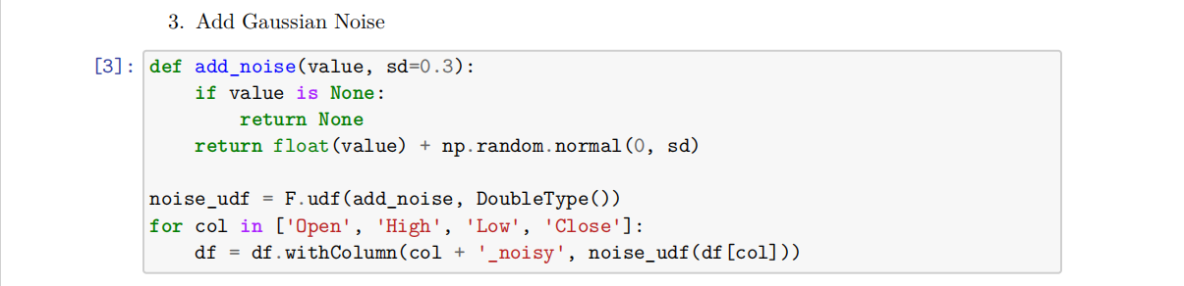
Adding Gaussian Noise
Why Gaussian Noise was added:
To make the model more robust
To simulate real-world variation
Helps avoid overfitting

Slide 7
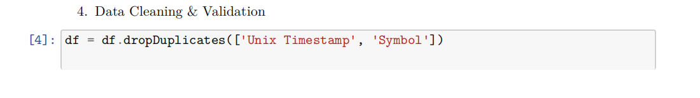
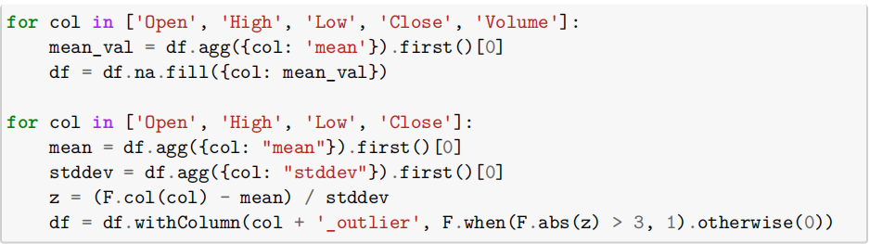
Data Cleaning & Validation
Tasks performed:
Removed missing or null values
Fixed incorrect datatypes
Handled outliers
Validated feature consistency

Slide 8
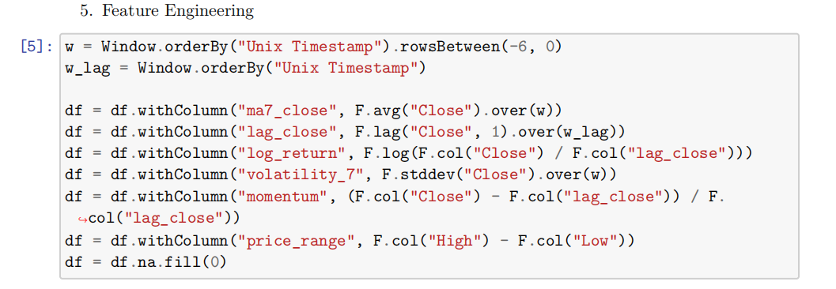
Feature Engineering
Steps performed:
Feature transformation
Normalization / scaling
Creating meaningful derived features
Selecting relevant inputs for regression

Slide 9
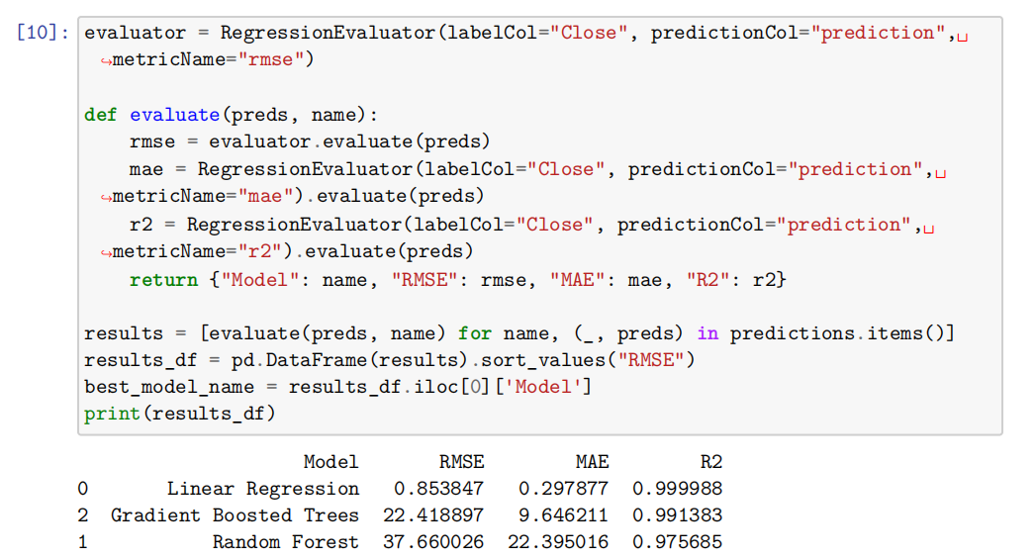
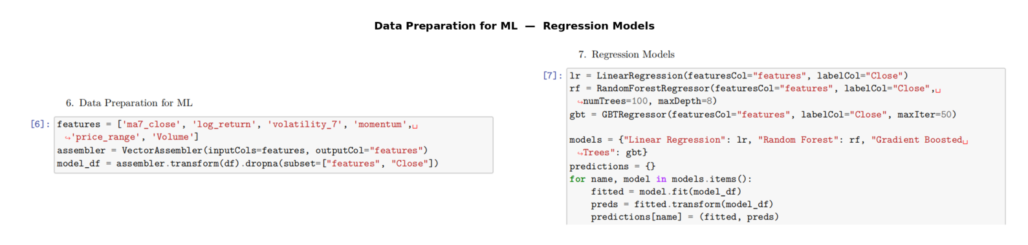
ML Data Preparation
Model Evaluation
Split data into train and test sets
Converted features into a single vector column
Selected regression model (e.g., Linear Regression / RandomForestRegressor)

Slide 10
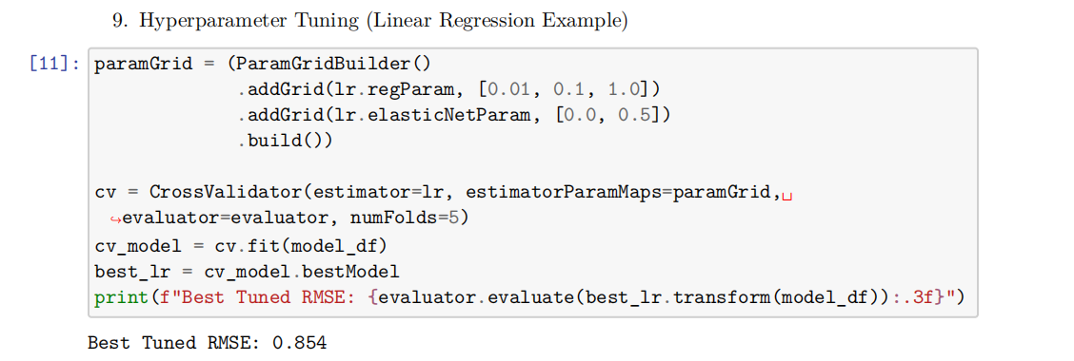
Hyperparameter Tuning
Used CrossValidator / ParamGridBuilder
Tuned parameters like:
maxIter
regParam
elasticNetParam
Selected best model based on RMSE

Slide 11
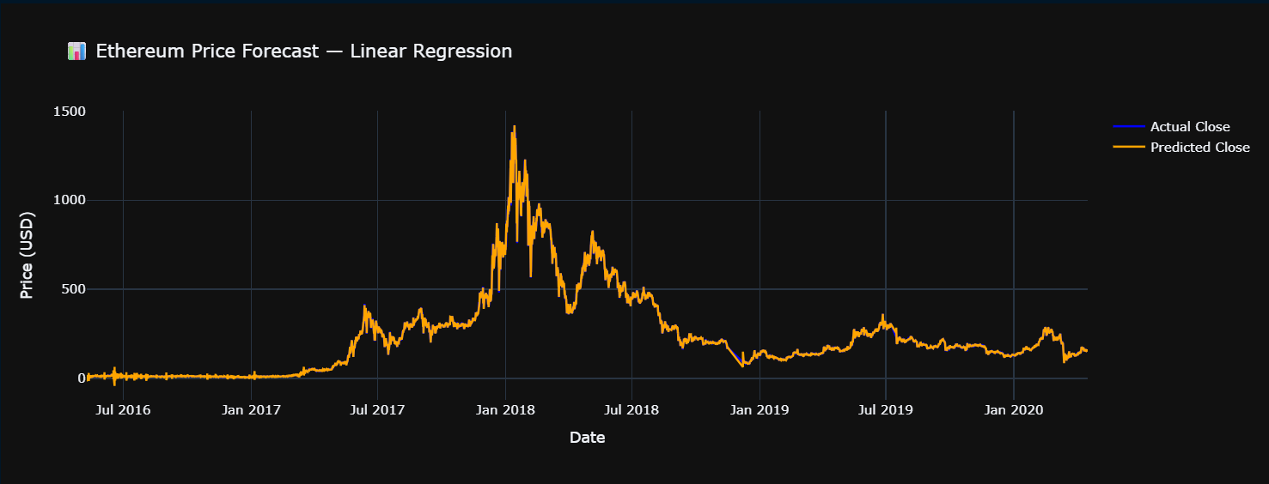
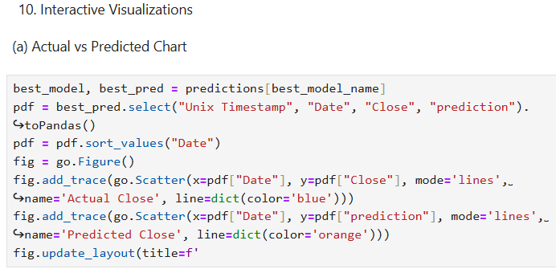
Actual vs Predicted Values
Interpretation:
Compares actual target values with model predictions
Helps check if the model is underfitting/overfitting

Slide 12
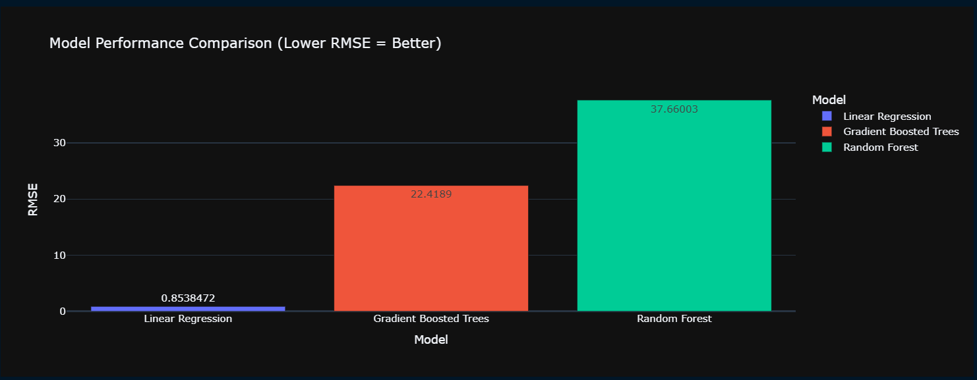
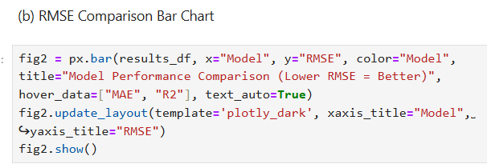
RMSE Comparison (Bar Chart)
RMSE used as performance metric
Compared different models or parameter sets
Best model showed lowest RMSE score

Slide 13
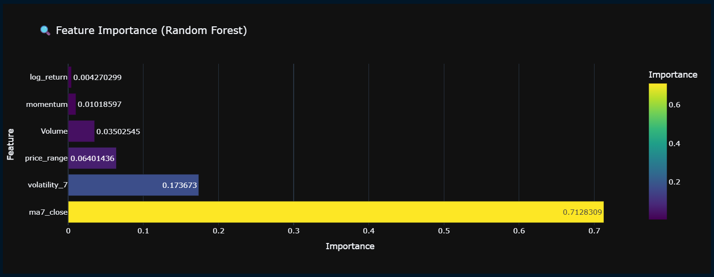
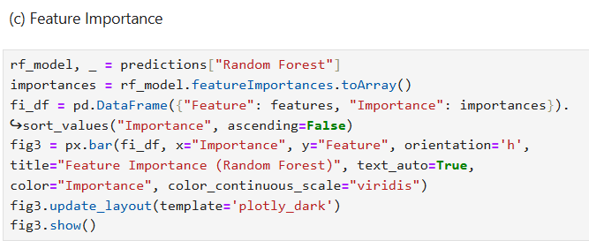
Feature Importance
Shows which feature affect the prediction most
Helps understand model’s decision-making
Useful for insights & improvements

Slide 14
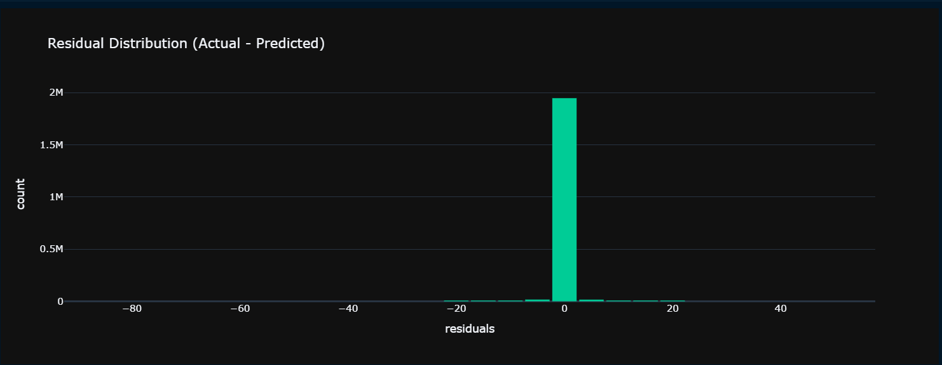
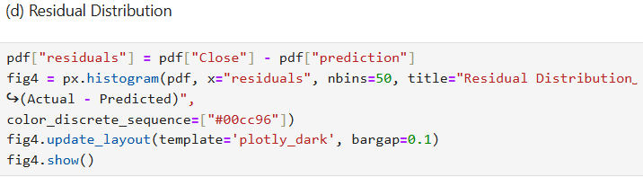
Residual Distribution
Residuals = Actual – Predicted
A good model has residuals centered around zero
Helps diagnose model errors

Slide 15
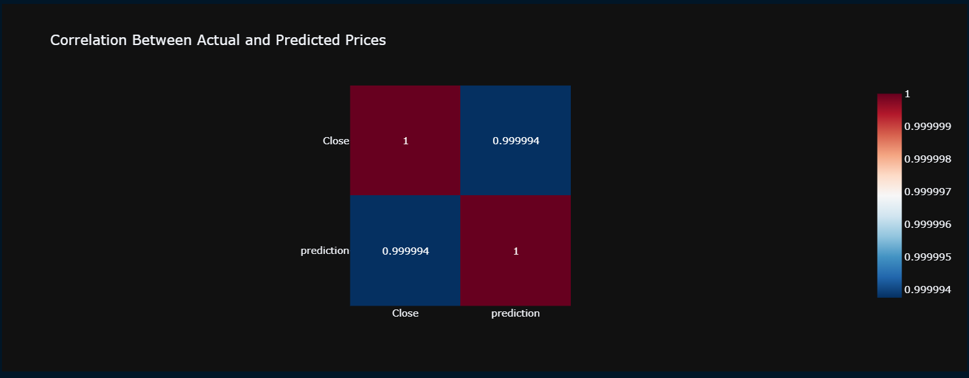
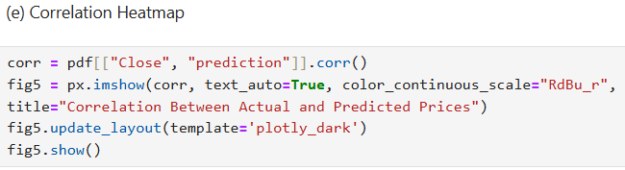
Correlation Heatmap
Shows relationship strength among features
Helps identify multicollinearity
Used for feature selection

Slide 16
Conclusion & Scope for Improvement
Conclusion:
Successfully built a PySpark regression model
Gained insights through data cleaning, engineering, and ML workflow
Best model achieved good performance (mention RMSE)
Scope for Improvement:
Use more advanced ML algorithms
Hyper-tune with more parameters
Add more data for better generalization
Try deep learning or ensemble models

