Slide 1

Jenkins Health Monitoring, Metrics Collection & Automated Scoring System
Group Name: - DEVDYNAMOS
Team Members :-
Subrat Malik
Shyam Sundar Bala
Amlan Jyoti Parida
Basak Pramanik
Swagnik Shit
Swattik Shit
Bijaya Kumar Rout
Chandan Goria
Sai Sankar Sethi
Brajendra Prasad Samal
Rakesh Samal
Alok Kumar Bisoi

Slide 2




Problem Statement
Health Monitoring
Monitor Jenkins job health and performance in real-time to identify bottlenecks and failures before they impact delivery pipelines.
Metrics Collection
Collect comprehensive metrics using Prometheus to track build success rates, resource utilisation, and system stability.
Visualization
Build Grafana dashboards for real-time insights into Jenkins performance, enabling data-driven decision-making.
Automated Scoring
Develop a Python scoring engine to quantify Jenkins health and security posture through weighted algorithmic assessment.

Slide 3

Project Objectives
Set up a functional Jenkins CI environment.
Integrate Prometheus for real-time metric scraping.
Build Grafana dashboards for effective visualization.
Process collected metrics using Python
Compute Jenkins health and security scores.
Export results as JSON and generate a visual score chart.

Slide 4
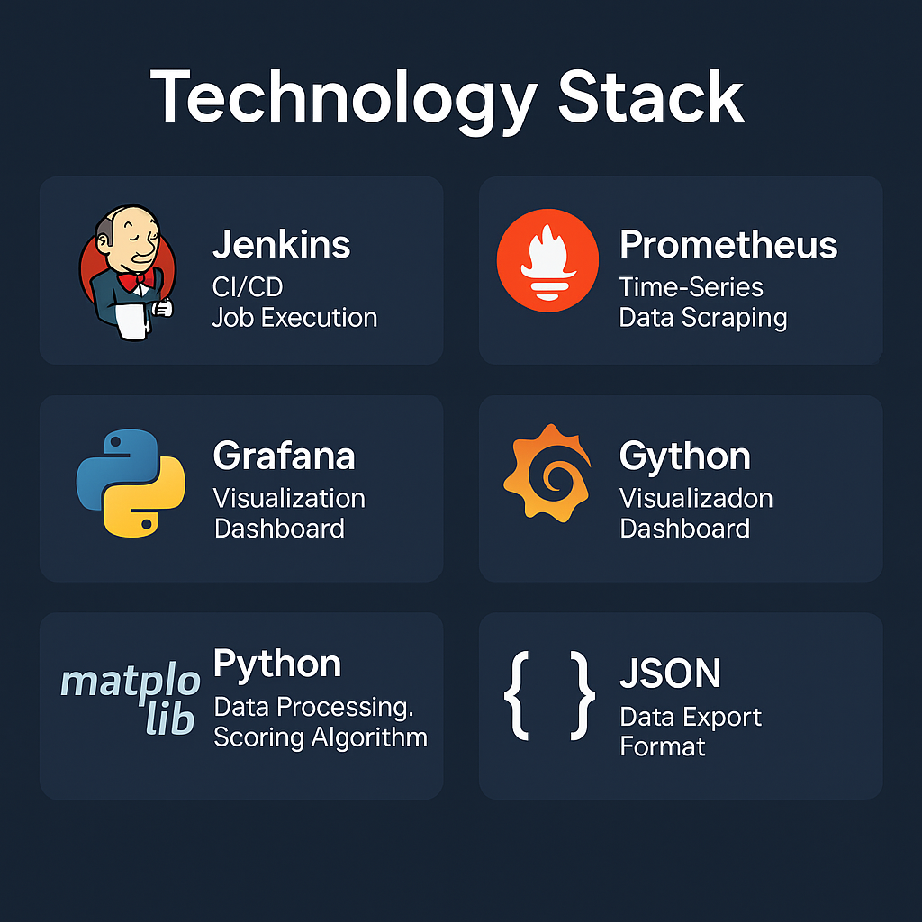
Technology Stack
Tools | Function | Version
Jenkins | CI/CD Job Execution | 2.528.1
Prometheus | Time-series data scraping | Latest
Grafana | Visualization dashboard | Latest
Python | Data processing, scoring algorithm | 3.9+
Matplotlib | Score visualization | Latest
JSON | Data export format | Standard

Slide 5





System Architecture
The monitoring pipeline follows a multi-stage architecture where Jenkins exposes metrics, Prometheus collects and stores them, Grafana provides visualisation, and Python performs advanced analysis.
Jenkins
Exposes metrics via Prometheus plugin
Prometheus
Scrapes and stores time-series data
Grafana
Visualises metrics in real-time
Python Script
Consumes API, calculates scores, exports results

Slide 6
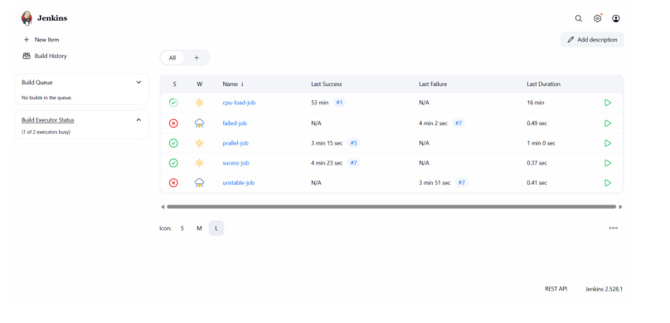
Jenkins Environment Setup
Configuration Details
  Installed Jenkins version 2.528.1 with latest security patches
  Configured test jobs: success-job, failed-job, unstable-job, and cpu-load-job
  Enabled Prometheus metrics plugin for metric exposure
  Activated "Add build status label" for enhanced tracking
The Jenkins instance serves as the foundation for our monitoring infrastructure, providing the metrics that drive our health scoring system.

Slide 7
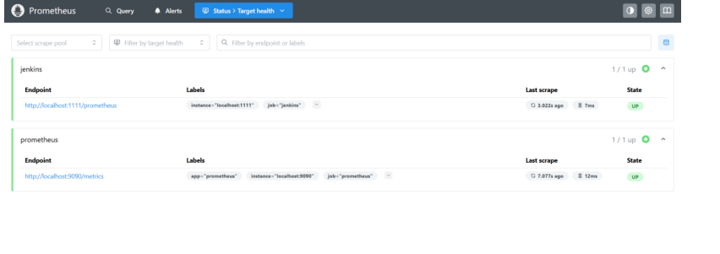
Prometheus Integration
Jenkins exposes build metrics under the prefix default_jenkins_builds_last_build_result, allowing Prometheus to scrape and store job execution data.
Jenkins added as a Prometheus scrape target
Metrics available under /Prometheus
Scrape status: UP

Slide 8
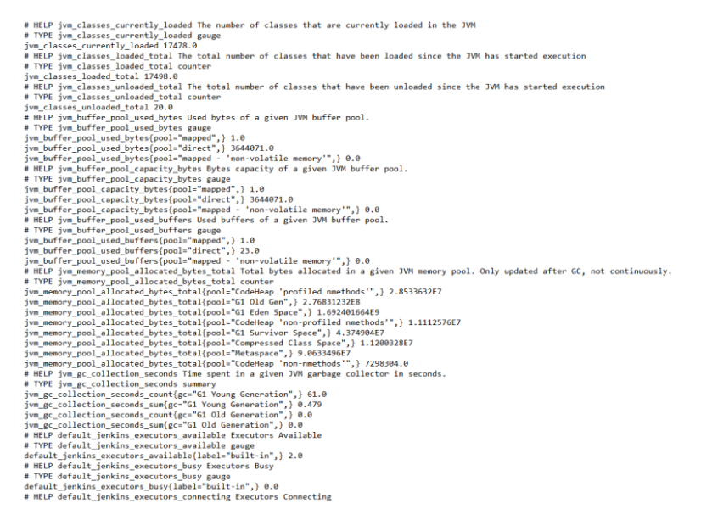
Prometheus Metric Endpoints
Jenkins exposes metrics under prefix:
default_jenkins_builds_last_build_result
Used PromQL queries:
    SUCCESS -> == 0
    FAILURE -> == 1
    UNSTABLE -> == 2
    ABORTED -> == 3

Slide 9
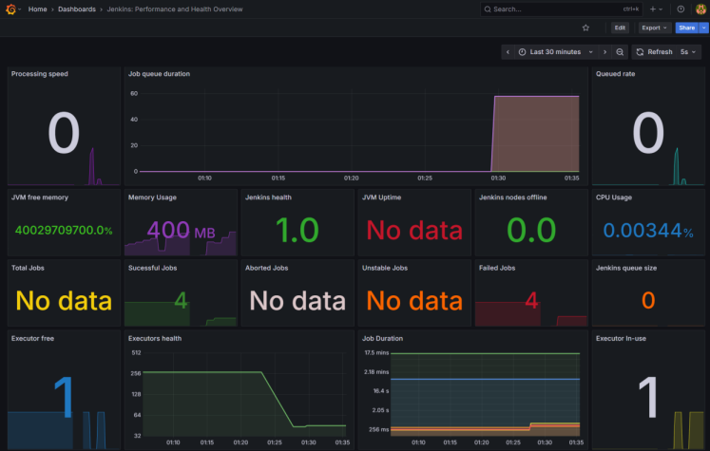
Grafana Dashboard
Comprehensive Visual Insights
Monitor CPU utilization, memory consumption, executor availability, and job counts across all pipeline stages.
Time-Series Analysis
Track metric trends over configurable time ranges to identify patterns, anomalies, and performance degradation.
Real-Time Updates
Dashboard refreshes every 5 seconds, ensuring DevOps teams have immediate visibility into system state changes.

Slide 10
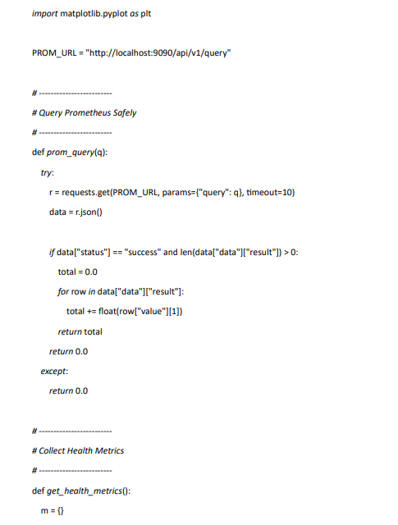
Python-Based Metric Processing
Automated Analysis Pipeline
The Python script serves as the intelligence layer, fetching metrics from Prometheus API endpoints and applying sophisticated scoring algorithms.
  Queries Prometheus HTTP API for Jenkins metrics
  Computes weighted health score based on multiple factors
  Calculates security score using simulated vulnerability data
  Generates JSON output for integration with other systems
  Creates visualisation graphs using Matplotlib

Slide 11
Health Metrics Computation
The health score employs a weighted model that prioritises build success whilst accounting for resource utilisation and system load.

Slide 12
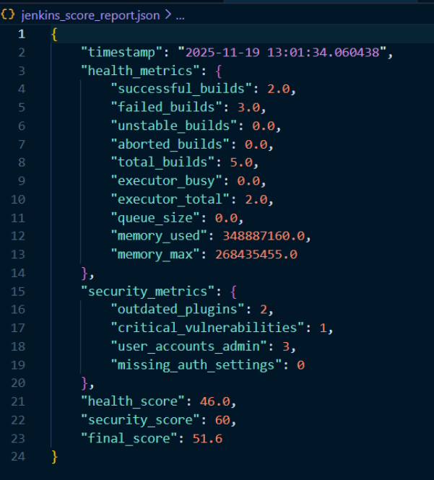
Security Metrics Computation
Variables (from simulated logic):
• outdated_plugins
• critical vulnerabilities
• admin users
• missing authentication
Security Score formula: score = 100 - penalties
Final Score Computation
Final Score Formula:
Final Score = (Health Score × 0.6) + (Security Score × 0.4)
Sample Output:
Health: 46.0
Security: 60.0
Final: 51.6

Slide 13
Visualization Output
60.0
51.1
46.0

Slide 14

Results & Insights
      Jenkins has moderate health
      Memory usage is high → decreasing score
      Build failures impacting stability
      Security risks due to outdated plugins/admin users
      Grafana dashboards show real-time state
      Python scoring model provides data-driven assessment

Slide 15

Future Enhancements
Conclusion
Add Slack / email alerting based on low scores
Make dashboard interactive
Containerize the whole pipeline (Docker + Docker Compose)
Add ML-based anomaly detection
Store scoring history in database
Successfully built Jenkins Health Analysis System
Integrated Jenkins → Prometheus → Grafana → Python
Automated scoring system works with real metrics
JSON & visual outputs provide clear assessment
Useful for DevOps monitoring & decision-making

