Slide 1
Incident Handling Automation an update from CERT.AT and CERT.PT
L. Aaron Kaplan – kaplan@cert.at
Tomás Lima – tomas.lima@cert.pt

Slide 2
Overview
AbuseHelper – What‘s that?
New/Update: Document updates
New: Generic Sanitizer
New: LogCollector Bot
New: LogCollector Server (demo)
Update: ContactDB
Cooperation and outlook
How to participate

Slide 3
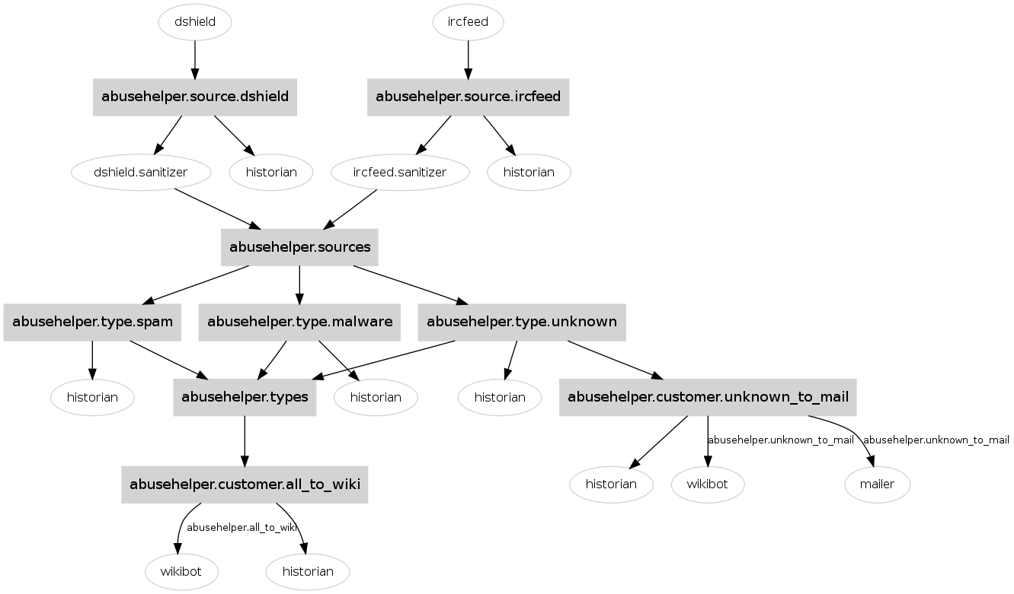
AbuseHelper – What‘s that?

Slide 4
AbuseHelper – What‘s that?
Sources: (X-) ARF, CSV, Email+CSV, IRC, …, STIX?
Screaming Experts: bots, which enrich flow
Output:
Filter + copy to other channel
Mail report
Put into ticket System, Wiki
Pro: very flexible, multiple CERTs use it
Con: DB, statistics/trending, transactions, not so easy to implement, no UI, documentation lacking, no human checking possible

Slide 5
Our Approach
Team up with other CERTs (→ and you!)
We are a small team, can‘t implement it all
Standardize / Harmonize incident handling processes
Help other CERTs to „run“
Share source code / modules: open source
Side effect: information sharing becomes much easier: you give not only people a feed, but also a parser / code / example code

Slide 6
New/Update: Document updates
Incident Handling Requirements Analysis [link]
AbuseHelper Installation Guide on Ubuntu Server (CERT-EU) [link]
Event Data Harmonization [link]

Slide 7
Generic Sanitizer
Problem: AbuseHelper feeds have non-uniform key/values. Example: host=1.2.3.4 or ip=1.2.3.4
Solution: feed all data through generic sanitizer, which unifies key-value names
How to use it:
Subclass the sanitizer from GenericSanitizer
Assign the field name mapping
Example output: status="online" source_name="Abuse.ch" event_type="citadel" asn="30496“ register_time="2013-09-24T23:41:07.338396“ as_name="COLO4 - Colo4, LLC“ host="trade4money.com" incident_type="C&C" country_code="US" ip="67.222.133.242“ incident_class="Malware"

Slide 8
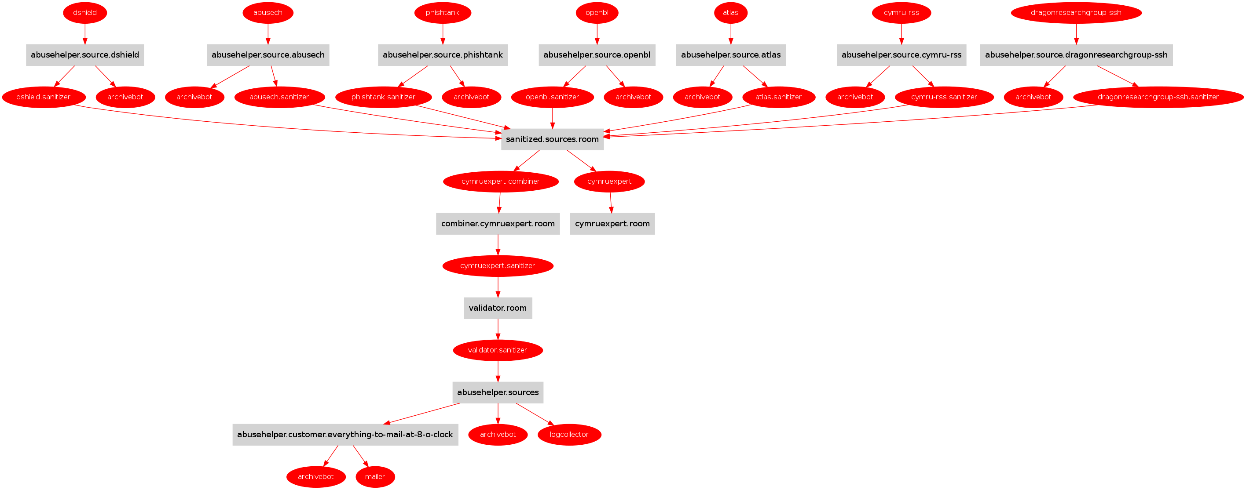

Slide 9
LogCollectorBot
Problem:
AbuseHelper does not come with a database for the logs
How to store all events so that we can easily search and get intelligence out of it?
Solution: new bot named LogCollectorBot
How does it work?
Send all events to an IP:Port (a LogCollector Server)
KISS principle ☺

Slide 10
LogCollector Server Logstash + ElasticSearch + Kibana
LogCollectorBot sends events from AbuseHelper to LogStash
LogStash can filter, handle and send the events to ElasticSearch (Database)
ElasticSearch can store/index events
Kibana is web-interface for ElasticSearch

Slide 11
LogCollector Server Kibana Screenshot + Demo

Slide 12
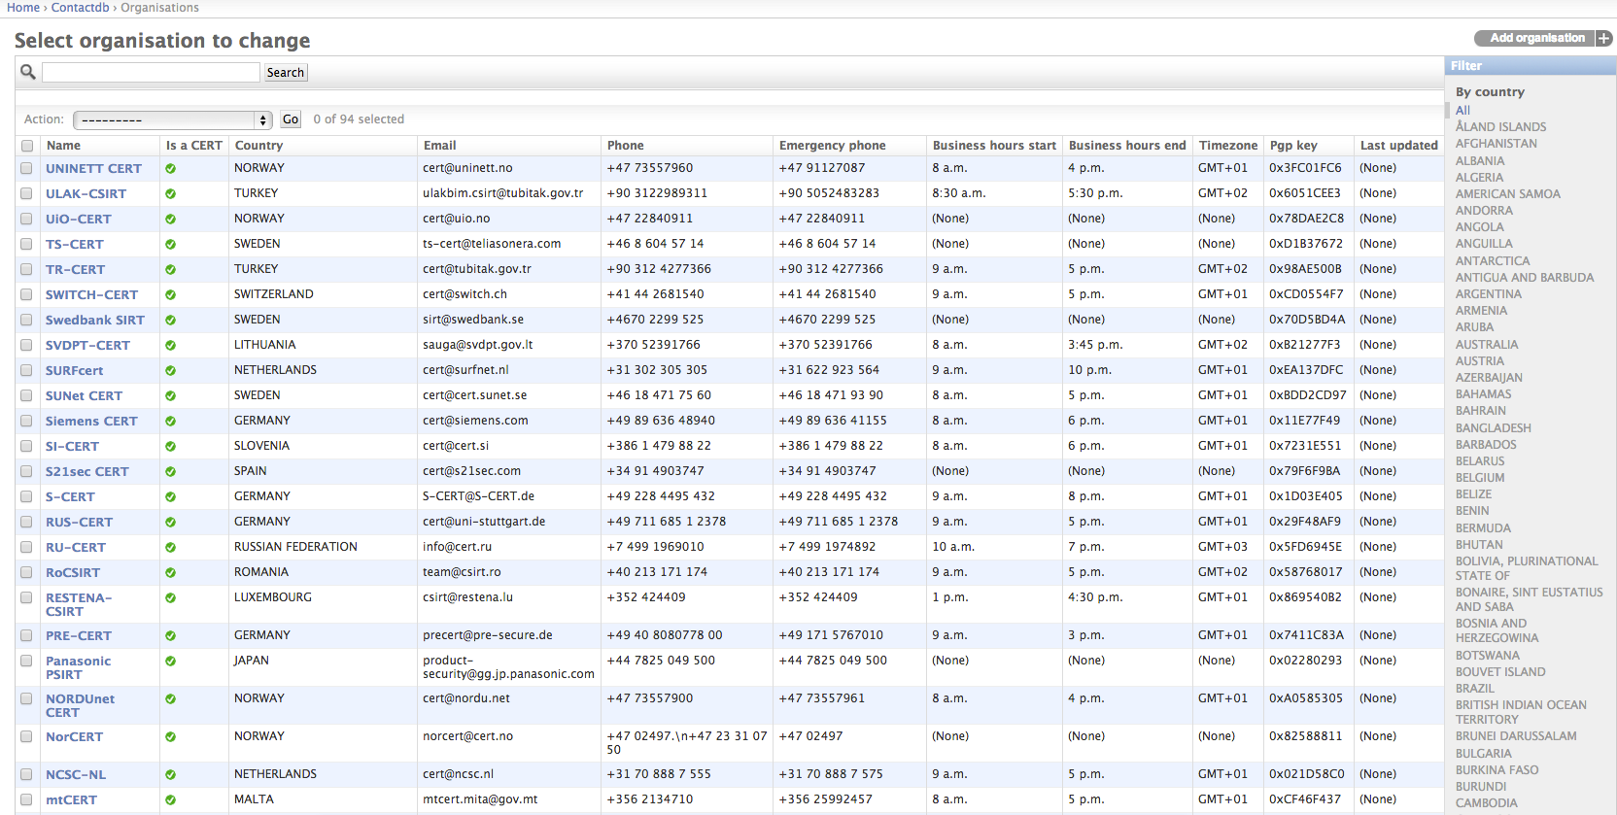
Update: ContactDB

Slide 13
Update: ContactDB Data
TI data automatically fetched and updated
Planned: FIRST DB
Whois cache (?)
Searches:
Give me the best match for ASN x
Give me the best match for netblock x
Give me the best match for domain x

Slide 14
Update: ContactDB ContactDB API
Built on tastypie
Automatically generate RESTful interface based on class model
Can query DB via HTTP. Example:
http://hostname/api/v1/country/?format=json&limit=200
http://hostname/api/v1/organisation/?format=json&organisation_name_endswith=CERT.at
http://hostname/api/v1/asn/?format=json&asn=AS1234

Slide 15
Update: ContactDB ContactDB Future
Exporters: VCARD, LDAP, keyrings
Whoisserver
Interface with stat.ripe.net/data/abuse-contact-finder
Permission system for RESTful API
Federation (?)
UI (not just admin interface)
Combine with XXX FIXME: contacts.cert.at XXX

Slide 16
Update: ContactDB TODO
Put on github,
check security of implementation
Finalize object model
UI
RESTful API
Get TI, FIRST, national CSIRT DB in there
(web service): filter functionality

Slide 17
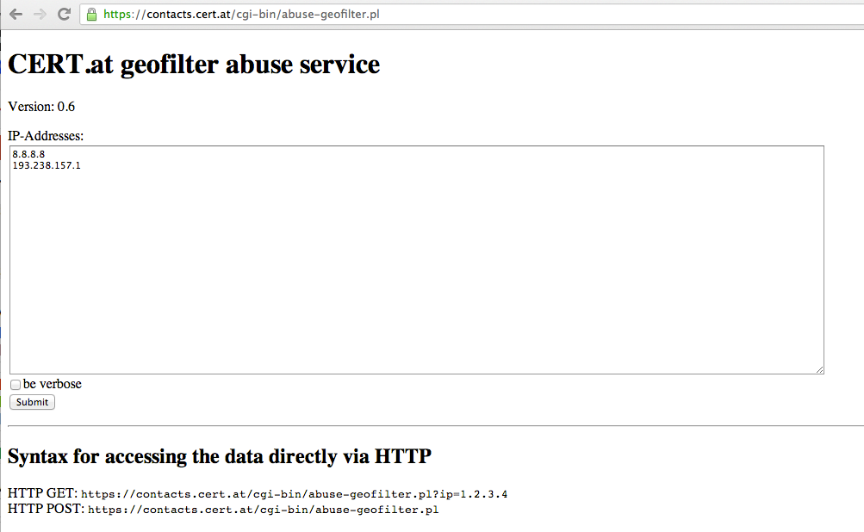
Update: ContactDB Web Service

Slide 18
Overview Picture
automatic Input
AH
manual Input
config
biz logic
REST
Web gui
eventDB
ticket system
scripts
email
Trending
web
contactDB
Archive DB
IMG
malware
basic data / supporting data
CRM/contacts
Web IF

Slide 19
How to participate
Fill this Aaron please…

Slide 20
How to participate Useful Links
AbuseHelper Share
https://bitbucket.org/ahshare/abusehelper-share
ContactDB
LogCollectorBot
https://bitbucket.org/clarifiednetworks/abusehelper/src/87270eaeb6b205db641dd1c0a290698b254829fc/abusehelper/contrib/logcollector?at=default

Slide 21
Thank you!

