Slide 1
SEQUENTIAL LOGIC
A circuit’s output depends on its previous state (condition) in addition to its current inputs
The state of the circuit is kept in memory devices
The state dependency is accomplished by feedback path

Slide 2
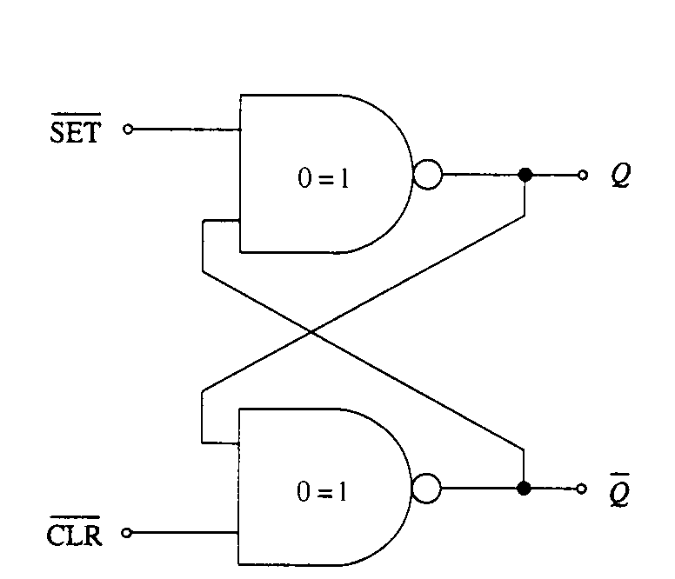
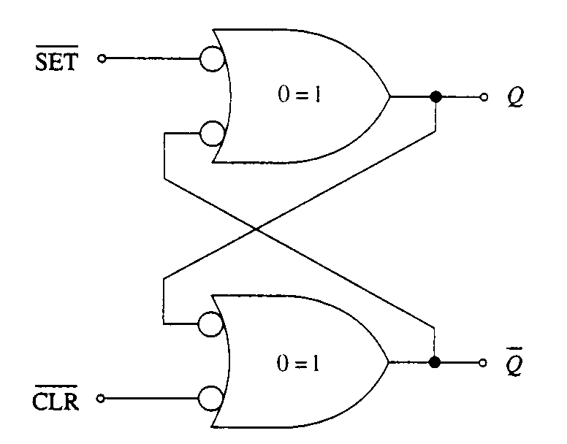
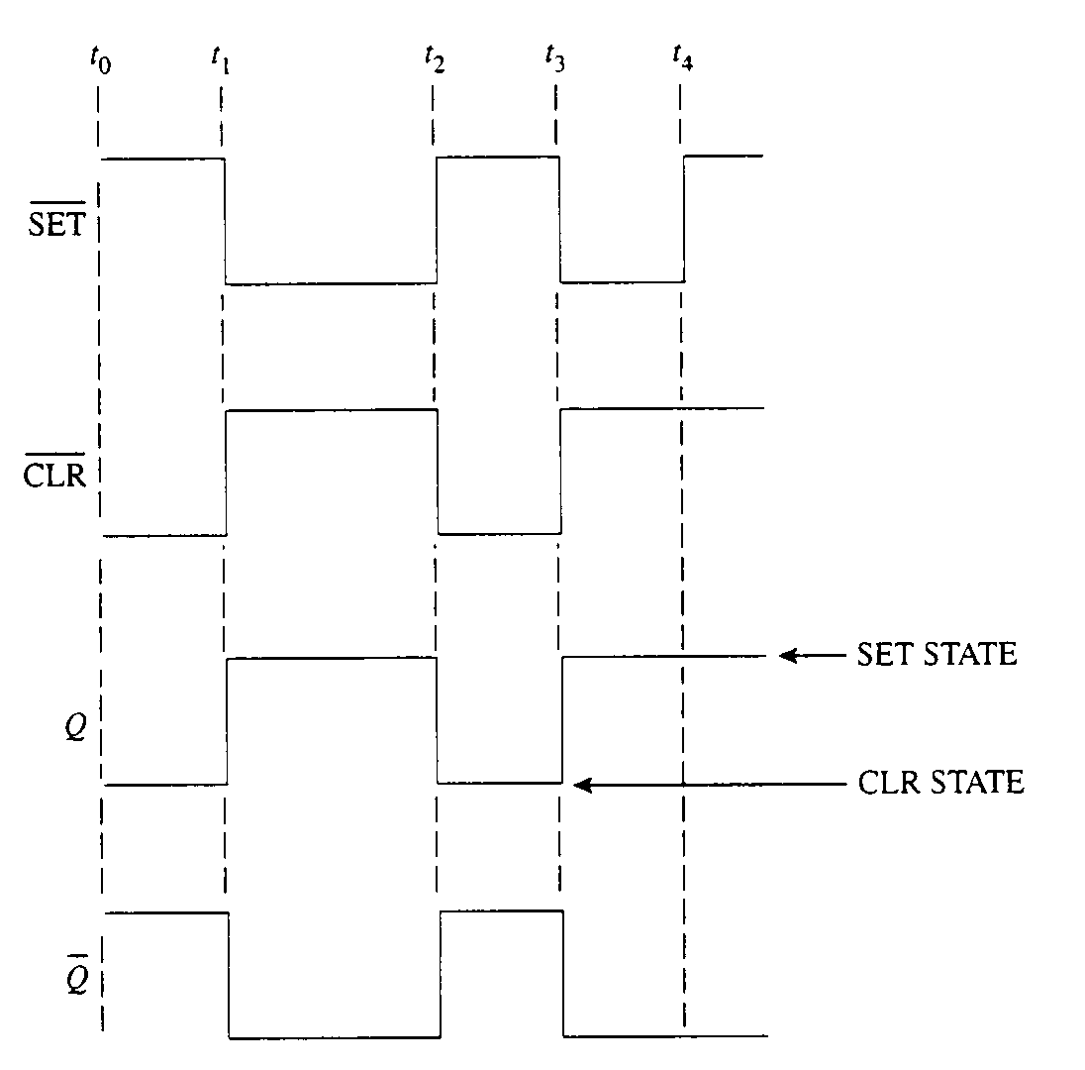
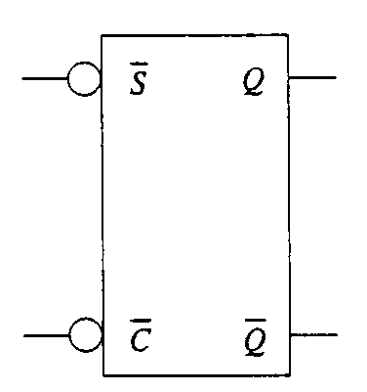
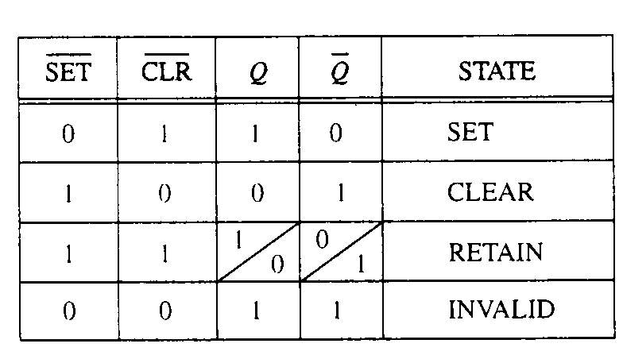
LATCH
Active Low

Slide 3
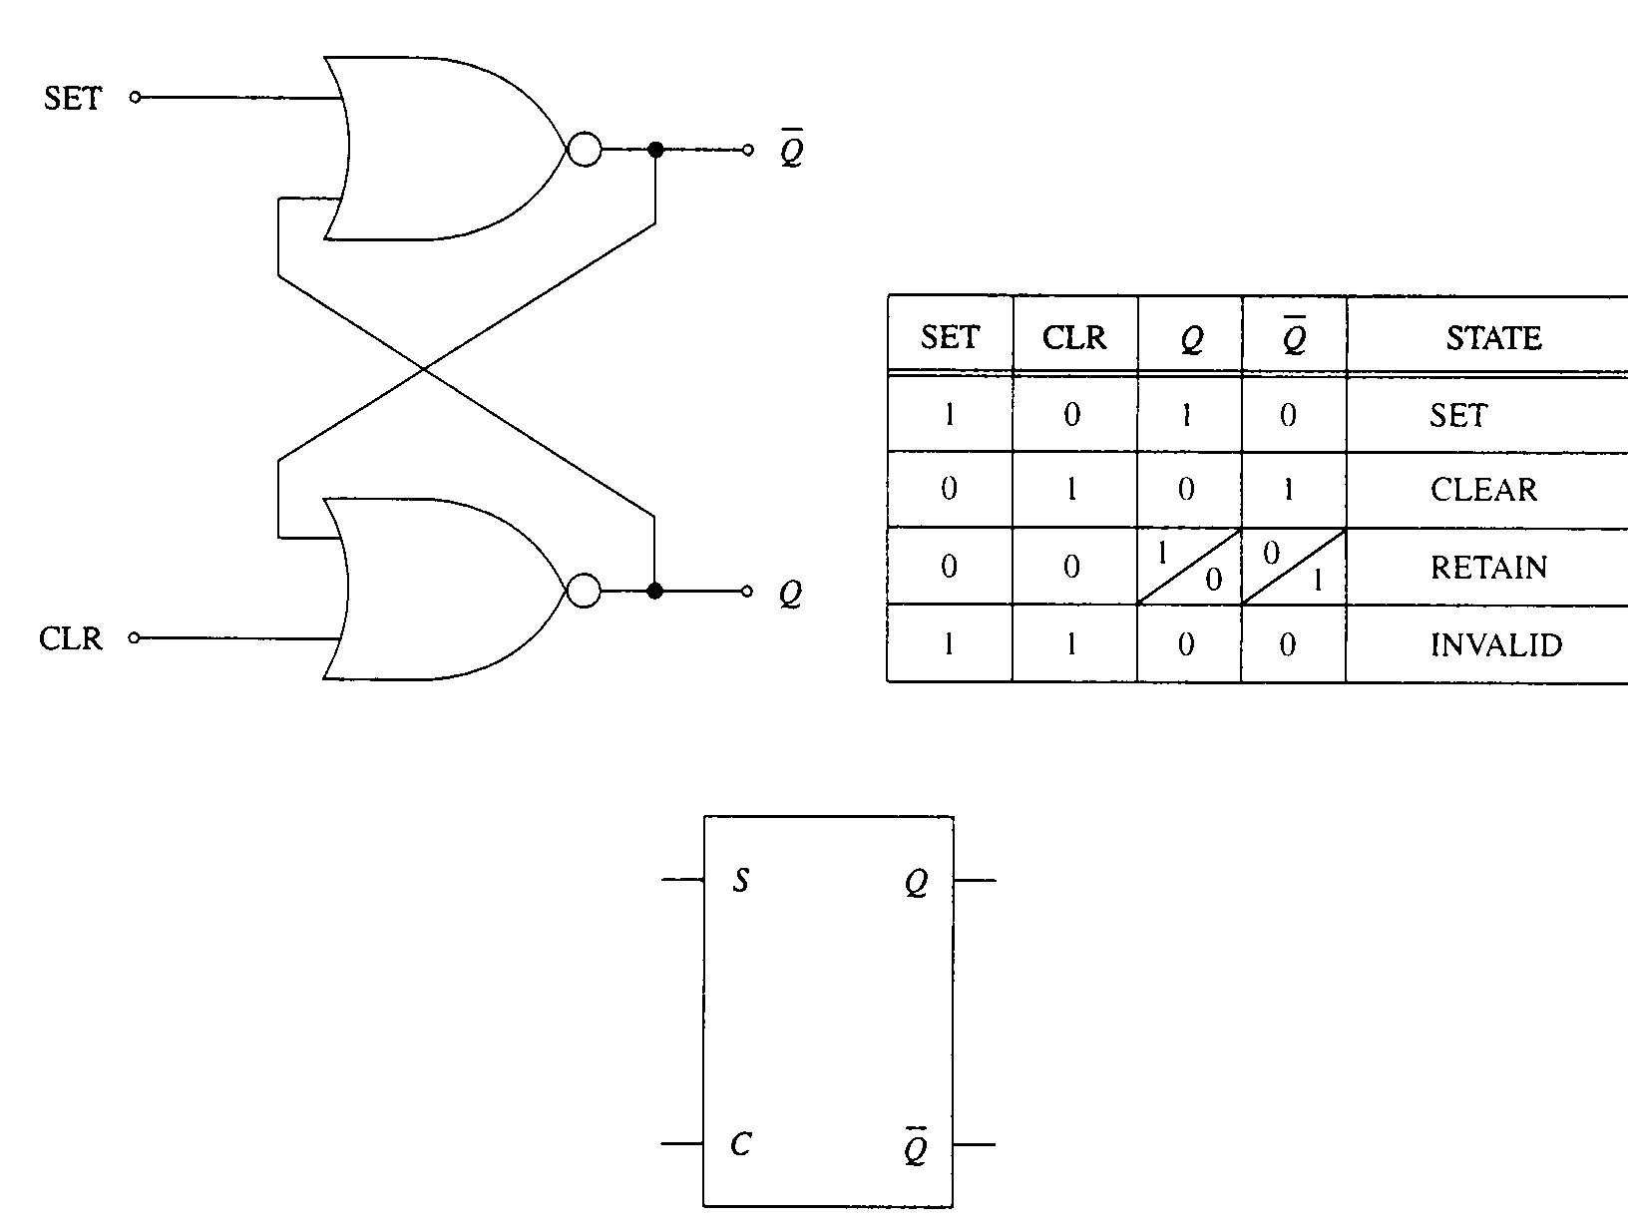
LATCH
Active High

Slide 4
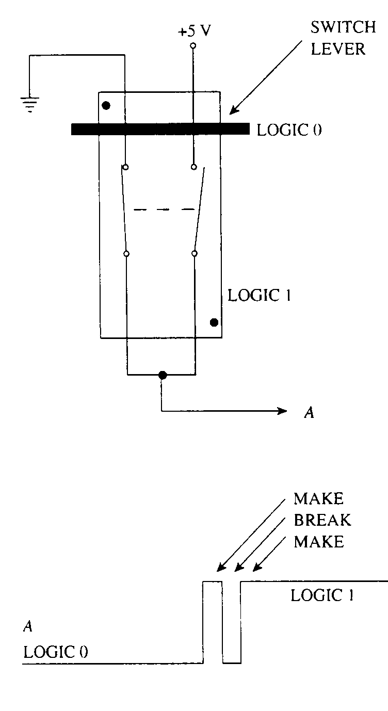
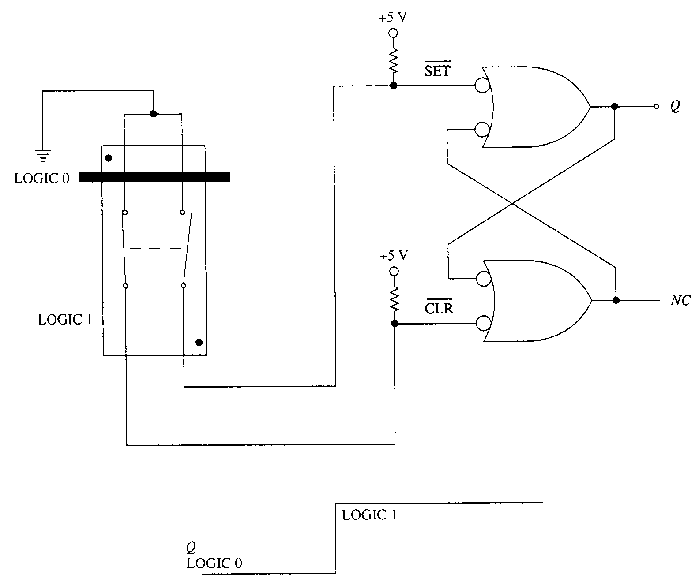
LATCH APPLICATION
Switch Debounce
  Almost all mechanical switches have contact bounce problem

Slide 5
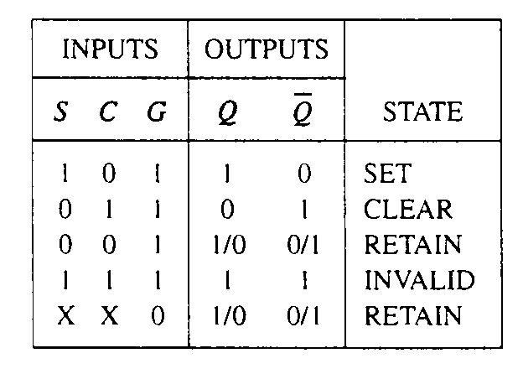
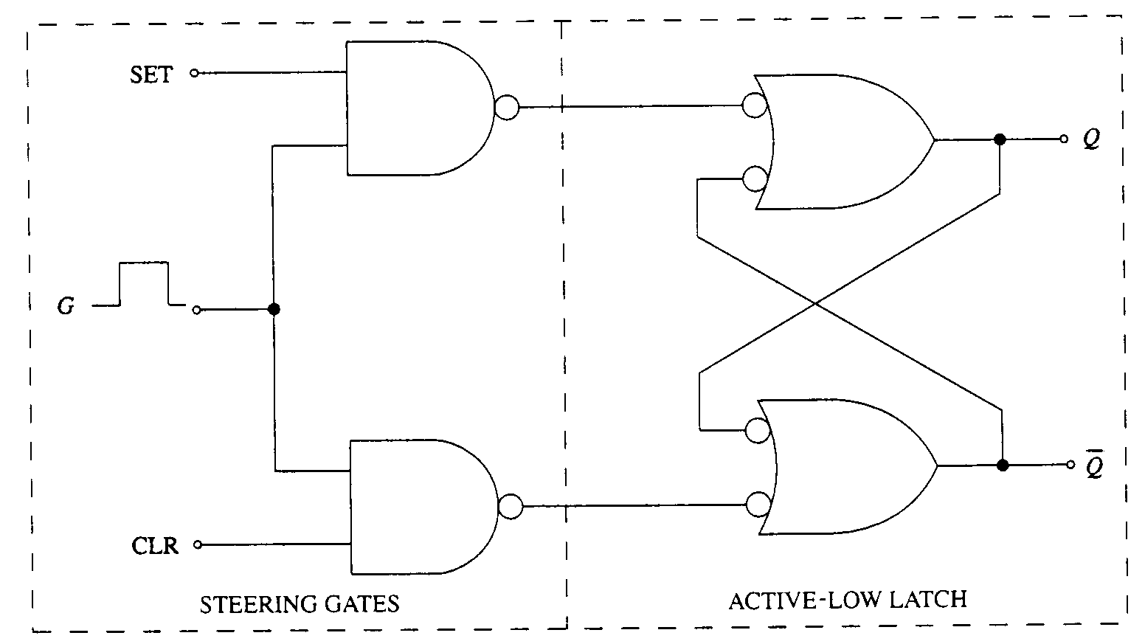
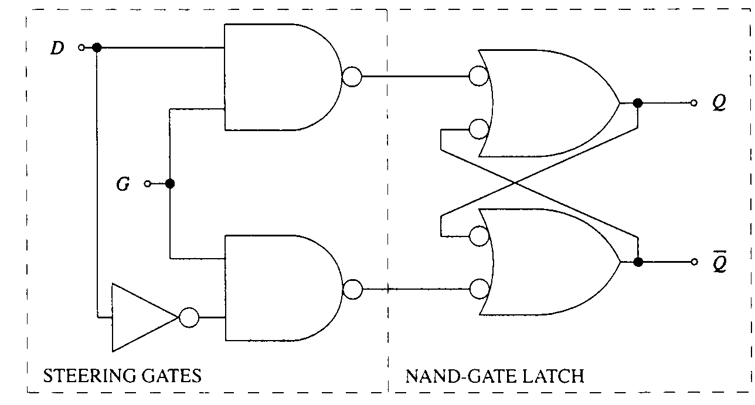
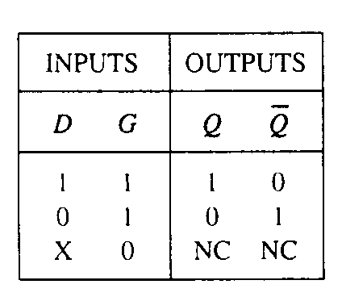
GATED-LATCH
Also known as level-triggered
S-C Type
D-Type

Slide 6
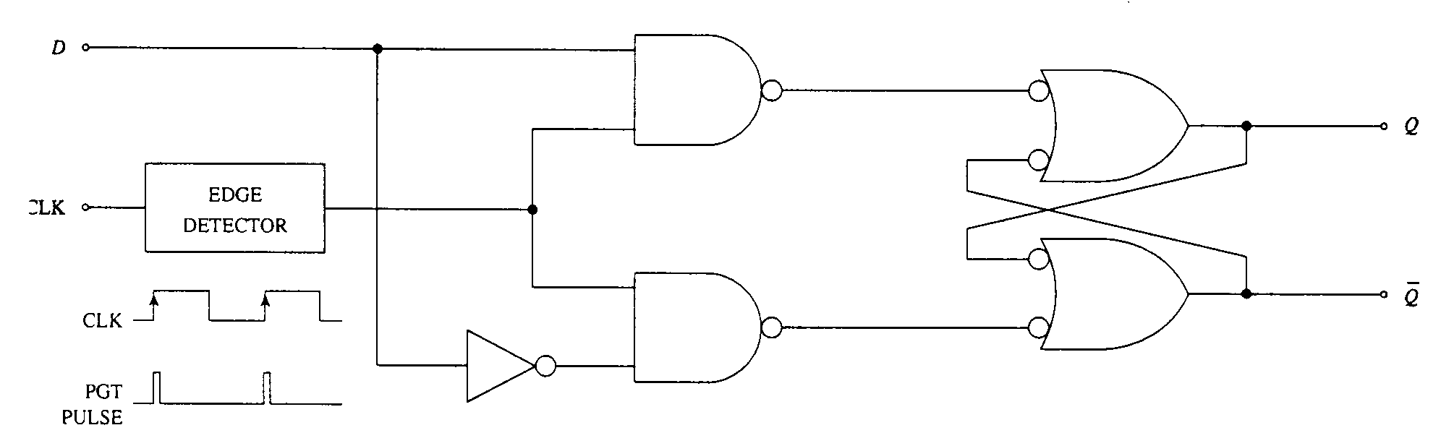
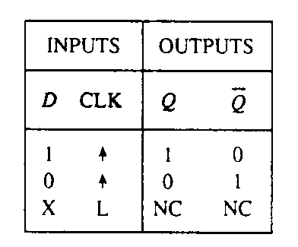
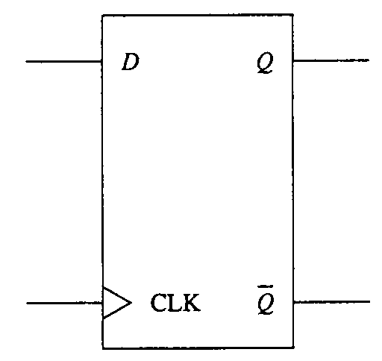
EDGED-TRIGGERED FLIP-FLOP
D-Type

Slide 7
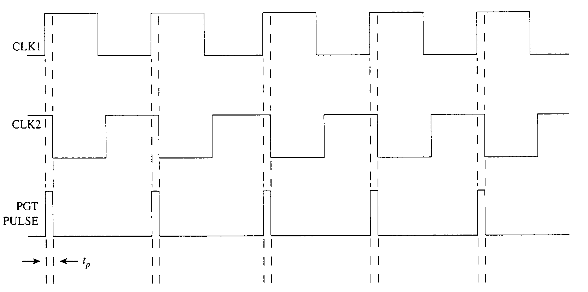
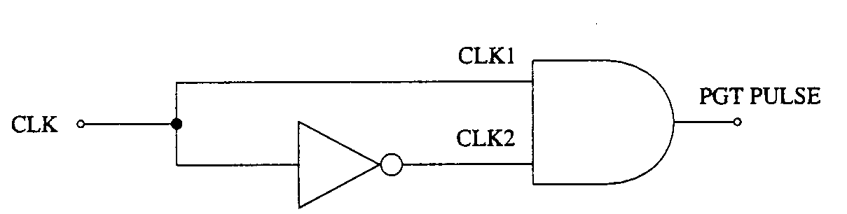
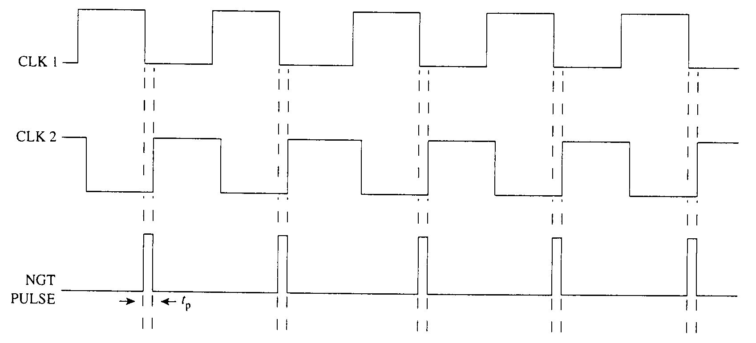
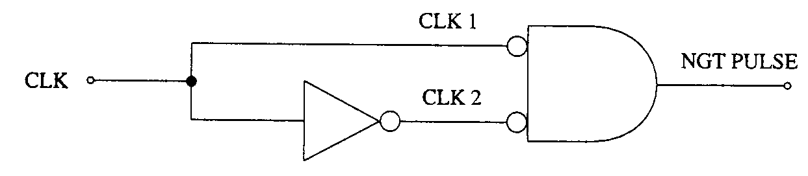
Positive-Edge Detector
Negative-Edge Detector

Slide 8
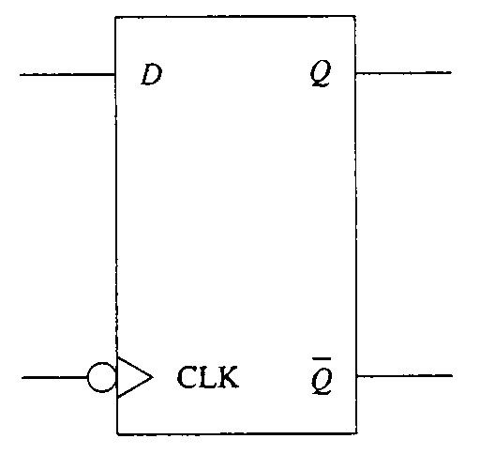
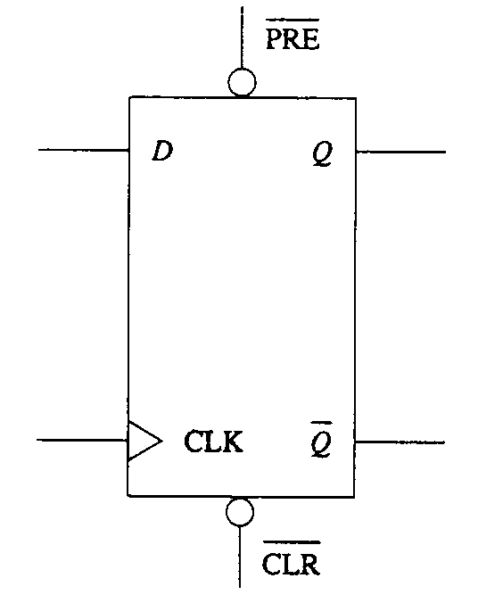
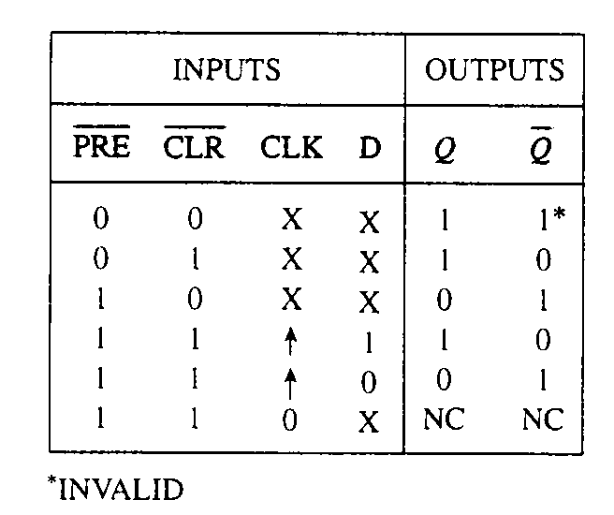
D-TYPE FLIP-FLOP VARIATIONS
Negative-Edge Triggered
With Asynchronous Controls

Slide 9
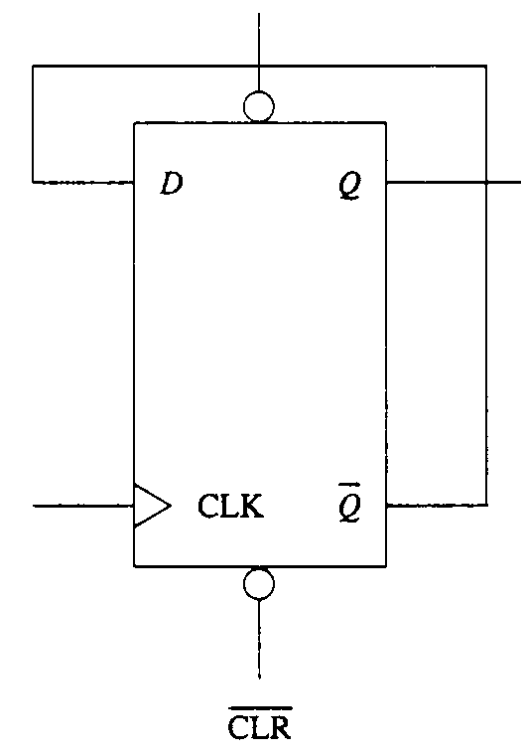
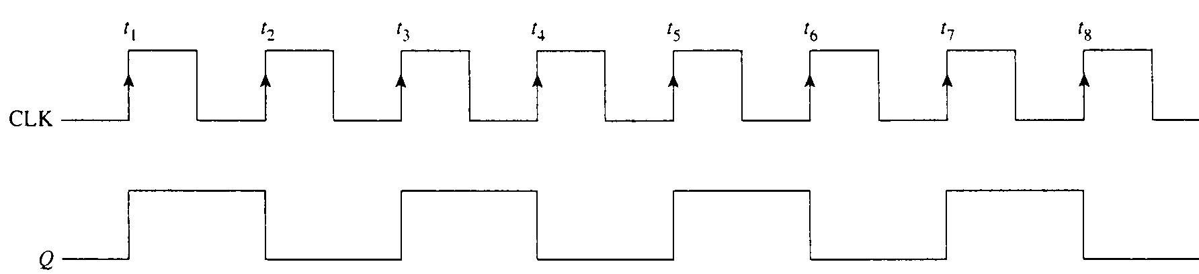
TOGGLE FLIP-FLOP
The flip-flop changes states on every active clock transition
From the waveform, one can observe that when a toggle flip-flop is continuously driven by a clock signal of frequency f_{in}, the output (Q) produces a repetitive waveform of frequency f_{out}=f_{in}/2
Divide-By-2 Circuit

Slide 10
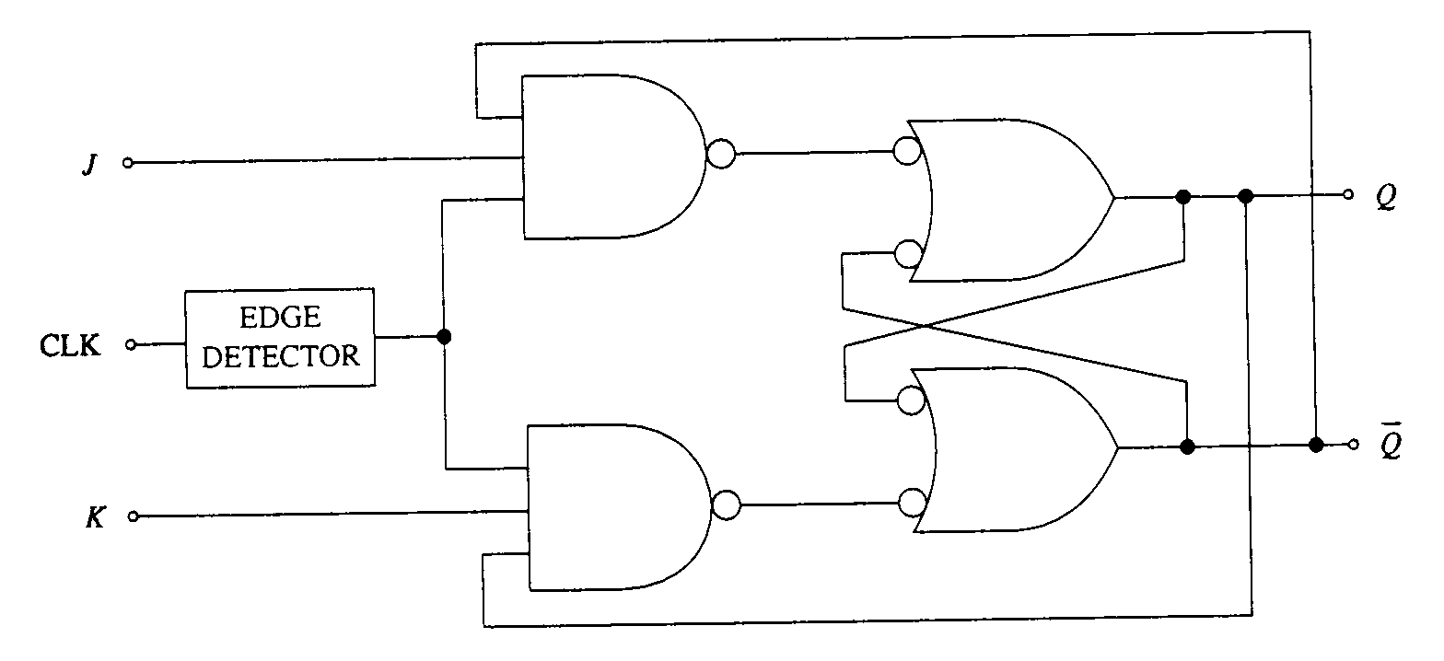
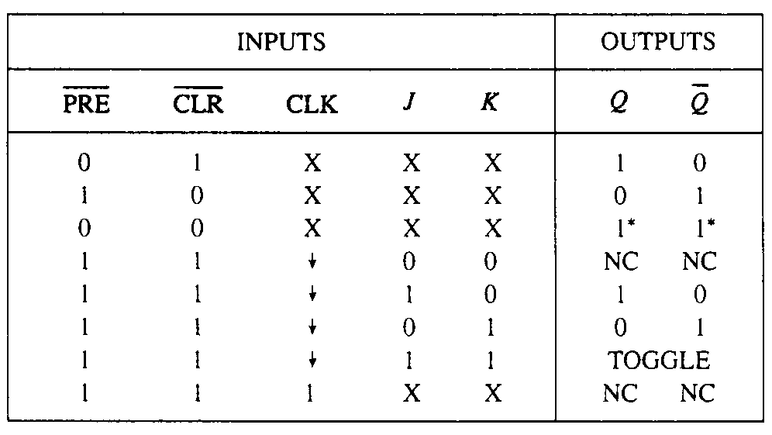
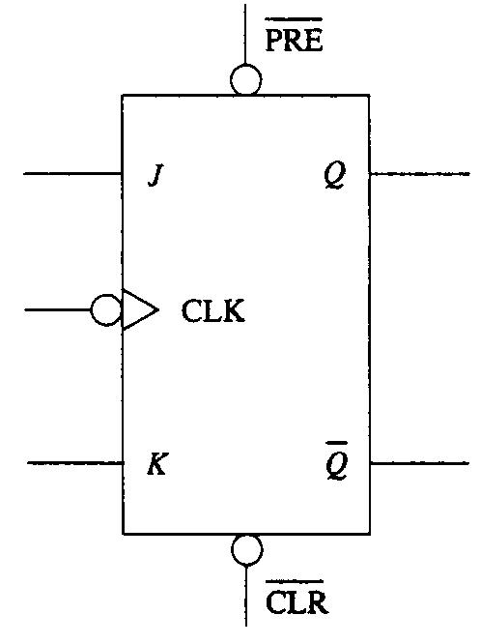
J-K FLIP-FLOP

Slide 11
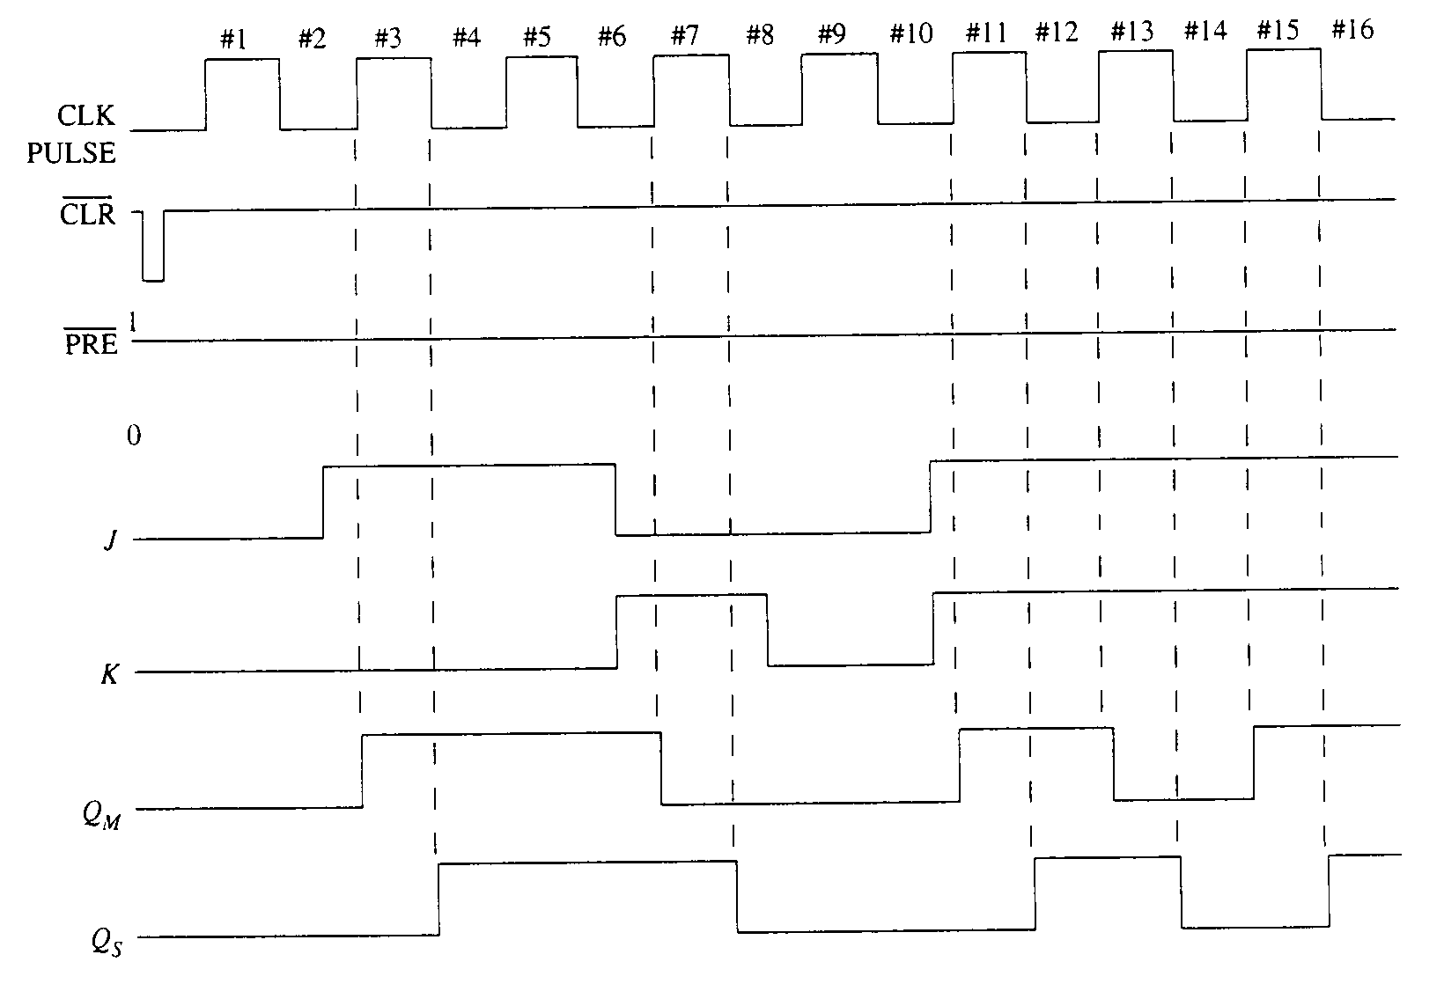
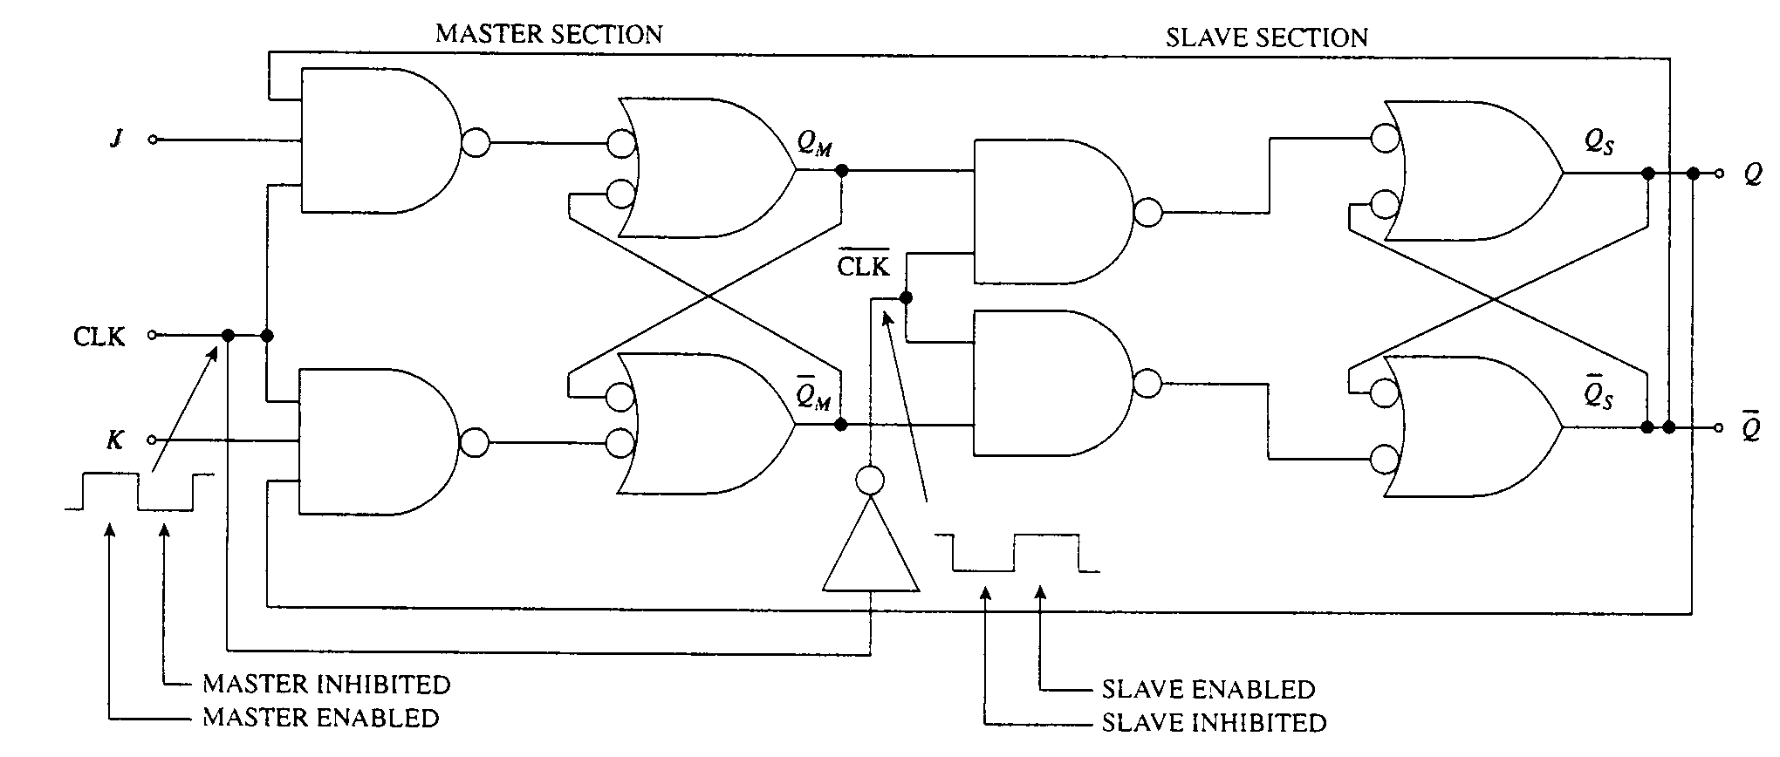
J-K FLIP-FLOP WITH MASTER-SLAVE CONFIGURATION

Slide 12
COMMON SEQUENTIAL CIRCUITS
Counters
  A digital counter is a circuit used to generate binary numbers in a specific count sequence. That sequence is mainly governed by input clock pulses, and it is repetitive as long as these clock pulses are applied. Counters serve two main functions in digital systems – counting and frequency division
  ASYNCHRONOUS SYNCHRONOUS

Slide 13
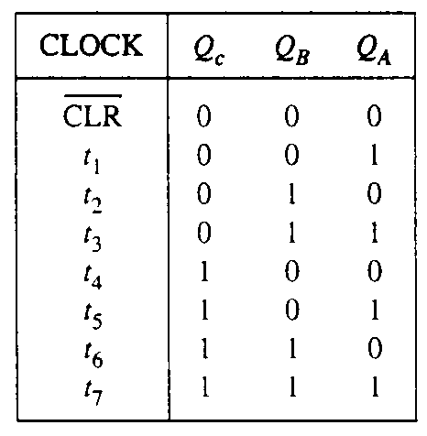
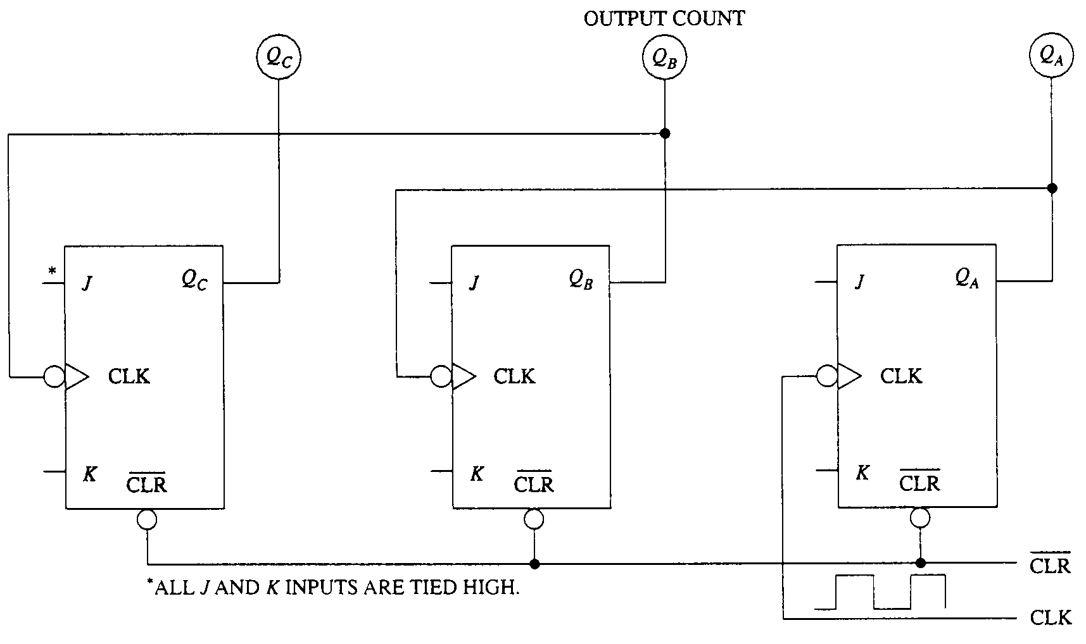
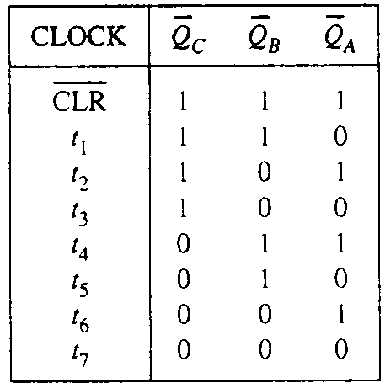
ASYNCHRONOUS COUNTER
(RIPPLE COUNTER)
Basic building block is a toggle flip-flop
Since each flip-flop receives its clock pulse from another flip-flop, there will be delay through these flip-flops. This addition delay is the longest for the MSB flip-flop

Slide 14
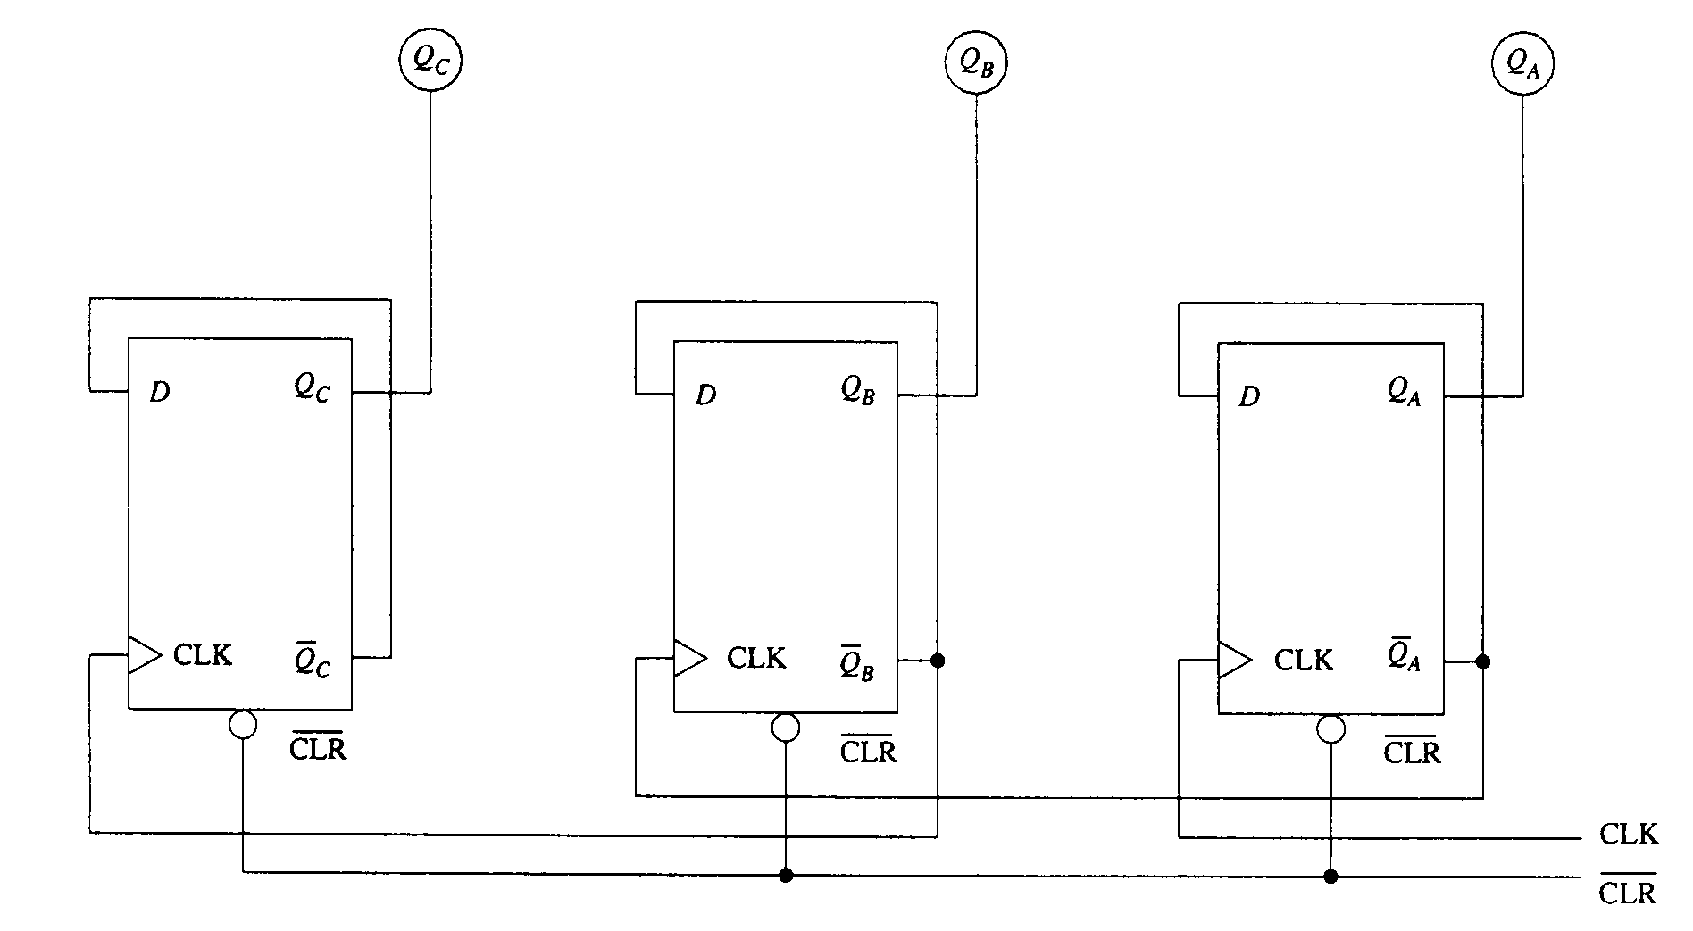
ALTERNATIVE MOD-8 UP-COUNTER

Slide 15
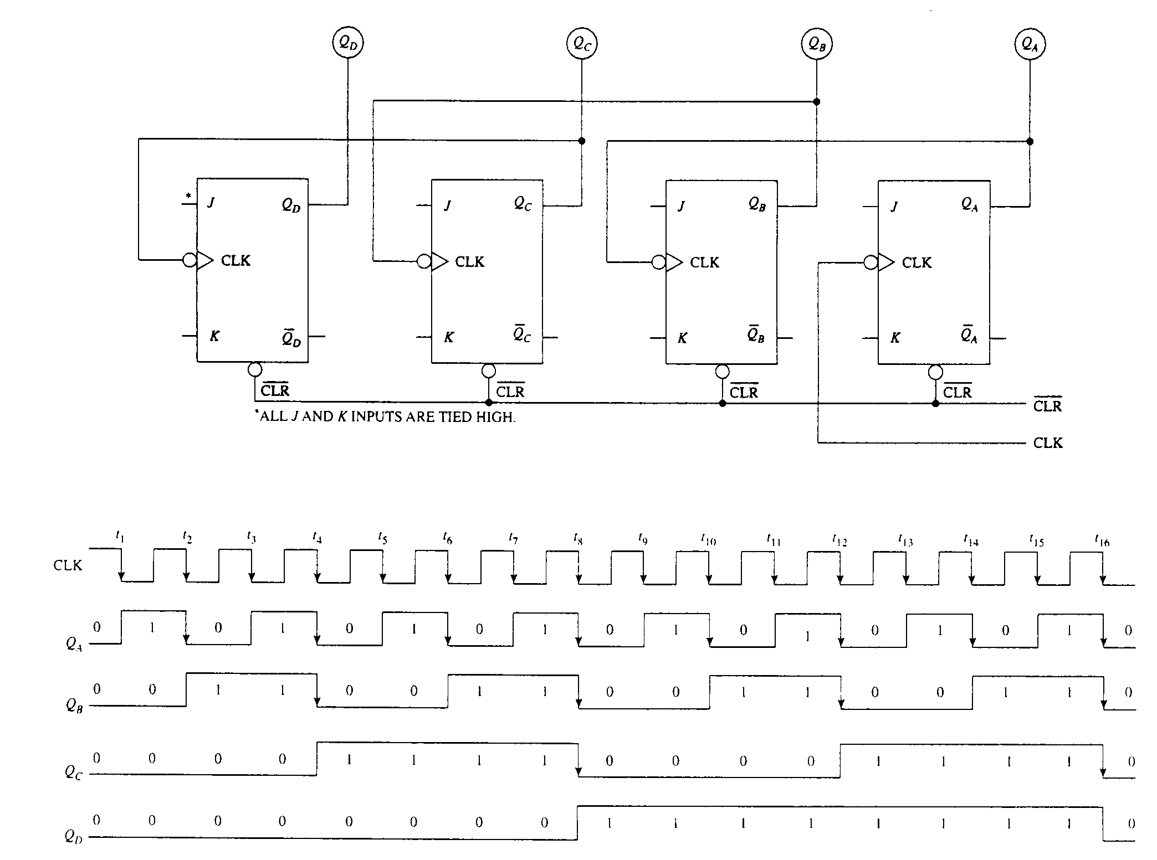
MOD-16 UP-COUNTER

Slide 16
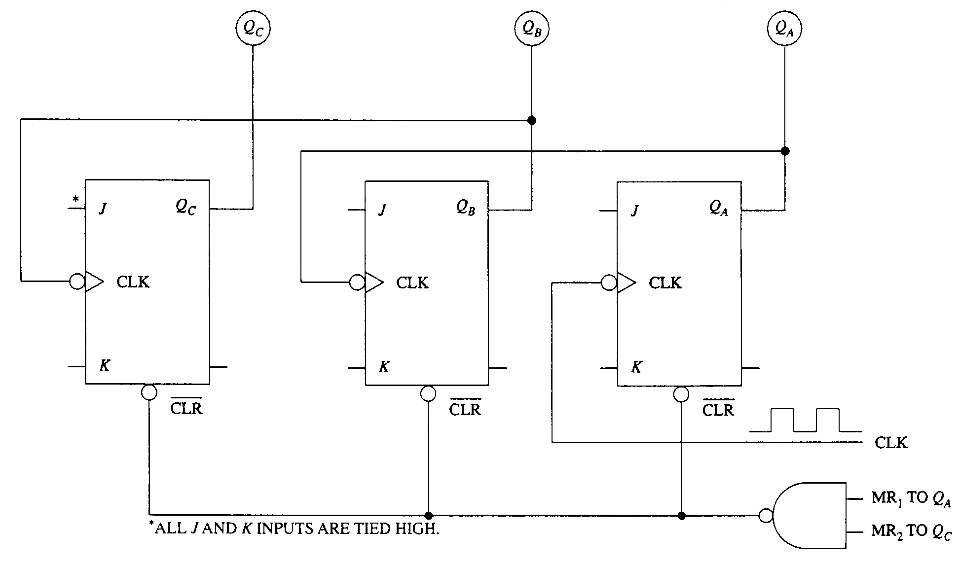
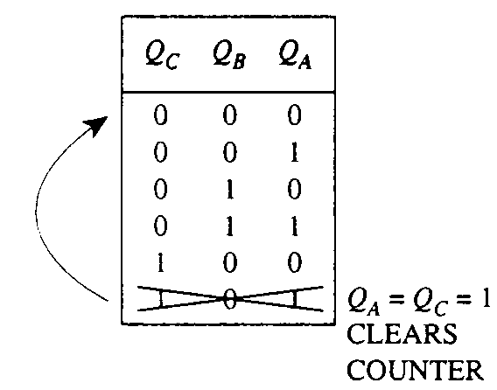
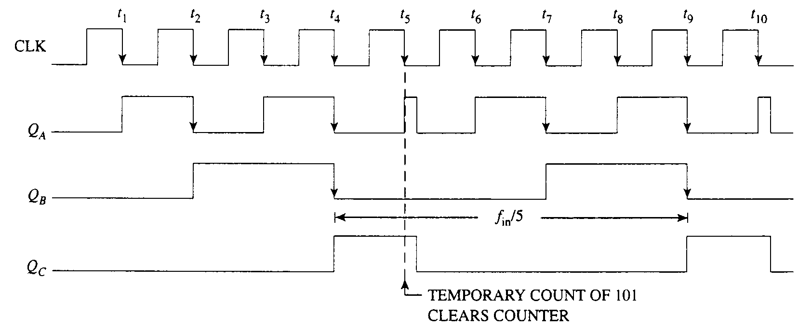
COUNTERS OF OTHER MODULUS
Mod-5

Slide 17
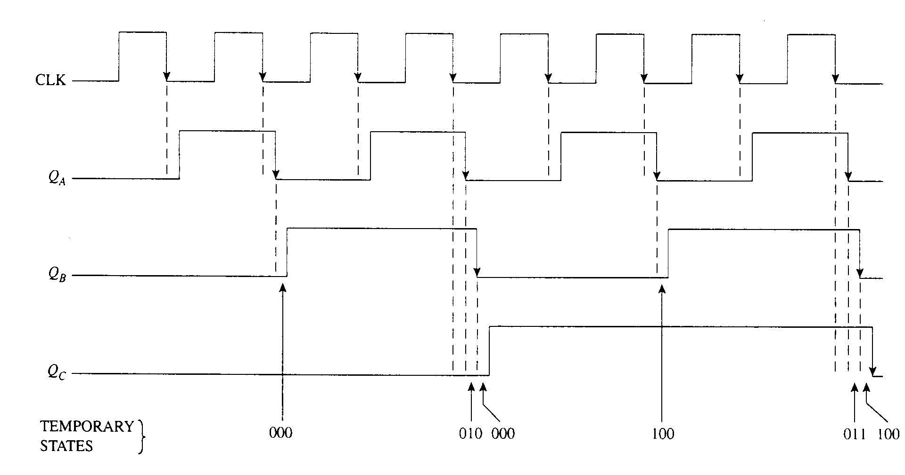
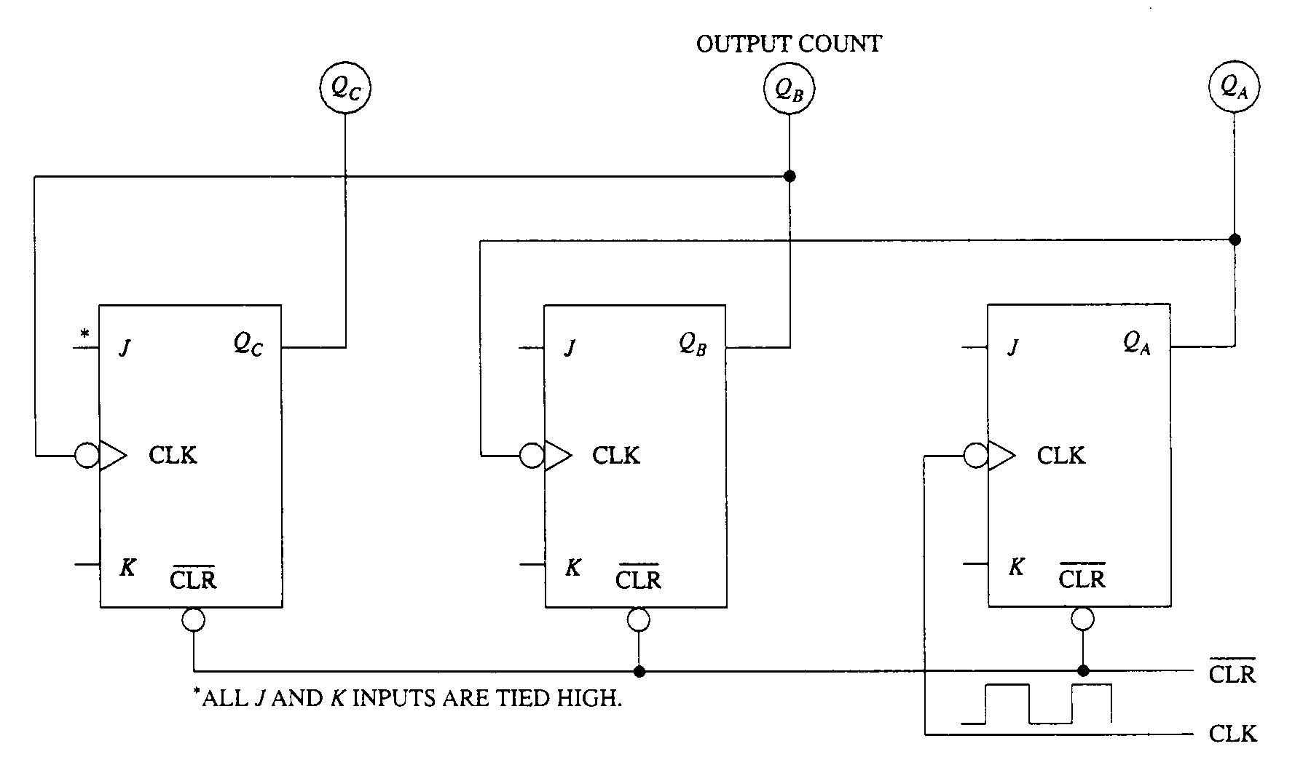
MISCOUNTS IN ASYNCHRONOUS COUNTER
The additive propagation delays produce short duration of miscounts

Slide 18
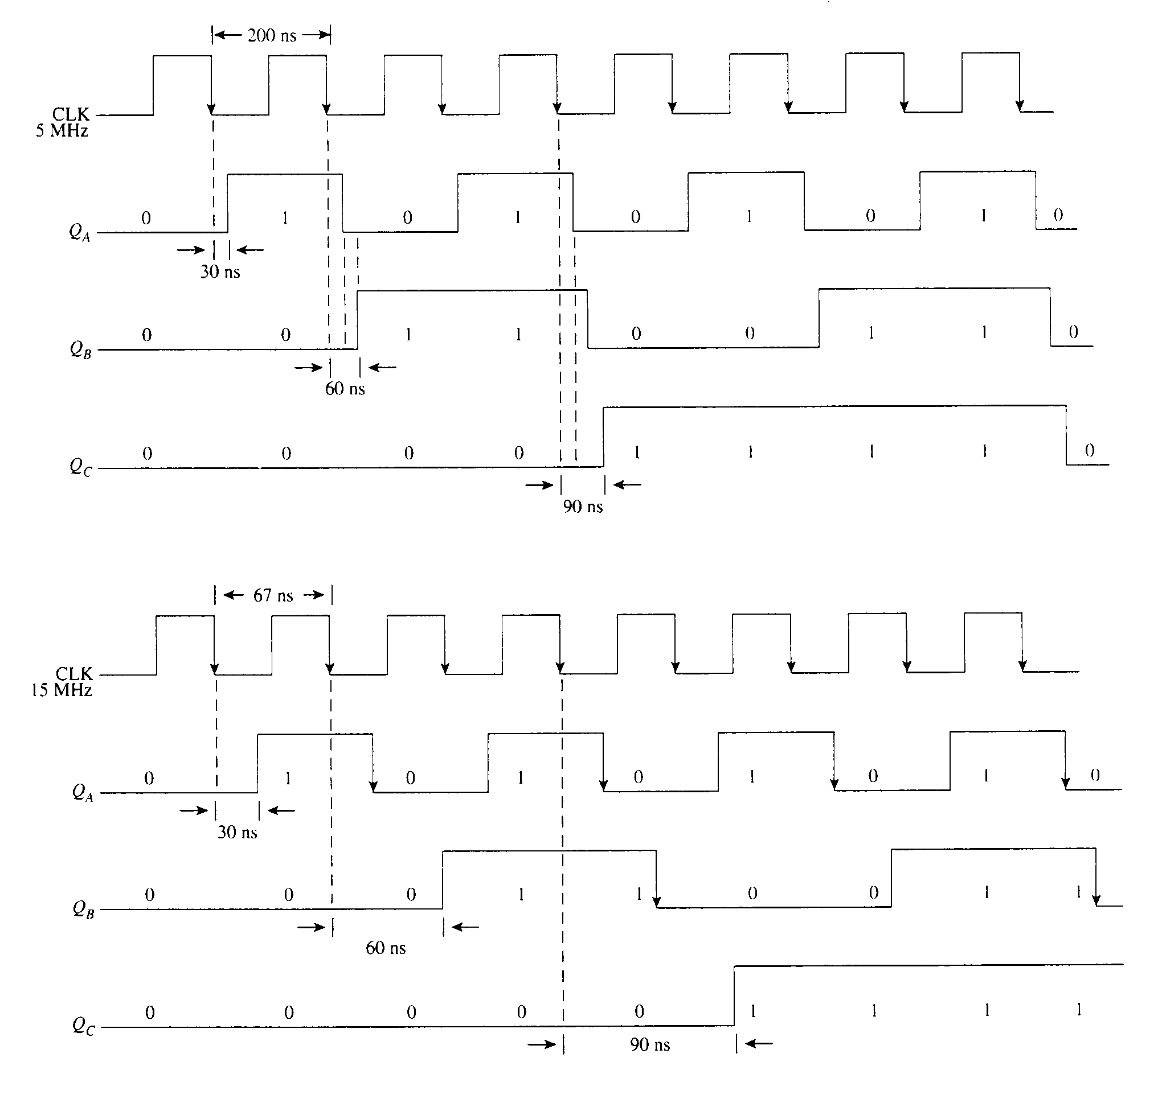
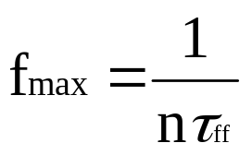
MAXIMUM CLOCK FREQUENCY ALLOWED IN ASYNCHRONOUS COUNTERS
n – number of stages
τ_{ff} – propagation delay of flip-flop

Slide 19
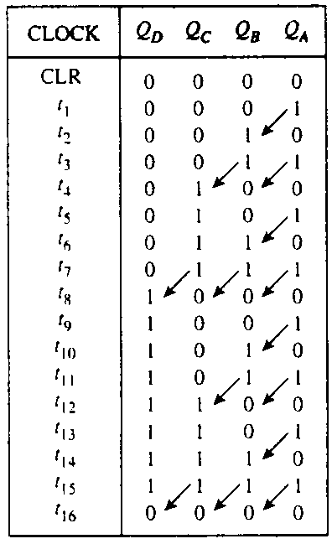
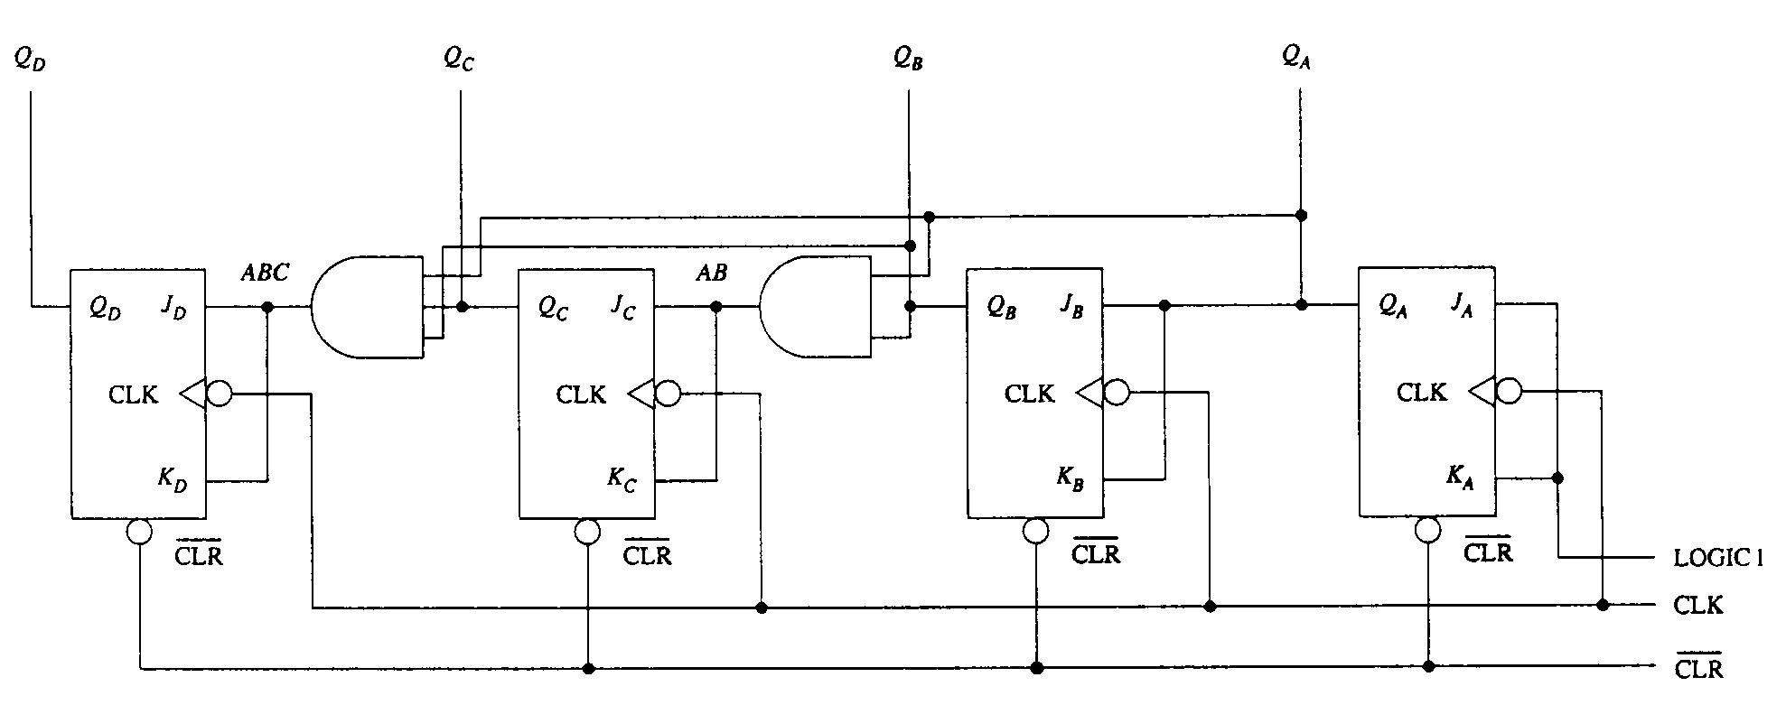
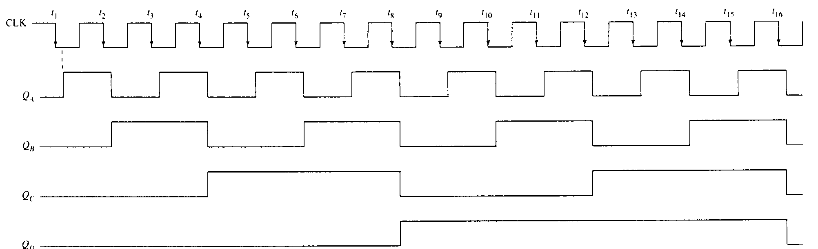
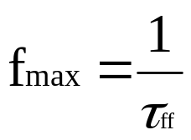
SYNCHRONOUS COUNTERS
All flip-flops are clocked simultaneously
Mod-16 Synchronous Up-Counter

Slide 20
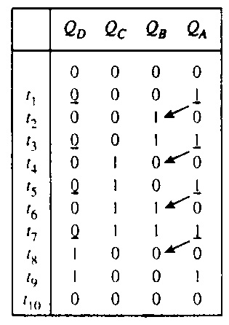
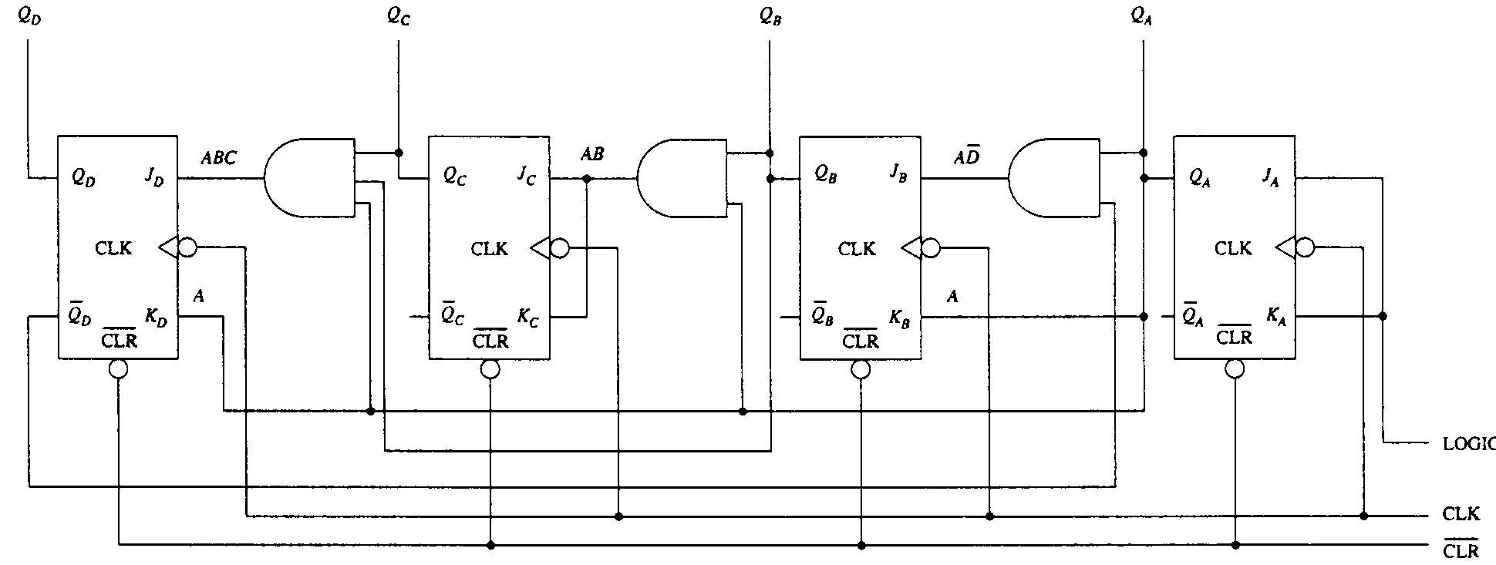
MOD-10 SYNCHRONOUS UP-COUNTER
(BCD OR DECADE)
QA – toggle every time
QB – toggle at A high and D low
QC – toggle at A and B high
QD – change high at A, B and C high but change low afterwards (A high)

Slide 21
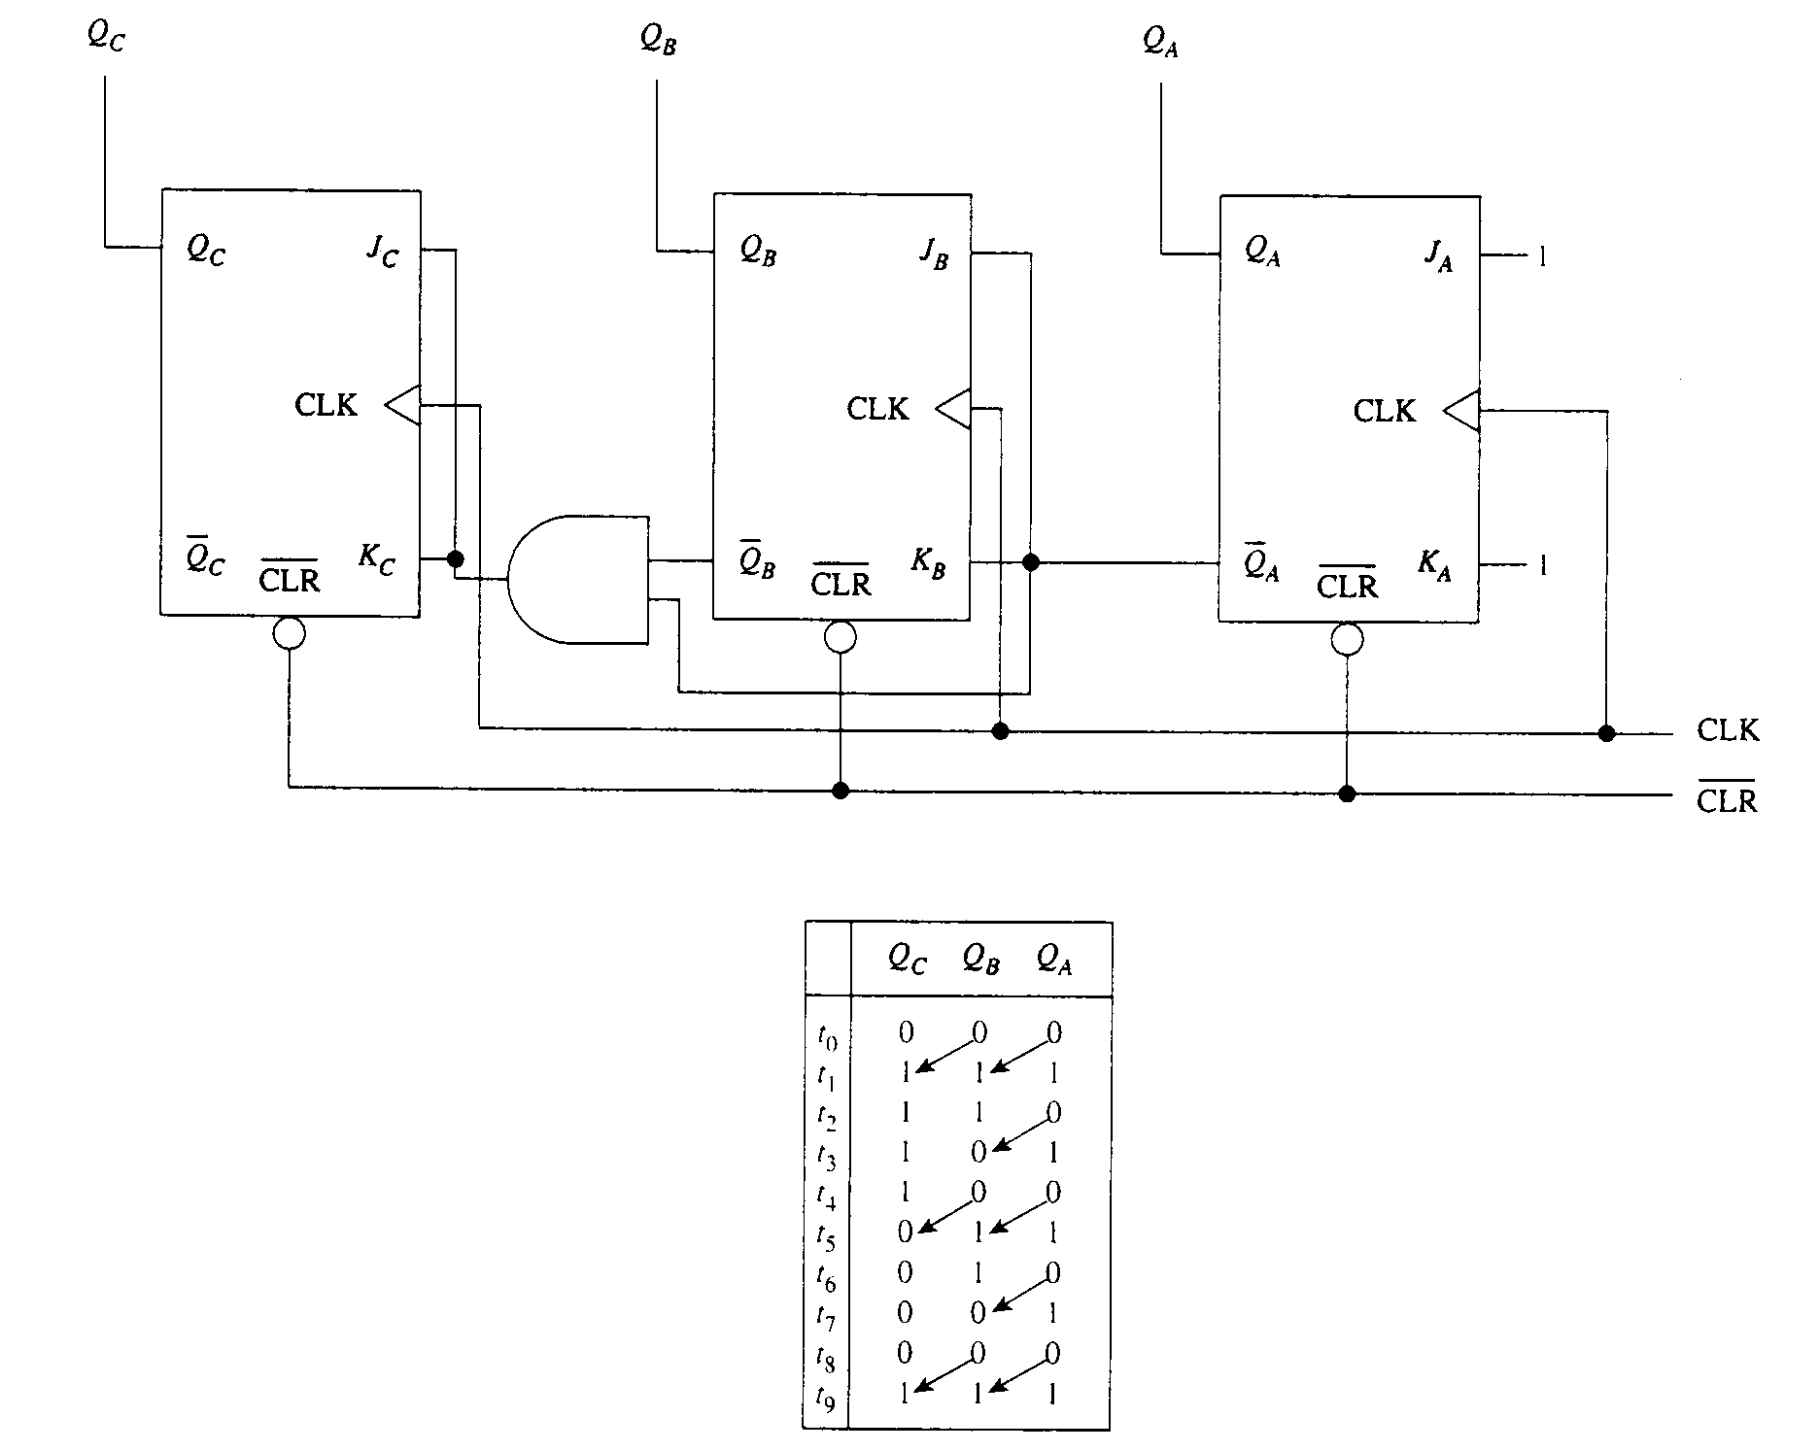
MOD-8 DOWN COUNTER

Slide 22
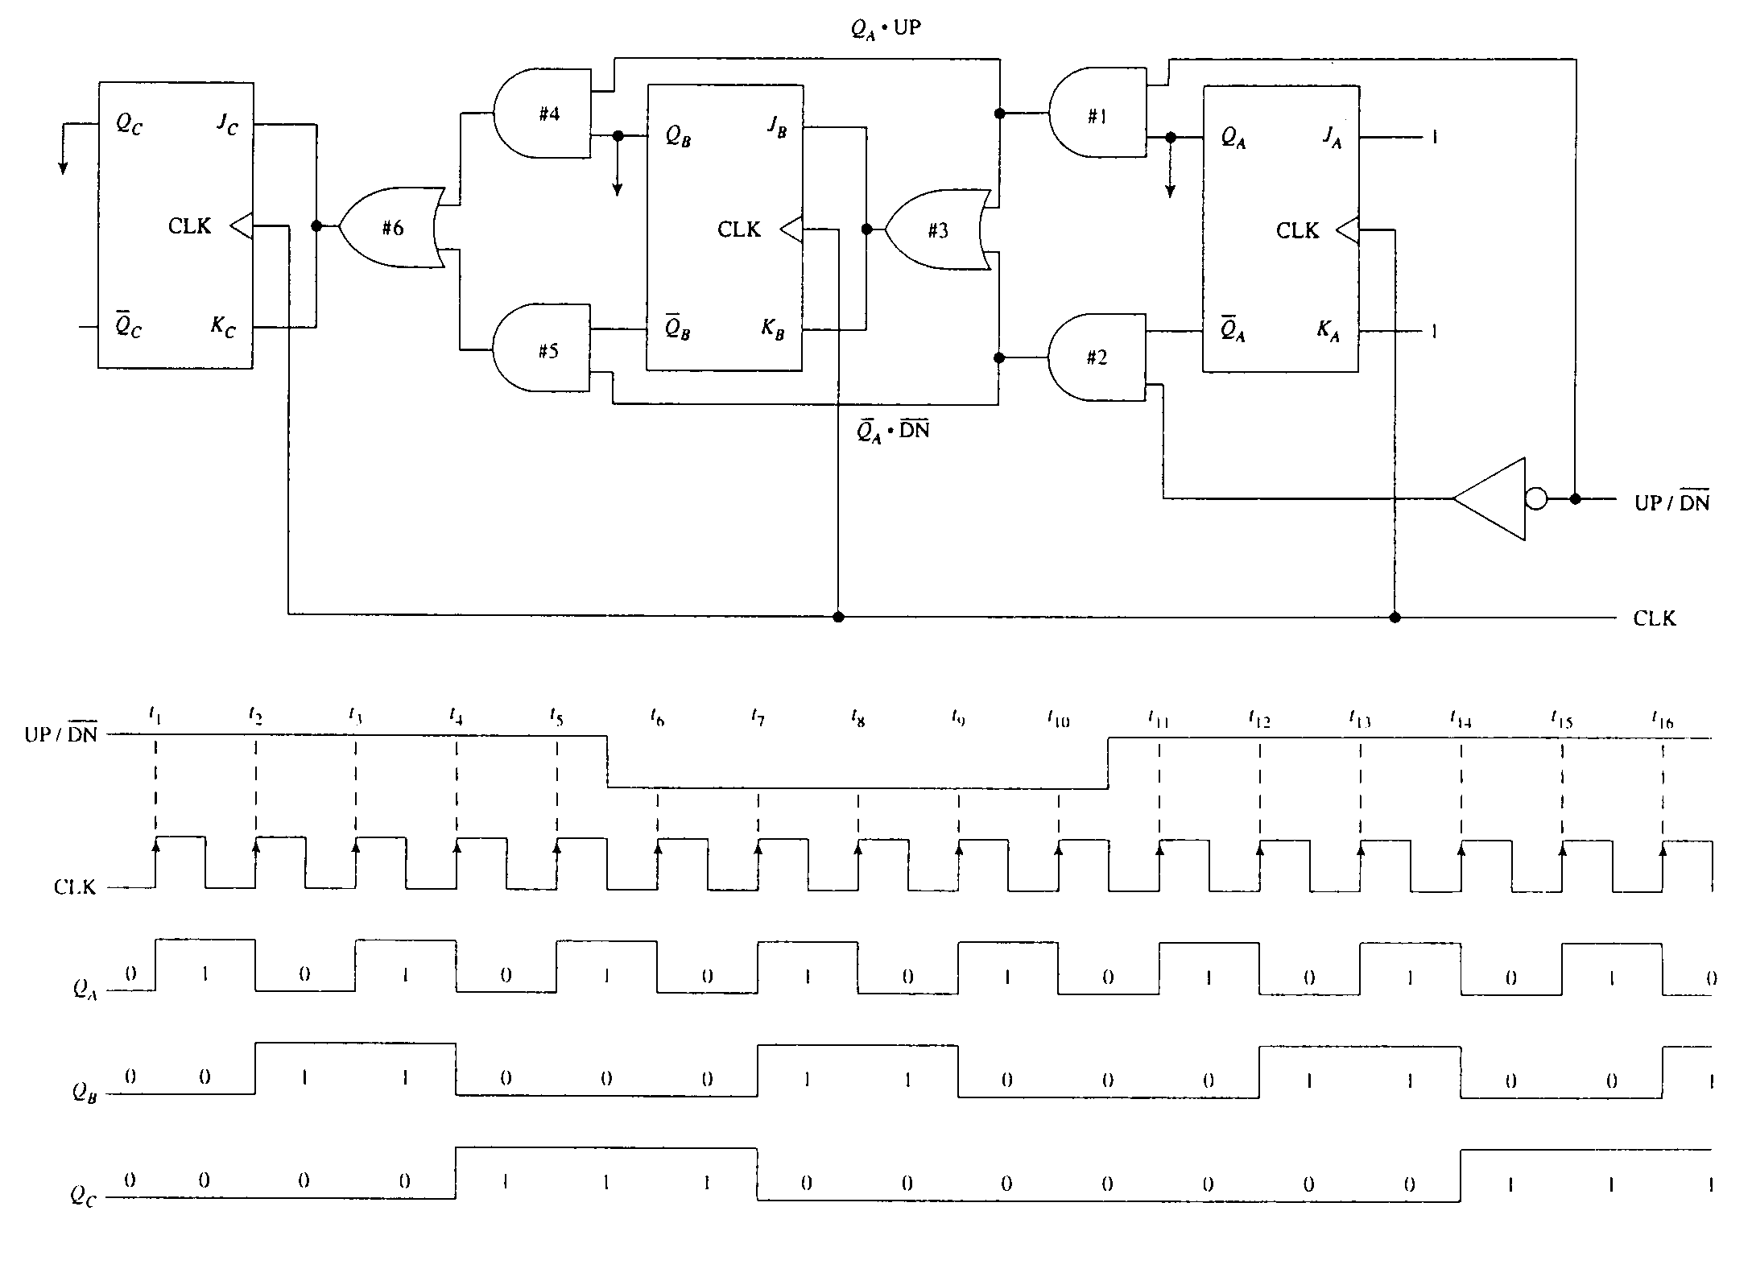
MOD-8 SYNCHRONOUS UP/DOWN COUNTER

Slide 23
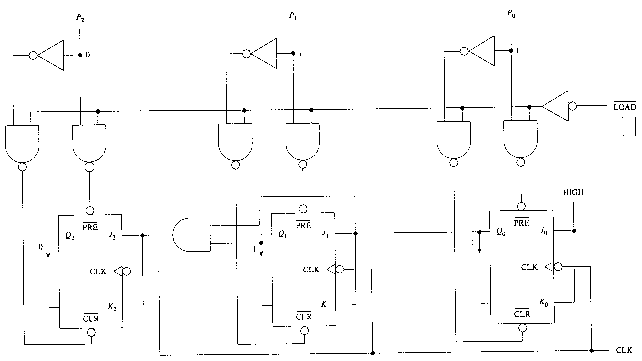
PRESETABLE COUNTERS

Slide 24

SYNCHRONOUS COUNTER DESIGN
Mod-6 Up-Counter Using D-flip-flops
  Design table

Slide 25




MOD-6 UP-COUNTER
  K-maps
  Final design

Slide 26


REGISTERS
A group of latches or flip-flops used to store, transfer, or shift data
Serial Shift Register
  Data is clocked into the register bit by bit
  It is important to note that level-triggered type of latches will not work properly

Slide 27

AN UNIVERSAL REGISTER
S₁ | S₀ | Mode of operation
1 | 1 | Parallel load
1 | 0 | Shift left
0 | 1 | Shift right
0 | 0 | Hold

Slide 28

RING COUNTER
The counter is a shift register that has its output connected back to its own input

Slide 29

JONHSON COUNTER
Each bit is toggled in turn
Mod-6
      000
      100
      110
      111
      011
      001
      000
  With its unique bit pattern, any sequence can be detected with a 2-input gate

Slide 30

MULTIPLY/DIVIDE REGISTER
A left shift operation multiplies a binary number by a factor of 2
A right shift operation divides a binary number by a factor of 2

Slide 31

PSEUDO-RANDOM-SEQUENCE GENERATOR
Q_{A} | Q_{B} | Q_{C} | Q_{D}
0 | 0 | 0 | 0
1 | 0 | 0 | 0
0 | 1 | 0 | 0
0 | 0 | 1 | 0
1 | 0 | 0 | 1
1 | 1 | 0 | 0
0 | 1 | 1 | 0
1 | 0 | 1 | 1
0 | 1 | 0 | 1
1 | 0 | 1 | 0
1 | 1 | 0 | 1
1 | 1 | 1 | 0
1 | 1 | 1 | 1
0 | 1 | 1 | 1
0 | 0 | 1 | 1
0 | 0 | 0 | 1
1 | 0 | 0 | 0
INVALID CONDITION

