Slide 1


NAT

Slide 2
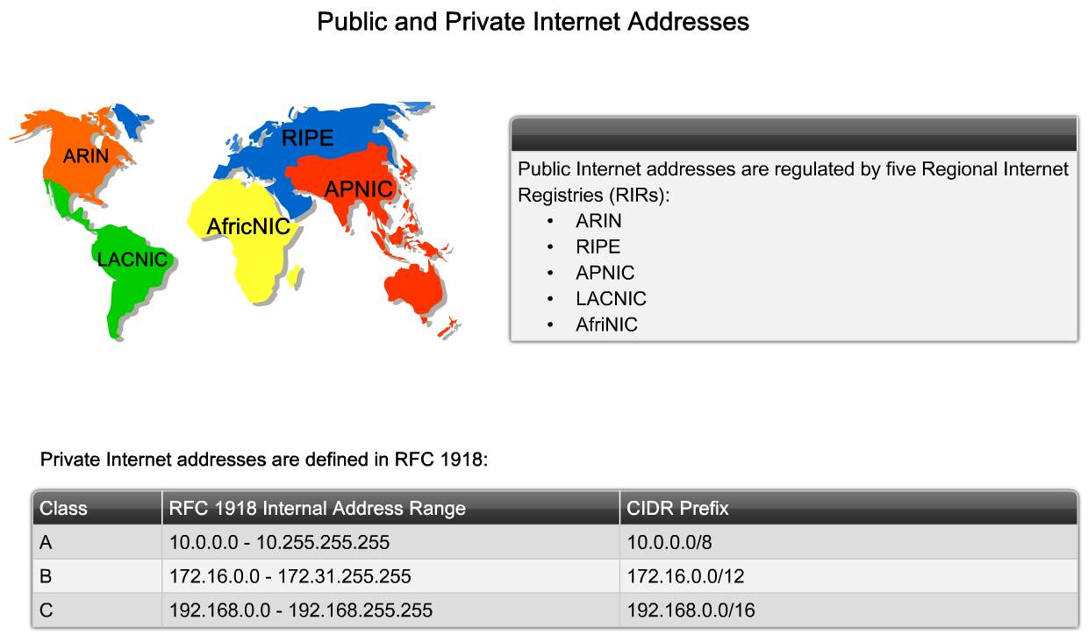
NAT

Slide 3
NAT
Network Address Translation (NAT) is similar to Classless Inter-Domain Routing (CIDR) in that the original intention for NAT was to slow the depletion of available IP address space by allowing multiple private IP addresses to be represented by a much smaller number of public IP addresses.
Because NAT really decreases the overwhelming amount of public IP addresses required in a networking environment, it comes in really handy when two companies that have duplicate internal addressing schemes merge. NAT is also a great tool to use when an organization changes its Internet service provider (ISP) but the networking manager needs to avoid the hassle of changing the internal address scheme

Slide 4
NAT
Here’s a list of situations when NAT can be especially helpful:
When you need to connect to the Internet and your hosts don’t have globally unique IP addresses
When you’ve changed to a new ISP that requires you to renumber your network
When you need to merge two intranets with duplicate addresses
You typically use NAT on a border router.

Slide 5
NAT Terms
Names | Meaning
Inside local | Source host inside address before translation—typically an RFC 1918 address.
Outside local | Address of an outside host as it appears to the inside network. This is usually the address of the router interface connected to ISP—the actual Internet address.
Inside Global | Source host address used after translation to get onto the Internet. This is also the actual Internet address.
Outside global | Address of outside destination host and, again, the real Internet address.

Slide 6
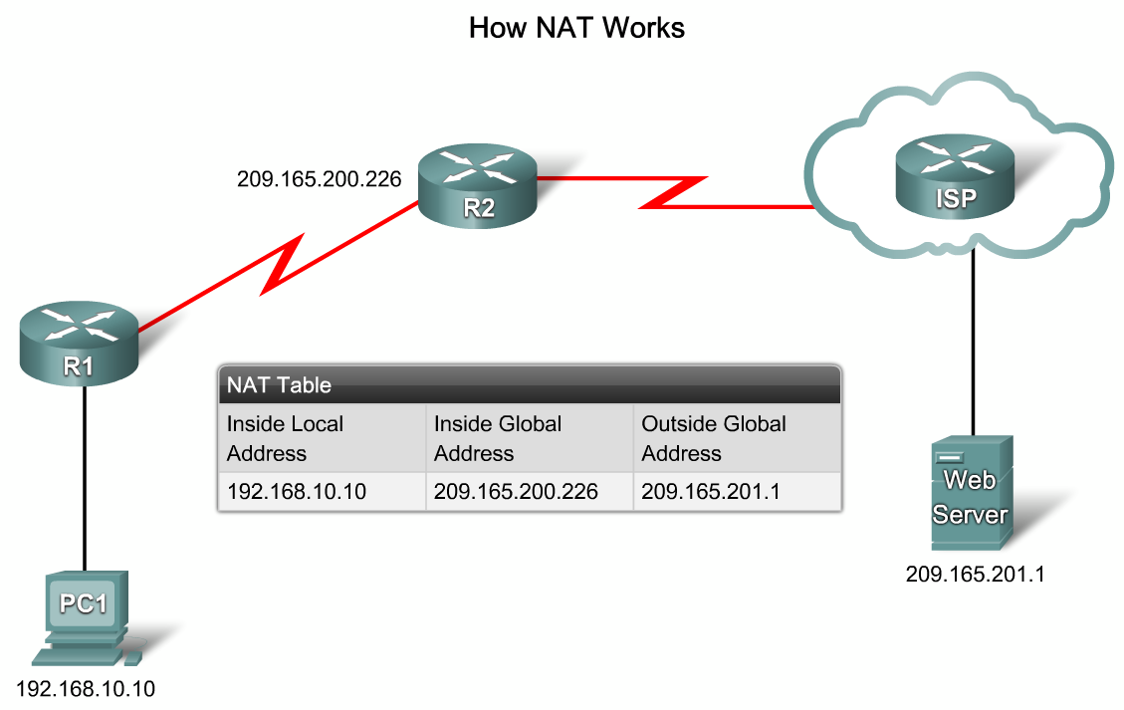
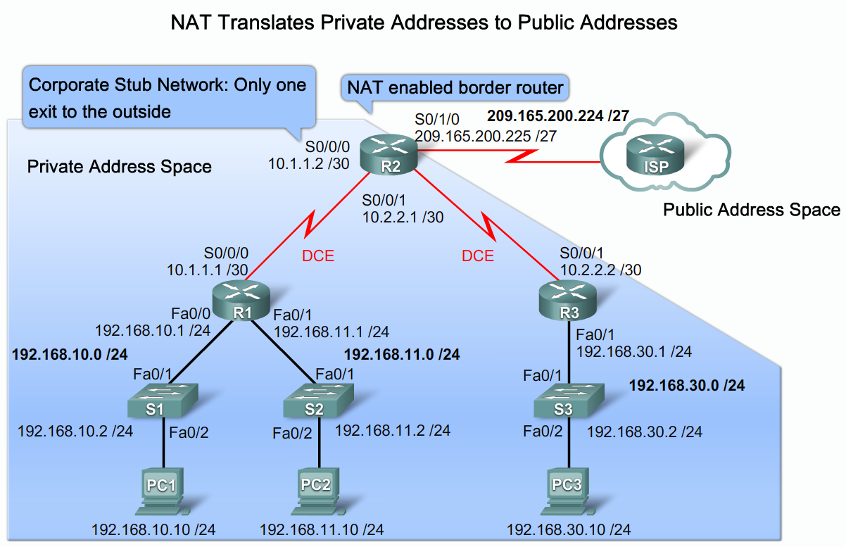
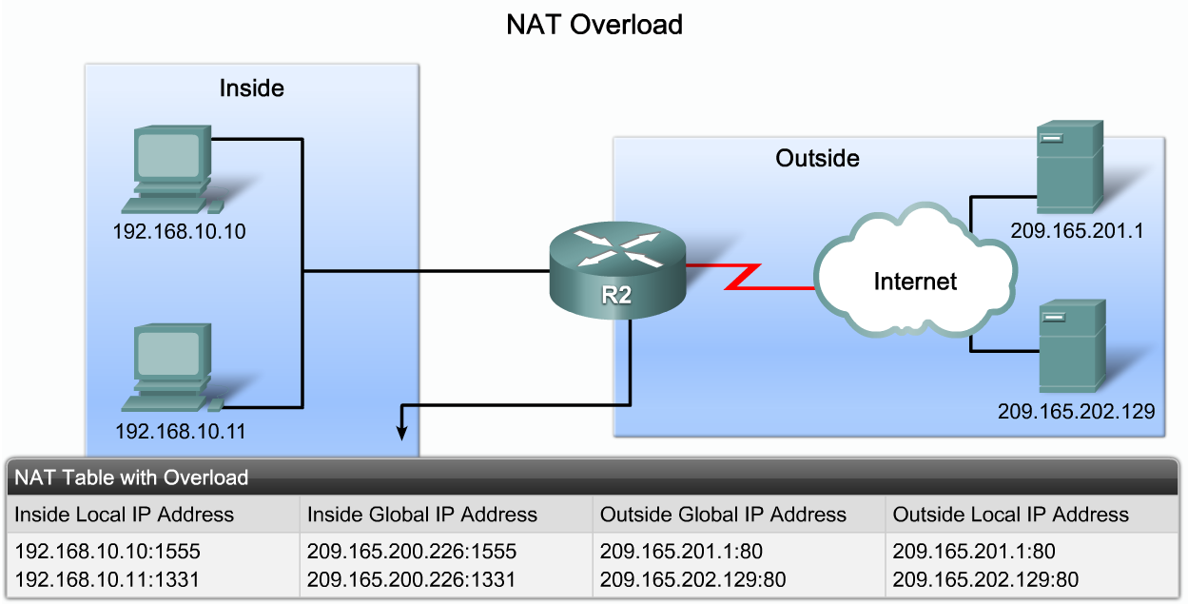
NAT
The key features of NAT and NAT overload:

Slide 7
NAT
Advantages | Disadvantages
Conserves legally registered addresses. | Translation results in switching path delays.
Remedies address overlap events. | Causes loss of end-to-end IP traceability
Increases flexibility when connecting to the Internet. | Certain applications will not function with NAT enabled
Eliminates address renumbering as a network evolves. | Complicates tunneling protocols such as IPsec because NAT modifies the values in the header

Slide 8
Types of NAT
Static NAT (one-to-one):
This type of NAT is designed to allow one-to-one mapping between local and global addresses. Keep in mind that the static version requires you to have one real Internet IP address for every host on your network.

Slide 9
Types of NAT
Dynamic NAT (many-to-many):
This version gives you the ability to map an unregistered IP address to a registered IP address from out of a pool of registered IP addresses. You don’t have to statically configure your router to map each inside address to an individual outside address as you would using static NAT, but you do have to have enough real, bona fide IP addresses for everyone who’s going to be sending packets to and receiving them from the Internet at the same time.

Slide 10
Types of NAT
NAT Overload (one-to-many):
This is the most popular type of NAT configuration. Understand that overloading really is a form of dynamic NAT that maps multiple unregistered IP addresses to a single registered IP address (many-to-one) by using different source ports. Now, why is this so special? Well, because it’s also known as Port Address Translation (PAT), which is also commonly referred to as NAT Overload. Using PAT allows you to permit thousands of users to connect to the Internet using only one real global IP address—pretty slick, right?
Seriously, NAT Overload is the real reason we haven’t run out of valid IP addresses on the Internet.

Slide 11
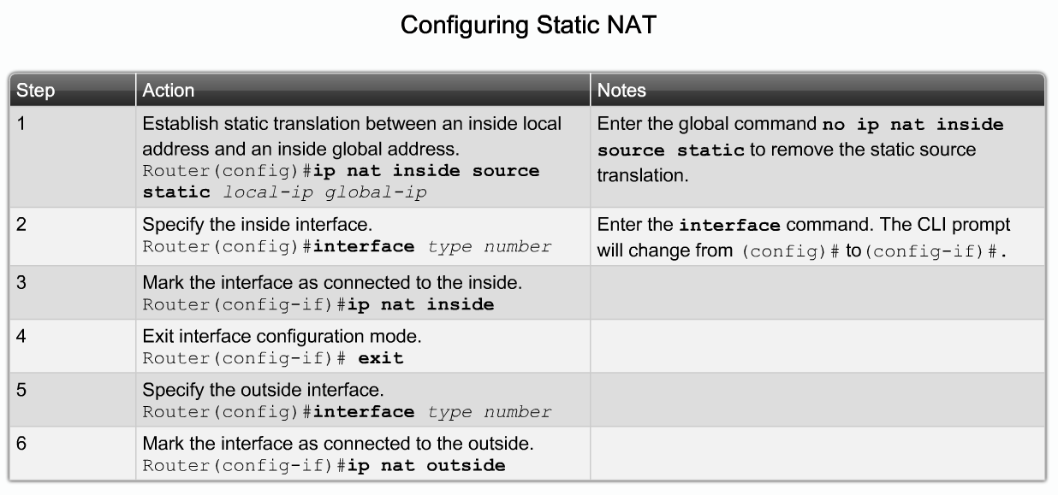
Static NAT

Slide 12
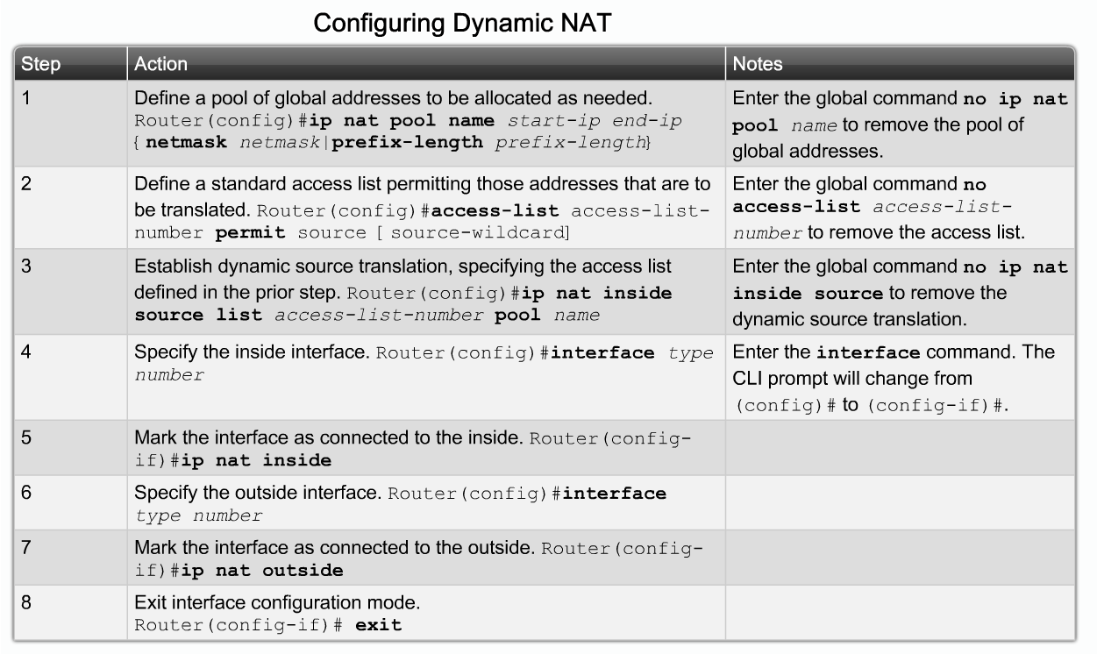
Dynamic NAT

Slide 13
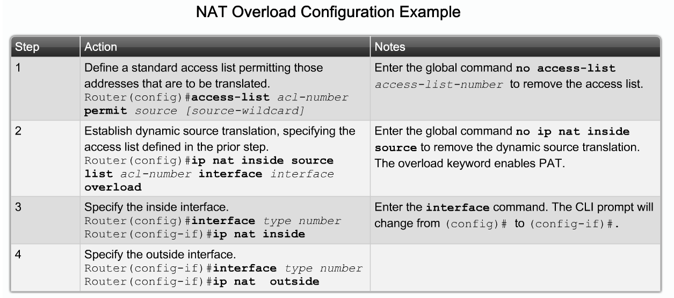
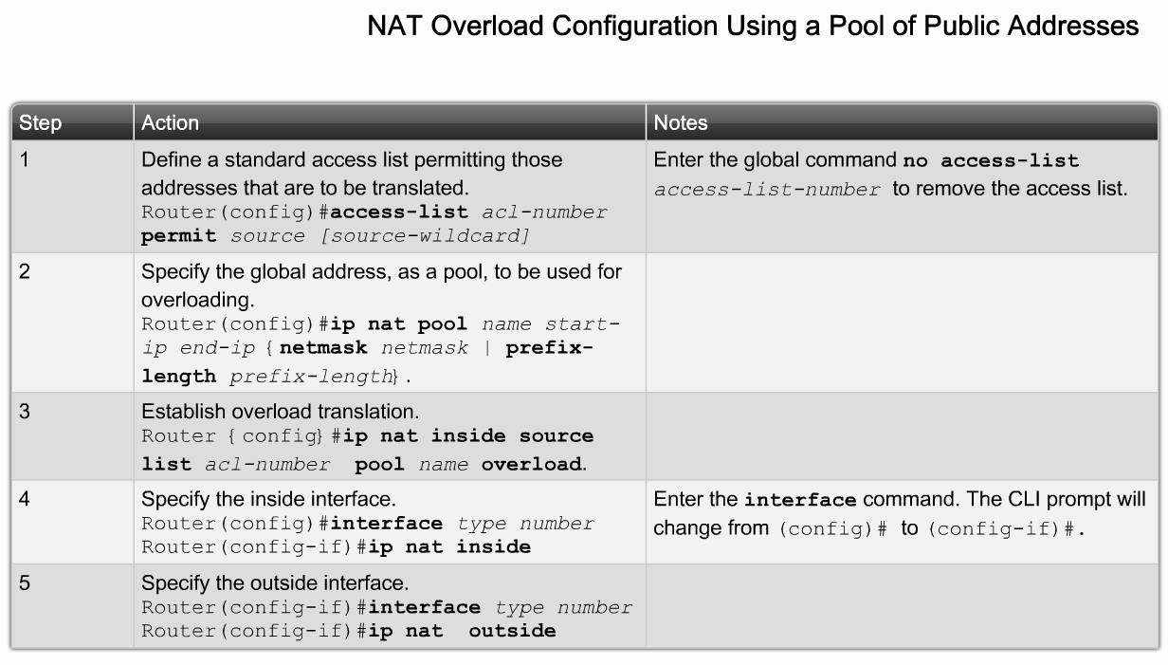
PAT

Slide 14

Thank You

