Slide 2
Let’s Find Out ….!!
Write a Program using any language you know to print “ HELLO WORLD “.

Slide 3
Python Is Easy to Use
C++ Program :
#include <iostream>
int main()
{
cout << "Hello World" << endl;
return 0;
}

Slide 4
C Program
#include <stdio.h>
int main()
{
printf(“Hello, World!\n”);
Return 0;
}

Slide 5
Java Program :
public class Hello
{
public static void main(String argv[])
{
System.out.println(“Hello, World!”);
}
}

Slide 6

Python Program :
print ( "Hello World")

Slide 7
COMPARISON WITH JAVA
Python programs are typically 3-5 times shorter than equivalent Java programs.
Python programs are generally expected to run slower than Java programs.
Java, on the other hand, can perform an efficient integer or floating point addition, but requires variable declarations for a and b.

Slide 8
COMPARISON WITH C++
Python code is often 5-10 times shorter than equivalent C++ code.
Python uses algorithmic approach unlike C++.
Python is an interpretable language whereas C++ is a compiled language.

Slide 9
SALIENT FEATURES
Simple- Python is a simple language. Reading a good Python program feels almost like reading English. It allows you to concentrate on the solution to the problem rather than the syntax i.e. the language itself.
Easy to Learn-Python is extremely easy to get started with. Python has an extraordinarily simple syntax.

Slide 10
Open source : Python is publicly available open source software, any one can use source code that doesn't cost anything.
Portable :
High level languages are portable, which means they are able to run across all major hardware and software platforms with few or no change in source code. Python is portable and can be used on Linux, Windows, Macintosh, Solaris, FreeBSD, OS/2, Amiga, AROS, AS/400 and many more.
Object-Oriented : Python is a full-featured object-oriented programming language, with features such as classes, inheritance, objects, and overloading.

Slide 11
Python is Interactive :
Python has an interactive console where you get a Python prompt (command line) and interact with the interpreter directly to write and test your programs. This is useful for mathematical programming.
Interpreted : Python programs are interpreted, takes source code as input, and then converts (to portable byte-code) each statement and executes it immediately. No need to compiling or linking

Slide 12
Extendable : Python is often referred to as a “glue” language, meaning that it is capable to work in mixed-language environment. The Python interpreter is easily extended and can add a new built-in function or modules written in C/C++/Java code.
Libraries : Databases, web services, networking, numerical packages, graphical user interfaces, 3D graphics, others.
Supports :Support from online Python community

Slide 13
VERSIONS OF PYTHON
Python 1.0 - January 1994
  Python 1.5 - December 31, 1997
  Python 1.6 - September 5, 2000
Python 2.0 - October 16, 2000
  Python 2.1 - April 17, 2001
  Python 2.2 - December 21, 2001
  Python 2.3 - July 29, 2003
  Python 2.4 - November 30, 2004
  Python 2.5 - September 19, 2006
  Python 2.6 - October 1, 2008
  Python 2.7 - July 3, 2010

Slide 14
VERSIONS OF PYTHON
Python 3.0 - December 3, 2008
  Python 3.1 - June 27, 2009
  Python 3.2 - February 20, 2011
  Python 3.3 - September 29, 2012
  Python 3.4 - March 16, 2014
  Python 3.5 - September 13, 2015
  Python 3.6 – 2016
  Python 3.7 – 2018
  Python 3.7.2 -- 2019

Slide 15
Version Recomended
Version: 3.6.2

Slide 16
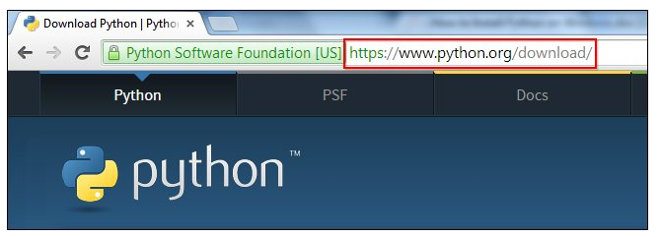
DOWNLOADING PYTHON

Slide 17
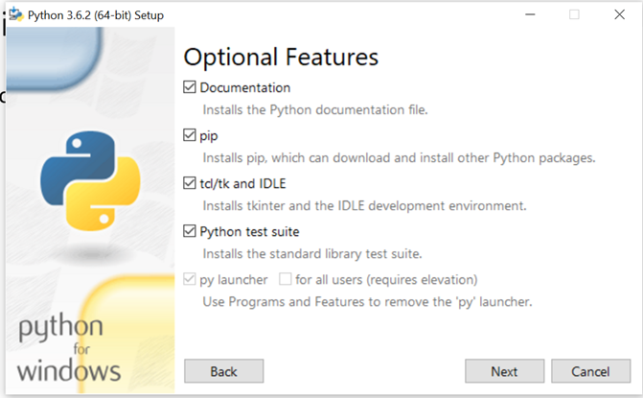

Slide 18
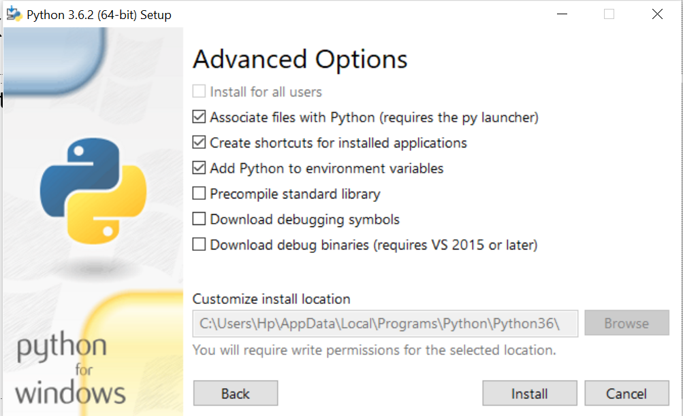

Slide 19


