Slide 1
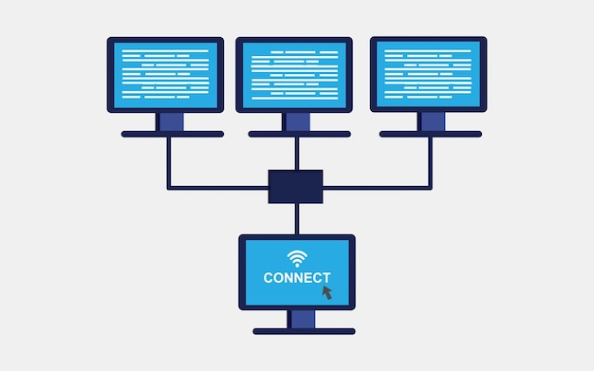
What is the Internet?
The internet is like a huge network of computers and devices that are all connected together.

Slide 2
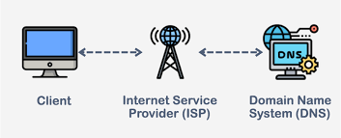
What is the Internet?

Slide 3
What is the Web Development ?
Building website for the Internet

Slide 4
Demo
Notes:
snapdeal demo

Slide 5
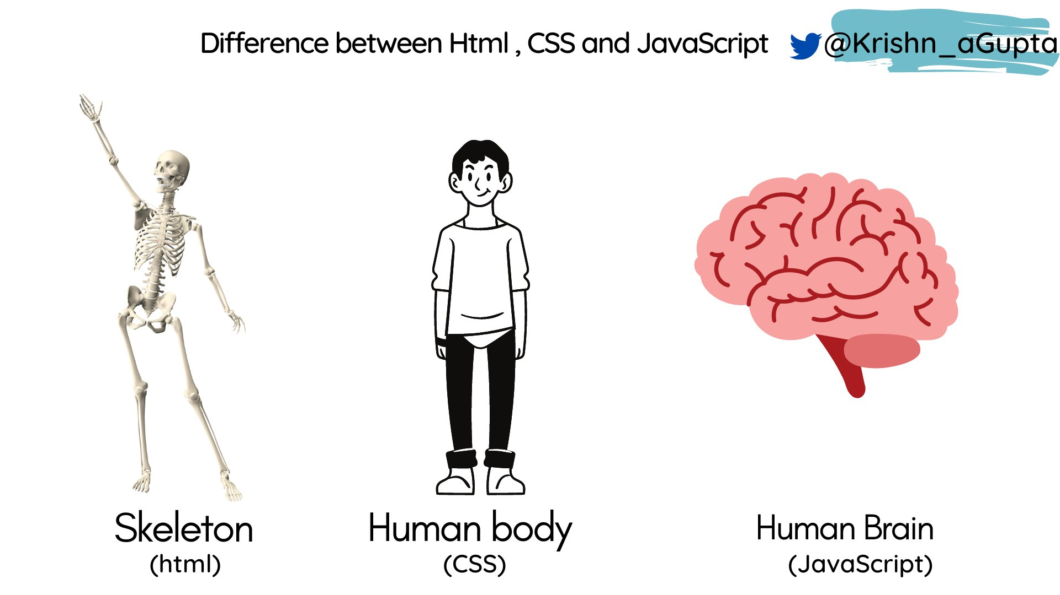




Slide 6
What we will need to Learn ?
Frontend : HTML, CSS & JavaScript
More if you want to learn by yourself -
Frontend : React/Vue/Qwik JS
Backend : PHP(Laravel)/JavaScript(Nitro JS)/Java(Spring Boot, Helidon)
Database : SQL(MySQL,SQLite)/NoSQL(MongoDB)

Slide 7
Prerequisites
Firefox(Browser)
Visual Studio Code(Code Editor)
Setup yourself!!!

Slide 8
What is the HTML ?
HTML : Hypertext Markup Language
Not Case Sensitive
Not a Programming Language
( it doesn’t have variables, conditional statements or iterative loops )

Slide 9
Let’s Start

Slide 10
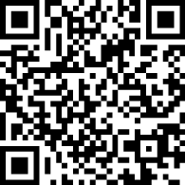
Discord Channel

Slide 11
HTML Elements

