Slide 1
Color Model
name
rgb()
hex
hsl()

Slide 2
Pseudo Class
:hover
:focus
:disable
:required
.....more

Slide 3
Structural Pseudo Class
:first-child
:last-child
:n-th-child
:first-of-type
:last-of-type
:n-th-child(2n)

Slide 4
Box Model
Margin
Padding
Border
—box-sizing

Slide 5
Size Units
cm, m (Never Use)
px
vw
vh
%
rem
em

Slide 6
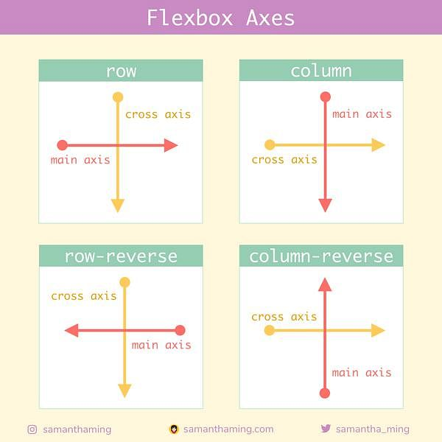
Flexbox
One-dimensional layout method for arranging items in rows or columns
flex-direction

Slide 7
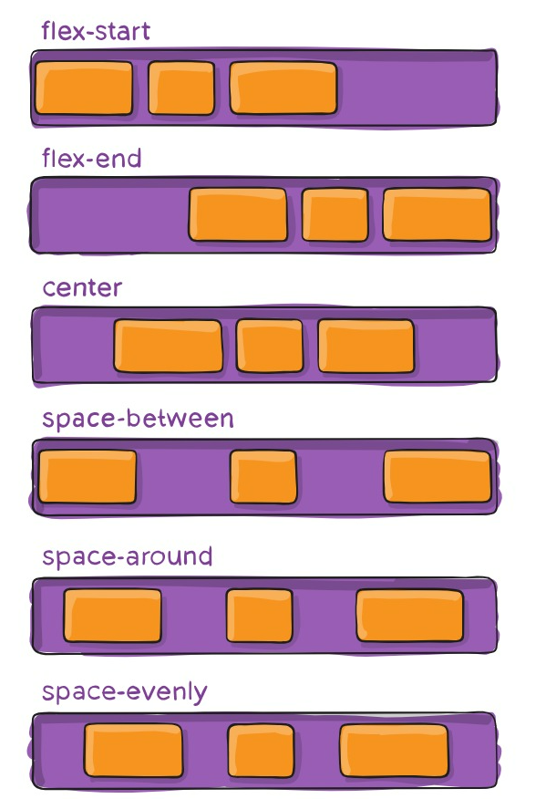
Flexbox
justify-content

Slide 8
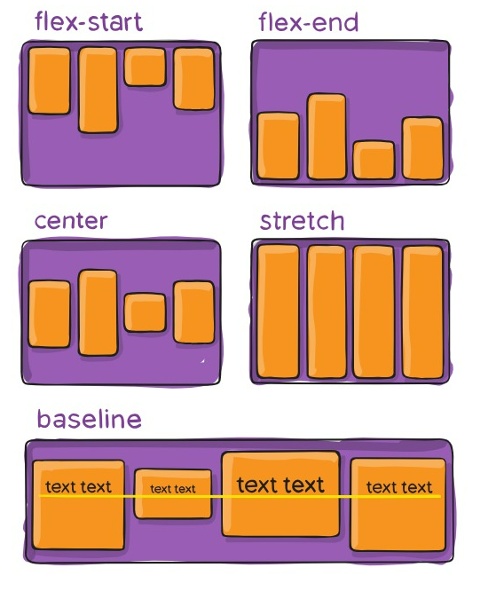
Flexbox
align-items

Slide 9
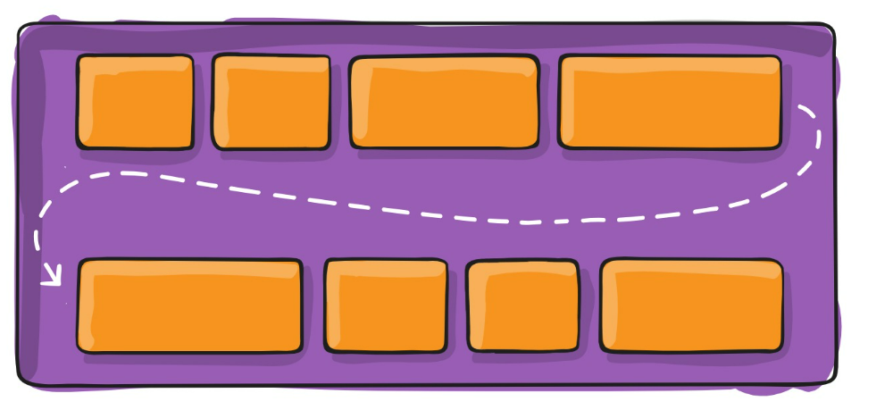
Flexbox
flex-wrap

Slide 10
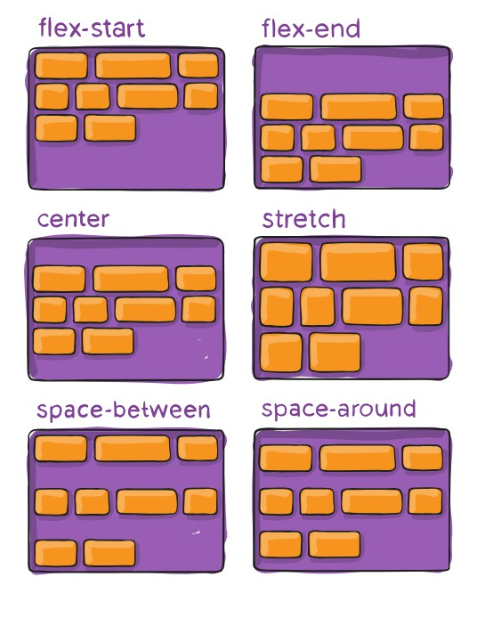
Flexbox
align-content

Slide 11
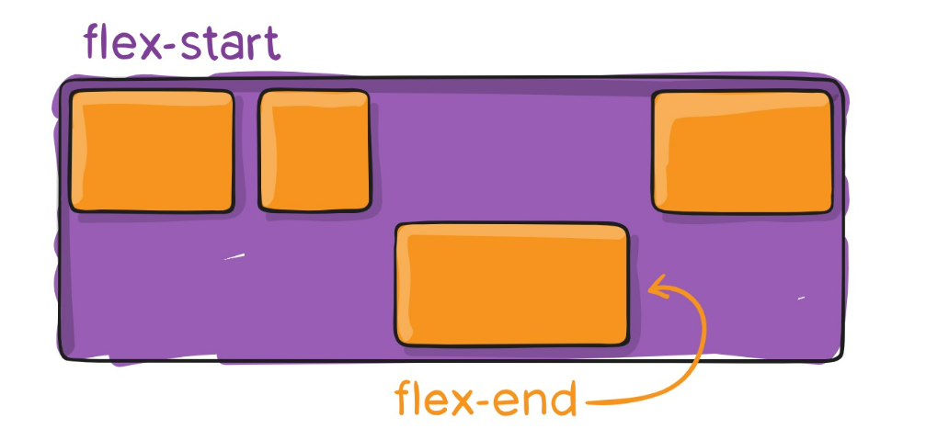
Flexbox
align-self

Slide 12
Flexbox
order
flex-grow
flex-shrink
flex-basis
flex (shorthand)

Slide 13
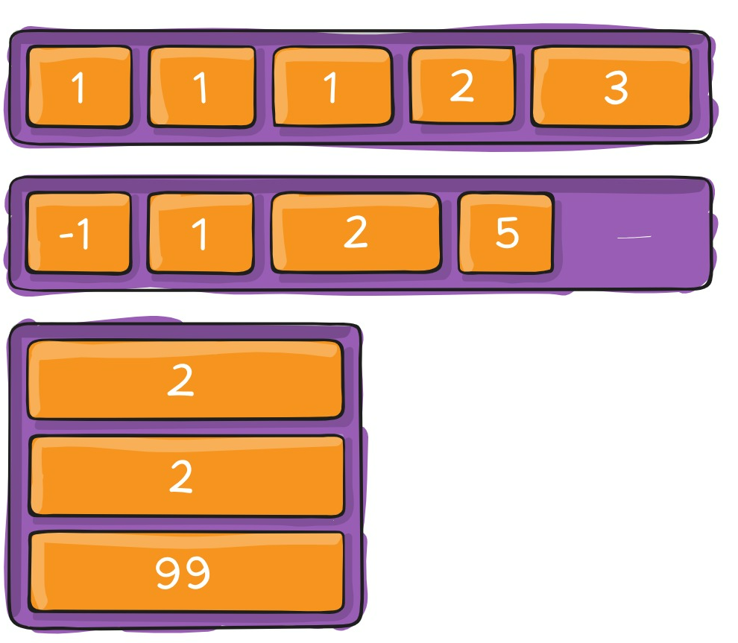
Flexbox
flex-order

Slide 14
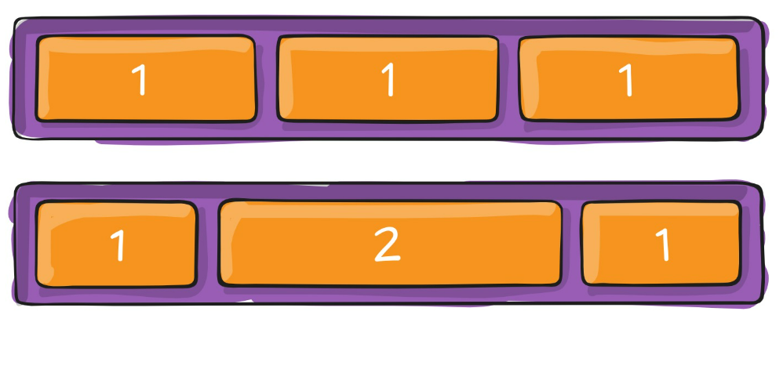
Flexbox
flex-grow

Slide 15
Navbar

