Slide 1
Community Detection
Presented by-
A rjun Bhattacharya
D ipanjan Karmakar
B ijon Bose

Slide 2
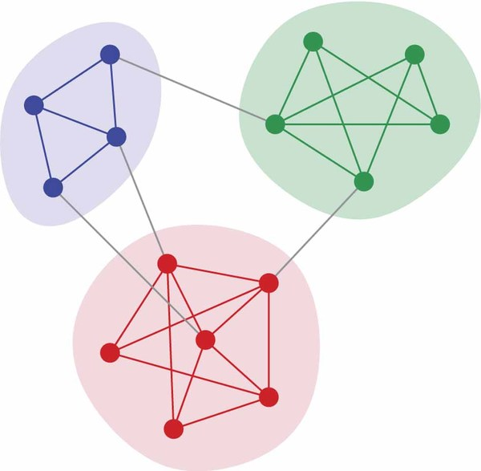
What is a Community?
Closely related nodes within the graph.
Number of edges between the nodes within the community is more than with nodes outside.

Slide 3
Related Work
Communities Detection in large networks(Andrea Capocci et al): They introduced ‘Spectral Method’ utilizing edge-betweenness technique. This method assigns nodes to communities based on eigenvectors of matrices related to the adjacency matrix. The disadvantage of their method is, it increases the complexity with increased number of matrix computations for large n.
Community Extraction for Social Networks(Chang Su et al): ] They have proposed a new Community Extraction framework using criterion that has a natural probabilistic interpretation and hypothesis test to determine the number of communities in a network when prior information on true or desired number of communities to be extracted is not available.

Slide 4
Seed Set Expansion
Overlapping Community Detection Using Seed Set Expansion(Joyce Jiyoung Whang et al): They have introduced a seeding strategy based on using a multilevel weighted kernel k-means algorithm on the graph (Graclus algorithm). They use distance function to compute centroid vertex and then use page ranking random walk algorithm to grow the seeds.

Slide 5
Main Contributions
we have defined two new factors – degree of connectedness and degree of reputation & using that a new seeding strategy
a new algorithm for seed set expansion phase,
experimental results on real life data sets
analysis of the experimental results and study the behavior of our algorithm.

Slide 6
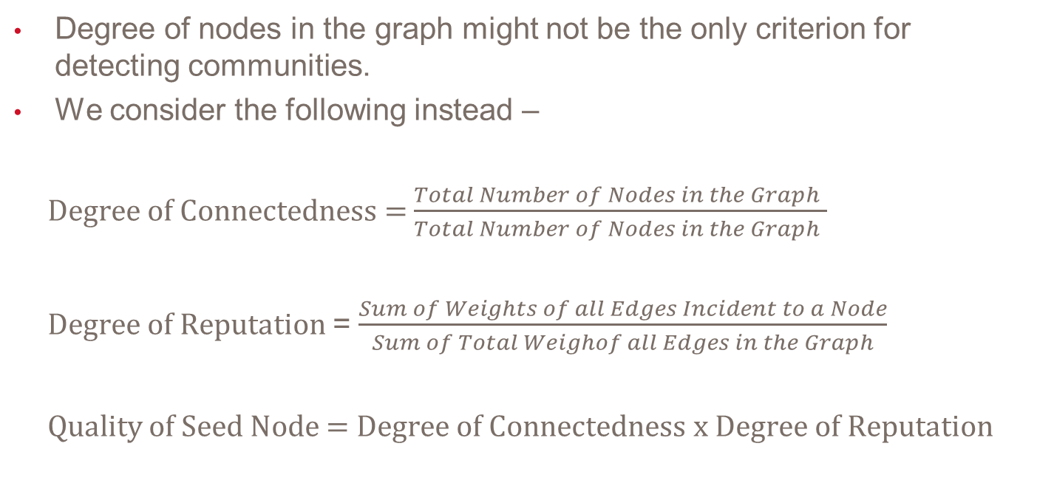
Tweaking this approach…
Degree of nodes in the graph might not be the only criterion for detecting communities.
We consider the following instead –
Degree of Connectedness = $\frac{Total Number of Nodes in the Graph }{Total Number of Nodes in the Graph }$
Degree of Reputation = $\frac{Sum of Weights of all Edges Incident to a Node}{Sum of Total Weighof all Edges in the Graph}$
Quality of Seed Node = Degree of Connectedness x Degree of Reputation

Slide 7
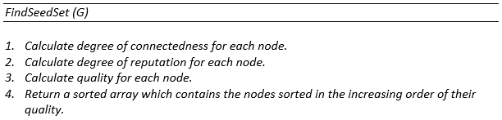
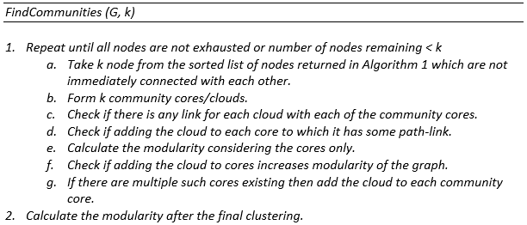
Our Algorithm

Slide 8
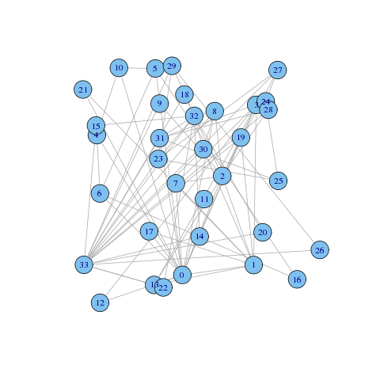
Seed Selection

Slide 9
Seed Set Expansion by adding clouds

Slide 10
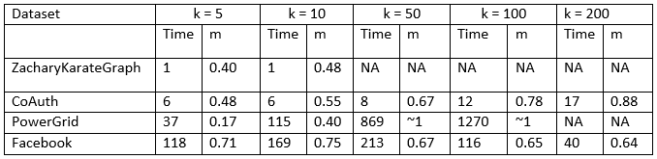
Experiments
For dense networks, running time does not change drastically with the value of k or the number of nodes.

Slide 11
Conclusion
This approach considers edge weight.
Thus valuable information like popularity, influence, trustworthiness of the nodes is not lost.
The method gives us k most central nodes in the graph in terms of above mentioned attributes.
Runtime is independent of number of edges.
Runtime comparable to existing methods.

Slide 12
Future Work
During merging of communities through overlapping, there are k comparisons each time.
This increases the runtime exponentially for increase in k.
Optimization is required in this expansion phase.
Use of more efficient data structures can be explored.

Slide 13
References
Overlapping Community Detection Using Seed Set Expansion
Joyce Jiyoung Whang, David F. Gleich, Inderjit S. Dhillon
doi: 10.1145/2505515.2505535
Community Extraction for Social Networks
Yunpeng Zhao, Elizaveta Levina1, and Ji Zhu
doi: 10.1073/pnas.1006642108
Communities Detection in Large Networks
Andrea Capocci, Vito D.P. Servedio, Guido Caldarelli and Francesca Colaiori
doi:10.1016/j.physa.2004.12.050

Slide 14
Thank You

