Slide 1
Introduction
Sujit Kumar Saha | Lecturer, Dept. of CSE, VU, Rajshahi.

Slide 2
Outline
Programming Languages
Language Translator
Basic Structure of C Program
Description of simple program
Needs of C programming

Slide 3
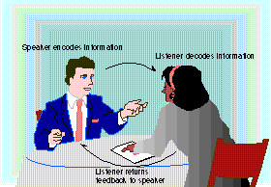
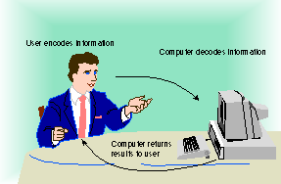
Communicating with a Computer
Speaker encodes information
Listener decodes information
User encodes information
Computer decodes
information
What is communication?
How with computer?
Listener returns feedback to speaker
Computer returns results to user

Slide 4
Programs and Programming Languages
Programming languages bridge the gap between human thought processes and computer binary circuitry.
Programming language: A series of specifically defined commands designed by human programmers to give directions to digital computers.
Commands are written as sets of instructions, called programs.
All programming language instructions must be expressed in binary code before the computer can perform them.
Notes:
ENIAC (Electronic Numerical Integrator And Computer was the first electronic general-purpose computer. Used programs to complete a number of different mathematical tasks. Programs were entered by plugging connector cables directly into sockets on a plug-in board.

Slide 5
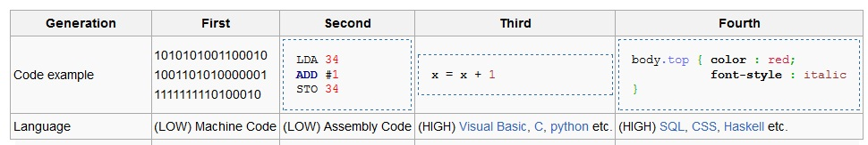
Programs and Programming Languages
In the beginning… To use a computer, you needed to know how to program it.
Today… People no longer need to know how to program in order to use the computer.
To see how this was accomplished, lets investigate how programming languages evolved.
First Generation - Machine Language (code)
Second Generation - Assembly Language
Third Generation - People-Oriented Programming Languages
Fourth Generation - Non-Procedural Languages
Fifth Generation - Natural Languages
Let’s see some example!

Slide 6
Definition | Programming Languages
First Generation - Machine Language (code): Machine language programs were made up of instructions written in binary code.
Second Generation - Assembly Language: Assembly language programs are made up of instructions written in mnemonics.
Third Generation - People-Oriented Programs: Instructions in these languages are called statements. High-level languages: Use statements that resemble English phrases combined with mathematical terms needed to express the problem or task being programmed.
Fourth Generation - Non-Procedural Languages: Programming-like systems aimed at simplifying the programmers task of imparting instructions to a computer. Many are associated with specific application packages. Query Languages, Report Writers, Application Generators.
Object-Oriented Languages: A language that expresses a computer problem as a series of objects a system contains, the behaviors of those objects, and how the objects interact with each other.

Slide 7
Definition | Programming Languages
Fifth Generation - Natural Languages: Languages that use ordinary conversation in one’s own language.
Research and experimentation toward this goal is being done.
Intelligent compilers are now being developed to translate natural language (spoken) programs into structured machine-coded instructions that can be executed by computers.
Effortless, error-free natural language programs are still some distance into the future.

Slide 8
Translator | Programming Languages
Computer languages can be grouped according to which translation process is used to convert the instructions into binary code:
Assemblers.
Interpreters.
Compilers.

Slide 9
Definition | Assembler
Assembled languages:
Assembler: a program used to translate Assembly language programs.
Produces one line of binary code per original program statement.
The entire program is assembled before the program is sent to the computer for execution.

Slide 10
Definition | Interpreter
Interpreted Languages:
Interpreter: A program used to translate high-level programs.
Translates one line of the program into binary code at a time:
An instruction is fetched from the original source code.
The Interpreter checks the single instruction for errors.
The instruction is translated into binary code.
The binary coded instruction is executed.
The fetch and execute process repeats for the entire program.

Slide 11
Definition | Compiler
Compiled languages:
Compiler: a program used to translate high-level programs.
Translates the entire program into binary code before anything is sent to the CPU for execution. The translation process for a compiled program:
First, the Compiler checks the entire program for syntax errors in the original source code.
Next, it translates all of the instructions into binary code.
Two versions of the same program exist: the original source code version, and the binary code version (object code).
Last, the CPU attempts execution only after the programmer requests that the program be executed.

Slide 12
Interpreter Vs Compiler
A complier converts the high level instruction into lower level language (e.g., assembly language or machine code) while an interpreter converts the high level instruction into an intermediate form.
The compiler executes the entire program at a time, but the interpreter executes each and every line individually.
List of errors is created by the compiler after the compilation process while an interpreter stops translating after the first error.
Autonomous executable file is generated by the compiler while interpreter is compulsory for an interpreter program.
Interpreter is smaller and simpler than compiler
Interpreter is slower than compiler.

Slide 13
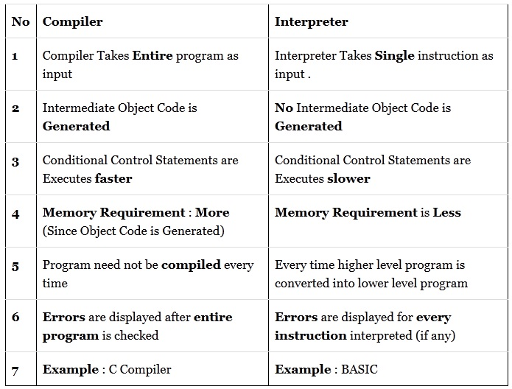
Interpreter Vs Compiler
compilerVSinterpreter

Slide 14
Building A Program
Whatever type of problem needs to be solved, a careful thought out plan of attack, called an algorithm, is needed before a computer solution can be determined.
1) Developing the algorithm.
2) Writing the program.
3) Documenting the program.
4) Testing and debugging the program.

Slide 15
C Programming
Why C?
Operating System (OS)
Embedded System (ES)
Microcontroller based programming (Robotics)
System Programming
Programming Language Development
Game Engine
Programming Contest
Importance of C:
C language is efficient and fast.
C is highly portable.
C language is well suited for structured programming.
C is a machine independent language.
C has the ability to extend itself.

Slide 16
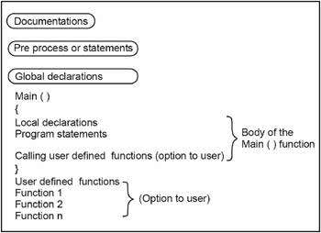
Basic Structure of C Program
C structure

Slide 17
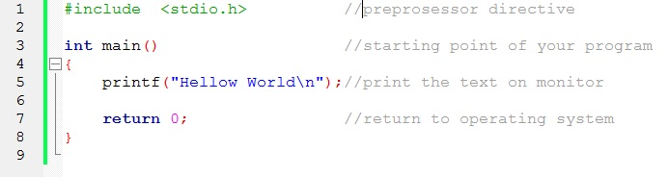

Simple C Program
C program
A comment is descriptive text used to help a reader of the program understand its content.
A C program line begins with # provides an instruction to the C preprocessor. It is executed before the actual compilation is done.
Every program must have a function called main. This is where program execution begins.
The statement return 0; indicates that main() returns a value of zero to the operating system.
Output

Slide 18
Thank You.
Questions and Answer

Slide 19
References
Books:
Programming in ANSI C By E. Balagurusamy
Teach yourself C. By Herbert Shield
Programming With C. By Byron Gottfried
Web:
www.wikbooks.org
and other slide, books and web search.
Notes:
License: You are free to read, share, copy, distribute and transmit the work for educational purpose. But not commercial.

