Slide 1
Operators and Expressions
Sujit Kumar Saha | Lecturer, Dept. of CSE, VU, Rajshahi.

Slide 2
Outline
Operators
Expressions
Some examples

Slide 3
Operators
An operator is a symbol that tells the computer to perform certain mathematical and logical manipulations. Operators are used in programs to manipulate data and variables. Such as, +, --, <, > etc.
C operators can be classified into a number of categories. They are as follows:
Arithmetic operators.
Relational operators.
Logical operators.
Assignment operators.
Increment and decrement operators.
Conditional operators.
Bitwise operators.
Special operators.

Slide 4
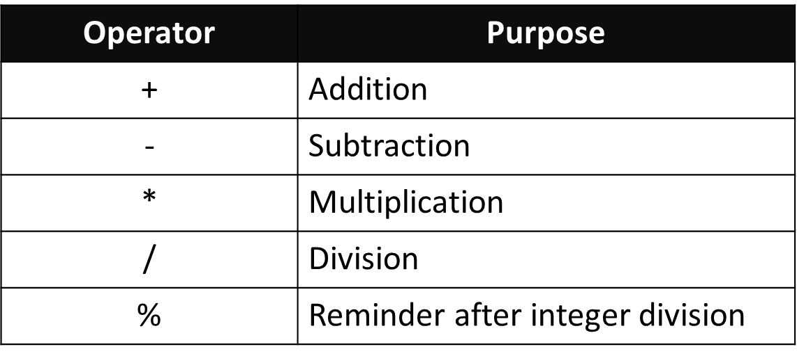
Arithmetic Operators
The arithmetic operators are +, -, *, /,%.
Integer arithmetic: Here operands are integer. For a=14 and b=4,
a+b=18 a/b=3(decimal part)
a%b=2(remainder of division)
Real arithmetic: Here, operands are only real number. Such as, if a=6.0 and b=7.0
then a/b=0.857143
There are five arithmetic operators in C.

Slide 5
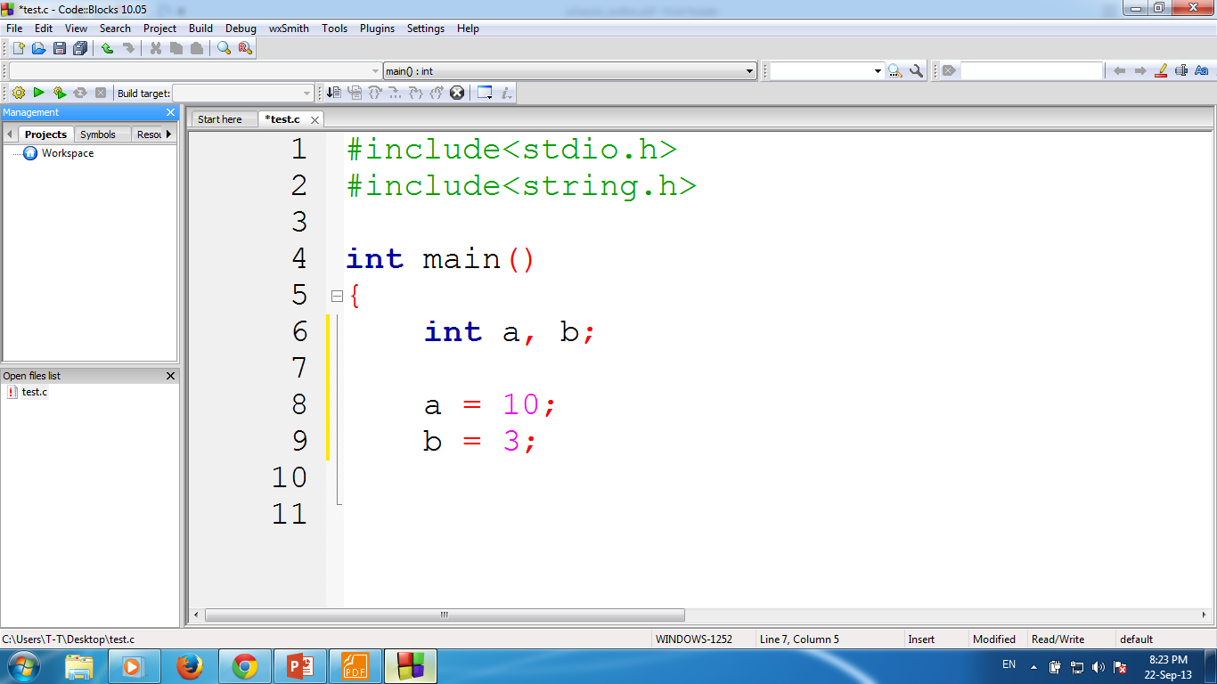
Arithmetic Operators
example integer
a + b
13
a - b
7
a * b
30
a / b
3
Fractional part omitted.
a % b
1
Remainder of division

Slide 6
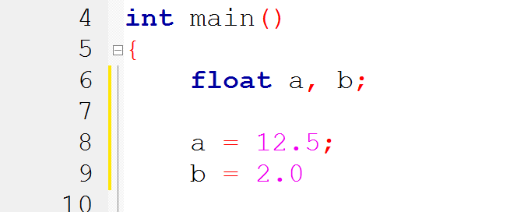
Arithmetic Operators
example floating point
a + b
14.5
a - b
10.5
a * b
25.0
a / b
6.25
a % b
Not Possible!!!

Slide 7

Arithmetic Operators
example character
a
65
a + b
131
a + 1
66
a + ‘A’
130
a + ‘1’
114

Slide 8
Type Conversion
Operands that differ in type may undergo type conversion before the expression takes on its final value.
In general, the final result will be expressed in the highest precision possible, consistent with the data types of the operands.
Example
int i = 7;
float f = 5.5;
char c = ‘w’;
ASCII Value
w = 119
0 = 48
i + f
12.5
float (double)
i + c
126
integer
i + c – ‘0’
78
integer
(i + c) - (2 * f / 5)
123.8
float (double)

Slide 9
Type Cast
To transform the type of a variable temporarily.
To do so, the expression must be preceded by the name of the desired data type, enclosed in parentheses
(data type) expression
int number;
(float) number;

Slide 10
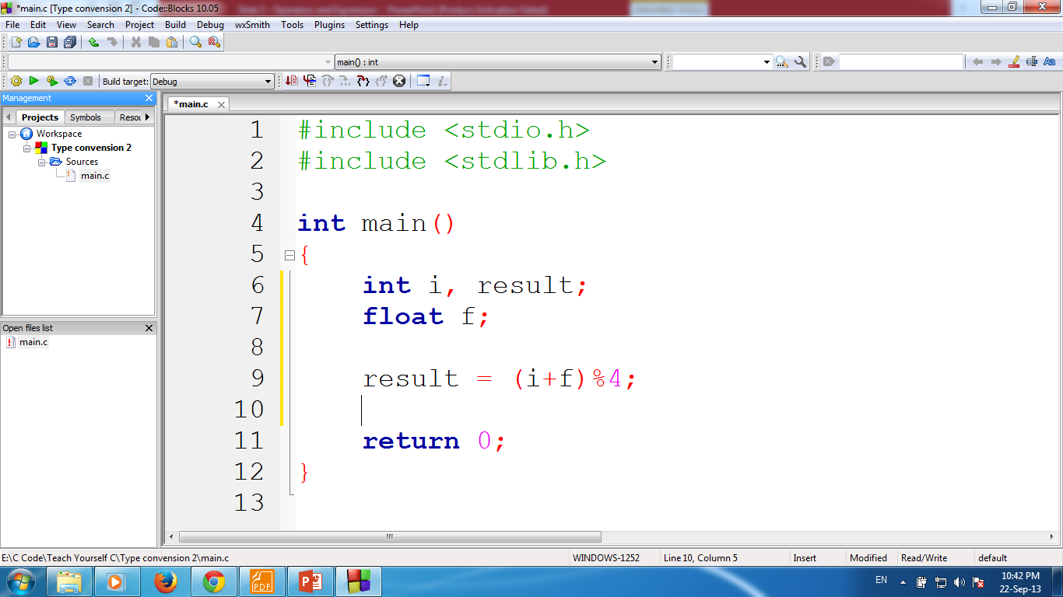

Check Type Cast
Check example
Again
i = 7;
f = 8.5;
float num = 10.5;
num % 2;
result = (i + f) % 4;
float num = 10.5;
((int)num) % 2;
Invalid

Slide 11
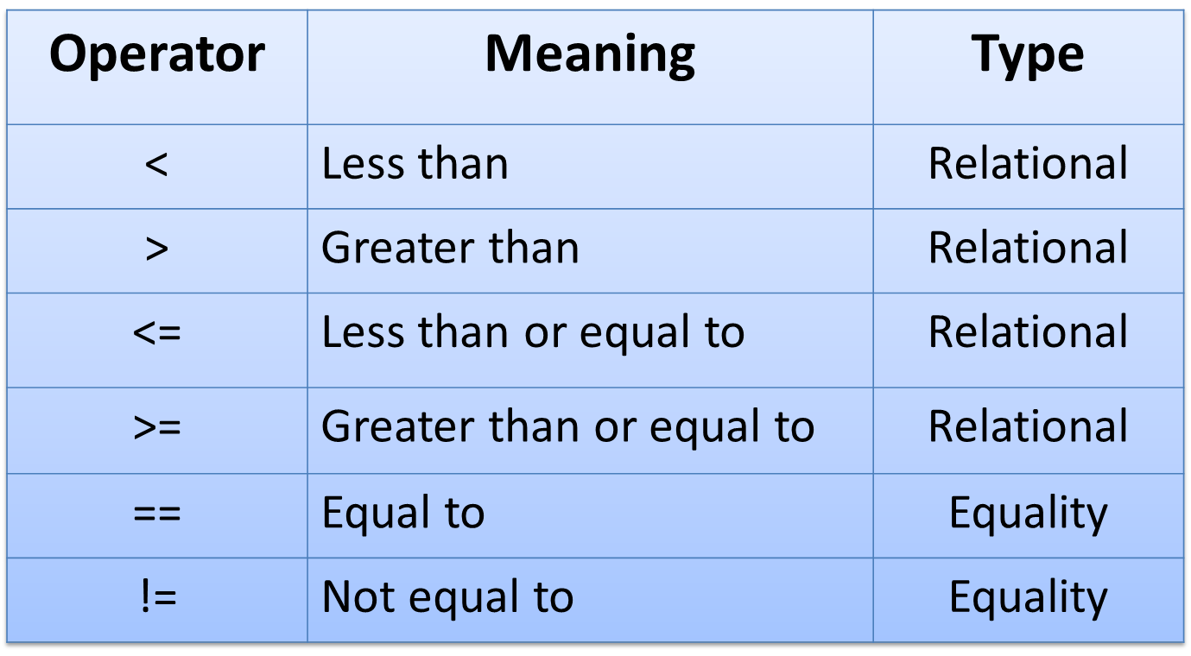
Relational Operator
The operators which are used to compare two numbers and take decision depending on their relation are called relational operators.
Example

Slide 12
Relational Operator
Given the following C declarations:
int a =1, b = 2, c = 3, d = 1;
a == d is true
c > b is true
c >= b is true
a >= c is false
a != d is false
a <= d is true

Slide 13
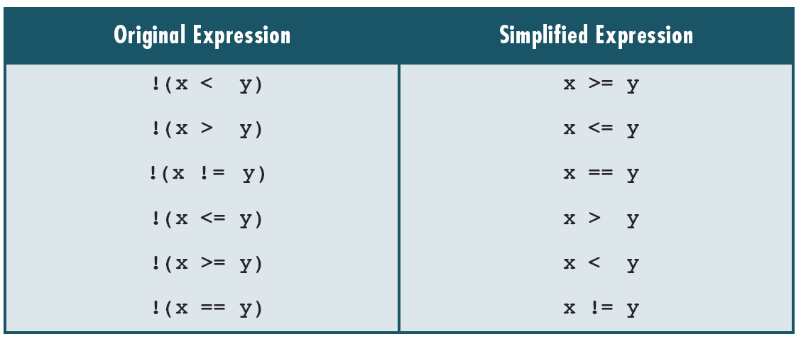
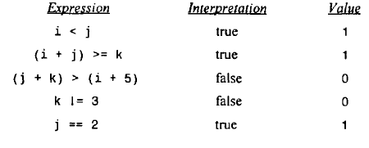
Relational Operator
Suppose that i, j and k are integer variables.
Where, i=1;
j=2;
k=3;
Several logical expressions involving these variables are shown below.
Simplified Expression

Slide 14
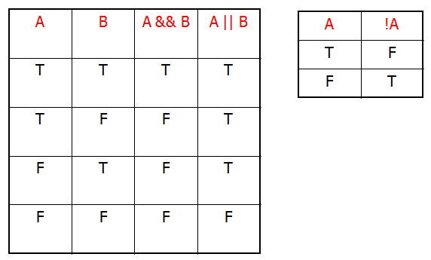
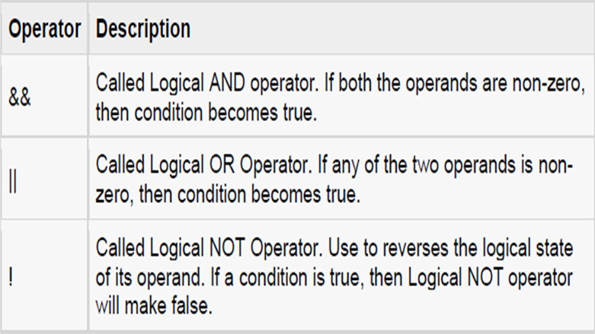
Logical Operator
Operators which are used to combine two or more relational expressions are known as logical operators.
There are three logical operators.
Truth table of Logical Operator

Slide 15
Assignment Operator
Operators which are used to assign the result of an expression to a variable are known as assignment operators.
Consider an example:
x= 100; meaning: 100 is assigned to x
x += (y+1);
The operator += means ‘add y+1 to x’ or ‘increment x by y+1’.
For y=2; the above statement results x= 103,
x += 3; that is (x = x + 3)

Slide 16
Increment Decrement Operator
C allows two very useful operators increment (++) and decrement (--) operators.
The operator ++ adds 1 to the operand, while -- subtracts 1.
Rules for ++ and – operators:
i) Increment (++) and decrement (--) operators are unary operators
ii) When postfix ++ (or --) is used with a variable in an expression, the expression is evaluated first using the original value of the variable and then the variable is incremented (or decremented) by one.
iii) When prefix ++ (or --) is used in an expression, the variable is incremented (or decremented) first and then the expression is evaluated using the new value of the variable.

Slide 17
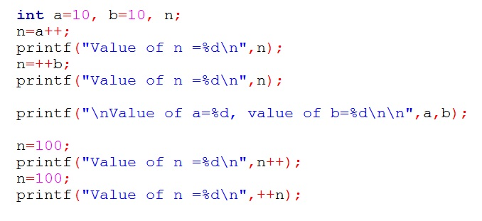
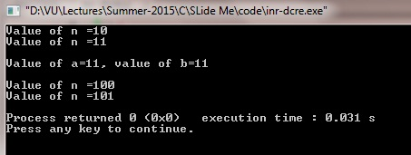
Increment Decrement Operator
Example:
Please guess the output
Check your output!!!

Slide 18
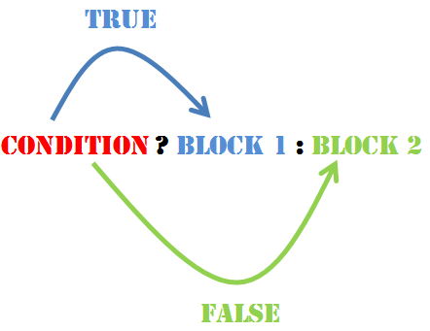
Conditional Operator
A ternary operator pair “ ? : ” is available in C
exp1?exp2:exp3.
exp1 is evaluated first. If it is nonzero (true) then the expression exp2 is evaluated and becomes the value of the expression.
if exp1 is false, then exp3 is evaluated and becomes the value of the expression.
Suppose a=10;
b=15;
x=(a>b)?a:b;
In this example,
x will be assigned the value of b.

Slide 19
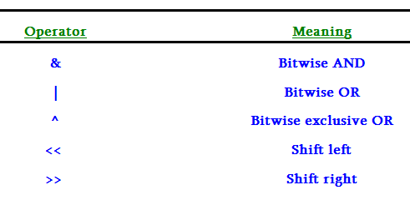
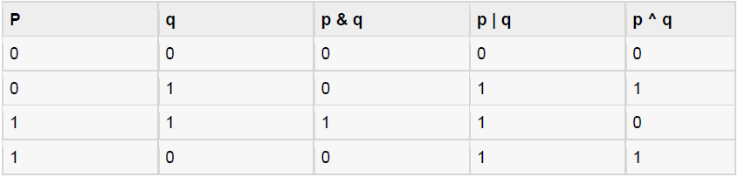
Bitwise Operator
Operators which are used to manipulate data at their bit level are known as bitwise operators. Bitwise operators and their meanings are given below,
Assume if A = 60; and B = 13;
A = 0011 1100
B = 0000 1101
------------------------
A&B = 0000 1100
A|B = 0011 1101
A^B = 0011 0001

Slide 20
Special Operator
C supports some special operators of interest such as comma operator, sizeof operator, pointer operators (& and *) and member selection operators (. and ->).
All these are special operators.
Example of sizeof operator:
int a;
float b;
double c;
char d;
printf("Size of int=%d bytes\n",sizeof(a));
printf("Size of float=%d bytes\n",sizeof(b));
printf("Size of double=%d bytes\n",sizeof(c));
printf("Size of char=%d byte\n",sizeof(d));

Slide 21
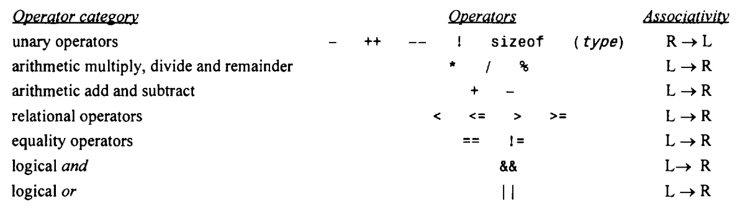
Operator Precedence
An operator’s precedence determines its order of evaluation.

Slide 22
Thank You.
Questions and Answer

Slide 23
References
Books:
Programming in ANSI C By E. Balagurusamy
Teach yourself C. By Herbert Shield
Programming With C. By Byron Gottfried
Web:
www.wikbooks.org
and other slide, books and web search.
Notes:
License: You are free to read, share, copy, distribute and transmit the work for educational purpose. But not commercial.

