Slide 1
Control Statements
Sujit Kumar Saha | Lecturer, Dept. of CSE, VU, Rajshahi.

Slide 2
Outline
Control Statements
if statements
if-else statements
Switch statements
Goto Statements
Conditional Operator (Statements)

Slide 3
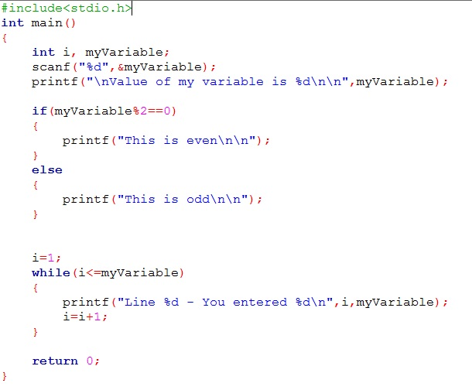
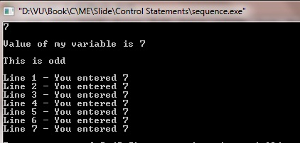
Control Statements
Let see a C program
Selection
OR
Many time
Repetition

Slide 4
Control Statements
Let see a C program

Slide 5
Control Statements
Let see a C program
Sequential statements
Selection statements
Loop statements

Slide 6
Control Statements
Control the flow of execution in a program or function.
There are three kinds of execution flow:
Sequence: The execution of the program is sequential.
Selection: A control structure which chooses alternative to execute.
Repetition: A control structure which repeats a group of statements.

Slide 7
if Statements
One of C’s selection statement.
Sometimes called conditional statements
Its operation is governed by the outcome of a conditional test evaluates to either true or false.
In its simplest form, the if statement allows our program to conditionally execute a statement.

Slide 8
if Statements
Simplest form of if statement:
For multiple statements:
if(expression)
statement;
if(expression)
{
statement;
}
if(expression)
{
statement 1;
statement 2;
……
statement n;
}

Slide 9
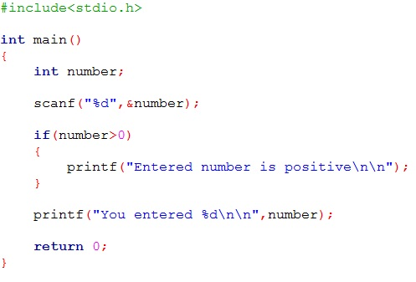
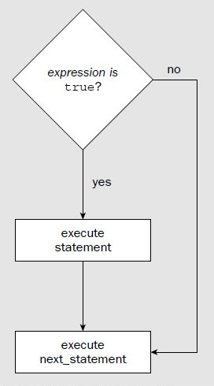
if Statements
The expression may be any valid C expression.
If the expression evaluated as true, the statement will be executed.
If it does not - the statement is bypassed and the line of code following the if is executed.

Slide 10
if Statements
The expression may be any valid C expression.
If the expression evaluated as true, the statement will be executed.
If it does not - the statement is bypassed and the line of code following the if is executed.

Slide 11
if Statements
In C, an expression is true if it evaluates to any nonzero values (5,9,-4,100 etc).
If it evaluate to zero, it is false.
int a=10, b=20;
if(a<b)
printf(“This line will print.”);
Output
This line will print.
int a=10, b=20;
if(a>b)
printf(“This line will print.”);
Output
int a=10, b=20;
if(0)
printf(“This line will print.”);
Output

Slide 12
if Statements
if
int a=10, b=20;
printf(“%d”, a<=b);
Output
1
int a=10, b=20;
printf(“%d”, a>b);
Output
0
int a=10, b=20;
if(a)
printf(“This line will print.”);
Output
This line will print.
int a=-10, b=20;
if(a)
printf(“This line will print.”);
Output
This line will print.

Slide 13
If-else Statements
We can add else statement to the if.
Then the if statement looks like this:
if(expression)
statement1;
else
statement2;

Slide 14
If-else Statements
Structure of simple if-else is:
if(expression)
{
statements
}
else
{
statements
}
True
OR

Slide 15
If-else Statements
Structure of simple if-else is:
if(expression)
{
statements
}
else
{
statements
}
False
OR

Slide 16
If-else Statements
Structure of nested if-else is:
if(expression)
{
statements
}
else if(expression)
{
statements
}
...
else
{
statements
}
OR
OR

Slide 17
Switch Statements
If is good for choosing between two alternatives
When several alternatives are needed we should use switch statement.
switch is C’s multiple selection statement.
Use to select one of several alternative paths in program execution

Slide 18
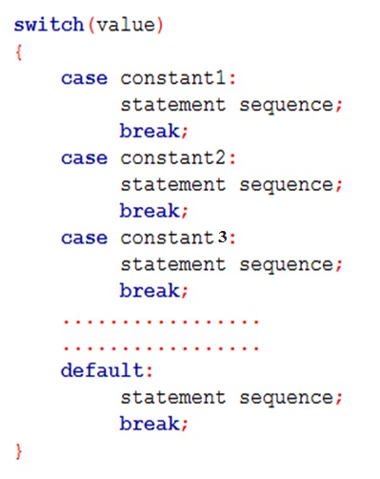
Switch Statements
switch
A value is successively tested against a list of integer or character constants.
When the match is found, the statement sequence associated with that match is executed.
Statement sequence are not blocks, not use curly braces

Slide 19
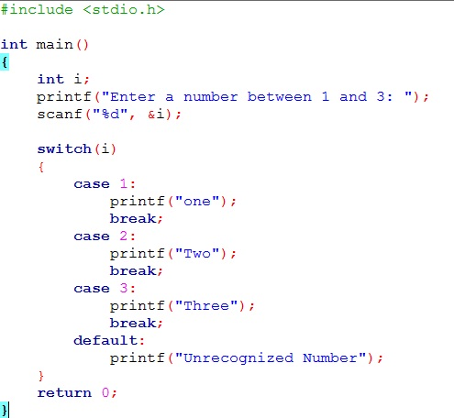
Switch Statements
switch

Slide 20
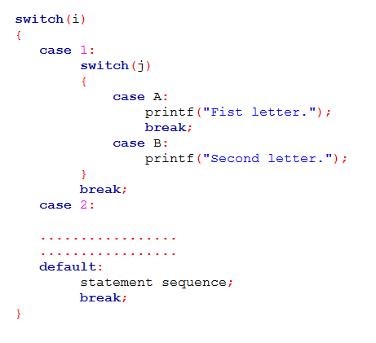
Switch Statements
Nested switch:

Slide 21
If vs Switch
switch can only test for equality, where the if conditional expression can be of any type
switch will work with only int or char types. We can’t use float or others.

Slide 22
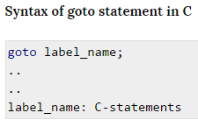
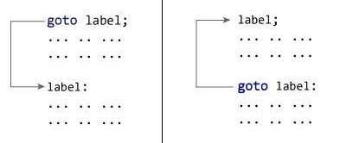
Goto Statement
When compiler encounters goto statement in a C program, the control jumps to the corresponding label mentioned along with

Slide 23
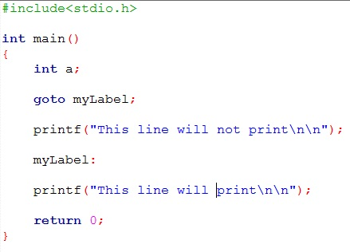
Goto Statement
Goto example

Slide 24
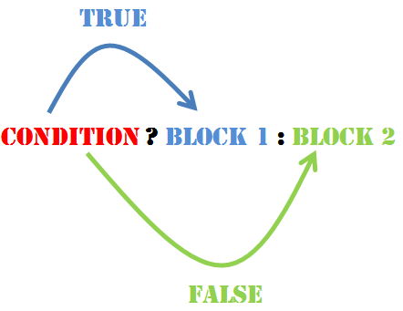
Conditional Operator (Statements)
The conditional operator
A conditional expression is written in the form
? :
expression 1 ? expression 2 : expression 3
True or False?
True
False

Slide 25
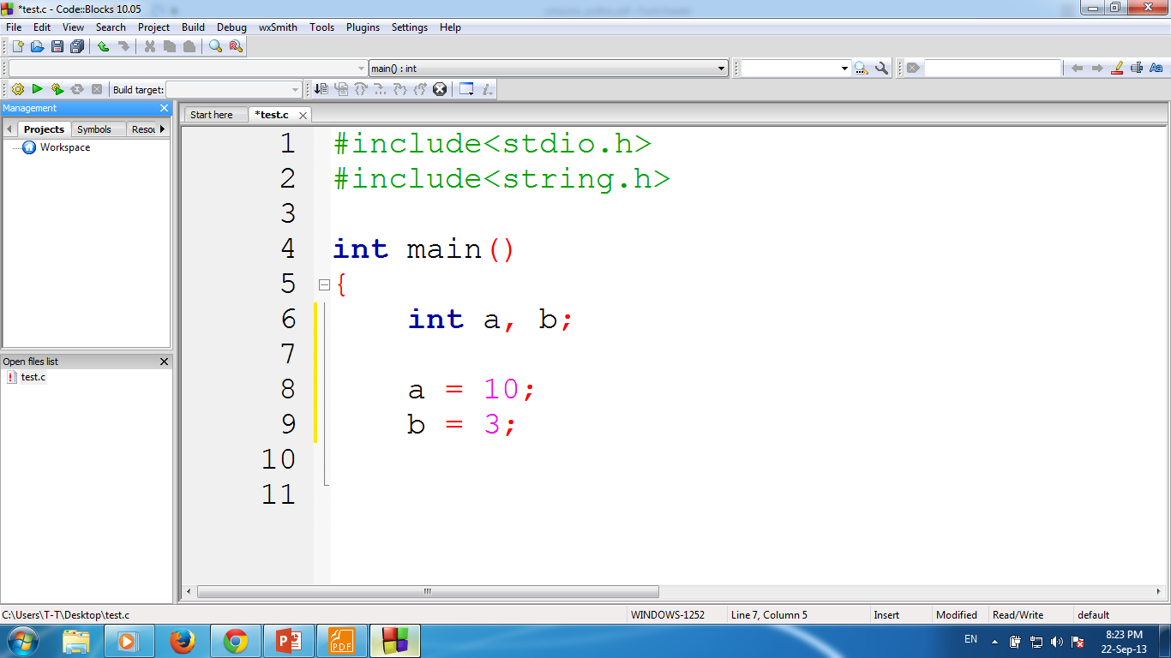
Conditional Operator (Statements)
conditional operator
(a+b)>=13 ? a = 100 : a = 1000
Now a is 100
True or False?
True

Slide 26
Conditional Operator (Statements)
conditional operator
i = (a+b)<13 ? 100 : 1000
Now i is 1000
True or False?
False

Slide 27
Thank You.
Questions and Answer

Slide 28
References
Books:
Programming in ANSI C By E. Balagurusamy
Teach yourself C. By Herbert Shield
Programming With C. By Byron Gottfried
Web:
www.wikbooks.org
and other slide, books and web search.
Notes:
License: You are free to read, share, copy, distribute and transmit the work for educational purpose. But not commercial.

