Slide 1
Control Statements
Sujit Kumar Saha | Lecturer, Dept. of CSE, VU, Rajshahi.

Slide 2
Outline
Control Statements
For loop
While loop
Do-while loop
Loop using goto statement

Slide 3
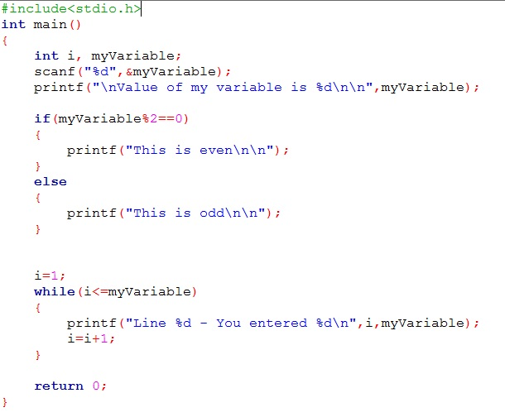
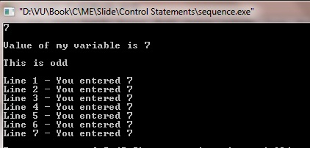
Control Statements
Let see a C program

Slide 4
Control Statements
Let see a C program
Sequential statements
Selection statements
Loop statements

Slide 5
Control Statements
Control the flow of execution in a program or function.
There are three kinds of execution flow:
Sequence: The execution of the program is sequential.
Selection: A control structure which chooses alternative to execute.
Repetition: A control structure which repeats a group of statements.

Slide 6
Some programing situations!!!
1. Write a C program that will print numbers from 1 through 10 on screen.
2. Write a C program that will print all numbers from 1 through n, where 1<=n<=1000.
3. Write a C program that will print “Welcome to our CSE family” 1000 times on screen.
4. Write a C program that will print all even numbers between 1 and 100.
5. Write a C program that will print the value of s where,
a) s = 1+2+3+ …… +n
b) s = 2+4+8+ …… up to n^{th} term.
c) s = l+…… +n+(n+2)+(n+4)+……+u, where l<=n<=u
d) s = 5+11/2+6+13/2+…… up to n^{th} term.
6. Write a C program that will print all prime numbers between 1 and 100.

Slide 7
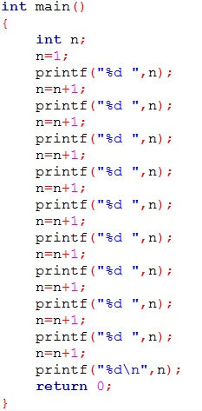
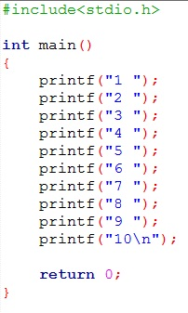
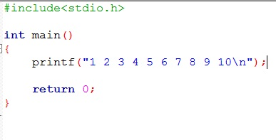
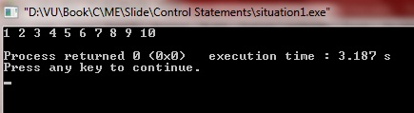
Some programing situations!!!
1. Write a C program that will print numbers 1 through 10 on screen.
How?

Slide 8
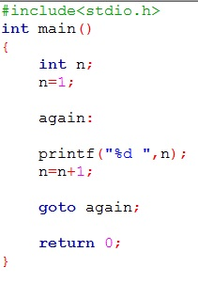
Some programing situations!!!
1. Write a C program that will print numbers 1 through 10 on screen.
How?

Slide 9
Some programing situations!!!
1. Write a C program that will print numbers 1 through 10 on screen.
How?
n
UK
Output

Slide 10
Some programing situations!!!
1. Write a C program that will print numbers 1 through 10 on screen.
How?
n
1
Output

Slide 11
Some programing situations!!!
1. Write a C program that will print numbers 1 through 10 on screen.
How?
n
1
Output
1

Slide 12
Some programing situations!!!
1. Write a C program that will print numbers 1 through 10 on screen.
How?
n
2
Output
1

Slide 13
Some programing situations!!!
1. Write a C program that will print numbers 1 through 10 on screen.
How?
n
2
Output
1

Slide 14
Some programing situations!!!
1. Write a C program that will print numbers 1 through 10 on screen.
How?
n
2
Output
1 2

Slide 15
Some programing situations!!!
1. Write a C program that will print numbers 1 through 10 on screen.
How?
n
3
Output
1 2

Slide 16
Some programing situations!!!
1. Write a C program that will print numbers 1 through 10 on screen.
How?
Continue this process…
n
3
Output
1 2 3

Slide 17
Some programing situations!!!
1. Write a C program that will print numbers 1 through 10 on screen.
How?
n
10
Output
1 2 3 4 5 6 7 8 9

Slide 18
Some programing situations!!!
1. Write a C program that will print numbers 1 through 10 on screen.
How?
n
10
Output
1 2 3 4 5 6 7 8 9 10

Slide 19
Some programing situations!!!
1. Write a C program that will print numbers 1 through 10 on screen.
How?
n
Terminate this program
10
Output
1 2 3 4 5 6 7 8 9 10

Slide 20
Some programing situations!!!
1. Write a C program that will print numbers 1 through 10 on screen.
How?
n
Terminate this program
11
Output
1 2 3 4 5 6 7 8 9 10

Slide 21
Some programing situations!!!
1. Write a C program that will print numbers 1 through 10 on screen.
How?
Continue…
n
Terminate this program
11
Output
1 2 3 4 5 6 7 8 9 10 11

Slide 22
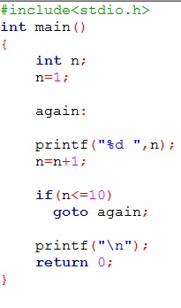
Some programing situations!!!
1. Write a C program that will print numbers 1 through 10 on screen.
How?

Slide 23
Some programing situations!!!
1. Write a C program that will print numbers 1 through 10 on screen.
How?
∞

Slide 24
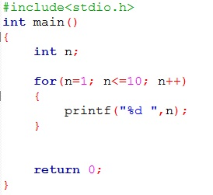
Using for loop
1. Write a C program that will print numbers 1 through 10 on screen.
How?

Slide 25
Using for loop
1. Write a C program that will print numbers 1 through 10 on screen.
For loop analysis

Slide 26
Using for loop
1. Write a C program that will print numbers 1 through 10 on screen.
For loop analysis
Start
(Step-0)
Check?
(Step-1)
Increment/Decrement
(Step-3)
True(1)
(Step-2)
If check
False(1)

Slide 27
Using for loop
1. Write a C program that will print numbers 1 through 10 on screen.
For loop analysis
Start
(Step-0)
Check?
(Step-1)
Increment/Decrement
(Step-3)
1
3
0
If True
True(1)
(Step-2)
2
If step-1 False, loop terminate
and execute next statement
If check
False(0)

Slide 28
Using for loop
1. Write a C program that will print numbers 1 through 10 on screen.
Step-1 will be true or false.
True: When n is 1 to 10
False: When n is 11
1
3
0
If True
2
If step-1 False, loop terminate
and execute next statement

Slide 29
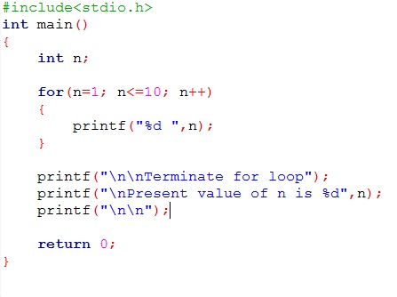
Using for loop
1. Write a C program that will print numbers 1 through 10 on screen.
For loop analysis
n
UK
Output

Slide 30
Using for loop
1. Write a C program that will print numbers 1 through 10 on screen.
For loop analysis
n
UK
Output

Slide 31
Using for loop
1. Write a C program that will print numbers 1 through 10 on screen.
For loop analysis
n
1
Output

Slide 32
Using for loop
1. Write a C program that will print numbers 1 through 10 on screen.
For loop analysis
n
True
1
Output

Slide 33
Using for loop
1. Write a C program that will print numbers 1 through 10 on screen.
For loop analysis
n
True
1
Output

Slide 34
Using for loop
1. Write a C program that will print numbers 1 through 10 on screen.
For loop analysis
n
True
1
Output
1

Slide 35
Using for loop
1. Write a C program that will print numbers 1 through 10 on screen.
For loop analysis
n
1
Output
1

Slide 36
Using for loop
1. Write a C program that will print numbers 1 through 10 on screen.
For loop analysis
n
2
Output
1

Slide 37
Using for loop
1. Write a C program that will print numbers 1 through 10 on screen.
For loop analysis
n
True
2
Output
1

Slide 38
Using for loop
1. Write a C program that will print numbers 1 through 10 on screen.
For loop analysis
Continue …
n
True
2
Output
1 2

Slide 39
Using for loop
1. Write a C program that will print numbers 1 through 10 on screen.
For loop analysis
n
True
10
Output
1 2 3 4 5 6 7 8 9

Slide 40
Using for loop
1. Write a C program that will print numbers 1 through 10 on screen.
For loop analysis
n
True
10
Output
1 2 3 4 5 6 7 8 9 10

Slide 41
Using for loop
1. Write a C program that will print numbers 1 through 10 on screen.
For loop analysis
n
10
Output
1 2 3 4 5 6 7 8 9 10

Slide 42
Using for loop
1. Write a C program that will print numbers 1 through 10 on screen.
For loop analysis
n
11
Output
1 2 3 4 5 6 7 8 9 10

Slide 43
Using for loop
1. Write a C program that will print numbers 1 through 10 on screen.
For loop analysis
Terminate loop
n
False
11
Output
1 2 3 4 5 6 7 8 9 10

Slide 44
Using for loop
1. Write a C program that will print numbers 1 through 10 on screen.
For loop analysis
n
11
Output
1 2 3 4 5 6 7 8 9 10

Slide 45
Using for loop
1. Write a C program that will print numbers 1 through 10 on screen.
For loop analysis
n
11
Output
1 2 3 4 5 6 7 8 9 10
Terminate for loop

Slide 46
Using for loop
1. Write a C program that will print numbers 1 through 10 on screen.
For loop analysis
n
11
Output
1 2 3 4 5 6 7 8 9 10
Terminate for loop

Slide 47
Using for loop
1. Write a C program that will print numbers 1 through 10 on screen.
For loop analysis
n
11
Output
1 2 3 4 5 6 7 8 9 10
Terminate for loop
Present value of n is 11

Slide 48
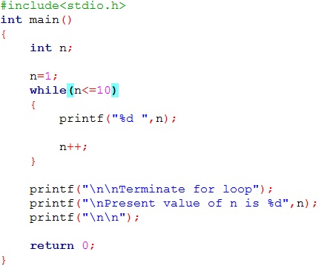
for loop vs while loop
1. Write a C program that will print numbers 1 through 10 on screen.
For loop analysis
They are same

Slide 49
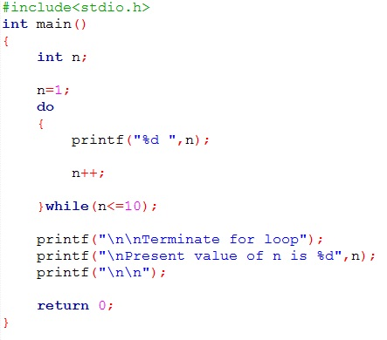
for loop vs while loop vs do while loop
1. Write a C program that will print numbers 1 through 10 on screen.
For loop analysis
They are same

Slide 50
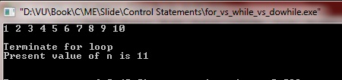
while loop vs do while loop
1. Write a C program that will print numbers 1 through 10 on screen.
For loop analysis
They produce same result
But they are different in some situation

Slide 51
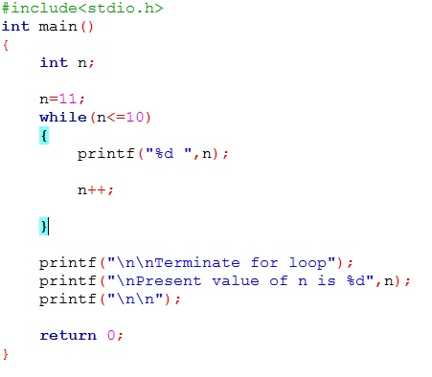
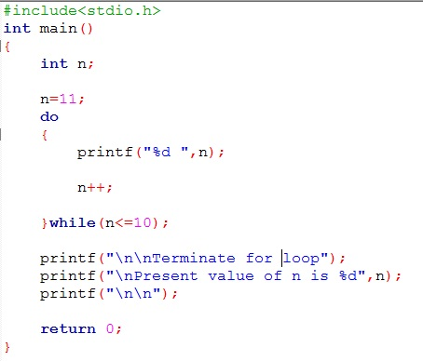
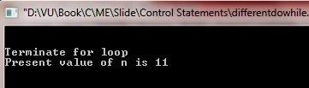

while loop vs do while loop
While-dowhile
False

Slide 52
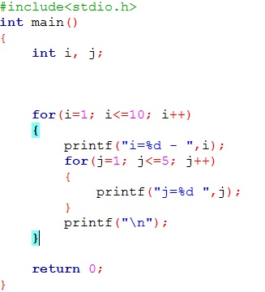
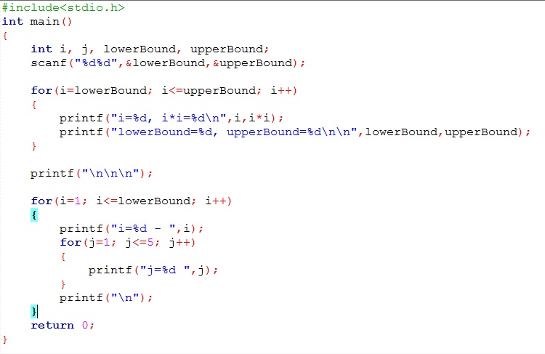
Nested loop
Consider the following code and analysis these code…
Run these code and try to understand the output
Rewrite various nesting loop and analyze the output

Slide 53
Thank You.
Questions and Answer

Slide 54
References
Books:
Programming in ANSI C By E. Balagurusamy
Teach yourself C. By Herbert Shield
Programming With C. By Byron Gottfried
Web:
www.wikbooks.org
and other slide, books and web search.
Notes:
License: You are free to read, share, copy, distribute and transmit the work for educational purpose. But not commercial.

