Slide 1
Array String Function
Sujit Kumar Saha | Lecturer, Dept. of CSE, VU, Rajshahi.

Slide 2
Outline
Array
String
Function

Slide 3
Array
Arrays is the collection of elements of the same data types. or
A collection of objects of the same type stored contiguously in memory under one name
Some Applications:
Given a list of test scores, determine the maximum and minimum scores.
Read in a list of student names and rearrange them in alphabetical order (sorting).
Given the height measurements of students in a class, output the names of those students who are taller than average.

Slide 4
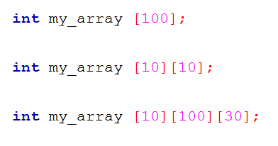
Types of Array
array
One dimensional Array:
Let see the addressing/indexing :
Multi dimensional Array:
These variables are:
my_array[0],
my_array[1],
my_array[2],
…
my_array[99].
These variables are:
my_array[0][0],
my_array[0][1],
my_array[0][2],
…
my_array[9][9].
00, 01, 02, … 09,
10, 11, 12, … 19,
…
90, 91, 92, … 99.
0, 1, 2, … 99.
Array indexes always start at zero in C

Slide 5
One Dimensional Array
In C, a one dimensional array is a list of variables that are all of the same type and are accessed through a common name.
An individual variable in the array is called an array element.
It is useful to handle groups of related data.
General form-
type is a valid C data type.
var_name is the name of the array.
size specifies the number of elements in the array.
type var_name[size]
Size – can hold 100 elements
Type
Array name

Slide 6
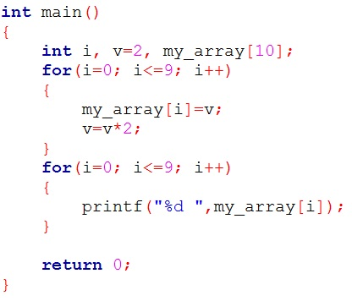

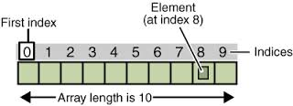
One Dimensional Array
An array element is accessed by indexing the array using the number of the element.
In C, all arrays begin at zero.

Slide 7
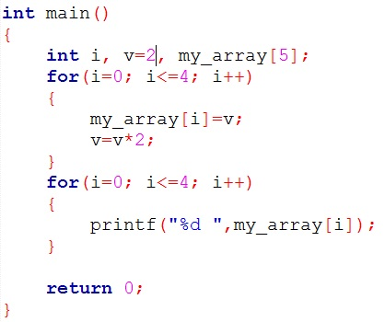
One Dimensional Array (Input from Keyboard)
array
UK
2
UK
UK
UK
UK
UK
0 1 2 3 4
i
v
my_array

Slide 8
One Dimensional Array (Input from Keyboard)
array
0
2
UK
UK
UK
UK
UK
0 1 2 3 4
i
v
my_array

Slide 9
One Dimensional Array (Input from Keyboard)
array
0
2
2
UK
UK
UK
UK
0 1 2 3 4
i
v
my_array

Slide 10
One Dimensional Array (Input from Keyboard)
array
0
4
2
UK
UK
UK
UK
0 1 2 3 4
i
v
my_array

Slide 11
One Dimensional Array (Input from Keyboard)
array
1
4
2
UK
UK
UK
UK
0 1 2 3 4
i
v
my_array

Slide 12
One Dimensional Array (Input from Keyboard)
array
1
4
2
4
UK
UK
UK
0 1 2 3 4
i
v
my_array

Slide 13
One Dimensional Array (Input from Keyboard)
array
1
8
2
4
UK
UK
UK
0 1 2 3 4
i
v
my_array

Slide 14
One Dimensional Array (Input from Keyboard)
array
2
8
2
4
UK
UK
UK
0 1 2 3 4
i
v
my_array

Slide 15
One Dimensional Array (Input from Keyboard)
array
2
8
2
4
8
UK
UK
0 1 2 3 4
i
v
my_array

Slide 16
One Dimensional Array (Input from Keyboard)
array
2
16
2
4
8
UK
UK
0 1 2 3 4
i
v
my_array

Slide 17
One Dimensional Array (Input from Keyboard)
array
3
16
2
4
8
UK
UK
0 1 2 3 4
i
v
my_array

Slide 18
One Dimensional Array (Input from Keyboard)
array
3
16
2
4
8
16
UK
0 1 2 3 4
i
v
my_array

Slide 19
One Dimensional Array (Input from Keyboard)
array
3
32
2
4
8
16
UK
0 1 2 3 4
i
v
my_array

Slide 20
One Dimensional Array (Input from Keyboard)
array
4
32
2
4
8
16
UK
0 1 2 3 4
i
v
my_array

Slide 21
One Dimensional Array (Input from Keyboard)
array
4
32
2
4
8
16
32
0 1 2 3 4
i
v
my_array

Slide 22
One Dimensional Array (Input from Keyboard)
array
4
64
2
4
8
16
32
0 1 2 3 4
i
v
my_array

Slide 23
One Dimensional Array (Input from Keyboard)
array
5
64
2
4
8
16
32
0 1 2 3 4
i
v
my_array

Slide 24
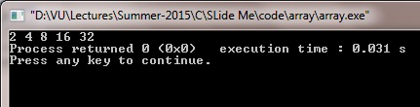
One Dimensional Array (Input from Keyboard)
array
0
64
2
4
8
16
32
0 1 2 3 4
i
v
my_array

Slide 25


One Dimensional Array (Input from Keyboard)
array
0
64
2
4
8
16
32
0 1 2 3 4
i
v
my_array

Slide 26


One Dimensional Array (Input from Keyboard)
array
0
64
2
4
8
16
32
0 1 2 3 4
i
v
my_array

Slide 27


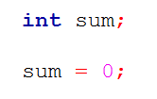
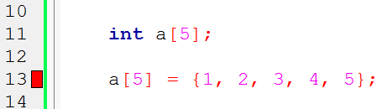
One Dimensional Array (Initializing)
array
Variable Initialization:
Array Initialization:

Slide 28
One Dimensional Array (Initializing)
int Ar[10] = {9, 8, 7, 6, 5, 4, 3, 2, 1, 0};
Ar[3] = -1;
0
1
2
3
4
5
6
7
8
9
Ar
9
8
7
6
5
12
3
-2
1
0
6
-1
0
1
2
3
4
5
6
7
8
9
Ar
9
8
7
-1
5
12
3
-2
1
0

Slide 29
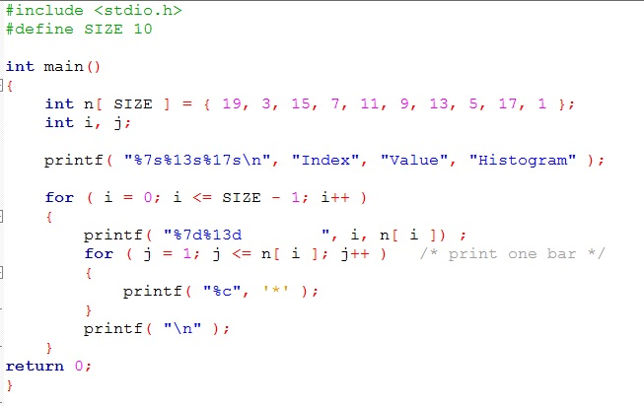
Array (Histogram)
array
What will be the output?

Slide 30
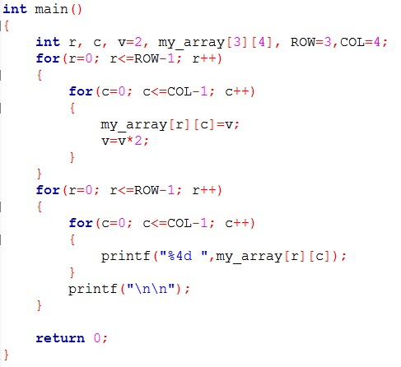
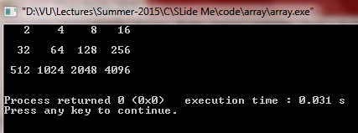
Two Dimensional Array
2d array
0 1 2 3
2
4
8
16
0,3
0
1
2
32
64
128
256
512
1024
2048
4096

Slide 31
Two Dimensional Array
Please try to manipulate two dimensional array.
For matrix addition
For matrix subtraction
Access diagonal values of a matrix etc

Slide 32
String

Slide 33
String(character) Array
How to manipulate names to your software (program)?
These are character data. But char data type only store one character.
The solution is string (character array).
The string is actually a one-dimensional array of characters which is terminated by a null character '\0'.
To hold the null character at the end of the array, the size of the character array containing the string is one more than the number of characters in the word "Hello."
char greeting[6] = {'H', 'e', 'l', 'l', 'o', '\0'};
Google Inc.
Yahoo Inc.
Samsung
Apple Inc.
Microsoft Corporation
Adobe Systems Incorporated
Twitter, Inc.
Facebook, Inc.

Slide 34
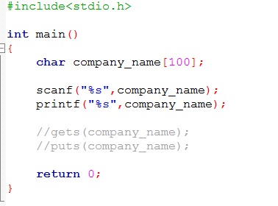
String(character) Array
How to declare?
type name_of_araay[n];
n is how many character needed for representing name.
Example: char company_name[100];
How to use?
It’s 100 element array.
We can use each element same as normal char variable.
These variables are:
company_name[0],
company_name[1],
company_name[2],
…
company_name[99].

Slide 35
String(character) Array
Character arrays
String “first” is really a static array of characters
Character arrays can be initialized using string literals
char string1[] = "first";
Null character '\0' terminates strings
string1 actually has 6 elements
It is equivalent to
char string1[] = {'f', 'i', 'r', 's', 't', '\0'};
Can access individual characters
string1[ 3 ] is character ‘s’
Array name is address of array, so & not needed for scanf ()
scanf( "%s", string2 );
Reads characters until whitespace encountered

Slide 36
String(character) Array
A string is defined as null terminated character array.
A string must be terminated by a null – means that we need one byte extra for holding null character.
A string constant is null-terminated by the compiler automatically.
Each character takes one byte in string.

Slide 37
Read String From Keyboard
There are several ways-
Using scanf() function-for string C use “%s” format specifier
Most common is: gets()
gets()
C’s standard library function
uses the STDIO.H header file
To use – call it using the name of a character array without any index.

Slide 38
Read String From Keyboard -gets()
get() function reads character until we press ENTER
The ENTER key (carriage return - \r) is not stored, but is replaced by a null, which terminates the string.
Be aware!
The get() function performs no bounds checking.
It is possible to enter more characters than the array receiving them can hold – unwanted result!
For example, if we call gets() with an array that is 20 characters long, there is no mechanism to stop us from entering more than 20 character.
char str[100];
gets(str);

Slide 39
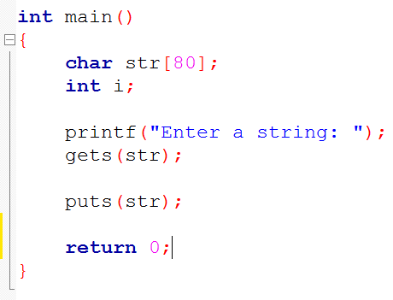
Write String to Monitor-puts()
C’s standard library function
uses the STDIO.H header file
To use – call it using the name of a character array without any index.
char str[100] = “This is it”;
puts(str);

Slide 40
String – STRING.H
The most string related library functions are
strcpy() – for copy
strcat() – for concatenation
strcmp() – for compare two strings
strlen() – for finding length of a string
strrev()- reverse the string
strcpy (to, from);
strcat (to, from);
strcmp(s1,s2);
strlen (str);
strrev (str);

Slide 41
String – strcmp()
It returns zero – if s1 and s2 same (s1 = s2)
It returns less than zero – if s1 less than s2 (s1 < s2)
It returns greater than zero – if s1 greater than s2 (s1 > s2)
strcmp(s1,s2);

Slide 42
String
Please try to understand other string function …

Slide 43
Function

Slide 44
Function
A function is a self-contained program segment that caries out some specific, well-define task.
Every C program consists of one(at least) or more functions
One of these function must be called main()
Execution of a program always begin by carrying out the instructions in main().
Basically, there are two types of functions in C on basis of whether it is defined by user or not.
Library function
User defined function

Slide 45
Advantages of user defined functions
User defined functions helps to decompose the large program into small segments
makes programmer easy to understand, maintain.
If repeated code occurs in a program.
Function can be used to include those codes and execute when needed by calling that function.
Programmer working on large project can divide the workload by making different functions.

Slide 46
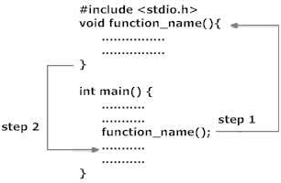
Working of Function
fn

Slide 47
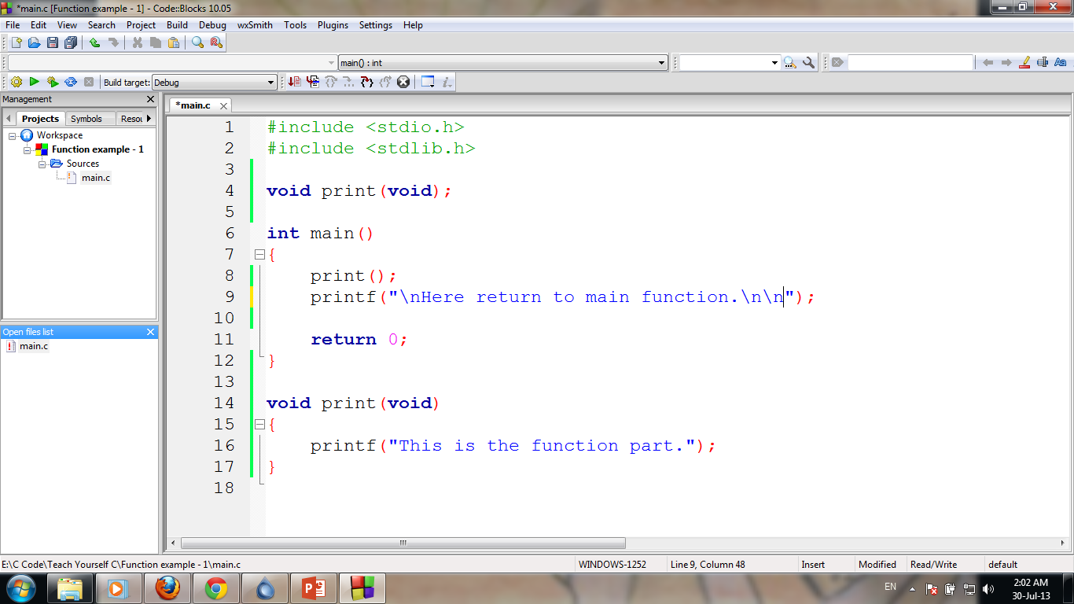
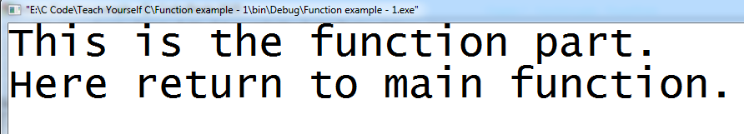
Simple example
fn
Function Prototype

Slide 48
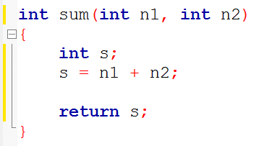
Function General Form
fn
return-type fun-name(type parameter1, type parameter2)
{
/*……function body…*/
}

Slide 49
Function Prototype
The function prototype declares the input and output parameters of the function.
The function prototype has the following syntax:
type function-name(parameter list);
return-type fun-name(type parameter1, type parameter2)
{
/*……function body…*/
}
return-type fun-name(type parameter1, type parameter2);

Slide 50
Function Prototype
fn
Function Prototype
Function Definition

Slide 51
Function Prototype
A function prototype declares a function before it is used and prior to its definition.
Compiler needs to know this information in order for it to properly execute a call to function.
main() does not need prototype.

Slide 52
Argument and Parameter
A function’s argument is a value that is passed to the function when the function is called.
A function can have zero to several argument.
For function to be able to take arguments, special variables to receive argument values must be declared, called parameter of the function.
The parameters are declared between the parentheses that follow the function’s name during function definition.
Functions that take arguments are called parameterized function.

Slide 53
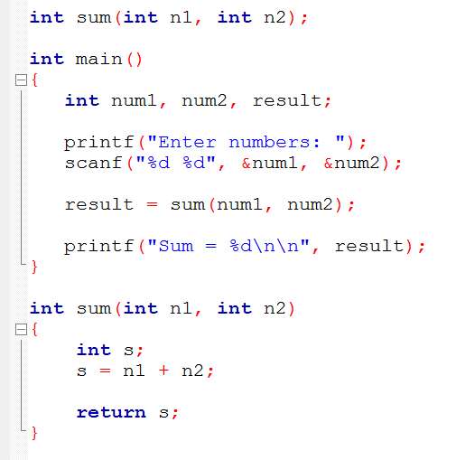
Argument and Parameter
fn
Function Prototype
Function Call
Arguments
Parameter

Slide 54
Function Call
We can accessed a function by specifying its name, followed by a list of arguments enclosed in parentheses and separated by commas.
If the function call does not require any arguments, an empty pair of parentheses must follow the name of the function.
A function will carry out its intended action whenever it is accessed (called) from some other portion of the program.
Once the function has carried out its intended action (end of that function is reached), control will be returned to the point from which the function was accessed.
Traditionally, main function is not called by any other function, but there is no technical restriction.

Slide 55
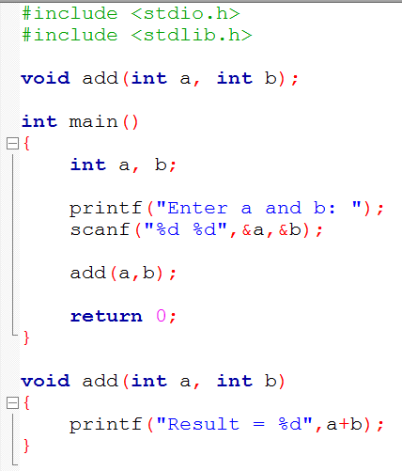
Function Call
fn
1
2
Function Call
3
4
5
Finish!
10
Start the called function execution
7
8
End of Function

Slide 56
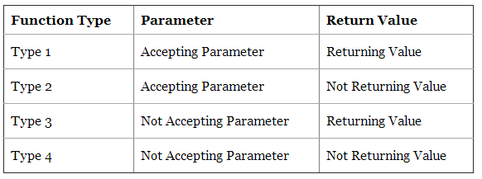
Function Type
There are four types of functions and they are:

Slide 57
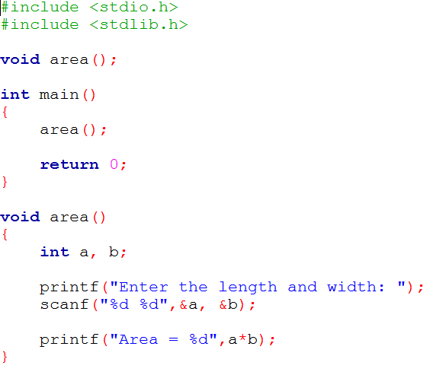
Functions with no arguments and no return values
fn

Slide 58
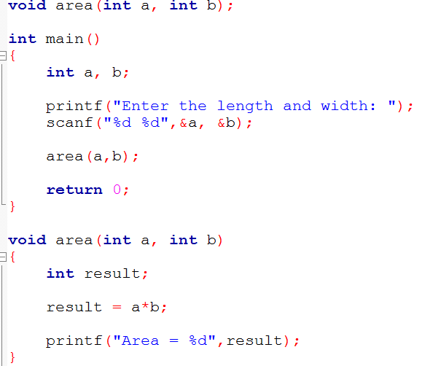
Functions with arguments and no return values
fn

Slide 59
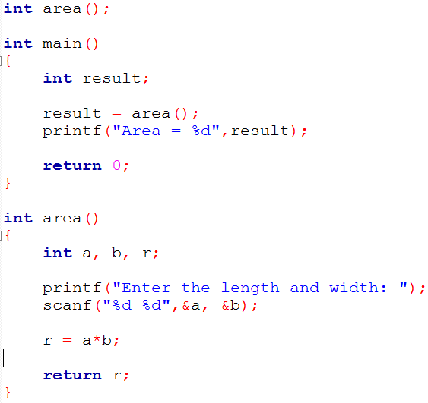
Functions with no arguments and return values
fn

Slide 60
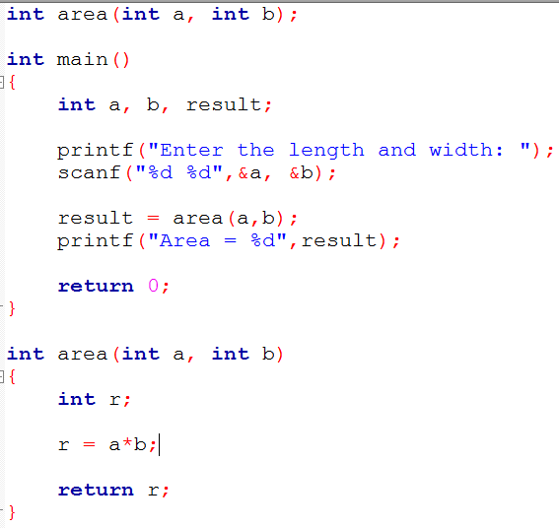
Functions with arguments and return values
fn

Slide 61
Functions arguments
We can pass arguments to functions in two way
Call by value
Call by reference

Slide 62
Call by value
This method copies the value of an argument into the formal parameter of the subroutine (function).
The change made to a parameter of the subroutine have to no effect on the argument used to call it.

Slide 63
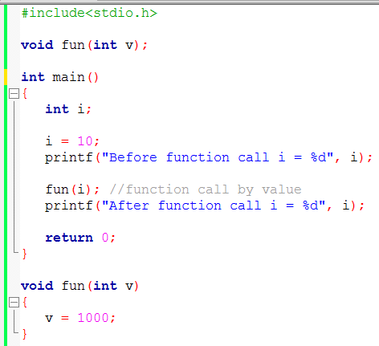
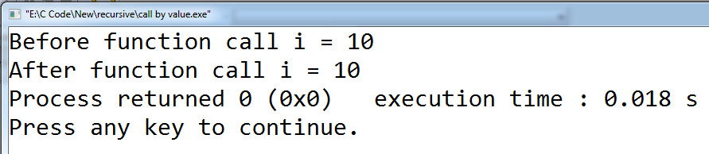
Call by value
fn

Slide 64
Call by Reference
In this method, the address of an argument is copied into the parameter.
Should use pointer
Inside the subroutine, the address is used to access the actual argument.
This means the change made to the parameter will affect the argument.

Slide 65
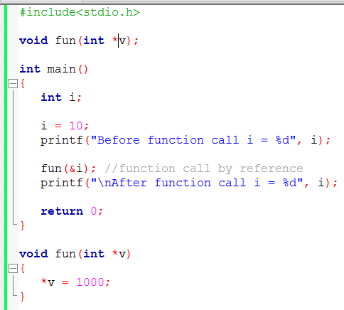
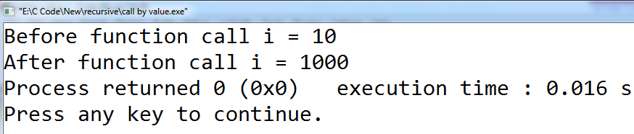
Call by Reference
fn

Slide 66
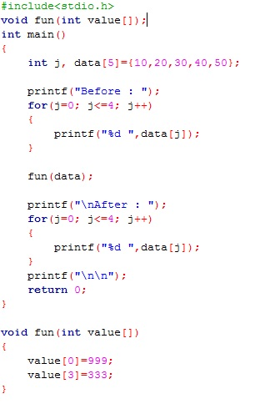
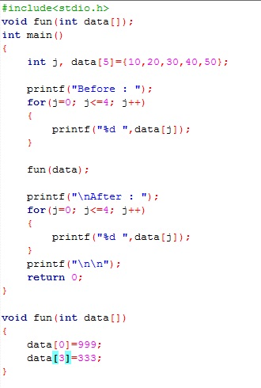
Call by Reference (Array Argument)
fn

Slide 67
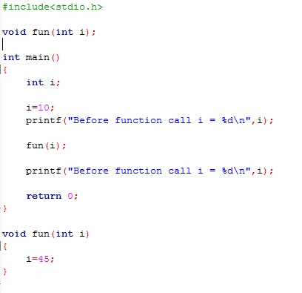
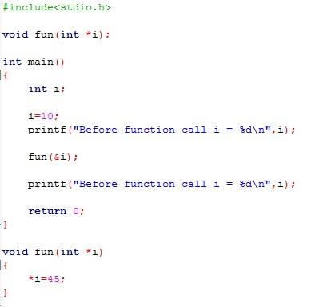
What will happen?
fn

Slide 68
Local vs Global Variables
Variables that are declared inside a function or block are local variables.
Global variables are defined outside of all the functions, usually on top of the program.

Slide 69
Local Variables Scope
Local variables can be used only by statements that are inside that function, for which it is local.
Local variables are created when a function is called and they are destroyed when the function is exited.
Local variables are not known to functions outside their own.
Local variable of one function have no relation to the local variable in another function.
Several functions can have local variables with same name(s) but have no relation with one another.
Formal Parameters are also local variable to that function.

Slide 70
Global Variables Scope
Global variables are exist the entire time our program is executing.
Global variables may be accessed by any function in our program.
Hold their value during the entire execution of the program.

Slide 71
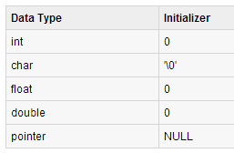
Local vs Global : Initialization
When a local variable is defined, it is not initialized by the system, you must initialize it yourself.
Global variables are initialized automatically by the system when you define them as follows:

Slide 72
Recursion Function
Recursion is a process by which a function calls itself repeatedly, until some specified condition has been satisfied.
The process is used for repetitive computations in which each action is stated in terms of a previous result.
In recursion, no multiple copies of the recursive function will create. Only one copy exist.
When a function is called, storage for its parameters and local data are allocated on the stack.
Thus, when a function is called recursively, the function begins executing with a new set of parameter and local variables, but the function code remain same.

Slide 73
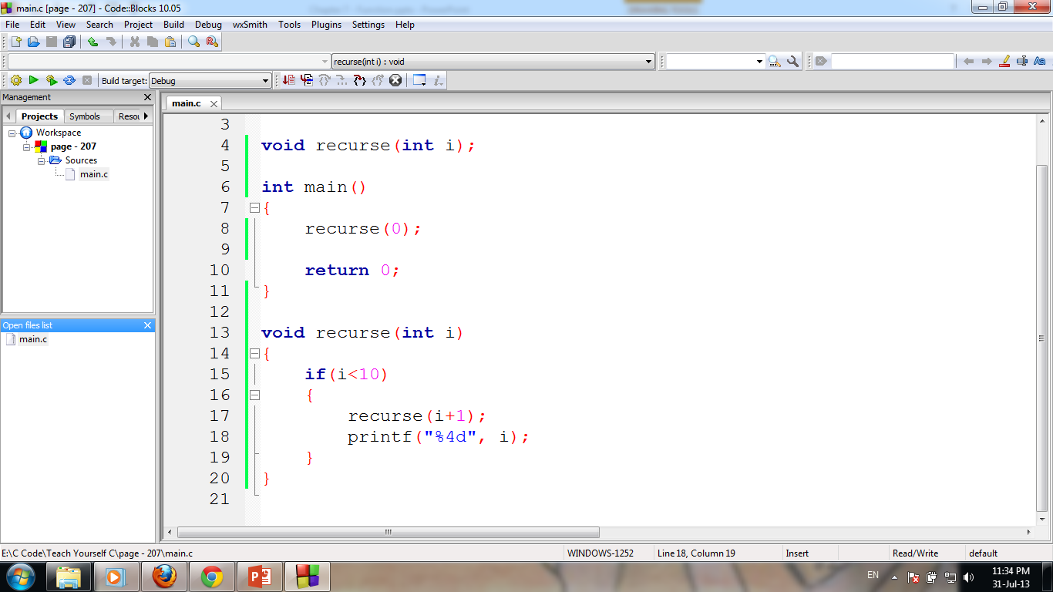
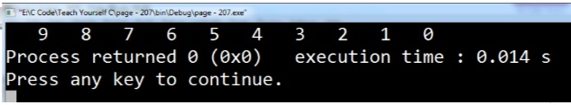
Recursion Function
In order to solve a problem recursively, two conditions must be satisfied.
the problem must be written in a recursive form
the problem include a stopping condition

Slide 74
Functions that return multiple values
Method 1 : Using Array
If more than two variables of same type is to be returned then we can use array .
Store each and every value to be returned in an array and return base address of that array.
Method 2 : Using Pointer and One Return Statement
Pointer Variable can updated directly using Value at ['*'] Operator.
Usually Function can return single value.
If we need to return more than two variables then update 1 variable directly using pointer and return second variable using ‘return Statement‘. [ Call by Value + Call by Reference ]
Method 3 : Using Structure
Construct a Structure containing values to be returned and then return the base address of the structure to the calling function.

Slide 75
Thank You.
Questions and Answer

Slide 76
References
Books:
Programming in ANSI C By E. Balagurusamy
Teach yourself C. By Herbert Shield
Programming With C. By Byron Gottfried
Web:
www.wikbooks.org
and other slide, books and web search.
Notes:
License: You are free to read, share, copy, distribute and transmit the work for educational purpose. But not commercial.

