Slide 1
Exception Handling in Java

Slide 2
Exception Handling in Java
Exception handling in java is one of the powerful mechanism to handle the runtime errors so that normal flow of the application can be maintained.

Slide 3
What is an exception?
An exception is an error condition that changes the normal flow of control in a program
Exceptions in Java separates error handling from main business logic
Exception Handling is a mechanism to handle runtime errors such as ClassNotFound, IO, SQL, Remote etc.
Java has a uniform approach for handling all synchronous errors
From very unusual (e.g. out of memory)
To more common ones your program should check itself (e.g. index out of bounds)
From Java run-time system errors (e.g., divide by zero)
To errors that programmers detect and raise deliberately

Slide 4
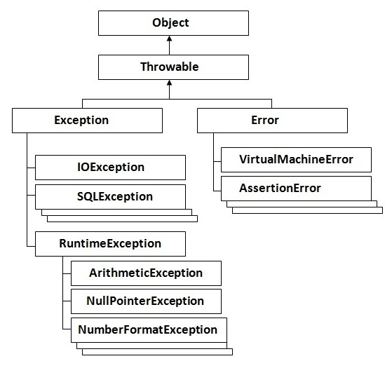
Hierarchy of Java Exception classes

Slide 5
Java built-in exceptions
ArithmeticException
ArrayIndexOutOfBounds
ArrayStore
ClassCast
IllegalArgument
IllegalState
IllegalThreadState

Slide 6
Types of Exception
Checked Exception
The classes that extend Throwable class except RuntimeException and Error are known as checked exceptions
Example: IOException, SQLException etc. Checked exceptions are checked at compile-time.
2. Unchecked Exception
The classes that extend RuntimeException are known as unchecked exceptions
Example:. ArithmeticException, NullPointerException, ArrayIndexOutOfBoundsException etc. Unchecked exceptions are not checked at compile-time rather they are checked at runtime.
3. Error
Error is irrecoverable
Example: OutOfMemoryError, VirtualMachineError, AssertionError etc.

Slide 7
Some Scenarios
int a=50/0; //ArithmeticException
2. String s=null;
System.out.println(s.length()); //NullPointerException
3. String s="abc";
int i=Integer.parseInt(s); //NumberFormatException
4. int a[]=new int[5];
a[10]=50; //ArrayIndexOutOfBoundsException

Slide 8
Java Exception Handling Keywords
There are 5 keywords used in java exception handling.
Try
Catch
Finally
Throw
throws

Slide 9
Exception Handling Terms
try – used to enclose a segment of code that may produce a exception
catch – placed directly after the try block to handle one or more exception types
finally – execute important code such as closing connection, stream etc.
throw – to generate an exception or to describe an instance of an exception

Slide 10
Try-Catch-Finally
Syntax of java try-catch:
try{
//code that may throw exception
}catch(Exception_class_Name ref){}
OR
Syntax of try-finally block:
try{
//code that may throw exception
}finally{}

Slide 11
Problem without exception handling
public class ExceptionExample {
public static void main(String[] args) {
int data = 50 / 0;
System.out.println("rest the code ....");
}
}
Output:
Exception in thread "main" java.lang.ArithmeticException: / by zero

Slide 12
Solution by exception handling Try-Catch
public class ExceptionExample {
public static void main(String[] args) {
try {
int data = 50 / 0;
}
catch (ArithmeticException e) {
System.out.println(e);
}
System.out.println("rest the code ....");
}
}
Output:
java.lang.ArithmeticException: / by zero
rest the code ....

Slide 13
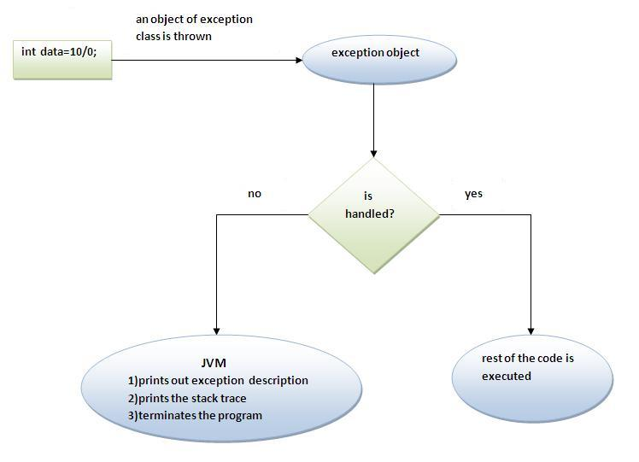
Internal working of java try-catch block

Slide 14
Catch multiple exceptions
public class MultipleCatch {
public static void main(String[] args) {
try {
int a[] = new int[5];
a[5] = 30 / 0; }
catch (ArithmeticException e) {
System.out.println("task1 is completed"); }
catch (ArrayIndexOutOfBoundsException e) {
System.out.println("task 2 completed"); }
catch (Exception e) {
System.out.println("common task completed"); }
System.out.println("rest of the code...");
}}
Output:
task1 is completed
rest of the code...

Slide 15
Compilation error (Not hierarchy maintained!)
public class MultipleCatch {
public static void main(String[] args) {
try {
int a[] = new int[5];
a[5] = 30 / 0; }
catch (Exception e) {
System.out.println("common task completed"); }
catch (ArithmeticException e) {
System.out.println("task1 is completed"); }
catch (ArrayIndexOutOfBoundsException e) {
System.out.println("task 2 completed"); }
System.out.println("rest of the code...");
}}

Slide 16
Java finally block
Java finally block is a block that is used to execute important code such as closing connection, stream etc.
Java finally block is always executed whether exception is handled or not.
Java finally block must be followed by try or catch block.
Why use java finally
Finally block in java can be used to put "cleanup" code such as closing a file, closing connection etc.

Slide 17
exception doesn't occur.
public class FinallyException {
public static void main(String[] args) {
try {
int data = 25 / 5;
System.out.println(data); }
catch (NullPointerException e) {
System.out.println(e); }
finally {
System.out.println("finally block is always executed");
}
System.out.println("rest of the code..."); }
}
exception occurs and not handled.
public class FinallyException {
public static void main(String[] args) {
try {
int data = 25 / 0;
System.out.println(data); }
catch (NullPointerException e) {
System.out.println(e); }
finally {
System.out.println("finally block is always executed");
}
System.out.println("rest of the code...");
}
}
Output:
5
finally block is always executed
rest of the code...
Output:
finally block is always executed
Exception in thread "main" java.lang.ArithmeticException: / by zero

Slide 18
exception occurs and handled.
public class FinallyException {
public static void main(String[] args) {
try {
int data = 25 / 0;
System.out.println(data);
}
catch (ArithmeticException e) {
System.out.println(e);
}
finally {
System.out.println("finally block is always executed");
}
System.out.println("rest of the code...");
}
}
Output:
java.lang.ArithmeticException: / by zero
finally block is always executed
rest of the code...

Slide 19
Throw
The Java throw keyword is used to explicitly throw an exception.
We can throw either checked or unchecked exception in java by throw keyword.
The throw keyword is mainly used to throw custom exception.
Syntax of java throw keyword:
throw exception;
throw new IOException("sorry device error);

Slide 20
Example
public class ThrowException {
static void validate(int age){
if(age<18)
throw new ArithmeticException("not valid");
else
System.out.println("welcome to vote");
}
public static void main(String args[]){
validate(13);
System.out.println("rest of the code...");
}
}
Output:
Exception in thread "main" java.lang.ArithmeticException: not valid

Slide 21
Java throws keyword
Java throws keyword is used to declare an exception. It gives an information to the programmer that there may occur an exception so it is better for the programmer to provide the exception handling code so that normal flow can be maintained.
It provides information to the caller of the method about the exception.
return_type method_name() throws exception_class_name{
//method code
}

Slide 22
RULES
If you are calling a method that declares an exception, you must either caught or declare the exception.
Case1:You caught the exception i.e. handle the exception using try/catch.
Case2:You declare the exception i.e. specifying throws with the method.

Slide 23
Case1: You handle the exception
import java.io.IOException;
class M {
void method() throws IOException {
throw new IOException("device error");
} }
public class throwsExample {
public static void main(String args[]) {
try {
M m = new M();
m.method(); }
catch (Exception e) {
System.out.println("exception handled");
}
System.out.println("normal flow...");
} }
Output exception handled normal flow...

Slide 24
Example if exception occurs
import java.io.IOException;
class M {
void method() throws IOException {
throw new IOException("device error"); }
}
public class throwsExample {
public static void main(String args[]) throws IOException {//declare exception
M m = new M();
m.method();
System.out.println("normal flow...");
}
}
Output: Runtime Exception

Slide 25
Difference
No. | throw | throws
1) | Java throw keyword is used to explicitly throw an exception. | Java throws keyword is used to declare an exception.
2) | Checked exception cannot be propagated using throw only. | Checked exception can be propagated with throws.
3) | Throw is followed by an instance. | Throws is followed by class.
4) | Throw is used within the method. | Throws is used with the method signature.
5) | You cannot throw multiple exceptions. | You can declare multiple exceptions e.g. public void method()throws IOException,SQLException.

Slide 26
ExceptionHandling with Method Overriding
If the superclass method does not declare an exception
If the superclass method does not declare an exception, subclass overridden method cannot declare the checked exception but it can declare unchecked exception.
If the superclass method declares an exception
If the superclass method declares an exception, subclass overridden method can declare same, subclass exception or no exception but cannot declare parent exception.

Slide 27
the superclass method does not declare an exception, subclass overridden method cannot declare the checked exception but can declare unchecked exception.
class Parent{
void msg(){System.out.println("parent");}
}
public class OverridingException extends Parent{
void msg()throws ArithmeticException{
System.out.println("child");
}
public static void main(String args[]){
Parent p=new OverridingException();
p.msg();
}
}
Output: child

Slide 28
If the superclass method does not declare an exception, subclass overridden method cannot declare the checked exception.
class Parent{
void msg(){System.out.println("parent");}
}
public class OverridingException extends Parent{
void msg()throws IOException{
System.out.println("TestExceptionChild");
}
public static void main(String args[]){
Parent p=new OverridingException();
p.msg();
}
}
Output: Compile Time Error

Slide 29
Java Custom Exception
If you are creating your own Exception that is known as custom exception or user-defined exception.
Java custom exceptions are used to customize the exception according to user need.
By the help of custom exception, you can have your own exception and message.

Slide 30
Java Custom Exception Example:
class InvalidAgeException extends Exception {
InvalidAgeException(String s) {
super(s);
}
}
public class CustomeExceptiom {
static void validate(int age) throws InvalidAgeException {
if (age < 18) {
throw new InvalidAgeException("not valid");
} else {
System.out.println("welcome to vote");
}
}
public static void main(String args[]) {
try {
validate(13);
}
catch (Exception m) {
System.out.println("Exception occured: " + m);
}
System.out.println("rest of the code...");
}
}
Output:
Exception occured: exceptionexample.InvalidAgeException: not valid
rest of the code...

