Slide 1
DATE & TIME

Slide 2
Getting Current Date & Time
Java provides the Date class available in java.util package, this class encapsulates the current date and time.
import java.util.Date;
public class DateDemo{
public static void main(String args[]){
// Instantiate a Date object
Date date =new Date();
// display time and date using toString()
System.out.println(date.toString());
}
}
Output:
Sun Jan 31 22:00:27 BDT 2016

Slide 3
Date Comparison:
There are following three ways to compare two dates:
You can use getTime( ) to obtain the number of milliseconds that have elapsed since midnight, January 1, 1970, for both objects and then compare these two values.
You can use the methods before( ), after( ), and equals( ). Because the 12th of the month comes before the 18th, for example, new Date(99, 2, 12).before(new Date (99, 2, 18)) returns true.
You can use the compareTo( ) method, which is defined by the Comparable interface and implemented by Date

Slide 4
Date Formatting using SimpleDateFormat:
import java.util.*;
import java.text.*;
public class DateDemo{
public static void main(String args[]){
Date dNow =new Date();
SimpleDateFormat ft =new SimpleDateFormat("E yyyy.MM.dd 'at' hh:mm:ss a zzz");
System.out.println("Current Date: "+ ft.format(dNow));
}
}
Output:
Current Date: Sun 2016.01.31 at 10:07:55 PM BDT

Slide 5
Parsing Strings into Dates:
import java.util.*;
import java.text.*;
public class DateDemo{
public static void main(String args[]){
SimpleDateFormat ft =new SimpleDateFormat("yyyy-MM-dd");
Scanner in=new Scanner(System.in);
String input=new String();
input=in.nextLine();
System.out.print(input +" Parses as ");
Date t;
try{
t = ft.parse(input);
System.out.println(t);
}
catch(ParseException e){
System.out.println("Unparseable using "+ ft);
} } }
Output:
2016-01-15
2016-01-15 Parses as Fri Jan 15 00:00:00 BDT 2016

Slide 6
Sleeping for a While:
import java.util.*;
public class SleepDemo{
public static void main(String args[]){
try{
System.out.println(new Date()+"\n");
Thread.sleep(5*60*10);
System.out.println(new Date()+"\n");
}
catch(Exception e){
System.out.println("Got an exception!");
}
}
}

Slide 7
GregorianCalendar Class:
GregorianCalendar is a concrete implementation of a Calendar class that implements the normal Gregorian calendar with which you are familiar.
The getInstance( ) method of Calendar returns a GregorianCalendar initialized with the current date and time in the default locale and time zone.

Slide 8
Example:
import java.util.*;
public class GregorianCalendarDemo{
public static void main(String args[]){
String months[]={ "Jan","Feb","Mar","Apr",
"May","Jun","Jul","Aug",
"Sep","Oct","Nov","Dec"};
int year;
// Create a Gregorian calendar initialized with the current date and time in the default locale and timezone.
GregorianCalendar gcalendar =new GregorianCalendar();
// Display current time and date information.
System.out.print("Date: ");
System.out.print(months[gcalendar.get(Calendar.MONTH)]);
System.out.print(" "+ gcalendar.get(Calendar.DATE)+" ");
System.out.println(year = gcalendar.get(Calendar.YEAR));
System.out.print("Time: ");
System.out.print(gcalendar.get(Calendar.HOUR)+":");
System.out.print(gcalendar.get(Calendar.MINUTE)+":");
System.out.println(gcalendar.get(Calendar.SECOND));
// Test if the current year is a leap year
if(gcalendar.isLeapYear(year)){
System.out.println("The current year is a leap year");
}
else{
System.out.println("The current year is not a leap year");
} } }
Date: Jan 31 2016
Time: 10:28:36
The current year is a leap year

Slide 9
Calculate Your Age Example:
public class AgeCalculation {
public static void main(String[] args) {
int y = 1990,m = 8,d = 29;
Calendar cal=new GregorianCalendar(y, m, d);
Calendar now=new GregorianCalendar();
int res=now.get(Calendar.YEAR)-cal.get(Calendar.YEAR);
if (cal.get(Calendar.MONTH)>now.get(Calendar.MONTH)||
(cal.get(Calendar.MONTH)==now.get(Calendar.MONTH)) &&
(cal.get(Calendar.DAY_OF_MONTH)>now.get(Calendar.DAY_OF_MONTH)))
{
res--; }
System.out.println(res);
} }

Slide 10
Another Calculate Your Age Example:
public class AgeCalculation {
int month[]={31,28,31,30,31,30,31,31,30,31,30,31};
String id; int d,m,y;
public AgeCalculation(){
Scanner input=new Scanner(System.in);
System.out.println("Enter your day=");
d=input.nextInt();
System.out.println("Enter your Month=");
m=input.nextInt();
System.out.println("Enter your year=");
y=input.nextInt(); }
public void calculateAge(){
int date=0,mon=0,year=0;
if(1<d&&1<m){
date=((month[m-1]+01)-d);
mon=12-m;
year=2016-y; }
else if(1<d&&1>=m){
date=((month[m-1]+01)-d);
mon=12-m;
year=2016-y;
}
else if(d==1&&m==1){
date=1-d;
mon=13-m;
year=2016-y;
}
System.out.println(year+" years" + mon +"Months " + date + "days");
}
public static void main(String[] args) {
AgeCalculation obj=new AgeCalculation();
obj.calculateAge();
}}

Slide 11
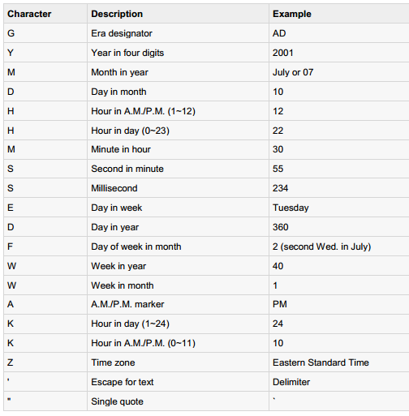
Simple DateFormat format codes:

