Slide 1
Polymorphism

Slide 2
What is Polymorphism
Polymorphism in java is a concept by which we can perform a single action by different ways.
Polymorphism is derived from 2 greek words: poly and morphs.
The word "poly" means many and "morphs" means forms. So polymorphism means many forms.
There are two types of polymorphism in java:
Compile time/Static Binding/Early Binding polymorphism and
Runtime/Dynamic Binding/Late Binding polymorphism.
We can perform polymorphism in java by method overloading and method overriding.
If you overload static method in java, it is the example of compile time polymorphism. Here, we will focus on runtime polymorphism in java.

Slide 3
Compile-time /Static binding(also known as early binding)
When type of the object is determined at compiled time(by the compiler), it is known as static binding.
If there is any private, final or static method in a class, there is static binding.
Example:
class Dog{
private void eat(){
System.out.println("dog is eating..."); }
public static void main(String args[]){
Dog d1=new Dog();
d1.eat();
} }

Slide 4
Runtime(Dynamic binding) Polymorphism
Runtime polymorphism or Dynamic Method Dispatch is a process in which a call to an overridden method is resolved at runtime rather than compile-time.
or
When type of the object is determined at run-time, it is known as dynamic binding.
In this process, an overridden method is called through the reference variable of a superclass. The determination of the method to be called is based on the object being referred to by the reference variable.
Let's first understand the upcasting before Runtime Polymorphism.

Slide 5
Example of Java Runtime Polymorphism
class Bike{
void run(){System.out.println("running");}
}
class Splender extends Bike{
void run(){System.out.println("running safely with 60km");}
public static void main(String args[]){
Bike b = new Splender(); //upcasting
b.run();
}
}
Output:
running safely with 60km

Slide 6
Benefits of Polymorphism
Simplicity:
This makes your code easier for you to write and easier for others to understand.
Extensibility:
Polymorphism design and implements system that are more extensible.

Slide 7

Static Vs Dynamic Polymorphism
Static polymorphism is considered more efficient, and dynamic polymorphism more flexible.
Statically bound methods are those methods that are bound to their calls at compile time. Dynamic function calls are bound to the methods during run-time.
Involves the additional step of searching the functions during run-time. On the other hand, no run-time search is required for statically bound functions.

Slide 8
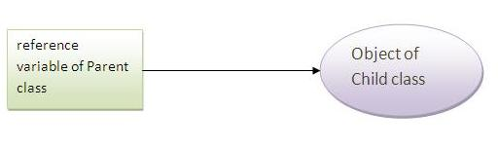
Upcasting
When reference variable of Parent class refers to the object of Child class, it is known as upcasting. For example:
class A{}
class B extends A{}
class C{
public static void main(String args[]){
A a= new B(); //upcasting
}

Slide 9
Downcasting
When Subclass type refers to the object of Parent class, it is known as downcasting.
If we perform it directly, compiler gives Compilation error. If you perform it by typecasting, ClassCastException is thrown at runtime. But if we use instanceof operator, downcasting is possible.
Dog d=new Animal();//Compilation error
If we perform downcasting by typecasting, ClassCastException is thrown at runtime.
Dog d=(Dog)new Animal(); // Compiles successfully

Slide 10
Downcasting Example
Possibility of downcasting with instanceof
class Animal { }
class Dog3 extends Animal {
static void method(Animal a) {
if(a instanceof Dog3){
Dog3 d=(Dog3)a; //downcasting
System.out.println("ok downcasting performed");
}
}
public static void main (String [] args) {
Animal a=new Dog3();
Dog3.method(a);
} }
Output:ok downcasting performed
Downcasting without the use of java instanceof
class Animal { }
class Dog4 extends Animal {
static void method(Animal a) {
Dog4 d=(Dog4)a; //downcasting
System.out.println("ok downcasting performed");
}
public static void main (String [] args) {
Animal a=new Dog4();
Dog4.method(a);
}
Output:ok downcasting performed

Slide 11
Method Overriding
Child class has the same method as of base class. In such cases child class overrides the parent class method without even touching the source code of the base class. This feature is known as method overriding.
Example:
class Bike{
void run(){System.out.println("running");}
}
class Splender extends Bike{
void run() {System.out.println("running safely with 60km"); }
public static void main(String args[]){
Bike b = new Splender();
b.run();
} }

Slide 12
Overriding vs. Overloading

Slide 13
Java Runtime Polymorphism with Multilevel Inheritance
class Animal{
void eat() {System.out.println("eating");}
}
class Dog extends Animal{
void eat() {System.out.println("eating fruits");}
}
class BabyDog extends Dog{
void eat() {System.out.println("drinking milk");}
public static void main(String args[]){
Animal a1,a2,a3;
a1=new Animal();
a2=new Dog();
a3=new BabyDog();
a1.eat();
a2.eat();
a3.eat();
} }
class Animal{
void eat(){
System.out.println("animal is eating...");}
}
class Dog extends Animal{
void eat(){
System.out.println("dog is eating...");}
}
class BabyDog1 extends Dog{
void eat() {System.out.println("drinking milk");}
public static void main(String args[]){
Animal a=new BabyDog1();
a.eat();
}}
Output:
eating eating fruits drinking milk

Slide 14
Java Runtime Polymorphism with data member
class Bike{
int speedlimit=90;
}
class Honda3 extends Bike{
int speedlimit=150;
public static void main(String args[]){
Bike obj=new Honda3();
System.out.println(obj.speedlimit) ; //90
}
Output:
90

Slide 15
super keyword in Overriding:
class Vehicle {
public void move () {
System.out.println ("Vehicles are used for moving from
one place to another ");
}
}
class Car extends Vehicle {
public void move () {
super. move (); // invokes the super class method
System.out.println ("Car is a good medium of transport ");
}
}
public class TestCar {
public static void main (String args []){
Vehicle b = new Car (); // Vehicle reference but Car object
b.move (); //Calls the method in Car class
}
}
Output:
Vehicles are used for moving from one place to another
Car is a good medium of transport

Slide 16
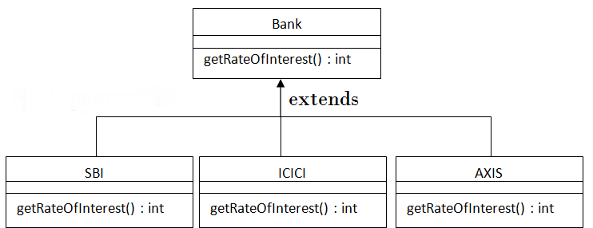
Real example of Java Runtime Polymorphism

Slide 17
Real example of Java Runtime Polymorphism
class Bank{
int getRateOfInterest()
{return 0;}
}
class SBI extends Bank{
int getRateOfInterest()
{return 8;}
}
class ICICI extends Bank{
int getRateOfInterest()
{return 7;}
}
class AXIS extends Bank{
int getRateOfInterest()
{return 9;}
}
class Test3{
public static void main(String args[]){
Bank b1=new SBI();
Bank b2=new ICICI();
Bank b3=new AXIS();
System.out.println("SBI Rate of Interest: "+b1.getRateOfInterest());
System.out.println("ICICI Rate of Interest: "+b2.getRateOfInterest());
System.out.println("AXIS Rate of Interest: "+b3.getRateOfInterest());
}
}
Output:
SBI Rate of Interest: 8 ICICI Rate of Interest: 7 AXIS Rate of Interest: 9

