Slide 1
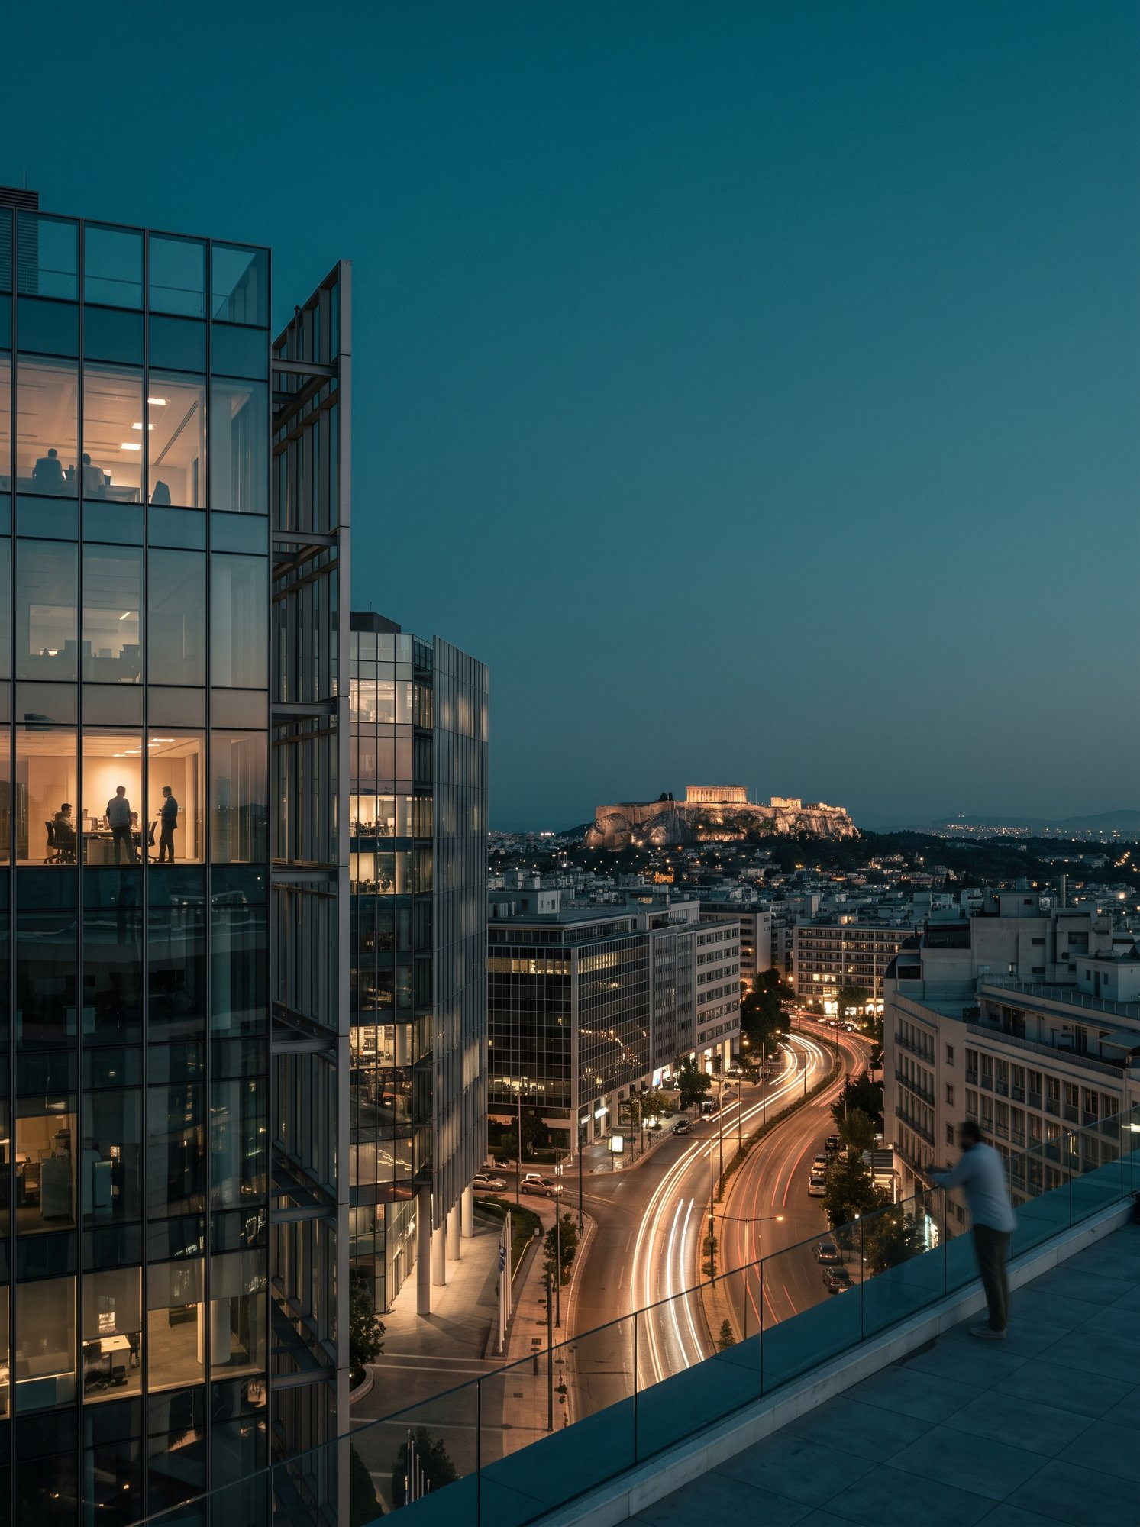


A Presentations Skill inspired by the NBG Brand
The
nbg-design
skill
How it is built, how it works, and how anyone who receives a deck can edit it.
Skill v1.25.0
Oct 2026

Slide 2
01
WHAT IT MAKES POSSIBLE
nbg-design · Oct 2026
ASK, BUILD, EDIT
02
Agenda
03
MAKE IT YOUR OWN
Three sections. Each stands on its own.
2

Slide 3

01
Section 01
What it
makes possible
A design system inspired by the NBG brand, a build pipeline and an in-deck editor, packaged as one Claude skill.
3

Slide 4



01 · What it makes possible
WHAT THE SKILL IS
One Claude Code skill that turns a request into a finished presentation in a look inspired by the NBG brand.
A design system in a box
A deterministic build pipeline
Decks the recipients can edit
A design system inspired by the NBG brand: 16:9 artboard, Aptos, a nine-colour teal-led palette.
Claude authors the HTML; zero-dependency scripts embed the images, add the editor, verify, write the rebuild script, screenshot and export.
Every delivered deck carries a right-click editor: fix a word, resize a card, align a row, ask an AI assistant.
Nine slide templates (covers, dividers, content), logos and photography bundled with the skill.
Nothing to install: it works from a file on the desktop, in any modern browser.
A strict, browser-free gate that a deck must pass before it is delivered.
Guardrails written down once, applied to every deck.
Edits stay inside the look: the skill's fonts and palette only.
The PDF and the PowerPoint file are made from the deck itself, so they look like the HTML.
1 file
0
HTML · PDF · PPTX
en · gr · bi
the whole deck: HTML with every image embedded
installs for the viewer, npm packages for the builder
plus a rebuild script that refreshes the editor later; the PowerPoint file is editable, never screenshots
languages supported by the design system
4

Slide 5




01 · What it makes possible
WHY IT MATTERS
Four problems every presentation team knows, and how the skill answers each.
Consistency
Speed
Portability
Ownership
Every deck shares one look. One palette, one type stack, one artboard, one logo lockup — enforced by the skill, not by the author's memory.
From any content to a finished deck in minutes — a brief in chat, notes, a document, a spreadsheet, an existing deck or a Google Slides draft. Once the generator exists, every re-run is one command.
One self-contained file. It can be emailed, put on a share or opened from a USB stick; it renders identically everywhere because nothing points back to the machine that built it.
Recipients fix their own slides. A typo, a longer title, a card that should be teal, a row that needs aligning — done in place, saved as a copy, exported to PDF — without a regeneration.
The verifier rejects a deck with a fake logo, a missing photo or an external image path.
Key point
The skill moves the effort from making slides look right to deciding what they should say.
5

Slide 6








01 · What it makes possible
WHAT YOU RECEIVE
The files of a deck, produced and verified the same way every time.
The deliverables
What the skill asks before it starts
The HTML deck — 1920×1080 slides that scale to any screen, keyboard and button navigation, every logo and photo embedded, the right-click editor inlined.
Topic, audience, slide count. The three inputs it never guesses; it asks instead.
Language — English by default; Greek or bilingual on request.
The PDF — printed from that HTML by the browser engine: one page per slide, vector text, same colours and photography, verified page count.
Output — HTML by default; "send as PDF" adds the PDF, "in PowerPoint" an editable .pptx.
The PowerPoint file (on request) — converted from that HTML element by element: text boxes, shapes and pictures you edit in PowerPoint, checked slide by slide against the deck.
No pictures of slides. PDF and PowerPoint are exported from the finished HTML, never authored separately or stitched from screenshots.
The rebuild script — ​deck.rebuild.mjs​: run it after the skill is updated and the deck
receives the newer editing tools, verified, with its PDF re-exported — no regeneration.
No fallbacks: a missing input is a question to you, never a silent default.
A generator for data-driven decks — a small Python script that rebuilds the deck from its content, so updates are a diff, not a redo.
6

Slide 7


01 · What it makes possible
THE NEWEST CAPABILITIES
What arrived most recently in the skill. Each is explained further on; the recipient needs no new tooling for any of them.
Edit SVG
One toolbar, three tabs
PowerPoint export
The rebuild script
A drawn icon, diagram or chart is no longer a picture: its parts — paths, shapes, text, groups — move, resize, recolour, reorder, duplicate and reword in place.
Text, Shape and SVG share one floating panel; the tab of the editor in use comes to the front by itself.
Any deck as an editable .pptx (1.25): real text boxes with their fonts and weights, shapes, cropped pictures, SVG pictures — never slide screenshots.
Every deck ships with ​
<deck>.rebuild.mjs​: after a skill update
it re-embeds the newer editing tools,
keeps a backup, re-verifies and re-exports
the PDF.
Pin, hide, anchor or detach it — remembered per deck.
Checked against the deck in PowerPoint itself, slide by slide.
Path data is never rewritten; one reversible record per drawing.
​--check​ only reports.
27 bundled photos with a written catalogue (Athens at dusk, data centre, network, microchip, security, developer, team analytics — three takes each); assistant settings kept per provider and an Ask about… popup on any row of the Outline or Tree; a full set of keyboard shortcuts for text, shapes, SVG parts and panels; PDFs whose shadows render correctly in macOS Preview (1.19); four themes chosen per deck — NBG, BikS2013, AIHub, Instrument (1.20–1.23).
Also
7

Slide 8
02
Section 02
Ask,
build, edit
Asking for a deck, what happens in between, the quality gates, and everything the right-click editor can do.
8

Slide 9



02 · Ask, build, edit
INSTALLING THE SKILL
One public marketplace, two commands. No npm install, no build step: the skill is Markdown, assets and zero-dependency Node scripts.
In Claude Code
What lands on the machine
# 1 · register the marketplace (once)
The plugin is cached under ​~/.claude/plugins/cache/nbg-design/nbg-design/<version>/​;
the skill root is its ​skills/nbg-design/​ folder — the ​<skill-root>​ the pipeline commands
use.
/plugin marketplace add BikS2013-coding-agents/nbg-design
# 2 · install the plugin from it
/plugin install nbg-design@nbg-design
Requirements: Node 18 or newer for the scripts. Chrome, Chromium or Edge only for screenshots, the PDF and the PowerPoint export (its check also uses PowerPoint or LibreOffice, and poppler); without a browser the strict verifier is still the gate and the exports are made elsewhere.
# 3 · restart Claude Code, then check
/plugin list
# later · pick up a new release
/plugin marketplace update nbg-design
claude plugin update nbg-design@nbg-design
Nothing to configure. The skill holds no credentials and reads no configuration file; assistant keys are entered by each viewer in their own browser.
The marketplace is the public repository ​github.com/BikS2013-coding-agents/nbg-design​
(branch ​working​); its name and the plugin's name are both ​nbg-design​, hence ​
nbg-design@nbg-design​.
A delivered deck outlives the install: after an update, ​node <deck>.rebuild.mjs​ re-embeds
the newer editing tools — pointed at the new cache folder with ​--scripts​ or ​
NBG_DESIGN_SCRIPTS​ when the recorded one is gone.
From then on Claude uses the skill by itself whenever a presentation in this look is asked for; say nbg-design to make sure.
9

Slide 10



02 · Ask, build, edit
ASKING FOR A DECK
What the skill needs from you, what it decides by itself, and what it refuses to do.
It always asks for
Approved defaults
It will not
Topic — what the deck is about.
Language: English. ​gr​ and ​bi​ exist; anything else
must come from you.
Hand over a PowerPoint made of slide pictures: the .pptx is converted element by element.
Audience — who reads it; this sets depth and tone.
Slide count or depth — 8, 16, 20+.
Output: HTML. A PDF or a PowerPoint file is always exported from the finished HTML, never authored separately.
Guess a missing input or substitute a fallback value.
Whether the bundled design-system files may be changed (they normally are not).
Put an API key, token or endpoint into a deck or into the skill.
Logo: shown, unless you ask to hide it.
Reference an image by a path: every image is embedded, or the deck fails the gate.
Cover first, dividers between sections, content slides in between.
Any content is a source
A brief typed in chat, meeting notes, a Word or Markdown document, a spreadsheet, a report, an existing HTML deck, or a Google Slides draft (read through the Slides API and rebuilt 1:1, page count kept). The skill turns whatever it is given into a cover, dividers and content slides; it only asks for what it cannot infer.
10

Slide 11
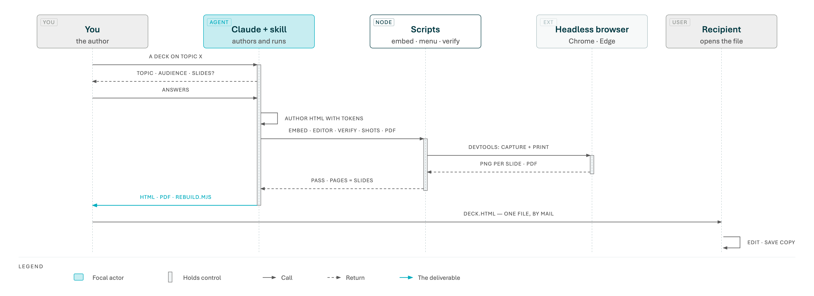
02 · Ask, build, edit
A DECK, END TO END
One request, three answers, one command chain, two files — and a recipient who can edit the result.
11

Slide 12
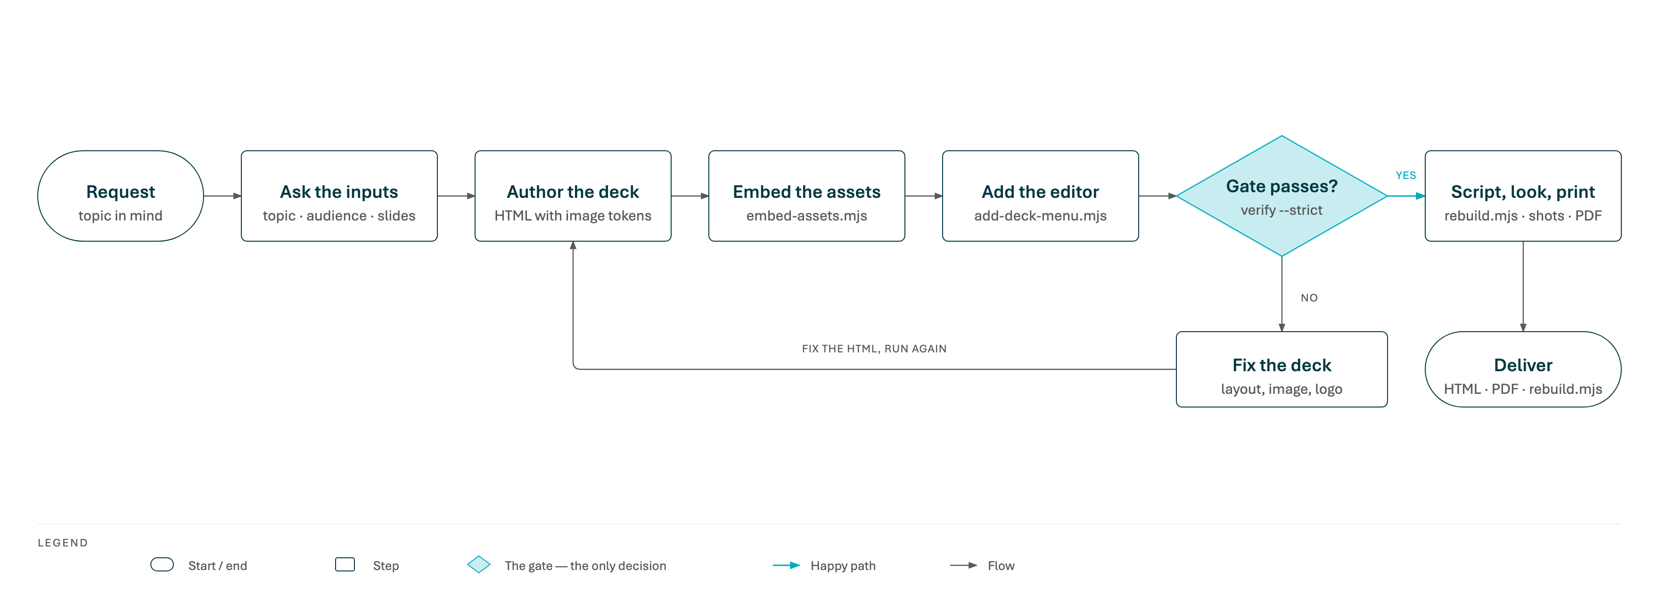
02 · Ask, build, edit
THE PIPELINE: FIVE STEPS AND ONE GATE
Claude authors; the scripts embed, add the editor and verify; a failing gate sends the deck back to the author, never forward.
12

Slide 13





02 · Ask, build, edit
THE PIPELINE, STEP BY STEP
What each step does and the command behind it. Steps 2 to 4 and the rebuild script are mandatory for every deck.
1
2
3
4
5
Author with tokens
Embed the assets
Add the editor
Verify (strict)
Script, look, export
Claude writes the deck on the
1920×1080 artboard, the design-system
CSS and placeholders where
images go: ​{{LOGO_PRIMARY}}​, ​
{{PHOTO_STREET}}​.
Every token becomes the verbatim base64 image. The script finds the assets next to itself, so it works from any folder and any machine.
One script block is inlined before ​
</body>​: the right-click menu,
editing, toolbars, assistant, print. Re-running
upgrades an older block.
Browser-free gate: no unresolved tokens, no external image paths, real logo, enough images, current menu. A failing deck is never delivered.
The rebuild script is written next to the deck; screenshots are read for overlaps and clipping; the PDF is printed, and on request the PowerPoint file converted and compared.
embed-assets.mjs deck.html
add-deck-menu.mjs deck.html
verify-deck.mjs deck.html --strict
screenshot-deck · export-pdf · export-pptx
Why tokens
Hand-pasting a 600 KB base64 photo is the step that silently fails on a headless run. Tokens make embedding a script's job, and the gate catches any slip.
13

Slide 14


02 · Ask, build, edit
THE DESIGN SYSTEM THE SKILL CARRIES
Inspired by the NBG brand and distilled into one HTML reference: nine colours, one typeface and nine templates.
Deep teal
Teal
Bright cyan
Electric cyan
Black
Grey 1
Grey 2
Cream
White
#003841
#007B85
#00ADBF
#00CFE7
#0A1416
#BEC1BE
#939793
#F5F8F6
#FFFFFF
primary accent, dark panels, covers
secondary accent, rules, icons
highlight accent
highlight, sparingly
body text on light
rules, muted surfaces
secondary text
light page background
text on dark, cards on cream
Format & type
Nine templates
Eight assets
16:9, 1920×1080 artboard, scaled to fit any viewport. Aptos for everything, with a system fallback where it is absent — the stack is never swapped.
Covers (hero photo, image card, alternate), dividers (photo, deep teal, bright), content (image right, two columns, stat-led). Content pages stay calm and mostly monochrome; accent blocks belong to covers and openers.
Three logo lockups — primary for light backgrounds, knockout for dark, small for footers — and five photographs, each shipped with a ready-made data URI. The logo is always the image, never text or a box.
14

Slide 15


02 · Ask, build, edit
QUALITY GATES
What must be true before a deck leaves. The first gate runs anywhere; the others need a browser.
verify-deck --strict (browser-free, mandatory)
Visual and print checks
No unresolved tokens and no image referenced by ​file://​, absolute, relative or ​http​
path — every image is a ​data:​ URI.
Fit: the full slide visible at 1366×768 and 1440×900 with no scrolling caused by the artboard.
No collisions: title, body, card rows, callouts, footer and page number keep separate zones — at least 32 px between groups and 72 px above the footer. Crowded content is cut or split, never squeezed or hidden.
Enough embedded images (default 2) and a minimum size (200 KB): a photo-less deck is the classic tell of a skipped step.
A real logo: bare ​“NBG”​ text nodes that could stand in for the lockup fail the gate.
PDF = deck: page count equals slide count and every slide box equals the page box, or the exporter exits with an error.
The current editor block: missing, PDF-only or older than the skill's — fail or warn; incomplete — always fail.
PowerPoint ≈ deck: compare-pptx renders the .pptx in PowerPoint and scores every slide against the HTML.
Read the pictures: screenshots, PDF pages and comparison images are inspected, not just produced.
15

Slide 16
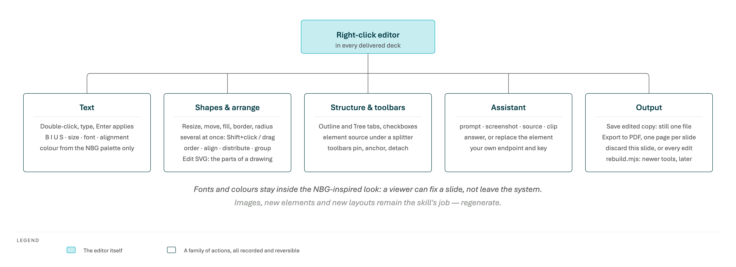
02 · Ask, build, edit
WHAT A VIEWER CAN DO
Five families of actions, all in the file itself, all recorded and reversible. The slides that follow walk through them, and end with every keyboard shortcut.
16

Slide 17




02 · Ask, build, edit
EDITING 1 · THE RIGHT-CLICK MENU
Every delivered deck carries its own editor. Right-click anywhere on a slide; Escape or a click outside closes it.
Menu
Assistant
Outline
Tree
📌
⧉
✕
It shows what applies to the spot you clicked. Text under the pointer offers Edit text; a card, image or panel offers Resize / move shape; a stack of nested shapes lists every level so you can pick the one you mean.
At this point
Edit text
double-click does the same
Four tabs. Menu holds the actions. Assistant is the AI panel. Outline lists the slide's shapes with checkboxes. Tree shows the slide's HTML, with the selected element's source underneath.
Resize / move shape
card · 420 × 300
Select at this point
Text block
front-most
📌 pins it — it stays open after a choice, keeps its place and can be dragged by its header. ⧉ detaches it into a window of its own (always-on-top in Chrome and Edge).
Card
encloses the one above
Photo panel
behind
Slide
Toolbars section. Ticks show which toolbar tabs are shown and which is in front; tick one to pin it and bring it forward, untick to hide, Automatic toolbars restores the default where they appear with the selection.
Select all shapes on this slide
Ctrl/Cmd+A
Ask the assistant
Ctrl/Cmd+Shift+L
Deck
Lives outside the slides. The menu, frames and toolbars never appear in screenshots, in the PDF or in the print layout.
Export to PDF
one page per slide
Save edited copy
deck-edited.html
Discard changes on this slide
3 changes
Discard edits
every slide
17

Slide 18

02 · Ask, build, edit
EDITING 2 · TEXT
Double-click any text. The whole block becomes editable in place, with a teal outline; the slide's CSS is never touched.
⋮⋮
Text
Shape
SVG
⚓
B
I
U
S
A−
24 px
A+
Aptos ▾
Colour
≡
☰
≡
Clear
Done
⧉
Editing
The formatting row
Double-click a text (or right-click → Edit text). Type, , for a line break, to undo.
Selection first. Every control applies to the selected run when there is one, and to the whole block when there is none.
Backspace
Shift+Enter
Ctrl/Cmd+Z
or a click outside applies; cancels. Deck shortcuts (arrows, space) are paused while you edit.
B / I / U / S ( ), A− / A+ or an exact px size ( / ), font from the design-system stacks, colour from the skill's palette only, alignment for the block.
Enter
Esc
Ctrl/Cmd+B
I
U
Ctrl/Cmd+Shift+>
<
Paste and drop insert plain text. Anything a browser wraps around typed text is unwrapped when the edit is applied, so no stray formatting leaks in.
Clear removes the selection's formatting, or returns the block to its authored style. Done applies.
Accent spans inside a title (the teal word in a heading) stay intact.
Fonts and colours are limited on purpose: a viewer can fix a slide but cannot leave the look.
18

Slide 19
02 · Ask, build, edit
EDITING 3 · SHAPES
Right-click a card, photo panel, image or text block → Resize / move shape. A teal frame with eight handles appears.
⋮⋮
Text
Shape
SVG
⚓
X
120
Y
300
W
420
H
300
Fill
Transparent ▾
Border
1 px ▾
Radius
8
Opacity
100
Shadow
Soft ▾
Stack ▾
Reset
Done
⧉
Order
Front
Forward
Backward
Back
Align
⇤
⇹
⇥
⤒
⇳
⤓
Distribute
↔
↕
to selection ▾
Group
Ungroup
</>
Moving and resizing
The shape row
Drag a handle to resize ( keeps the proportions), drag inside to move. Arrow keys nudge by 1 px, by 10; +arrows resize.
X / Y / W / H typed exactly; fill (the palette, transparent or default); border none to 6 px in a palette colour; corner radius, opacity, shadow none / soft / strong.
Shift
Shift
Alt
selects the enclosing shape, steps back in; , or a click outside finishes.
Everything is inline style on the element, recorded as one reversible edit per element.
Tab
Shift+Tab
Esc
Enter
Neighbours do not re-flow. Widen one card in a row, then use Distribute or move the next card to restore the spacing. The overlap rules still apply to the result.
Only inline geometry changes — left, top, width, height — and pointer movement is divided by the slide's current scale, so coordinates stay exact artboard pixels at any window size.
Stack lists the enclosing shapes, the selected one and its children, for the level a click cannot reach.
Elements in normal flow get only the right and bottom handles: they grow right and down. Reset restores size, position and style.
Edit SVG: a drawn icon, diagram or chart has parts of its own — the next two slides. The SVG as a whole is still a shape: Resize / move shape sizes and places it.
19

Slide 20
02 · Ask, build, edit
EDITING 4 · EDIT SVG: THE PARTS OF A DRAWING
Right-click a drawn icon, diagram or chart → Edit SVG. The drawing gets a dashed outline and every part inside it becomes a thing you can pick.
⋮⋮
Text
Shape
SVG
⚓
Parts ▾
X
240
Y
256
W
280
H
88
Fill
None ▾
Stroke
1.5 ▾
Opacity
100
Text
deck-menu.js
Order
Front
Forward
Backward
Back
Duplicate
Delete
All
⧉
Reset SVG
Done
Entering and selecting
Moving, resizing, styling
Three ways in: right-click the drawing → Edit SVG; double-click a drawing that is already selected as a shape; click one of its parts in the Tree tab.
The selection gets a frame with eight handles — several parts: one frame spanning them, a dashed mark per part. Drag inside to move, a handle to resize ( keeps proportions); arrows nudge by one SVG unit, ten, +arrows resize — all selected parts together, keeping their places.
Shift
What a part is: a path, rect, circle, ellipse, line, polygon, text, image, ​use​ reference or group.
Nothing inside ​defs​, clip paths, masks or symbols.
Shift
Alt
The SVG row: X / Y / W / H in the drawing's own units; fill and stroke from the palette, None or Default; stroke width; opacity; the text of a label (one run; Enter applies).
A click picks the innermost part under the pointer — through the frame of a selected group too, so its members are one click away. +click adds a part (or removes a selected one); +click selects what is inside the part there; or All every top-level part.
Shift
Ctrl/Cmd
Ctrl/Cmd+A
Order in the drawing ( / ), Duplicate (; copies sit on the originals), Delete (), Reset SVG (every part as designed), Done.
Ctrl/Cmd+]
[
Ctrl/Cmd+D
selects the enclosing group, the first part inside; the Parts list offers every part in drawing order.
Delete
Tab
Shift+Tab
deselects the part, then ends the session; , Done, Finish SVG editing in the menu or a click outside the drawing end it too.
Esc
Enter
20

Slide 21

02 · Ask, build, edit
EDITING 5 · WHAT AN SVG EDIT WRITES
Geometry goes into attributes, colour into presentation attributes, and the whole drawing becomes one reversible record. The path data itself is never touched.
Geometry, never path data
Colours, order, text
One record for the whole drawing
A move or resize is written in the part's parent coordinate system: the screen box is mapped back through the parent's transform.
Fill, stroke, stroke width and opacity become presentation attributes, or the inline style property when the part already sets one — so the change wins over the stylesheet without touching it.
Every operation records the ​<svg>​ element's inner
HTML as a single html edit — the same kind as a text
edit — so it persists in the browser, lands in the saved
copy, is discarded per slide and prints.
A rect or image without a transform gets plain ​
x / y / width / height​; a pure move of text, a ​use​, a
circle, an ellipse or a line changes ​x / y​, ​cx / cy​ or ​
x1…y2​.
Order is a real move in the drawing order inside the parent; Duplicate clones without ids and places the copy after the original.
Reset SVG drops that record. Sessions are exclusive: editing text, selecting a shape or preparing a print ends the SVG session first.
Everything else — a path, a scaled text, a group — gets
a ​matrix()​ prepended to its own transform. The ​d​
attribute stays as drawn.
The text field replaces the one run of a ​<text>​; labels
with several runs are edited as source in the Tree tab.
SVG text is never ​contenteditable​; the SVG as a whole
is still a shape for Resize / move shape.
Known limits
The frame is the axis-aligned screen box: a part inside a rotated group is moved correctly in that group's space, but its frame does not rotate. Parts sized in percentages or with a CSS transform take the matrix path. The five diagrams in this deck are editable this way.
21

Slide 22

02 · Ask, build, edit
EDITING 6 · SEVERAL SHAPES AT ONCE
Text blocks, cards, panels and images alike. The frame spans the selection and each member gets a dashed mark.
Selecting
Arranging
Grouping
+click adds the smallest shape under the pointer, or removes it when it is already selected.
Order: bring to front / forward, send backward / to back ( and , for front / back).
Group () / Ungroup ().
Shift
Ctrl/Cmd+G
Ctrl/Cmd+Shift+G
Ctrl/Cmd+]
[
Shift
A group is logical: members carry a ​data-nbg-group​
mark and always select, move, resize, align and order
together.
+drag on the slide draws a box: every top-level shape fully inside is added.
Align left, centre, right, top, middle, bottom — relative to the selection's own box or to the slide.
Shift
selects every top-level shape of the slide; +click selects everything inside the shape under the pointer; a shape with nothing inside is picked alone, even a group member, and on the same spot again cycles outward.
Distribute horizontally or vertically with equal gaps; the first and last stay put.
Groups persist in the browser, land in the saved copy and are removed by Discard edits.
Ctrl/Cmd+A
Ctrl/Cmd
Dragging moves all, handles scale all proportionally, every style control applies to all.
The page structure is never rebuilt: ordering is an inline z-index, grouping an attribute, so every earlier edit stays valid.
The menu offers Add to / Remove from selection / Select all shapes; the Outline tab does it with checkboxes.
A click lands on one level only. Use Select at this point in the menu (front-most first, containers, shapes behind), the toolbar's Stack list, or / to reach the others.
Nested shapes
Tab
Shift+Tab
22

Slide 23

02 · Ask, build, edit
EDITING 7 · STRUCTURE, WINDOWS AND THE PICKER
The Outline and Tree tabs, panels that leave the browser window, and the compact menu that takes over while the big one is away.
Outline & Tree
Detachable panels
The picker
Outline: the slide's shapes nested by containment — cards, text blocks, images — with kind icons, sizes, group badges, a text filter, checkboxes, All / None. Click a name to select it, Shift+click adds.
⧉ on the menu (structure and assistant included) or on the toolbar moves it into a window of its own: a Document Picture-in-Picture window in Chrome and Edge — always on top, no browser chrome, anywhere on the desktop, even off the browser — or a pop-up elsewhere.
While the menu is detached, or open on a panel tab, a right-click on the slide opens a compact picker at the pointer instead of the full menu.
It holds the same Select at this point hierarchy — front-most first, containers and shapes behind — plus Edit text.
Tree: the slide's HTML elements, synced both ways with the selection; double-click edits a text; hovering outlines the element on the slide.
The panel keeps working on the deck from there; closing the window, ✕ or Esc brings it back.
A click selects, +click adds, closes it. The big menu keeps its place and its tab.
Shift
Esc
Under the tree, the selected element's editable source behind a draggable splitter. Apply records it like any other edit; scripts are stripped. For people who know what they are doing.
A detached panel is pinned: it idles rather than disappears when nothing is selected. Screenshots asked from a detached assistant use that window's permission.
Ctrl/Cmd+Shift+O
/ open Outline / Tree directly; the assistant.
H
Ctrl/Cmd+Shift+L
23

Slide 24
02 · Ask, build, edit
EDITING 8 · THE TOOLBAR: ONE PANEL, THREE TABS
Text, Shape and SVG share one floating panel with one grip, one anchor and one detach button. One tab's row shows at a time.
⋮⋮
Text
Shape
SVG
⚓
B
I
U
S
A−
24 px
A+
Aptos ▾
Colour
≡
☰
≡
Clear
Done
⧉
⋮⋮
Text
Shape
SVG
⚓
X
120
Y
300
W
420
H
300
Fill
Transparent ▾
Border
1 px ▾
Radius
8
Opacity
100
Shadow
Soft ▾
Stack ▾
Reset
Done
⧉
Order
Front
Forward
Backward
Back
Align
⇤
⇹
⇥
⤒
⇳
⤓
Distribute
↔
↕
to selection ▾
Group
Ungroup
</>
⋮⋮
Text
Shape
SVG
⚓
Parts ▾
X
240
Y
256
W
280
H
88
Fill
None ▾
Stroke
1.5 ▾
Opacity
100
Text
deck-menu.js
Order
Front
Forward
Backward
Back
Duplicate
Delete
All
Reset SVG
Done
⧉
The editor in use takes the front. Text being edited, or a selection made only of text blocks → Text; any other selection → Shape; a drawing in SVG editing → SVG. The panel appears with the selection and follows it.
Anchored: drag the panel by its grip and it opens at that spot from then on, showing ⚓; click ⚓ or double-click the grip and it follows the selection again.
Detached: ⧉ moves the whole panel, tabs included, into a window of its own (always on top in Chrome and Edge). It keeps working on the deck; closing the window brings it back.
A tab you click stays in front until another editor takes over. A tab whose editor has nothing to work on is dimmed but opens: its row idles with the controls greyed.
Every tab adapts to the selection: the Shape row shows the selection's geometry and style, the SVG row the part's units, and the Text row formats selected text blocks without entering edit mode.
Three modes per tab — auto (with the selection), on (pinned), off (hidden until shown again) — set from a row's ✕ or the menu's Toolbars section, and remembered per deck in that browser.
24

Slide 25
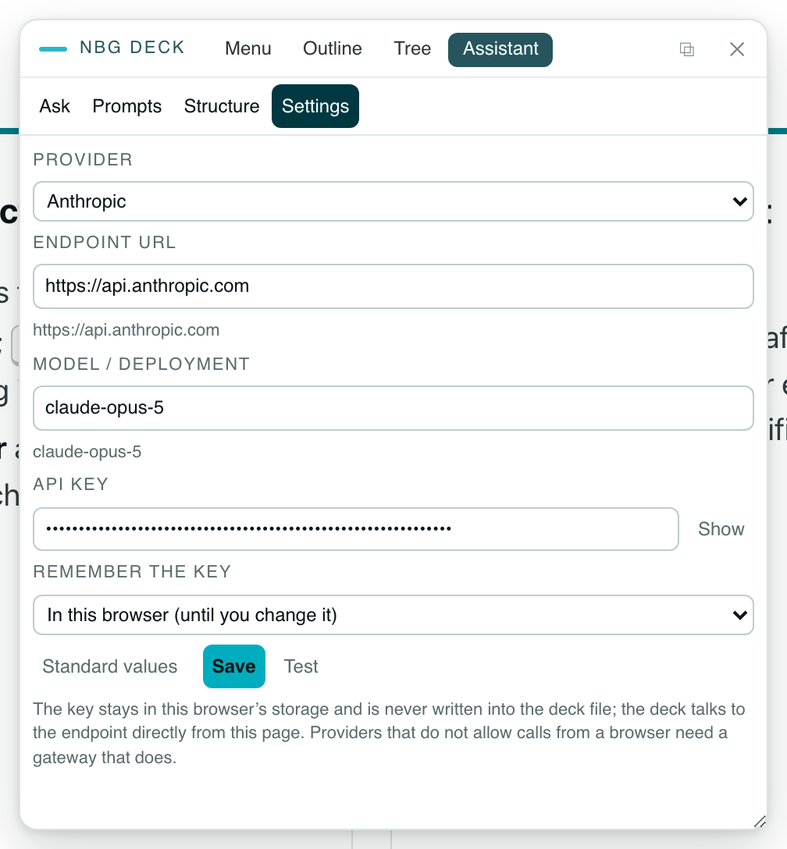
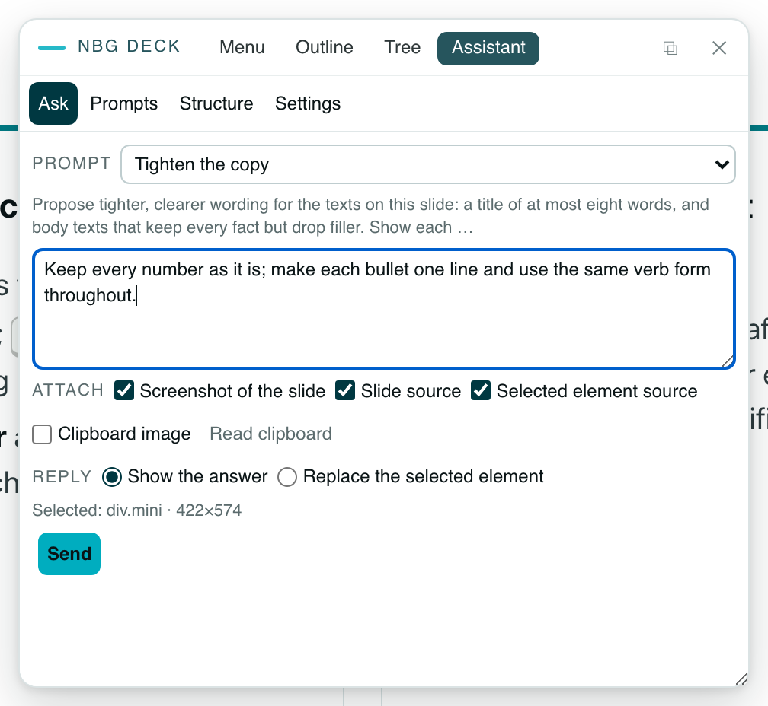
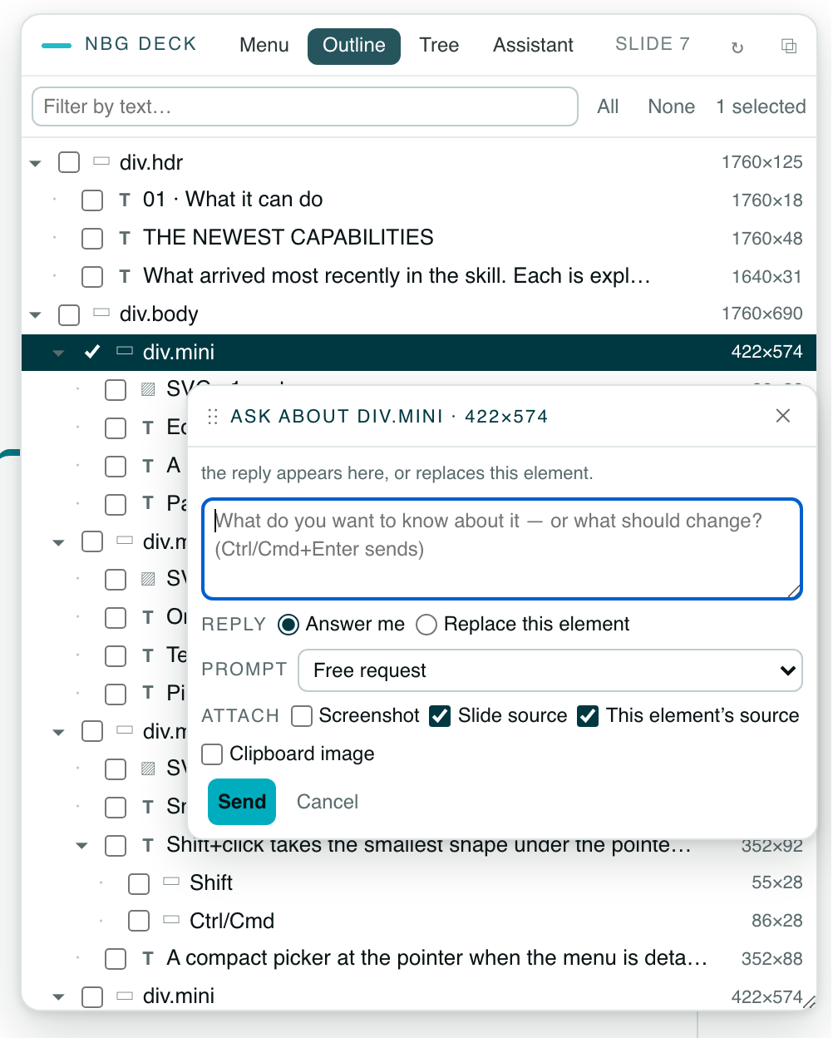
02 · Ask, build, edit
EDITING 9 · THE ASSISTANT, AS IT LOOKS
Three real screenshots from this deck: the Settings view, the Ask view with a card selected, and the Ask-about popup opened from a row of the Outline.
Ask about… on a row
Settings
Ask
Right-click a row of the Outline or Tree: a compact popup for that element, with its text, a request box, Answer me / Replace this element, the prompt and the attachments. It stays put until you close it and never opens the panel by itself.
Provider, endpoint, model or deployment, API key and where it is remembered. Settings are kept per provider; Standard values fills a fixed endpoint, Test sends a one-line request. The key never enters the deck file.
A prompt from the drop-down with its text shown beneath, a request box, the four attachments as checkboxes, the reply mode, and what is selected. Send shows the answer here, or replaces the selected element with Undo.
25

Slide 26

02 · Ask, build, edit
EDITING 10 · ASK THE ASSISTANT
An AI request from inside the deck, with the slide as context. The viewer brings their own endpoint and key; nothing is baked in.
Ask
Attach
Reply
Settings
A prompt from the drop-down: Free request, Review the slide, Proofread the text, Tighten the copy, Speaker notes, Restyle the selection, Rewrite the selection's text, plus your own.
Screenshot of the slide (tab capture; toolbars hidden, cropped to the slide).
Show the answer in the panel, with Copy and Apply to selection.
Providers: Anthropic, Azure-hosted Anthropic (Microsoft Foundry), OpenAI-compatible, Azure OpenAI, DeepSeek.
Slide source — its HTML plus the CSS rules it uses; embedded images travel as small placeholders, so photos cost no tokens.
Replace the selected element: the reply is the element's replacement HTML — same tag, scripts stripped, recorded as a normal edit — with Undo.
Endpoint, model or deployment, API key (kept in this browser, or for the tab only), Test.
A request box for extra instructions.
Selected element source.
Right-click a row in Outline or Tree for an Ask about… popup on that element.
Settings are kept per provider; nothing is defaulted — a missing value blocks the request with a message.
Clipboard image — paste, drop or Read clipboard.
The page calls the endpoint directly; a provider that blocks browser calls needs a gateway.
Privacy
Each attachment is a checkbox, so the viewer decides per request what leaves the machine. The key never enters the deck file or a saved copy.
26

Slide 27

02 · Ask, build, edit
EDITING 11 · KEEPING, SHARING AND PRINTING YOUR CHANGES
The deck on disk never changes by itself. Edits live in the browser until you save a copy.
Edits persist in the browser, keyed by the file: reload the deck and they are still there. They exist only in that browser — the original file is untouched.
What the editor can and cannot do
In the deck, by anyone
By regenerating, with the skill
Text, formatting, size, font, palette colour, alignment
New images or photos
Save edited copy downloads ​<name>-edited.html​: your edits applied to a pristine
snapshot of the deck taken at load. The copy is still one self-contained file and carries
the editor itself.
Geometry and style of shapes: fill, border, radius, opacity, shadow
New elements, new slides, new layouts
Order, alignment, distribution, groups of several shapes
Structural changes to the page
Discard changes on this slide restores the slide under the pointer (the hint counts its changes); Discard edits restores every slide.
AI-assisted rewrites and restyles of an element
Anything outside the skill's fonts and palette
Refresh the tools later: ​node deck.rebuild.mjs​ replaces only the editor block with the
one the skill ships now, keeps a backup, re-runs the strict gate and re-exports the PDF. ​
--check​ only reports CURRENT or REBUILD NEEDED.
A PDF of an edited deck is printed from the saved copy — the CLI prints what is on disk.
Export to PDF applies the same print layout as the command-line exporter and opens the print dialog: choose Save as PDF in Chrome or Edge. Page size, zero margins and backgrounds are preset — one page per slide, the same layout as the CLI export. Blurred shadows are printed as images on this path (block v13), so the PDF also renders correctly in macOS Preview.
27

Slide 28
02 · Ask, build, edit
KEYBOARD SHORTCUTS
Every shortcut the editor understands, by mode. Ctrl on Windows and Linux, Cmd on a Mac; deck navigation keys are paused while you edit.
Editing text
Shapes (one selected)
SVG parts
Menu and panels
Enter
applies the edit; a click outside does the same
↑↓←→
nudge by 1 px; Shift 10 px
Click
innermost part; drag moves it
Right-click
the menu, or the picker while the menu is away
cancels the edit and its formatting
Alt+arrows
resize
Shift+click
add a part, or remove a selected one
closes the menu, the picker, a popup
Esc
Esc
Tab
Shift+Tab
enclosing shape / child shape
what is inside the part there
Shift+Enter
line break
Ctrl/Cmd+click
Ctrl/Cmd+Shift+O
Outline tab
undo while editing
Shift+click
add the smallest shape there, or remove a selected one
Ctrl/Cmd+A
every top-level part
Tree tab with the element's source
Ctrl/Cmd+Z
Ctrl/Cmd+Shift+H
bold, italic, underline
Tab
Shift+Tab
enclosing group / first part inside
Ctrl/Cmd+B
I
U
selection box on the slide
Ctrl/Cmd+Shift+L
the assistant
larger / smaller text
Shift+drag
nudge one unit; Shift ten; Alt resizes
Ctrl/Cmd+Shift+>
<
everything inside the shape; a leaf alone, again cycles outward
↑↓←→
Ctrl/Cmd+V
paste an image into the assistant's request
a text: start editing it
Ctrl/Cmd+click
Double-click
Ctrl/Cmd+]
[
drawing order; Shift front / back
Double-click
a shape selects it; a selected drawing opens its parts; a grip releases an anchored panel
Ctrl/Cmd+A
every top-level shape of the slide
duplicate
Ctrl/Cmd+D
Ctrl/Cmd+]
[
forward / backward; Shift front / back
Delete
Backspace
delete the part
Esc
deselect, then end; Enter ends
Ctrl/Cmd+G
Shift+G
group / ungroup
Esc
Enter
finish
28

Slide 29
03
Section 03
Make it
your own
How it is built: the folder, the scripts and libraries, the editor's internals, the PDF and PowerPoint paths, the configuration hook and the rules to keep.
29

Slide 30
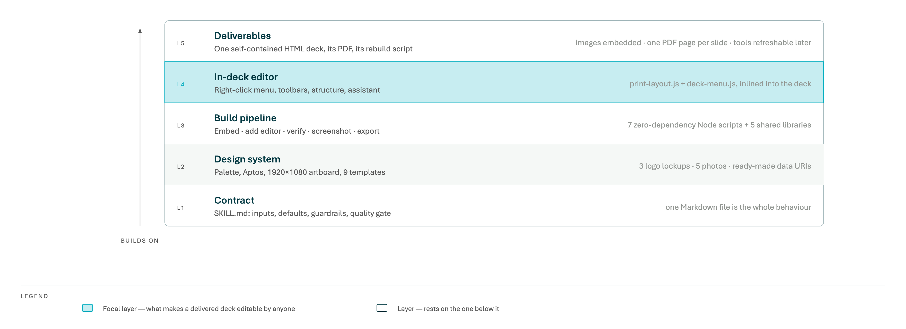
03 · Make it your own
HOW IT IS BUILT, IN FIVE LAYERS
Each layer rests on the one below; extend the one you need. The editor is the layer that turns a deck into something recipients can change themselves.
30

Slide 31
03 · Make it your own
ANATOMY OF THE SKILL FOLDER
31 MB, 30 of them photography; one Markdown file that is the whole behaviour, nine scripts, seven libraries, and four themes with their assets.
nbg-design/​plugin nbg-design v1.25.0 · marketplace BikS2013-coding-agents/nbg-design · MIT
├─ SKILL.md​104 KB · 621 lines​the single source of behaviour, defaults, assets, guardrails
├─ NBG-Design/
│ ├─ NBG Design System.html​39 KB​visual reference
│ ├─ slide-templates.jsx​32 KB​nine 1920×1080 templates
│ ├─ tweaks-panel.jsx​24 KB​tweak / edit helper reference
│ ├─ assets/​14 MB​3 logos + 27 photos, each with a .datauri.txt
│ └─ screenshots/​8 reference renders
├─ BikS2013-Design/ · AIHub-Design/ · Instrument-Design/​the other three themes
├─ scripts/​660 KB​nine scripts, seven libraries
│ ├─ embed-assets.mjs · add-deck-menu.mjs · verify-deck.mjs
│ ├─ write-rebuild-script.mjs · screenshot-deck.mjs · export-pdf.mjs
│ ├─ fix-pdf-soft-masks.mjs · export-pptx.mjs · compare-pptx.mjs
│ └─ lib/ find-browser.mjs · cdp.mjs · print-layout.js
│ pdf-soft-masks.mjs · deck-menu.js​339 KB
│ pptx-extract.js · pptx-writer.mjs​93 KB
└─ references/​design decisions, functions, config guide, issue register
SKILL.md is the contract. Inputs, defaults, palette, templates, embedding rules, the editor's behaviour, the PDF and PowerPoint rules and the quality checklist — all in one file, no separate configuration.
Everything resolves relative to the skill root, never to the working directory: the scripts find the assets next to themselves, so the skill works from any folder, on any machine, through a symlink.
Installed as a project skill via a symlink in ​.claude/skills/​ pointing at the plugin
checkout, so the working tree is the live skill.
References are history, not behaviour: every design decision from v1.3 to v1.25 is recorded with its rationale, mechanism and verification in project-design.md.
31

Slide 32

03 · Make it your own
THE SCRIPTS AND LIBRARIES
Zero-dependency Node (18+). No npm install, no build step; nine single-file scripts that import from lib/.
Script
What it does
Needs
Exit codes
​embed-assets.mjs​
Replaces every ​{{TOKEN}}​ with the verbatim data URI; tokens map to files by name; fails loudly on a missing asset.
none
0 / 1
​add-deck-menu.mjs​
Inlines one ​<script id="nbg-deck-menu-script" data-nbg-deck-menu="17">​ before the last ​</body>​: print-layout.js then deck-menu.js. Idempotent;
upgrades older blocks; ​--remove​ strips.
none
0 / 1
​verify-deck.mjs​
The gate: tokens, image paths, image count, size, bare-logo text, editor block version. ​--strict​ promotes the warnings to failures.
none
0 pass / 1 fail
​write-rebuild-script.mjs​
Writes ​<deck>.rebuild.mjs​ next to the deck: a self-contained script that later re-embeds the skill's current editor block (backup, verify, re-export the PDF); ​
--check​ only reports.
none
0 / 1 / 2
​screenshot-deck.mjs​
Drives a headless browser over the DevTools protocol; isolates the Nth ​.slide​ in place, so ​.active​, ​.hidden​, inline-display and stacked decks all work; PNG
per slide per viewport.
browser
0 / 1 / 3 no browser
​export-pdf.mjs​
Lifts the host layer, prints with ​Page.printToPDF​ at the slide box, verifies pages = slides and slide box = page box; then re-anchors the soft masks so shadows
render in macOS Preview.
browser
0 / 1 / 3 no browser
​fix-pdf-soft-masks.mjs​
Re-anchors the soft masks of a PDF exported earlier (or saved from the print dialog): an incremental update, the original bytes intact; ​--check​ only reports.
none
0 / 1 / 2
​export-pptx.mjs​
Measures every slide in the browser and writes an editable .pptx: text boxes with real runs, shapes, cropped pictures, SVG pictures, the theme's fonts and colours.
browser
0 / 1 / 3 no browser
​compare-pptx.mjs​
Renders the .pptx with PowerPoint (macOS) or LibreOffice and writes deck | PowerPoint | difference images with a score per slide.
browser
0 / 1 / 3 missing tool
lib/find-browser.mjs
lib/cdp.mjs
lib/print-layout.js
lib/pdf-soft-masks.mjs
lib/deck-menu.js
lib/pptx-*
Locates Chrome, Chromium or Edge; ​
--browser​, ​NBG_BROWSER​, ​
CHROME_BIN​ override.
A minimal DevTools-protocol client over the debugging pipe: launch, navigate, evaluate, print, count pages.
The print shim shared by the exporter and the in-deck menu; a registry undoes every change after printing. On the menu path it prints blurred shadows as images (v13).
Zero-dependency PDF rewriter: re-anchors Chrome's luminosity soft masks so macOS Preview renders shadows; incremental update.
The editor: ~4,000 lines of plain browser JavaScript — editing, selection, SVG parts, toolbars, structure, assistant, persistence, print.
pptx-extract.js measures every slide in the browser; pptx-writer.mjs writes the Office Open XML and its zip.
32

Slide 33
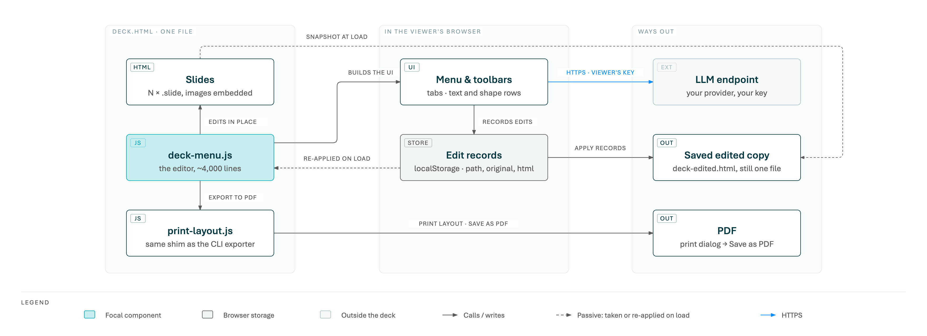
03 · Make it your own
INSIDE A DELIVERED DECK
One HTML file carries the slides and the editor; the browser keeps the edits; three ways lead out.
33

Slide 34
03 · Make it your own
INSIDE THE EDITOR
How a standalone file:// deck can be edited, remembered and handed back without ever writing to itself.
Edit records
Pristine snapshot
Geometry, order, groups
Every change is a record ​{{ path, original, … }}​
where path is the child-index path from the root —
cheap, exact, and the reason the DOM is never
restructured.
When the inlined script runs — after the deck's own
scripts, before any runtime element and before stored
edits — it takes an ​outerHTML​ snapshot.
A "shape" is a positioned element, one with a background, border or shadow, or an image; otherwise the text block.
Save edited copy parses that snapshot with ​
DOMParser​, applies the records, and downloads the
result: it loads exactly like the original and carries the
menu.
Pointer deltas are divided by the slide's scale
(​rect.width / offsetWidth​), so coordinates are
artboard pixels.
Three kinds: html (text and selection-level formatting),
style (block formatting, geometry, fill, border, z-index),
group (the ​data-nbg-group​ attribute). An SVG session
records the whole ​<svg>​ as one html record.
Ordering ranks siblings by effective layer and writes an
inline ​z-index​; a negative index makes the parent a
stacking context with ​isolation: isolate​.
The print path uses the same print-layout shim as the CLI, then restores every class, style and attribute it touched.
Stored in ​localStorage​ under ​
nbg-deck-edits:<path>#<title>​; re-applied on load; a
record whose original no longer matches is dropped.
Rich ​contenteditable​, not ​plaintext-only​, because
the latter forces ​pre-wrap​ and re-flows titles.
Design rule
Inline style and attributes only, never DOM re-ordering — so every earlier record's path stays valid and every change stays reversible.
34

Slide 35

03 · Make it your own
THE PDF PATH
The PDF is the deck, printed by the same engine that renders it. Nothing is re-laid out for paper.
What the exporter does
Rules that are not negotiable
Opens the deck in headless Chrome, Chromium or Edge over the DevTools pipe — nothing to install.
Aesthetics are frozen. No print stylesheets, no resized slides, no font swaps "to make it print". A mismatch is a bug in the deck, fixed in the HTML.
Lifts the host layer only: navigation toggles (​.active​, ​.hidden​, inline display), the
viewport-fit wrappers and scaling, buttons and counters; jumps animations to their end
state; forces ​print-color-adjust: exact​.
No fakes. No ​window.print()​ at A4, no browser Save-as-PDF with headers and margins, no
office round-trips, no stitched screenshots.
Every top-level slide carries the ​slide​ class — the exporter and the screenshot helper key
on it.
Makes every top-level ​.slide​ visible in flow and prints with ​Page.printToPDF​: page size =
the measured slide box (1920×1080 px = 20 × 11.25 in), zero margins, backgrounds on, scale
1.
Fonts come from the exporting host: with Aptos absent, PDF and screenshots share the same fallback. Export where Aptos is installed if it must appear.
Verifies: page count equals slide count and every slide box equals the page box; otherwise exit 1 (the PDF is still written for diagnosis). Exit 3 means no browser on the host.
Never print a deck that fails ​verify-deck --strict​. The in-deck Export to PDF inlines the
very same shim; since the print dialog's PDF cannot be post-processed, that path prints
blurred shadows as images instead (block v13).
Re-anchors the soft masks (since 1.19): Chrome writes every blurred shadow as a
luminosity mask that macOS Preview mis-positions into gray blocks. The exporter rewrites
them to page space as an incremental update; every other viewer draws the same picture. ​
fix-pdf-soft-masks.mjs​ does it for older PDFs.
35

Slide 36
03 · Make it your own
THE POWERPOINT PATH
An editable .pptx, converted element by element from the deck the browser lays out. Never a screenshot per slide.
What export-pptx does
Why it lands where the HTML does
Opens the deck in headless Chrome with the PDF exporter's print layout, then measures every element where the browser put it — positions are Chrome's, never re-derived.
Calibrated against PowerPoint: its first baseline sits at 0.75 × the line pitch, so each box is placed to put it on Chrome's; the pitch is written as a percentage, because exact spacing is rounded to whole points.
Text → text boxes with real runs: typeface and the weight actually drawn (Aptos Light, Avenir Next Ultra Light), size, colour, letter-spacing, capitals, raised runs, links, line breaks.
Chrome's line breaks are kept where a greedy renderer cannot find them: balanced titles, paragraphs with code or key chips.
Boxes → shapes: fills and gradients, borders, per-corner radii, shadows, transparency. Photos → pictures with their full source and a crop. Inline SVG → SVG pictures, convertible to shapes in PowerPoint.
compare-pptx renders the file in PowerPoint itself and writes deck | PowerPoint | difference images with a score per slide — read, not just produced.
The theme carries the deck's fonts and palette, so new text and PowerPoint's colour picker match the deck.
Fonts are named, not embedded: the presenting machine needs the deck's faces. Aptos ships with Office.
36

Slide 37
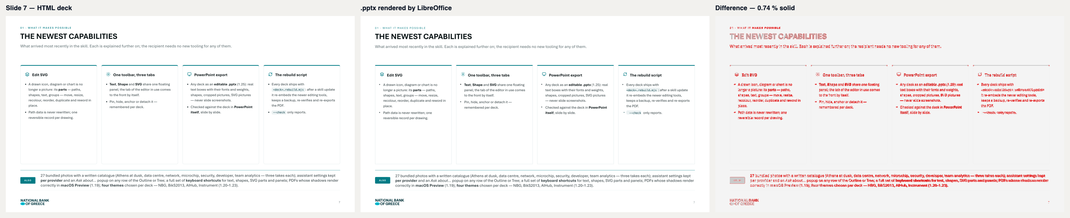
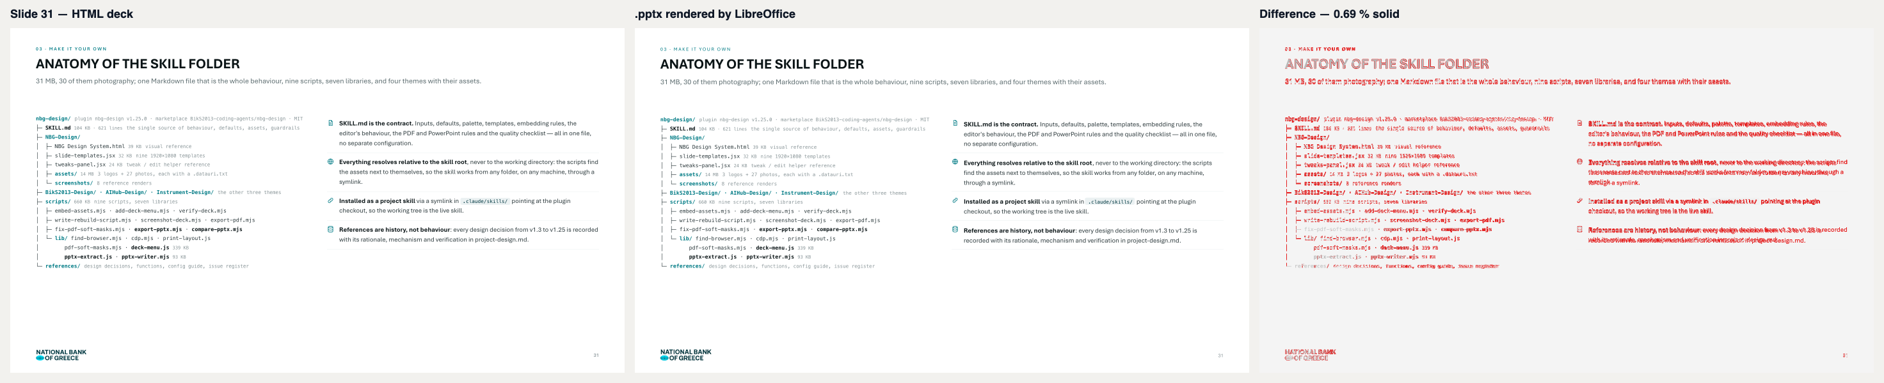
03 · Make it your own
THE POWERPOINT FILE, CHECKED
Two slides of this very deck: the HTML, its .pptx as rendered, and the pixels that differ. compare-pptx writes one such image per slide.
How to read it
Left the deck, middle the .pptx (here rendered by LibreOffice), right the differences in red. Below about 0.5 % solid difference is anti-aliasing and sub-pixel font metrics; text that re-wraps or a shape out of place would show as a red block.
37

Slide 38

03 · Make it your own
THE CONFIGURATION HOOK: ONE EDITOR FOR ANY HTML PAGE
Since v1.15 the editor is configured, not forked. A deck keeps its defaults; any other document declares what its editable regions are.
window.nbgDeckMenuConfig
Reusing the skill in generators
A deck can be a data-driven Python generator: a helper section (icons, header, footer, pills,
numbered circles) and one ​add()​ per slide, sharing one ​deck.css​ and ​deck.js​ with sibling
decks.
window.nbgDeckMenuConfig = {
mode: 'deck' | 'page',​print: one page per slide, or the browser's pagination
root: '.slide',​CSS selector of the editable regions (top-level matches)
unit: 'Slide',​the word the UI uses: Slide, Page, Section …
title: '…',​the label in the menu header
aiSystem: '…'​replaces the assistant's system prompt
};
Slides can be sliced out of another generator by comment markers and re-executed, so a slide reused across decks is one line.
A ​rebuild.sh​ per deck detects skill, generator or asset changes, builds the next version
through the five steps and refreshes a fixed-name ​-latest​ copy — the stable link.
Written as the block's first statement by ​addMenu(html, config)​ / ​buildMenuBlock(config)​; ​
readMenuConfig(html)​ reads it back. The CLI has no flags: a deck always gets the defaults.
This deck was built that way: a 550-line generator, the shared CSS plus 150 lines of additions, and the pipeline.
Page mode: the print path adds only background and animation rules; wording says page / Section N; the assistant gets page-oriented prompts (Review the page, Summarise the page …).
38

Slide 39
03 · Make it your own
RULES THAT KEEP IT SAFE
The constraints written into SKILL.md that every generated deck, and every future change to the skill, must respect.
Delivery
Secrets & fallbacks
Scope
Run order: author → embed → add menu → verify strict → rebuild script → screenshots → PDF / PowerPoint. Never deliver a deck that fails the gate.
The skill holds no credentials. Assistant keys are the viewer's and live only in their browser — never in the skill, a deck or a saved copy.
The look cannot be left from the editor: fonts limited to the design-system stacks, colours to the NBG-inspired palette. The Tree tab's source editor is the one deliberate exception, for experts.
Every image a ​data:​ URI; the logo always the bundled
lockup.
No fallback values: a missing input is a question, a missing setting a message. Exceptions are written into the project memory first.
The editor changes text, formatting, geometry, order, groups and shape style. Images, new elements and structure are the skill's job — regenerate.
Fit at 1366×768 and 1440×900; no element collisions; 32 px between groups, 72 px above the footer.
The agent never enters endpoints or keys for a recipient and never relies on the assistant for its own work.
PDF and PowerPoint only from the verified HTML, only through the exporters; the .pptx always compared.
PowerPoint is an export of the HTML deck, never a second source to edit and re-import; newsletters, GPT and NotebookLM artifacts of the original project are excluded unless asked for.
39

Slide 40


Summary
USING IT TOMORROW
One line for recipients, eight commands for builders, one marketplace to install from.
Tell the recipient
The eight commands
Double-click any text to edit it (Enter applies, Esc cancels). Right-click for
Resize / move shape (Shift+click or Shift+drag selects several; the toolbar
orders, aligns, distributes and groups them), Edit SVG (the parts of a drawn
icon, diagram or chart; one toolbar with Text, Shape and SVG tabs serves all
three), Ask the assistant, Export to PDF and Save edited copy. After a skill
update, ​node deck.rebuild.mjs​ refreshes the editing tools and the PDF.
S=<skill-root>/scripts
node $S/embed-assets.mjs deck.html​tokens → data URIs
node $S/add-deck-menu.mjs deck.html​inline the editor
node $S/verify-deck.mjs deck.html --strict​the gate
node $S/write-rebuild-script.mjs deck.html​deck.rebuild.mjs, delivered too
node $S/screenshot-deck.mjs deck.html -o shots​look
node $S/export-pdf.mjs deck.html​one page per slide
node $S/export-pptx.mjs deck.html​editable PowerPoint
node $S/compare-pptx.mjs deck.html deck.pptx​check it
Where it lives
Public marketplace ​github.com/BikS2013-coding-agents/nbg-design​: ​
/plugin marketplace add BikS2013-coding-agents/nbg-design​, then ​
/plugin install nbg-design@nbg-design​.
Next steps
Ask for your next deck in this look and hand the three files to its readers.
This deck: ​github.com/BikS2013-presentations/deck-work-nbgdesign​, browsable on GitHub
Pages and always current as ​deck/NBG-Design-Skill-Explained-latest.html​; its generator
and ​rebuild.sh​ live in the same repository.
Hand a deck to two colleagues, watch them edit it, and feed the friction back into the next release.
Ask for the PowerPoint version of a deck and read its comparison images.
40

