Slide 1


User guide · llm-wiki
A wiki your LLM
keeps for you.
Index and search your personal documentation with Karpathy's LLM Wiki pattern: compiled once, kept current, cross-linked.
BikS2013 · field notes
Athens · October 2026
Notes:
Welcome. This deck shows how to use llm-wiki day to day: set it up once, then feed it sources, search it, ask it questions and keep it healthy.

Slide 2
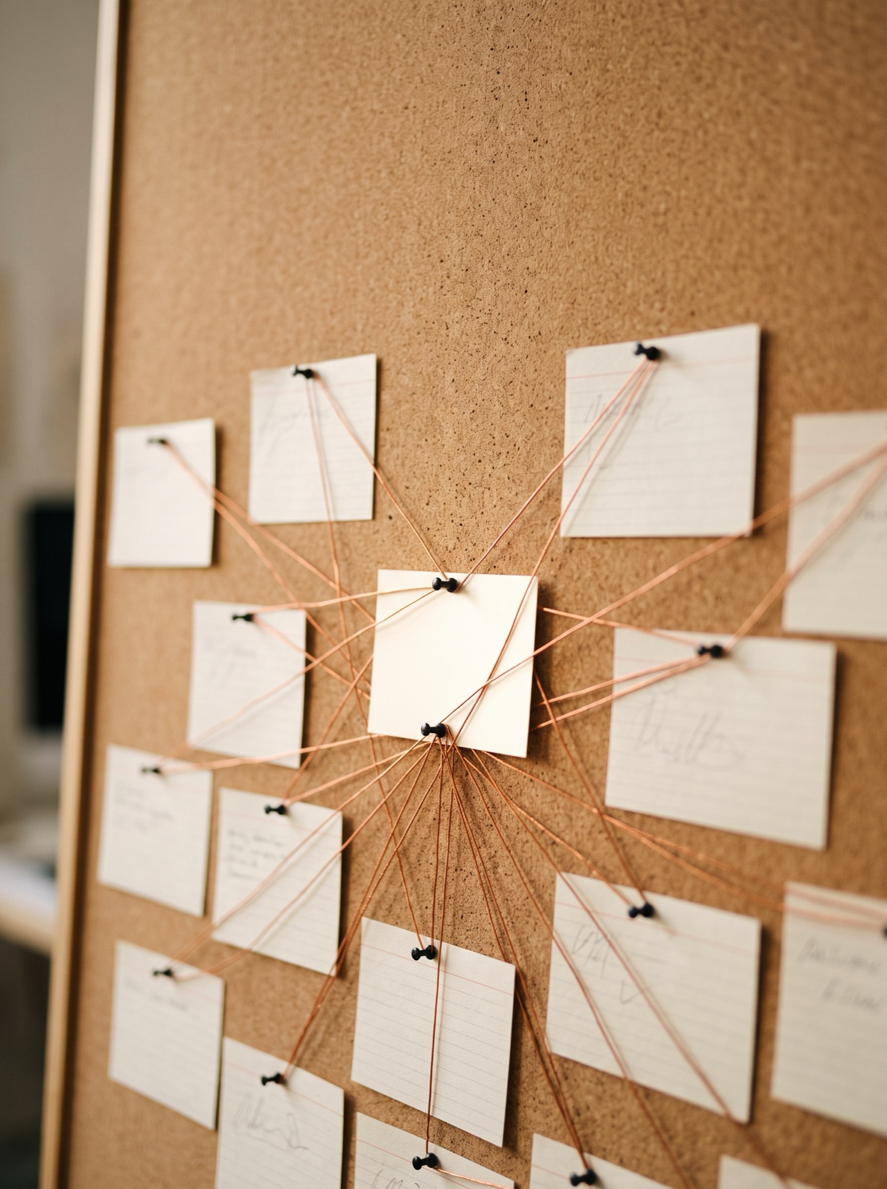

00 · The idea
Not retrieval at question time
— compilation at ingest time.
01
You curate the sources
Drop articles, notes, PDFs and DOCX files into ​raw/​. They are never modified — this
is your source of truth.
02
The LLM writes the wiki
Every ingest produces a summary page and updates the entity and concept pages it
touches, with wikilinks and citations.
03
You ask, it compounds
Search locally, ask with citations, file good answers back as pages, and lint for
contradictions and gaps.
Pattern: Andrej Karpathy, "LLM Wiki" (gist, April 2026). Implementation: github.com/BikS2013/llm-wiki.
llm-wiki · user guide
2
Notes:
RAG retrieves fragments every time; nothing accumulates. llm-wiki compiles knowledge into pages the model maintains, so every source and every question makes the wiki richer.

Slide 3
00 · The idea
Three layers in one folder.
Layer 1 · immutable
Layer 2 · LLM-owned
Layer 3 · the contract
Raw sources
The wiki
The schema
Your documents, exactly as you added them. Read, never written — except the markdown conversion placed beside a PDF or DOCX.
Interlinked pages — markdown, or HTML for the browser — the model creates and keeps consistent, plus a generated catalog and an append-only log.
A CLAUDE.md / AGENTS.md written by init: layout, page format, link rules and the ingest / query / lint workflows any agent must follow.
→
→
raw/article.md
raw/report.pdf
raw/report.pdf.md
raw/assets/
wiki/index · wiki/log (.md|.html)
wiki/sources/ · entities/
wiki/concepts/ · syntheses/
wiki/lint/
CLAUDE.md
AGENTS.md
.llm-wiki/ (tool state)
llm-wiki · user guide
3
Notes:
Three layers. Raw is immutable. Wiki is owned by the model. The schema file tells any agent how the wiki is structured and how to maintain it.

Slide 4

01
Set it up once.
Install the CLI, choose the models, then create and register your wikis — markdown or HTML. Nothing is defaulted silently — every missing setting is a clear error.
Section 01 · Setup
4
Notes:
Section one: install, configure, initialise. Ten minutes, done once.

Slide 5
01 · Setup
Install in three commands.
An OS command: the link points at the checkout, so ​pnpm
build​ updates it; ​pnpm unlink:global​ removes it.
# requires Node 22+ and pnpm
git clone git@github.com:BikS2013/llm-wiki.git
cd llm-wiki
pnpm install
pnpm link:global # build + put `llm-wiki` on your PATH
llm-wiki --version
llm-wiki guide # the complete manual
Built-in guide: ​llm-wiki guide <topic>​ or ​--json​ —
generated from the installed CLI, never stale.
Check the build with ​pnpm test​: 54 tests, no network needed.
Dependencies are vetted and audited.
llm-wiki · user guide
5
Notes:
Node 22 and pnpm. Build once; link:global puts llm-wiki on your PATH as an OS command. llm-wiki guide prints the complete manual, also for agents.

Slide 6
01 · Setup
Configure once — four tiers, no hidden defaults.
1 · lowest
2
3
4 · highest
# ~/.tool-agents/llm-wiki/.env
LLM_WIKI_PROVIDER=anthropic
LLM_WIKI_MODEL=claude-opus-5
ANTHROPIC_API_KEY=…
LLM_WIKI_EMBEDDING_PROVIDER=openai
LLM_WIKI_EMBEDDING_MODEL=text-embedding-3-small
OPENAI_API_KEY=…
LLM_WIKI_PARSER_PROVIDER=gemini
LLM_WIKI_PARSER_MODEL=gemini-3.6-pro
GOOGLE_API_KEY=…
Shell env
~/.tool-agents/
llm-wiki/.env
./.env
CLI flags
What your shell already exports
Per-project overrides
--wiki, --model, …
Your long-lived settings (0600)
Setting
Purpose
LLM_WIKI_NAME / --wiki
Which registered wiki · or LLM_WIKI_ROOT / --root
LLM_WIKI_PROVIDER / _MODEL
Chat model for ingest, query, lint --llm
LLM_WIKI_EMBEDDING_PROVIDER / _MODEL
Optional · enables vector and hybrid search
LLM_WIKI_PARSER_PROVIDER / _MODEL
Optional · converts PDF and DOCX originals
llm-wiki config shows every resolved setting, its tier, and masks the keys.
llm-wiki · user guide
6
Notes:
Four tiers, lowest to highest priority. Put long-lived settings in the tool-agents env file; override per run with flags. A missing setting raises an error — there are no hidden defaults.

Slide 7
01 · Setup
Eight providers, vendor-canonical variables.
Provider
Variables it reads
Chat
Embed
PDF natively
openai
OPENAI_API_KEY · OPENAI_BASE_URL · OPENAI_ORG_ID
yes
yes
yes
anthropic
ANTHROPIC_API_KEY · ANTHROPIC_BASE_URL
yes
—
yes
gemini
GOOGLE_API_KEY (or GEMINI_API_KEY)
yes
yes
yes
azure-openai
AZURE_OPENAI_API_KEY · _ENDPOINT · _DEPLOYMENT · _API_VERSION
yes
yes
yes
azure-anthropic
AZURE_AI_INFERENCE_KEY · AZURE_AI_INFERENCE_ENDPOINT
yes
—
yes
ollama
OLLAMA_HOST
yes
yes
text extracted locally
litellm
LITELLM_PROXY_URL · LITELLM_MASTER_KEY
yes
yes
yes
mlx
OPENAI_BASE_URL (OpenAI-compatible server)
yes
yes
text extracted locally
Model names are yours to choose (e.g. claude-opus-5, gpt-5, gemini-3.6-flash, llama3). For azure-openai the chat model is the deployment in AZURE_OPENAI_DEPLOYMENT.
llm-wiki · user guide
7
Notes:
Eight providers out of the box, each read through the vendor's canonical variable names — never a tool-specific prefix. Any of them can be the chat, embedding or parser model independently.

Slide 8
01 · Setup
Create the wiki: init.
$ llm-wiki init ~/notes-wiki --format markdown \
--name notes --description "Personal notes"
initialised markdown wiki at /Users/you/notes-wiki
created …/raw raw/assets
created …/wiki/sources entities concepts syntheses lint
created …/.llm-wiki/wiki.json CLAUDE.md AGENTS.md
created …/wiki/index.md wiki/log.md
registered as "notes"
"notes" is now the current wiki
$ llm-wiki init ~/handbook --format html --name handbook
What you get
A folder that is also a repo
Markdown for Obsidian and editors, or HTML pages that open in a browser — your choice per wiki. Put it under git; open it in Claude Code and the schema makes the agent its maintainer.
Safe to re-run
Existing files are kept
init refuses to overwrite a wiki that already has a schema; --force rewrites only CLAUDE.md and AGENTS.md.
llm-wiki · user guide
8
Notes:
init creates the layout and the schema in the format you choose, and registers the wiki by name. The first one becomes the current wiki.

Slide 9

02
The daily loop.
Ingest a source, search the pages, ask a question, file the answer, lint now and then. Each step leaves the wiki richer than it found it.
Section 02 · The daily loop
9
Notes:
Section two: the daily loop. Ingest, search, query, lint. Index and log run alongside.

Slide 10
02 · The loop
Ingest: one source in, five to fifteen pages touched.
Context for the model: the index plus the most related existing pages,
found by search — so it updates pages instead of duplicating them.
$ llm-wiki ingest ~/Downloads/deploy-notes.md
reading related pages for raw/deploy-notes.md
asking anthropic/claude-opus-5 to compile raw/deploy-notes.md
# Deployment notes for the Ntakker API
Takeaways:
- Deploys to Azure Web App as a Docker container …
Pages written:
- replace wiki/sources/deploy-notes.md
- create wiki/entities/ntakker-api.md
- create wiki/entities/azure-blob-storage.md
- create wiki/concepts/configuration-management.md
…
$ llm-wiki ingest # every pending source
$ llm-wiki ingest raw/x.md --dry-run
After writing: ​index.md​ is regenerated, the search index rebuilt, a log
entry appended, and the source's hash recorded.
Idempotent: an unchanged source is skipped; ​--force​ redoes it; ​--dry-
run​ shows the plan only.
Never truncates: a source above ​--max-source-chars​ is refused with a
message, not silently cut.
llm-wiki · user guide
10
Notes:
Ingest is the heart. Files outside raw are copied in. The model gets the index and related pages as context, writes a summary page and touches the entity and concept pages. Then the index, the search index, the ledger and the log are updated. Unchanged sources are skipped.

Slide 11
02 · The loop
Search: local, instant, three modes.
bm25 · default
vector
hybrid
Keyword ranking
Semantic similarity
Both, fused
Okapi BM25 over heading-level chunks with a light stemmer. No model, no network, works the moment a page exists.
Cosine over embeddings cached by chunk hash. Run llm-wiki index --embed once; only new or changed chunks are embedded afterwards.
Reciprocal-rank fusion of the two lists. The default for query as soon as embeddings exist.
$ llm-wiki search "postgres docker" # bm25, wiki pages
$ llm-wiki search "how do I run the db" --mode hybrid --limit 5
$ llm-wiki search "psql" --layer all --json # include raw/ sources, machine-readable
1. wiki/entities/postgres.md › Postgres (0.727)
Postgres runs in a Docker container on port 5432. See [[docker]] …
llm-wiki · user guide
11
Notes:
Search is local and instant. BM25 needs no model. Compute embeddings once with index --embed and hybrid search fuses both rankings.

Slide 12
02 · The loop
Query: answers with citations — filed back on request.
Every claim cites a page. If the wiki lacks the answer, the model
says what is missing instead of inventing it.
$ llm-wiki query "Where does the API read its config?" --file
### Where the API reads configuration
The [[entities/ntakker-api|Ntakker API]] fetches its configuration
at startup from [[entities/azure-blob-storage]] in the `app-config`
container ([[sources/deploy-notes]]).
### What remains undecided
Whether to move to Azure App Configuration ([[entities/giorgos]]).
### Sources
- [[sources/deploy-notes]] · [[entities/ntakker-api]] · …
filed as wiki/syntheses/where-does-the-api-read-its-config….md
​--file​ stores the answer under ​wiki/syntheses/​ with
frontmatter, updates the index and logs it.
Several wikis at once: ​--wikis a,b​ or ​--all-wikis​; citations
read ​[[wiki:page]]​.
Tune the context: ​--limit​, ​--pages​, ​--context-chars​, ​
--mode​.
llm-wiki · user guide
12
Notes:
Query reads the index, searches, loads the top pages within a character budget, and answers with wikilink citations. With --file the answer becomes a synthesis page, indexed and logged, so your questions compound too.

Slide 13
02 · The loop
Lint: a health check in two passes.
Structural · no LLM
Semantic · --llm
Deterministic findings
What only a reader can see
Dangling wikilinks · orphan pages · pages without outbound links · missing frontmatter or summary · basename collisions · stale index.md · sources in raw/ not yet ingested · PDF/DOCX originals not yet converted.
Contradictions between pages · claims superseded by newer sources · concepts mentioned repeatedly but lacking a page · missing cross-references · data gaps · suggested questions and sources.
$ llm-wiki lint # structural, exit 1 on errors
$ llm-wiki lint --fix # also regenerate index.md and the search index
$ llm-wiki lint --llm --report # semantic pass, filed as wiki/lint/<date>.md and logged
llm-wiki · user guide
13
Notes:
Lint keeps the wiki healthy. The structural pass is free and deterministic. The LLM pass reads all pages within a budget and reports contradictions, stale claims, missing pages and good next questions. --report files it as a page.

Slide 14
02 · The loop
Two special files: index.md and log.md.
index.md — what is in the wiki
log.md — what happened, when
A catalog of every page grouped by type, each with a link, its one-line ​summary​, its date and
source count. Generated from page frontmatter by ​llm-wiki index​ — never hand-edit it;
edit the frontmatter instead.
Append-only. Every entry starts with the same prefix, so the log is grep-able: ​grep "^## \["
log.md | tail -5​. The CLI reads it too: ​llm-wiki log --last 5 --kind ingest​.
## [2026-09-12] ingest | Deployment notes for the Ntakker API
Source: raw/deploy-notes.md
Pages touched: … · Takeaways: …
## [2026-09-12] query | Where does the API read its config…
Filed as [[syntheses/where-does-the-api-…]].
## Entities (6)
- [[azure-blob-storage|Azure Blob Storage]] — Object storage
used for runtime configuration. _(2026-09-12, 1 source)_
- [[ntakker-api|Ntakker API]] — Backend API deployed to
Azure Web App in Docker. _(2026-09-12, 1 source)_
In HTML wikis they are index.html and log.html. llm-wiki index --raw also indexes raw sources for search; --embed computes missing embeddings.
llm-wiki · user guide
14
Notes:
index.md is content-oriented and generated; log.md is chronological and append-only. Both are what the gist calls the two special files.

Slide 15

03
Documents,
originals intact.
A dedicated parser model converts the document to markdown. The original stays untouched in raw/ and every derived page points back to it.
Section 03 · Documents
15
Notes:
Section three: PDF and DOCX. A dedicated parser model converts them; the original is kept and referenced.

Slide 16
03 · Documents
A separate parser model, chosen for the job.
1 · you add
2 · parser LLM
3 · the wiki reads
raw/report.pdf
faithful markdown
raw/report.pdf.md
Any PDF or DOCX, copied into raw/ if it was elsewhere. It is never modified.
Headings, lists, tables, figures as bracketed descriptions. Nothing summarised, nothing dropped. Set by LLM_WIKI_PARSER_PROVIDER / _MODEL.
Written beside the original with provenance frontmatter, then ingested like any other source.
→
→
$ llm-wiki ingest raw/report.pdf # convert, then ingest
$ llm-wiki parse raw/contract.docx # convert only — review raw/contract.docx.md first
$ llm-wiki ingest raw/report.pdf --reparse # redo the conversion; cached by hash otherwise
llm-wiki · user guide
16
Notes:
Ingest a PDF and it is converted first, then ingested like any markdown source. parse converts only, so you can review. Providers with native document input get the PDF itself; local servers get pdf.js text; DOCX always goes through mammoth to HTML first.

Slide 17
03 · Documents
Provenance travels with every page.
# raw/report.pdf.md
---
title: Quarterly Report
original: raw/report.pdf
original_type: PDF
original_sha256: 3f2a9c…
parsed_by: gemini/gemini-3.6-pro
parsed_at: 2026-09-12
---
> **Converted from the original PDF document
> [[raw/report.pdf]]** (412 KB) by gemini/gemini-3.6-pro
> on 2026-09-12. The original is kept unmodified in raw/.
# Quarterly Report
…
On the wiki page too
sources/quarterly-report.md
Gets original: raw/report.pdf in its frontmatter and a link to the original in its body — stamped by the tool, whatever the model wrote.
Native vs extracted
Scanned PDFs work
Anthropic, Gemini, OpenAI, Azure and LiteLLM receive the PDF itself. Ollama and MLX receive text extracted with pdf.js — a scanned page yields nothing there, and the tool says so.
llm-wiki · user guide
17
Notes:
This is what provenance looks like. The conversion carries the original path, type, hash and parser. The wiki source page carries original too, and links it in its body.

Slide 18

04
Let the agent do
the bookkeeping.
Obsidian is the IDE, the LLM is the programmer, the wiki is the codebase. The schema and the MCP server make that literal.
Section 04 · Agents
18
Notes:
Section four: working with agents. The schema makes Claude Code the maintainer; the MCP server gives it the tools.

Slide 19
04 · Agents
The schema turns any coding agent into the maintainer.
§1
§2
§3
Layout & page format
Operations
Working style
Where each page type lives, the frontmatter keys, kebab-
case slugs, wikilink conventions, citing ​raw/​ for every non-
obvious claim.
Step-by-step ingest, query and lint workflows — including
"run ​llm-wiki index​ after editing pages" and how to flag
a contradiction.
Never touch ​raw/​; keep pages atomic; prefer updating
over duplicating; mark possible duplicates for the next
lint pass.
$ cd ~/notes-wiki && claude # CLAUDE.md is read automatically; AGENTS.md serves Codex and others
> ingest raw/podcast-notes.md and tell me what changed in the overview
llm-wiki · user guide
19
Notes:
Open the wiki root in Claude Code or Codex. The CLAUDE.md / AGENTS.md written by init is the contract: layout, page format, link rules, and the three workflows. Co-evolve it with the agent as your domain settles.

Slide 20
04 · Agents
The MCP server: native tools for the agent.
Tool
Does
$ claude mcp add llm-wiki -- llm-wiki mcp
# or run it yourself for any MCP client
$ llm-wiki mcp # stdio
wiki_list_wikis
the registered wikis and their status
wiki_search
one, several or all wikis
wiki_read_page
a page, or index / log
One server serves every registered wiki: each tool takes an optional wiki argument (default: the
selected wiki), and the registry is re-read on every call.
wiki_list_pages
id, type, title, summary; filter by type
wiki_write_page
create / replace / append; reindexes
wiki_append_log
an entry in the standard format
wiki_lint
the structural health check
wiki_reindex
index.md + search index
llm-wiki · user guide
20
Notes:
Register the MCP server once and the agent gets native tools for every registered wiki: each tool takes a wiki argument. Writing through wiki_write_page keeps index and search index current, in either format.

Slide 21
04 · Agents
What a page looks like.
Frontmatter feeds the index: ​title​, ​summary​, ​type​, ​
updated​, ​sources​.
---
title: Ada Lovelace
type: entity # entity | concept | source | synthesis
summary: One sentence shown verbatim in index.md.
tags: [mathematics, computing]
created: 2026-04-02
updated: 2026-04-09
sources: [raw/some-article.md]
aliases: [Countess of Lovelace]
---
# Ada Lovelace
Worked with [[charles-babbage]] on the
[[concepts/analytical-engine|Analytical Engine]]
([[sources/some-article]]).
> **Contradiction:** [[sources/a]] dates the notes to 1842,
> [[sources/b]] to 1843.
Wikilinks by basename when unique, by ​folder/slug​ when not; lint
flags collisions and dangling links.
Contradictions are callouts, never silent overwrites.
After hand edits, run ​llm-wiki index​.
HTML wikis store the same metadata as JSON in the page head and the
body in ​<main>​; the tool writes them from this same form.
llm-wiki · user guide
21
Notes:
If you ever write a page by hand, this is the shape. Frontmatter drives the index; wikilinks drive the graph and the lint.

Slide 22
04 · Agents
A worked example, from one small note.
Step
Result
8
ingest
8 pages written · index and log updated · 17 chunks indexed
index --embed
17 embeddings computed once, cached by hash
search --mode hybrid
"where does production config live" → the configuration-management page, first hit
pages from a four-line deployment note
query --file
Answer cited 5 pages · filed under syntheses/
One source page, six entities (the API, the team member, three Azure services, Docker) and one concept — all cross-linked, all indexed.
lint --llm --report
Suggested a missing page (Azure App Configuration), one missing cross-reference, three next questions
Run on 2026-09-12 with gemini-3.6-flash as chat and parser model and text-embedding-3-small for embeddings.
llm-wiki · user guide
22
Notes:
A real run on a four-line deployment note: eight pages, hybrid search ranked the right chunk first, the filed query cited five pages, and lint suggested the one concept that deserved its own page.

Slide 23
04 · Agents
When it stops, it tells you why.
Message
What to do
No wiki selected. / No wiki named "x" is registered.
Pass --wiki <name> (the message lists them), or llm-wiki wikis use <name>.
Missing required configuration setting LLM_WIKI_…
Add it to ~/.tool-agents/llm-wiki/.env or the shell — there are no defaults.
… is not an initialised wiki (missing raw/)
Run llm-wiki init <dir> first.
… is a PDF/DOCX original and needs the parser LLM
Set LLM_WIKI_PARSER_PROVIDER and _MODEL.
Search mode "hybrid" needs an embedding provider / No embeddings are stored yet
Set the embedding settings, then llm-wiki index --embed.
… hit the N-token output limit before finishing
Raise --max-tokens (ingest, query, lint) or --parse-max-tokens.
… is above the --max-source-chars / --max-bytes limit
Split the source or raise the limit — the tool never truncates silently.
Add --verbose to any command for a stack trace. Exit codes: 2 configuration, 3 LLM request, 1 anything else.
llm-wiki · user guide
23
Notes:
The errors you will meet and what they mean. All of them are deliberate: the tool prefers to stop with a clear message than to guess.

Slide 24
05
Many wikis, two formats.
Keep one wiki per subject, pick the one each command works on, ask across them — and read them as markdown or in the browser.
Section 05 · Many wikis
24
Notes:
Section five, new in 0.2 and 0.3: several named wikis, questions across them, markdown or HTML pages, converting a wiki, and the built-in guide and Claude skill.

Slide 25
05 · Many wikis
A registry of wikis — every command names one.
How a command picks its wiki
$ llm-wiki wikis list
* notes ~/notes-wiki
Personal notes
markdown, 42 page(s), 0 pending source(s)
handbook ~/handbook
Team handbook, read in a browser
html, 118 page(s), 2 pending source(s)
$ llm-wiki --wiki handbook ingest ~/Downloads/onboarding.pdf
$ llm-wiki wikis use handbook # change the default
$ llm-wiki wikis add old ~/old-wiki # register an existing one
1
--wiki <name> or --root <dir>
or ​LLM_WIKI_NAME​ / ​LLM_WIKI_ROOT​
2
the current wiki
set with ​wikis use​
3
ask on the terminal
a numbered prompt; ​--pick​ forces it
Otherwise the command stops and lists the wikis. Registry: ~/.tool-agents/llm-wiki/wikis.json.
llm-wiki · user guide
25
Notes:
Every wiki you init is registered by name. Each command works on exactly one wiki: the one you name with --wiki, else the current one, else you are asked. Nothing is guessed.

Slide 26
05 · Many wikis
Search and ask across wikis.
Fair ranking: each wiki is searched on its own index; the
lists are merged by reciprocal-rank fusion.
$ llm-wiki search "enigma" --all-wikis
1. [notes] wiki/entities/bombe.md › Bombe (0.033)
2. [site] wiki/concepts/enigma-cipher.html › Enigma Cipher (0.032)
$ llm-wiki query "How did the Polish work relate to Turing's?" \
--wikis site,notes
The Polish bomba (1938) was the basis of Turing's British
Bombe [[notes:entities/bombe]], designed at Bletchley Park
[[site:entities/bletchley-park]] …
### Sources
notes · [[notes:entities/bombe]] · [[notes:entities/marian-rejewski]]
site · [[site:entities/bletchley-park]] · …
One budget: the best pages from all wikis share ​
--pages​ and ​--context-chars​.
Citations name the wiki and every wiki consulted gets a
log entry. A cross-wiki answer is not filed — re-ask one wiki
with ​--file​.
llm-wiki · user guide
26
Notes:
Search and query span wikis. Each wiki is ranked on its own index and the rankings are fused, so a large wiki cannot drown a small one. Query cites pages with the wiki name.

Slide 27
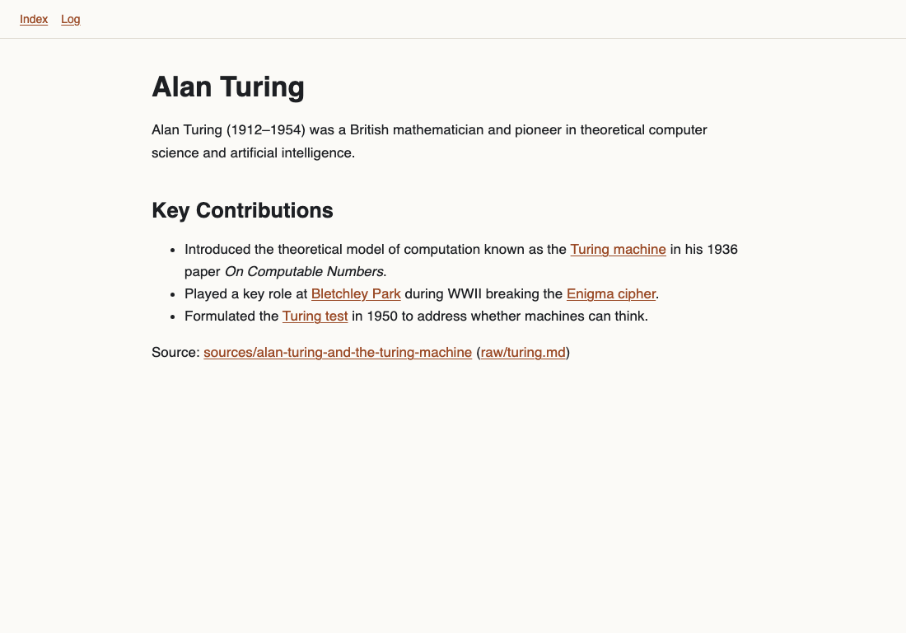
05 · Two formats
Markdown or HTML — per wiki.
markdown
html
wiki/entities/alan-turing.html
Page
wiki/<id>.md
wiki/<id>.html
Metadata
YAML frontmatter
JSON in the page head
Links
[[ada-lovelace]]
relative <a href>
Read in
Obsidian, editors, agents
any browser, offline
Chosen at ​init --format​ — required, never defaulted.
Same commands: the LLM writes frontmatter + body; the tool builds the HTML,
turns ​[[links]]​ into real links and disables scripts.
llm-wiki · user guide
27
Notes:
Choose the page format per wiki at init. Markdown suits Obsidian, editors and agents. HTML gives standalone pages with relative links, a shared stylesheet and scripts disabled. Ingest, query, search, lint and MCP work the same in both.

Slide 28
05 · Two formats
Convert a wiki; let Claude drive it.
convert
guide
skill
Markdown → HTML, in place
The manual, built in
A Claude skill
Ids, metadata and links survive; log, index and search are rebuilt. No LLM. The markdown is kept in a backup folder; a customised CLAUDE.md keeps your own sections.
llm-wiki guide prints eleven topics, with a command reference generated from the CLI itself; --json for tools.
pnpm skill:install installs it for Claude Code: Claude picks the wiki, uses --json and keeps to the guardrails.
$ llm-wiki --wiki notes convert --to html --dry-run # pages, unresolved links, schema plan
$ llm-wiki --wiki notes convert --to html # then: open ~/notes-wiki/wiki/index.html
llm-wiki · user guide
28
Notes:
convert turns a markdown wiki into an HTML wiki in place, without an LLM, keeping a backup. The built-in guide documents everything, and the Claude skill built from it lets Claude drive the tool.

Slide 29
Cheat sheet
Your documentation,
compiled.
llm-wiki init ~/notes --format markdown|html --name notes
llm-wiki --wiki notes ingest <file> # markdown, text, or PDF / DOCX via the parser model
llm-wiki --wiki notes search "<terms>" # --all-wikis · --mode hybrid after `index --embed`
llm-wiki --wiki notes query "<q>" --file # cited answer, filed · --wikis a,b to ask several
llm-wiki --wiki notes lint --llm # contradictions, gaps, next questions
llm-wiki --wiki notes convert --to html # make a markdown wiki browsable
llm-wiki guide · llm-wiki mcp # the manual · tools for your agent
github.com/BikS2013/llm-wiki
Pattern: Karpathy, LLM Wiki, 2026
Notes:
The whole workflow on one slide. Thank you.

