Slide 1
Text Mining & NLP TM Basics
Bikalpa Neupane, Ph.D

Slide 2


Slide 3

Warning: Twitter Profanity
Twitter demographics skew young and as a result have profanity that appear in the examples. “Keyboard Courage” is rampant.
It’s the easiest place to get a lot of messy text fast, if it is offensive feel free to talk to me and I will work to get you other texts for use on your own. No offense is intended.
#%@*!!!

Slide 4
Basic String Searching
Basic R Unix Commands
Setup
grepl returns a vector of T/F if the pattern is present at least once
grepl(“pattern”, searchable object, ignore.case=TRUE)
grep returns the position of the pattern in the document
grep(“pattern”, searchable object, ignore.case=TRUE)
“library(stringi)” Functions
stri_count counts the number of patterns in a document
stri_count(searchable object, fixed=“pattern”)

Slide 5

Coffee!! Open ﻿ ﻿A_Strings.R
Learning Outcome: Start working with strings and related functions.

Slide 6
How about some additional strings? Yippee!!
B_more_strings.R

Slide 7
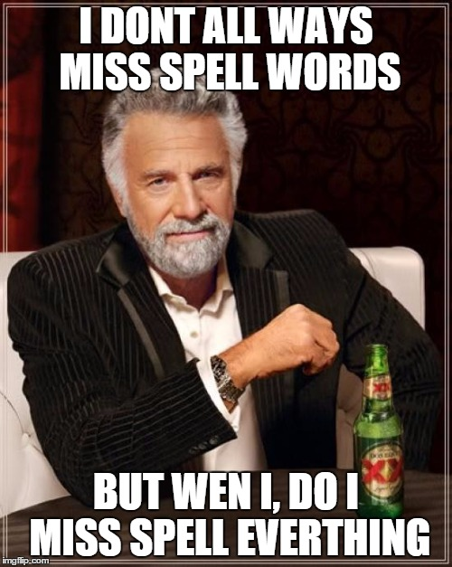
What about misspelling?
Prevalent
Painful to correct
Channel specific

Slide 8
R packages to deal with misspelling
library(qdap)
check_spelling(…)
check_spelling_interactive(…)
Crashes Rstudio.cloud!
Separate the words from a string into individual terms.
Look those words up in a dictionary to find words not recognized/found (considered possibly misspelled).
These misses (possible misspellings) will be what is looked up for suggested replacements and top “n” terms returns. It uses “string distance” the number of characters needed to change the unknown into the known word in the dictionary.

Slide 9
R packages to deal with misspelling
library(hunspell) #https://hunspell.github.io
hunspell_check(…)
hunspell_suggest(…)
hunspell_analyze(…)
Clunky to use!
Check the terms (doesn’t always catch the terms as well as qdap in my exp)
Identify the suggestions
No way to get suggestions easily corrected and inserted!
Same spelling engine used for Chrome/Firefox etc.

Slide 10
R packages to deal with misspelling
Library(spelling)
hunspell_check(…)
hunspell_suggest(…)
hunspell_analyze(…)
We will use in this course but pg 45 of the book has the qdap option
Check the terms
Identify the suggestions
Organize the suggestions into a lexicon
Use a global substitution (gsub) to correct identified misspellings
Still uses the benefit of hunspell but is easier to interact with.

Slide 11
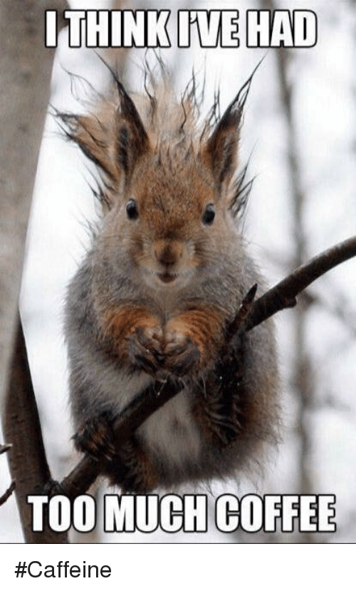
Too much coffee! Open ﻿C_spellCheck.R
Learning Outcome: Identify and correct misspelled words in a text vector.

