Slide 1
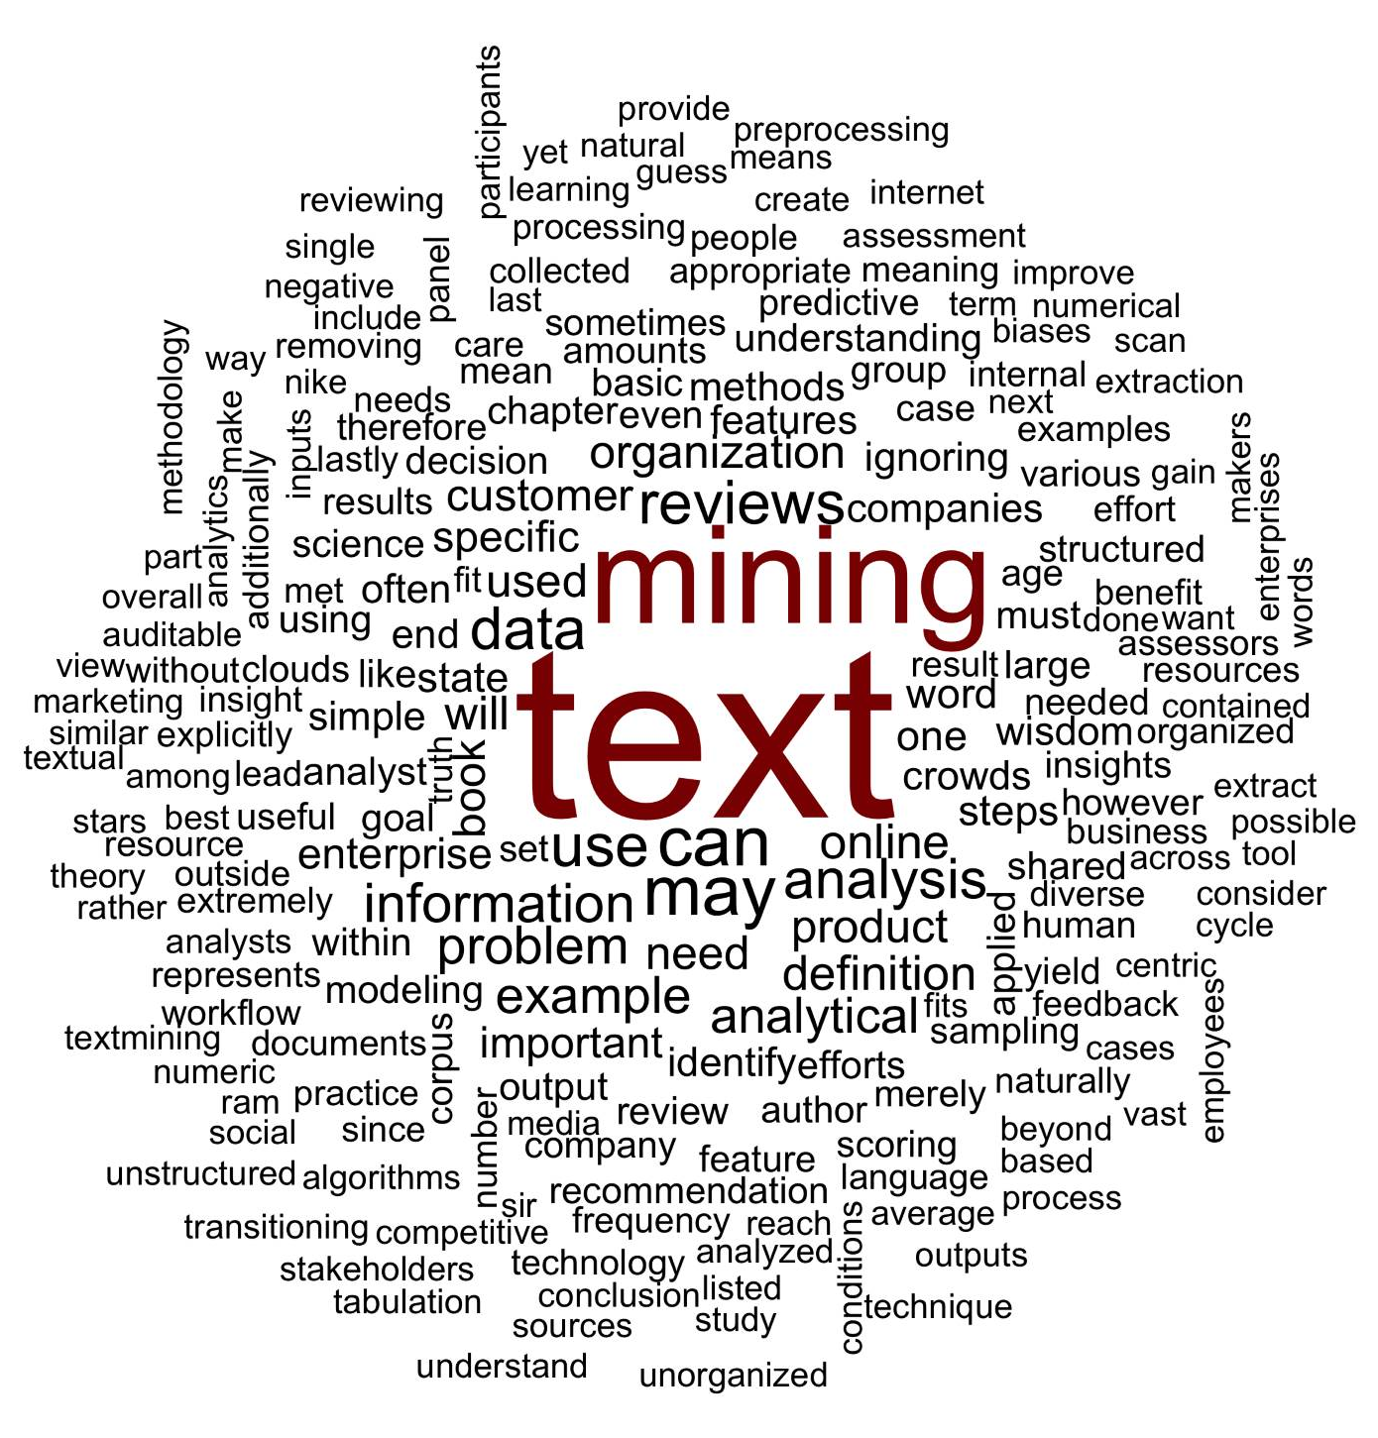
What is a word cloud?
Maligned and overused, a word cloud is a frequency visualization.

Slide 2

Unigram Tokenization
Thus far, we have performed unigram tokenization of terms.
“Text mining is so fun. So do text mining!
*with common stopwords

Slide 3

Changing Tokenization Schema
First create a function defining tokenization then add as a control parameter to TDM or DTM.
Within R
#bigram token maker
bigramTokens <-function(x)
unlist(lapply(NLP::ngrams(words(x), 2), paste, collapse = " "), use.names = FALSE)
wineTDM<-TermDocumentMatrix(txtCorpus, control=list(tokenize=bigramTokens))

Slide 4
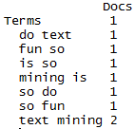
Tokenization is the process of chopping up a string into predefined units called tokens.
Now the TDM has two terms instead of one.
“Text mining is so fun. So do text mining!
#bigram token maker
bigramTokens <-function(x)
unlist(lapply(NLP::ngrams(words(x), 2), paste, collapse = " "), use.names = FALSE)
wineTDM<-TermDocumentMatrix(txtCorpus, control=list(tokenize=bigramTokens))

Slide 5
To make a wordcloud start with a WFM
# Get Row Sums & organize
wineTDMv <- sort(rowSums(wineTDMm), decreasing = TRUE)
wineDF <- data.frame(word = names(wineTDMv), freq = wineTDMv)
Term Document Matrix
Word Freq Matrix
 | Tweet1 | Tweet2 | Tweet3 | Tweet4 | … | Tweet_n
Term1 | 0 | 0 | 0 | 0 | 0 | 0
Term2 | 1 | 1 | 0 | 0 | 0 | 0
Term3 | 1 | 0 | 0 | 2 | 0 | 0
… | 0 | 0 | 3 | 0 | 1 | 1
Term_n | 0 | 0 | 0 | 1 | 1 | 0
word | freq
Term1 | 1
Term2 | 2
Term3 | 3
… | 5
Term_n | 2

Slide 6
Then sort it decreasing = TRUE
# Get Row Sums & organize
wineTDMv <- sort(rowSums(wineTDMm), decreasing = TRUE)
wineDF <- data.frame(word = names(wineTDMv), freq = wineTDMv)
word | freq
Term1 | 1
Term2 | 2
Term3 | 3
… | 5
Term_n | 2
word | freq
… | 5
Term3 | 3
Term2 | 2
Term_n | 2
Term1 | 1

Slide 7
Setting a pre-made color palette for your WC
# Review all Pallettes
display.brewer.all()
# Choose a color & drop light ones
pal <- brewer.pal(8, "Blues")
pal <- pal[-(1:2)]

Slide 8
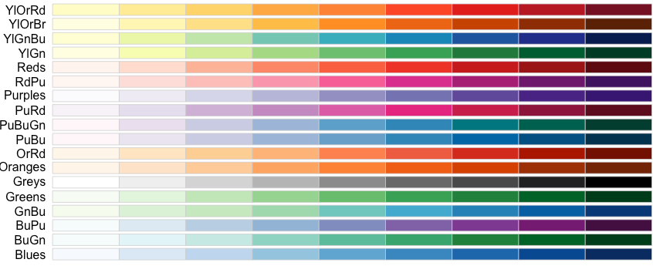
Setting a pre-made color palette for your WC
In R…

Slide 9
Let’s practice!
D_SimpleWordCloud.R

Slide 10
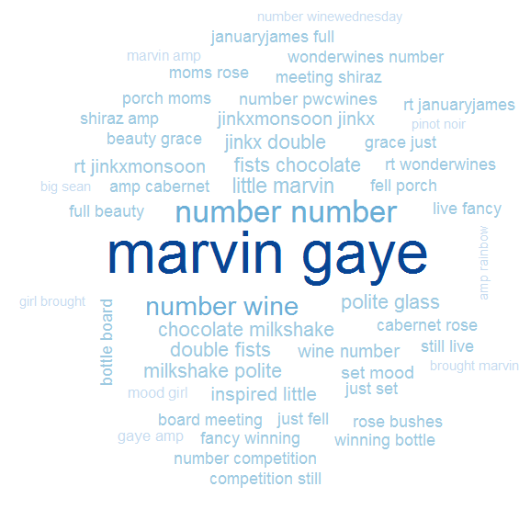
D_SimpleWordCloud.R
Bigram Tokenization has captured “marvin gaye”
A word cloud is a frequency visualization. The larger the term (or bigram here) the more frequent the term.
You may get warnings if certain tokens are to large to be plotted in the graphics device.
Be careful with your preprocessing steps!

Slide 11
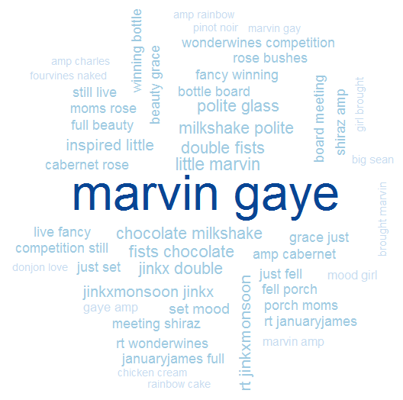
D_SimpleWordCloud.R
In cleanCorpus() the function replace_symbol() changes numeric with the generic string “number” so be careful with your preprocessing steps!

Slide 12
Another WC package
E_d3_wordcloud.R

Slide 13
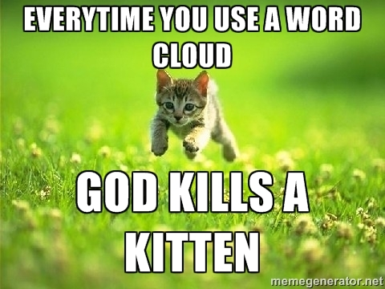
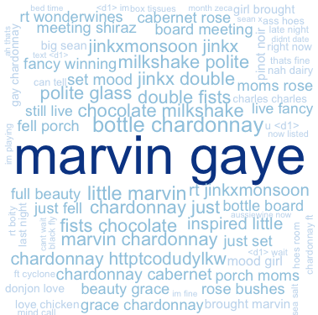
WCs are boring with a single corpus.
Single Corpus
wordcloud( )

Slide 14
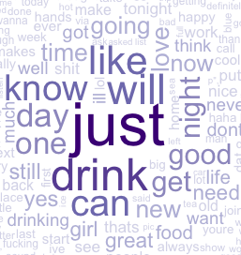
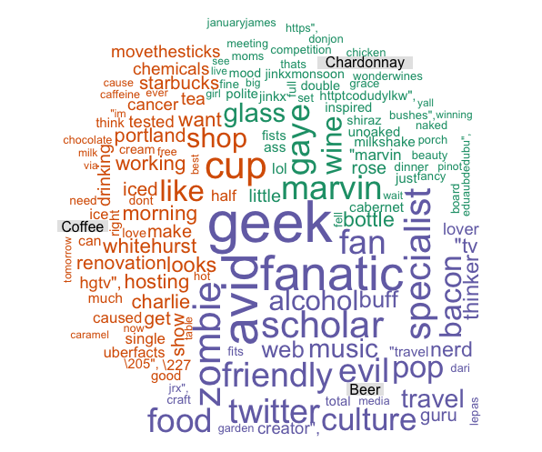
With 2+ Corpora, WCs are more insightful
Multiple Corpora
comparison.cloud( )
commonality.cloud( )
comparison.cloud( )
comparison.cloud( )

Slide 15
Dealing with many text files is tricky.
Option 1
# Read in multiple files as individuals; list.files(); dir()
txtFiles <- c('chardonnay.csv','coffee.csv','beer.csv')
for (i in 1:length(txtFiles)){
assign(txtFiles[i], read.csv(txtFiles[i]))
cat(paste('read completed:',txtFiles[i],'\n'))
}
Using a loop each file is an individual object.

Slide 16
Dealing with many text files is tricky.
Option 2
# Read in multiple files as individuals; list.files(); dir()
txtFiles <- c('chardonnay.csv','coffee.csv','beer.csv')
# Read them into a single list with individual elements
allDocs <- pblapply(txtFiles,read.csv)
With lapply functions each document is a list element of a single object.

Slide 17
Out 3 Documents as a single list object
allDocs <- pblapply(txtFiles,read.csv)
allDocs
chardonnay.csv
coffee.csv
beer.csv

Slide 18

Out 3 Documents as a single list object
allDocs <- pblapply(txtFiles,read.csv)
allDocs
chardonnay – 1000 Tweets
chardonnay.csv
cofee – 1000 Tweets
coffee.csv
beer – 1000 Tweets
beer.csv

Slide 19
Multiple Document Collections as a single list object
allDocs <- pblapply(txtFiles,read.csv)
allDocs
allDocs[[1]]
chardonnay.csv
allDocs[[2]]
coffee.csv
allDocs[[3]]
beer.csv

Slide 20
Each list “element” is a data frame
allDocs <- pblapply(txtFiles,read.csv)
allDocs
allDocs[[1]]
chardonnay.csv
allDocs[[1]]$text
allDocs[[1]]$doc_id
allDocs[[1]][,2]
allDocs[[2]]
coffee.csv
allDocs[[3]]
beer.csv

Slide 21
Manipulating multiple corpora
Combined/Collapsed
into a 2 document corpus
CorpusA – 1000 Tweets
Clean & Collapse
CorpusB – 1000 Tweets
Clean & Collapse
When you collapse, all the information for a subject is considered one document.

Slide 22
Manipulating multiple corpora
Combined/Collapsed
into a 2 document corpus
chardonnay – 1000 Tweets
Clean & Collapse
beer – 1000 Tweets
Clean & Collapse
We now have 2 documents, not 2000. Document 1 is everything we know about chardonnay and document 2 is everything we know about beer.

Slide 23
The new WC will examine inner and disjoins
The collapses documents can be examined using set theory. “inner join”, “outer join”

Slide 24
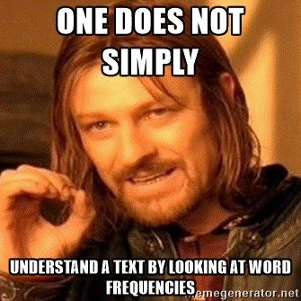
Lets make some improved word clouds
F_CommonalityCloud.R

Slide 25
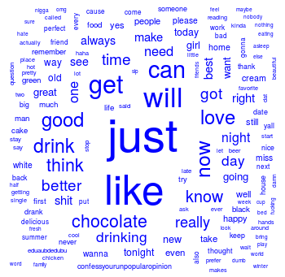
What tokens are in common?

Slide 26
Introducing TF-IDF Term Frequency Inverse Document Frequency
So far, you have used simple term frequency to identify informative words. Chardonnay is highly frequent in the tweets, but since it appears in all documents it isn’t informative.
Term frequency * inverse-document-frequency
If a term appears often, it must be important to the corpus.
But, if a term appear in many documents, it can’t be distinctive or informative
Increasing
importance
Offsetting
importance

Slide 27
The TF of TF-IDF
Term Frequency isn’t just a count. It is normalized because unique terms will naturally increase the longer the document.
Term frequency = Term Occurrence / total unique terms in a document

Slide 28
Inverse Document Frequency
IDF is the natural log of total documents divided by the number of documents containing a specific token.
Inverse Document Frequency =
log(total documents in corpus) / number of documents with term in it
Notes:
Pg 101 in book has explanation

Slide 29
Original Term Frequency
In 1000 documents suppose token “coffee” occurs 1000 times
TF = 1000

Slide 30
TF-IDF Simple Example
Coffee TF = 1000 will look VERY important but TFIDF = 0.69 will correctly have minimal impact for analysis.
In 1000 documents each of 10 words suppose token “coffee” occurs 1000 times
TF = 1000 / 10 #normalizes to doc length
TF = 100
IDF = log(1000) / 1000
IDF = 6.90 /1000
IDF = .0069
*Caveat – the results in R are normalized/scaled by default.
TF-IDF = 100 * .0069
TF-IDF = .69

Slide 31
Applying TF-IDF to a DTM/TDM
You can pass in more than one control parameter like tokenization & weighting.
# Control Paramter
ctrl <- list(weighting = weightTfIdf)
# Apply in TDM/DTM construction
drinkTDM <- TermDocumentMatrix(allDrinks, control = ctrl)
# Change to a simple matrix
drinkTDMm <- as.matrix(drinkTDM)

Slide 32
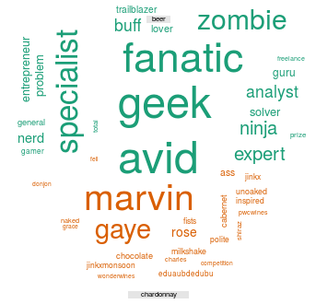
What tokens are in not in common (disjoint)?

Slide 33
What about proportional similarities?
The problem is that if corpusA has 1 instance & corpus has 1000 they appear as shared.

Slide 34
What about disjoint tokens?
G_ComparisonCloud.R

