Slide 1
Solar Power Plant Performance & Fault Analysis Project
-Bikalpa Regmi
-Nasib Bartaula

Slide 2
Executive Summary
- This report analyzes performance, fault, risk, efficiency and impact of environment on solar power plant data. Solar plant performance is primarily influenced by time-based patterns, fault occurrences, and environmental conditions.
- The core objective of this report is to help identify underperforming solar units and assist in predicting fault-prone conditions. To support data-driven maintenance and operational decisions the project use EDA tools such as Pandas, SQL and BI tool PowerBI.

Slide 3
Key Findings
There are total of 68 fault panels and 2 of them probably are on verge of being damaged.
The conversion of DC to AC power is strongly efficient.
The faults occurs mainly on peak afternoon (12pm-3pm).
The performance ratio stayed average around 20-25% throughout month.
The performance peaked at peak afternoon at 11pm-1pm.
The module temperature and performance were highly correlated.
The overall DC_Power and Performance performed well in high irridation despite some panel being fault.

Slide 4
Data Overview
Source of data: Solar Power Generation Data
(https://www.kaggle.com/datasets/anikannal/solar-power-generation-data?select=Plant_1_Weather_Sensor_Data.csv)
Source of PDF: Huawei SUN2000 for Scraping
(https://solar.huawei.com/download?p=%2F-%2Fmedia%2FSolarV4%2Fsolar-version2%2Fmiddle-east-africa%2Fma%2Fprofessionals%2Fall-products%2FUtility-Smart-PV%2Fsmart-pv-controller%2FSUN2000-200KTL-H2%2FSUN2000-200KTL-H2-Datasheet-20230822.pdf)

Slide 5
Data Overview
Key Columns -: DATE_TIME, SOURCE_KEY_x, DC_POWER, AC_POWER, DAILY_YIELD, TOTAL_YIELD, AMBIENT_TEMPERATURE, MODULE_TEMPERATURE, IRRADIATION, isfault, fault_severity, Performance_Ratio
Tools Used -:
Python [Data preprocessing, EDA, PDF Scraping, Derived new Columns, Co-Relation analysis]
SQL [Data Query, Data Exploration]
PowerBI [Interactive Dashboards]

Slide 6
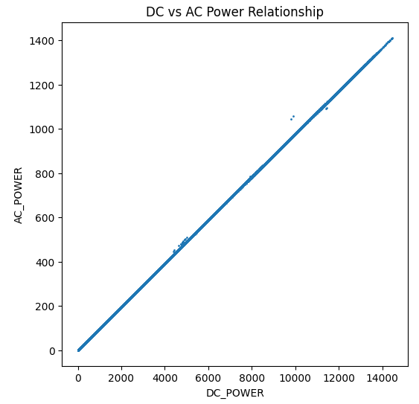
AC vs DC Power Relation
It was observed that the AC and DC power were highly co-related.
Although there lied some of inconsistency, but we can easily say
that both of the values were majorly dependent to each other.

Slide 7
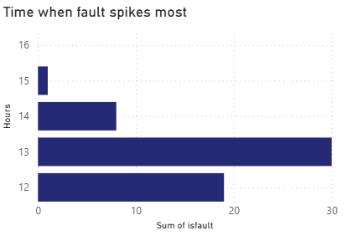
Fault and Risk
The faults means the condition when does DC not produce power even on high presence of sun.
All of the faults occurred between 12pm-3pm. There is the probability that panel didn’t function properly due to some seasonal imbalance.

Slide 8
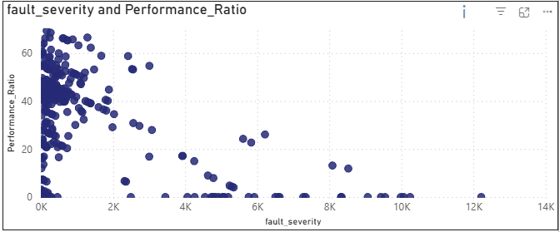
Fault_Severity & Performance
The fault severity mainly occurred on low performance ratio. The fault severity means the difference between irridation*10k and DC. The high the value, the high the severity of faultiness.

Slide 9
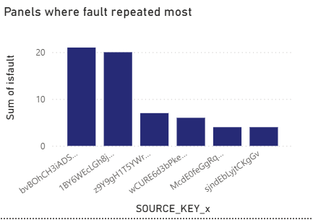
Faulty Panels
It was found 6 panels where the faults were repeated most, there is the high possibility that there are some defectiveness in these panels. Specially, in peak afternoon these panel malfunctions meaning these panels are sensitive to high irridation.

Slide 10
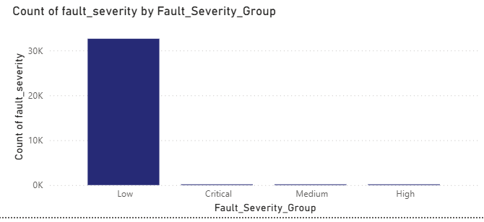
Fault Severity
The Group were divided based on the severity values. Low denotes the severity being less than 1k. Medium being less than 3k and greater than 1k. High being greater than 3k and less than 5k. Greater than 5k were declared critical. It was observed 58 of panels were critically fault. 34 mediumly fault and 20 highlt fault. Majority of panels were on low faultiness.

Slide 11
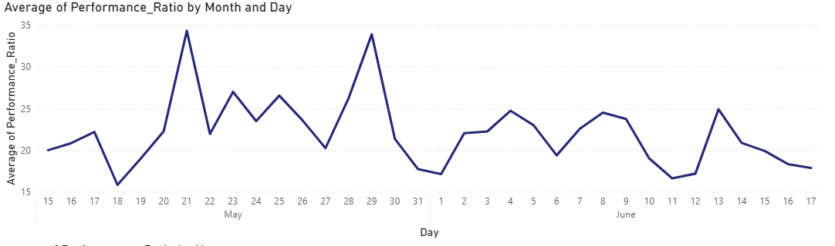
Performance ratio
The performance were derived by dividing each AC_POWER by max ac power. The Performance peaked at 21 may after its all time low at 18 may. We can say that the Performance_Ratio highly depends upon irridation and ambient_temperature.

Slide 12
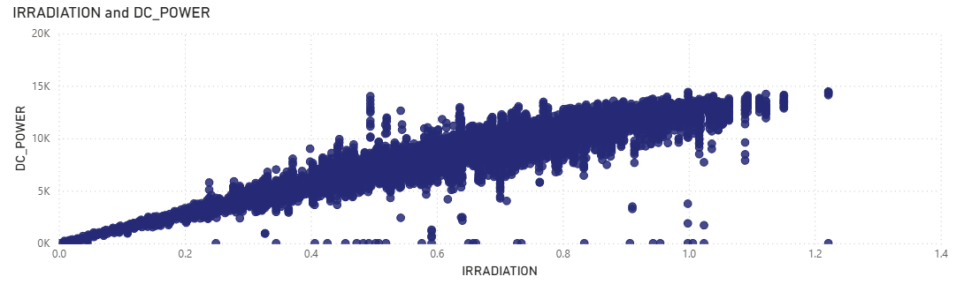
Irridation & dc power relation
The maximum power DC can generate is 15k no matter how high the irradiation be. The chart shows consistent behavior of relation between IRRADIATION and DC_POWER. Although there lies some faults majority of this relation is consistence.

Slide 13
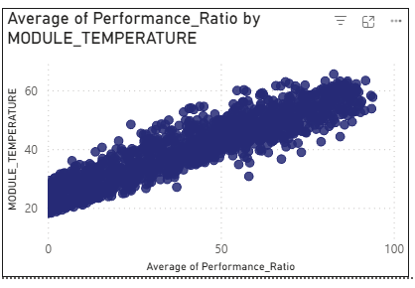
Environment impact
The Module temperature and performance are highly correlated almost no faults. It means the higher the module_temperature, higher the performance.

Slide 14
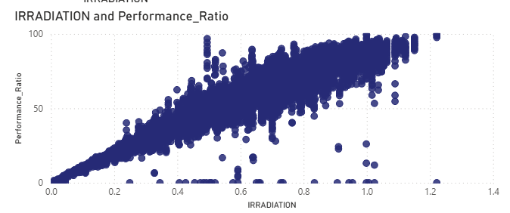
Environment impact
Although high irradiation and performance shows strong correlations, there also lies little bit of inconsistency meaning high irradiation can also some times result in less performance.

Slide 15
Recommendation
Repairment or replacement of source keys.
Monitor underperforming source keys regularly.
Schedule maintenance during high fault-prone period.
Use irradiation trends to optimize power generation timing.
Leverage environmental data for better operational planning

Slide 16
Conclusion
This project successfully analyzes solar plant performance, identifying key inefficiencies related to power loss, fault patterns, and environmental conditions. The insights highlight opportunities to improve efficiency and reduce operational issues. The dashboard enables clear, data-driven monitoring and decision-making. This work can be further extended using machine learning for predictive analysis.

