Slide 1
Identify and prioritize the farmers’ problems by using PRA/RRA
Conducting PRA Exercises
Step 1: Community Engagement
Initial Meetings: Hold meetings to explain the purpose of the PRA and gain community buy-in. Emphasize that their input is crucial for identifying problems.
Step 2: Data Collection Techniques
Utilize various participatory tools to gather information:
Social Mapping: Create maps that illustrate community resources, land use, and social structures. This helps visualize relationships and identify key areas of concern.
Transect Walks: Conduct walks through different areas of the community to observe land use, resource availability, and environmental conditions while discussing issues with farmers.
Focus Group Discussions: Organize discussions among different groups (e.g., women farmers, youth) to explore specific challenges they face in agriculture.
Problem Ranking: Use matrix scoring or ranking exercises where participants list problems and prioritize them based on severity and impact on their livelihoods

Slide 2
Step 3: Analysis and Reflection
Data Compilation: Gather all findings from mapping, discussions, and ranking exercises. Summarize key issues identified by the community.
Validation Meetings: Present findings back to the community for validation. This ensures that the identified problems accurately reflect their concerns.
Step 4: Prioritization
Consensus Building: Facilitate discussions to reach consensus on which problems are most critical. Use criteria such as urgency, impact on food security, or economic viability for prioritization.
Action Planning: Collaboratively develop action plans that outline potential solutions for the prioritized problems. Assign responsibilities for implementation within the community.

Slide 3
Post-Exercise Follow-up
Documentation: Record all findings, discussions, and action plans in a report that can be shared with stakeholders and used for future reference.
2. Capacity Building: Provide training sessions for community members on problem-solving techniques and project implementation to empower them further in managing their development initiatives

Slide 4
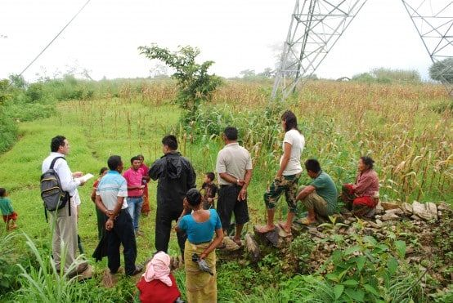
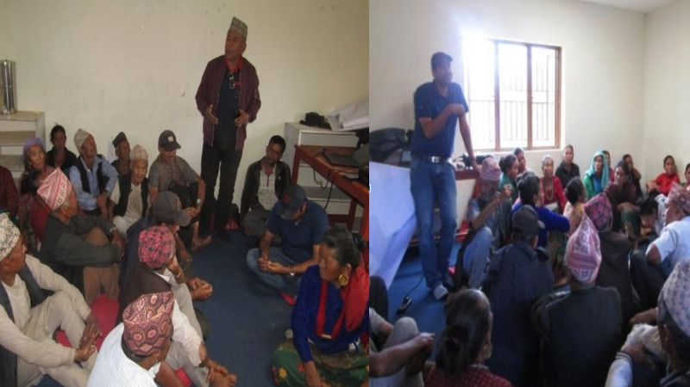

Slide 5


Slide 6
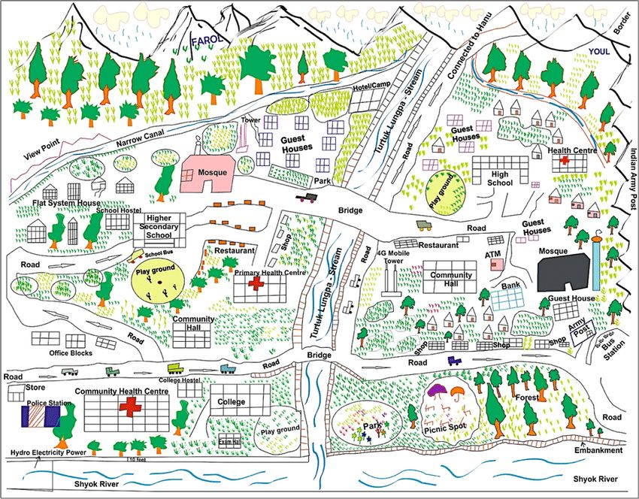

Slide 7
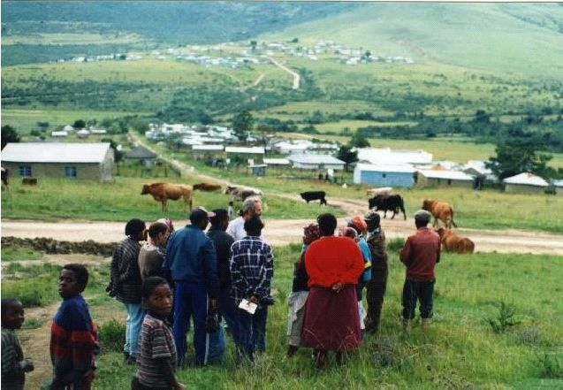
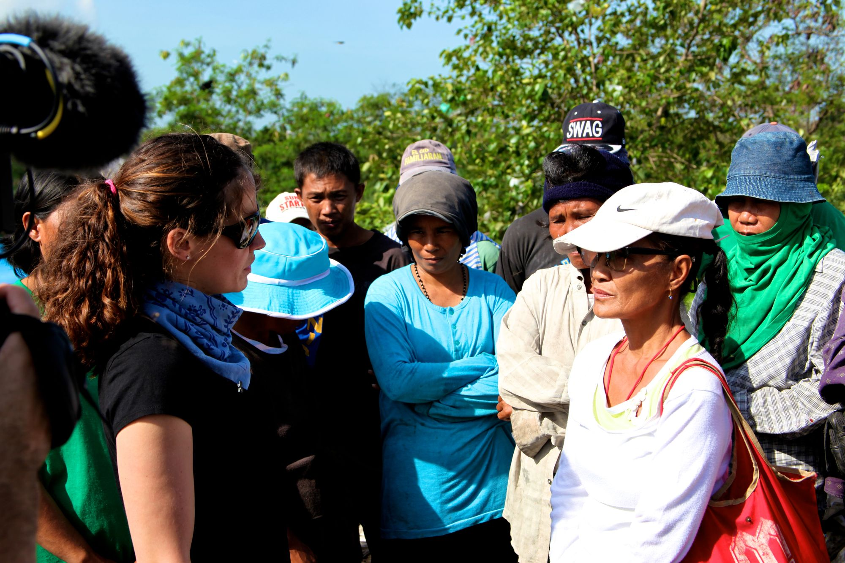

Slide 8
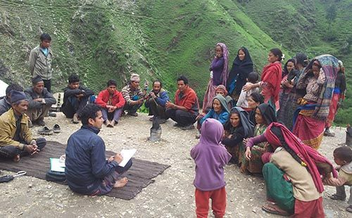
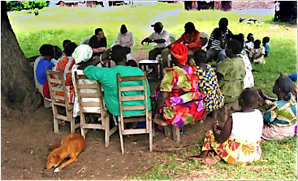

Slide 9
https://sfna.org.my/archives/2sfna2022/2sfna2022-67-73.pdf
https://faer.com.my/archive/2faer2022/2faer2022-55-59.pdf

