Slide 1
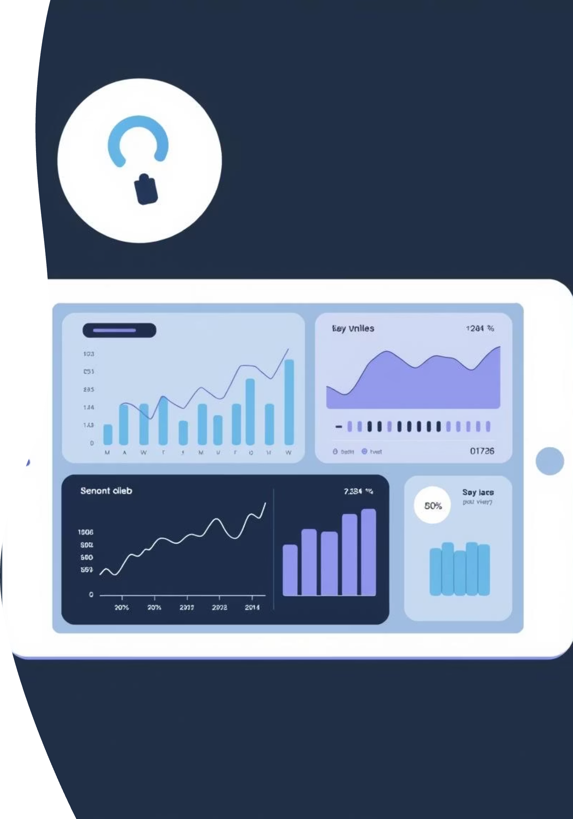
Power BI
Banking Dashboard

Slide 2
About the Project
This project features a comprehensive banking dashboard built with Power BI, leveraging a rich banking dataset. Our analysis focuses on key financial dimensions:
Loan Analysis: Deep dive into loan portfolios, identifying trends and risk factors.
Deposit Analysis: Examination of deposit behaviors and liquidity insights.
Overall Summary: A concise overview of the entire dataset, highlighting crucial KPIs for strategic decision-making.

Slide 3
Key Performance Indicators
188
$18.26K
$135
Total Clients
Total Engaged Accounts
Total CC Accounts
Our client base represents a diverse portfolio of individuals and businesses.
Revenue from actively engaged client accounts, reflecting client loyalty and product utilization.
Number of active credit card accounts, indicating market penetration and credit portfolio size.
These core metrics provide a snapshot of our operational scale and client engagement.

Slide 4
Achieving Financial Goals
$139.9M
$111.49M
$5.17M
Total Loan Portfolio
Total Deposits Held
Total Fees Generated
Our extensive loan book supports diverse client needs, driving economic growth.
Reflecting strong client trust and robust liquidity management.
Revenue from banking services, enhancing profitability and sustainable growth.
These figures underscore the bank's significant role in financial intermediation and value creation.

Slide 5
Bank's Core Financials
$55.5M
$60.18M
$83.52M
Bank Loan
Bank Deposit
Business Lending
The current volume of our bank's active loans, reflecting our lending reach across various sectors and client segments.
Total customer deposits held, demonstrating the trust clients place in our institution for their financial holdings.
Dedicated lending to businesses, supporting entrepreneurial ventures and economic development.
These numbers highlight the fundamental pillars of our banking operations, showcasing both asset deployment and funding base.

Slide 6
Account Insights
Checking Account Balance (in Millions)
Foreign Currency Amount (in Millions)
19.85
2.71
Our checking accounts reflect the daily transaction volume and liquidity preferences of our clients, indicating active engagement with our services.
Significant foreign currency holdings demonstrate our capabilities in international banking and support for global trade and investments.

Slide 7

$2.71M
FOREIGN CURRENCY AMOUNT
This substantial figure in foreign currency highlights our robust international banking operations and diversified asset portfolio, catering to global financial needs and transactions.

Slide 8

Loan Portfolio by Income Segment
Bank loan distribution segmented by client income bands provides critical insights into our lending strategy and market targeting.
Key Observation:
Bank loan volume is highest for the Mid Income band, indicating strong demand and successful targeting within this segment.
Conversely, loan volume is lowest for the High Income band, suggesting different financial behaviors or competitive landscape in this segment.

Slide 9
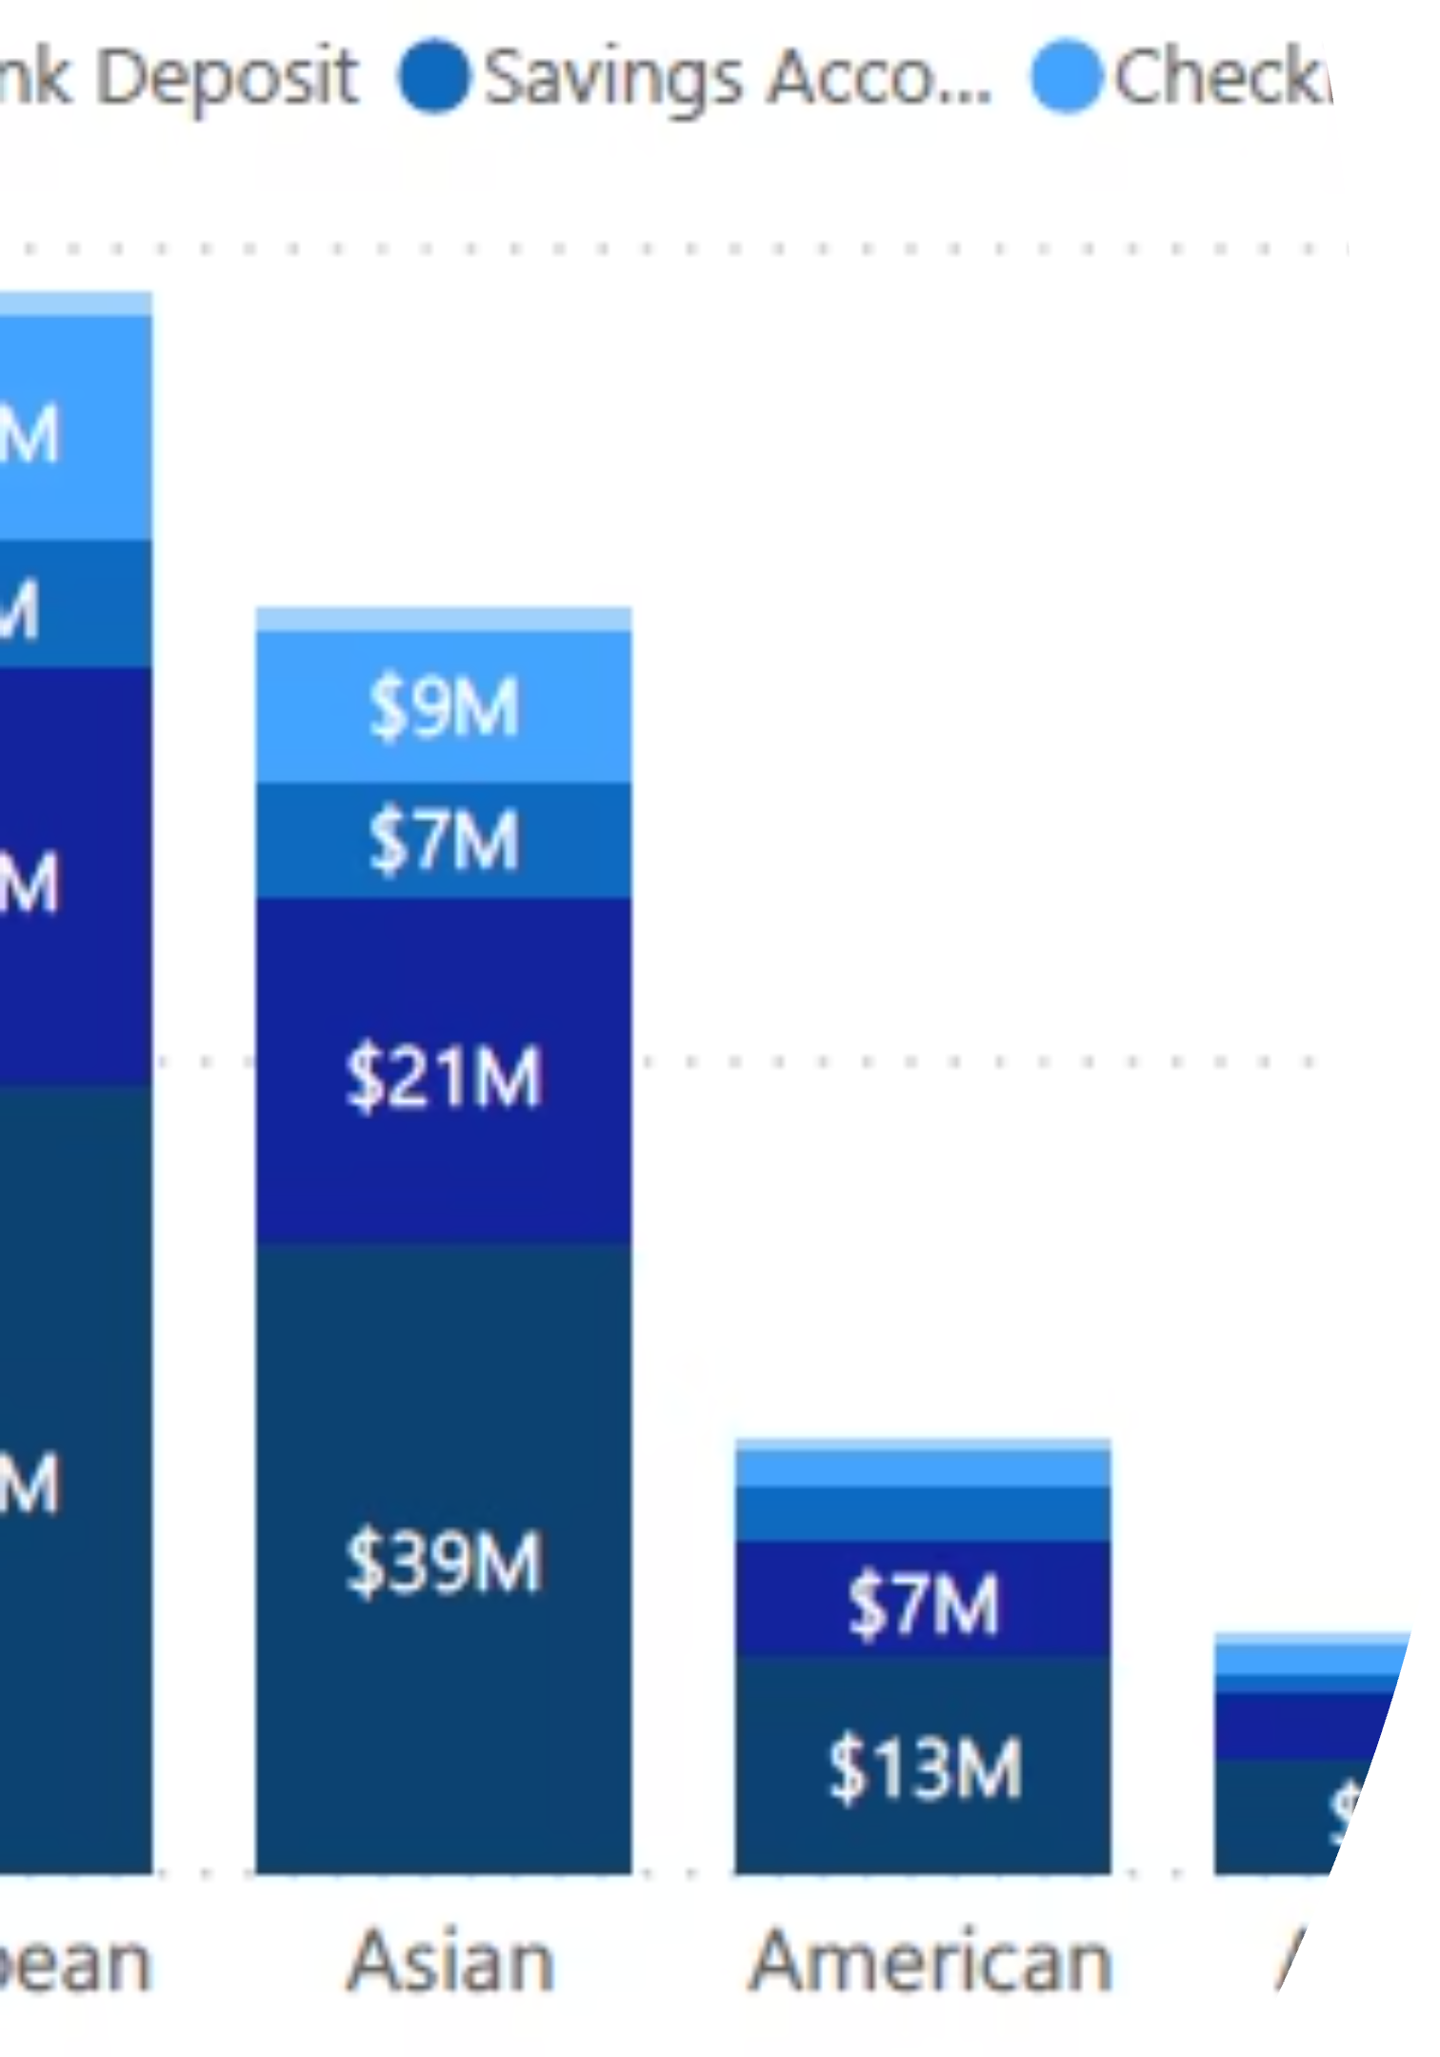
Regional Loan Distribution
An analysis of bank loan features across various geographic regions provides a global perspective on our lending activities.
Regional Insights:
The highest concentration of loan features is in European countries, followed closely by Asian countries, reflecting robust economic activity and market presence.
In contrast, the lowest loan feature presence is in Australian countries, with African countries also showing lower volumes, indicating areas for potential market development or differing lending environments.

Slide 10

Bank Loan by Nationality
Examining bank loan distribution by client nationality offers insights into diverse client segments and international lending patterns.
Nationalities Impacting Loan Volume:
Bank loan volume is highest for European countries, underscoring strong business and personal ties with the region.
Conversely, loan volume is lowest for Australian countries, pointing to specific market dynamics or less engagement from this demographic.

