Slide 1

Credit Card Delinquency Predictor
Presented by : Bikash Nath
AI-Powered Risk Assessment System
Corporate Analytics Dashboard Presentation

Slide 2
Agenda
• Business Problem
• Solution Overview
• Machine Learning Approach
• Dashboard Walkthrough
• Key Insights
• Business Impact

Slide 3
Business Problem
Traditional credit risk assessment is reactive and manual.
Financial institutions require:
• Early delinquency detection
• Risk-based customer segmentation
• Actionable insights for decision-making

Slide 4
Proposed Solution
An AI-powered system that predicts credit card delinquency risk.
Key Capabilities:
• Automated risk classification
• Interactive dashboards
• High-priority customer alerts

Slide 5
System Architecture
1. Customer Data Upload (CSV / Excel)
2. Data Preprocessing & Scaling
3. Machine Learning Prediction
4. Risk Categorization
5. Visual Analytics & Reporting

Slide 6
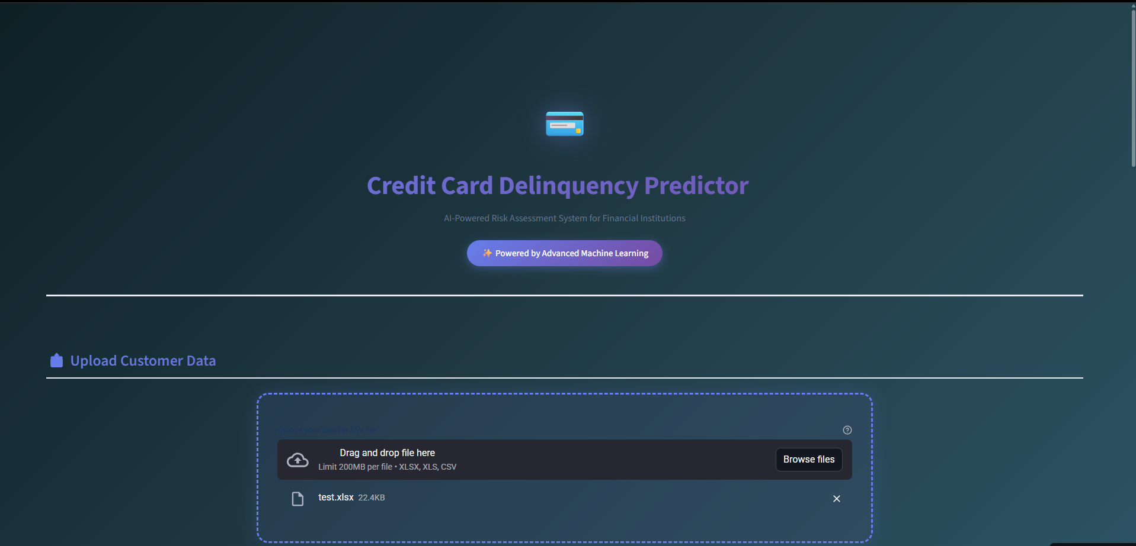
Application Dashboard Overview

Slide 7
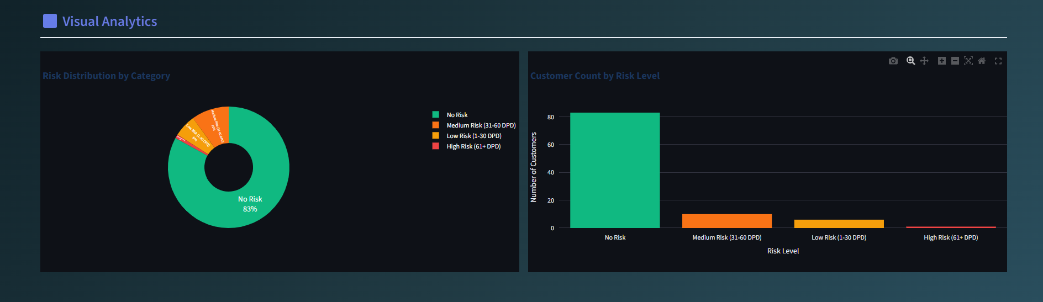
Visual Analytics – Risk Distribution

Slide 8
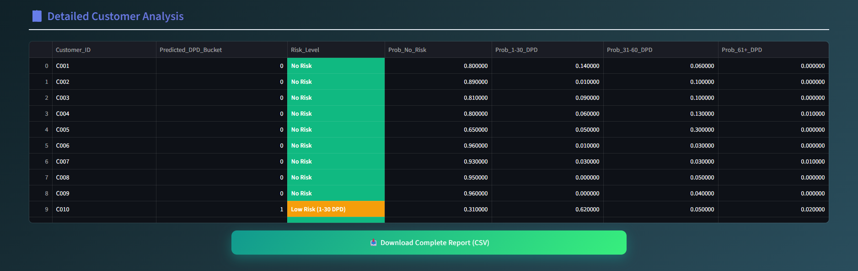
Detailed Customer Risk Analysis

Slide 9
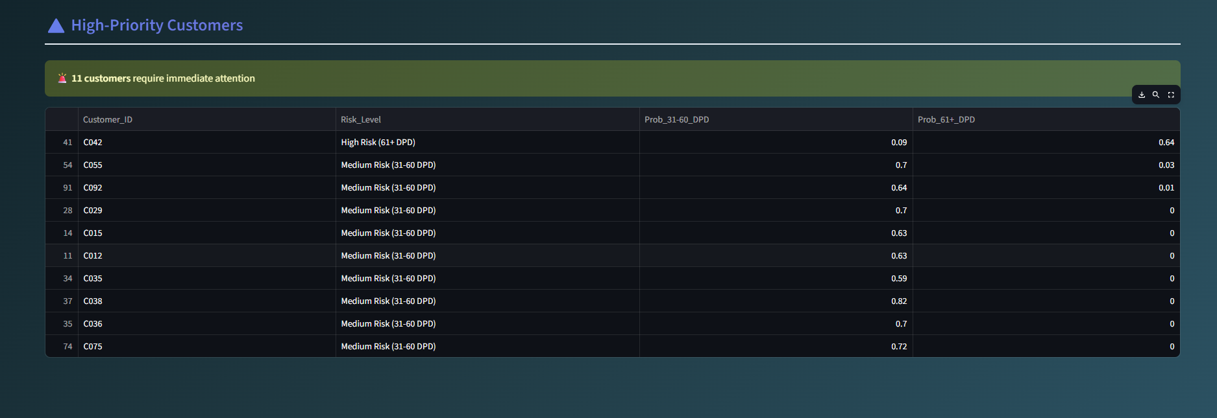
High Priority Customer Identification

Slide 10
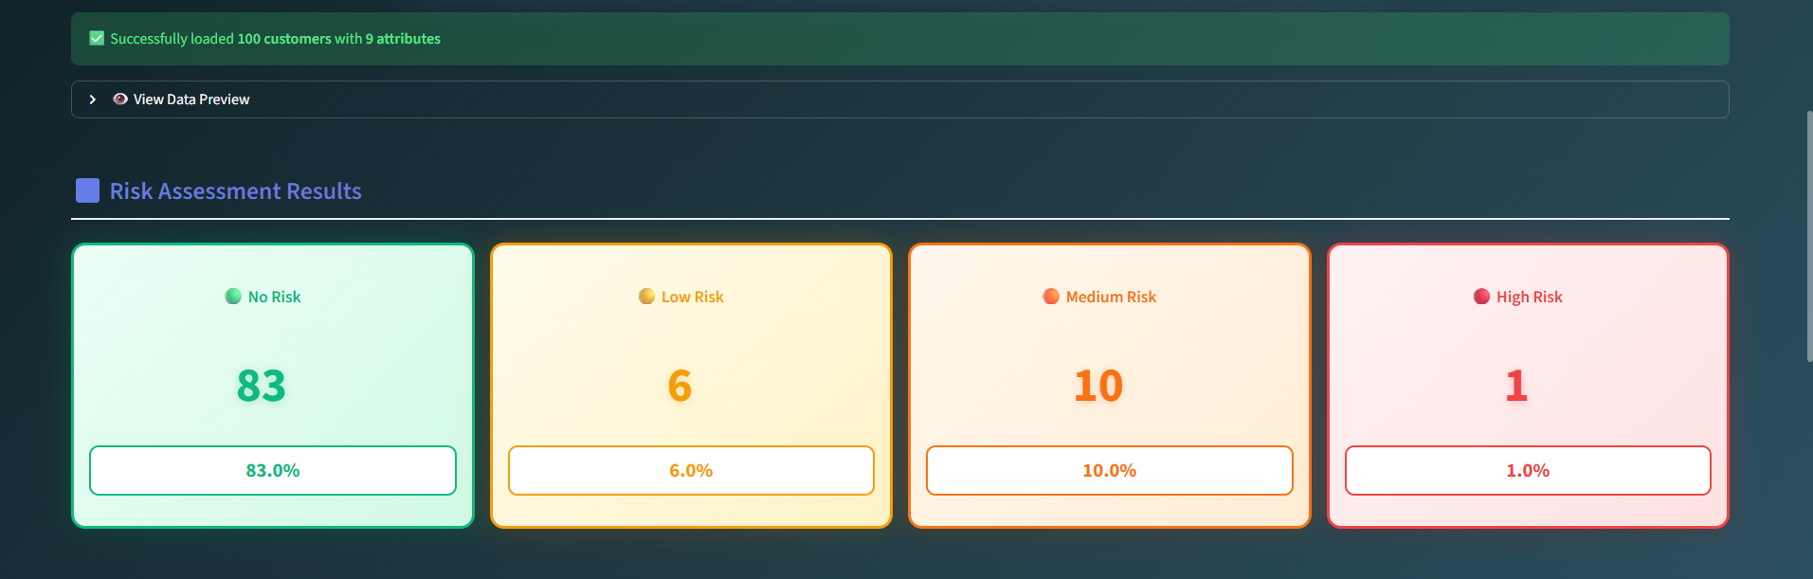
Risk Assessment Summary Cards

Slide 11

Key Business Insights
• 83% customers classified as No Risk
• 17% customers require monitoring
• 11 customers flagged as high priority
• Enables proactive risk mitigation

Slide 12
Business Impact
• Reduced default probability
• Improved portfolio health
• Faster credit decision cycles
• Scalable for enterprise deployment

Slide 13
Conclusion & Next Steps
The solution demonstrates effective AI-driven credit risk prediction.
Next Steps:
• Real-time API integration
• Model retraining with live data
• Enterprise banking system integration

Slide 14

Thank You
Questions & Discussion
Presented by: Bikash Nath
Demo - https://c6xmscjrxzuugtjs78eezo.streamlit.app/

