Slide 1
AWS

Slide 2
What is Cloud Computing?
-->Cloud Computing is the on-demand delivery of IT resources (Compute, Storage, Applications) through a cloud services platform(AWS) via the internet with pay-as-you go pricing.
-->Accessing IT resources provided by cloud provider(AWS) through web.
-->Three key words
1)On-Demand
2)Scalable
3)Pay only for the capacity you use.

Slide 3
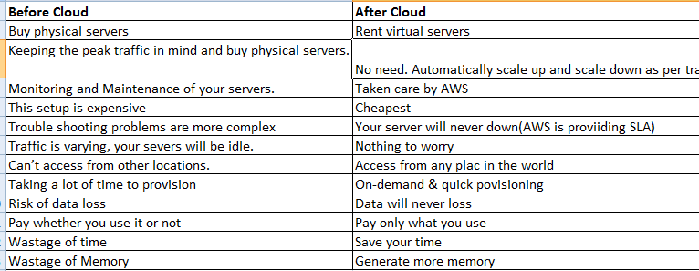

Slide 4
Why AWS:
→31% market share
→Flexible pricing
EC2:
→EC2 stands for Elastic compute cloud
Elastic:
→Increase the configuration and decrease the configuration
Compute:
→Instance is nothing but server. You launch computers.
Cloud:
→You are working on cloud
EC2:
→EC2 is a webservice that provides resizable compute capacity in the cloud.
→Ec2 is reduces the time to launch new server instances in minutes allowing you to quickly scale capacity both up and down.

Slide 5
1)Steps to launch the instance
1)Select an OS
Choose an Amazon machine image(AMI)
2)Choose an instance type
3)Configure instance details.(here no of instances we are selecting)
4)Add storage
5)Add tags
6)Configure security groups
7)Review and launch
(here we have to select keypair for logging into instance)
Note:
User name: ec2-user
Pwd: password can be given as .pem(text format)
→We are logging into the system by using putty. Putty have only .ppk format.
→We have to convert .pem to .ppk format
Why we have to convert pem to ppk key?
PuTTY doesn't natively support the private key format (.pem) generated by Amazon EC2. You must convert your private key into a .ppk file before you can connect to your instance using PuTTY. You can use the Putty-gen tool for this conversion.

Slide 6
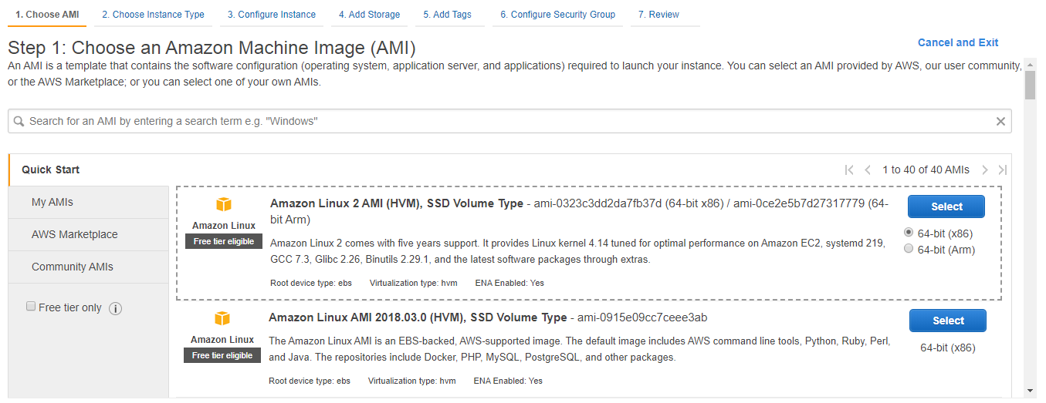
Step1) Choose an Amazon machine image
-->Amazon machine image is a packaged environment contains software configuration.
-->Configurations` contains operating system as well.
Step2)Choose an instance type
--> Instance Types comprise various combinations of CPU, memory, storage, and networking capacity.
-->Types of AWS instances

Slide 7
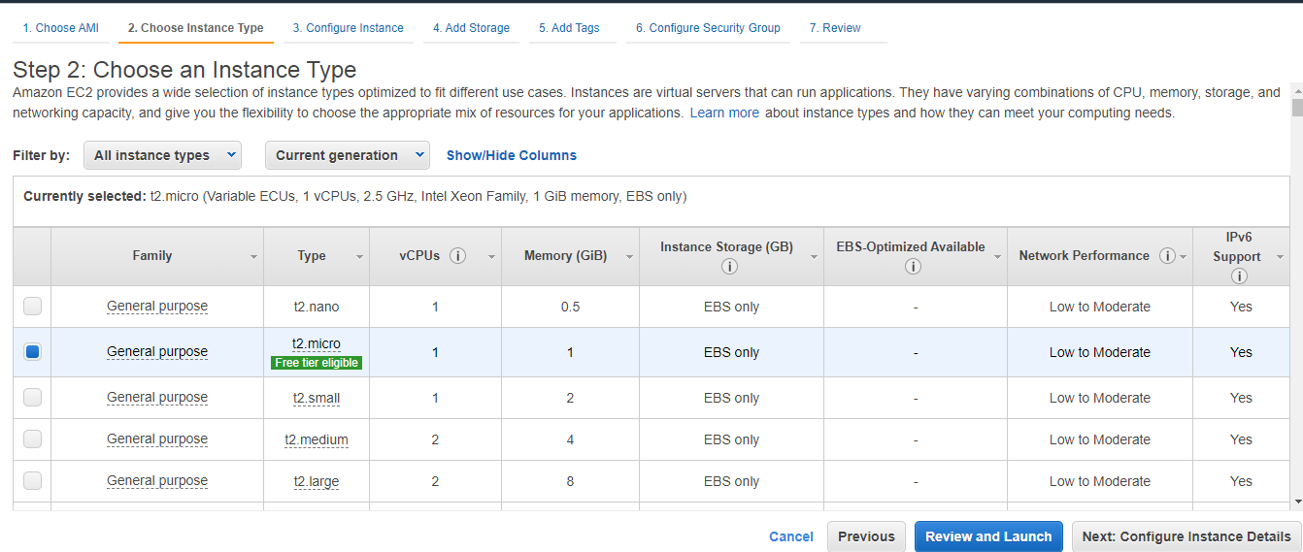
Here are AWS EC2 Instance Types:
1)General Purpose Instances - T2, M5, M4, M3.
2)Computer Optimized Instances - C5, C4, C3.
3)Memory Optimized Instances - X1, R4, R3.
4)Accelerated Computing Instances - P3, P2, G3, F1.
5)Storage Optimized Instances - I3.
6)Dense Storage Instances - D2

Slide 8
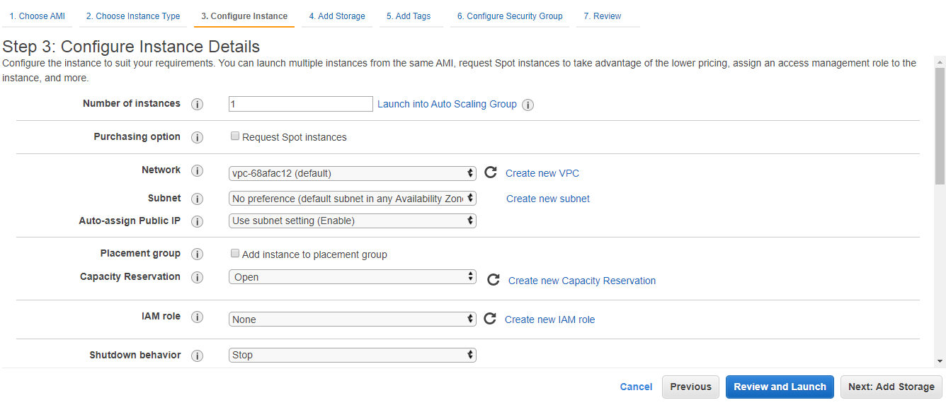
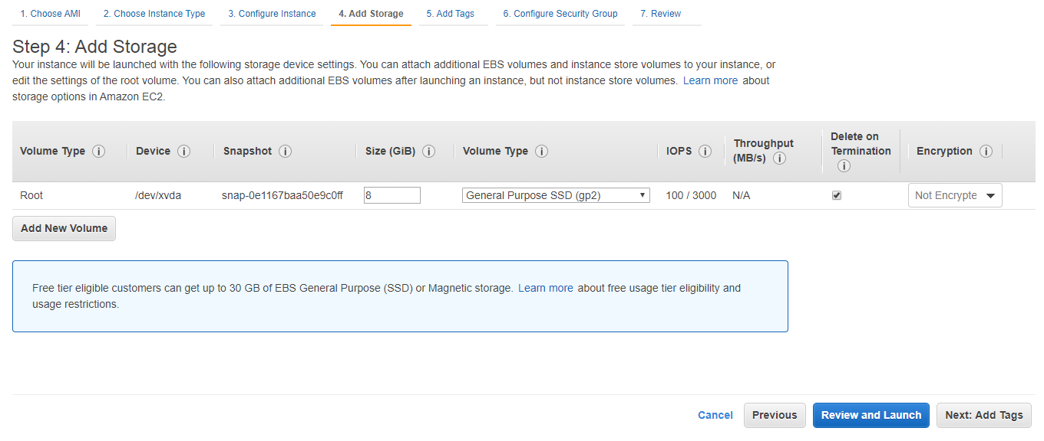
Step3)Configure install details
-->We can configure no of instances from here
Step4)Add storage
-->This will be used to add extra storage

Slide 9
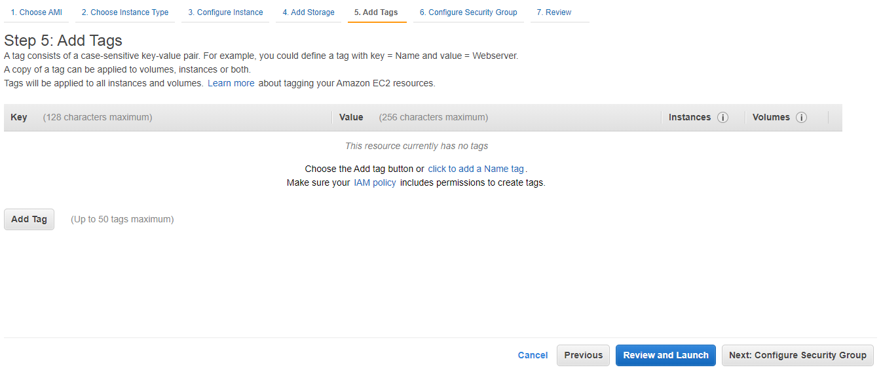
Step5)Add tags
-->A tag is a label that you or AWS assigns to an AWS resource. Each tag consists of a key and a value. For each resource, each tag key must be unique, and each tag key can have only one value. You can use tags to organize your resources, and cost allocation tags to track your AWS costs on a detailed level.

Slide 10
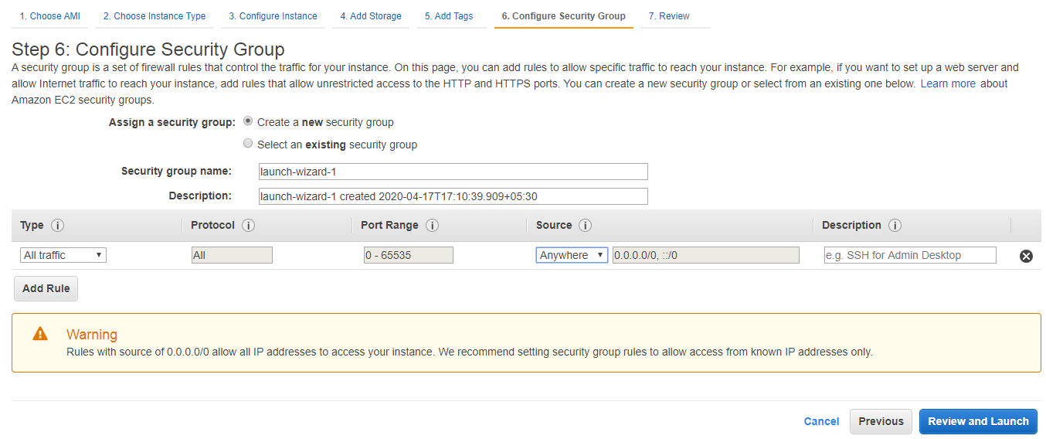
Step6)Configure security group
-->AWS Security Groups act like a firewall for your Amazon EC2 instances controlling both inbound and outbound traffic. When you launch an instance on Amazon EC2, you need to assign it to a particular security group

Slide 11
Step7)Review and Launch
-->You can review the details at configuration level and launch it.
-->Download pem key and launch the instance
How to convert pem key to ppk key:
-->open puttygen and load the pemkey
-->Click on option called save private key
Difference between public key and private key:
Private Key is used to both encrypt and decrypt the data and is shared between the sender and receiver of encrypted data. The public key is only used to encrypt data and to decrypt the data, the private key is used and is shared. ... The public key is free to use and the private key is kept secret only.
How to login to instance:
-->Open putty
-->Give public ip address and give thee ppk key as well
-->Once you open the console you have to give username as ec2-user

Slide 12
2)Route53
DNS: Stands for Domain Name system. Which converts name to IP address and ip address to name.
Types:
1.Top level domain.
2.Secondary level domain
-->Top Level Domain: The last word in a domain name represents the "toplevel domain"'
eg: .com
-->Second level domain: The second last word in a domain name represents the "second level domain name“
eg: .gov.in

Slide 13
Types of Routing policies:
1)Simple routing Policy
2)Weighted Routing Policy
3)Latency Routing policy
4)Failover routing Policy
5)Geo-location Routing Policy

Slide 14
1)Simple Routing Policy:
-->This is the default routing policy
-->This is the most commonly used when you have a single resource that performs a given function for your domain.
2)Weighted Routing Policy:
-->Weighted routing policies lets you split your traffic based on different weights assigned.
3)Latency Routing Policy:
-->Latency based routing allows you to route your traffic based on the lowest network latency for your end user(which region will give them the faster response time)

Slide 15
4)Failover Routing Policy:
-->Failover routing policies are used when you want to create an active/passive setup.
5)Geo-Location Routing Policy:
-->Geo Location routing lets you choose where your traffic will be sent based on the geographical location of your users.

Slide 16
3)VPC
-->VP lets you provision a logically isolated section for the Amazon web services cloud where you can launch AWS resources in a virtual network that you define.
VPC – Virtual Private Cloud
Subnet
A sub-network or subnet is a logical subdivision of an IP network.

Slide 17
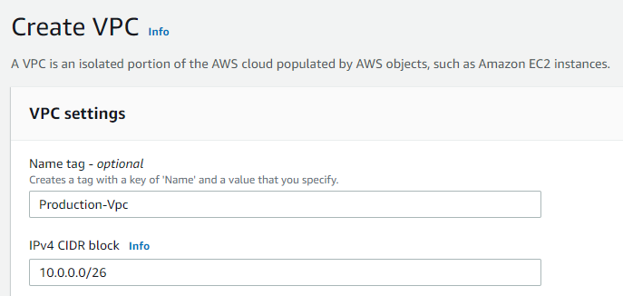
Steps to Create VPC and it's Private network:
1)Creating VPC:
-->Go to AWS console-->Search for VPC-->Click on create VPC-->give name
-->Also provide CIDR block as below and click on create VPC
CIDR: 10.0.0.0/26

Slide 18
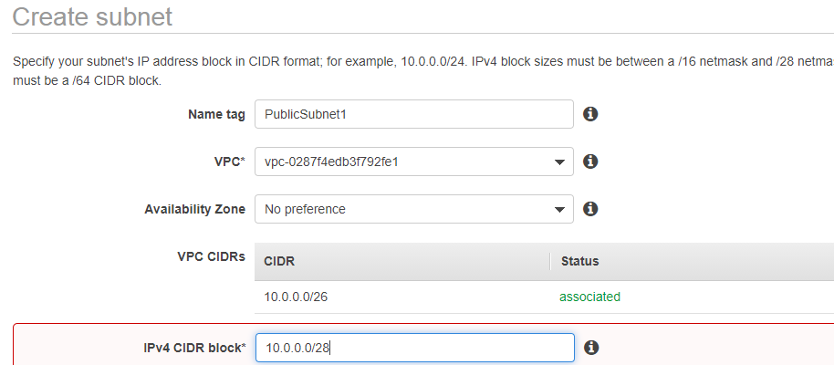
2)Creating Subnet
-->Go to AWS console-->Search for VPC→ Under that click on subnet
→Click on create subnet and choose your VPC other than default.
→Create 4 subnets and give CIDR range as below.
PublicSubnet1: CIDR=10.0.0.0/28
PublicSubnet2:CIDR=100.0.0.16/28
PrivateSubnet1:CIDR=10.0.0.32/28
PrivateSubnet2:CIDR=10.0.0.48/28

Slide 19
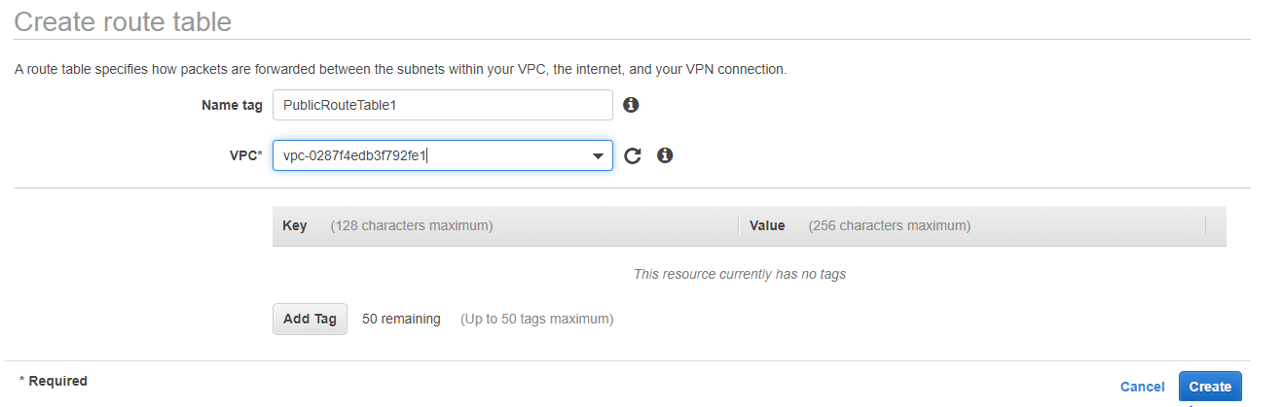
3)Creating Route table
-->Go to AWS console-->Search for VPC→ Under that click on Route Table.
→We have to create two route tables.

Slide 20
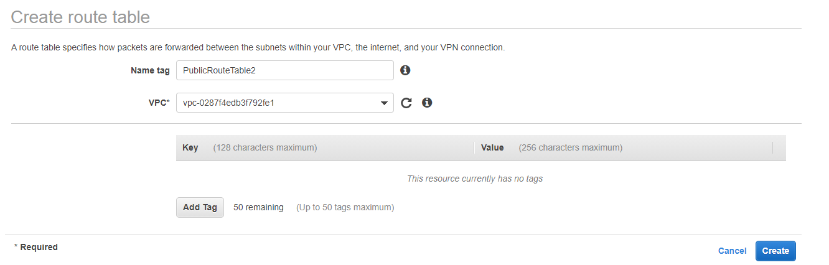
4)Creating Route table
-->Creating second Route Table

Slide 21
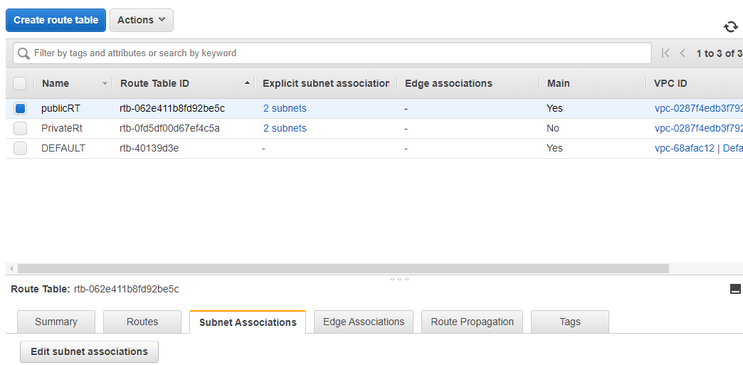
5)Subnet association to the Route Table
→Choose the public route table and click on edit

Slide 22
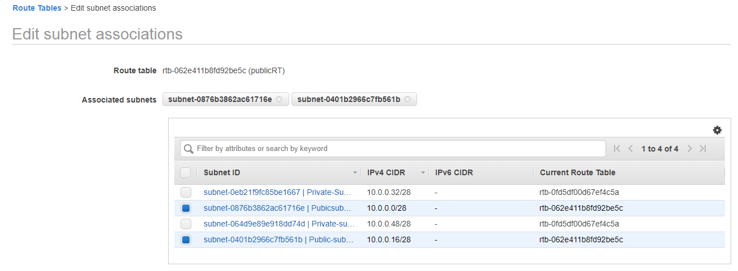
6)Subnet association to the Route Table
→Click on edit subnet association and select your public subnets

Slide 23
6)Subnet association to the Route Table
→Note: Public Route Table- attach public Subnets
Private Route Table- attach private subnets
This step all about subnet association.

Slide 24
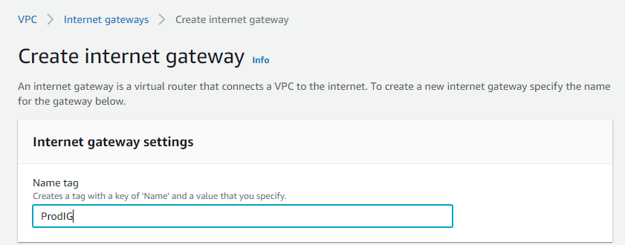
7)Creating Internet gateway
→Click on Internet gateway
→Click on create internet gateway
→Give name and create
→once it created go to actions and attach to VPC.

Slide 25
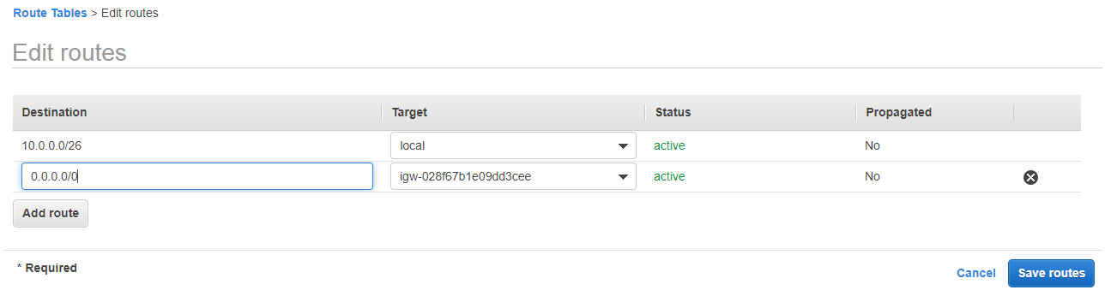
8)Adding Internet Gateway to Public Route Table
→Click on public Route Table →edit routes→ Add internet gateway as below. Give 0.0.0.0 for internet gateway.

Slide 26
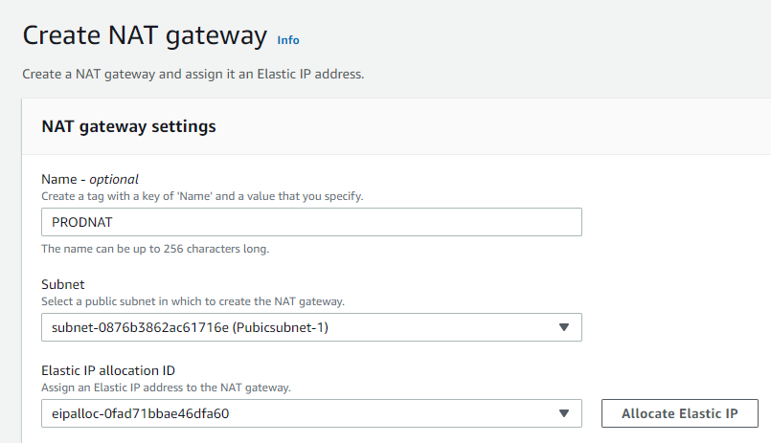
9)Creating NAT gateway for public subnet only.
→Click NAT gateway-->Click on create NAT gateway → Choose public subnet only.
→Give name and choose Public subnet and also choose allocate elastic ip.

Slide 27
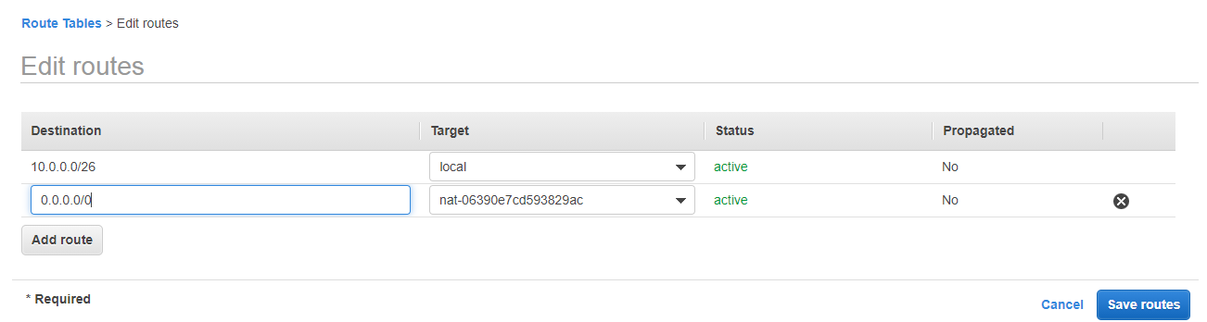
10)Attaching NAT gateway to your private subnet
→Click on private route table and click on edit add routes as bellow.

Slide 28
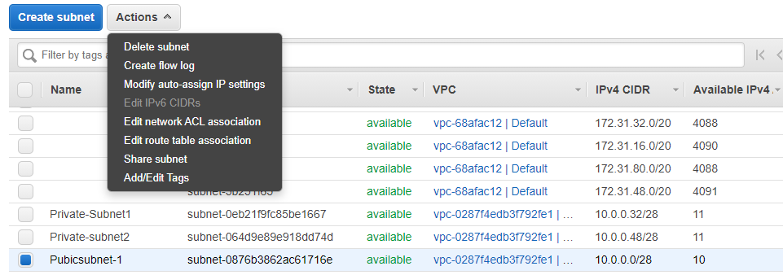
11)Modify auto assign ip address on your public subnet
→Click on public subnet1 and click on actions and select modify auto assign ip address.

Slide 29
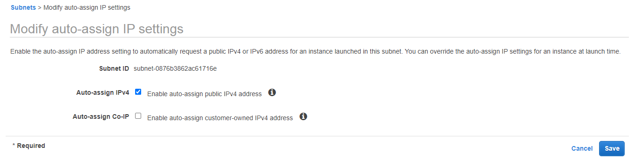
11)Modify auto assign ip address on your public subnet
→follow the same as below and save.

Slide 30
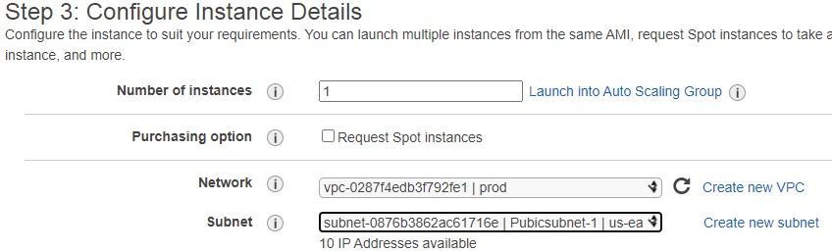
12)Launch the ec2 instances in your VPC and subnet
→click on ec2 and in third step use your customized VPC and subnet what you have created. Below is the reference for the same.
→These are all the steps to create customized VPC.

Slide 31
4)Creating Load Balancer
Use: Distributing incoming application traffic across multiple ec2 instances.
Types of Load Balancers:
1)Classic Load balancer
2)Application Load balancer
3)Network Load balancer
Creating Classic Load Balancer:
Step1: Launch 2 ec2 instances
Step2: Setup httpd package in both machines
Process: Login to ec2 machine
[]yum -y install httpd
[]cd /var/www/html
[]vi index.html
[]systemctl start httpd
enter some data
Follow the same process in both the instances.

Slide 32
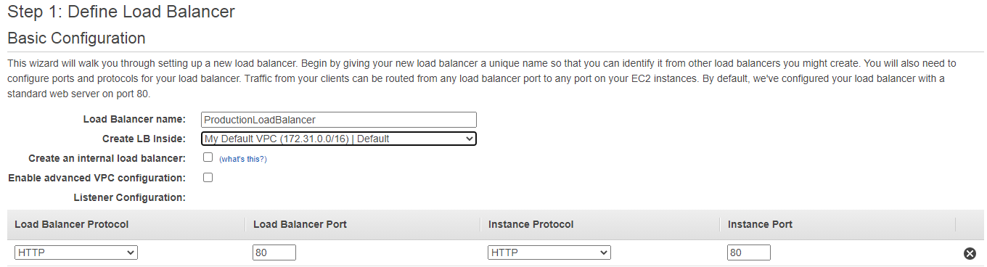
Creating Classic Load balancer:
→go to ec2 console→ check for load balancer → Click on load balancer → click on create load balancer.
→Click on create classic load balancer
→Provide the name and VPC details.
→Note: Choose the same VPC for Load Balancer and instances also.

Slide 33
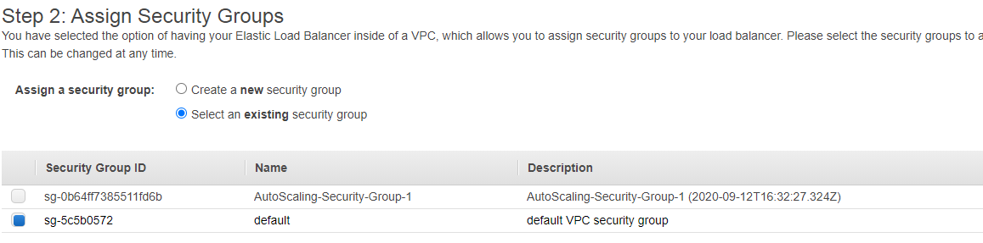
Creating Classic Load balancer:
→Click on next assign security groups.
→Choose the security group

Slide 34
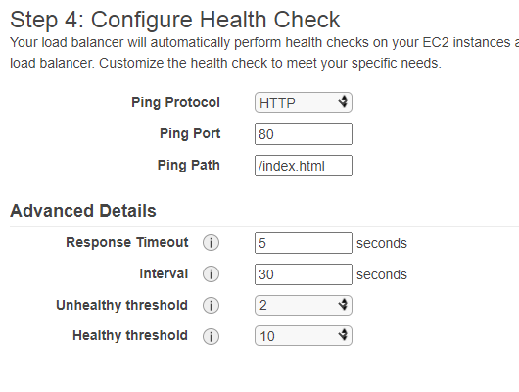
Creating Classic Load balancer:
→Click on configure security groups
→Click on Configure health checks

Slide 35
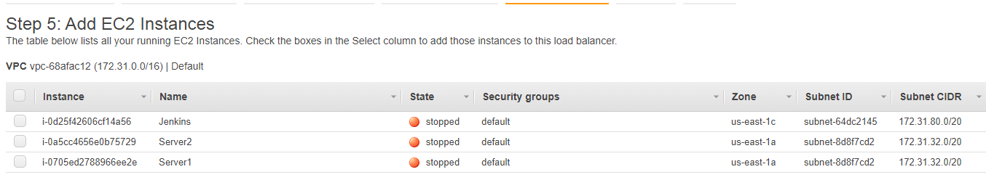
Creating Classic Load balancer:
→Click on Add ec2 instances

Slide 36
Creating Classic Load balancer:
→Click on Add tags
→Click on review
→Click on create

Slide 37
5)RDS
→RDS stands for Relational Database system. By using RDS we can create database.
→ways of creating database
1)We ca create by using instance
2)We can use RDS service.
1)We ca create by using instance
step1)We ca create by using instance
→We are going to launch mysql database
→Launch t2 medium instance
→Login to instance and run the following commands.
→Note give username as root and password as root
MySQL installation:
# sudo apt install mysql-server -y
# sudo systemctl start mysql
Login into mysql server, create a database, user & add privileges to that user
# mysql -u root -p
#pwd: root

Slide 38
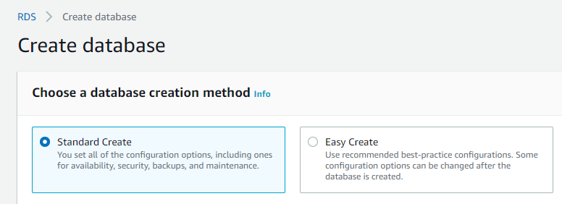
2)We can use RDS service.
step1)Go to RDS service
Step2)Click on databases → Click on create database

Slide 39
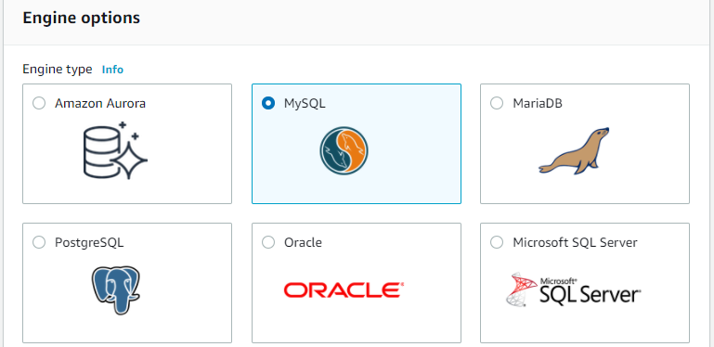
2)We can use RDS service.
Step3)Choose the engine options

Slide 40
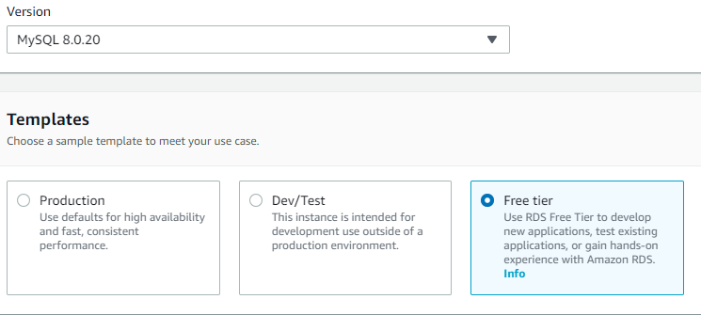
2)We can use RDS service.
Step4)Choose version and template as below.

Slide 41
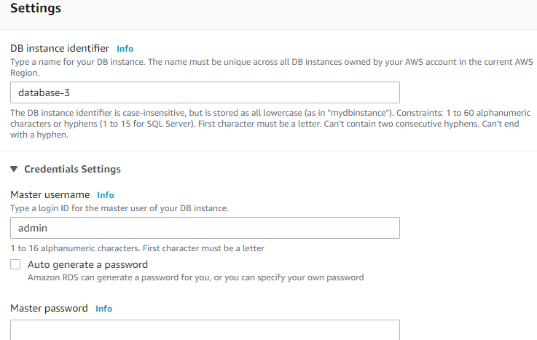
2)We can use RDS service.
Step5)Give name and password for your Database

Slide 42
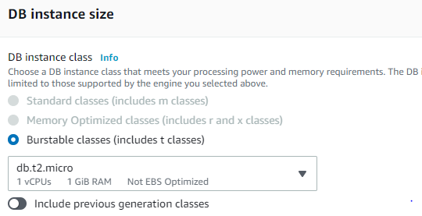
2)We can use RDS service.
Step6)Choose the type

Slide 43
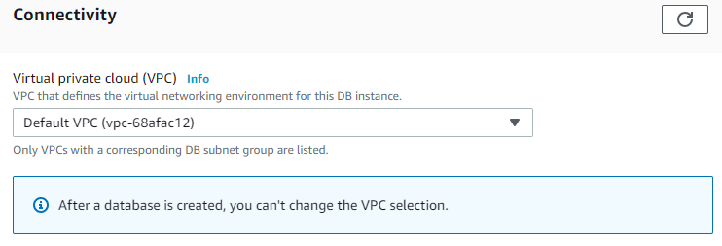
2)We can use RDS service.
Step7)Choose the VPC
Step8)click on create database

Slide 44
6)S3
Amazon S3 has a simple web services interface that you can use to store and retrieve any amount of data, at any time, from anywhere on the web.
S3-simple storage service
Types of S3:
S3: durable, immediately avaiable,frequectly accessed.
S3-IA(In-frequent Access): durable, immediately avaiable,infrequently accessed.
S3 one Zone-IA: even cheaper than IA, but only in one availability zone
Reduced redundant storage: For frequently accessed data, Store noncritical, reproducible data.
Glacier: Achieved data, where you can wait 3-5 hours before accessing.

Slide 45
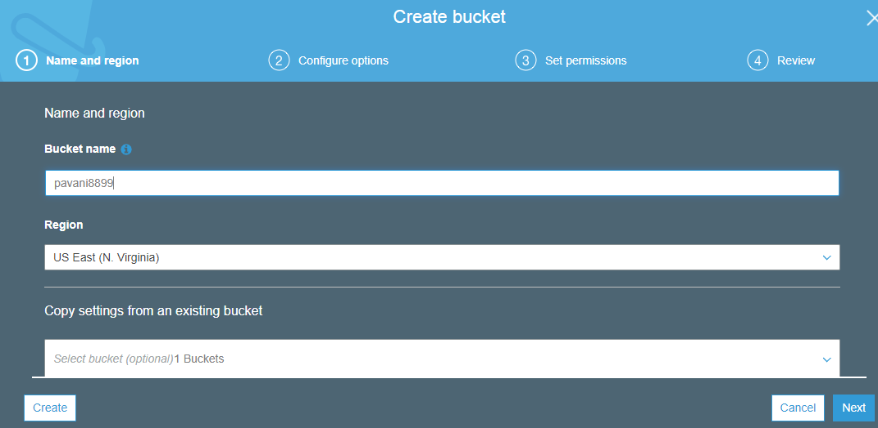
6)S3
Creating Bucket:
→go to s3 service→ click on create bucket option →give name and region and create bucket.
→click on the bucket which you have created and upload files.

Slide 46
7)Auto scaling
Auto scaling:
Amazon EC2 Auto Scaling helps you ensure that you have the correct number of Amazon EC2 instances available to handle the load for your application.
Launch Configuration:
Collection of attribute values to be used for launching EC2 instances.
Auto scaling group:
1)Define minimum and maximum desired capacity
2)Subnets
3)Scale-out policy
4)Scale-in policy

Slide 47
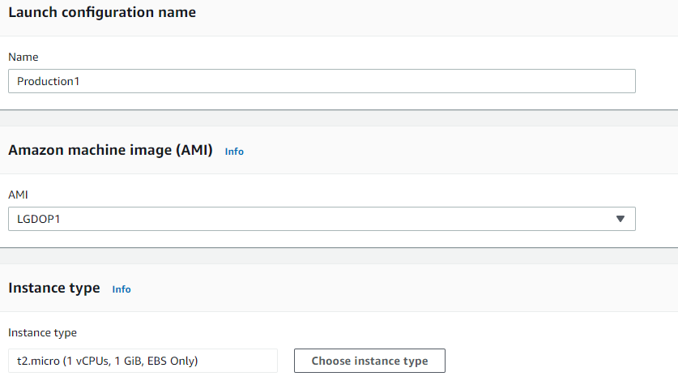
7)Auto scaling
Creating Launch configuration Template:
Go to EC2→move to launch configuration → click on create launch configuration template
→provide name, give AMI and select instance type.

Slide 48
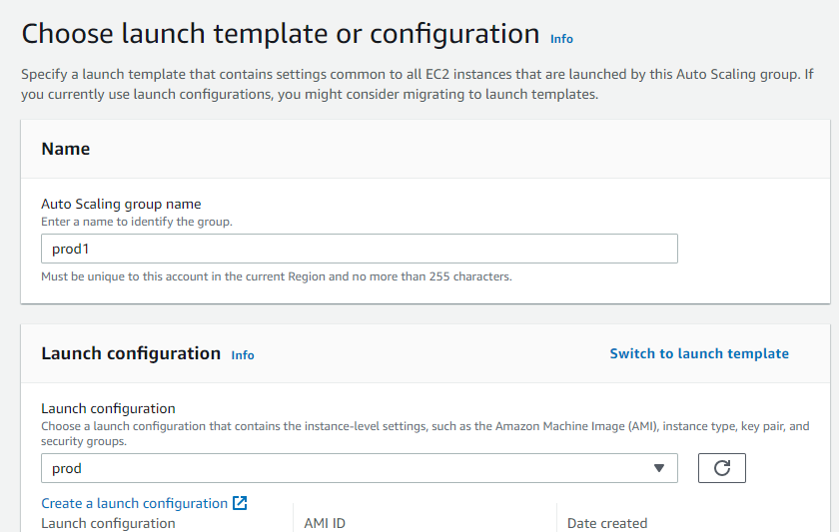
7)Auto scaling
Creating Launch configuration Template:
Next step select security group → select key pair and launch.
→You are able to see launch configuration template.
Creating Autos calling Group:
→go to ec2 → Click on auto scaling group →switch to launch template (you have choose otherwise you will able to select your launch template)

Slide 49
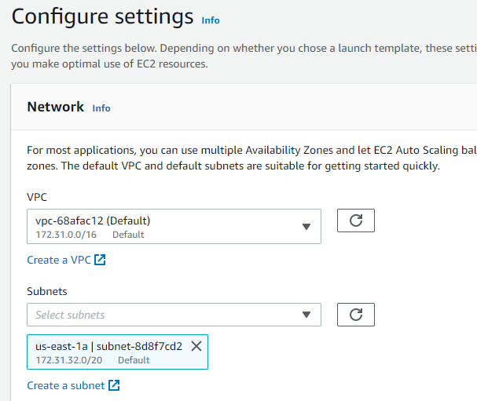
7)Auto scaling
Creating Autos calling Group:
→select VPC and subnet

Slide 50
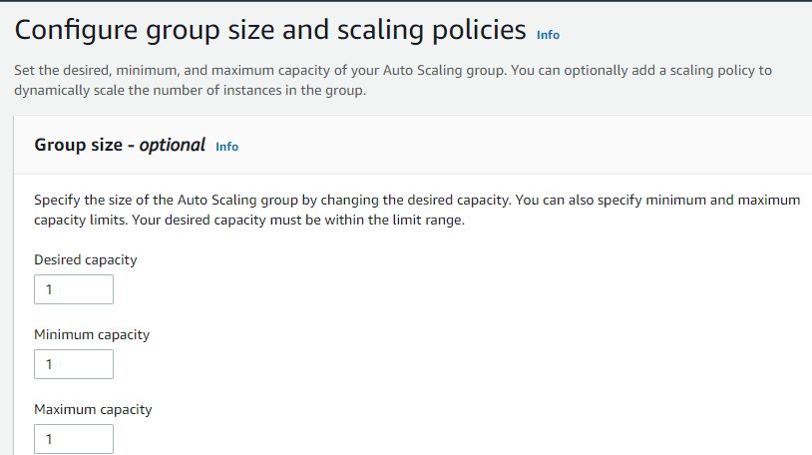
7)Auto scaling
Creating Autos calling Group:
→click on Next → select desired capacity , minimum capacity and maximum capacity.

Slide 51
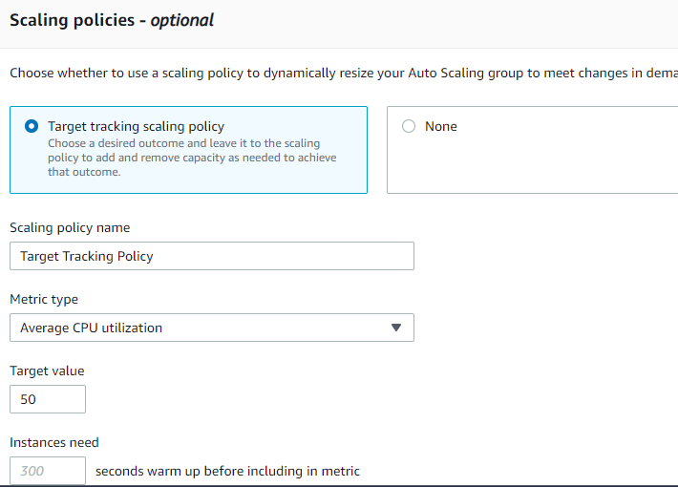
7)Auto scaling
Creating Autos calling Group:

Slide 52
7)Auto scaling
Creating Autos calling Group:
→Click on next →create autos calling.
Note: always choose launch configuration template and autos calling group must be in the same region.

Slide 53
8)Cloud Formation
→AWS Cloud Formation provides a common language for you to model and provision AWS resources in your cloud environment.
Cloud Formation Template:
A template is a declaration of the AWS resources that make up a stack. The template is stored as a text file whose format complies with the JavaScript Object Notation (JSON) or YAML standard.

Slide 54
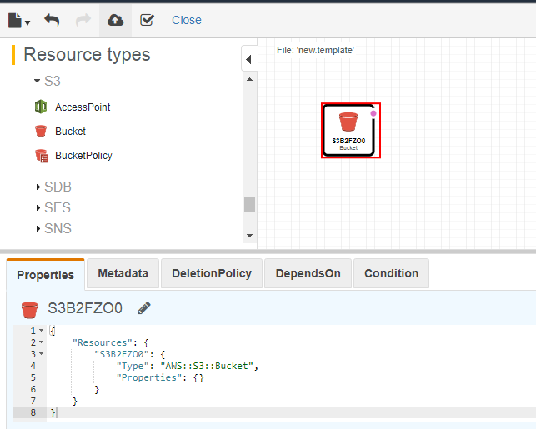
8)Cloud Formation
Creating cloud formation template:
Go to Cloud Formation→ click on create stack → create template in Designer →Again click on create designer template →choose s3 → drag the s3 bucket → click on right mark to check the syntax.

Slide 55
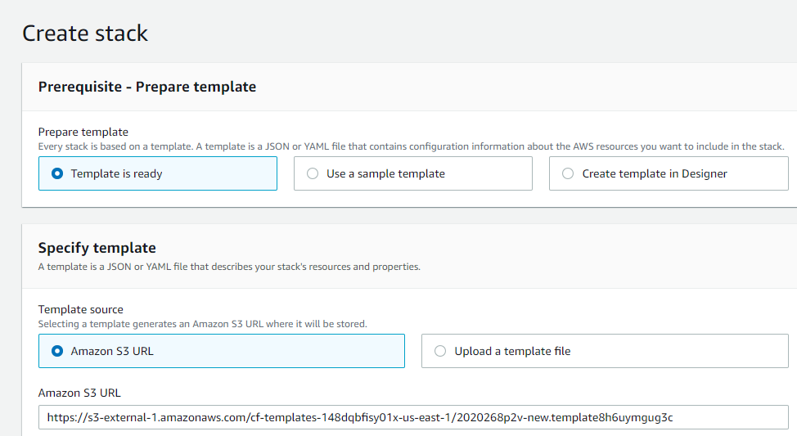
8)Cloud Formation
Creating cloud formation template:
Next step click on up-arrow→ you will be navigating to below window.

Slide 56
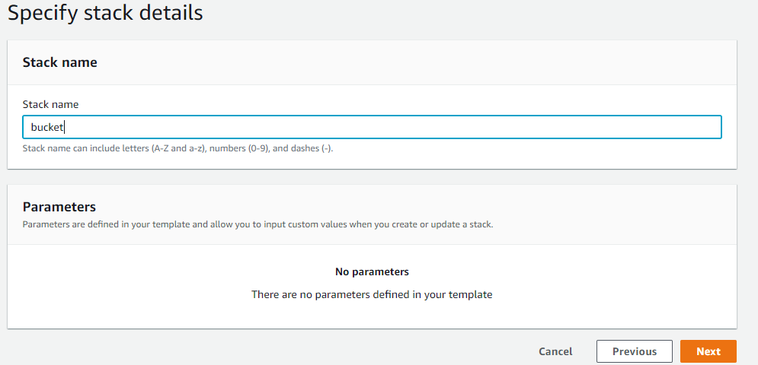
8)Cloud Formation
Creating cloud formation template:
Click on next→ give the stack name and click on next.

Slide 57
8)Cloud Formation
Creating cloud formation template:
Click on next→ click on create stack.
→Go to s3 service → you will be able to see s3 bucket.

Slide 58
9)IAM
→Using IAM, you can create and manage AWS users and groups, and use permissions to allow and deny their access to AWS resources.
→IAM- Identity and Access Management
IAM policy:
You manage access in AWS by creating policies and attaching them to IAM identities (users, groups of users,)A policy is an object in AWS that defines their permissions. ... Most policies are stored in AWS as JSON documents.

